Slide 1


Real Time CLOCK
Presented by: Group 4

Slide 2





OUR TEAM
Aya Gamal Mohamed
Mohamed Abd Elmaksoud
The Leader
Abdullah Mohamed
Mohamed Gamal
Mostafa Mohamed Gaber

Slide 3
CONTENT
Introduction
Modes Of Operation
SW (Drivers , Main Function)
HW components
Simulation
Future Work
References

Slide 4

INTRODUCTION
This full clock system uses Atmega16 microcontrollers and an LCD to display date and time. It uses a scheduler to maintain tasks' priorities and is layered in three layers: MCAL, HAL, and APP. The system includes DIO, interrupts, timer, LCD, and application drivers.

Slide 5
MODES OF OPERATION
Setting Mode
Running mode
In running mode, seconds and minutes increase by one for each second, minute, hour, and hour. The PM/AM flag toggles when hours reach 12. Days increase by one when time changes from PM to AM, with the maximum number of days based on the month.
To set mode, press MODE button, then edit hours by INC or DEC buttons, and minutes by pressing MODE button..

Slide 6
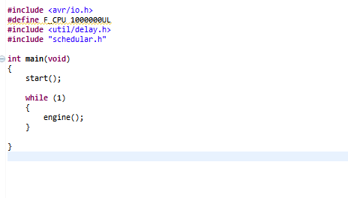
DRIVERS AND MAIN FUNCTION
Main Function
DIO
LCD
Interrupt
Timer
Schedular
Clock

Slide 7
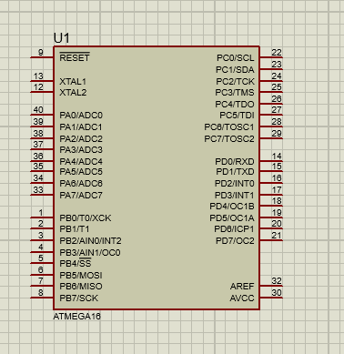
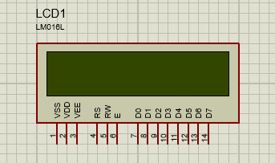

HW Components
3 push buttons
Atmega 16
2 × 16 LCD (LM016L)
to project on-screen information of a microcomputer onto a larger screen
To change state sat
And reset.
40 pin microcontroller based on enhanced RISC (Reduced Instruction Set Computing)

Slide 8
FUTURE PLANS
Add alarm mode.
Re-implement the system with Free RTOS.
Implement the system on hardware with PCB.

Slide 9
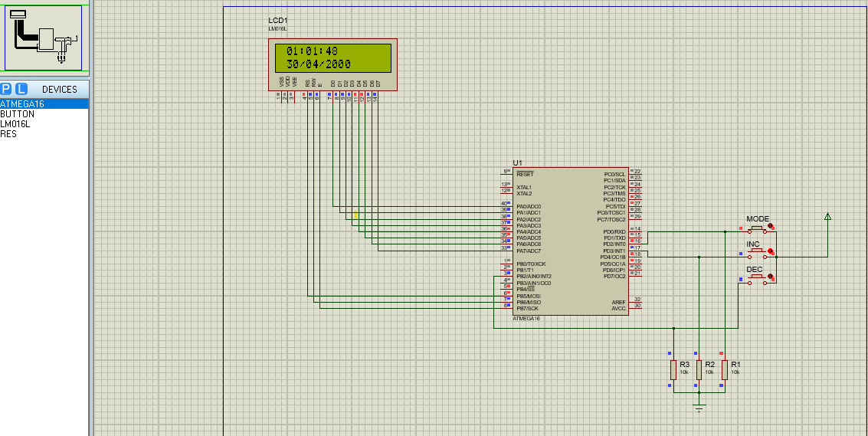
SIMULATION

Slide 10
REFERENCES
1-https://cselectricalandelectronics.com/500-embedded-system-projects-for-engineer-diploma-mtech-phd/
2-https://deepbluembedded.com/top-embedded-systems-projects-ideas-for-engineering-students/
3-https://egfwd.com/specializtion/professional-embedded-systems/

Slide 11

THANK YOU

