Slide 1
GLIM Map Building Automation System
Abdullah AlMusalami
Senior Robotics Engineer
May 2026

Slide 2
System Overview

Slide 3
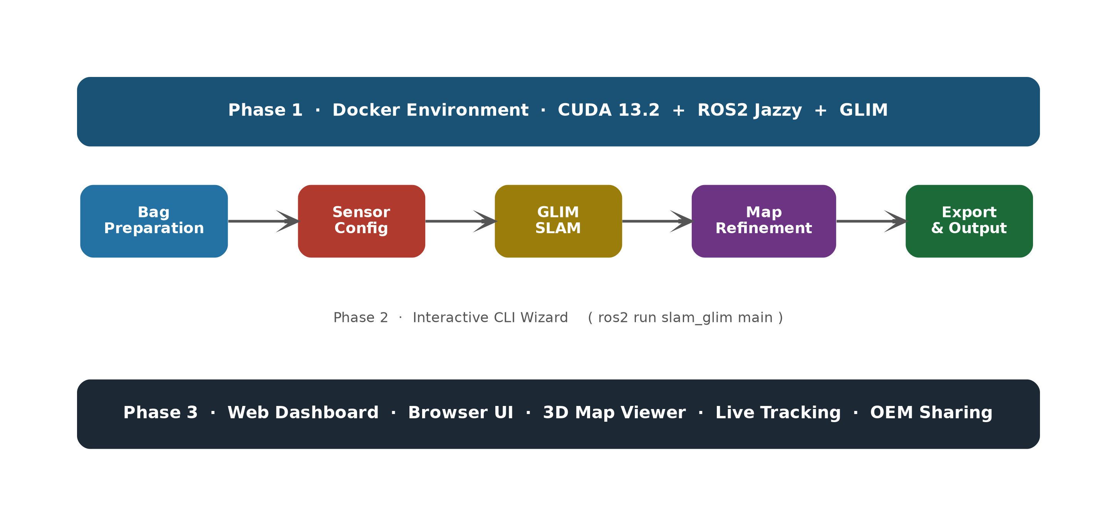
GLIM Map Building Automation System
3-Phase System Architecture

Slide 4
Phase 1 · Docker Environment

Slide 5
Phase 1 · Docker Environment
Environment Setup
Base image: nvidia/cuda:13.2 + Ubuntu 22.04
ROS2 Jazzy Desktop
GLIM — GPU-accelerated 3D SLAM (koide3 PPA)
All dependencies pre-installed: GTSAM 4.3, Iridescence, GLFW, METIS
GTSAM version conflict resolved inside the container — zero manual steps
ROS2 bag files mounted at runtime ( -v /path/to/bags:/bags )
GPU passthrough: --gpus all (requires nvidia-container-toolkit)

Slide 6
Phase 2 · Interactive CLI Wizard

Slide 7
Phase 2 · Interactive CLI Wizard
Full Pipeline: ros2 run slam_glim main

Slide 8
Phase 2 · CLI Wizard
Step 1: Bag Preparation + Step 1.5: Sensor Configuration
Step 1 — Bag Preparation:
User provides the bag file path
ROS1 .bag? → auto-convert to ROS2 .db3 (rosbags-convert)
Step 1.5 — Sensor Configuration:
User edits ONE YAML file: config/user_config.yaml
Only 3 fields required:
imu_topic: /imu/gravity
lidar_topic: /velodyne_points
T_lidar_imu: [tx, ty, tz, qx, qy, qz, qw]
System auto-fills all 6 GLIM JSON config files — user never edits JSON

Slide 9
Phase 2 · CLI Wizard
Step 2: Sensor Validation
Runs GLIM's built-in validator_node against the bag
Checks: IMU rate, LiDAR rate, topic existence, gravity vector detection
Prints a human-readable report to the terminal
Human reviews the report → fix config/user_config.yaml if needed
Catches misconfigured topics before wasting a full SLAM run
Press Enter when satisfied to proceed to SLAM

Slide 10
Phase 2 · CLI Wizard
Steps 3–4: GLIM SLAM Execution
Pipeline selection (asked every run):
[1] GPU — VGICP_GPU + CUDA (default, RMC robot)
[2] CPU — VGICP CPU, no GPU required
[3] LiDAR-only — CT-ICP, no IMU required
Config review: shows IMU topic, LiDAR topic, T_lidar_imu — confirm before SLAM starts
Mode selection:
[1] Live Viewer — glim_rosnode + ros2 bag play + Iridescence 3D viewer
[2] Fast Offline — glim_rosbag, no viewer, faster than real-time
Dump auto-saved → maps/<bag_name>_<YYYYMMDD_HHMMSS>/

Slide 11
Phase 2 · CLI Wizard
Steps 5–6: Map Refinement & Merging
Step 5 — Edit / Modify Map:
Opens GLIM map_editor GUI with the current dump
Add or remove loop closures, re-optimize the pose graph
Loop: edit more? → repeat until satisfied
Step 6 — Merge Maps:
User provides a second dump directory
map_editor loads both dumps → user aligns and merges in the GUI
Merged dump path saved for the export step

Slide 12
Phase 2 · CLI Wizard
Steps 7–8: Map Export & 2D Map Generation
Step 7 — Export Map (fully automated, no GUI):
Reads dump binary: points_compact.bin (float32 XYZ) + data.txt (T_world_origin)
Transforms all submaps to world frame → voxel filter 0.05 m
Writes ASCII PCD v0.7 → maps/<run>/map.pcd
No PLY step — dump binary is parsed directly in Python
Step 8 — 2D Occupancy Map:
Ground detection: z-histogram from 1st percentile, find floor peak
Height filter: floor+0.3 m to floor+3.0 m
Output: map_2d.pgm + map_2d.yaml (nav2_map_server compatible)

Slide 13
Phase 2 · CLI Wizard
Step 9: POI Registration
RViz2 opens automatically with the 3D PCD map displayed
Select the Publish Point tool in the RViz2 toolbar (crosshair icon)
Click any point on the 3D cloud
Red sphere + text label appear at the clicked location
POI saved automatically to YAML in maps/<run>/POI_Poses/
YAML format:
pois: [ { id, name, timestamp, frame_id, position, orientation } ]
orientation: identity quaternion — compatible with ROS2 nav goals

Slide 14
Phase 3 · Web Dashboard

Slide 15
Phase 3 · Web Dashboard
Browser-Based Interface (Coming Soon)
Replaces CLI wizard with a web page — same pipeline, zero terminal interaction
3D map viewer in the browser (Three.js / Potree)
POI editor: click-to-place on the 3D map in the browser
Live robot tracking: WebSocket stream of robot pose overlaid on the global map
Map library: browse all saved map runs with metadata and thumbnails
OEM export: download PCD + 2D map + POI YAML for distribution
Architecture:
Flask / FastAPI backend → calls the same step modules as the CLI
Design constraint: all step modules accept decisions as parameters (no input())

Slide 16
Implementation Plan
Phase 2 — Implementation Order
1. export_map.py — Binary dump → PCD (core unique logic, first)
2. convert_map.py — PCD → 2D occupancy grid
3. pcd_publisher.py + poi_selector.py (copy + adapt from glim_test)
4. view_map.launch.py + view_map.rviz
5. config_setup.py — user_config.yaml → GLIM JSON files
6. slam_runner.py — GLIM launch: pipeline select + two modes
7. validator.py — Sensor validation subprocess + report
8. bag_convert.py — ROS1 bag conversion wrapper
9. map_editor_launcher.py — Map editing / merging subprocess
10. main.py — CLI wizard orchestrator (wires all steps)

