Slide 1
Multi-Disease Chest X-Ray
Diagnostic AI
Team Lead: Abdullah Hasan Shah (BSCS 5th semester)
Abdullah Hasan Shah | BS Computer Science | University of Technology Nowshera

Slide 2
Multi-Disease Chest X-Ray
Diagnostic AI
DenseNet121 · Grad-CAM · Streamlit
For doctors who are not radiologists
Abdullah Hasan Shah | BS Computer Science | University of Technology Nowshera

Slide 3
The Problem in Pakistan
TB and pneumonia cause tens of thousands of deaths every year.
Tuberculosis (TB)
Pneumonia
≈ 51,000 deaths / year
140+ deaths every day
1,800+ new cases daily
5th highest TB burden globally
669k–686k people affected yearly
≈ 80,000 children die yearly
Leading cause of child mortality
Many clinics lack radiologists
Delays in reading X-rays cost lives

Slide 4
Who Is This For?
Not a replacement for radiologists — support for frontline doctors.
General Physicians
Quick second opinion on chest X-rays in busy OPDs
Rural / Tehsil Clinics
Where specialist radiologists are not available
Emergency & Screening
Fast triage for pneumonia, TB, and COVID-19 patterns
Medical Students
Learning aid with visual Grad-CAM explanation

Slide 5
Our Method
1
2
3
4
Dataset
Model
Explain
Deploy
Kaggle multi-class chest X-rays
Normal · Pneumonia · COVID · TB
DenseNet121 transfer learning
Fine-tuned for 4 classes
Grad-CAM heatmaps
Shows where model looked
Streamlit web app
Upload X-ray → instant result

Slide 6
Results
83.79%
0.85
4
Test Accuracy
Macro F1-Score
Disease Classes
What the doctor sees
1) Predicted disease + confidence 2) Probability chart 3) Grad-CAM heatmap
(warmer colors = regions the model focused on — helps non-specialists trust the result)

Slide 7
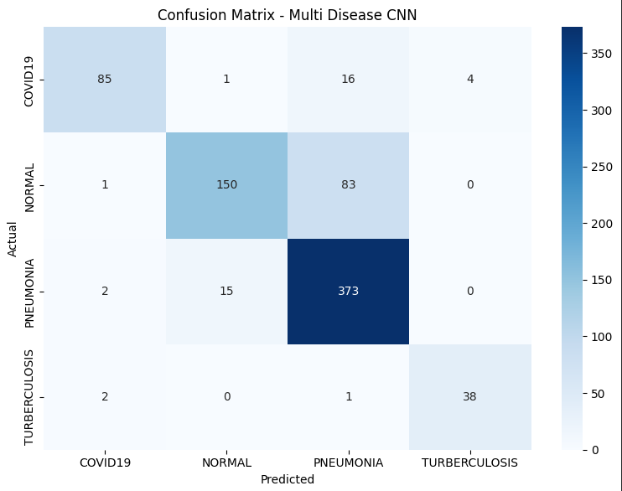
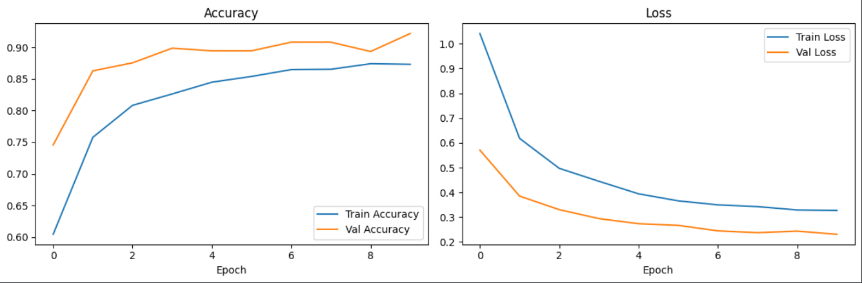
Per-class F1-Score
COVID 0.87
Normal 0.75
Pneumonia 0.86
TB 0.92

Slide 8
Live Demo & Links
Streamlit App
https://multi-disease-chest-x-ray-diagnostic.streamlit.app/
GitHub Repository
https://github.com/AbdullahHasan707/Multi-Disease-Chest-X-Ray-Diagnostic-AI
Upload X-ray → Get diagnosis, confidence, and Grad-CAM in seconds

Slide 9
Key Takeaway
A simple AI tool that helps non-radiologist doctors
screen chest X-rays for pneumonia, TB, and COVID-19
with visual explanations they can understand.
AI support only — not a final medical diagnosis.
Thank you

