Slide 1



Prepared for:
Thesis Proposal Defense Committee
Department of Computer Science and Engineering
IUBAT–INTERNATIONAL UNIVERSITY OF BUSINESS AGRICULTURE AND TECHNOLOGY
Founded 1991 by Md. Alimullah Miyan
A Comparative Study of Mental Health Detection Using PHQ-9 and Social Media Analysis with Traditional ML and NLP Techniques
Course Code: CSC 488 (Thesis)
Supervised by:
Snaholata Mondal
Lecturer
Prepared by:
MD Abdullah Ibne Aziz ID: 22203246
Shahriar Ahmed ID: 22203202
Date of Presentation: 01/07/2025

Slide 2
Contents
Introduction
Related Work
Objectives
Methodology: Traditional ML (PHQ-9 Dataset)
Methodology: NLP (Facebook Dataset)
Contributions
Conclusion
References
2

Slide 3
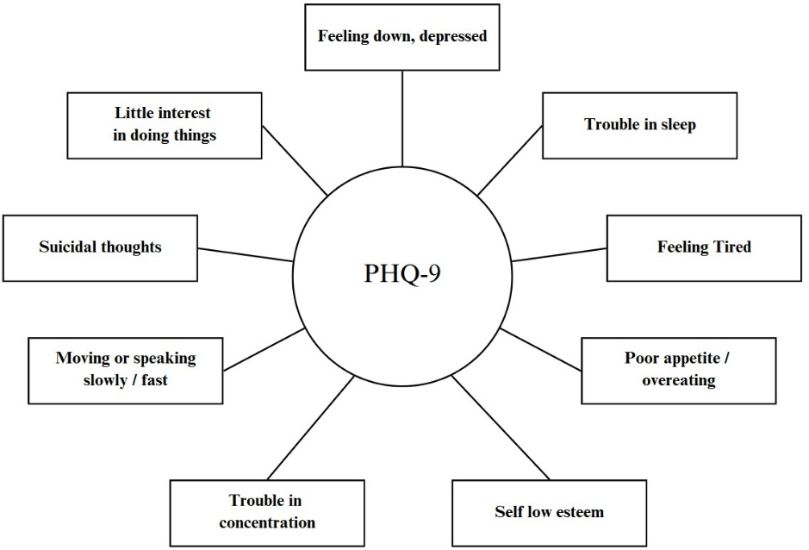
Introduction
Mental health issues are widespread, affecting millions globally. Early detection is crucial for timely intervention.
The PHQ-9 questionnaire is a popular self-report tool for assessing mental health, specifically depression.
Social media platforms, like Facebook, offer rich insights into individuals' emotional states, making them a valuable resource for mental health analysis.
Figure: PHQ-9 Questionnaires Topic
A Comparative Study of Mental Health Detection Using PHQ-9 and Social Media Analysis with Traditional ML and NLP Techniques
3

Slide 4
Introduction (Cont.)
Motivation
  Mental health disorders, especially depression, affect millions worldwide. Early detection is crucial for timely intervention.
  The PHQ-9 is a widely used tool for assessing depression.
  Social media platforms like Facebook offer rich, real-time data that can provide additional insights into an individual's mental health.
  Analyzing Bangla Facebook posts may help detect mental health conditions beyond traditional survey-based methods.
  Integrating PHQ-9 survey data with social media analysis allows for a more complete approach to mental health detection.
A Comparative Study of Mental Health Detection Using PHQ-9 and Social Media Analysis with Traditional ML and NLP Techniques
4

Slide 5
Introduction (Cont.)
Challenges
  Collecting user data and verifiable evidence is the most
  challenging aspect of finding out about mental illness.
  Issues with noisy and incomplete data, especially in social media posts.
  Tuning BERT models for Bangla text, which requires substantial computational resources.
  Difficulty in explaining NLP model decisions compared to traditional ML models.
A Comparative Study of Mental Health Detection Using PHQ-9 and Social Media Analysis with Traditional ML and NLP Techniques
5

Slide 6
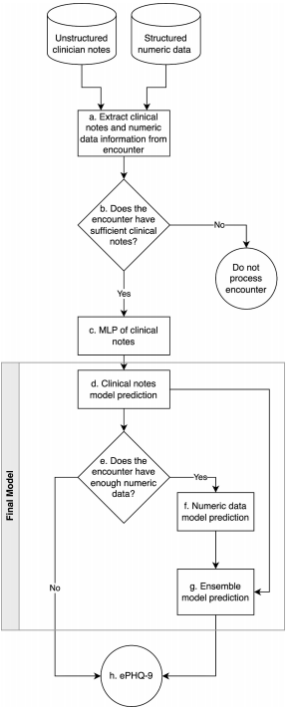
Related Work
A machine learning model using clinical notes to estimate PHQ-9 symptom severity scores in depressed patients (Alves et al., 2025) [1]
Three Models have been developed – 1) An unstructured model, 2) A structured model, and 3) An ensemble model that combined the first two.
Showed ML models can effectively estimate the PHQ-9 scores for major depressive disorder (MDD) patients.
Limitation:
The PHQ-9 is designed to be patient-reported, whereas this model estimates PHQ-9 scores using clinicians’ notes.
A Comparative Study of Mental Health Detection Using PHQ-9 and Social Media Analysis with Traditional ML and NLP Techniques
6

Slide 7
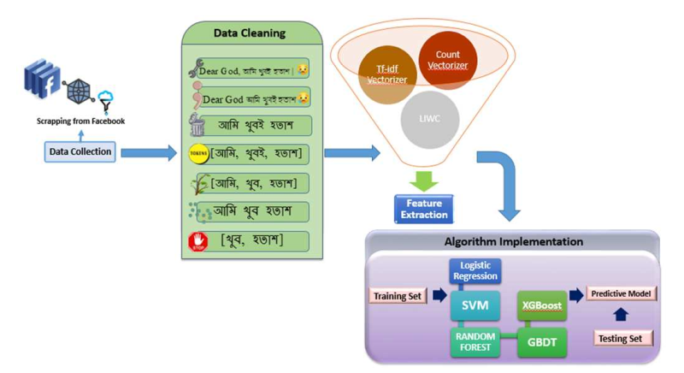
Related Work (Cont.)
Machine Learning Combined with PHQ-9 for Analyzing Depression in Bangladeshi Metropolitan Areas (Dey et al.) [2]
This system has used BNLTK (Bangla Natural Language Processing Toolkit)
Showed the viability of determining the level of depression in Bangladeshi Metropolitan areas using NLP techniques and ML algorithms.
Limitation:
Challenges arose from the subjective nature of social media expressions, as posts might falsely suggest depression or vice versa.
A Comparative Study of Mental Health Detection Using PHQ-9 and Social Media Analysis with Traditional ML and NLP Techniques
7

Slide 8
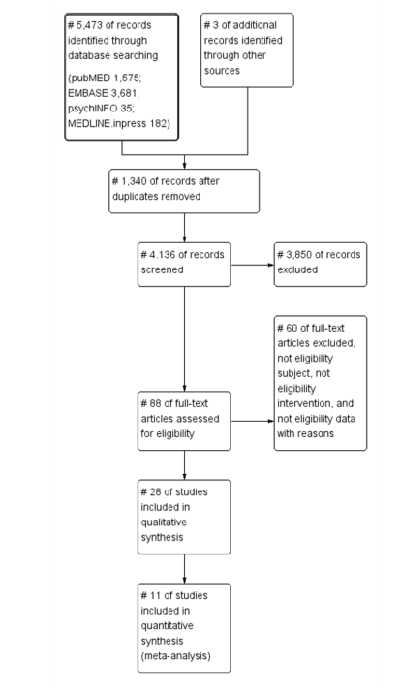
Related Work (Cont.)
Screening for Depression in Mobile Devices Using Patient Health Questionnaire-9 (PHQ-9) Data: A Diagnostic Meta-Analysis via Machine Learning Models (Kim & Lee, 2021) [3]
The system used various machine learning algorithms like Random Forest, Support Vector Machine, Artificial Neural Network (ANN), and 10-fold cross validation
Showed through meta-analysis, PHQ-9 depression screening on mobile devices is an effective tool
Limitation:
The reference standards for diagnosing depression are narrow within the mobile health field.
A Comparative Study of Mental Health Detection Using PHQ-9 and Social Media Analysis with Traditional ML and NLP Techniques
8

Slide 9
Related Work (Cont.)
Which PHQ-9 Items Can Effectively Screen for Suicide? Machine Learning Approaches (Kim et al., 2021) [4]
The system used K-Nearest Neighbors (KNN), Linear Discriminant Analysis (LDA), and Random Forest Classification.
Evaluated suicidal ideation by applying ML algorithms.
Showed that ML algorithms can reliably and accurately screen individuals for suicidal ideation when applied to PHQ-9
Methodology:
Used Patient Health Questionnaire-9 (PHQ-9) and the Mini-International Neuropsychiatric Interview (MINI) suicidality module to identify suicidal ideation.
Machine learning (ML) algorithms, specifically K-nearest neighbors (KNN), Linear Discriminant Analysis (LDA), and Random Forest, were applied.
Limitation:
The study did not consider the effect of depression as a potential confounding variable.
A Comparative Study of Mental Health Detection Using PHQ-9 and Social Media Analysis with Traditional ML and NLP Techniques
9

Slide 10
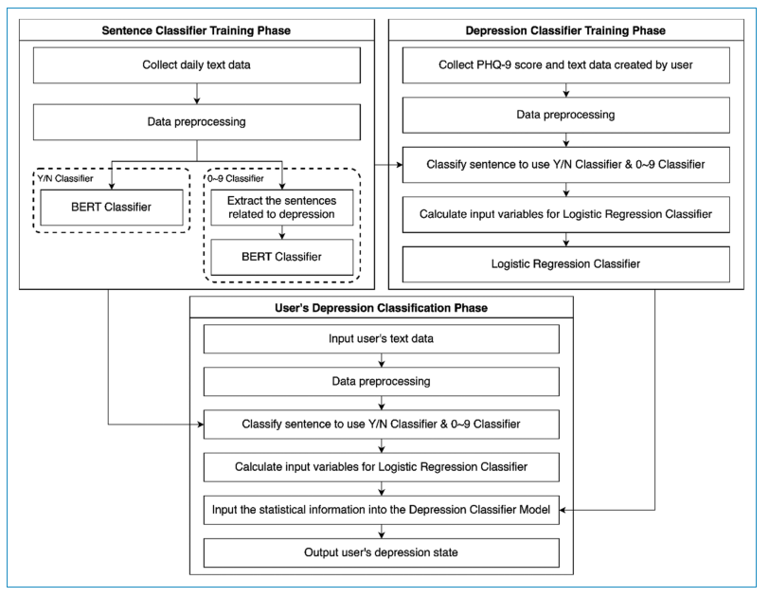
Related Work (Cont.)
Analysis of depression in social media texts through the Patient Health Questionnaire-9 and natural language processing (Kim et al., 2022) [5]
The addition of PHQ-9 scores substantially increased the average number of scores per patient per year by 2.8 times.
Showed the possibility of determining users depressing levels solely from their social media textual data.
Limitation:
The most significant limitation was the small dataset.
The proposed model is limited to a binary classification.
A Comparative Study of Mental Health Detection Using PHQ-9 and Social Media Analysis with Traditional ML and NLP Techniques
10

Slide 11
Objectives
To collect the dataset consisting of PHQ-9 survey responses from university students and Facebook posts in Bangla.
To apply traditional machine learning models on the PHQ-9 survey data to predict mental health status.
  To utilize NLP techniques, specifically Bangla BERT, to analyze sentiment and emotions from Facebook posts for predicting mental health status.
  To identify patterns and correlations between mental health status and social media sentiment to enhance prediction accuracy.
A Comparative Study of Mental Health Detection Using PHQ-9 and Social Media Analysis with Traditional ML and NLP Techniques
11

Slide 12
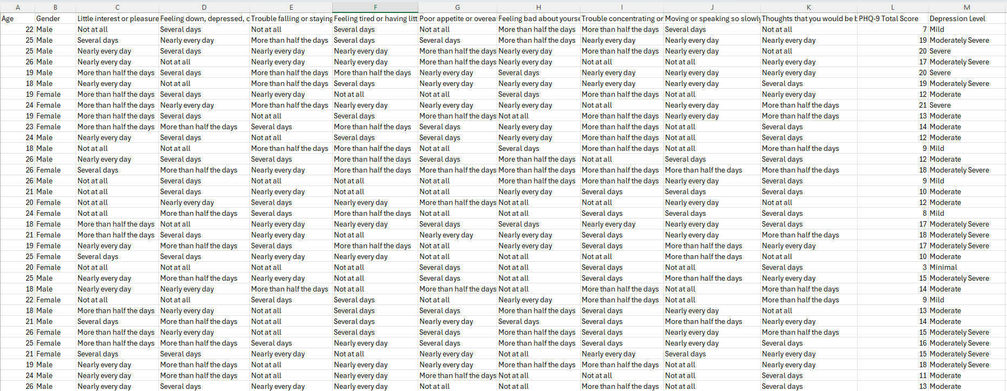
Methodology: Traditional ML (PHQ-9 Dataset)
Data are collected through 400 university students.
Responses are categorized into five levels: Minimal, Mild, Moderate, Moderately Severe, and Severe.
A Comparative Study of Mental Health Detection Using PHQ-9 and Social Media Analysis with Traditional ML and NLP Techniques
12

Slide 13
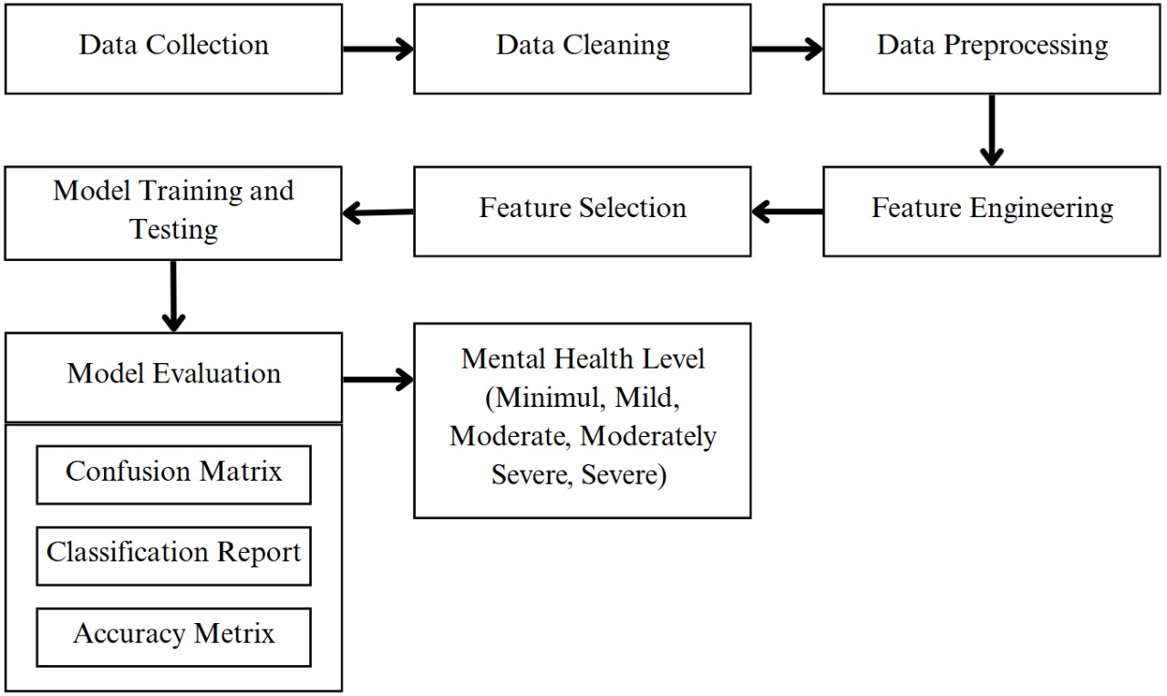
Methodology: Traditional ML (PHQ-9 Dataset) (Contd.)
A Comparative Study of Mental Health Detection Using PHQ-9 and Social Media Analysis with Traditional ML and NLP Techniques
13

Slide 14
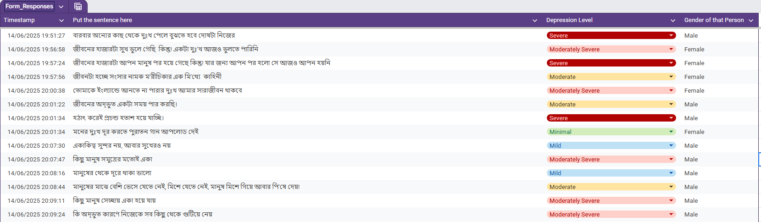
Methodology: NLP (Facebook Dataset)
Facebook statuses are being collected in Bangla language.
Posts are analyzed for sentiment and emotion to predict the mental health status.
Statuses are being evaluated into five categories – Minimal, Mild, Moderate, Moderately Severe, Severe
A Comparative Study of Mental Health Detection Using PHQ-9 and Social Media Analysis with Traditional ML and NLP Techniques
14

Slide 15
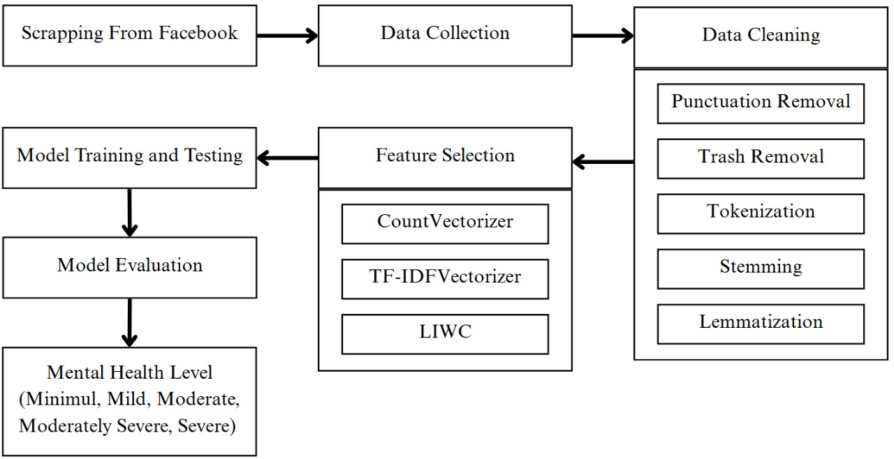
Methodology: NLP (Facebook Dataset) (Contd.)
A Comparative Study of Mental Health Detection Using PHQ-9 and Social Media Analysis with Traditional ML and NLP Techniques
15

Slide 16
Contributions
Implementation of a combined approach for mental health detection using both structured and unstructured data.
Comparative analysis of traditional ML models and advanced NLP techniques (Bangla BERT) in detecting mental health status.
Insights into using social media data for mental health analysis, particularly in the Bangla language.
A Comparative Study of Mental Health Detection Using PHQ-9 and Social Media Analysis with Traditional ML and NLP Techniques
16

Slide 17
Conclusion
The research aims to combine traditional survey-based analysis with advanced NLP techniques to improve the accuracy and efficiency of mental health detection.
The comparative study will highlight the strengths and weaknesses of both approaches.
A Comparative Study of Mental Health Detection Using PHQ-9 and Social Media Analysis with Traditional ML and NLP Techniques
17

Slide 18
References
Alves, P., Marci, C.D., Cohen-Stavi, C.J., Whelan, K.M. and Boussios, C., 2025. A machine learning model using clinical notes to estimate PHQ-9 symptom severity scores in depressed patients. Journal of Affective Disorders, 376, pp.216-224. https://doi.org/10.1016/j.jad.2025.01.152
Dey, S., Nawshin, A.T., Hossain, A. and Rahman, R.M., 2022. Machine learning combined with PHQ-9 for analyzing depression in Bangladeshi metropolitan areas. 2022 IEEE 11th International Conference on Intelligent Systems (IS), pp.1-8. https://doi.org/10.1109/is57118.2022.10019625
Kim, S. and Lee, K., 2021. Screening for depression in mobile devices using Patient Health Questionnaire-9 (PHQ-9) data: A diagnostic meta-analysis via machine learning methods. Neuropsychiatric Disease and Treatment, 17, pp.3415-3430. https://doi.org/10.2147/ndt.s339412
Kim, S., Lee, H. and Lee, K., 2021. Which PHQ-9 items can effectively screen for suicide? Machine learning approaches. International Journal of Environmental Research and Public Health, 18(7), p.3339. https://doi.org/10.3390/ijerph18073339
Kim, N.H., Kim, J.M., Park, D.M., Ji, S.R. and Kim, J.W., 2022. Analysis of depression in social media texts through the Patient Health Questionnaire-9 and natural language processing. Digital Health, 8, p.205520762211142. https://doi.org/10.1177/20552076221114204
18

Slide 19
Any Questions ?

Slide 20
Thank You

