Slide 1
Huffman CODING for File Compression
Data structure project by
ABDULLAH IQBAL 26904
Abdullah khalid 26969
Abdullah ahmedani 25896
Notes:
Asslamo alaikum everyone so today my team and i have created a project for our data structure course. I’ll first move on with introducing my coallegues, aprt from me , abdullah khalid, our team includes abdullah ahmedani and abdullah Iqbal.
Our project is based upon huffman compression which is a compression technique for files. WE’LL TALK ABOUT THIS IN MORE DETAIL: but first off witht the slides content and things that the viewers can expect from our presentation:

Slide 2
contents
Project Introduction
Motivation
Solution/Method
Reasoning to use particular Data Structure
Data – sources & description
Complexity Analysis
Notes:
After the basic idea, and the reason why we chose to build a huffman compression over anything else and what eaxctly it is. After that my coallegues will join in to tell you more about the code - how it works and its working and then in a later phase we’re going to tell its time complexity, limitations and the data sources.

Slide 3
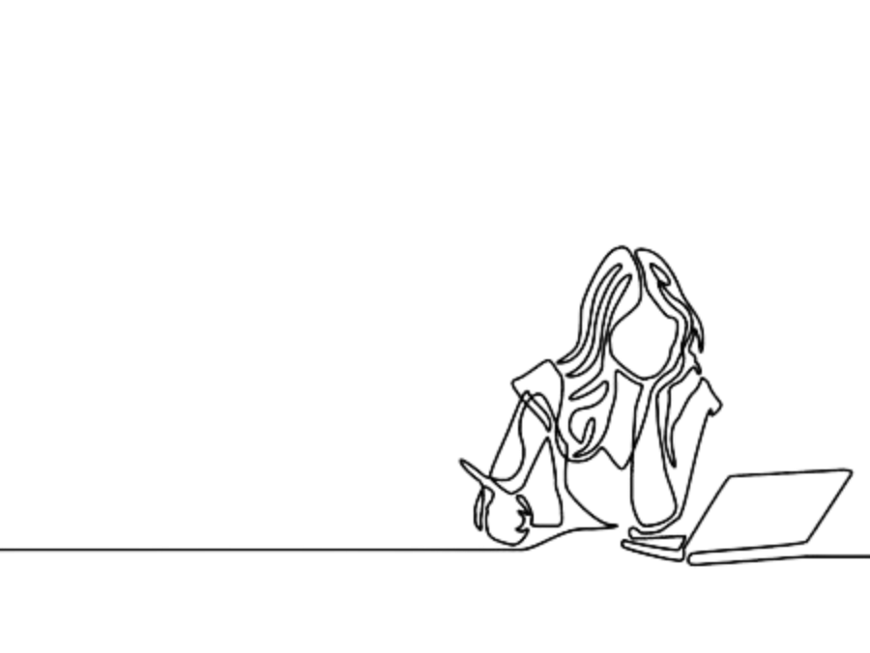
MOTIVATION
ANNA IS A DATA SCIENTIST WORKING REMOTELY.
SHE WANTS TO SEND A LARGE DATA FILES TO A COMPANY IN UNITED STATES.
HOWEVER THE LARGE DATA SIZE OF THE FILES MAKES IT NEARLY IMPOSSIBLE AND TIME CONSUMING!
Notes:
Moving on, lets say: if we want to send a huge data file, it can be a book, a report or as in this case a data scientist who wants to send her work to her client on a data file.. Now such large chunk of data to move takes time - a lot of time, regardless if its from one computer to another, or if its via the internet to cloud or anything else.

Slide 4
WHY WAS IT TIME CONSUMING & NEARLY IMPOSSIBLE TO SHARE LARGE DATA FILES?
Infrastructure Limitations:
The infrastructure of the platforms or services used for file sharing may have limitations on the size of files that can be uploaded or downloaded. This can lead to additional steps or the need to split files, adding to the time-consuming nature of the process.
File Size:
Large data text files tend to have a considerable size. Transmitting such large files over the internet requires more time due to the volume of data that needs to be transferred.
Server Load:
The server on which the files are hosted may experience heavy loads, particularly on popular platforms or during peak usage times. This can lead to slower processing speeds and increased wait times for file transfers.
Notes:
The problem can come due to the infrasturcture - for example if its over the internet then bandwidth of the internet connection plays a crucial role, it can either be because of server load which can increase time but most importantly The problem is the data size which we have to reduce in order to reduce so the time required to move the data reduces... this is where compression comes in:

Slide 5




What is the solution for this ?
Huffman Compression
Notes:
Basically you have a file - lets say 1 mb and want to send it to a friend… you’ll first carry out some algorithms on it to reduce the file size so that in can be moved easily… A special charcter is assigned along with some codes which use lesser number of bits than the ascii code which is the standard used today...
the contents of the file remain same but the file size is greatly reduced.

Slide 6
wHAT IS HUFFMAN COMPRESSION ?
Huffman coding stands as a variable-length prefix coding algorithm, optimizing data compression by assigning shorter codes to more frequently occurring characters and longer codes to less common ones.
The process involves analyzing character frequencies, constructing a Huffman tree that prioritizes high-frequency characters, and assigning binary codes based on the tree structure. Shorter codes are designated to characters higher in frequency, streamlining the representation of frequently used elements.
The construction of the Huffman tree ensures that no code is a prefix of another, ensuring efficient decoding. Overall, Huffman coding offers a compact and efficient approach to data compression, making it a widely used technique in various applications.
Notes:
Why particularly huffman ?
Because huffman works best for text file compression - and thats what we’ve actually targetted in our project. It can reduce data size drastically thus saving time and reducing files to a greater extent.

Slide 7
HOW DOES HUFFMAN COMPRESSION WORKS ?
Counting Letters: First, we look at how often each letter or symbol appears in our text. We count them up.
Codes: Assigning 0 & 1s to the left and right node respectively.
Making a Tree: We organize these unique codes into a tree structure. This tree helps us keep track of which letter has which code.
Encoding: Now, we replace each letter in our text with its unique code and write it in the file. This coded message is shorter than the original text because common letters have short codes.
5. Decoding: The same Huffman tree can be used to de-compress file allowing us to view the original content.
Notes:
Huffman compression works by first reading the files and counting the frequencies of each letters. After we have the frequencies along with the ltters, we make a tree, assigning 0s to the left side and 1s on the right side. This process is done until every letter is in that tree. Latsly now comes the encoding part where we traverse the tree upto each alphabet and the binary codes i.e the 0s and 1s we get till that node becomes the unique code for that letter and then that code is stored as an alternative to the ascii code which means less number of bits being used. Now since we have the tree and the unique codes we just reverse the process when it comes to decompression in which the letters we want according to the unique codes we just created.
Now Abdullah Iqbal will take over the presentation to explain more about our code, its working and testing as well.

Slide 8

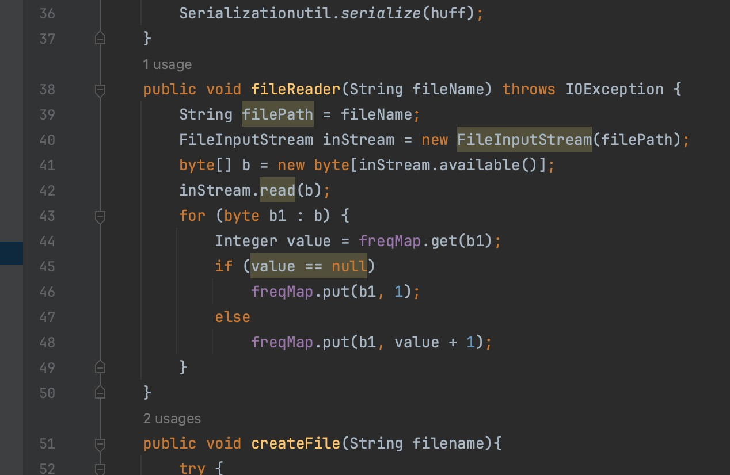
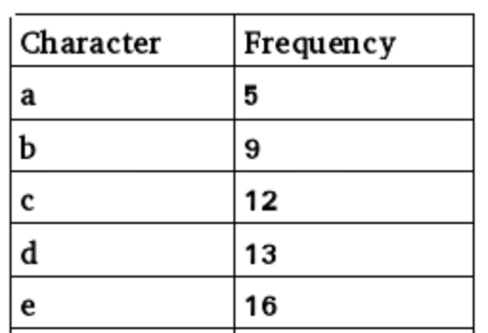
How does our code works ?
Frequency Calculation:
Read each letter from the text file to be compressed using FileReader() built-in class.
Using HashMap, we calculated the frequency of each letter by first inserting the letters individually and incrementing the corresponding frequencies by searching from in hashmap, keeping the time complexity O(1) in average case in mind.

Slide 9

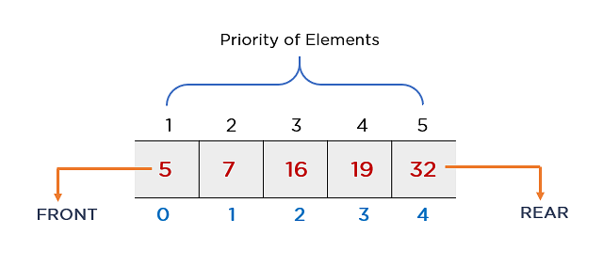
2. Create Nodes for Each letter:
Create a Huffman node for each letter, with the frequency of the letters as the weight of the node. These nodes initially represent individual characters in the data.
This Huffman Node class contains;
. Data variable of type Byte, Frequency as int, and Huffman Left & Right
3. Build a Priority Queue:
Place all the Huffman nodes into a min priority queue, ordering them based on their frequencies. The node with the lowest frequency has the highest priority.
. Why did we use Min-priority queue over here?
Since we have to make Max heap tree.
.Why do we used Max Heap tree?
Since the letter with the most frequency will be the node of the huffman so no need to be traverse whole list to find letter repeatedly why while file reader and writing.

Slide 10
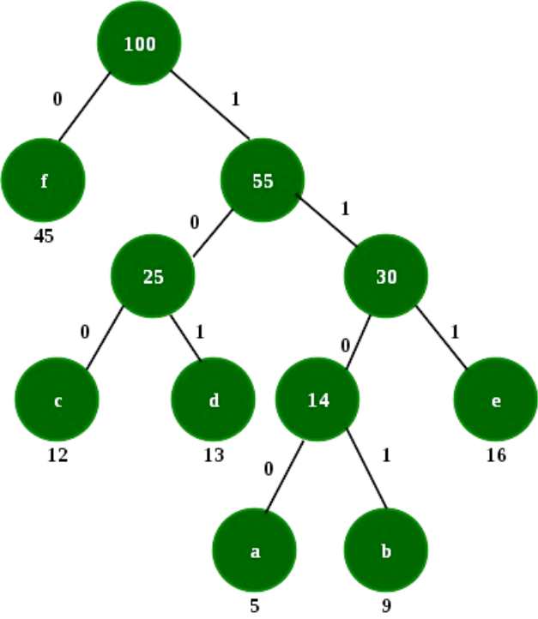
4. Build Huffman Tree:
While there is more than one node in the priority queue:
  Remove the two nodes with the lowest frequencies from the queue.
  Create a new node with a frequency equal to the sum of the frequencies of the two nodes.
  Insert the new node back into the priority queue.
The process continues until there is only one node left in the priority queue, which becomes the root of the Huffman tree.
. Assign Binary Codes:
Traverse the Huffman tree to assign binary codes to each symbol. Assign a '0' for each left branch and a '1' for each right branch. The code for a symbol is the sequence of '0's and '1's from the root to the leaf node corresponding to that symbol.
After assigning binary codes to each symbol, create a Hash mapping that associates each symbol with its corresponding Huffman code.

Slide 11
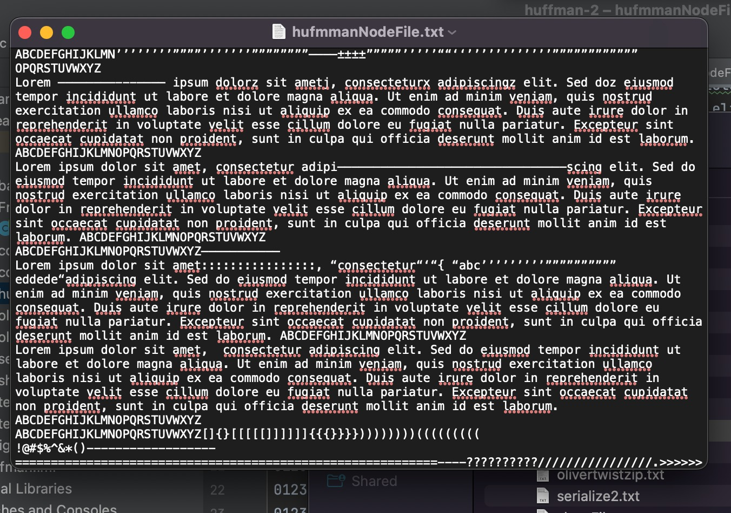
Our Huffman Node →

Slide 12
Compressing File:
Read the contents of the file.
Substitute each letter with its respective binary code using the hashmap created.
Save the compressed content to a new file.
Replace each letter in the original data with its Huffman code (special character). The result is a compressed representation of the input data.

Slide 13
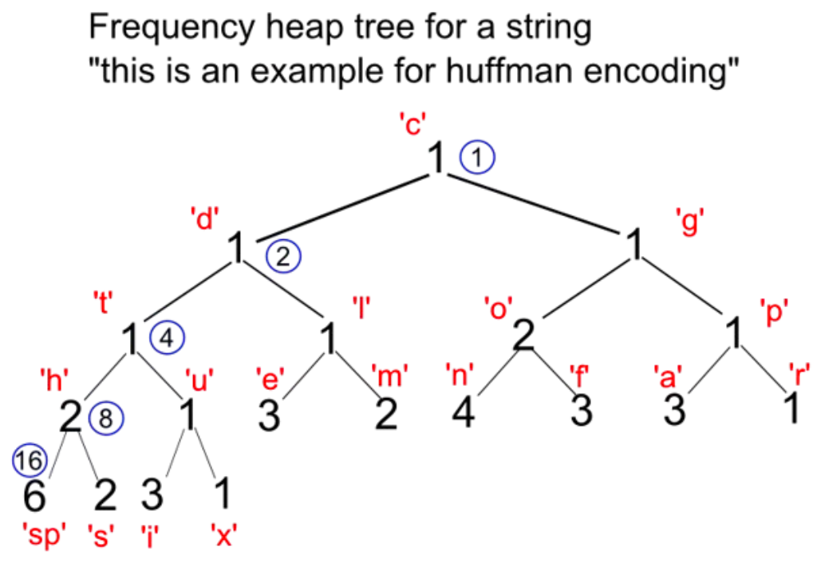
6. Decompression:
Calculate the binary equivalent values of the corresponding characters with the compressed files.
To decompress, use the stored Huffman tree to traverse the encoded data and reconstruct the original symbols.
Huffman coding is efficient for compressing data with varying symbol frequencies, and it's widely used in applications like file compression (e.g., ZIP files) and image compression.

Slide 14
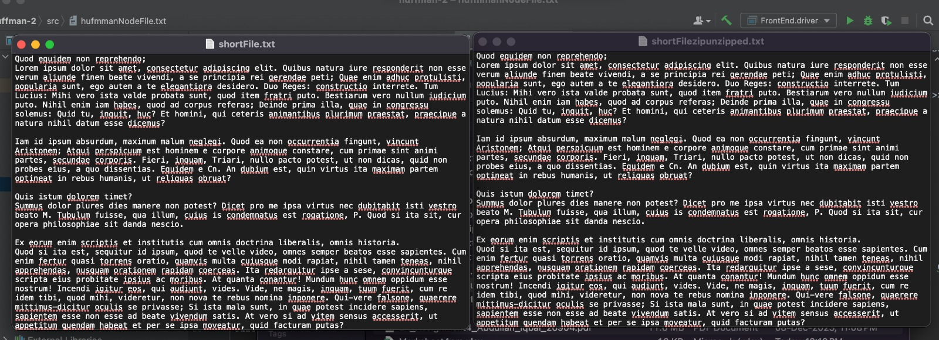
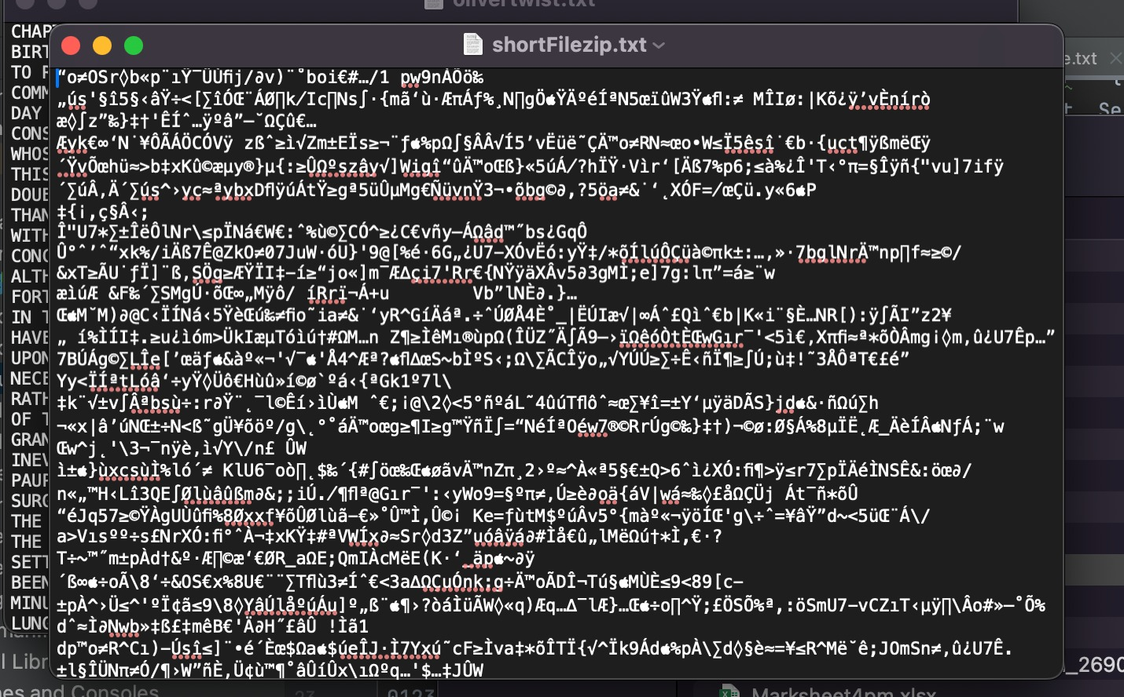

Slide 15
WHICH DATA STRUCTURES WE USED ?
PRIORITY QUEUE
HASHMAP
Max Heap Tree
More about this in next slide:→

Slide 16
WHY HASHMAP ?
Fast Symbol Lookup:
Advantage: Hashmaps allow constant-time (O(1)) average-case lookup. This is crucial during encoding, where quick access to the Huffman code for a given symbol is needed.
Dynamic Codebook Updates:
Advantage: In some scenarios where the symbol frequencies change dynamically (adaptive Huffman coding), hashmaps make it easy to update the codebook
Ease of Codebook Generation:
Advantage: Constructing the symbol-to-code mappings is straightforward with hashmaps. During the traversal of the Huffman tree, the code for each symbol can be directly stored in the hashmap.

Slide 17
WHY PRIORITY QUEUE?
Efficient Frequency Analysis: In Huffman coding, the first step involves analyzing the frequency of each symbol in the input data. A priority queue facilitates quick extraction of symbols based on their frequencies.
Efficient Element Retrieval:
Priority queues excel at quickly retrieving the element with the highest (or lowest) priority, making them suitable for scenarios where the order of processing is crucial.
Huffman coding dynamically constructs a binary tree where symbols with lower frequencies are assigned higher priorities. A priority queue efficiently manages the evolving structure of the Huffman tree during construction.

Slide 18
WHY max heap?
For retrieving Huffman code, we get a time complexity of o(log n) which can only be achieved using Max Heap tree.
Memory Efficiency:
The heap structure requires less memory overhead compared to alternatives like sorted arrays or linked lists. This contributes to better memory efficiency, which is important in resource-constrained environments.
Optimized Tree Construction:
During Huffman tree construction, the most frequent symbols need to be combined to form internal nodes. Using a max heap ensures that the symbols with the highest frequencies are always at the top of the heap, making it easy to identify and merge them to build the tree.

Slide 19
lIMITATIONS:
Fixed Alphabet Size: Huffman coding is designed for a fixed alphabet size, meaning it assumes a predetermined set of symbols. When dealing with variable-sized alphabets or dynamic datasets where the set of symbols can change, adapting Huffman coding becomes more challenging.
Not Always Optimal for Short Messages: Huffman coding may not be optimal for very short messages or small files. The overhead of encoding the Huffman tree or codebook can become a significant portion of the compressed data, reducing the overall compression efficiency.
If the Huffman node originates from a file in which the letter frequencies exhibit a greater difference compared to the file being compressed, it will result in the creation of leaf nodes for the alphabet. This, in turn, leads to an augmentation in the number of bits and consequently increases the overall file size. If the frequencies exceeds beyond a certain limit, it will not compress properly because the binary code generated will exceed the original number of letters in the file.

Slide 20
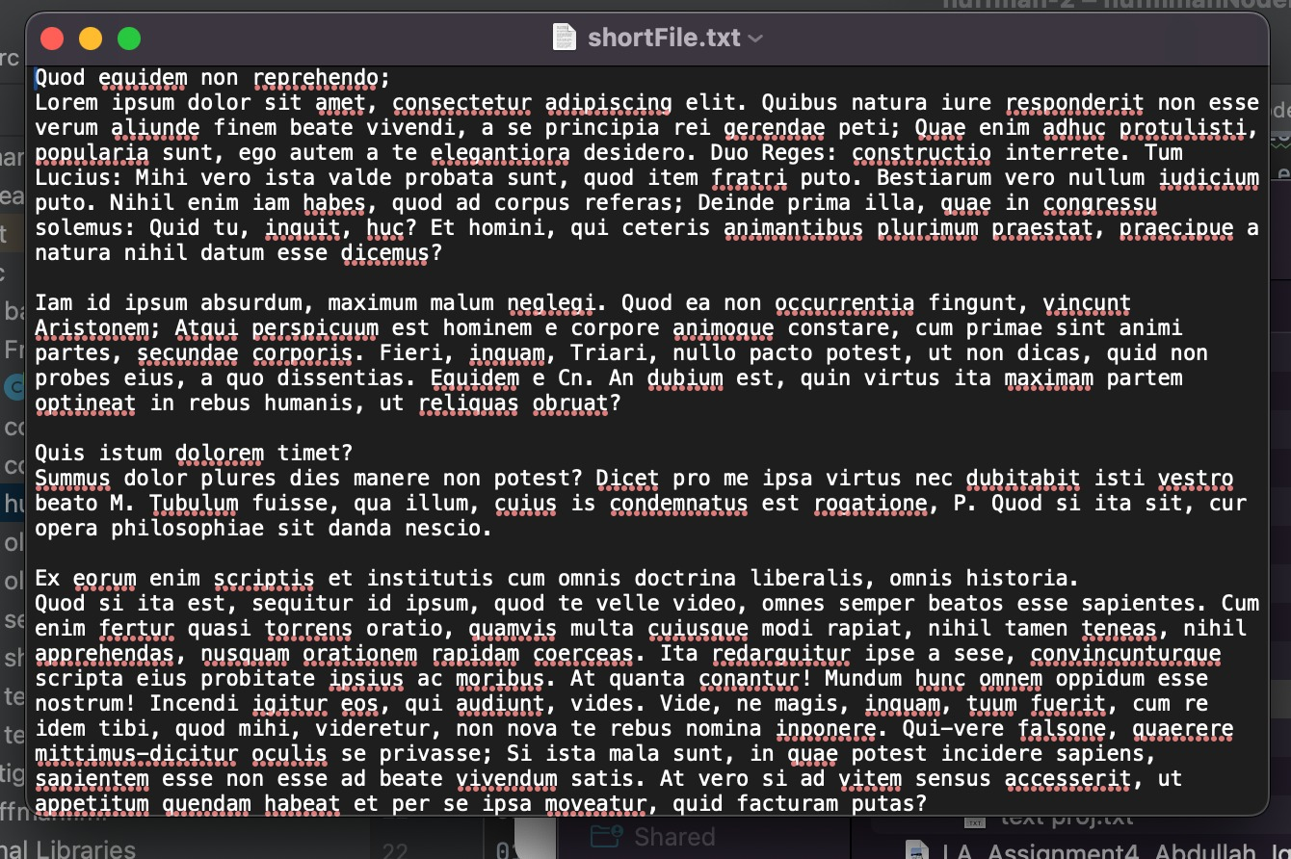
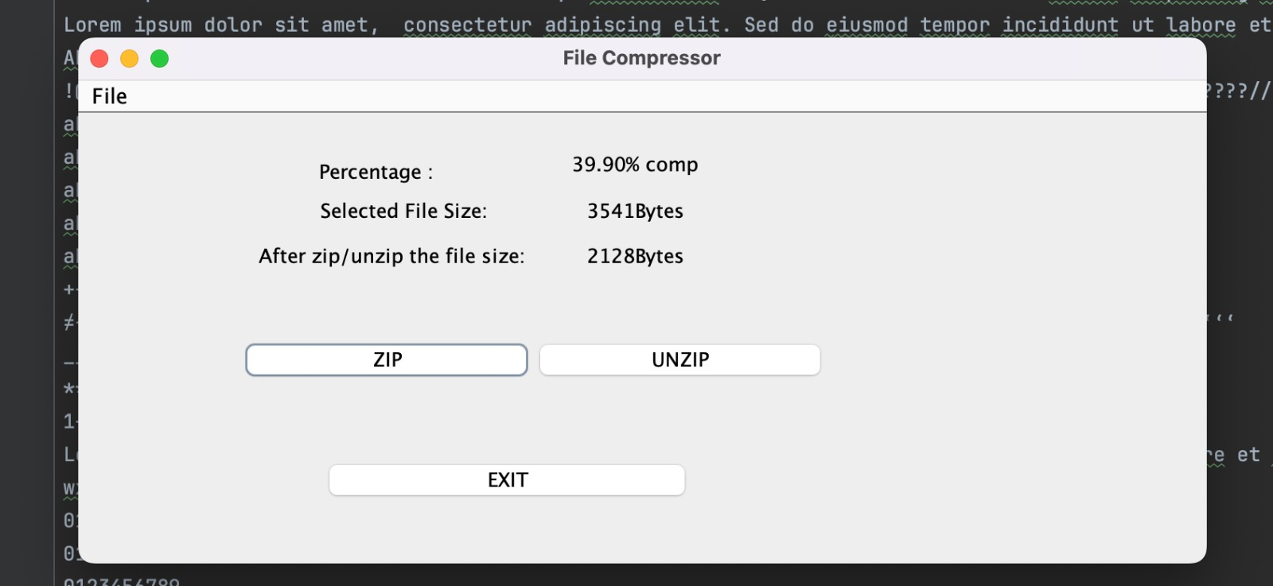
Since the frequency of the letters of this file somehow matches the freqency of Huffman tree, so file is compressed approximately 40%.

Slide 21
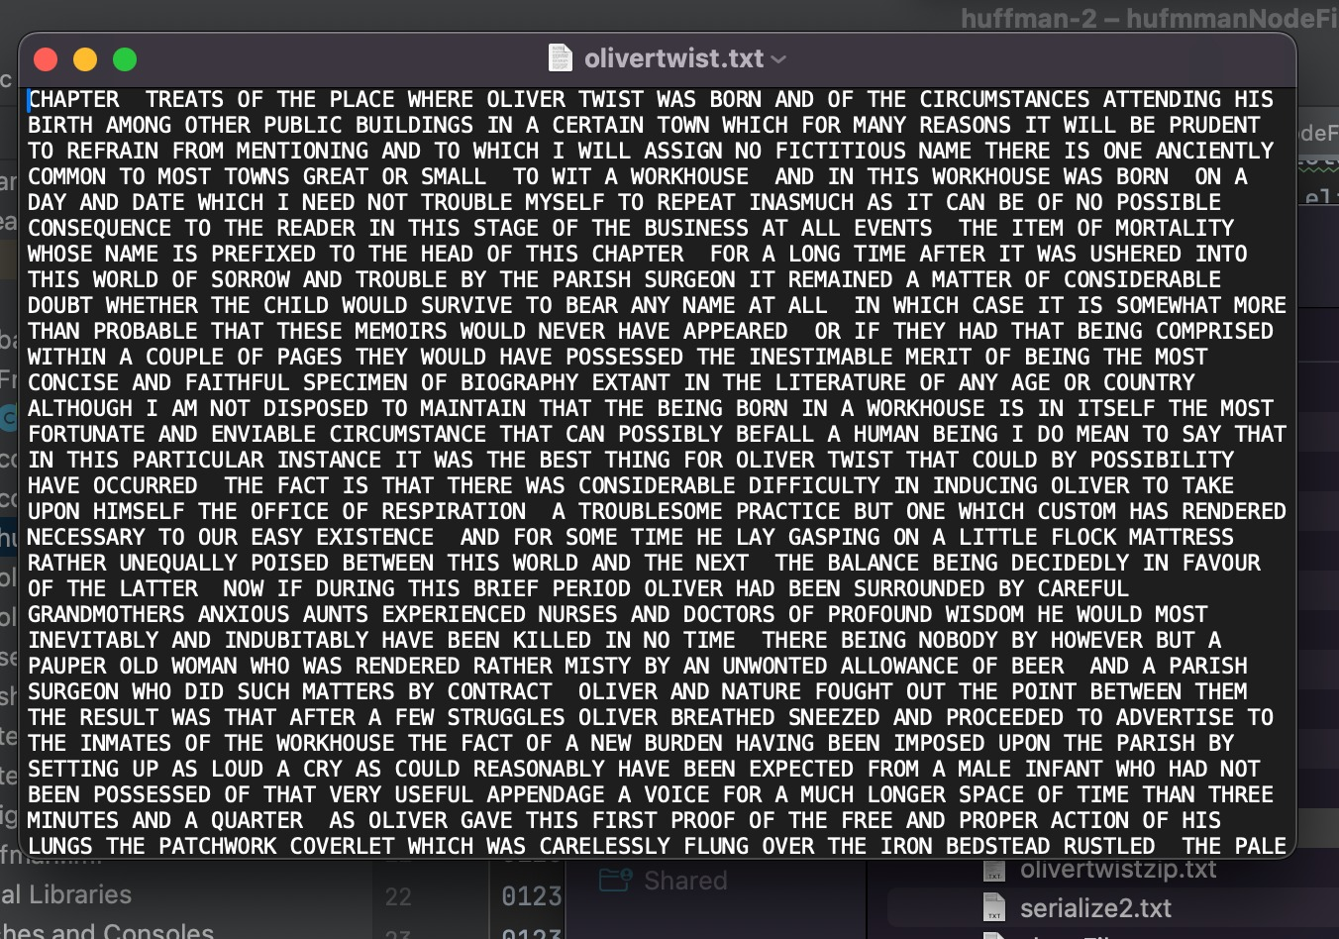
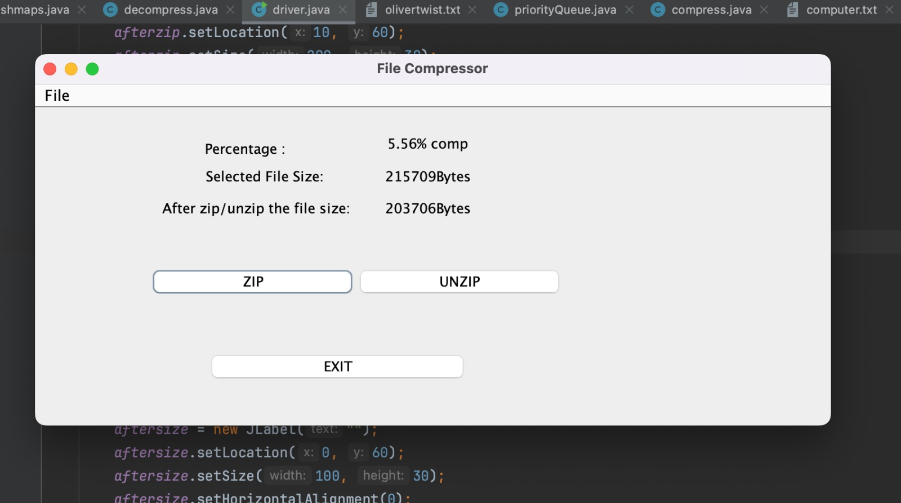
The frequency of letters here is greater than the frequency generated from the huffman file thus a drastic decrease in the compression percentage.

Slide 22
The BIG OH’S !
Buildhuffmantree() = O(n log n)
priorityadd() = O(n).
Huff: O(n)
printcode: o(n)
serialize: O(1) deserialize: O(n)
compress: O(n)
decompress: O(n log n)
Writeto file: O(k) where k is the length of binary representation.
dectobin: O(n)

Slide 23
More Big o
Enqueue: O(n)
Dequeue: O(1)
isEmpty: O(1).
toString: O(n),
put: O(1) average case, O(n) worst case (due to potential collisions and linear search in the linked list).
get: O(1) average case, O(n) worst case (due to potential collisions and linear search in the linked list).

Slide 24
TESTING: ABOUT THE DATA & ITS SOURCE:
We tested many different data files, such as books, medical files used by physicians for their reports and reports related to the emrging technologies.
We’re proud that our Huffman was able to compress them all with an average of 50% memory saving.
Some Notable files include:
-Oliver Twist (Novel by Charles Dickens)
-A custom file made with different sources to test the increasing frequencies.

Slide 25
Resources:
Data Resources: Oliver twist from https://e-school.kmutt.ac.th/
https://www.sietk.org/downloads/javabook.pdf
https://rlmc.edu.pk/themes/images/gallery/library/books/Anatomy/Clinical_Anatomy__Applied_Anatomy_for_Students_and_Junior_Doctors_11th_Edition.pdf
https://repository.poltekkes-kaltim.ac.id/1147/1/Guyton%20and%20Hall%20Textbook%20of%20Medical%20Physiology%20(%20PDFDrive%20).pdf
https://www.geeksforgeeks.org/serialization-in-java/

Slide 26
GETTING A JOB AT GOOGLE NOW DUE TO THIS PROJECT….
THANK YOU.

