Slide 1


Farmer Marketplace
(FYP Project)
Project Coordinator: Dr. Fahad Maqbool
Project Supervisor: Prof. Abid Rafique

Slide 2
Agenda
A clear roadmap of our project's key points and goals.
1
2
3
4
5
Motivation
Meet Our
Team
Individual
Contribution
Concept’s
Overview
Relevant Works
6
7
8
9
10
Target Audience
Problems to Solve
Solutions we Provide
Project Challenges
Conclusion

Slide 3
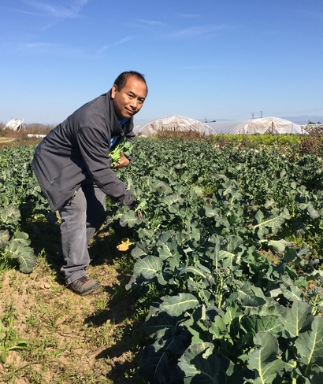
Motivation
Farmers interested in making a profit.
Consumers interested in healthy and fresh food.
The farmer is the only man in our economy who buys everything at retail, sells everything at wholesale, and pays the freight both ways.

Slide 4
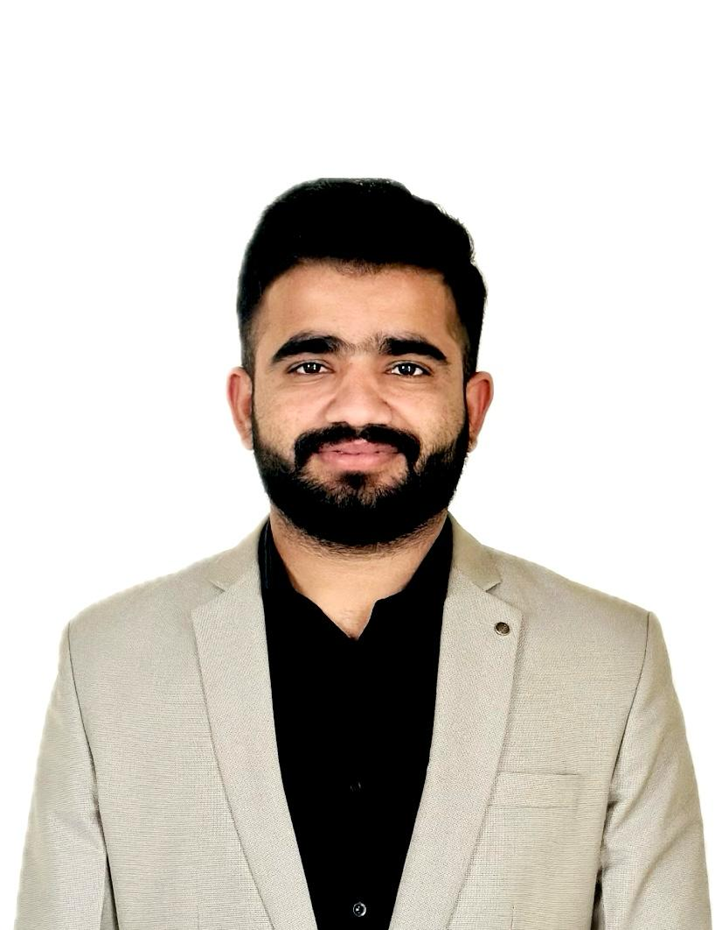

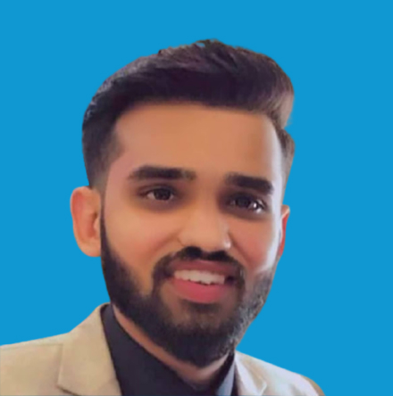
Meet Our Team
Chaman Abbas
Abdullah Jaspal
Zeeshan Ahmad
Team lead, React Native & Node JS Dev
React Native Dev.
UX/UI Designer

Slide 5
Individual Contribution
Led the project team by coordinating tasks, setting goals
Developed seller side frontend with React Native with JS
Developed the backend infrastructure using Node.js and MongoDB
Implemented robust data models, APIs
Conducted thorough testing and debugging of backend components
Provide APIs to Abdullah after testing on Postman
Acted as a mentor and resource for team members, providing guidance on technical challenges and facilitating knowledge sharing of project concept
Chaman Abbas

Slide 6
Individual Contribution
Translated the UI/UX designs to responsive frontend components
Implemented user interface elements, navigation flows, and state management logic
Collaborated closely with Chaman to integrate frontend components with the backend infrastructure
Conducted extensive testing of the frontend interface across multiple devices
Overall improvement of the app's performance and usability.
Abdullah Jaspal

Slide 7
Individual Contribution
Designed all screens and user interface elements for the mobile app using Figma
Collaborated closely with Chaman and Abdullah to understand project requirements
Improved the designs based on feedback from stakeholders
Created design assets, style guides, and documentation to ensure consistency
Worked closely with Abdullah to ensure seamless integration of design elements
Zeeshan Ahmad

Slide 8
Overview of Concept
A mobile app connecting Pakistani farmers directly with consumers, ensuring fair prices and fresh produce
Farmer Empowerment
Consumer Benefit
Economic Boost
This app gives farmers the power to set their own prices and directly reach customers, increasing their earnings and market presence.
Consumers enjoy the convenience of purchasing straight from the source, ensuring they get the freshest and most authentic products.
By simplifying the supply chain, the app helps to strengthen Pakistan's agricultural economy and reduce unnecessary food waste.

Slide 9



Relevant Apps in Market
Bakhabar Kissan
Agri Smart
Ricult Pakistan
Jazz Bakhabar Kissan is a dedicated app that helps farmers to increase their crop yield with updated information and technology.
The Punjab Public Management Reform Program (PPMRP) launched an ‘Agri Smart’ app for extension workers with a wide range of services including farmer training sessions, pest warnings, monitoring agricultural inputs, soil sampling and receiving complaints.
Ricult Pakistan is another digital app that is working to increase the productivity & profitability of small farmers in the country by providing them agricultural information, solutions for their problems and providing access to credit and the marketplace.

Slide 10

Proposed Work
Farmers gain a user-friendly platform to manage listings and fulfill orders. Consumers enjoy a convenient way to access fresh, local produce. We'll provide marketing materials and user guides for a seamless launch, empowering a thriving online marketplace.

Slide 11
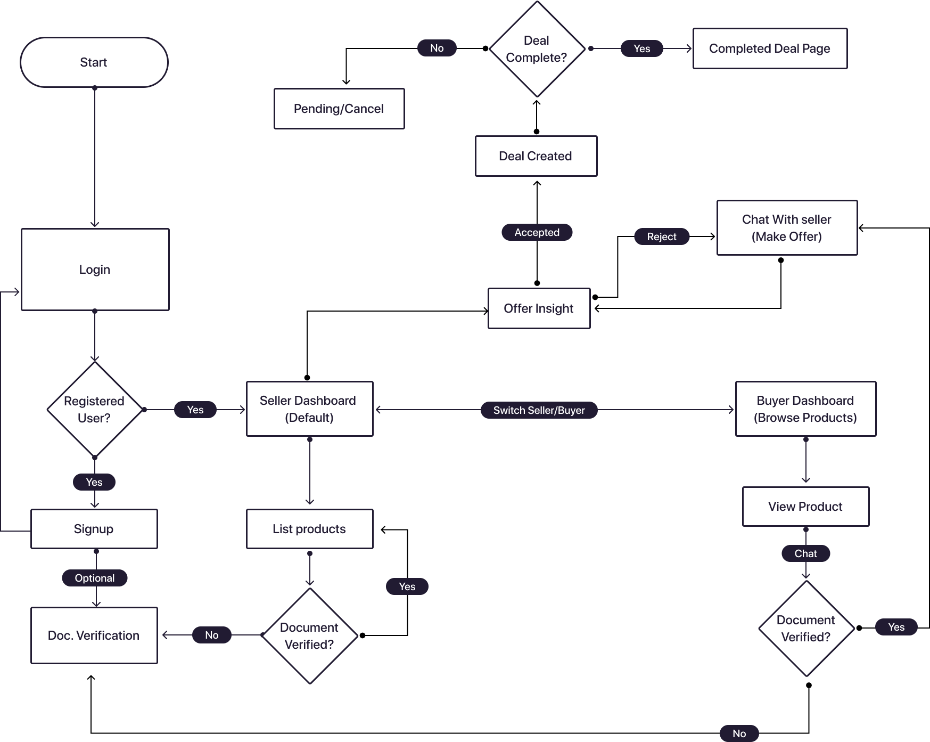
Platform Flowchart

Slide 12
Problems to solve
Intermediary Costs
Limited Choice
Market Access
Farmers incur significant losses due to the fees and commissions charged by middlemen.
Traditional markets may lack access to a wide variety of fresh, local produce for consumers.
Limited market access forces farmers to sell at lower prices than the actual value of their produce.
Pricing Strategy
Consumer Trust
Sales management by government is affected the farmer.
Consumers lack trust in the quality and source of produce due to the absence of direct farmer interaction.

Slide 13
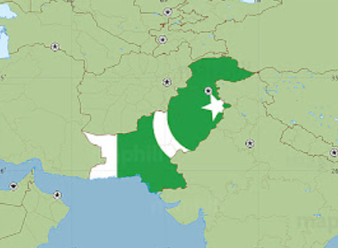
Target Audience
Locations
Demographics
Behavior
Age
any
local farmers seeking a wider customer base for their profit
consumers yearning for fresh, local produce delivered directly to their doors.
Gender
Male and female
Occupation
all
Region
Pakistani
Family situation
Any
Area
Any
Income
Any

Slide 14






Experimental Setup
React Native (Version ^0.72.0)
Node JS (Version ^20.7.0)
MongoDB (Version 6.3)
Android Studio (Version IntelliJ)
VS Code
Figma

Slide 15
Conclusion
The proposed mobile application is poised to revolutionize the agricultural market in Pakistan. By directly connecting farmers with consumers, it promises to enhance the livelihoods of farmers and provide consumers with healthier, fresher food options. This initiative not only stands to benefit individual stakeholders but also aims to contribute to the sustainability and resilience of the national economy.

Slide 16
Thanks!
Do you have any questions?
chaman,devv@gmail.com

