Slide 1
Final Project Report and Code
Abdullah Kasri
Data science internship LISUM03

Slide 2
Which patients are more likely to experience a failure while ingesting the drug?
The file Coefficint.csv provided explicitly shows how did all the factors in the dataset impact the drug’s persistency, I’ve mostly notice that most of the times where the drug didn’t function as expected occurred with patients experiencing previous problems related to immunity , bone density, cardiovascular diseases, etc.

Slide 3
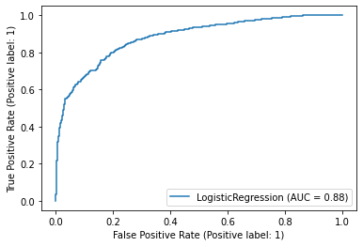
ROC curve (persistency vs other factors)

Slide 4
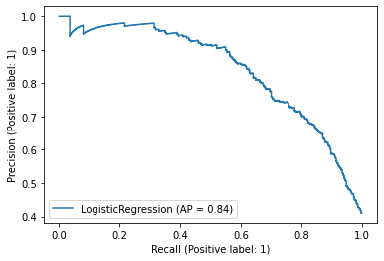
Recall curve

Slide 5
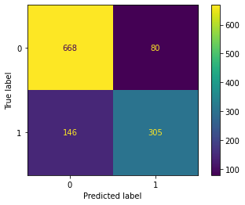
Confusion matrix

Slide 6
More technical details are available in the EDA.
And if you want, you can also check out the Standard deviation.csv file in order to better understand the patterns in the model.

Slide 7
Thanks for reading!!!

