Slide 1
Customer Segmentation
Week 12 project
Abdullah kasri
Data science intern
Abdullah00kasri@gmail.com

Slide 2
I’ve decided to split and analyze the
I’ve decided to split and analyze the dataset given into five main groups in order to help the bank make better offerings to their customers.
Those groups are; Customer activity, customers’ relationship with the bank, type of customers, Gender-based-decisions among customers & newly joined customers.
By using these groups, I'm optimistic about clarifying the patterns.

Slide 3
But first,
Let me show you all the technical and statistical points and then explain what they exactly mean…

Slide 4
Activity index

Slide 5
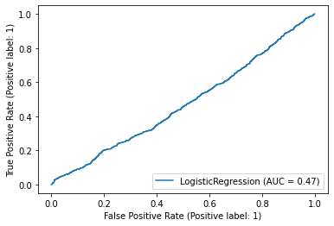
ROC curve shows a modest effect

Slide 6
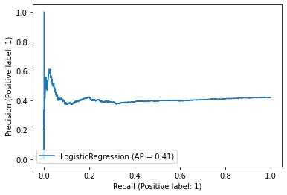
Recall also is telling us something similar about the effect

Slide 7
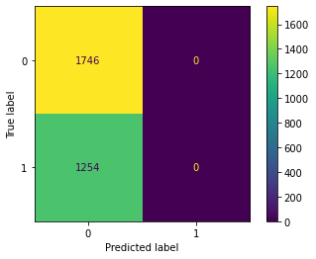
Confusion Matrix

Slide 8
We can summarize this section by concluding that the activity level of customers typically increases as does their age. But it showed little to no effect whether the customers were female or male

Slide 9
Customers’ relationship with the bank

Slide 10
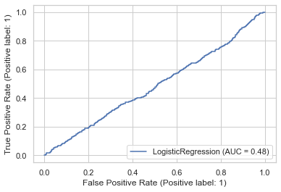
ROC curve

Slide 11
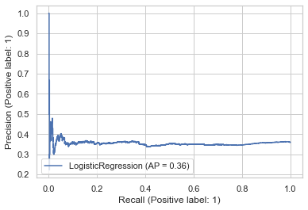
Recall curve

Slide 12
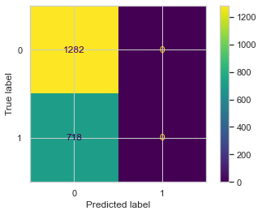
Confusion matrix

Slide 13
Customers’ seniority(the time they spent) with the bank have had a positive impact on the relationship between the two, such that, the longer the customer stays with the bank, the higher their chance of them of getting the Christmas bonus offer.

Slide 14
Customer type

Slide 15
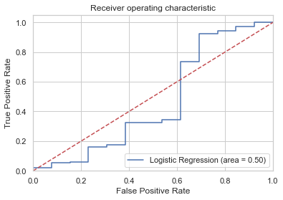
ROC curve

Slide 16
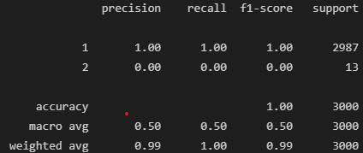
The customer type can slightly tell us about the general distribution of this section. We mostly see that primary customers(1) and co-owners(2), dominate the majority of this field and are worthy of the bonus.

Slide 17
Gender

Slide 18
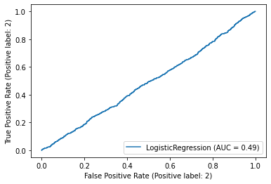
Gender’s role. ROC curve

Slide 19
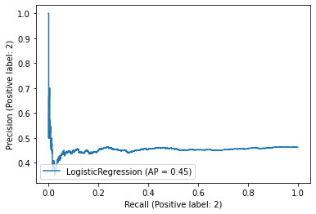
Recall curve

Slide 20
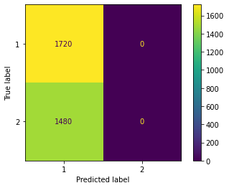
Confusion matrix

Slide 21
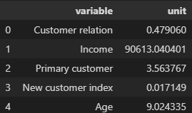
Here, we detect a bias in income between the two genders. Males out-earning females. On the bright side, bonuses can be given to customers recorded as primary.

Slide 22
New customers

Slide 23
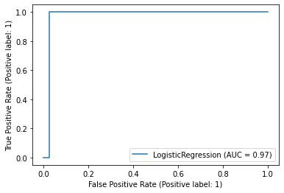
New customers’ ROC curve

Slide 24
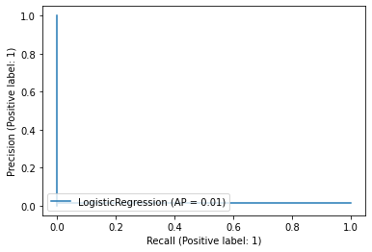
Recall

Slide 25
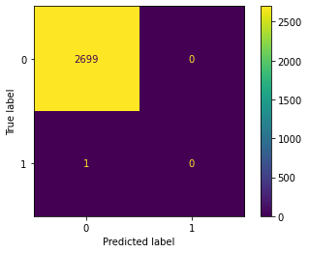
Confusion matrix

Slide 26

And, this model has proven to us that newer customers(signed up within the last 6 months) tended to more active than former ones. Earning higher salaries, making more bank transactions, and therefore, are more worthy of the Christmas bonus

Slide 27
So, there you have it!
My top 5 approaches in figuring out which customers should the bank award with the bonus.
I hope this was helpful.

Slide 28
Thank you!!
Abdullah kasri
Data science intern at Data Glacier
Week-8 project; Customer Segmentation

