Slide 1
Sales Trucks app
Business model

Slide 2
Team members
Abdulaziz Alorabi 1636938
Abdullah Kimrigh 1743285
Abdullah Alhazmi 1639266
Mohammad Bamousa 1741323
Abdullah hafiz 1638731
Abdulrhman Alnujaimy 1742971
Feras Hamadani 1741408

Slide 3
introduction
What is our idea?
How we implement it?
How we find revenue?
What is our business model?

Slide 4
Case Background:
Who are we?
How do we work?
Finally

Slide 5
Value proposition:
Save time
Save effort
Satisfied the customers needs
Collect all sales trucks in the one app

Slide 6
Revenue Model:
Advertising revenue model
Transaction fee revenue model
Sales revenue model

Slide 7
Market opportunities:
Customer
Competition
Company
Technology

Slide 8
Competitive environment:
Who’s the competitors?
What if a competitor shows up?

Slide 9
competitive advantages:
New Entrants & first-mover
Saudi Arabia
E-Commerce trend
What the value that distinguishes us in the market?

Slide 10
Market Strategy:
What our service
Our work process
App price

Slide 11
Organization Development and Structure and Management Team:
Manager
Marketing
Information Technology
Finance
Operation
Human Resource

Slide 12
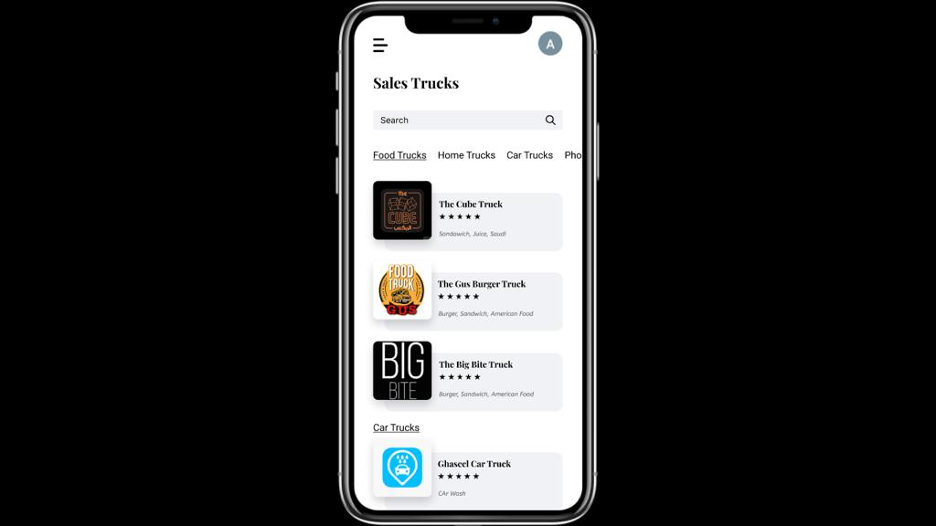
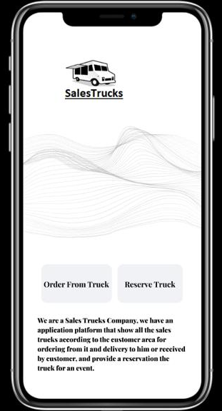
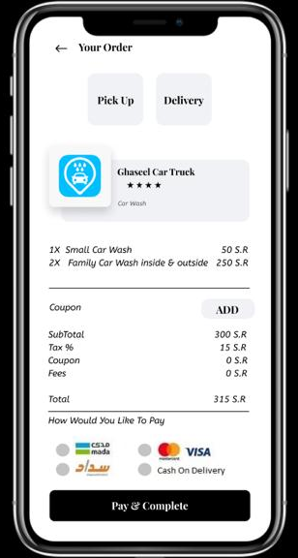
DEPECTION of application:

Slide 13
Thanks for listening
Any questions

