Slide 1

Person Re-Identification using Multiple Cameras
Group Members
Shurjeel Fayyaz
Salman Akhtar
Abdullah Makhdoom
Advisor
Dr. Muhammad Shahzad
Co-Advisor
Dr. Moazam Fraz
Notes:
‹#›

Slide 2
Before Starting
1) FYP report reviewed by the Advisor (Yes)
2) FYP Report uploaded on PMS/ LMS (Yes)
3) FYP Demo reviewed by the advisor (Yes)
4) FYP Demo uploaded on PMS/LMS (Yes)
5) Course feedback of all courses submitted on CMS (Yes)
Notes:
‹#›

Slide 3


Project Motivation
Looking at the state of current security plight in the form of frequent street crimes and burglary incidents taking place in every city of our country, we felt a need to come up with a modern and potent solution to the problem.
Notes:
‹#›

Slide 4
Project Objective
“An Intelligent Surveillance Software capable of automatically finding a specific person through a series of CCTV footage.”
Notes:
‹#›

Slide 5
Literature Review
Closed World Setting vs Open World Settings
Homogenous Data vs Heterogeneous Data
Sufficient Annotated Data vs Limited/Unavailable Data
Bounding-Box Generation vs Raw Videos/Images
Correct Annotation vs Noisy Annotation
Query Person present in Gallery vs Query Person missing in Gallery
Re-ID literature focuses on closed world setting while practically deployable Re-ID system face open world scenario.
Notes:
‹#›

Slide 6
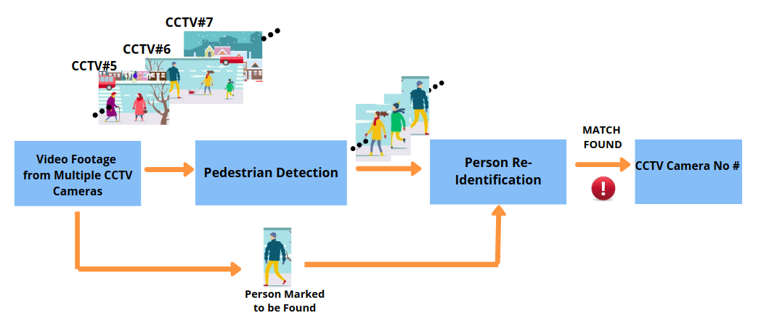
System Pipeline
(General Perspective)
Notes:
‹#›

Slide 7
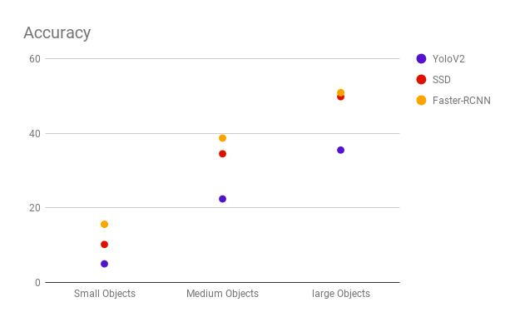
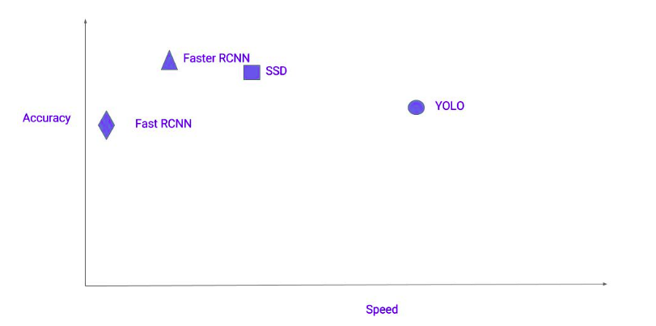
Comparison of Person Detection Models
Considering the trade-off between performance speed and detection accuracy, SSD were opted to be most suited for our needs.
Notes:
‹#›

Slide 8
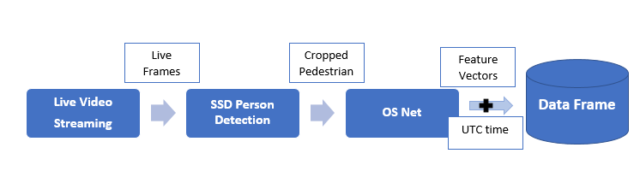
System Pipeline
(Technical Perspective)
Notes:
‹#›

Slide 9
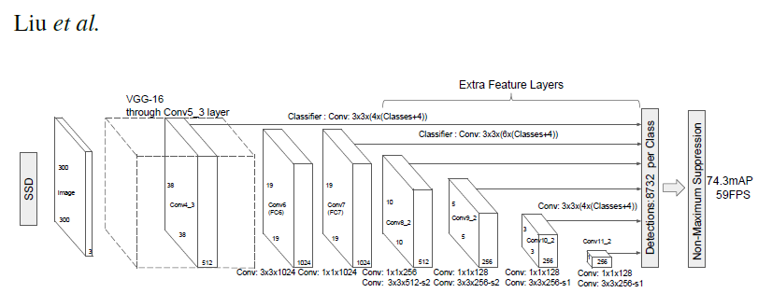
Component Details: Person Detection
Single Shot Detector pre-trained on COCO dataset
Notes:
‹#›

Slide 10
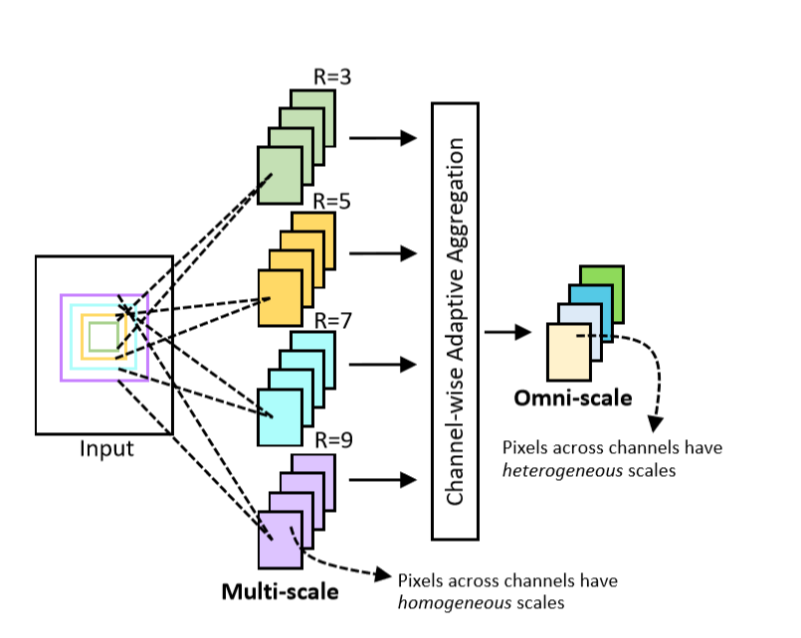
Component Details : Person Re-ID
Omni-Scale Feature Learning for Person Re-Identification (CVPR 2019)
Notes:
‹#›

Slide 11
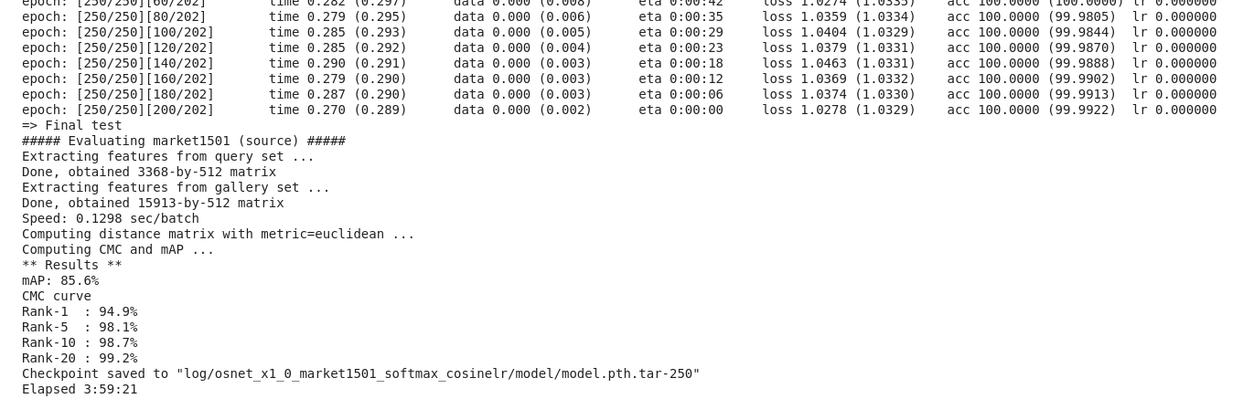
Training & Testing of OS Net
Notes:
‹#›

Slide 12
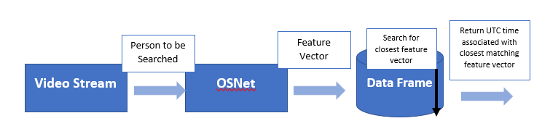
Person Query
Notes:
‹#›

Slide 13
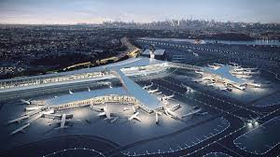
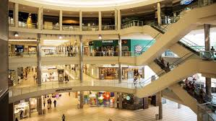

Industry Potential
Airports
Shopping Malls
Smart Cities
Notes:
‹#›

Slide 14




Tools & Technologies Used

Slide 15
Challenges / Limitations
Variation of pedestrian poses, occlusion in crowded areas and uniform clothing present challenges to effective Re-ID
Noisy video feed, illumination changes and resolution variation further add difficulty to the problem
Population to be monitored should be fed for the training Re-ID model for better prediction performance.
Notes:
‹#›

Slide 16
Future Work
Clustering the feature vectors for efficient query retrieval
Adaptive learning model that learns with incoming video feed
Introducing spatial and temporal constraints for Re-Identification
A better visualization for pedestrian ID’s registered in feature dataframe
Augmenting with Face and Gait Recognition for even more powerful prediction
Notes:
‹#›

Slide 17
Concluding Remarks
Successful in closing the gap between latest research and practically deployable system
Opportunity to discover the state-of-the-art artificial intelligence and appreciate it’s potential
Learned to apply technology for the welfare of humanity.
Notes:
‹#›

Slide 18
Question / Answers ?
?
Notes:
‹#›

