Slide 1
Design a Laurentian University Forensic Network for Reconstructing VolP (Voice over IP) Calls using Wireshark
NETWORK FORENSICS
CPSC_5207EL_03_2025W
Professor: Dr. Williams Nwadiugwu
Group # 4
Hafiz Muhammad Abdullah Qureshi (0453050)
Liying cao (0452502)
Prabha basnet (0470401)

Slide 2
Introduction
Voice over IP (VoIP) is a technology that allows voice communication and multimedia sessions over Internet Protocol (IP) networks.
It converts analog voice signals into digital data packets and transmits them over the internet or other IP-based networks.
Examples of VoIP applications: Skype, Zoom, WhatsApp calls, and Linphone.

Slide 3
Tools and Software Used
Linphone
Linphone is an open-source VoIP software that enables voice and video calls over IP networks.
It supports protocols like SIP and RTP, making it ideal for testing and analyzing VoIP communication.
Used in this project to establish VoIP calls for forensic analysis.
Wireshark
Wireshark is a widely-used network protocol analyzer for capturing and inspecting network traffic.
It supports deep inspection of hundreds of protocols, including SIP and RTP used in VoIP.
Used to capture and analyze VoIP packets for call reconstruction.

Slide 4
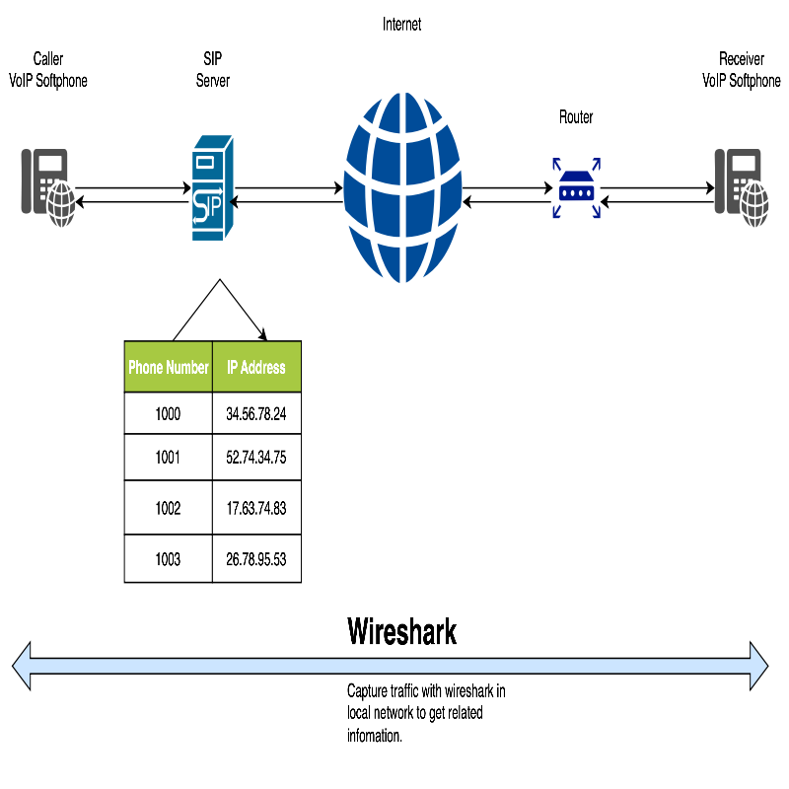
Project Overflow

Slide 5
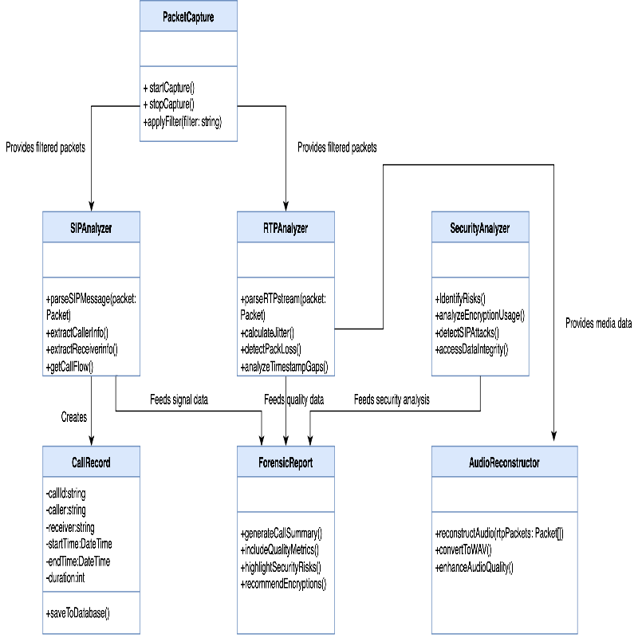
Class Diagram

Slide 6
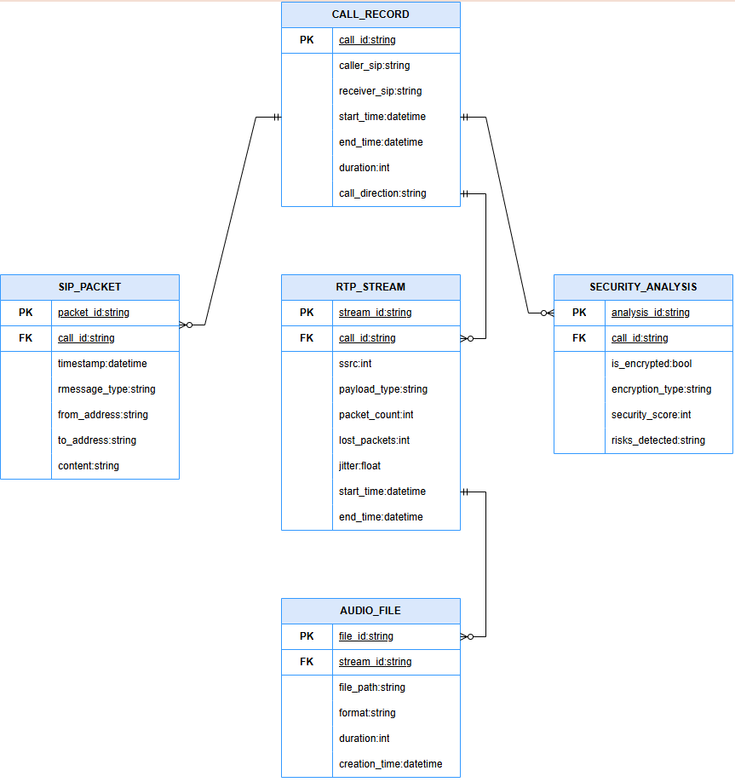
Entity Relationship Diagram

Slide 7
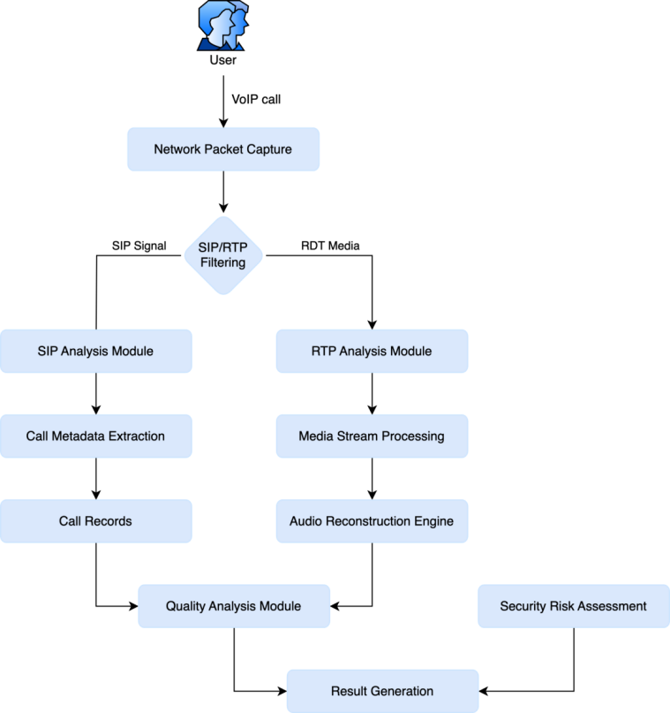
Dataflow Diagram

Slide 8
Results/Drawbacks
Results
Call Reconstruction: Successfully reconstructed parts of VoIP calls using RTP stream analysis in Wireshark.
Anomaly Detection: Detected network anomalies such as jitter, packet loss, and inserted silence.
Forensic Workflow: Created a repeatable and structured forensic analysis workflow for VoIP calls.
Drawbacks
Incomplete Audio: Most RTP streams had missing or silent audio due to incomplete SIP or RTP capture.
Capture Dependency: Accurate analysis depended heavily on capturing the full call setup and teardown.
Codec Limitations: Wireshark’s limited support for certain codecs (e.g., Opus, G.729) reduced compatibility with modern VoIP systems.

Slide 9
References
Wireshark User Guide: https://www.wireshark.org/docs/
Linphone Documentation: https://www.linphone.org/technical-corner
Narasimha Shashidhar, K. (2015). Forensic Analysis of VoIP Communications Using Wireshark.In Digital Forensics and Cyber Crime (Springer, pp. 65–78).
Barbeau, M., Kranakis, E., & Kienzle, D. (2006). Detection of VoIP Calls Traversing NAT with the Use of Signatures.

