Slide 1
CSE-312
Web Design and Programming Lab-I
Lab-9: JavaScript
Md. Rafsan Jani
Assistant Professor
Department of Computer Science and Engineering
Jahangirnagar University

Slide 2
What is JavaScript?
a lightweight programming language ("scripting language")
used to make web pages interactive
insert dynamic text into HTML (ex: user name)
react to events (ex: page load, user click)
get information about a user's computer (ex: browser type)
perform calculations on user's computer (ex: form validation)
a web standard (but not supported identically by all browsers)
NOT related to Java other than by name and some syntactic similarities

Slide 3
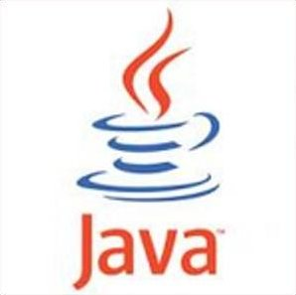
JavaScript vs Java
interpreted, not compiled
more relaxed syntax and rules
fewer and "looser" data types
variables don't need to be declared
errors often silent (few exceptions)
key construct is the function rather than the class
"first-class" functions are used in many situations
contained within a web page and integrates with its HTML/CSS content

Slide 4
Linking to a JavaScript file: script
In HTML, JavaScript code must be inserted between
<script> and </script> tags.
Example:
<script> document.getElementById("demo").textContent = "My First JavaScript"; </script>
Old JavaScript examples may use a type attribute: <script type="text/javascript">.
The type attribute is not required.
JavaScript is the default scripting language in HTML.

Slide 5
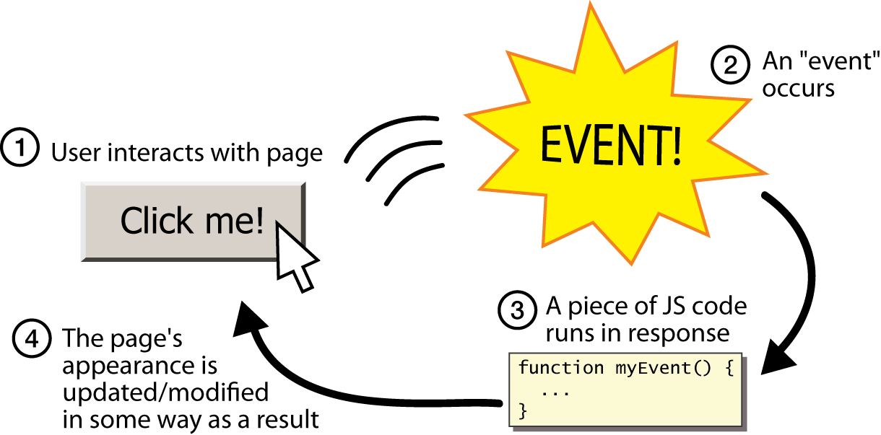
Event-driven programming
split breaks apart a string into an array using a delimiter
can also be used with regular expressions (seen later)
join merges an array into a single string, placing a delimiter between them

Slide 6
Event-driven programming
We are used to start a program with a main method (or implicit main like in PHP)
JavaScript programs instead wait for user actions called events and respond to them
event-driven programming: writing programs driven by user events
Let's write a page with a clickable button that pops up a "Hello, World" window...

Slide 7
Buttons
<button>Click me!</button> HTML
button's text appears inside tag; can also contain images
To make a responsive button or other UI control:
choose the control (e.g. button) and event (e.g. mouse click) of interest
write a JavaScript function to run when the event occurs
attach the function to the event on the control
Notes:
Reset is not working here! Debug! test1.html

Slide 8
JavaScript functions
function name() {
statement ;
statement ;
...
statement ;
} JS
function myFunction() {
alert("Hello!");
alert("How are you?");
} JS
the above could be the contents of example.js linked to our HTML page
statements placed into functions can be evaluated in response to user events

Slide 9
Event handlers
<element attributes onclick="function();">... HTML
<button onclick="myFunction();">Click me!</button> HTML
JavaScript functions can be set as event handlers
when you interact with the element, the function will execute
onclick is just one of many events HTML attributes we'll use
but popping up an alert window is disruptive and annoying
A better user experience would be to have the message appear on the page...

Slide 10
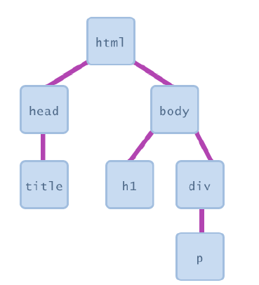
Document Object Model (DOM)
most JS code manipulates elements on an HTML page
we can examine elements' state
e.g. see whether a box is checked
we can change state
e.g. insert some new text into a div
we can change styles
e.g. make a paragraph red

Slide 11
Document Object Model (DOM)
Finding HTML Elements
Method | Description
document.getElementById(id) | Find an element by element id
document.getElementsByTagName(name) | Find elements by tag name
document.getElementsByClassName(name) | Find elements by class name
document.querySelectorAll("p.intro"); | Find elements with specific CSS class

Slide 12
Document Object Model (DOM)
Changing HTML Elements
Property | Description
element.textContent = new html content | Change the inner HTML of an element
element.attribute = new value | Change the attribute value of an HTML element
element.style.property = new style | Change the style of an HTML element
element.setAttribute(attribute, value) | Change the attribute value of an HTML element

Slide 13
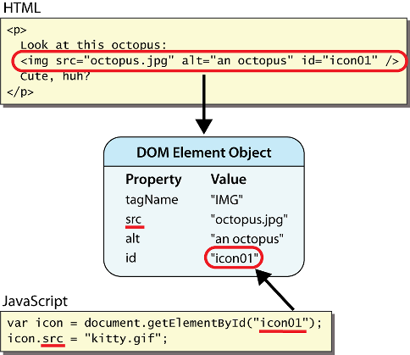
DOM element objects
Notes:
every element on the page has a corresponding DOM object access/modify the attributes of the DOM object with objectName.attributeName

Slide 14
Accessing elements: document.getElementById
var name = document.getElementById("id");
JS
<button onclick="changeText();">Click me!</button>
<span id="output">replace me</span>
<input id="textbox" type="text" /> HTML
function changeText() {
var span = document.getElementById("output");
var textBox = document.getElementById("textbox");
textbox.style.color = "red";
} JS
JS
Notes:
span.innerHTML = textBox.value;

Slide 15
Accessing elements: document.getElementById
document.getElementById returns the DOM object for an element with a given id
can change the text inside most elements by setting the textContent property
can change the text in form controls by setting the value property

Slide 16
Changing element style: element.style
Attribute | Property or style object
color | color
padding | padding
background-color | backgroundColor
border-top-width | borderTopWidth
Font size | fontSize
Font famiy | fontFamily

Slide 17
Prettify
function changeText() {
//grab or initialize text here
// font styles added by JS:
text.style.fontSize = "13pt";
text.style.fontFamily = "Comic Sans MS";
text.style.color = "red"; // or pink?
}
JS

Slide 18
JavaScript Syntax

Slide 19
Arithmetic Expressions
Like most languages, JavaScript specifies computation in the form of an arithmetic expression, which consists of terms joined together by operators.
Each term in an arithmetic expression is one of the following:
An explicit numeric value, such as 2 or 3.14159265
A variable name that serves as a placeholder for a value
A function call that computes a value
An expression enclosed in parentheses
The operators are typically the familiar ones from arithmetic:
+
Addition
–
Subtraction
*
Multiplication
/
Division
%
Remainder

Slide 20
The Remainder Operator
The only arithmetic operator that has no direct counterpart in traditional mathematics is %, which computes the remainder when the first divided by the second:
14 % 5
returns
4
14 % 7
returns
0
7 % 14
returns
7
The result of the % operator make intuitive sense only if both operands are positive.
The remainder operator turns out to be useful in a surprising number of programming applications and is well worth a bit of study.

Slide 21
Using the Console
The easiest way to get a sense of how arithmetic expressions work is to enter them on the browser console.
JavaScript Console
->
2 + 2
4
->
342 - 173
169
->
12345679 * 63
777777777
->
9 * 9 * 9 + 10 * 10 * 10
1729
->

Slide 22
Variables
The simplest terms that appear in expressions are constant literals and variables. A variable is a placeholder for a value that can be updated as the program runs.
A variable in JavaScript is most easily envisioned as a box capable of storing a value
answer
42
Each variable has the following attributes:
A name, which enables you to tell the variables apart.
A value, which represents the current contents of the variable.
The name of a variable is fixed; the value changes whenever you assign a new value to the variable.

Slide 23
Variable Declarations
The declaration establishes the name of the variable and, in most cases, specifies the initial value as well.
The most common form of a variable declaration is
var name = value;
let name = value;
const name = value;
where name is an identifier that indicates the name of the variable, and value is an expression specifying the initial value.
Most declarations appear as statements in the body of a function definition. Variables declared in this way are called local variables and are accessible only inside that function.

Slide 24
Constant Declarations
It is often useful to give names to values that you don’t intend to change while the program runs. Such values are called constants.
A constant declaration is similar to a variable declaration:
const name = value;
As before, name is an identifier that indicates the name of the constant, and value is an expression specifying its value.

Slide 25
Comparison var, let and const
var declarations are globally scoped or function scoped while let and const are block scoped.
var variables can be updated and re-declared within its scope; let variables can be updated but not re-declared; const variables can neither be updated nor re-declared.
They are all hoisted to the top of their scope. But while var variables are initialized with undefined, let and const variables are not initialized.
While var and let can be declared without being initialized, const must be initialized during declaration.

Slide 26
Naming Conventions
In JavaScript, all names must conform to the syntactic rules for identifiers, which means that the first character must be a letter([a-z, A-Z]), or underscore(_), or dollar($) and the remaining characters must be letters, digits, or the underscore character.
Beyond these rules that apply to all JavaScript names, there are several conventions that programmers use to make their identifier names easier to recognize:
Variable names and function names begin with a lowercase letter. If a name consists of more than one word, the first letter in each word is capitalized, as in numberOfStudents. This convention is called camel case.
Class names and program names begin with an uppercase letter.
Constant names are written entirely in uppercase and use the underscore character to separate words, as in MAX_HEADROOM.

Slide 27
Precedence
If an expression contains more than one operator, JavaScript uses precedence rules to determine the evaluation order. The arithmetic operators have the following relative precedence:
unary -
highest
* / %
+ -
lowest
Thus, JavaScript evaluates unary – operators first, then the operators *, /, and %, and then the operators + and -.
Precedence applies only when two operands compete for the same operator. If the operators are independent, JavaScript evaluates expressions from left to right. Parentheses may be used to change the order of operations.

Slide 28
Exercise: Precedence Evaluation
What is the value of the expression at the bottom of the screen?
42
51
45
6
3
2
9
15
1
*
2
*
3
+
(
4
+
5
)
%
6
*
(
7
+
8
)
-
9

Slide 29
Assignment Statements
You can change the value of a variable in your program by using an assignment statement, which has the general form:
variable = expression;
The effect of an assignment statement is to compute the value of the expression on the right side of the equal sign and assign that value to the variable that appears on the left. Thus, the assignment statement
total = total + value;
adds together the current values of the variables total and value and then stores that sum back in the variable total.
When you assign a new value to a variable, the old value of that variable is lost.

Slide 30
Shorthand Assignments
Statements such as
total = total + value;
are so common that JavaScript allows the following shorthand:
total += value;
The general form of a shorthand assignment is
variable op= expression;
where op is any of JavaScript’s binary operators. The effect of this statement is the same as
variable = variable op (expression);

Slide 31
Increment and Decrement Operators
Another important shorthand that appears frequently in JavaScript programs is the increment operator, which is most commonly written immediately after a variable, like this:
x++;
The effect of this statement is to add one to the value of x, which means that this statement is equivalent to
x += 1;
or
x = x + 1;
The -- operator (which is called the decrement operator) is similar but subtracts one instead of adding one.

Slide 32
Writing JavaScript Functions
The general form of a function definition is
function name(parameter list) {
statements in the function body
}
where name is the name of the function, and parameter list is a list of variables used to hold the values of each argument.
You can return a value from a function by including a return statement, which is usually written as
return expression;
where expression is an expression that specifies the value you want to return.

Slide 33
Examples of Simple Functions
The following function converts Fahrenheit temperatures to their Celsius equivalent:
function fahrenheitToCelsius(f) {
return 5 / 9 * (f – 32);
}
The following function computes the area of a triangle from its base and height:
function triangleArea(base, height) {
return (base * height) / 2;
}

Slide 34
Useful Functions in the Math Class
Math.PI
The mathematical constant π
Math.E
The mathematical constant e
Math.abs(x)
The absolute value of x
Math.max(x, y, . . .)
The largest of the arguments
Math.min(x, y, . . .)
The smallest of the arguments
Math.round(x)
The closest integer to x
Math.floor(x)
The largest integer not exceeding x
Math.log(x)
The natural logarithm of x
Math.exp(x)
The inverse logarithm (e ^{x})
Math.pow(x, y)
The value x raised to the y power (x ^{y})
Math.sin(θ )
The sine of θ, measured in radians
Math.cos(θ )
The cosine of θ, measured in radians
Math.random(x)
A random number between 0 and 1

Slide 35
Control Statements

Slide 36
Statement Types in JavaScript
Statements in JavaScript fall into three basic types:
Simple statements
Compound statements
Control statements
Simple statements are typically assignments, function calls, or applications of the ++ or -- operators. Simple statements are always terminated with a semicolon.
Compound statements (also called blocks) are sequences of statements enclosed in curly braces.
Control statements fall into two categories:
Conditional statements that specify some kind of test
Iterative statements that specify repetition

Slide 37
Boolean Expressions
JavaScript defines two types of operators that work with Boolean data: relational operators and logical operators.
There are six relational operators that compare values of other types and produce a true/false result:
= ==
Equals
!==
Not equals
<
Less than
<=
Less than or equal to
>
Greater than
>=
Greater than or equal to
For example, the expression n <= 10 has the value true if n is less than or equal to 10 and the value false otherwise.
There are also three logical operators:
&&
Logical AND
p && q means both p and q
||
Logical OR
p || q means either p or q (or both)
!
Logical NOT
!p means the opposite of p

Slide 38
Comparison = vs == vs ===
= | == | ===
= in JavaScript is used for assigning values to a variable. | == in JavaScript is used for comparing two variables, but it ignores the datatype of variable. | === is used for comparing two variables, but this operator also checks datatype and compares two values.
It is called as assignment operator | It is called as comparison operator | It is also called as comparison operator
The assignment operator can evaluate to the assigned value | Checks the equality of two operands without considering their type. | Compares equality of two operands with their types.
It does not return true or false | Return true if the two operands are equal. It will return false if the two operands are not equal. | It returns true only if both values and data types are the same for the two variables.
= simply assign one value of variable to another one. | == make type correction based upon values of variables. | === takes type of variable in consideration.
== will not compare the value of variables at all. | The == checks for equality only after doing necessary conversations. | If two variable values are not similar, then === will not perform any conversion.

Slide 39
Notes on the Boolean Operators
Remember that JavaScript uses = for assignment. To test whether two values are equal, you must use the = = = operator.
It is not legal in JavaScript to use more than one relational operator in a single comparison. To express the idea embodied in the mathematical expression
0 ≤ x ≤ 9
you need to make both comparisons explicit, as in
0 <= x && x <= 9
The || operator means either or both, which is not always clear in the English interpretation of or.
Be careful when you combine the ! operator with && and || because the interpretation often differs from informal English.

Slide 40
Short-Circuit Evaluation
JavaScript evaluates the && and || operators using a strategy called short-circuit mode in which it evaluates the right operand only if it needs to do so.
For example, if n is 0, the right operand of && in
n !== 0 && x % n === 0
is not evaluated at all because n !== 0 is false. Because the expression
false && anything
is always false, the rest of the expression no longer matters.
One of the advantages of short-circuit evaluation is that you can use && and || to prevent errors. If n were 0 in the earlier example, evaluating x % n would result in a division by zero.

Slide 41
The if Statement
The simplest of the control statements is the if statement, which occurs in two forms. You use the first when you need to perform an operation only if a particular condition is true:
if (condition) {
statements to be executed if the condition is true
}
You use the second form whenever you need to choose between two alternative paths, depending on whether the condition is true or false:
if (condition) {
statements to be executed if the condition is true
} else {
statements to be executed if the condition is false
}

Slide 42
Functions Involving Control Statements
The body of a function can contain statements of any type, including control statements. As an example, the following function uses an if statement to find the larger of two values:
function max(x, y) {
if (x > y) {
return x;
} else {
return y;
}
}
As this example makes clear, return statements can be used at any point in the function and may appear more than once.

Slide 43
The switch Statement
JavaScript evaluates statements in the case or default clause until it reaches a break or a return statement.
JavaScript then looks for a case clause that matches expression. If expression is equal to v₂, JavaScript chooses the second clause.
If none of the values in the case clauses match the expression, JavaScript evaluates the statements in the default clause.
The switch statement provides a convenient syntax for choosing among a set of possible paths:
When JavaScript executes a switch statement, it begins by evaluating expression.
The switch statement provides a convenient syntax for choosing among a set of possible paths:
switch ( expression ) {
case v₁:
statements to be executed if expression = v₁
break;
case v₂:
statements to be executed if expression = v₂
break;
. . . more case clauses if needed . . .
default:
statements to be executed if no values match
break;
}
switch ( expression ) {
case v₁:
statements to be executed if expression = v₁
break;
case v₂:
statements to be executed if expression = v₂
break;
. . . more case clauses if needed . . .
default:
statements to be executed if no values match
break;
}

Slide 44
Example of the switch Statement
The switch statement is useful when a function must choose among several cases, as in the following example:
function monthName(month) {
switch (month) {
case 1: return "January";
case 2: return "February";
case 3: return "March";
case 4: return "April";
case 5: return "May";
case 6: return "June";
case 7: return "July";
case 8: return "August";
case 9: return "September";
case 10: return "October";
case 11: return "November";
case 12: return "December";
default: return undefined;
}
}

Slide 45
The while Statement
The while statement is the simplest of JavaScript’s iterative control statements and has the following form:
while ( condition ) {
statements to be repeated
}
while ( condition ) {
statements to be repeated
}
When JavaScript encounters a while statement, it begins by evaluating the condition in parentheses.
If the value of condition is true, JavaScript executes the statements in the body of the loop.
At the end of each cycle, JavaScript reevaluates condition to see whether its value has changed. If condition evaluates to false, JavaScript exits from the loop and continues with the statement following the end of the while body.

Slide 46
Logging Output on the Console
One of the easiest ways to illustrate the operation of the iterative control structures is to display a message on the JavaScript console on every cycle of the loop. The easiest way to do so is to invoke the console.log method, which displays one string value on the console. For example, calling
console.log("hello, world");
prints the string "hello, world" on the console.
Calls to the console.log method often use concatenation to assemble the string, as in this call from the next slide:
console.log("digitSum(" + n + ") = " + result);
extremely
The console.log method is useful in debugging.

Slide 47
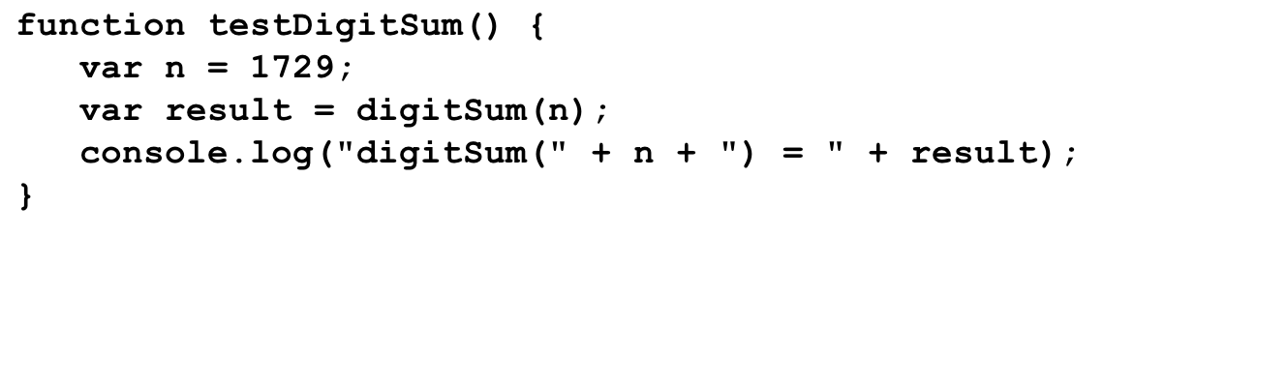
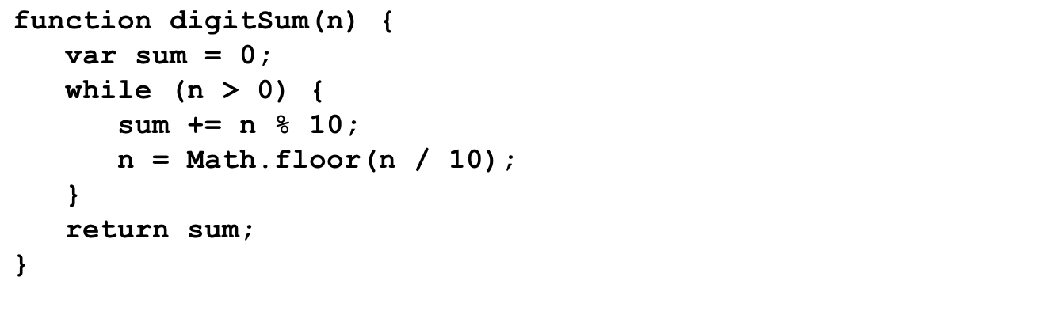
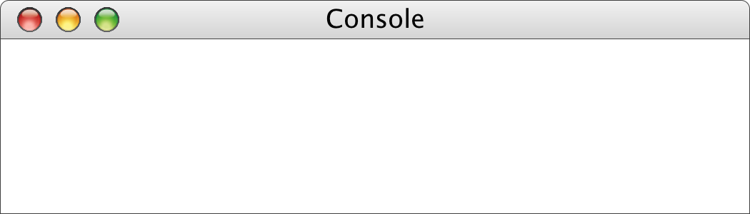
The digitSum Function
n
n
result
result
1729
19
1729
n
19
sum
1729
172
17
1
0
0
9
11
18
19
digitSum(1729) = 19

Slide 48
The for Statement
The for statement in JavaScript is a powerful tool for specifying the structure of a loop independently from the operations the loop performs. The syntax looks like this:
for ( init ; test ; step ) {
statements to be repeated
}
for ( init ; test ; step ) {
statements to be repeated
}
JavaScript evaluates a for statement as follows:
1.
Evaluate init, which typically declares a control variable.
2.
Evaluate test and exit from the loop if the value is false.
3.
Execute the statements in the body of the loop.
4.
Evaluate step, which usually updates the control variable.
5.
Return to step 2 to begin the next loop cycle.

Slide 49
Exercise: Reading for Statements
Describe the effect of each of the following for statements:
1.
for (var i = 1; i <= 10; i++)
This statement executes the loop body ten times, with the control variable i taking on each successive value between 1 and 10.
2.
for (var i = 0; i < N; i++)
This statement executes the loop body N times, with i counting from 0 to N - 1. This version is the standard Repeat-N-Times idiom.
3.
for (var n = 99; n >= 1; n -= 2)
This statement counts backward from 99 to 1 by twos.
4.
for (var x = 1; x <= 1024; x *= 2)
This statement executes the loop body with the variable x taking on successive powers of two from 1 up to 1024.

Slide 50
The factorial Function
The factorial of a number n (which is usually written as n! in mathematics) is defined to be the product of the integers from 1 up to n. Thus, 5! is equal to 120, which is 1 ^{x} 2 ^{x} 3 ^{x} 4 ^{x} 5.
The following function definition uses a for loop to compute the factorial function:
function fact(n) {
var result = 1;
for (var i = 1; i <= n; i++) {
result = result * i;
}
return result;
}

Slide 51
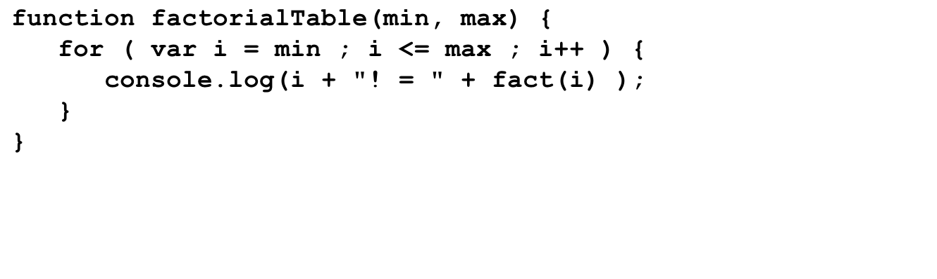
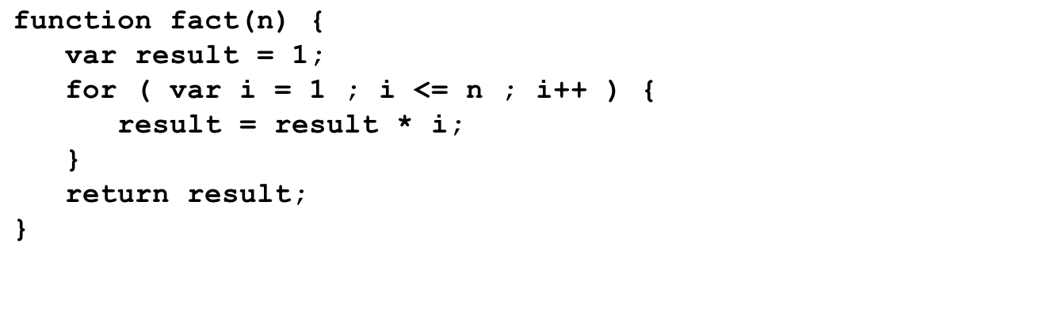
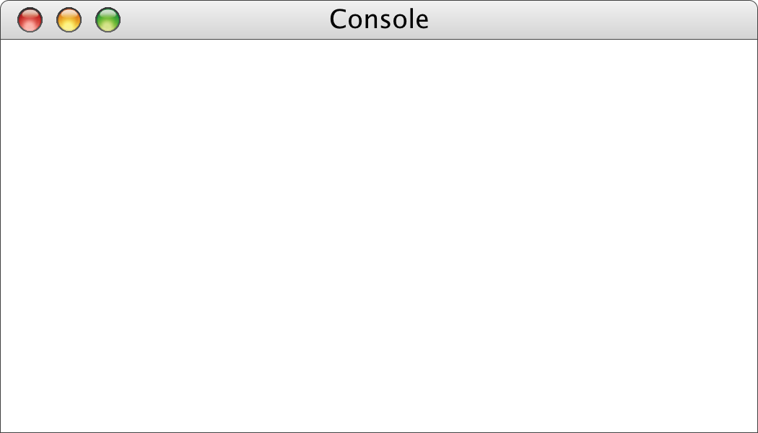
The factorialTable Function
run this loop
six more times
1
5040
min
max
i
min
max
i
0
n
n
7
result
result
0
1
6
7
8
i
0
7
i
8
0
7
1
1
1
2
6
24
120
720
5040
1
1
2
3
4
5
6
7
8
->
factorialTable(0, 7);
0! = 1
1! = 1
2! = 2
3! = 6
4! = 24
5! = 120
6! = 720
7! = 5040
->

Slide 52
Comparing for and while
The for statement
for ( init ; test ; step ) {
statements to be repeated
}
is functionally equivalent to the following code using while:
init;
while ( test ) {
statements to be repeated
step;
}
The advantage of the for statement is that everything you need to know to understand how many times the loop will run is explicitly included in the header line.

Slide 53
Arrays
var name = []; // empty array
var name = [value, value, ..., value]; // pre-filled
name[index] = value; // store element JS
var ducks = ["Huey", "Dewey", "Louie"];
var stooges = []; // stooges.length is 0
stooges[0] = "Larry"; // stooges.length is 1
stooges[1] = "Moe"; // stooges.length is 2
stooges[4] = "Curly"; // stooges.length is 5
stooges[4] = "Shemp"; // stooges.length is 5 JS
Notes:
two ways to initialize an array
length property (grows as needed when elements are added)

Slide 54
Array methods
var a = ["Stef", "Jason"]; // Stef, Jason
a.push("Brian"); // Stef, Jason, Brian
a.unshift("Kelly"); // Kelly, Stef, Jason, Brian
a.pop(); // Kelly, Stef, Jason
a.shift(); // Stef, Jason
a.sort(); // Jason, Stef JS
array serves as many data structures: list, queue, stack, ...
methods: concat, join, pop, push, reverse, shift, slice, sort, splice, toString, unshift
push and pop add / remove from back
unshift and shift add / remove from front
shift and pop return the element that is removed

Slide 55
Strings in JavaScript

Slide 56
Review: Strings as an Abstract Idea
Characters are most often used in programming when they are combined to form collections of consecutive characters called strings.
As you will discover when you have a chance to look more closely at the internal structure of memory, strings are stored internally as a sequence of characters in sequential memory addresses.
The internal representation, however, is really just an implementation detail. For most applications, it is best to think of a string as an abstract conceptual unit rather than as the characters it contains.
JavaScript emphasizes the abstract view by defining a built-in string type that defines high-level operations on string values.

Slide 57
Using Methods in the String Class
JavaScript defines many useful methods that operate on strings. Before trying to use those methods individually, it is important to understand how those methods work at a more general level.
Because strings are objects, JavaScript uses the receiver syntax to call string methods. Thus, if str is a string, you would apply the method name using str.name(arguments).
None of the methods in JavaScript’s String class change the value of the string used as the receiver. What happens instead is that these methods return a new string on which the desired changes have been performed.
Classes that prohibit clients from changing an object’s state are said to be immutable. Immutable classes have many advantages and play an important role in programming.

Slide 58
Selecting Characters from a String
Conceptually, a string is an ordered collection of characters.
In JavaScript, the character positions in a string are identified by an index that begins at 0 and extends up to one less than the length of the string. For example, the characters in the string "hello, world" are arranged like this:
h
e
l
l
o
,
w
o
r
l
d
0
1
2
3
4
5
6
7
8
9
10
11
You can obtain the number of characters by checking the length property, as in str.length.
You can select an individual character by calling charAt(k), where k is the index of the desired character. The expression
str.charAt(0);
returns the one-character string "h" that appears at index 0.

Slide 59
Concatenation
One of the most useful operations available for strings is concatenation, which consists of combining two strings end to end with no intervening characters.
As you know from earlier in the quarter, concatenation is built into JavaScript in the form of the + operator.
It is also important to recall that JavaScript interprets the + operator as concatenation only if at least one of the operands is a string. If both operands are numbers, the + operator signifies addition.

Slide 60
Extracting Substrings
The substring method makes it possible to extract a piece of a larger string by providing index numbers that determine the extent of the substring.
The general form of the substring call is
str.substring(p1, p2);
where p1 is the first index position in the desired substring and p2 is the index position immediately following the last position in the substring.
As an example, if you wanted to select the substring "ell" from a string variable str containing "hello, world" you would make the following call:
str.substring(1, 4);

Slide 61
Comparing Strings
JavaScript allows you to call the standard relational operators to compare the values of two strings in a natural way. For example, if s1 and s2 are strings, the expression
s1 === s2
is true if the strings s1 and s2 contain the same characters.
String comparisons involving the operators <, <=, >, and >= are implemented in a fashion similar to traditional alphabetic ordering: if the first characters match, the comparison operator checks the second characters, and so on.
Characters are compared numerically using their Unicode values. For example, "cat" > "CAT" because the character code for "c" (99) is greater than the code for "C" (67). This style of comparison is called lexicographic ordering.

Slide 62
Searching in a String
The method indexOf takes a string and returns the index within the receiver at which the first instance of that string begins. If the string is not found, indexOf returns -1. For example, if str contains the string "hello, world":
str.indexOf("h")
returns
0
str.indexOf("o")
returns
4
str.indexOf("ell")
returns
1
str.indexOf("x")
returns
-1
The indexOf method takes an optional second argument that indicates the starting position for the search. Thus:
str.indexOf("o", 5)
returns
8
The lastIndexOf method works similarly except that it searches backward from the end of the receiving string.

Slide 63
Other Methods in the String Class
String.fromCharCode(code)
Returns the one-character string whose Unicode value is code.
charCodeAt(index)
Returns the Unicode value of the character at the specified index.
toLowerCase()
Returns a copy of this string converted to lower case.
toUpperCase()
Returns a copy of this string converted to upper case.
startsWith(prefix)
Returns true if this string starts with prefix.
endsWith(suffix)
Returns true if this string ends with suffix.
trim()
Returns a copy of this string with leading and trailing spaces removed.

Slide 64
Simple String Idioms
When you work with strings, there are two idiomatic patterns that are particularly important:
1.
Iterating through the characters in a string.
for (var i = 0; i < str.length; i++) {
var ch = str.charAt(i);
. . . code to process each character in turn . . .
}
2.
Growing a new string character by character.
var result = "";
for (whatever limits are appropriate to the application) {
. . . code to determine the next character to be added . . .
result += ch;
}

Slide 65
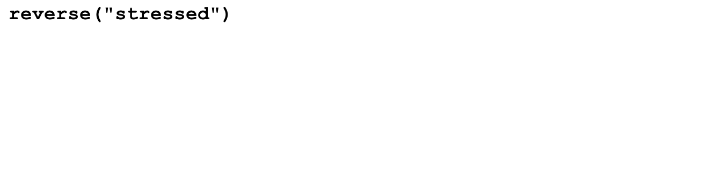
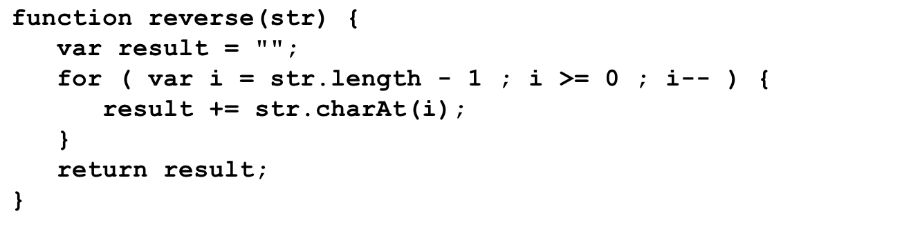
Reversing a String
str
str
result
result
i
i
"stressed"
""
"d"
"de"
"des"
"dess"
"desse"
"desser"
"dessert"
"desserts"
7
6
5
4
3
2
1
0
-1
>
reverse("stressed")
desserts
>

