Slide 1
CSE-312
Web Design and Programming Lab-I
Lab-3: HTML-I
Md. Rafsan Jani
Assistant Professor
Department of Computer Science and Engineering
Jahangirnagar University

Slide 2
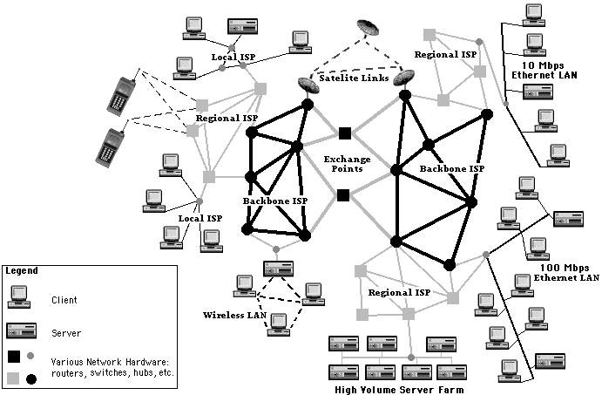
Internet
What the Internet is:
A world-wide network of computer networks
At the lowest level, since 1982, all connections use TCP/IP
TCP/IP hides the differences among devices connected to the Internet

Slide 3
History of Internet
Origins
In the 1960s, the U.S. Department of Defense (DoD) became interested in developing a new large-scale computer network.
The purposes of this network were communications, program sharing, and remote computer access for researchers working on defense-related contracts.
One fundamental requirement was that the network be sufficiently robust so that even if some network nodes were lost to sabotage, war, or some more benign cause, the network would continue to function.

Slide 4
History of Internet Cont…
Origins cont…
The DoD’s Advanced Research Projects Agency (ARPA) funded the construction of the first such network, which connected about a dozen ARPA funded research laboratories and universities.
The first node of this network was established at UCLA in 1969
Because it was funded by ARPA, the network was named ARPAnet.
Despite the initial intentions, the primary early use of ARPAnet was simple text-based communications through electronic mail.

Slide 5
History of Internet Cont…
Origins cont…
Because ARPAnet was available only to laboratories and universities that conducted ARPA-funded research, the great majority of educational institutions were not connected.
As a result, several other networks were developed during the late 1970s and early 1980s, with BITNET and CSNET among them.
BITNET, which is an acronym for Because It’s Time Network, began at the City University of New York.
It was built initially to provide electronic mail and file transfers.

Slide 6
History of Internet Cont…
Origins cont…
CSNET, which is an acronym for Computer Science Network, connected the University of Delaware, Purdue University, the University of Wisconsin, the RAND Corporation, and Bolt, Beranek, and Newman (a research company in Cambridge, Massachusetts). Its initial purpose was to provide electronic mail.
For a variety of reasons, neither BITNET nor CSNET became a widely used national network.

Slide 7
History of Internet Cont…
Origins cont…
A new national network, NSFnet, was created in 1986.
It was sponsored, of course, by the National Science Foundation (NSF). NSFnet initially connected the NSF-funded supercomputer centers that were at five universities.
Soon after being established, it became available to other academic institutions and research laboratories.
By 1990, NSFnet had replaced ARPAnet for most nonmilitary uses, and a wide variety of organizations had established nodes on the new network by 1992, NSFnet connected more than one million computers around the world.

Slide 8
History of Internet Cont…
Origins cont…
In 1995, a small part of NSFnet returned to being a research network.
The rest became known as the Internet, although this term was used much earlier for both ARPAnet and NSFnet.

Slide 9
Internet History Summary
Origins
ARPAnet - late 1960s and early 1970s
Network reliability
For ARPA-funded research organizations
BITnet, CSnet - late 1970s & early 1980s
email and file transfer for other institutions
NSFnet - 1986
Originally for non-DOD funded places
Initially connected five supercomputer centers
By 1990, it had replaced ARPAnet for non-military uses
Soon became the network for all (by the early 1990s)
NSFnet eventually became known as the Internet

Slide 10
Internet Protocols
Internet Protocol (IP) Addresses
Every node has a unique numeric address
Form: 32-bit binary number
IP addresses usually are written (and thought of) as four 8-bit numbers, separated by periods
New standard, IPv6, has 128 bits (1998)
Organizations are assigned groups of IPs for their computers
For example, a small organization may be assigned 256 IP addresses, such as 191.57.126.0 to 191.57.126.255.

Slide 11
Domain Names
Domain names
Because people have difficulty dealing with and remembering numbers, machines on the Internet also have textual names
Form: host-name.domain-names
First domain is the smallest; last is the largest
Last domain specifies the type of organization
Fully qualified domain name - the host name and all of the domain names
DNS servers - convert fully qualified domain names to IPs

Slide 12
Host & Domain Names
Each host name on a subnet must be unique
There is a hierarchy of domain names
Top level
Country (if not US) – e.g. BD, UK, FR, IE
Category - COM, MIL, GOV, EDU, ORG etc (or COM.BD, AC.BD, GOV.BD, ORG.BD etc)
NB: domain registration does not necessarily correspond to physical location!
Second level
Organisation (e.g. JU.AC.BD)
Third level
Subnet (e.g. CSE.JU.AC.BD)
Host names may be aliased
Host names are obtained from databases called name servers

Slide 13
IP Numbers and domain names
BdRen (Bangladesh Research and Education Network)
*.ac.bd
128.*.*.*
Jahangirnagar University
*.ju.ac.bd (also aliases – e.g. *.juniv.ac.bd)
128.243.*.*
Computer Science
*.cs.ju.ac.bd
128.243.20.* 128.243.21.* 128.243.22.*
Library (Unix server)
library.cs.ju.ac.bd
128.243.21.16

Slide 14
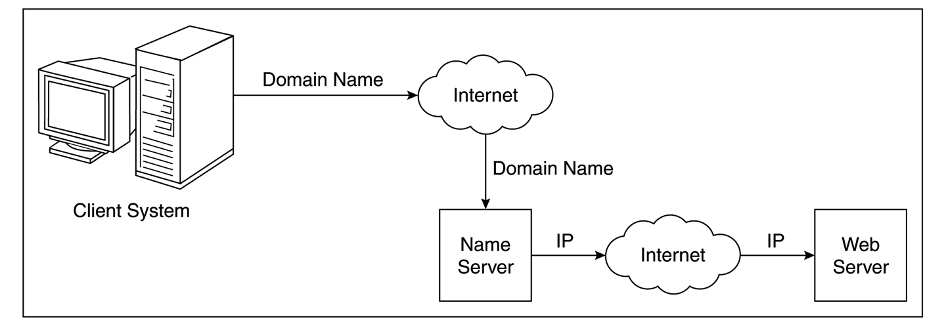
Domain Name Conversion
Fully qualified domain names must be converted to IP numbers before communication can take place over the Internet
DNS servers

Slide 15
Other Protocols
Problem: By the mid-1980s, several different protocols had been invented and were being used on the Internet, all with different user interfaces (e.g. telnet, FTP, Usenet, mailto)
telnet, was developed to allow a user on one computer on the Internet to log onto and use another computer on the Internet;
File Transfer Protocol (ftp), was developed to transfer files among computers on the Internet;
Usenet, was developed to serve as an electronic bulletin
mailto, was developed to allow messages transfer

Slide 16
The World-Wide Web
A possible solution to the proliferation of different protocols being used on the Internet
Origins
Tim Berners-Lee at Conseil Européen pour la Recherche Nucléaire (CERN) or European Organization for Particle Physics proposed the Web in 1989
Purpose: to allow scientists to have access to many databases of scientific work through their own computers
Document form: hypertext
Pages? Documents? Resources?
We’ll call them documents
Hypermedia – more than just text – images, sound, etc.

Slide 17
The World-Wide Web
Web or Internet?
It is important to understand that the Internet and the Web are not the same thing.
The Internet is a collection of computers and other devices connected by equipment that allows them to communicate with each other.
Where as, the Web is a collection of software and protocols that has been installed on most, if not all, of the computers on the Internet.
Some of these computers run Web servers, which provide documents, but most run Web clients, or browsers, which request documents from servers and display them to users.

Slide 18
Client and Server
Clients and Servers are programs that communicate with each other over the Internet
A Server runs continuously, waiting to be contacted by a Client
Each Server provides certain services
Services include providing web pages
A Client will send a message to a Server requesting the service provided by that server
The client will usually provide some information, parameters, with the request

Slide 19
Web Browsers
Browsers are clients - always initiate, servers react (although sometimes servers require responses)
Mosaic - NCSA (Univ. of Illinois), in early 1993
First to use a GUI, led to explosion of Web use
Initially for X-Windows, under UNIX, but was ported to other platforms by late 1993
Most requests are for existing documents, using HyperText Transfer Protocol (HTTP)
But some requests are for program execution, with the output being returned as a document

Slide 20
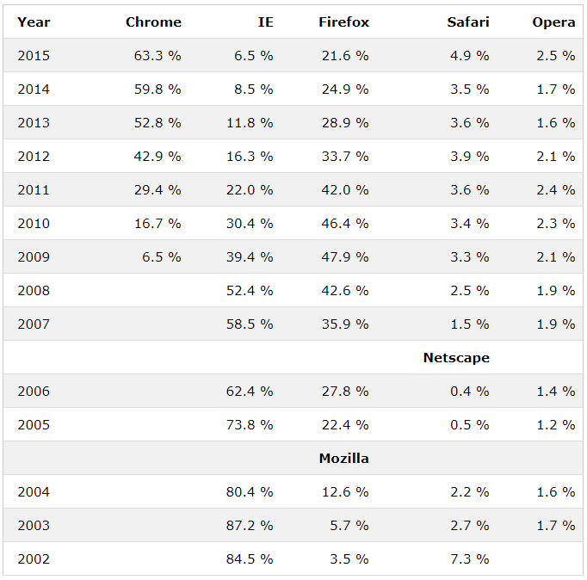
Web Browsers Statistics
Source: https://www.w3schools.com/browsers/

Slide 21
Web Servers
Provide responses to browser requests, either existing documents or dynamically built documents
Browser-server connection is now maintained through more than one request-response cycle
All communications between browsers and servers use Hypertext Transfer Protocol (HTTP)

Slide 22
Web Server Operation
Web servers run as background processes in the operating system
Monitor a communications port on the host, accepting HTTP messages when they appear
All current Web servers came from either
The original from CERN
The second one, from NCSA

Slide 23
Web Server Operation Details
Web servers have two main directories:
Document root (servable documents)
Server root (server system software)
Document root is accessed indirectly by clients
Its actual location is set by the server configuration file
Requests are mapped to the actual location
Virtual document trees
Virtual hosts
Proxy servers
Web servers now support other Internet protocols

Slide 24
Web Server Operation : Apache
Apache (open source, fast, reliable)
Directives (operation control):
ServerName
ServerRoot
ServerAdmin,
DocumentRoot
Alias
Redirect
DirectoryIndex
UserDir

Slide 25
Web Server Operation : IIS
IIS
Internet Information Server (IIS) by Microsoft
Operation is maintained through a program with a GUI interface

Slide 26
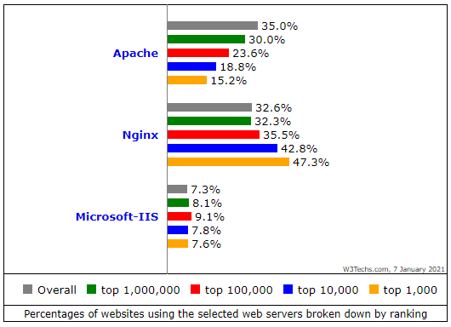
Web Server Statistics

Slide 27
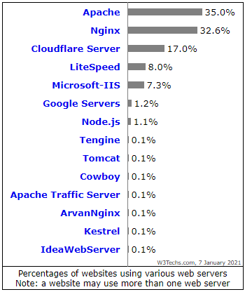
Web Server Statistics

Slide 28
URLs
General form:
scheme:object-address
The scheme is often a communications protocol, such as http, https, telnet or ftp
For the http protocol, the object-address is: fully qualified domain name/doc path
For the file protocol, only the doc path is needed

Slide 29
URLs
Host name may include a port number, as in zeppo:80 (80 is the default, so this is silly)
URLs cannot include spaces or any of a collection of other special characters (semicolons, colons, ...)
The doc path may be abbreviated as a partial path
The rest is furnished by the server configuration
If the doc path ends with a slash, it means it is a directory

Slide 30
Multipurpose Internet Mail Extensions (MIME)
Originally developed for email
Used to specify to the browser the form of a file returned by the server (attached by the server to the beginning of the document)
Type of specifications
Form: type/subtype
The most common MIME types are text, image, and video. The most common text subtypes are plain and html. Some common image subtypes are gif and jpeg. Some common video subtypes are mpeg and quicktime.
Examples: text/plain, text/html, image/gif, image/jpeg

Slide 31
Multipurpose Internet Mail Extensions (MIME)
Server gets type from the requested file name’s suffix (.html implies text/html)
Browser gets the type explicitly from the server
Experimental types
Subtype begins with x-
e.g., video/x-msvideo
Experimental types require the server to send a helper application or plug-in so the browser can deal with the file

Slide 32
The Hyper Text Transfer Protocol
The protocol used by ALL Web communications
Invented by Tim Berners-Lee in 1990
RFC 1945 (1996) - HTTP/1.0
RFC 2068 (1997) - HTTP/1.1
RFC 2616 (1999) - HTTP/1.1
(update to 2068)
Application level, client-server protocol
Primarily for distributed hypermedia systems
Flexible - thus has many other uses - e.g.:
Nameservers
Distributed & collaborative document management systems

Slide 33
Features of HTTP
HTTP is small and fast
Minimal performance overhead
Easy to implement
HTTP is a stateless protocol
Each request is an independent transaction - unrelated to any previous requests (unlike session-based protocols, e.g. FTP)
Advantage
Simplifies server design - information about previous transactions does not need to be stored
Disadvantage
More information must be included in each request

Slide 34


HTTP Operation
On the Internet HTTP usually uses TCP/IP connections
TCP Port 80 is the default (though others can be specified)
HTTP uses a Request/Response paradigm
Client establishes a connection to the server, and sends it a request
Server responds to the request by generating a response (which may or may not contain content)
HTTP Server
Apache
MS IIS
Client
Firefox
Internet Explorer
HTTP request (URL)
HTTP response (HTML data)

Slide 35
HTTP Request
Delivered from a client to a server containing instructions for the server
Contains
the method to be applied to the data resource
the identifier of the resource
the protocol version in use
Most commonly used methods:
GET - Fetch a document
HEAD - Fetch just the header of the document
POST - Execute the document, using the data in body
PUT - Store a new document on the server
DELETE - Remove a document from the server

Slide 36
Request message
General request message structure
METHOD /path-to-resource HTTP/version-number
Header-Name-1: value
Header-Name-2: value
[optional request body]
Example
GET /index.html HTTP/1.1
Host: www.juniv.edu
Accept: text/*
User-Agent: Mozilla/2.02Gold (WinNT; I)

Slide 37
HTTP Headers
Four categories of header fields:
General, request, response, & entity
Common request fields:
Accept: text/plain
Accept: text/*
If-Modified_since: date
Common response fields:
Content-length: 488
Content-type: text/html

Slide 38
HTTP Response
Message generated by a server after receiving and interpreting a request
Responses contain:
Status line with the protocol version, a status code, and a “reason phrase”
Response-Header (containing information about the server)
Entity Header (meta-information)
Entity Body (data)

Slide 39
Response message
General response message structure
HTTP/version-number status-code message
Response-Header-Name-1: value
Response-Header-Name-2: value
Entity-Header-Name-1: value
Entity-Header-Name-2: value
[optional entity body]
Example
HTTP/1.1 200 OK
Server: Apache (Red-Hat/Linux)
Content-Type: text/html
Content-Length: 9934
<HTML>
<HEAD>
<TITLE>School of Computer Science</TITLE>
…

Slide 40
HTTP Response
Status code is a three-digit number; first digit specifies the general status
1 => Informational
2 => Success
3 => Redirection
4 => Client error
5 => Server error
The header field, Content-type, is required

Slide 41
Some HTTP Status Codes
200 : OK
201 : Created
202 : Accepted
204 : No Content
301 : Moved Permanently
302 : Moved Temporarily
400 : Bad Request
401 : Unauthorized
403 : Forbidden
404 : Not Found
500 : Internal Server Error
503 : Service Unavailable

Slide 42
Introduction to HTML
HTML, or HyperText Markup Language is designed to specify the logical organization of a document, with important hypertext extensions.
hypertext refers to the fact that Web pages can contain multimedia, provide links for jumping within & without
markup refers to the fact that it works by augmenting text with special symbols (tags) that identify structure and content type
HTML allows you to mark selections of text as titles or paragraphs, and then leaves the interpretation of these marked elements up to the browser.
For example, one browser may indent the beginning of a paragraph, while another may only leave a blank line.

Slide 43
Introduction to HTML
It is not designed to be the language of a word processor such as MSWord.
HTML instructions divide the text of a document into blocks called elements.
These can be divided into two broad categories –
those that define how the BODY of the document is to be displayed by the browser,
and those that define information `about' the document, such as the title or relationships to other documents.
The detailed rules for HTML (the names of the tags/elements, how they can be used) are defined using another language known as the standard generalized markup language, or SGML.

Slide 44
Introduction to HTML
SGML is wickedly difficult, and was designed for massive document collections.
Fortunately, HTML is much simpler! However, SGML has useful features that HTML lacks.
For this reason, markup language and software experts have developed a new language, called XML (the eXtensible markup language) which has most of the useful features of HTML and SGML.

Slide 45
History of HTML
HTML 1.0 was originally developed by Tim Berners-Lee while at CERN, and popularized by the Mosaic browser developed at National Center for Supercomputing Applications (NCSA) in 1989.
During the course of the 1990s it has blossomed with the explosive growth of the Web and has been extended in a number of ways.
The Web depends on Web page authors and vendors sharing the same conventions for HTML.
HTML 2.0 was developed under the aegis of the Internet Engineering Task Force (IETF) to codify common practice in late 1994.

Slide 46
History of HTML
In late 1994, Tim Berners-Lee, who developed the initial version of HTML, started the World Wide Web Consortium (W3C), whose primary purpose was to develop and distribute standards for Web technologies, starting with HTML.
HTML 3.2 (1996) W3C proposed much richer versions.
Achieving interoperability lowers costs to content providers since they must develop only one version of a document.
If the effort is not made, there is much greater risk that the Web will devolve into a proprietary world of incompatible formats, ultimately reducing the Web's commercial potential for all participants.

Slide 47
History of HTML
The HTML 4.0 was published in late 1997 by W3C
The 4.01 version of HTML was approved by W3C in late 1999
HTML5 can be said for as an extended version of HTML 4.01 which is the latest version, published in the year 2014.
Each version of HTML has attempted to reflect greater consensus among industry players so that the investment made by content providers will not be wasted and that their documents will not become unreadable in a short period of time

Slide 48
HTML Vision
HTML has been developed with the vision that all manner of devices should be able to use information on the Web:
PCs with graphics displays of varying resolution and color depth,
cellular telephones,
handheld devices,
devices for speech for output and input,
computers with high or low bandwidth, and so on.

Slide 49
HTML Page Structure

Slide 50
HTML Tags
HTML tags can be considered as hidden keywords or commands incorporated in HTML which holds the capability to define how your browser will display the content and format of the web page.
Most tags of HTML have two sections, an opening, and a closing part, and any text written within that has its effect based on the category of the tag.
The most common example is the <html> tag which has both starting tag and ending tag.
HTML tag which is usually written as <html>…. </html> or <HTML>…. </HTML> is the only tag which is a must for writing HTML pages

Slide 51
HTML Tags
HTML tag has both a opening <html> and a closing tag </html>.
The closing of tags is done by a forward slash (/) at the very start of the tag name.
These types of tags having both opening and closing tags are called container tags.
Those who only have an opening tag and no closing tag are called empty tags.

Slide 52
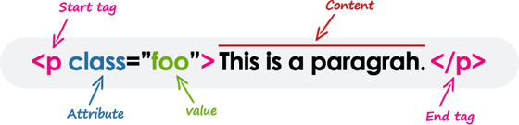
HTML Elements
HTML Elements represent semantics, or meaning.
For example, The title element represents the title of the document.
Most HTML elements are written with a start tag (or opening tag) and an end tag (or closing tag), with the content in between.
Elements can also contain attributes that define additional properties of an element. For example, a paragraph, which is represented by the p element, would be written as:

Slide 53
HTML Tags Vs Elements
Technically, an HTML element is the collection of start tag, its attributes, an end tag and everything in between.
On the other hand an HTML tag either opening or closing is used to mark the start or end of an element.
However, in common usage the terms HTML element and HTML tag are interchangeable i.e. a tag is an element and element is a tag.

Slide 54
HTML Attribute
Attribute is the characteristics of any HTML tag that needs to be placed within the opening tag.
Attributes are case insensitive.
HTML attributes consist of two parts:
a name and
a value
For an attribute, the name defines the property to be implemented.
For example, BODY Tag, <body> carries many attributes such as bgcolor, background using that you can give a specific image or background texture to your page.
The value defines the value which you want to assign to the property and is set within quotations.

Slide 55
HTML Attribute
There are four essential attributes which you can implement on almost all HTML elements:
id
title
class
style

Slide 56
id Attribute
This attribute can be implemented for providing unique identification to any element.
There are two primary reasons that you might want to use an id attribute on an element.
The id attribute provides a unique identifier which eventually makes possible in identifying the HTML element.
When you are containing two elements having the same name within the same script, id attribute helps to distinguish the two same elements via the unique ID.
<p id = "para1"> Paragraph 1 in your HTML document.</p>
<p id = "para2"> Paragraph 2 in your HTML document.</p>

Slide 57
title Attribute
The title attribute gives a recommended title for your element.
Its behavior depends on the element upon which it's implemented, even though this is often implemented to display a tooltip if the cursor hovers (comes over) the element.
<h3 title="Welcome to my Journal">Please visit</h3>

Slide 58
class Attribute
This attribute is implemented by combining an element through a stylesheet (CSS), and identify the element's class.
For more about class attribute, you can follow the Cascading Style Sheet (CSS).
Here's an example of class attribute:
<p class = "classname1">
This is a sample paragraph text.
</p>

Slide 59
style Attribute
This attribute gives you a chance for specifying the rules for Cascading Style Sheet (CSS) in your element.
Here's an example of style attribute:
<p style = "font-family:arial;">An example of style attribute.</p>

Slide 60
Example
<!DOCTYPE html> <html> <head> <title>Page Title</title> </head> <body> <h1>My First Heading</h1> <p>My first paragraph.</p> <p id="test">See It!!</p> </body> </html>

Slide 61
Example Anatomy
The <!DOCTYPE html> declaration defines this document to be HTML5
The <html> element is the root element of an HTML page
The <head> element contains meta information about the document
The <title> element specifies a title for the document
The <body> element contains the visible page content
The <h1> element defines a large heading
The <p> element defines a paragraph

Slide 62
<!DOCTYPE> Tag
The <!DOCTYPE> declaration represents the document type, and helps browsers to display web pages correctly.
It must only appear once, at the top of the page (before any HTML tags).
The <!DOCTYPE> declaration is not case sensitive.
The <!DOCTYPE> declaration for HTML5 is:
<!DOCTYPE html>

Slide 63
HEAD Tag
The HEAD tag is another important tag used to add the header in HTML.
It is used to give various additional information about the page along with description and title to your page; which gets displayed in the title bar or acts as an indicator of what information to use or on which page you are currently in.
HTML metadata is data about the HTML document. Metadata is not displayed. Metadata typically define the document title, character set, styles, links, scripts, and other meta information.
The following tags describe metadata: <title>, <style>, <meta>, <link>, <script>, and <base>.

Slide 64
<title>Element
The <title> element defines the title of the document, and is required in all HTML/XHTML documents.
The <title> element:
defines a title in the browser tab
provides a title for the page when it is added to favorites
displays a title for the page in search engine results

Slide 65
Body Element
This tag is used to give the body, i.e., the visible section of the HTML document.
All formatting and writing of content are done in the opening <body> and the closing </body> tag.
If your HTML code does not have a body tag associated with it, the HTML code will still run as written in the above example (only show the title in the title bar).
It is to be noted that, together these three necessary tags, <html>, <head> and <body> makes up the skeleton of an HTML document and these are the only foundation tags upon which all web pages are created or developed.

Slide 66
<hn>Element
Any content or article starts having a nice heading, provides the headline or the topic name of any document.
Similarly, in HTML code also, different sizes of heading can be given on your web page.
HTML allows six sizes for heading that uses elements name in the format of <hn>, where n starts from 1 till 6; like this:
<h1>, <h2>, <h3>, <h4>, <h5>, and <h6>

Slide 67
Aligning Text
The ALIGN attribute can be inserted in the <p> and <hn> tags to right justify, center, or left justify the text
For example,
<h1 ALIGN=CENTER> The New York Times </h1>
would create a centered heading of the largest size

Slide 68
HTML Formatting
Formatting is one of the crucial sections of every development.
For making any project or article or content looks attractive, readable and user-intractable, formatting plays a very important role.
Formatting can be defined as the appearance of your documentation or presentation of your HTML code in a meaningful and nicer way.
Formatting is mainly done for making the layout attractable.

Slide 69
HTML Formatting Cont…
Tag | Meanings
<u> | For making text underlined.
<b> | For making the text Bold.
<strong> | Used in those texts which are important and needs to highlight.
<i> | For making the text italics.
<em> | For emphasizing the texts.
<mark> | To make the texts marked or highlighted.
<small> | For making texts small in size than the regular texts surrounded.
<big> | For making texts bigger or larger than the rest of the texts surrounded.

Slide 70
HTML Formatting Cont…
Tag | Meanings
<del> | To show texts that have been deleted or removed or replaced.
<ins> | To show texts that have been inserted or added
<sub> | To give a subscript effect to any text.
<sup> | To give a superscript effect to any text.
<strike> | For displaying any text as strikethrough.
<tt> | For displaying any font as a mono-spaced font. This tag is abbreviated as typewriter type font tag.

Slide 71
HTML Comments
Comments are an essential part of HTML; it helps to provide the details of what is written in the HTML source code.
HTML comment tags are completely ignored to display by the browsers. It's used to insert comments into the source code.
When more than one developers work on the same application or web page, HTML comments can help to understand the source code.
Comment can be used anywhere to add information about HTML, which will be helpful for developers to understand the existing code in the future easily.

Slide 72
HTML Comments
For writing comments in HTML, they begin with the <! -- (starting comment tag) and ends with the close comment tag, i.e. -->.
Comments in HTML can be visible if and only if anyone tries to view the source code of the page, but anything is written within <!-- …. --> does not get rendered when you will render your HTML based web page through your browser.
<!-- This is a commented code -->

Slide 73
Resources
https://www.w3schools.com/html/default.asp
https://code.visualstudio.com/Download
https://www.freecodecamp.org/learn
https://caniuse.com/

