Slide 1
CSE-312
Web Design and Programming Lab-I
Lab-5: CSS
Md. Rafsan Jani
Assistant Professor
Department of Computer Science and Engineering
Jahangirnagar University

Slide 2
Overview
Introduction to CSS
History
Basic Syntax and how to use CSS
CSS Selectors
Box Model
Media Query

Slide 3
What is CSS?
CSS stands for Cascading Style Sheets
CSS describes how HTML elements are to be displayed on screen, paper, or in other media
CSS saves a lot of work. It can control the layout of multiple web pages all at once
External stylesheets are stored in CSS files

Slide 4
History
HTML was NEVER intended to contain tags for formatting a web page!
HTML was created to describe the content of a web page, like:
<h1>This is a heading</h1>
<p>This is a paragraph.</p>
When tags like <font>, and color attributes were added to the HTML 3.2 specification, it started a nightmare for web developers. Development of large websites, where fonts and color information were added to every single page, became a long and expensive process.

Slide 5
History
To solve this problem, the World Wide Web Consortium (W3C) created CSS.
CSS removed the style formatting from the HTML page!
This separation of structure from presentation simplifies maintaining and modifying web pages, especially on large-scale websites.
Though HTML5 has some attributes that control presentation, it’s better not to mix presentation with content.

Slide 6
History
Håkon Wium Lie an employee of CERN first proposed Cascading Style Sheets, or just CSS in October of 1994.
At the end of 1995, W3C set up the HTML Editorial Review Board (HTML ERB) to ratify future HTML specifications.
In February 1997, CSS got its own working group inside W3C .
CSS level 2 became a Recommendation in May 1998.
CSS3 came on 2001.
For details: https://www.w3.org/Style/CSS20/history.html

Slide 7
Why Use CSS?
CSS is used to define styles for your web pages, including the design, layout and variations in display for different devices and screen sizes.

Slide 8
Cascading + Style Sheet

Slide 9
The Stylesheet
A stylesheet is a set of rules defining how an html element will be “presented” in the browser.
These rules are targeted to specific elements in the html document.

Slide 10
The Cascade
The “cascade” part of CSS is a set of rules for resolving conflicts with multiple CSS rules applied to the same elements.
For example, if there are two rules defining the color or your h1 elements, the rule that comes last in the cascade order will “trump” the other.

Slide 11
How to use CSS?
When a browser reads a style sheet, it will format the HTML document according to the information in the style sheet.
There are three ways of inserting a style sheet:
External style sheet(<link />-element that references a file that contains multiple style definitions)
Internal style sheet(<style></style>, which summarizes several style rules)
Inline style(style-attribute that any HTML elements knows)

Slide 12
External Style Sheet
With an external style sheet, you can change the look of an entire website by changing just one file!
Each page must include a reference to the external style sheet file inside the <link> element.
The <link> element goes inside the <head> section
Within <link>
the rel attribute is used to specify the relationship of the linked document to the document
The href attribute of <link> is used to specify the URL of the style sheet
<head> <link rel="stylesheet" type="text/css" href="mystyle.css"> </head>

Slide 13
External Style Sheet
The file should not contain any html tags. The style sheet file must be saved with a .css extension.
Here is how the "mystyle.css" looks:
Do not add a space between the property value and the unit (such as margin-left: 20 px;). The correct way is: margin-left: 20px;
body { background-color: lightblue; } h1 { color: navy; margin-left: 20px; }

Slide 14
Internal Style Sheet
An internal style sheet may be used if one single page has a unique style.
Internal styles are defined within the <style> element, inside the <head> section of an HTML page:
<head> <style> body { background-color: grey; } h1 { color: maroon; margin-left: 40px; } </style> </head>

Slide 15
Inline Style Sheet
An inline style may be used to apply a unique style for a single element.
To use inline styles, add the style attribute to the relevant element.
The style attribute can contain any CSS property.
The example below shows how to change the color and the left margin of a <h1> element:
<h1 style="color:blue;margin-left:30px;">This is a heading</h1>

Slide 16
Cascading Order
If some properties have been defined for the same selector (element) in different style sheets, the value from the last read style sheet will be used.
All the styles in a page will "cascade" into a new "virtual" style sheet by the following rules, where number one has the highest priority:
Inline style (inside an HTML element)
External and internal style sheets (in the head section)
Browser default
So, an inline style has the highest priority, and will override external and internal styles and browser defaults.

Slide 17
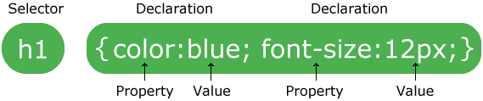
CSS Syntax
Three terms for describing CSS:
CSS selector
CSS declaration
CSS rule
Every style is defined by a selector and a declaration.
The declaration contains at least one property:value pair.
Together they are called a CSS Rule.

Slide 18
CSS Syntax Example
The selector, points to the HTML element you want to style.
The declaration block.
contains one or more declarations separated by semicolons(;)
declaration includes property name and a value, separated by a colon(:).
declaration always ends with a semicolon(;), and declaration blocks are surrounded by curly braces({}).
In the following example all <p> elements will be center-aligned, with a red text color:
p{color: red; text-align: center;}

Slide 19
Types of CSS Selector
CSS selectors are used to "find" (or select) HTML elements based on their
Element Selector: Targets all instances of an element (e.g., p, html, body, h1).
Class Selector: Targets all elements with a specific class (e.g., .classname).
ID Selector: Targets an element with a specific ID (e.g., #idname).
Universal Selector: Targets all elements (e.g., *).
Attribute Selector: Targets elements with a specific attribute (e.g., a[href]).

Slide 20
CSS Properties and Values
Common Properties:
Color and Background: color, background-color, background-image.
Text Formatting: font-family, font-size, font-weight, text-align.
Box Model Properties: width, height, margin, padding, border.
Positioning: position, top, bottom, left, right, z-index.

Slide 21
The element Selector
The element selector selects elements based on the element name.
You can select all <p> elements on a page like this (in this case, all <p> elements will be center-aligned, with a red text color):
p { text-align: center; color: red; }

Slide 22
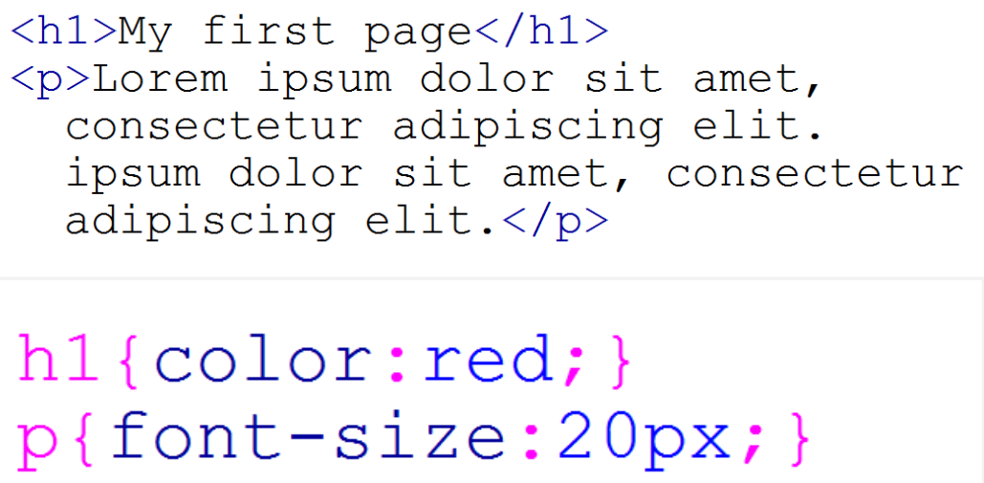
The Element Selector

Slide 23
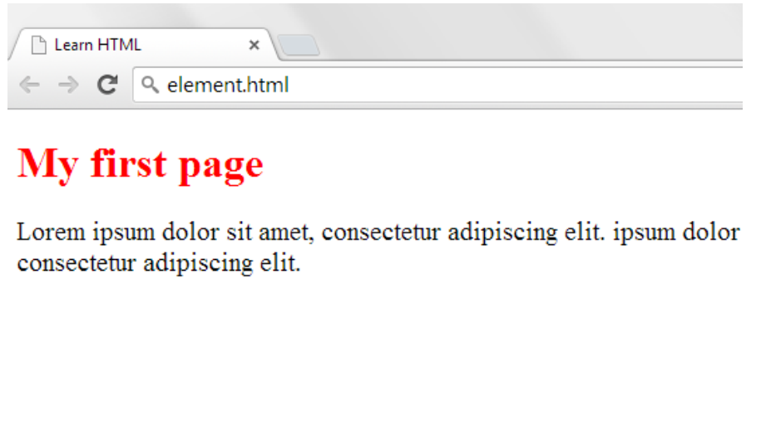
The Element Selector

Slide 24
The element Selector
Primary Structure html body
Body Elements p br h1 – h6 ul ol a img div etc
Formatting Elements em i strong b
q blockquote span etc

Slide 25
The id Selector
CSS #logo {declaration}
HTML <img id=“logo” src=“” alt=“”>
An ID is an html attribute that is added to html markup.
To reference that ID in css, a hash(#) is used as prefix.

Slide 26
The id Selector
The id selector uses the id attribute of an HTML element to select a specific element.
The id of an element should be unique within a page, so the id selector is used to select one unique element!
To select an element with a specific id, write a hash (#) character, followed by the id of the element.
An id name cannot start with a number!
The style rule below will be applied to the HTML element with id="para1":

Slide 27
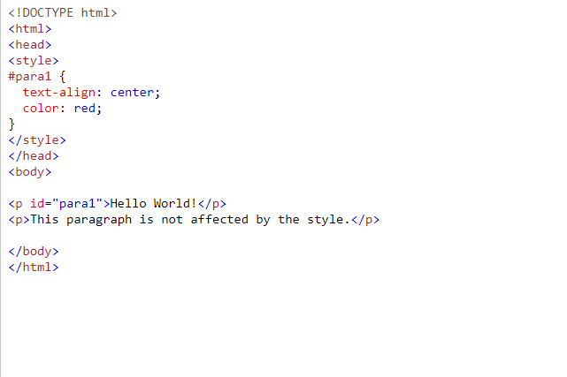
The Id Selector

Slide 28
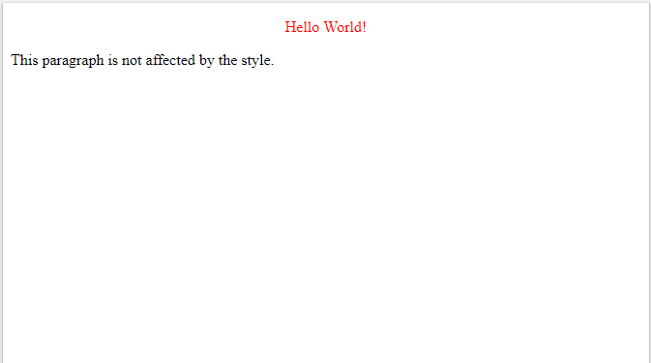
The Id Selector

Slide 29
The class Selector
CSS .ingredients {declaration}
HTML <ul class=”ingredients”>
A class is an html attribute that is added to html markup.
To reference that class in css, a period(.) is used as prefix.

Slide 30
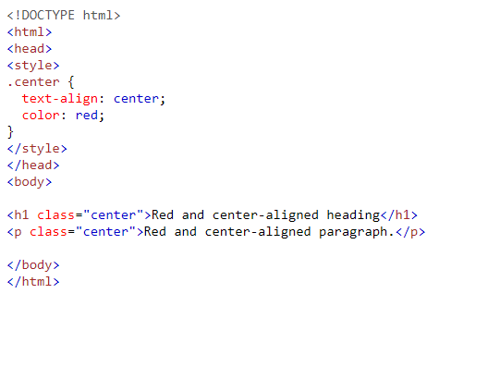
The class Selector

Slide 31
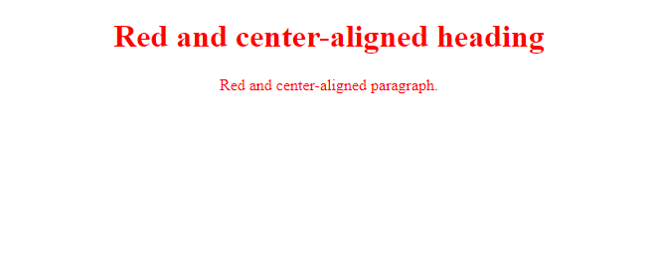
The class Selector

Slide 32
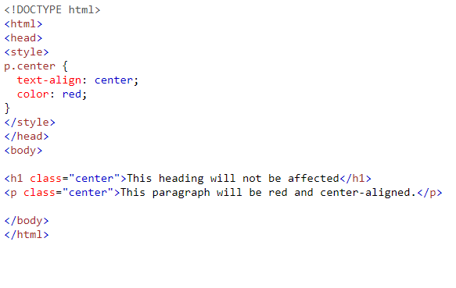

The class Selector
You can also specify that only specific HTML elements should be affected by a class.
In the example below, only <p> elements with class="center" will be center-aligned:

Slide 33
The class Selector
HTML elements can also refer to more than one class.
In the example below, the <p> element will be styled according to class="center" and to class="large":

Slide 34
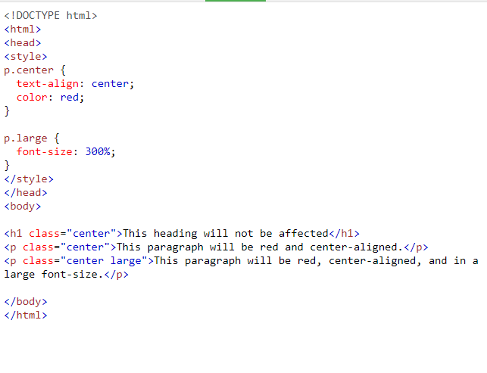
The class Selector

Slide 35
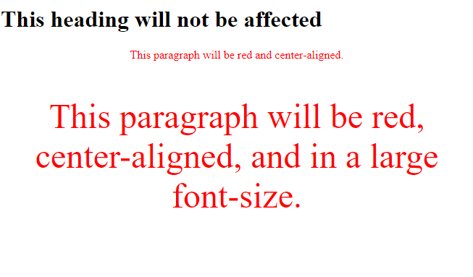
The class Selector

Slide 36
Grouping Selectors
If you have elements with the same style definitions, like this:
It will be better to group the selectors, to minimize the code.
To group selectors, separate each selector with a comma(,).
In the example below we have grouped the selectors from the code above:
h1 { text-align: center; color: red; } h2 { text-align: center; color: red; } p { text-align: center; color: red; }
h1, h2, p { text-align: center; color: red;}

Slide 37
CSS Font Family
In CSS, there are two types of font family names:
generic family - a group of font families with a similar look (like "Serif" or "Monospace")
font family - a specific font family (like "Times New Roman" or "Arial")
Generic family | Font family | Description
Serif | Times New Roman Georgia | Serif fonts have small lines at the ends on some characters
Sans-serif | Arial Verdana | "Sans" means without - these fonts do not have the lines at the ends of characters
Monospace | Courier New Lucida Console | All monospace characters have the same width

Slide 38
CSS Font Properties
Property | Description
font | Sets all the font properties in one declaration
font-family | Specifies the font family for text
font-size | Specifies the font size of text
font-style | Specifies the font style for text
font-variant | Specifies whether or not a text should be displayed in a small-caps font
font-weight | Specifies the weight of a font

Slide 39
CSS Font Properties
Font Size: Rem, Em, Px
Using Rem and Em units is better than using px.
When we use px, it means that we hardcode the font-size to all of the users. The user can't change the value whatsoever. This actually troubles the user that wants to have a bigger font-size from the default 16px

Slide 40
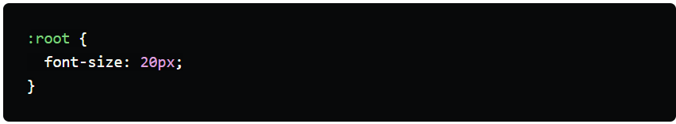
CSS Font-Size: Rem
How do rem works?
Rem and Em is a relative unit that many developers use to preserve accessibility.
Rem (root em) stands for "root element's font-size"
Usually, the default root font-size is 16px. So, if we see a font-size that is 1rem, we are looking at 16px
Because Rem means root element's font-size, we can also override the default value by using CSS like this:
Because we changed the root font-size, now 1rem = 20px

Slide 41
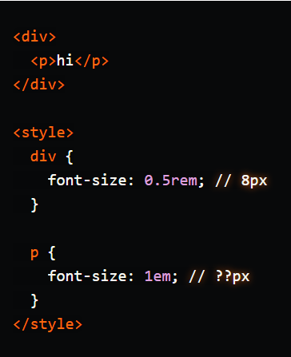
CSS Font-Size: em
How do em works?
Em stands for "parent element's font-size"
Because css is cascading and inheritable, em will inherit font-size value from the parent element.
For example, we have a parent div, and p tag inside:
Because p inherit the parent element's font-size, so 1em = 8px. This means, that the p will have font-size: 8px.

Slide 42
CSS Font-Size: em
Where can we use em unit?
Because of the inheritable, em unit will be helpful for padding and *margin.
By using em, we can make the padding and margin scale proportionately

Slide 43
More Selectors
Symbol | Description
* Tag .class #id [a] [a=v] [a~=v] [aˆ=v] [a$=v] [a*=v] | Universal / all Element’s name Class (Attribute class) ID (Attribute id) Attribute presence Attribute value Attribute contains a value as a standalone word Attribute starts with value Attribute ends with value Attribute contains a value

Slide 44
CSS Comments
Comments are used to explain the code, and may help when you edit the source code at a later date.
Comments are ignored by browsers.
A CSS comment starts with /* and ends with */. Comments can also span multiple lines:
p { color: red; /* This is a single-line comment */ text-align: center; } /* This is a multi-line comment */

Slide 45
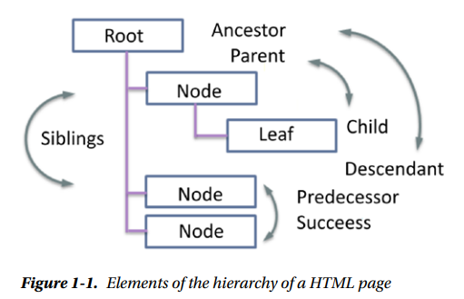
CSS Selectors for Hierarchies
Symbol | Description
e > f e f e + f e ~ f | Selection if f is a child element of e Select all f where e is ancestor Select first f element after e Select all the occurrences of f after e

Slide 46
Static Selector
Symbol | Description
::first-line ::first-letter ::before ::after ::selection | First line First letter Before the element After the element The highlighted (selected) area

Slide 47
Static Selector
<!DOCTYPE html>
<html>
<head>
<style>
p::after {
content: " - Remember this";
}
p::first-line {
color: red;
}
</style>
</head>
<body>
<p>My name is Donald</p>
<p>I live in Ducksburg</p>
<p><b>Note:</b> For this selector to work in IE8, a DOCTYPE must be declared, and you must use the old, single-colon CSS2 syntax (:after instead of ::after).</p>
</body>
</html>

Slide 48
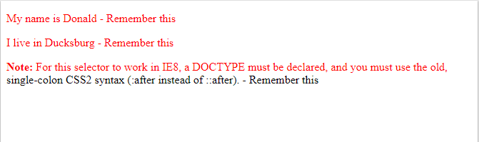
Static Selector

Slide 49
CSS Selectors for Areas
Symbol | Description
:root :empty :first-child :last-child :nth-child() :nth-last-child() :only-child :first-of-type :last-of-type :nth-of-type() :nth-last-of-type() :only-of-type | Basic element Applies only if the item is empty The first child element of a list The last child element of a list A particular child element of a list A particular child element by the end of a list Valid only when there is only one child element First child element of a type Last child element of a type Child element of a type in a list Child element of a type by the end of a list Only this type from a list

Slide 50
CSS Selectors for Areas
<!DOCTYPE html>
<html>
<head>
<style>
p:nth-child(2) {
background: red;
}
</style>
</head>
<body>
<p>The first paragraph.</p>
<p>The second paragraph.</p>
<p>The third paragraph.</p>
<p>The fourth paragraph.</p>
<p><b>Note:</b> Internet Explorer 8 and earlier versions do not support the :nth-child() selector.</p>
</body>
</html>

Slide 51
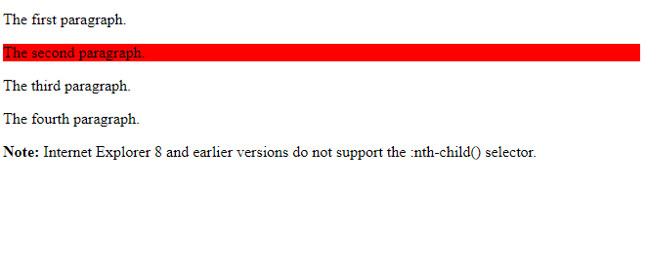
CSS Selectors for Areas

Slide 52
Dynamic CSS Selectors
Symbol | Description
:link :visited :hover :active :focus :target :disabled :enabled :checked :valid :invalid :lang() :not() | A hyperlink A hyperlink that has already been visited A hyperlink to the hovering the mouse A hyperlink that is active (clicked) An item that has the focus (blinking cursor) An item that has a target attribute An item that is disabled (disabled attribute) An item that is enabled (not disabled attribute) An item that is checked (only checkbox) An element that is valid An element that is invalid An item that the appropriate lang="" attribute is Negates the following selections (this is an operator)

Slide 53
Box Model and Text Flow
Block-level HTML5 elements have a virtual box drawn around them based on the box model
When the browser renders an element using the box model, the content is surrounded by padding, a margin and a border.
Padding
The padding property determines the distance between the content inside an element and the edge of the element
Padding be set for each side of the box by using padding-top, padding-right, padding-left and padding-bottom
Margin
Determines the distance between the element’s edge and any outside text
Margins for individual sides of an element can be specified by using margin-top, margin-right, margin-left and margin-bottom

Slide 54
Box Model and Text Flow (Cont.)
Border
The border is controlled using the properties:
border-width
May be set to any of the CSS lengths or to the predefined value of thin, medium or thick
border-color
Sets the color used for the border
border-style
Options are: none, hidden, dotted, dashed, solid, double, groove, ridge, inset and outset

Slide 55
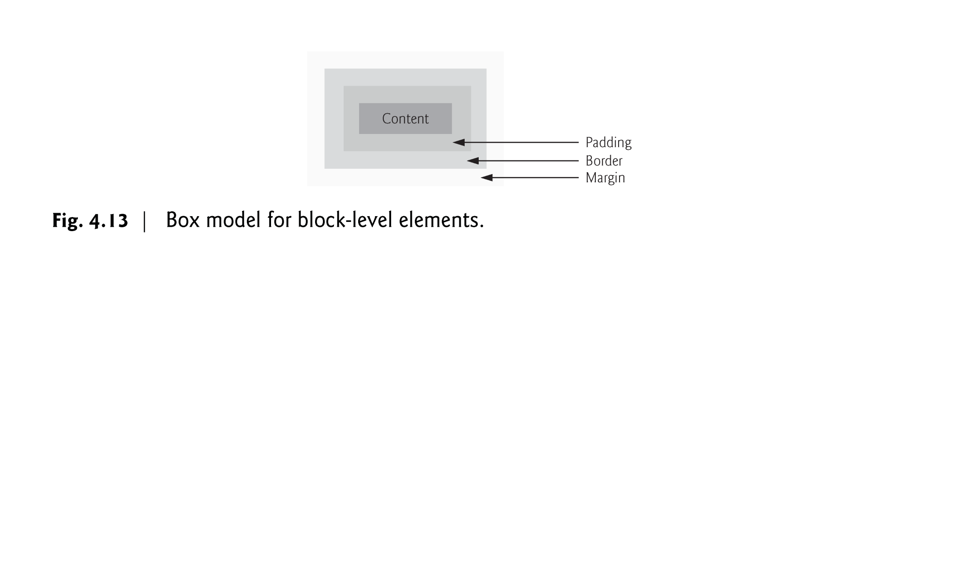

Slide 56
Box Model and Text Flow (Cont.)
CSS controls the border using three properties: border-width, border-color and border-style.
We illustrate these properties in Fig. 4.14.

Slide 57
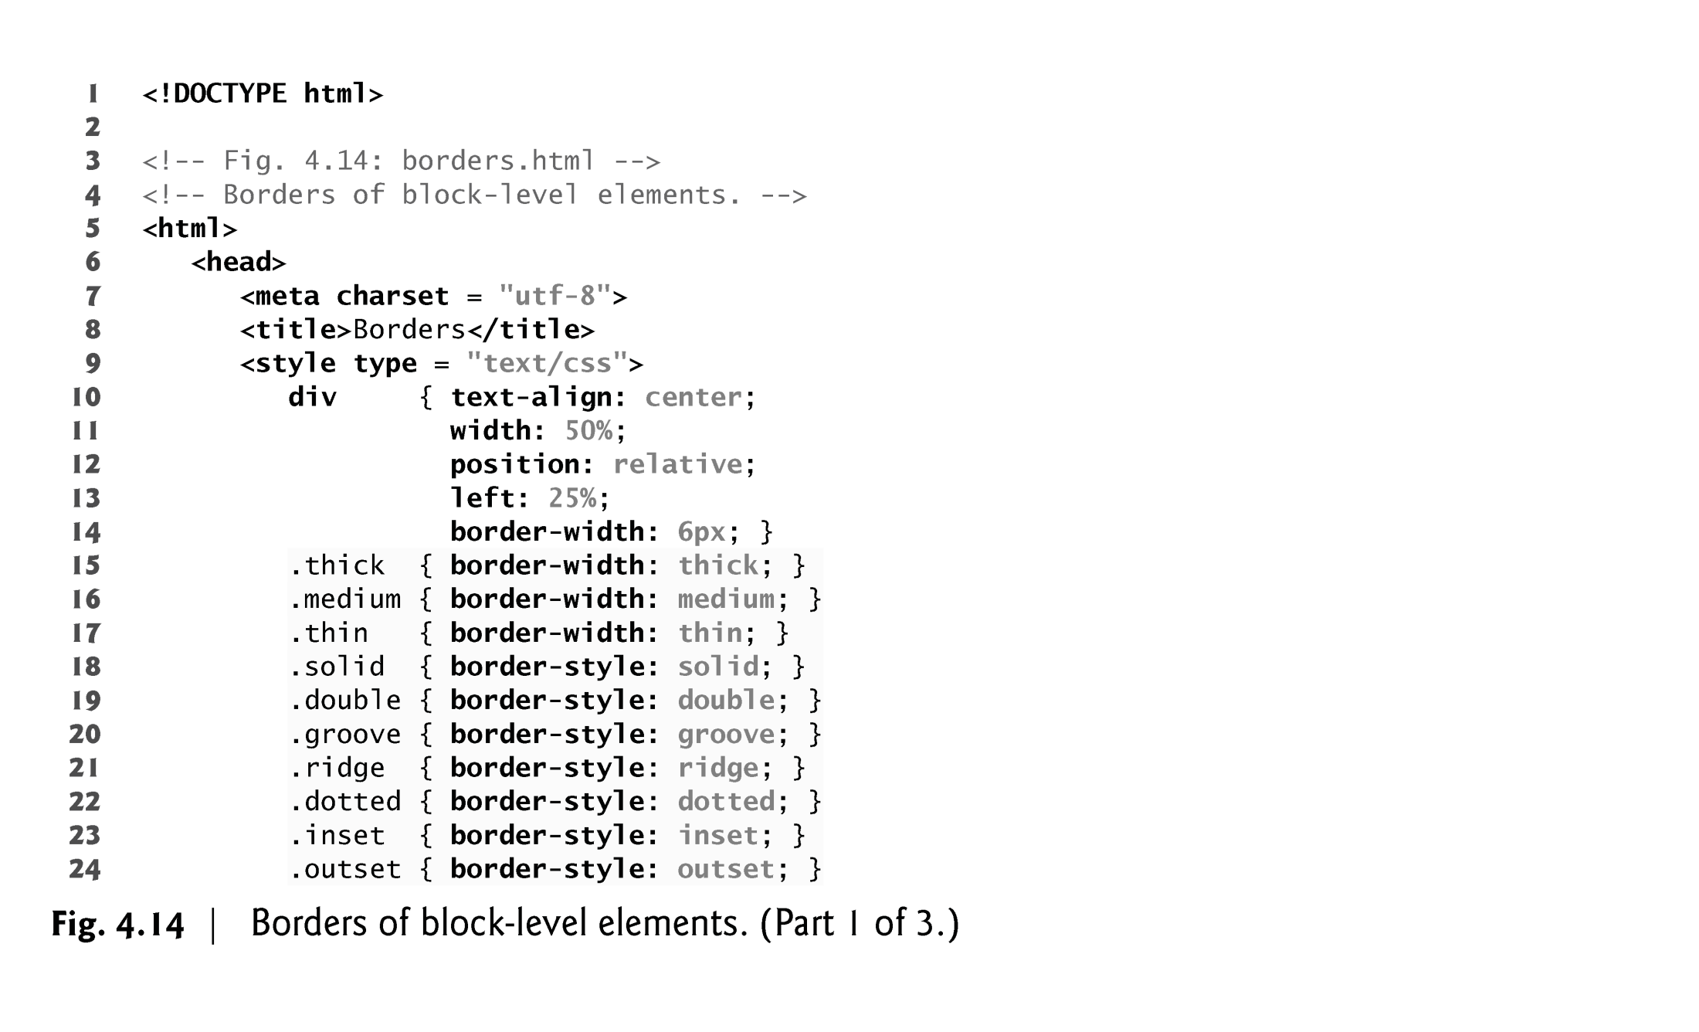

Slide 58
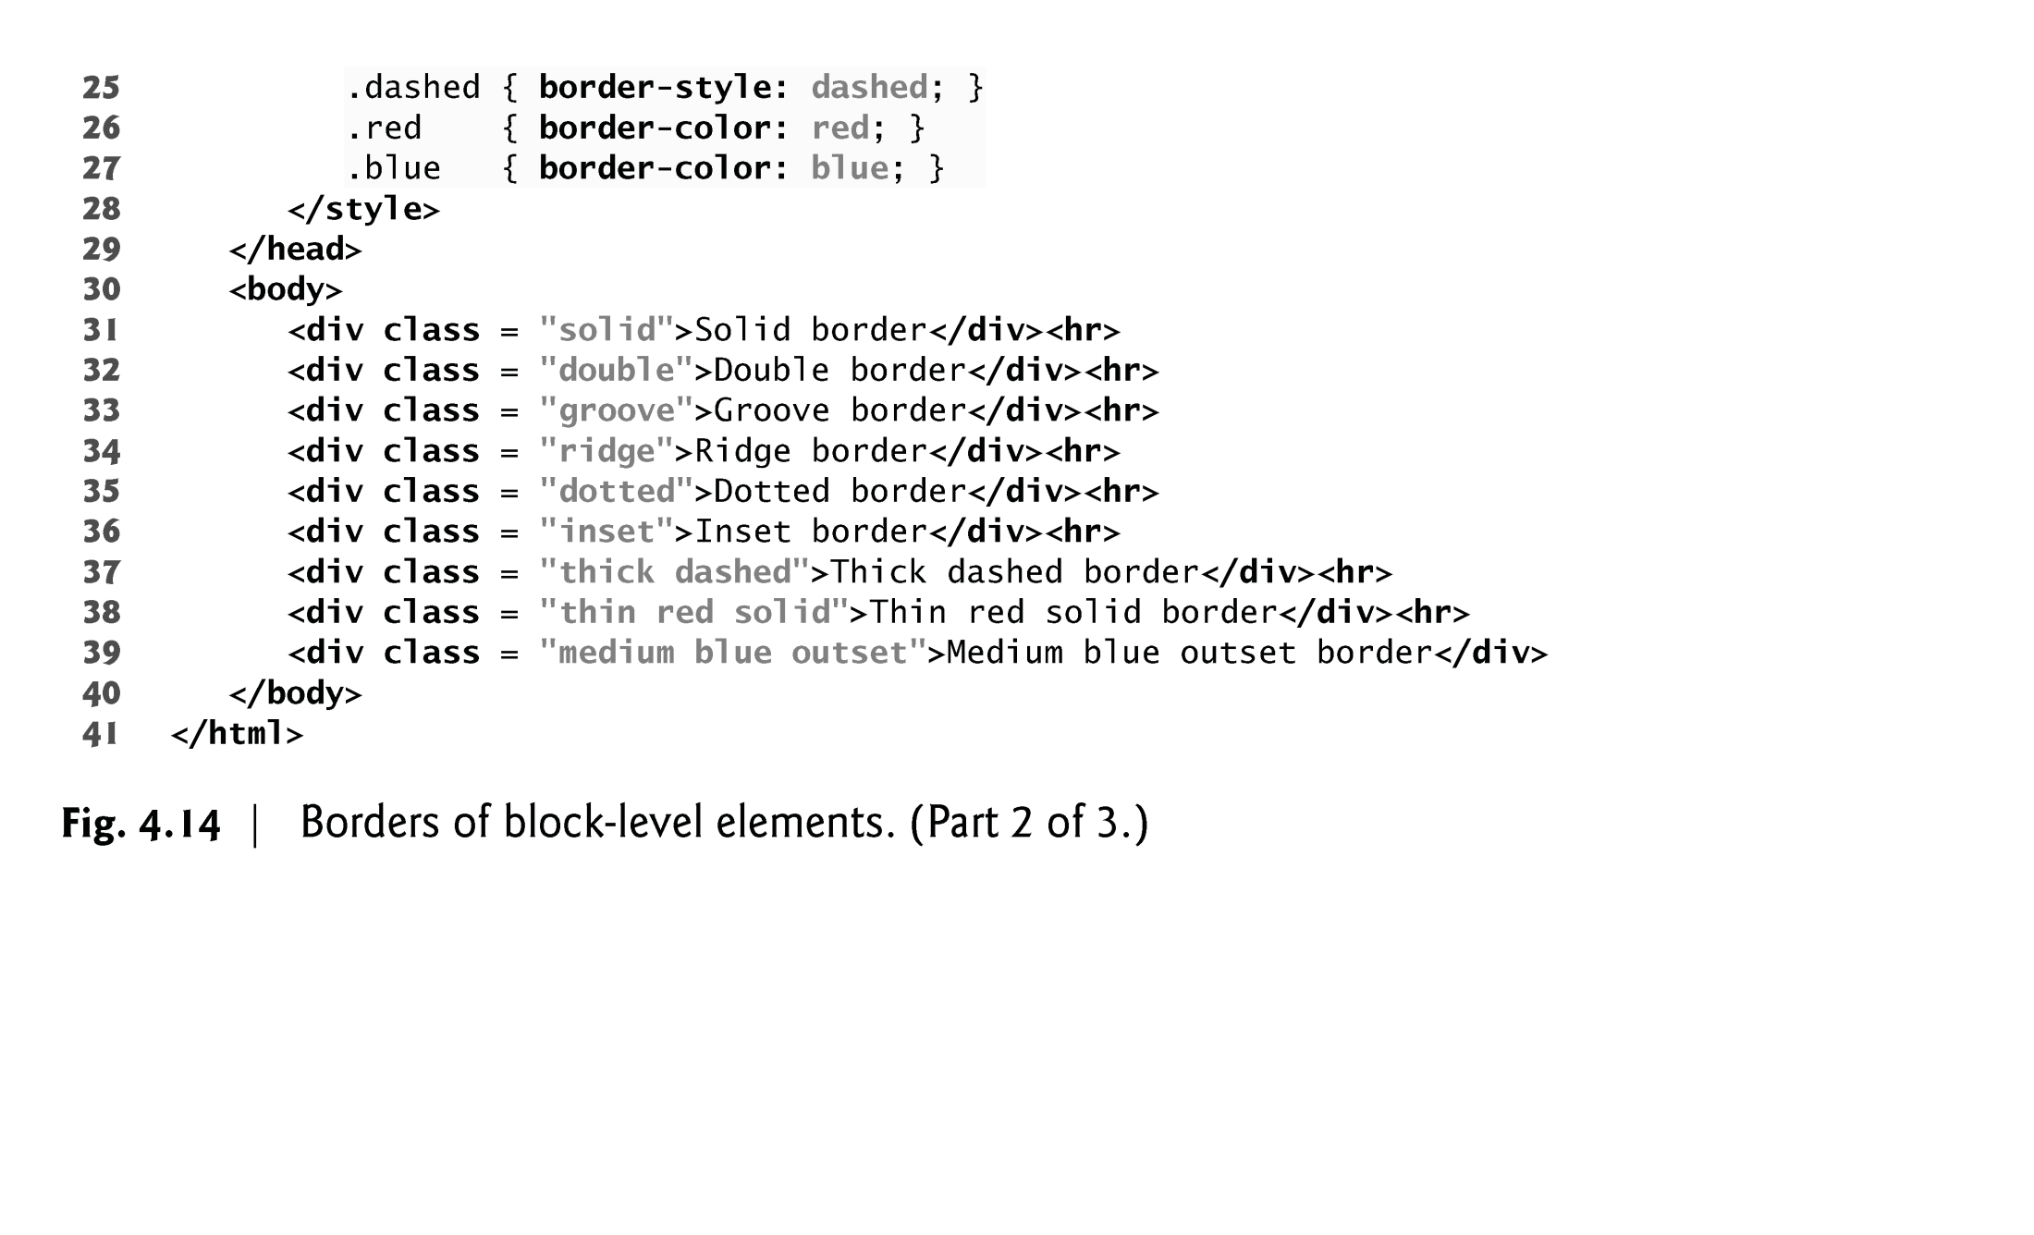

Slide 59
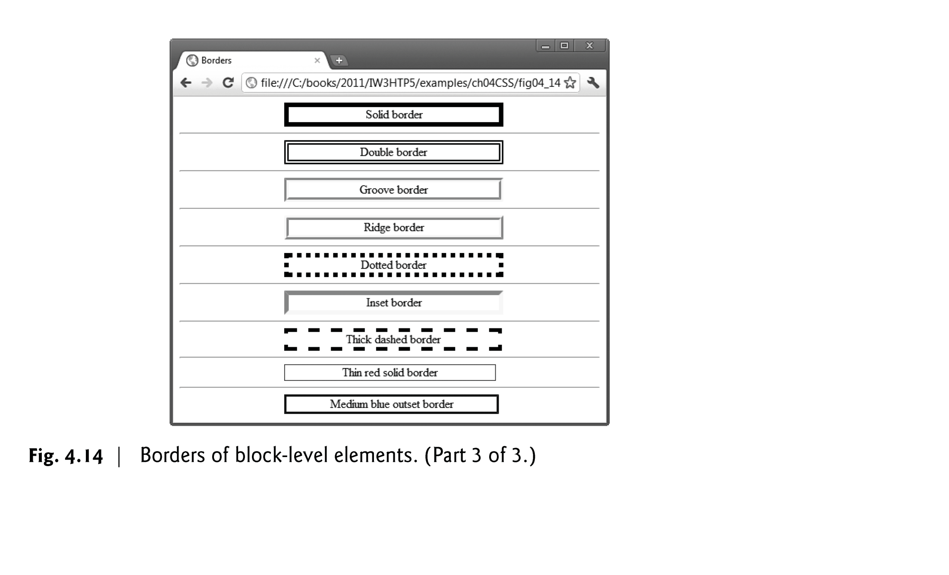

Slide 60
Box Model and Text Flow (Cont.)
Floating Elements
Floating allows you to move an element to one side of the screen; other content in the document then flows around the floated element.
Figure 4.15 demonstrates how floating elements and the box model can be used to control the layout of an entire page.

Slide 61
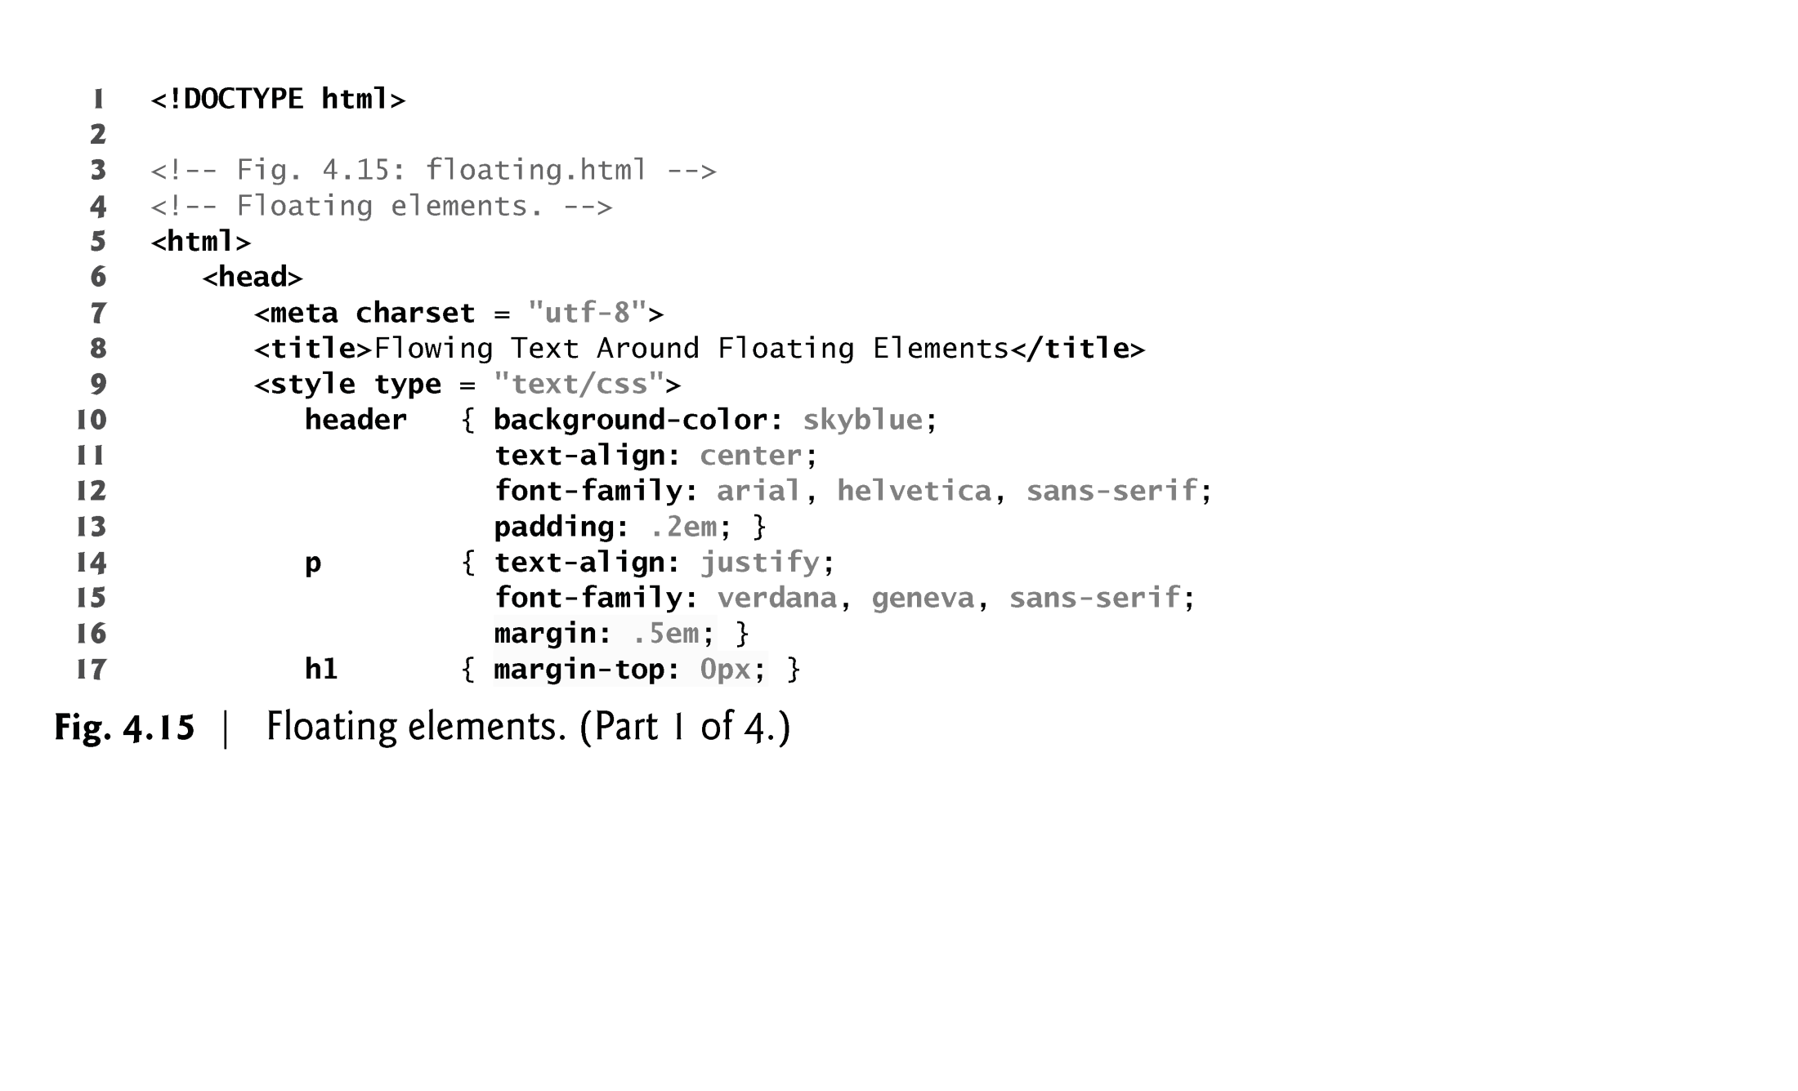

Slide 62
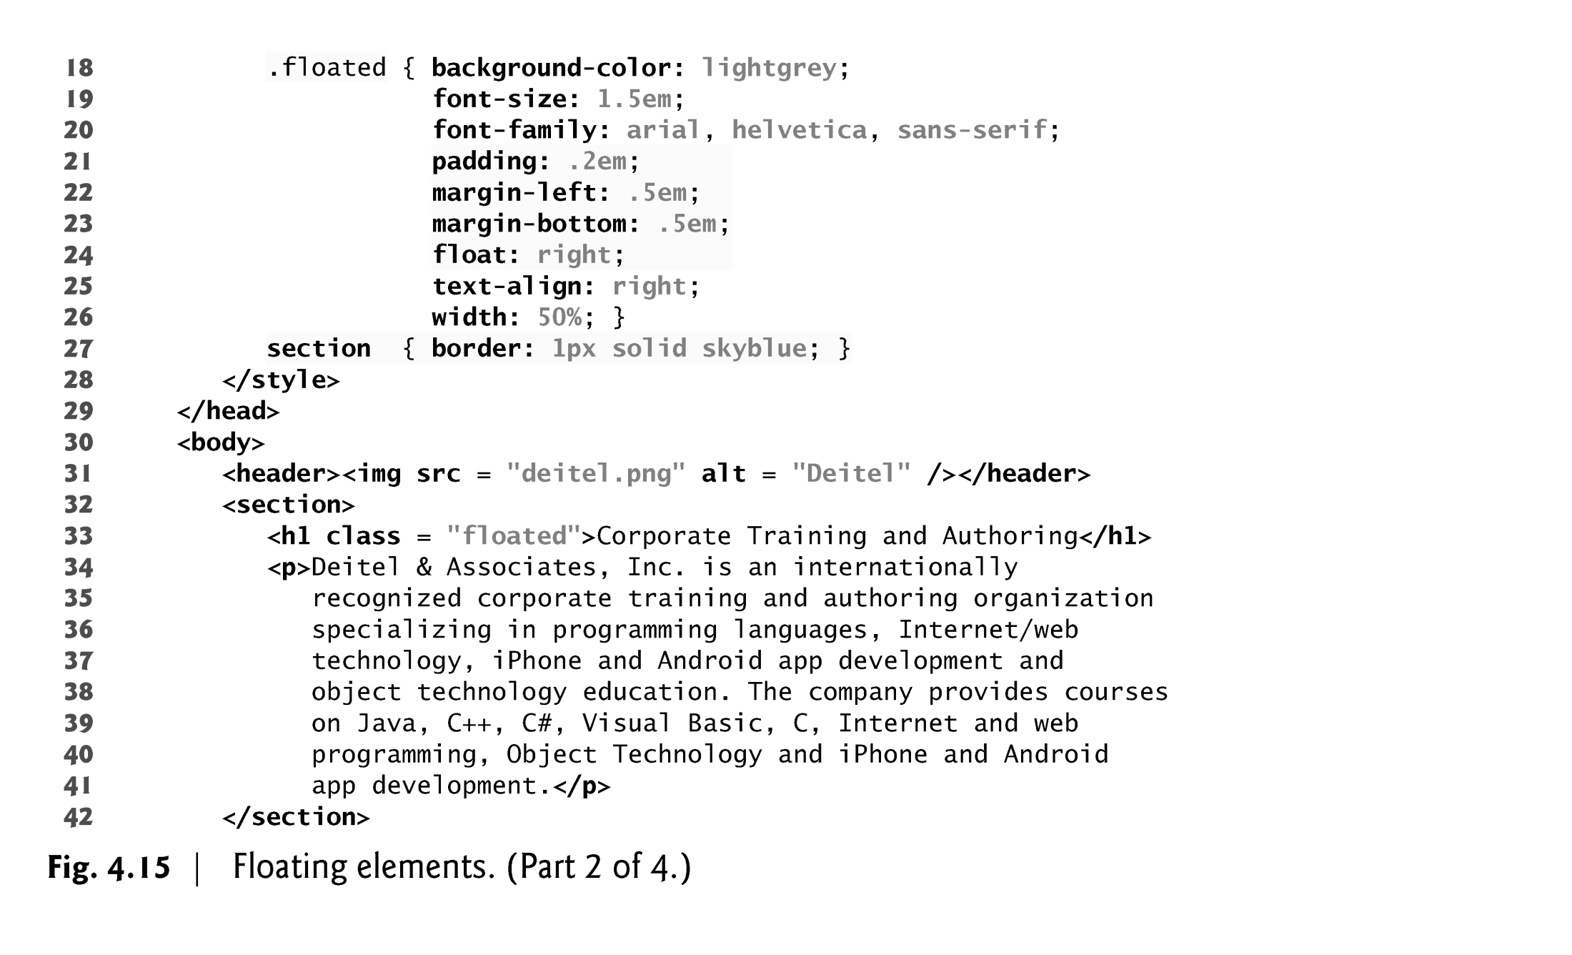

Slide 63
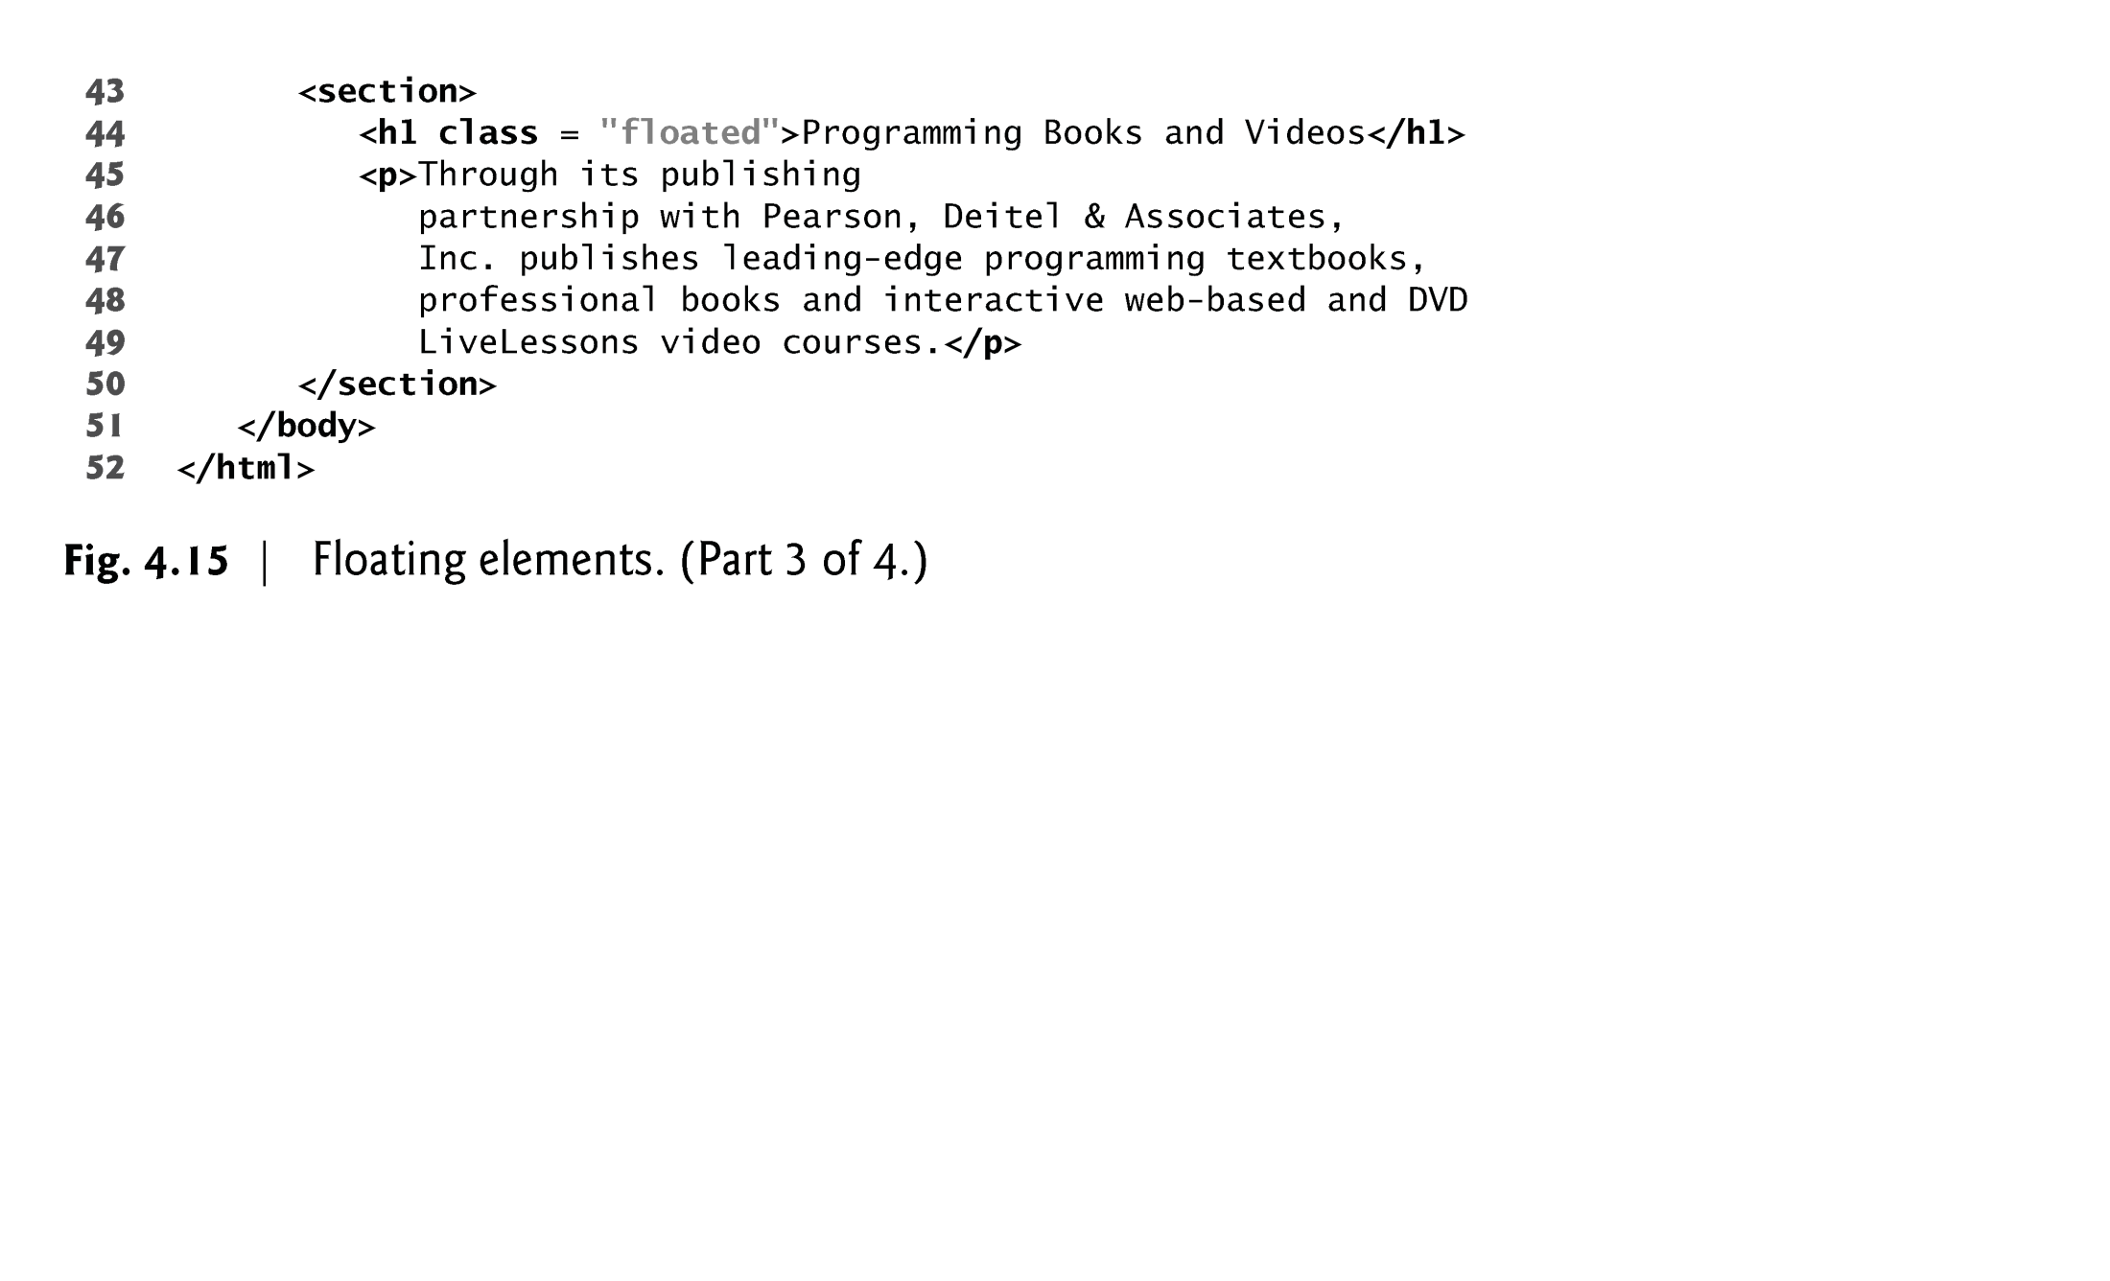

Slide 64
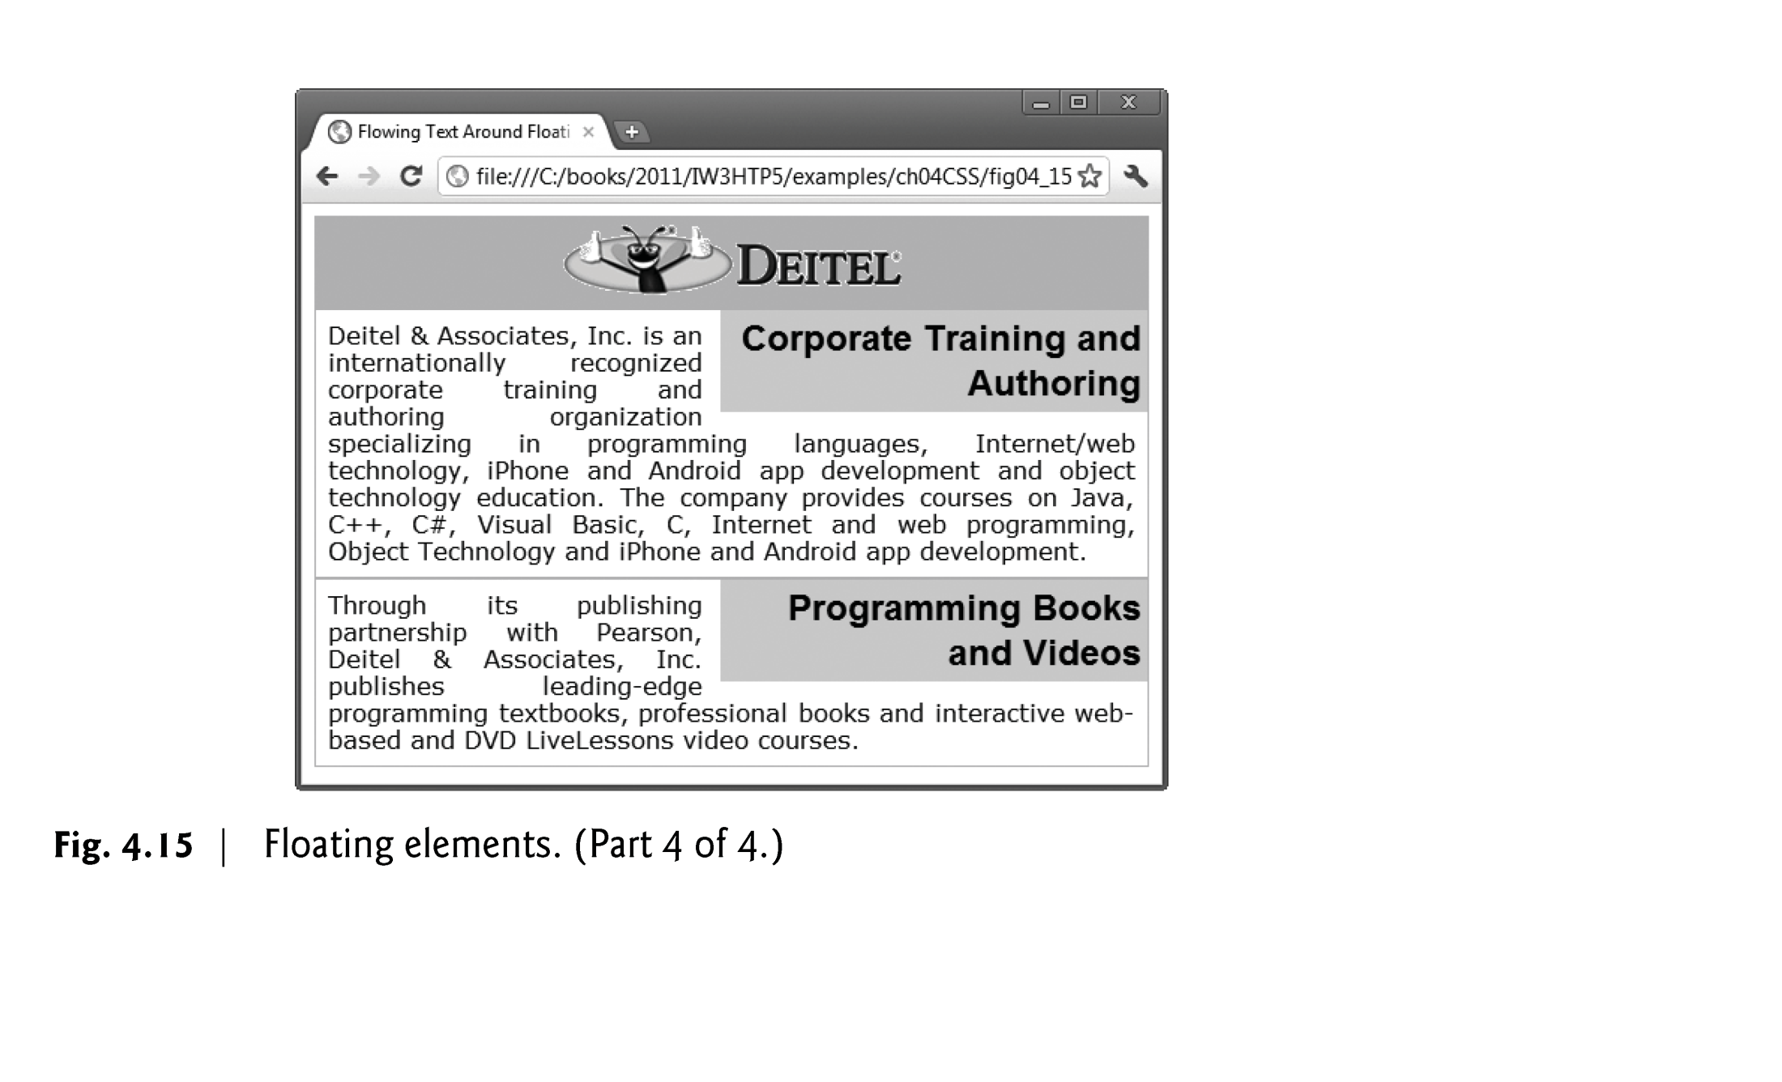

Slide 65
Box Model and Text Flow (Cont.)
margin and padding Properties
The margin property sets the space between the outside of an element’s border and all other content on the page.
The padding property determines the distance between the content inside an element and the inside of the element’s border.
Margins for individual sides of an element can be specified by using the properties margin-top, margin-right, margin-left and margin-bottom.
Padding can be specified in the same way, using padding-top, padding-right, padding-left and padding-bottom.

Slide 66
CSS Positioning and Layout
Positioning Types:
Static: Default; elements are positioned as they appear in the document flow.
Relative: Positioned relative to its normal position.
Absolute: Positioned relative to its nearest positioned ancestor.
Fixed: Positioned relative to the viewport, remains fixed when scrolling.
Sticky: Toggles between relative and fixed, depending on scroll position.

Slide 67
CSS Flexbox
What is Flexbox?
A CSS layout module designed for one-dimensional layouts. Useful for aligning items in a row or column.
Key Properties:
Display: display: flex; or display: inline-flex; to activate flexbox.
Flex Direction: flex-direction: row | column | row-reverse | column-reverse;
Justify Content: justify-content: flex-start | flex-end | center | space-between | space-around;
Align Items: align-items: flex-start | flex-end | center | baseline | stretch;

Slide 68

CSS Flexbox
Example
<div class="flex-container">
<div class="flex-item">Item 1</div>
<div class="flex-item">Item 2</div>
<div class="flex-item">Item 3</div>
</div>
.flex-container {
display: flex; /* Enables Flexbox */
flex-direction: column-reverse;
justify-content: center; /* Centers items horizontally */
align-items: center; /* Centers items vertically */
height: 200px; /* Height of the flex container */
background-color: #f0f0f0;
border: 2px dashed #ccc;
}
.flex-item {
background-color: #4caf50;
color: white;
padding: 20px;
margin: 10px;
font-size: 20px;
text-align: center;
border-radius: 5px;
}

Slide 69
CSS Color Models
What is a Color Model?
A color model is an abstract mathematical model describing the way colors can be represented as tuples of numbers, typically as three or four values or color components.
Common Color Models in CSS:
RGB (Red, Green, Blue)
HSL (Hue, Saturation, Lightness)
Hexadecimal (Hex)
RGBA (RGB with Alpha)
HSLA (HSL with Alpha)

Slide 70
RGB and RGBA Color Models
RGB (Red, Green, Blue):
A model for representing colors based on the combination of red, green, and blue light.
Each color component (R, G, B) has a value between 0 and 255.
Syntax: rgb(255, 0, 0) for red.
RGBA (Red, Green, Blue, Alpha):
Extends the RGB model to include an alpha channel for transparency.
The alpha value ranges from 0 (fully transparent) to 1 (fully opaque).
Syntax: rgba(255, 0, 0, 0.5) for semi-transparent red.

Slide 71
RGB and RGBA Color Models
When to Use RGB/RGBA:
Digital Media and Screens: RGB is ideal for devices like monitors, TVs, and digital screens that use additive color mixing (combining red, green, and blue light to create colors).
Precise Control Over Colors: If you need exact control over each color channel (red, green, blue), RGB allows for fine-tuning of color shades.
Transparency Needs: Use RGBA when you want to control the transparency (alpha) of a color. This is especially useful for overlays, modals, and elements that need varying opacity.
Advantages:
Widespread Support: RGB and RGBA are supported across all browsers and devices, making them reliable for web development.
Direct Color Control: You can specify exact color values, making it easy to match colors across digital platforms.
Disadvantages:
Not Intuitive for Designers: RGB values can be less intuitive for design purposes, especially when adjusting lightness or saturation.
Accessibility Concerns: Managing color contrast for accessibility requires additional tools and checks when using RGB/RGBA.

Slide 72
Hexadecimal Color Model
Hexadecimal Colors:
Represented as #RRGGBB where each pair of digits represents the intensity of red, green, and blue.
Each digit ranges from 00 to FF in hexadecimal notation (0-255 in decimal).
Short Notation: #RGB can be used as shorthand for #RRGGBB.
Syntax Examples:
#FF0000 for red.
#00FF00 for green.
#0000FF for blue.
#F00 is shorthand for #FF0000.
Adding Alpha with Hex:
hex values can include alpha for transparency: #RRGGBBAA.
Example: #FF000080 represents a semi-transparent red.

Slide 73
Hexadecimal Color Model
When to Use Hex:
Web Design Standards: Hex is a staple in web design due to its simplicity and compatibility with web tools like color pickers and editors.
Design Consistency: When working with design systems or brand guidelines that specify colors in hex, it’s easier to maintain consistency across projects.
Simple Projects or Prototyping: Hex codes are short and easy to write, making them ideal for quick projects or prototyping.
Advantages:
Compact and Readable: Hexadecimal notation is concise and easy to remember (e.g., #FFFFFF for white, #000000 for black).
Browser Compatibility: Like RGB, hex values are universally supported across all browsers and devices.
Disadvantages:
Lacks Flexibility: Hex doesn’t natively support opacity or adjustments to saturation and lightness.
Color Adjustments are Tricky: Making slight changes to color (e.g., creating a lighter shade) requires converting to a different model or using a color picker.

Slide 74
HSL and HSLA Color Models
HSL (Hue, Saturation, Lightness):
A cylindrical-coordinate representation of colors, making it easier to conceptualize.
Hue: Represents the color type (0-360 degrees on a color wheel).
Saturation: Represents the intensity or purity of the color (0% to 100%).
Lightness: Represents the lightness or darkness of the color (0% to 100%).
Syntax: hsl(120, 100%, 50%) represents a fully saturated green.
HSLA (Hue, Saturation, Lightness, Alpha):
Adds an alpha channel for transparency, similar to RGBA.
Syntax: hsla(240, 100%, 50%, 0.5) represents a semi-transparent blue.
Why Use HSL/HSLA?
Easier to adjust colors programmatically (especially saturation and lightness).
More intuitive for certain design tasks, such as creating tints and shades.

Slide 75
HSL and HSLA Color Models
When to Use HSL/HSLA:
Design Flexibility: HSL is more intuitive for designers because it separates hue, saturation, and lightness, making it easier to manipulate colors for thematic consistency.
Creating Color Variants: If you need to generate tints, shades, or gradients, HSL provides a straightforward way to adjust lightness and saturation.
Theming and Styling: When working with CSS custom properties for theming, HSL can simplify the process of creating and modifying color schemes.
Advantages:
Intuitive for Designers: Adjusting hue, saturation, and lightness separately makes it easier to create aesthetically pleasing colors.
Supports Transparency: HSLA provides an alpha channel, allowing for easy control over opacity.
Easy Color Adjustments: You can quickly generate lighter or darker colors by adjusting the lightness value.
Disadvantages:
Limited Browser Support (Older Versions): Older browsers may not fully support HSL, though this is less of an issue today.
Not as Precise for Screens: While more intuitive for adjustments, HSL may not be as precise as RGB for exact digital color matching.

Slide 76
Choosing the Right Color Model
When to Use RGB/RGBA:
Ideal for digital displays and screens where red, green, and blue light combine to create colors.
Suitable for scenarios requiring direct control over individual color channels.
When to Use Hex:
Hex is compact and widely used for web colors.
Preferred for design consistency and when working with tools that provide hex values.
When to Use HSL/HSLA:
Best for tasks where color adjustments are frequent (e.g., changing saturation or lightness).
Easier for creating color themes and gradients.

Slide 77
Media Types and Media Queries
CSS media types
allow you to decide what a page should look like depending on the kind of media being used to display the page
Most common media type for a web page is the screen media type, which is a standard computer monitor

Slide 78
Media Types and Media Queries
A block of styles that applies to all media types is declared by @media all and enclosed in curly braces
To create a block of styles that apply to a single media type such as print, use @media print and enclose the style rules in curly braces

Slide 79
Media Types and Media Queries
Other media types in CSS include:
handheld
Designed for mobile Internet devices
braille
For machines that can read or print web pages in braille
speech
Allow the programmer to give a speech-synthesizing web browser more information about the content of the web page
print
Affects a web page’s appearance when it is printed

Slide 80
Media Types and Media Queries
Figure 4.16 gives a simple classic example that applies one set of styles when the document is viewed on all media (including screens) other than a printer, and another when the document is printed.
To see the difference, look at the screen captures below the paragraph or use the Print Preview feature in your browser if it has one.

Slide 81
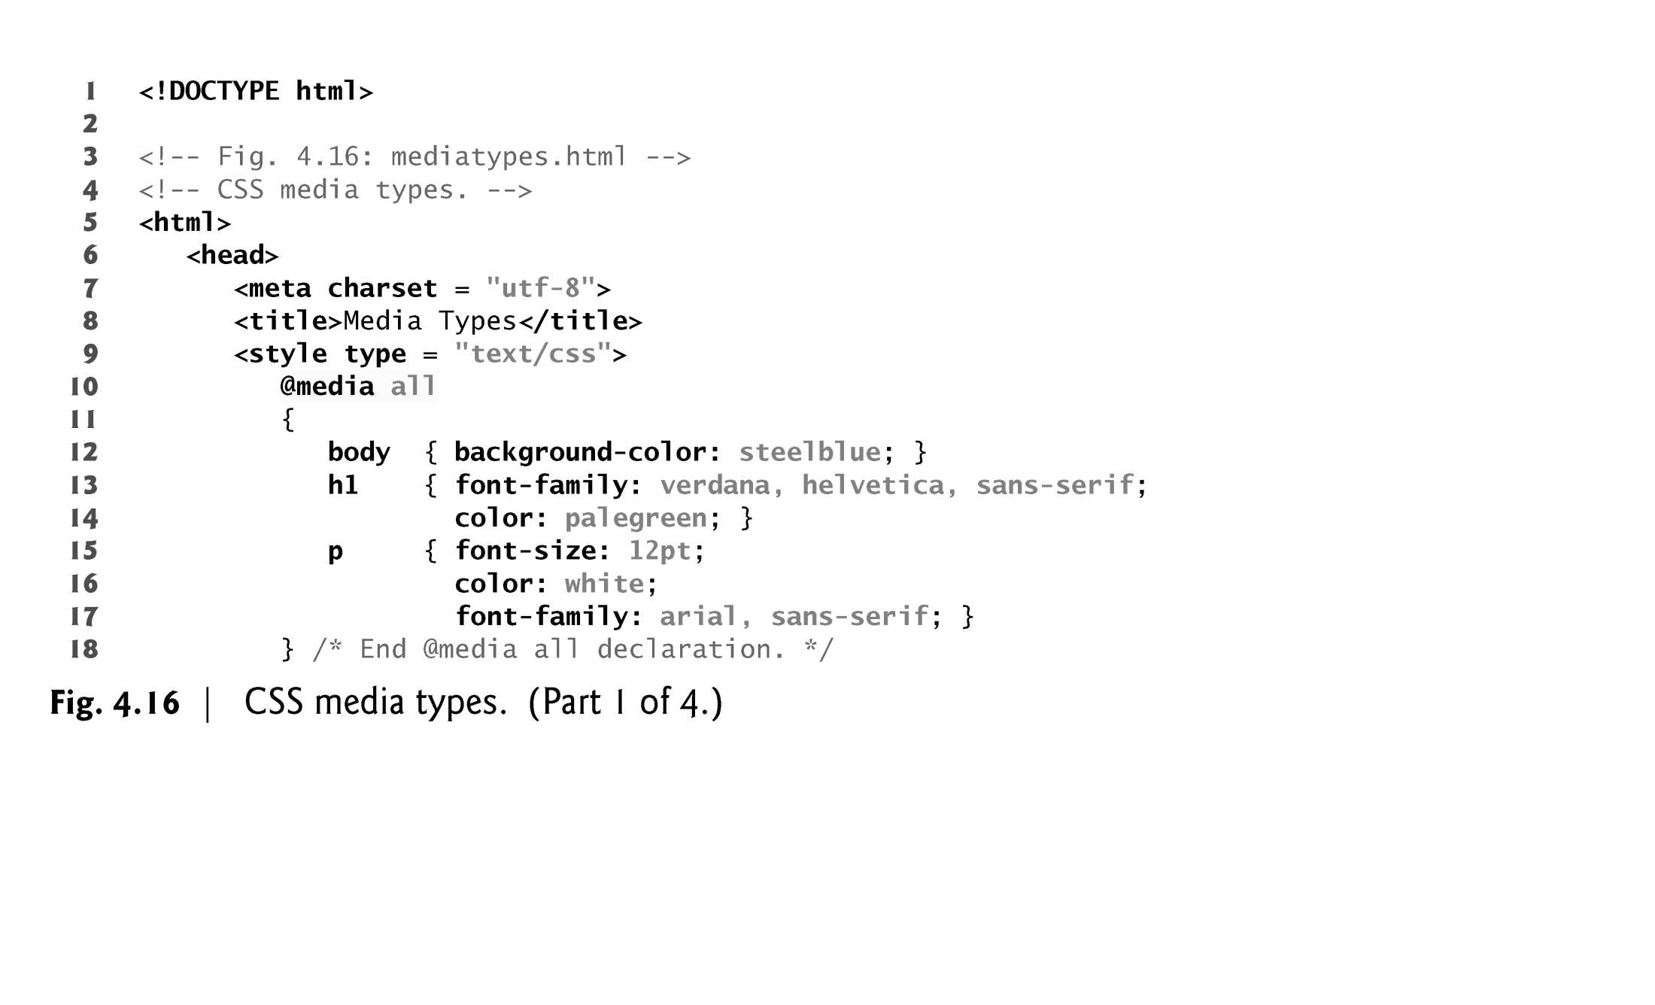

Slide 82
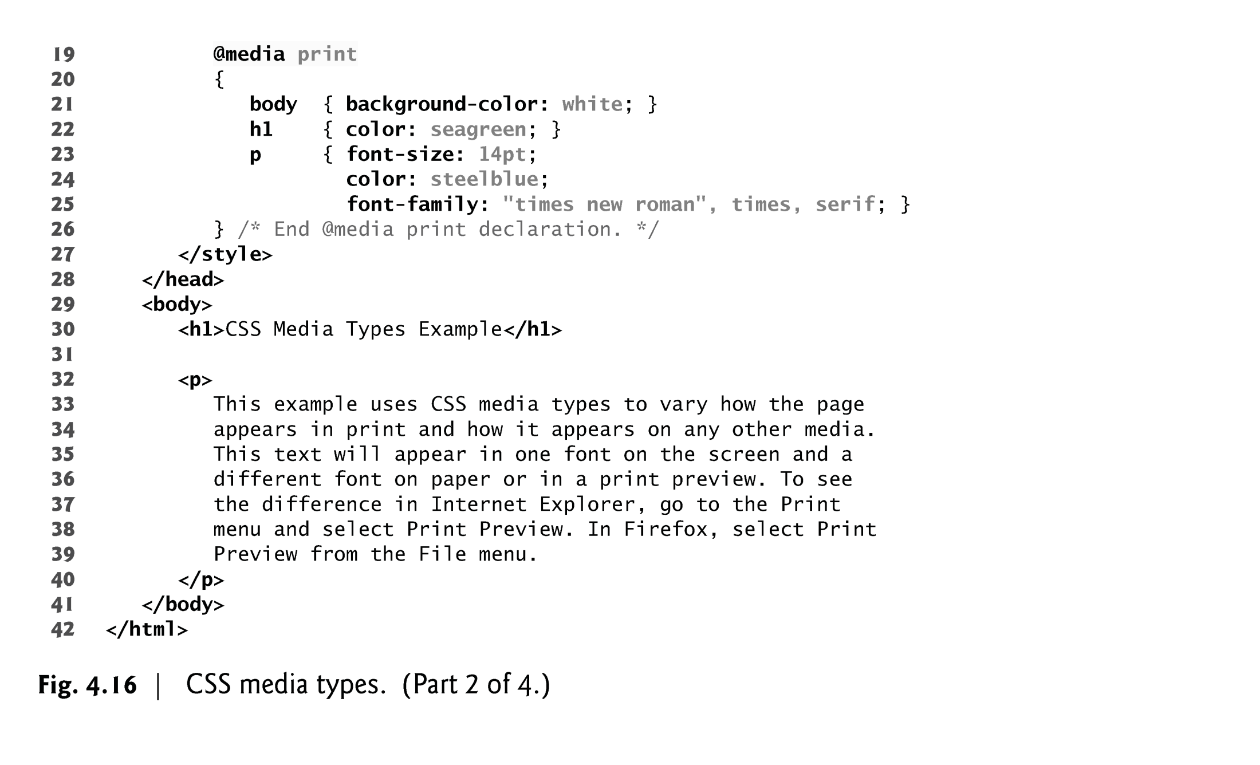

Slide 83
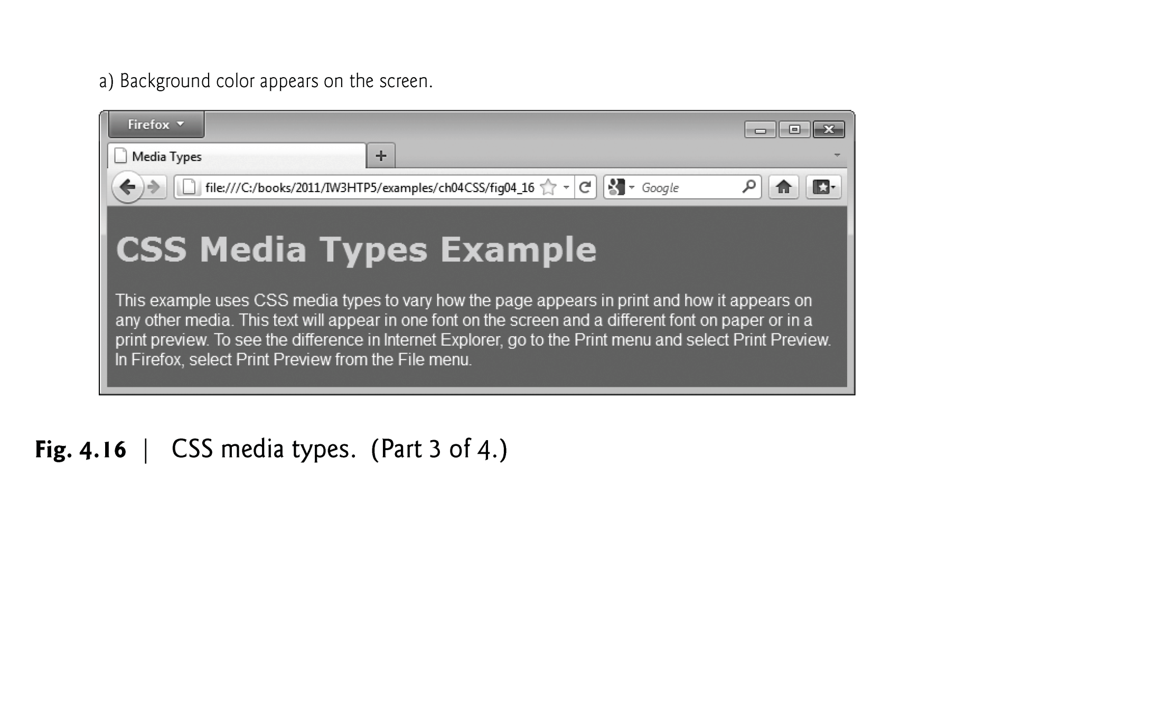

Slide 84
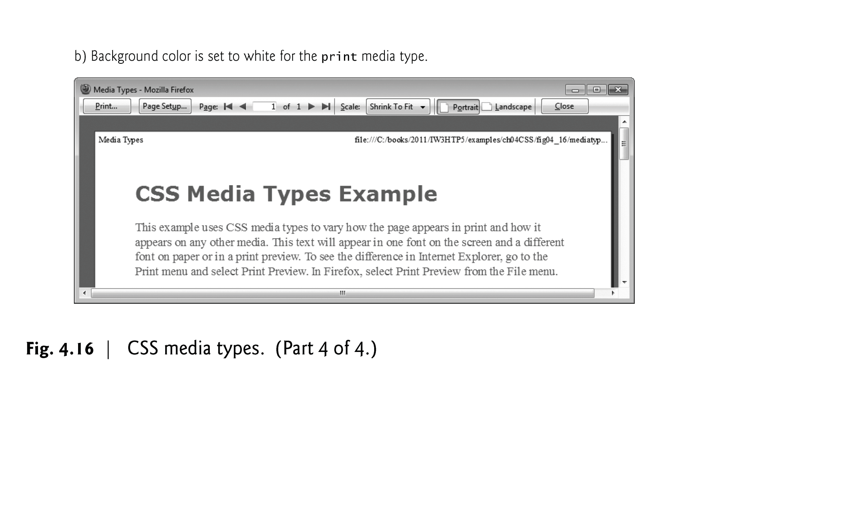

Slide 85
References
https://www.w3schools.com/cssref/playdemo.asp?filename=playcss_grid-row-start
https://webaim.org/

