Slide 1
CSE-312
Web Design and Programming Lab-I
Lab-6: Bootstrap
Md. Rafsan Jani
Assistant Professor
Department of Computer Science and Engineering
Jahangirnagar University

Slide 2
Overview
Responsive Web Design
What is Bootstrap?
History of Bootstrap
Bootstrap Advantages
How to use Bootstrap?
Container
Grid
Table
Image
Jumbotron
Buttons/ Navs/ Labels/ Icons

Slide 3
Responsive Web Design
Responsive web design is about creating web sites which automatically adjust themselves to look good on all devices, from small phones to large desktops.
Bootstrap is the most popular HTML, CSS, and JavaScript framework for developing responsive, mobile-first websites.
Bootstrap is completely free to download and use!

Slide 4
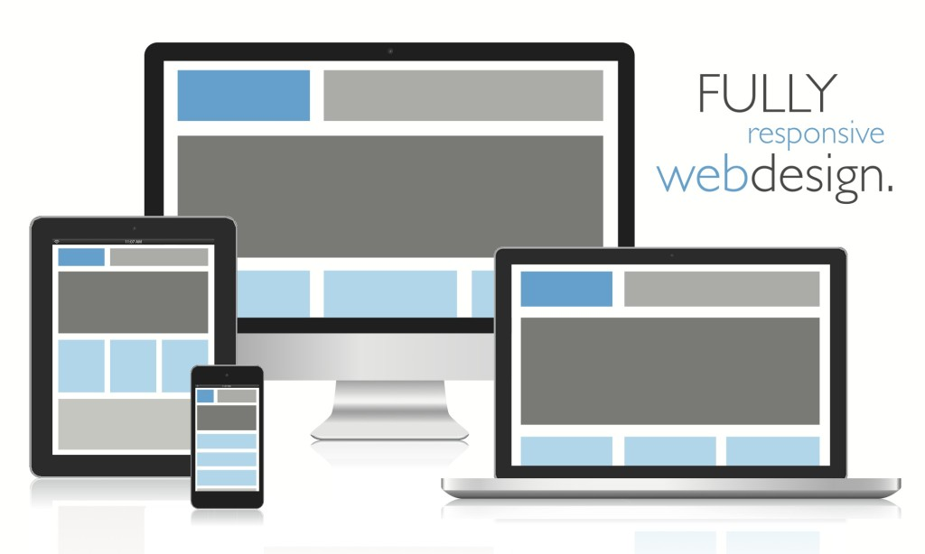
Responsive Web Design

Slide 5
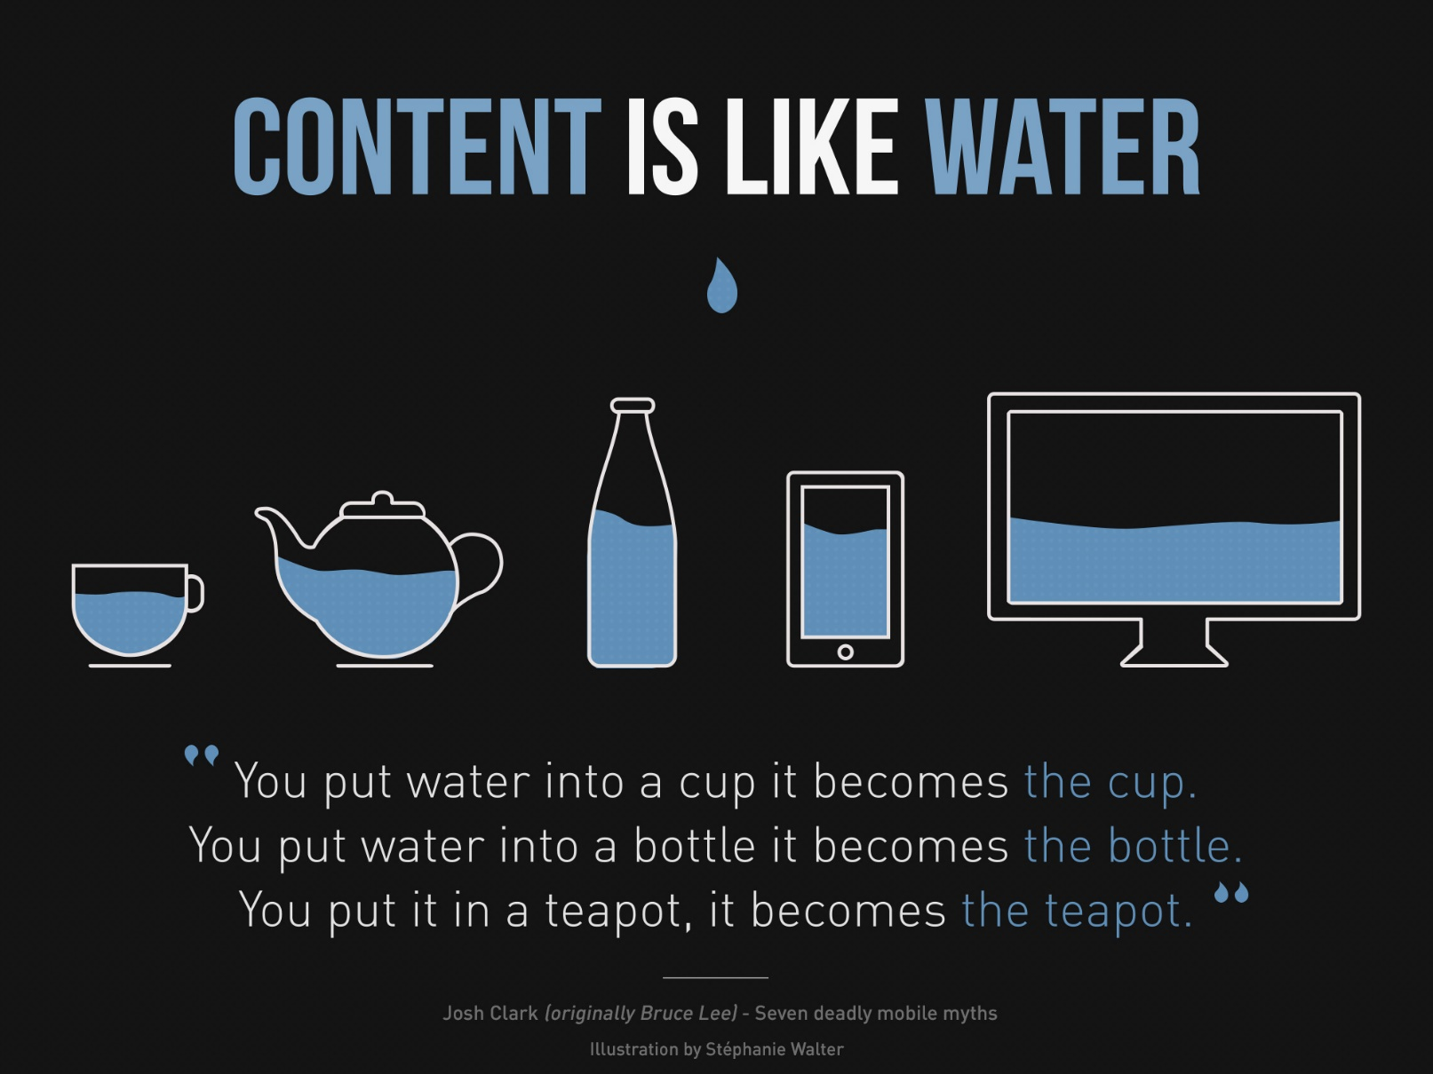
Illustration by Stéphanie Walter

Slide 6
What is Bootstrap?
Bootstrap is a free front-end framework for faster and easier web development
Bootstrap includes HTML and CSS based design templates for typography, forms, buttons, tables, navigation, modals, image carousels and many other, as well as optional JavaScript plugins
Bootstrap also gives you the ability to easily create responsive designs

Slide 7
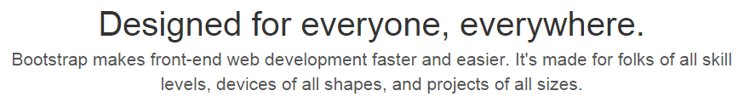
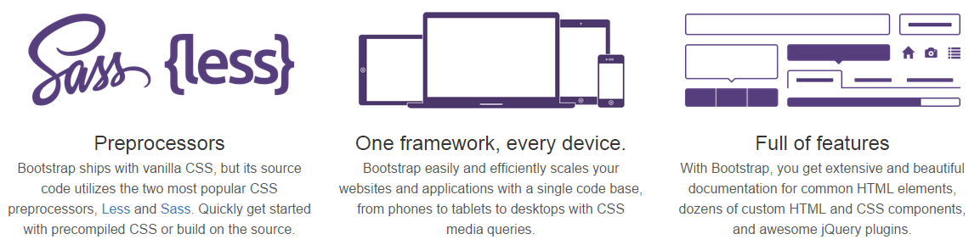
What is Bootstrap?

Slide 8
Bootstrap History
Bootstrap was developed by Mark Otto and Jacob Thornton at Twitter, and released as an open source product in August 2011 on GitHub.
Advantages of Bootstrap:
Easy to use: Anybody with just basic knowledge of HTML and CSS can start using Bootstrap
Responsive features: Bootstrap's responsive CSS adjusts to phones, tablets, and desktops
Mobile-first approach: In Bootstrap, mobile-first styles are part of the core framework
Browser compatibility: Bootstrap4 is compatible with all modern browsers (Chrome, Firefox, Internet Explorer 10+, Edge, Safari, and Opera)

Slide 9
Where to Get Bootstrap?
There are two ways to start using Bootstrap on your own web site.
Download Bootstrap from getbootstrap.com
If you want to download and host Bootstrap yourself, go to getbootstrap.com, and follow the instructions there.
Include Bootstrap from a CDN
If you don't want to download and host Bootstrap yourself, you can include it from a CDN (Content Delivery Network).
MaxCDN provides CDN support for Bootstrap's CSS and JavaScript. You must also include jQuery.

Slide 10
Bootstrap CDN
You must include the following Bootstrap’s CSS, JavaScript, and jQuery from MaxCDN into your web page.
<!-- Latest compiled and minified CSS --> <link rel="stylesheet" href="https://maxcdn.bootstrapcdn.com/bootstrap/4.5.2/css/bootstrap.min.css"> <!-- jQuery library --> <script src="https://ajax.googleapis.com/ajax/libs/jquery/3.5.1/jquery.min.js"></script> <!-- Popper JS --> <script src="https://cdnjs.cloudflare.com/ajax/libs/popper.js/1.16.0/umd/popper.min.js"></script> <!-- Latest compiled JavaScript --> <script src="https://maxcdn.bootstrapcdn.com/bootstrap/4.5.2/js/bootstrap.min.js"></script>
Advantage of using the Bootstrap CDN:
Many users already have downloaded Bootstrap from MaxCDN when visiting another site. As a result, it will be loaded from cache when they visit your site, which leads to faster loading time.
Also, most CDN's will make sure that once a user requests a file from it, it will be served from the server closest to them, which also leads to faster loading time.

Slide 11
Create Web Page with Bootstrap
Add the HTML5 doctype
Bootstrap uses HTML elements and CSS properties that require the HTML5 doctype.
Always include the HTML5 doctype at the beginning of the page, along with the lang attribute and the correct character set:
<!DOCTYPE html>
<html lang="en"> <head> <meta charset="utf-8"> </head>
</html>

Slide 12
Create Web Page with Bootstrap
Bootstrap is mobile-first
Bootstrap is designed to be responsive to mobile devices. Mobile-first styles are part of the core framework.
To ensure proper rendering and touch zooming, add the following <meta> tag inside the <head> element:
<meta name="viewport" content="width=device-width, initial scale=1">
The width=device-width part sets the width of the page to follow the screen-width of the device (which will vary depending on the device).
The initial scale=1 part sets the initial zoom level when the page is first loaded by the browser.

Slide 13

Create Web Page with Bootstrap
Containers
Bootstrap also requires a containing element to wrap site contents.
Bootstrap comes with different containers:
.container, class provides a responsive fixed width container
.container-fluid, class provides a full width container, spanning the entire width of the viewport

Slide 14
Create Web Page with Bootstrap
Containers
 | Extra small <576px | Small ≥576px | Medium ≥768px | Large ≥992px | Extra large ≥1200px
.container | 100% | 540px | 720px | 960px | 1140px
.container-sm | 100% | 540px | 720px | 960px | 1140px
.container-md | 100% | 100% | 720px | 960px | 1140px
.container-lg | 100% | 100% | 100% | 960px | 1140px
.container-xl | 100% | 100% | 100% | 100% | 1140px
.container-fluid | 100% | 100% | 100% | 100% | 100%

Slide 15
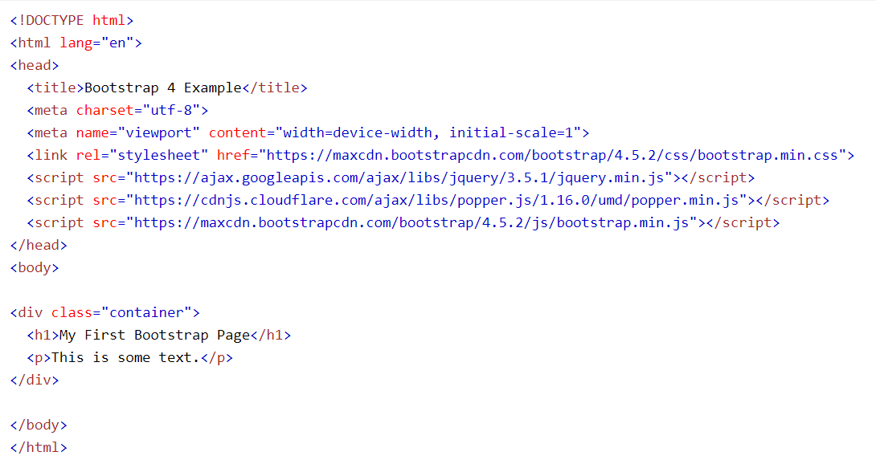

Create Web Page with Bootstrap

Slide 16
Bootstrap Grids
Bootstrap’s grid system allows up to 12 columns across the page.
If you do not want to use all 12 columns individually, you can group the columns together to create wider columns:
<div class="col-md-12">Span 12 columns</div>
<div class="col-md-4">Span 4</div><div class="col-md-4">Span 4</div> <div class="col-md-4">Span 4</div>
<div class="col-md-4">Span 4</div><div class="col-md-8">Span 8</div>
<div class="col-md-6">Span 6</div><div class="col-md-6">Span 6</div>
Bootstrap's grid system is responsive, and the columns will re-arrange automatically depending on the screen size.

Slide 17
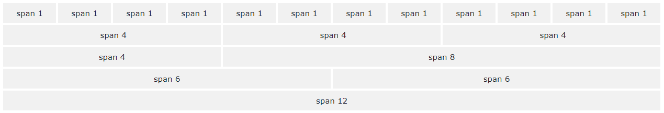
Bootstrap Grid System
Easy to use grid system for creating rows & columns for your content
https://getbootstrap.com/examples/grid/

Slide 18
Grid Classes
The Bootstrap grid system has five classes:
.col- (extra small devices - screen width less than 576px)
.col-sm- (small devices - screen width equal to or greater than 576px)
.col-md- (medium devices - screen width equal to or greater than 768px)
.col-lg- (large devices - screen width equal to or greater than 992px)
.col-xl- (extra large devices - screen width equal to or greater than 1200px)
The classes above can be combined to create more dynamic and flexible layouts.

Slide 19
Size of Bootstrap Gird
 | Extra small <576px | Small ≥576px | Medium ≥768px | Large ≥992px | Extra large ≥1200px
Max container width | None (auto) | 540px | 720px | 960px | 1140px
Class prefix | .col- | .col-sm- | .col-md- | .col-lg- | .col-xl-
# of columns | 12
Gutter width | 30px (15px on each side of a column)
Nestable | Yes
Column ordering | Yes

Slide 20
Bootstrap Grid
<div class="row"> <div class="col-*-*"></div> <div class="col-*-*"></div> </div> <div class="row"> <div class="col-*-*"></div> <div class="col-*-*"></div> <div class="col-*-*"></div> </div>
First; create a row (<div class="row">). Then, add the desired number of columns (tags with appropriate .col-*-*classes). Note that the first star (*) represents the responsiveness: sm, md, lg or xl, while the second star represents a number, which should add up to 12 for each row.

Slide 21
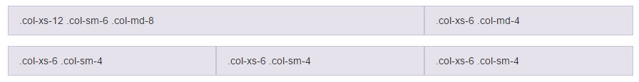
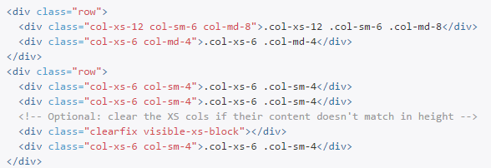
Grid: Mobile, Tablet, & Desktop

Slide 22
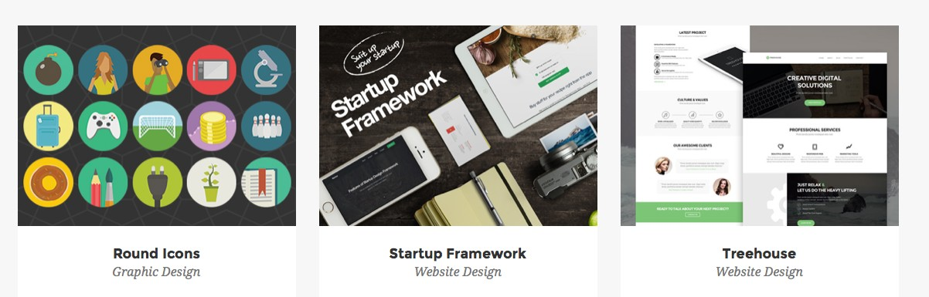
Bootstrap Grid Example
How many grids in each box?

Slide 23
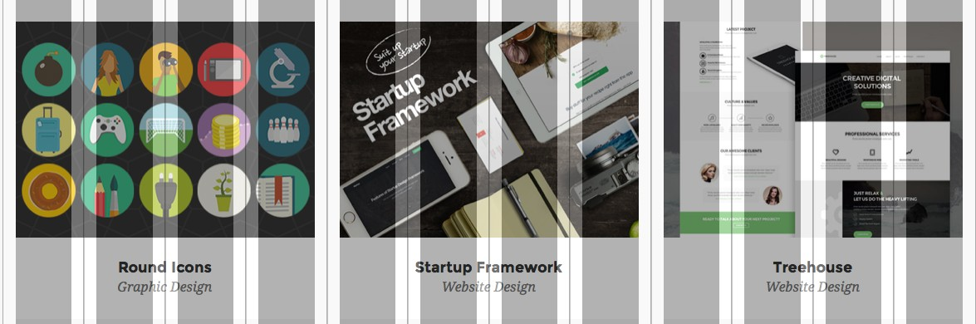
Bootstrap Grid Example
4 grids x 3 Columns

Slide 24
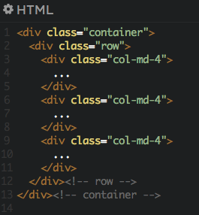
Bootstrap Grid Example

Slide 25
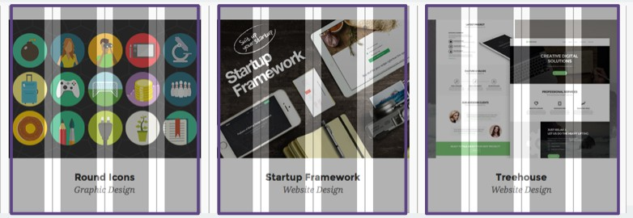
Bootstrap Grid Example

Slide 26
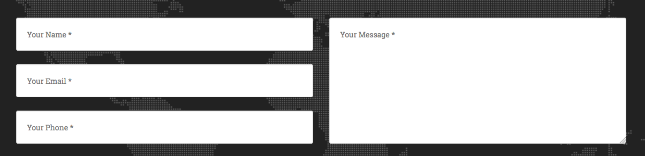
Bootstrap Grid Example 2
How many grids in each box?

Slide 27
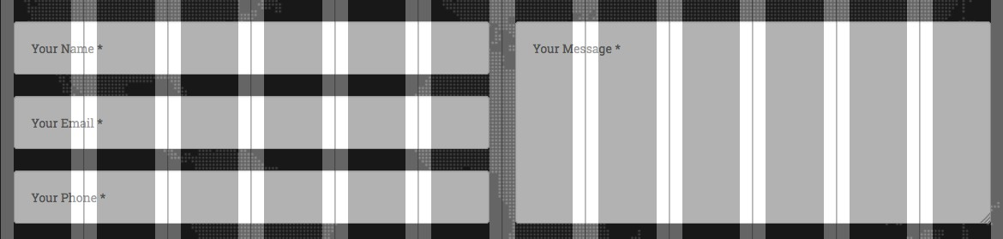
Bootstrap Grid Example 2
6 grids x 2 Columns

Slide 28
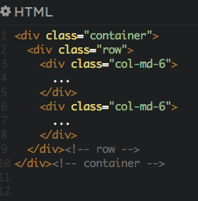
Bootstrap Grid Example 2

Slide 29
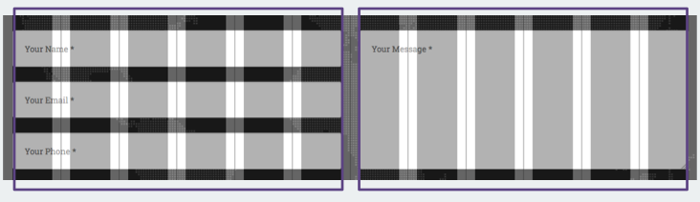
Bootstrap Grid Example 2

Slide 30
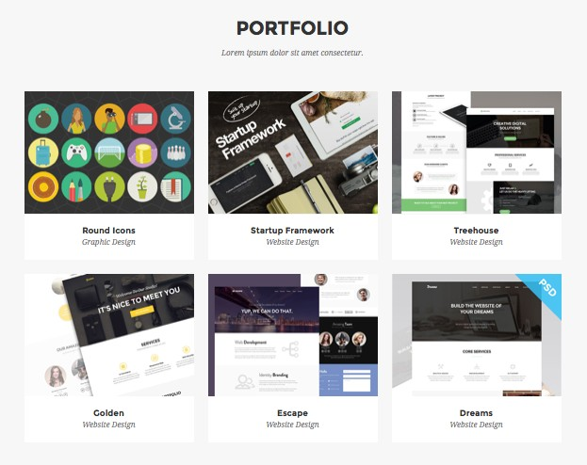
Bootstrap Row
1 Row = 12 Grids

Slide 31
Bootstrap Row
3 Rows

Slide 32
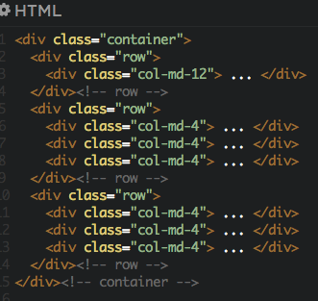
Bootstrap Row Example

Slide 33
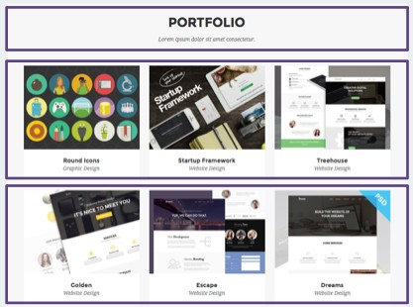
Bootstrap Row Example

Slide 34
Bootstrap Tables
A basic Bootstrap table has a light padding and only horizontal dividers.
The .table class adds basic styling to a table.
Striped Rows
The .table-striped class adds zebra-stripes to a table:
Bordered Table
The .table-bordered class adds borders on all sides of the table and cells:
Hover Rows
The .table-hover class enables a hover state on table rows:
Responsive Tables
The .table-responsive class creates a responsive table. The table will then scroll horizontally on small devices (under 768px). When viewing on anything larger than 768px wide, there is no difference:

Slide 35
Bootstrap Images
Rounded Corners
The .rounded class adds rounded corners to an image (IE8 does not support rounded corners):
Circle
The .rounded-circle class shapes the image to a circle (IE8 does not support rounded corners):
Thumbnail
The .img-thumbnail class shapes the image to a thumbnail:
Responsive Images
Images comes in all sizes. So do screens. Responsive images automatically adjust to fit the size of the screen.
Create responsive images by adding an .img-fluid class to the <img> tag. The image will then scale nicely to the parent element.
The .img-fluid class applies display: block; and max-width: 100%; and height: auto; to the image:

Slide 36
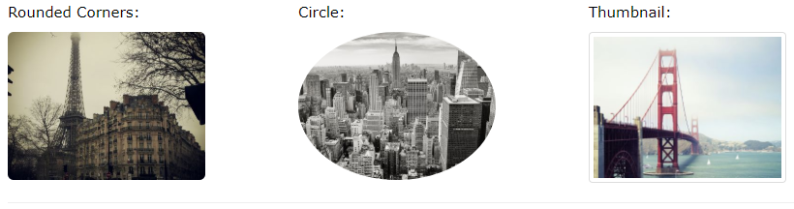
Bootstrap Images

Slide 37
Jumbotron
A jumbotron indicates a big grey box for calling extra attention to some special content or information.
Inside a jumbotron you can put nearly any valid HTML, including other Bootstrap elements/classes.
If you want a full-width jumbotron without rounded borders, add the .jumbotron-fluid class and a .container or .container-fluid inside of it:

Slide 38
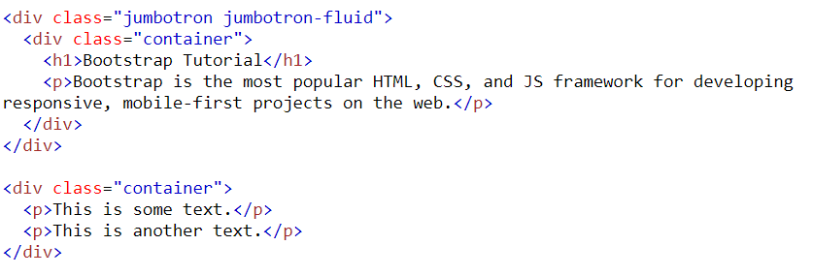
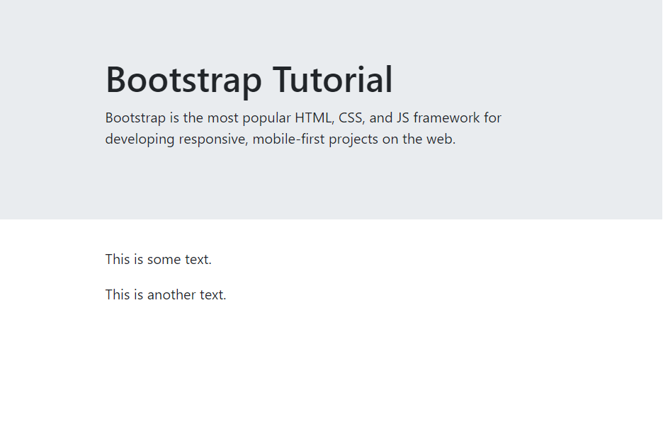
Jumbotron

Slide 39
Bootstrap Buttons
Button Styles
Bootstrap provides seven styles of buttons with the following classes:
.btn
.btn-primary
.btn-secondary
.btn-success
.btn-info
.btn-warning
.btn-danger
.btn-dark
.btn-light
.btn-link

Slide 40
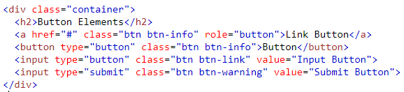

Bootstrap Button Elements
The button classes can be used on the following HTML elements:
<a>
<button>
<input>

Slide 41

Button Sizes
Bootstrap provides four button sizes with the following classes:
.btn-lg
.btn-md
.btn-sm
.btn-xs

Slide 42
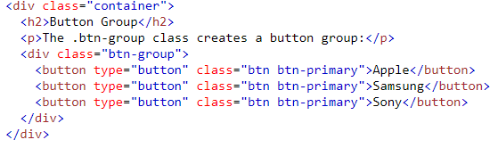

Button Groups
A Bootstrap allows you to group a series of buttons together (on a single line) in a button group:

Slide 43
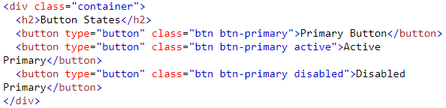

Active/Disabled Buttons
A button can be set to an active (appear pressed) or a disabled (unclickable) state:
The class .active makes a button appear pressed, and the class .disabled makes a button unclickable:

Slide 44
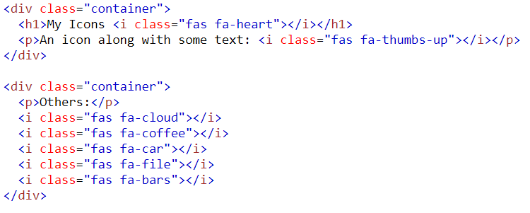
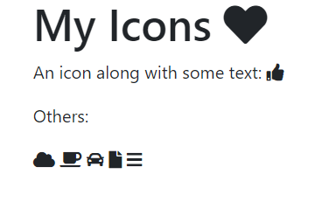
Icons
Bootstrap 4 does not have its own icon library (Glyphicons from Bootstrap 3 are not supported in BS4). However, there are many free icon libraries to choose from, such as Font Awesome and Google Material Design Icons.
To use Font Awesome icons, add the following to your HTML page (No downloading or installation is required):
<link rel="stylesheet" href="https://use.fontawesome.com/releases/v5.7.0/css/all.css" integrity="sha384-lZN37f5QGtY3VHgisS14W3ExzMWZxybE1SJSEsQp9S+oqd12jhcu+A56Ebc1zFSJ" crossorigin="anonymous">

Slide 45
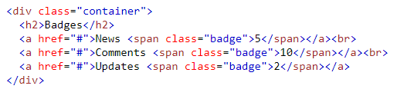
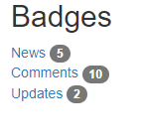
Badges
Badges are numerical indicators of how many items are associated with a link:
Use the .badge class within <span> elements to create badges:

Slide 46
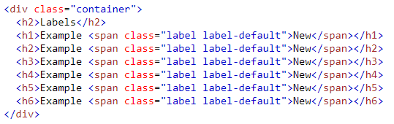
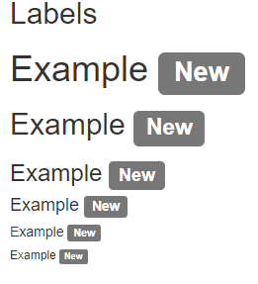
Labels
Labels are used to provide additional information about something:

Slide 47
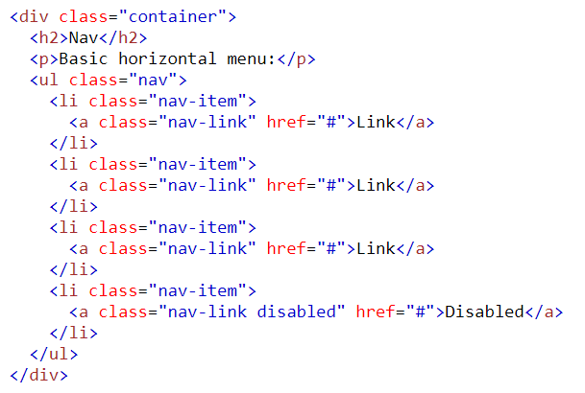
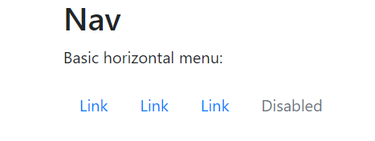
Navs
If you want to create a simple horizontal menu, add the .nav class to a <ul> element, followed by .nav-item for each <li> and add the .nav-link class to their links:

Slide 48
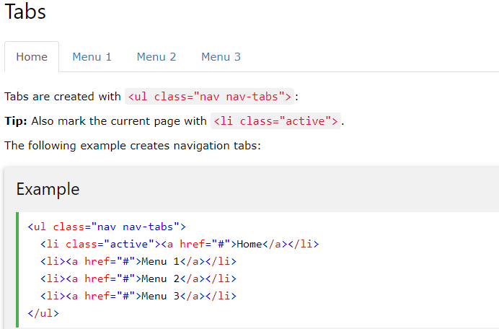
Navs

Slide 49
References
Discovering the Internet: Complete, Jennifer Campbell, Course Technology, Cengage Learning, 5th Edition-2015, ISBN 978-1-285-84540-1.
Basics of Web Design HTML5 & CSS3, Second Edition, by Terry Felke-Morris, Peason, ISBN 978-0-13-312891-8.
W3schools.com

