Slide 1
Object Oriented Design and Analysis

Slide 2
UML and Use Case Diagram

Slide 3
Analysis and Design
What to do ?
Analysis
understand
Object Oriented
Design
Programming
plan
How to do ?
build
The more you understand Analysis and Design better, the more easier the programming would be.

Slide 4
Analysis and Design
Analysis and design have been summarized in the phase:
do the right thing (analysis)
Analysis emphasizes an investigation of the problem and requirements, rather than a solution.
do the thing right (design)
Design emphasizes a conceptual solution that fulfills the requirements, rather than its implementation.
Notes:
"Analysis" is a broad term, best qualified, as in requirements analysis (an investigation of the requirements) or object analysis (an investigation of the domain
objects).
Design emphasizes a conceptual solution that fulfills the requirements, rather than its implementation. For example, a description of a database schema and
software objects. Ultimately, designs can be implemented.
‹#›

Slide 5
Object-oriented analysis and design
Object-oriented analysis emphasizes on finding and describing the objects or concepts in the problem domain.
Object-oriented design emphasizes on defining software objects and how they collaborate to fulfil the requirements

Slide 6
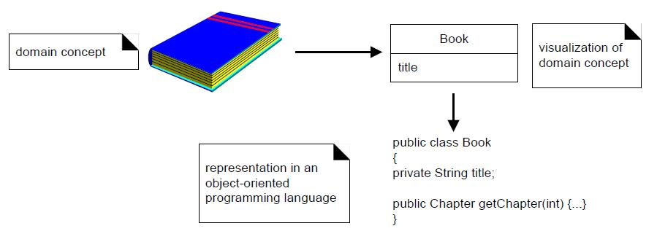
Object-oriented analysis and design

Slide 7
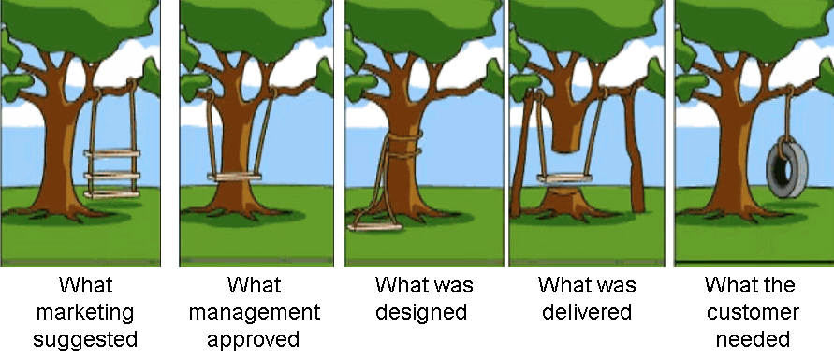
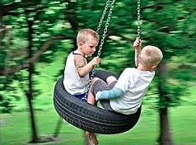

Slide 8
Software Development Process
A set of disciplined activities, subject to constraints and resources, to build a software system with pre-defined purposes from beginning to completion.
AKA “Software Lifecycles”.
Objectives – To understand the concept of software development process and the context in which software is developed
Different approaches
Different software process models

Slide 9
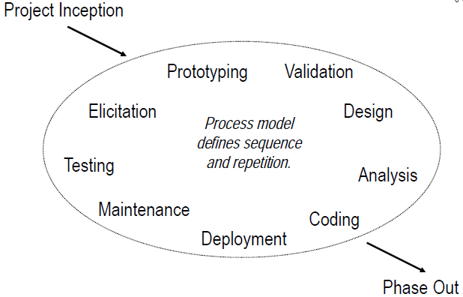
What is software development?

Slide 10
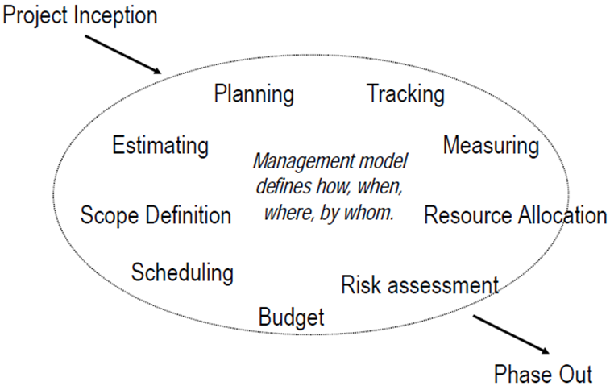
What is software development?

Slide 11
Modelling the software process
A software process model is an representation of the software development process.
The main purpose of the abstraction is to explain different approaches to software development.
The model captures the primary activities that we undertake in software development.

Slide 12
Why do we need a process model?
Have a guideline for the development process.
Help the team to understanding what to expect during the software development
The appropriateness of the development activities
The resources and constraints involved in the software development
The goals of the current software project
No single software process model is suitable for all different types of software.

Slide 13
Model
A model is a simplification of reality.
The model captures the important aspects of the thing being modeled and leaves out the rest of the details.

Slide 14
Why do we model?
We build models so that we can better understand the system we are developing.
Through modeling, we achieve four aims:
1. Models help us to visualize a system as it is or as we want it to be.
2. Models permit us to specify the structure or behavior of a system.
3. Models give us a template that guides us in constructing a system.
4. Models document the decisions we have made.

Slide 15
Unified Modeling Language (UML)
Not a programming language, a graphical notation – specifically for drawing diagrams for object oriented systems.
UML diagrams are
quick, useful communication tool
Support system for brain

Slide 16
Overview of UML
The UML is a language for (overview of UML):
Visualizing
Specifying
Constructing
Documenting the artifacts of a software intensive system.

Slide 17
UML
UML stands for Unified Modelling Language.
An industry standard modelling language for object-oriented software engineering.
Developed in the mid-1990’s and standardised in 1997 (UML 1.1).
UML 2.x is the current revision in use .
UML includes a set of graphic notation techniques to create visual models of object-oriented software-intensive systems.

Slide 18
History of UML
In 1993 Booch was working in Rational Corporation along with other members.
In 1994, Rumbaugh joined Rational. The first attempt of unification was made to combine Booch’s concepts, Rumbaugh’s OMT and CRC.
In 1995, Jacobson joined Rational. Another unification attempt was made to combine Booch’s concepts, Rumbaugh’s OMT and Jacobson’s Objectory. This unification was named as Unified Modeling Language (UML).
In 1996, proposal was made to Object Management Group (OMG) for recognizing UML as a standard language.
In 1997, OMG recognized UML as a standard language.
In 2000, ISO recognized UML as a standard language. The version of UML was 1.0.
In 2004, another major upgrade was made to UML’s specification which is known as UML 2.0.
The latest version of UML till date is UML 2.4.1 published in Aug 2011.

Slide 19
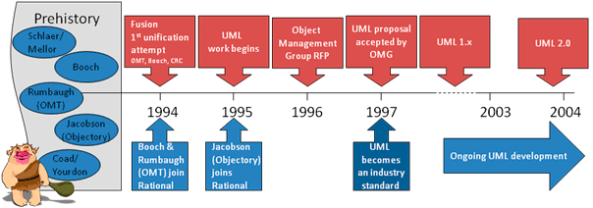
History of UML

Slide 20
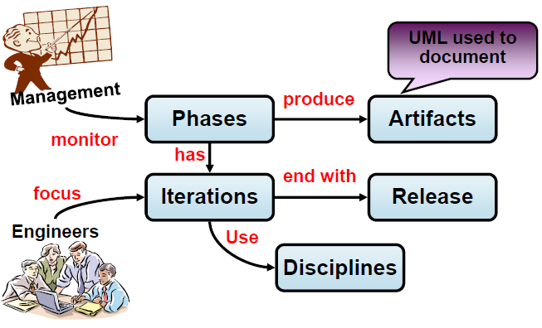
Unified Process and UML

Slide 21
Types of UML Diagrams
There are two main categories:
Structure diagrams
analyze and depict the structure of a system or process.
show different objects in a system.
Behavioral diagrams
show what should happen in a system.
describe the behavior of the system, its actors, and its building components.
describe how the objects interact with each other to create a functioning system.

Slide 22
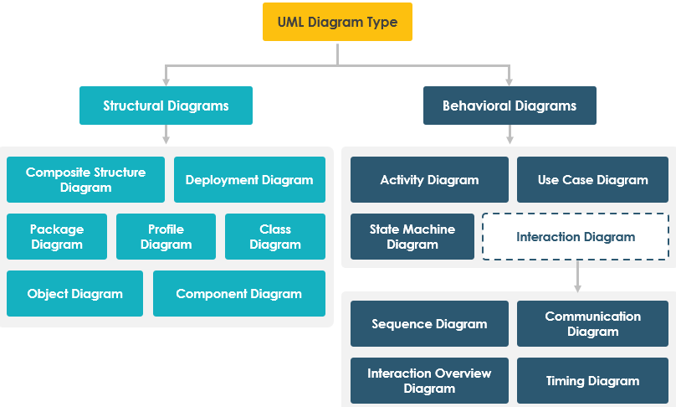
Types of UML Diagrams

Slide 23
Defining Requirements
What the application
requires to do
What must the app. do
Functional Requirements
What does app do?
Non Functional Requirements
What else?
Features / Capabilities
Help
Performance
Support
Security

Slide 24
Functional Requirements Example
Phrase starts with like
System must or application must or program must
Program must allow receipts to be generated by via e-mail
System must automatically produce monthly comparative analysis report. Report must be in PDF format and automatically emailed to everyone on first day of the month.
System must display the heart rate, temperature and
blood pressure of a patient connected to the patient monitor
Application must allow user to search by customer’s last name or telephone number

Slide 25
Non-Functional Requirements Example
Help desk available by telephone. Mon – Fri 8 am – 6 pm
System must respond to searches within 2 seconds.

Slide 26
FURPS / FURPS+
Functional requirements
Usability requirements
Reliability requirements
Performance requirements
Supportability requirements
The features of the App
Help, Documentation / Tutorial
Failure recovery
Capacity, Resource,
response time
Maintainability
+ Implementation requirements,
Physical requirements, Interface requirements

Slide 27
FURPS / FURPS+
Functional requirements
Usability requirements
Reliability requirements
Performance requirements
Supportability requirements
The features of the App
Help, Documentation / Tutorial
We need absolute minimum set of requirements
Not what is nice to have, not what is optional
Failure recovery
Capacity, Resource,
response time
Maintainability
+ Implementation requirements,
Physical requirements, Interface requirements

Slide 28
Use case modeling
Use case modeling (use case diagrams) describes what a system does or what is the functionality provided by the system to benefit the users.
Use case modeling was created by Ivar Jacobson.
More than any other diagrams in UML, use case diagrams allow us to quickly gather the requirements of the software system.
The primary components of a use case model are use cases, actors or roles and the system being modeled also known as the subject.

Slide 29
Use Cases
The primary purpose of use cases are:
To describe the functional requirements of the system, resulting in an agreement between the stakeholders and the software developers who are developing the system.
To give a clear and consistent description of what the system should do.
To provide a basis for conducting system tests to verify whether the system works appropriately or not.
To provide the ability to transform functional requirements into classes and operations in the system.

Slide 30

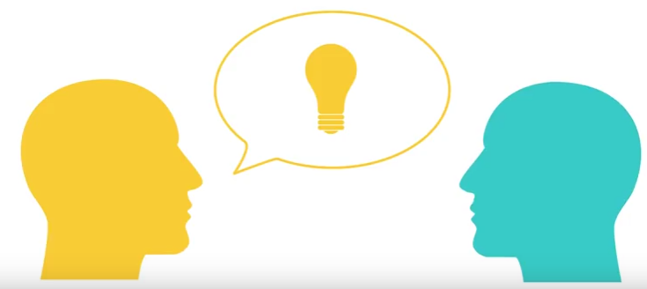

Slide 31
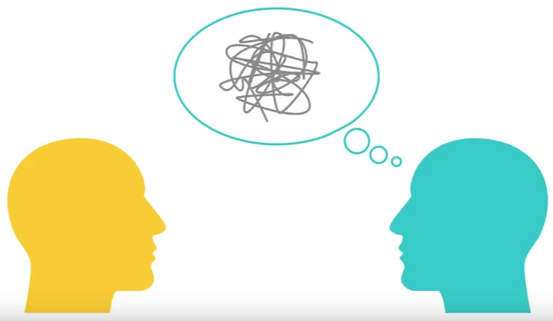

Slide 32
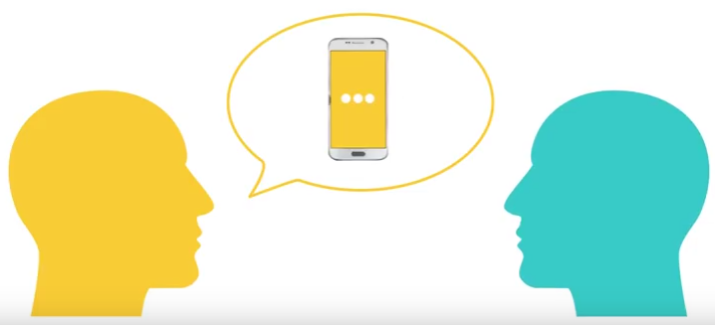

Slide 33
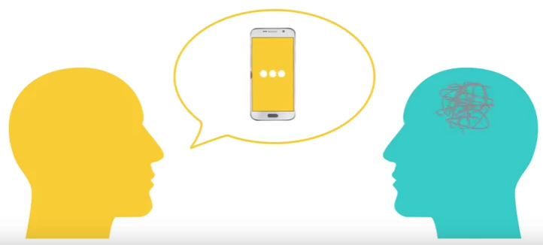


Slide 34
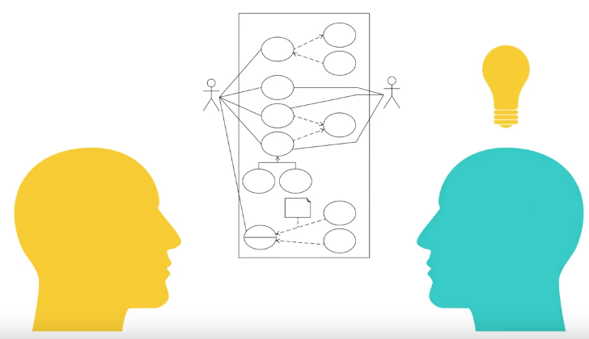

Slide 35
Use Cases
A set of scenarios related by a common actor and a goal
A description of sequences of actions performed by a given system to produce a result for an actor
Use cases specify the expected behaviour [what], and not the exact method of making it happen [how]
Use Cases should have the following three things:
Title
What is the goal ?
Actor
Who desires it ?
Scenario
How it is accomplished ?

Slide 36
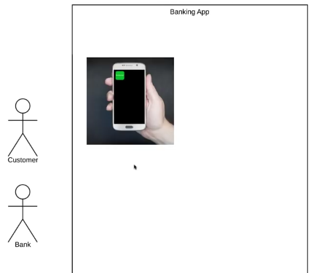




Slide 37
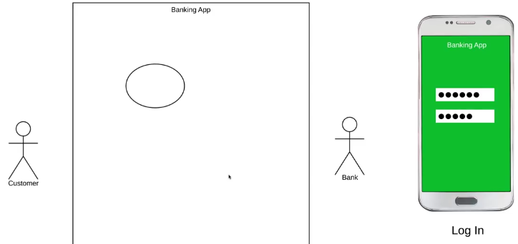
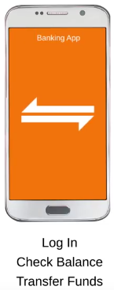
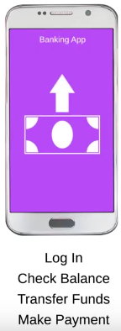
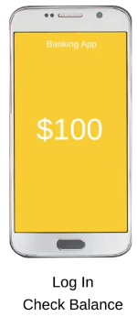

Slide 38
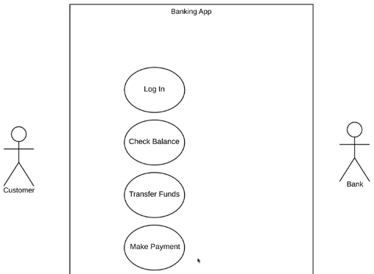
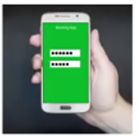

Slide 39
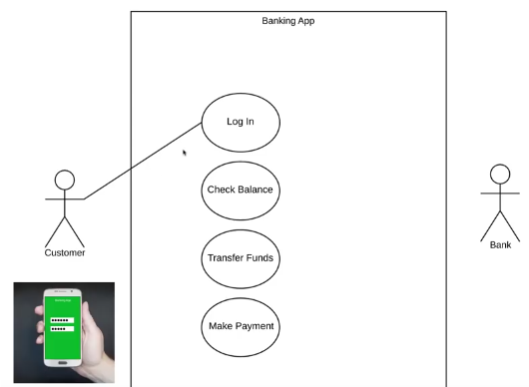



Slide 40
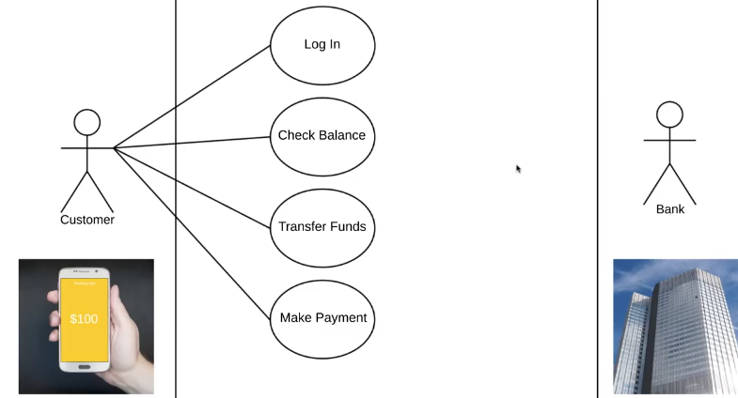

Slide 41
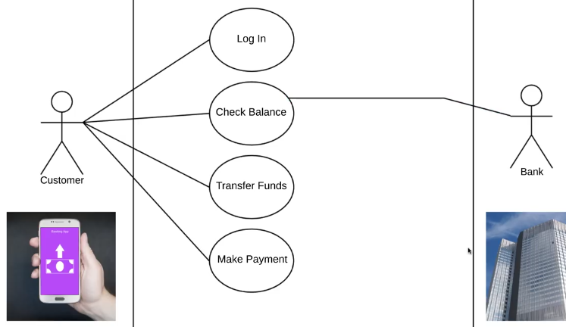


Slide 42
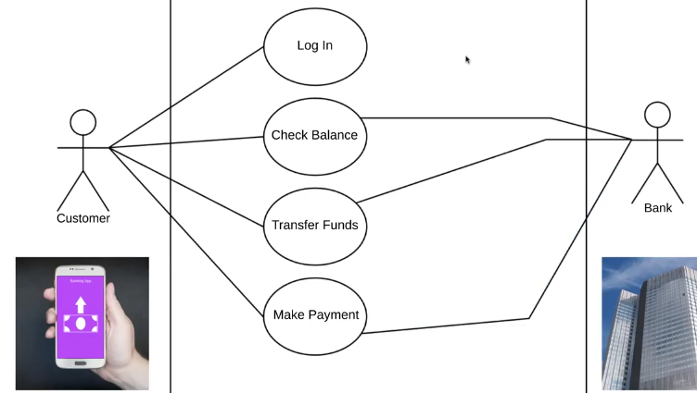

Slide 43
Use Cases : Title
Short Phrase, active verb
Register new member
Transfer funds
Purchase items
Collect late payments

Slide 44
Use Cases : Actor
Represent roles that humans, hardware devices, or external systems play while interacting with a given system
User
Customer
Member
Administrator
ATM Machine

Slide 45
Use Cases: Scenario as paragraph
Title: Purchase Items
Actor: Customer
Scenario: Customer reviews items in shopping cart. Customer provides payment and shipping information. System validates payment information and responds with confirmation of order and provides order number that Customer can use to check on order status. System will send Customer a confirmation of order details and tracking number in an email.

Slide 46
Use Cases: Scenario as Steps
Title: Purchase Items
Actor: Customer
Scenario:
Customer chooses to enter the checkout process.
Customer is shown a conformation page for their order, allowing them to change quantities, remove items, or cancel.
Customer enters his/her shipping address.
System validates the customer address.
Customer selects a payment method.
System validates the payment details
System create an order number that can be used for tracking
System displays a confirmation screen to the customer
Email is sent to the customer with order details.

Slide 47
Use Cases: Scenario Additional Details
Title: Purchase Items
Actor: Customer
Scenario:
Scope:
Level:
Extensions: Describe steps for out-of-stock situations
Extensions: Describe steps for order never finalized
Preconditions: Customer has added at least 1 item to the shopping cart
Postconditions:
Stakeholders:

Slide 48
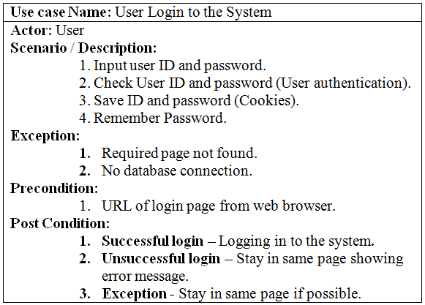
Example of Use Cases

Slide 49
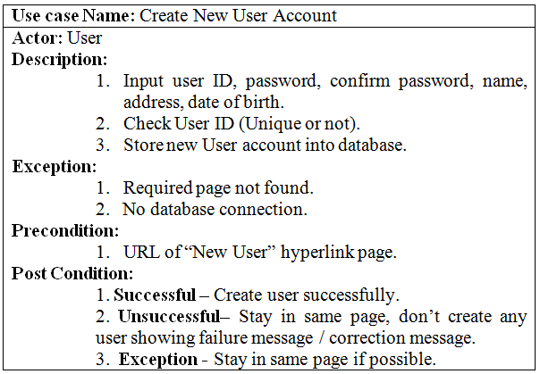
Example of Use Cases

Slide 50
Use Case Diagram
Use Case diagram shows a set of use cases and actors and their relationships.
A use case diagram at its simplest is a representation of a user's interaction with the system and depicting the specifications of a use case.
These diagrams are important in organizing and modeling the behaviors of a system.

Slide 51
Use Case Diagram
Use Case Diagrams have only 4 major elements:
The actors that the system you are describing interacts with,
the system boundary itself, Identify an implicit separation between actors (external to the system) and use cases (internal to the system)
the use cases, or services, that the system knows how to perform, and
the lines that represent relationships between these elements.

Slide 52
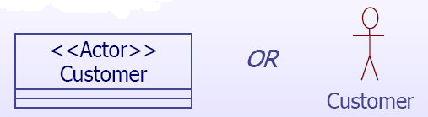

Use Case Diagram
Actor is represented by a labeled stick figure, or a class rectangle.
Use cases are represented by a labeled ellipse.

Slide 53
Use Case Diagram
A typical UML Use Case Diagram will be composed of many diagrams and sub-diagrams, and should contain use case ovals, one for each top-level service that the system provides to its actors. Any kind of internal behavior that the system may have that is only used by other parts of the system should not appear in the system boundary.
The system boundary only appears on the top-level diagram.

Slide 54
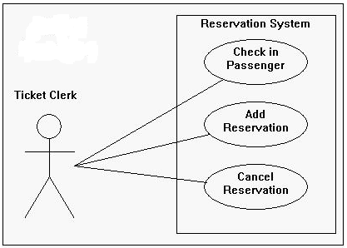
Use Case Diagram
System Boundary
System Name

Slide 55
Use Case Relationships
Include
Extend
Generalizations

Slide 56
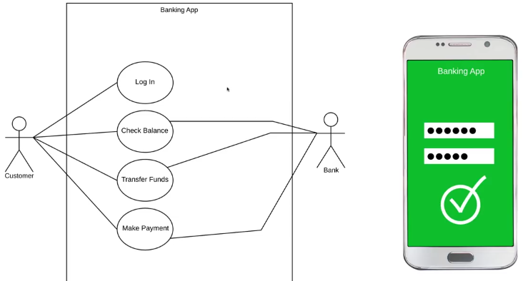



Slide 57
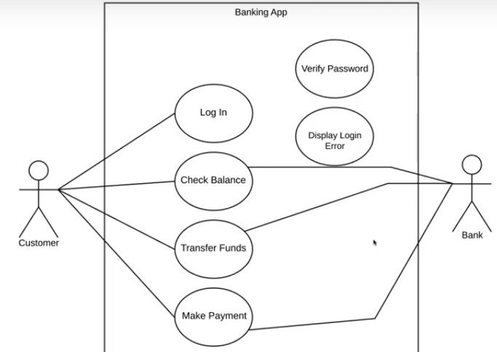
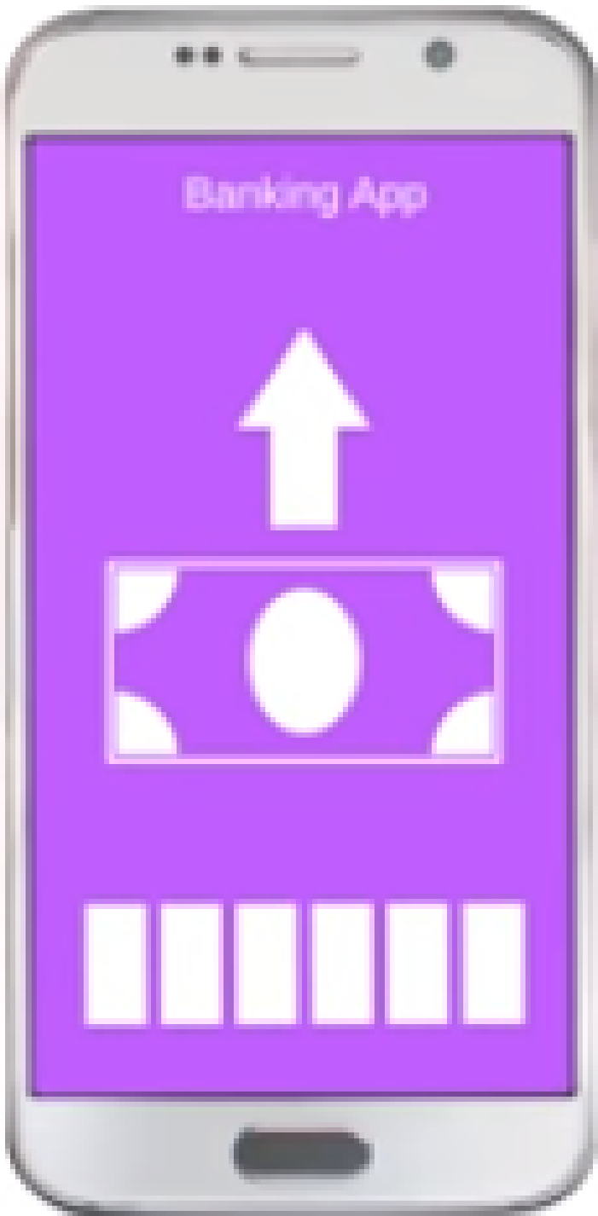

Slide 58
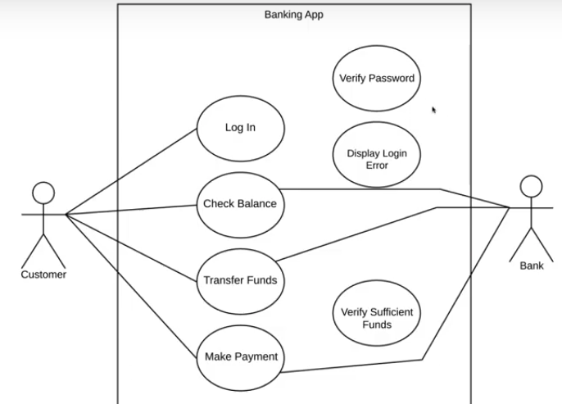

Slide 59
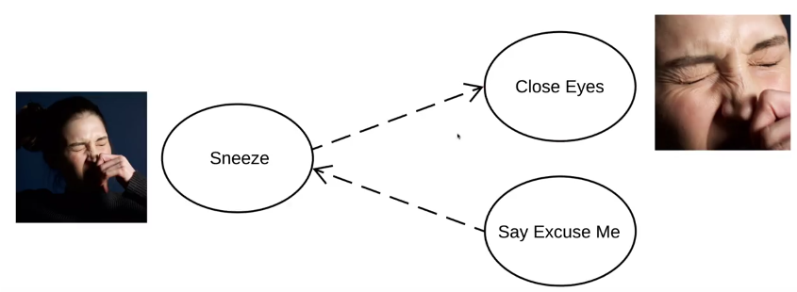

Slide 60
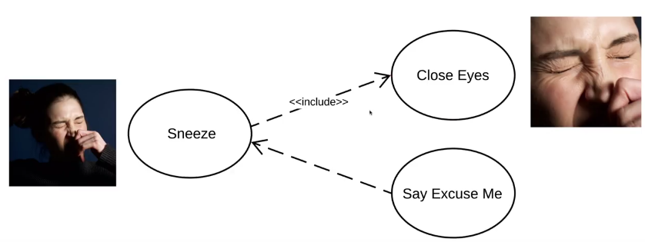



Slide 61
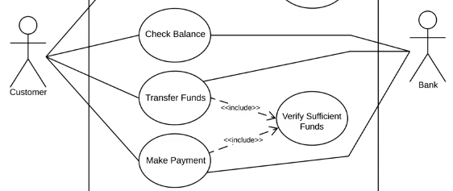

Slide 62
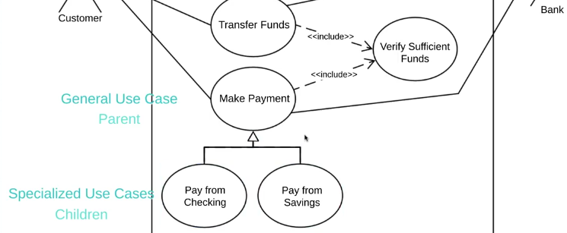

Slide 63
Use Case Relationships (Include)
Include relationship
The include relation is drawn from a use case X to another use case Y to indicate that the process of doing X always involves doing Y at least once.
If a certain use case includes several others, that means that all of the component use cases must be completed in the process of completing the aggregate use case (although there is no specification in UCDs of the order in which these are completed).
In brief, it can be read X uses Y means that "X has a Y" as part of it's behavior.

Slide 64
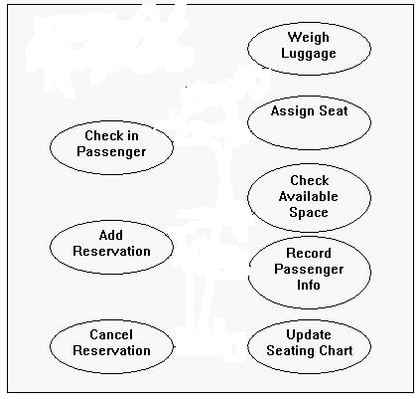
Use Case Relationships (Include)
<<include>>
<<include>>
<<include>>
<<include>>
<<include>>

Slide 65

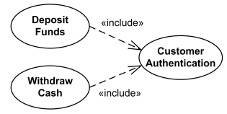
Use Case Relationships (Include)

Slide 66
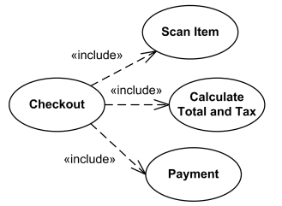
Use Case Relationships (Include)

Slide 67
Use Case Relationships (Extend)
Extend relationship
used for extracting alternative courses from a base use case into a new use case and attaching it to the base use case.
connects an extension use case to a base use case.
extending use case continues the behavior of a base use case. The extending use case accomplishes this by conceptually inserting additional action sequences into the base use-case sequence.
Extending use case typically defines optional behavior.

Slide 68
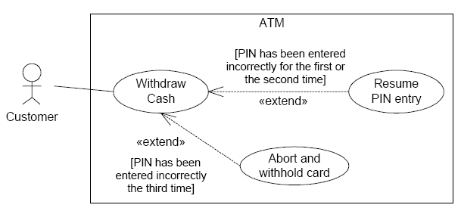
Use Case Relationships (Extend)
Condition
Condition

Slide 69

Use Case Relationships (Extend)
Registration use case is complete and meaningful on its own. It could be extended with optional Get Help On Registration use case.

Slide 70
Use Case Relationships (Generalizations)
Generalizations relationship
The generalizations relationship is drawn from a use case X to a use case Y to indicate that the process X is a special case behavior of the same type as the more general process Y.
A generalization relationship is a parent-child relationship between use cases in which the child use case is an enhancement of the parent use case.
Child use case is effectively, an alternate course of the base use case.
Base use case could be abstract use case

Slide 71
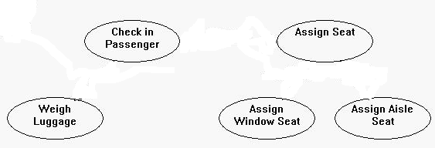
Use Case Relationships (Generalizations)
<<include>>
<<include>>

Slide 72
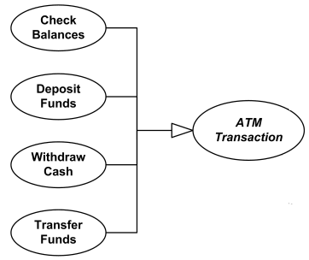
Use Case Relationships (Generalizations)

Slide 73
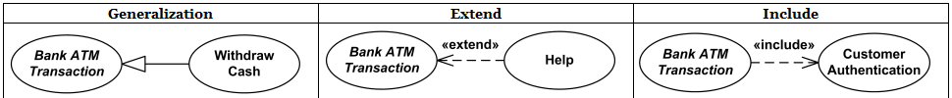
Difference between use case relationships
Base use case could be abstract use case (incomplete) or concrete (complete). | Base use case is complete (concrete) by itself, defined independently. | Base use case is incomplete.
Specialized use case is required, not optional, if base use case is abstract. | Extending use case is optional, supplementary. | Included use case required, not optional.
No explicit condition to use specialization. | Could have optional extension condition. | No explicit inclusion condition.

Slide 74
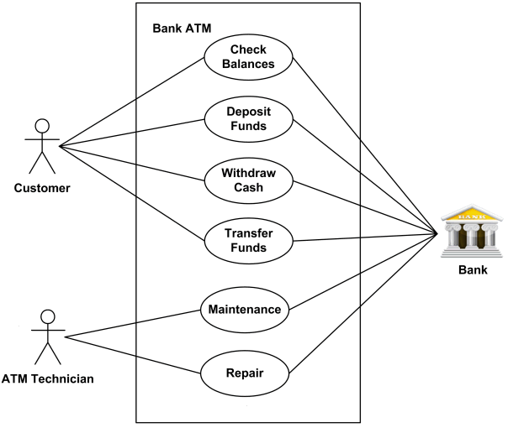
Bank ATM

Slide 75
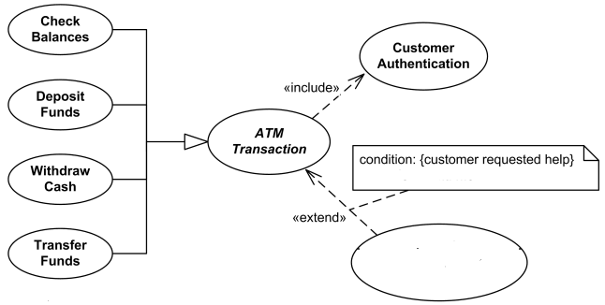
Bank ATM
ATM Help

Slide 76
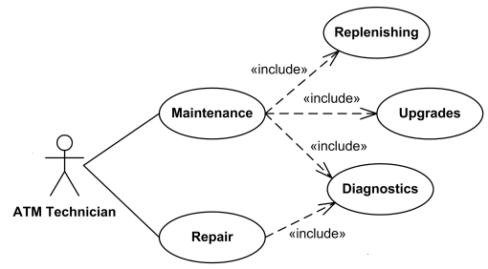
Bank ATM

Slide 77
