Slide 1
OOAD (CSE 314)
Lecture 8
(Class Diagram)

Slide 2
Class Diagram
A diagram that shows the building blocks of a system
Can be at different perspectives
Already encountered the Domain model made up of conceptual classes (with attributes but no responsibilities)
It shows the “classes” that make up the system
Can be seen as Entities or Things in the system
A class diagram captures the classes that make up the system along with potential collaboration among these classes

Slide 3
Class Diagram
A class diagram captures,
Types of objects in the system 🡨 “Class”
Attributes and behaviours of classes
Relationships between Classes
Generalisation (Subtypes)
E.g. A programmer is a kind of human
Associations
E.g. A customer may rent a number of videos
Other
E.g. dependency

Slide 4
What is a Class Diagram?
A class diagram depicts classes and their interrelationships
Used for describing structure and behavior in the use cases
Provide a conceptual model of the system in terms of entities and their relationships
Used for requirement capture, end-user interaction
Detailed class diagrams are used for developers
Notes:
4

Slide 5
Why do we need class diagrams?
Planning and modeling ahead of time make programming much easier.
Besides that, making changes to class diagrams is easy, whereas coding different functionality after the fact is kind of annoying.
When someone wants to build a house, they don’t just grab a hammer and get to work. They need to have a blueprint — a design plan — so they can ANALYZE & modify their system.
You don’t need much technical/language-specific knowledge to understand it.

Slide 6
Essential Elements of a UML Class Diagram
Class
Attributes
Operations
Relationships
Associations
Generalization
Realization
Dependency
Constraint Rules and Notes

Slide 7
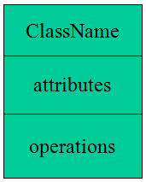
Class
Describes a set of objects having similar:
Attributes (status)
Operations (behavior)
Relationships with other classes
Graphically, a class is rendered as a rectangle, usually including its name, attributes, and operations in separate, designated compartments.

Slide 8
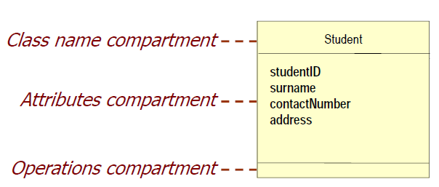
Class diagram : Class Symbol

Slide 9
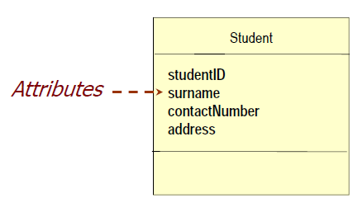
Class: Attributes and State
Attributes are:
Essential to the business description of a class
Each object has its own value for each attribute in its class
The attribute values determine the state of the object

Slide 10
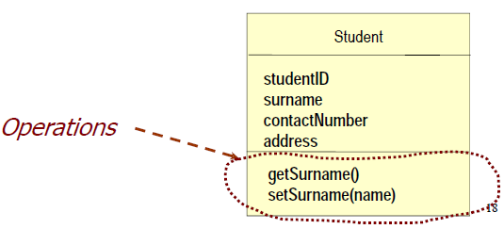
Class: Operations
Operations are
Essential to the design description of a class
The common behaviour shared by all objects of the class
Services that objects of a class can provide to other objects
Invoked by messages
Two types
Command
Query

Slide 11
Class Attributes and Operations
An attribute is a named property of a class that describes the object being modeled.
In the class diagram, attributes appear in the second compartment just below the name-compartment.
Attributes can be:
+ public
# protected
- private
Attributes are usually listed in the form:
attributeName : Type
Operations describe the class behavior and appear in the third compartment.
- number : int

Slide 12
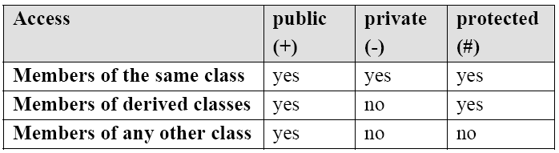
Visibility and Access for attributes and operations of a class

Slide 13
Class
Name
Account_Name
- Customer_Name
- Balance
Attributes
+addFunds( )
+withDraw( )
+transfer( )
Operations
Notes:
13

Slide 14
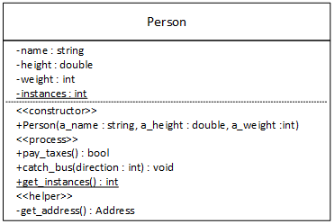
Class Attributes and Operations
public void catch_bus(int direction)
{
}
+ sum(num1 : int, num2: int) :int

Slide 15
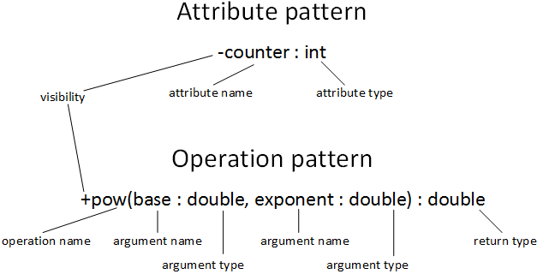
Class Attributes and Operations

Slide 16
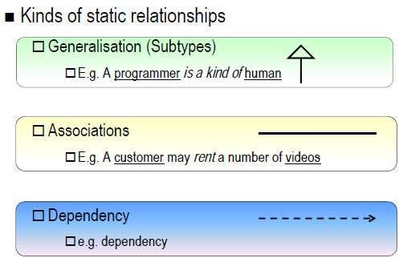
Relationships between classes

Slide 17
Association
A relationship between two separate classes. It joins two entirely separate entities.
In UML, object interconnections (logical or physical), are modeled as relationships.
An association between two classes indicates that objects at one end of an association “recognize” objects at the other end and may send messages to them.
Example: “An Employee works for a Company”
Employee
Company

Slide 18
Association Relationships
If two classes in a model need to communicate with each other, there must be link between them.
An association denotes that link.
Student
Instructor

Slide 19
Association Relationships
We can indicate the multiplicity of an association by adding multiplicity adornments to the line denoting the association.
The example indicates that a Student has one or more Instructors:
Student
Instructor
1..*

Slide 20
Association Relationships
The example indicates that every Instructor has one or more Students:
Student
Instructor
1..*

Slide 21
Association Relationships
We can also indicate the behavior of an object in an association (i.e., the role of an object) using rolenames.
teaches
learns from
Student
Instructor
1..*
1..*

Slide 22
Association Relationships
We can also name the association.
membership
Student
Team
1..*
1..*

Slide 23
Association Relationships
We can specify dual associations.
member of
Student
Team
1..*
1..*
1
president of
1..*

Slide 24
Associations
Multiplicity
the number of objects that participate in the association.
Indicates whether or not an association is mandatory.
Multiplicity Indicators
Exactly one | 1
Zero or more (unlimited) | * (0..*)
One or more | 1..*
Zero or one (optional association) | 0..1
Specified range | 2..4
Multiple, disjoint ranges | 2, 4..6, 8

Slide 25
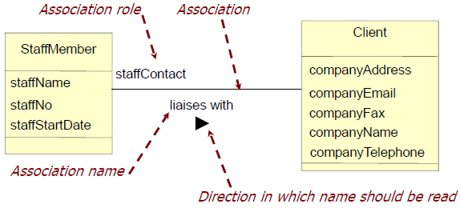
Class diagram: Associations
Associations represent:
The possibility of a logical relationship or connection between objects of one class and objects of another.
Information stored about the associated objects.

Slide 26
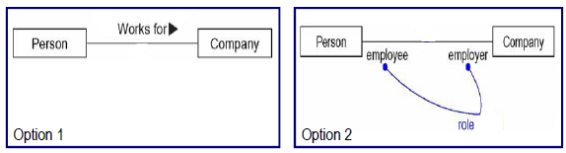
Class relationship: Associations (cont.)
An association can have a label, which is used to describe the nature of the relationship
You can exclude the association label, if you explicitly provide roles of classes for the association

Slide 27
Class Diagram: Cardinality
Associations have Cardinality
Cardinality is the range of permitted objects linked in an association to a given object.
Represent business rules.
For example:
A staff member may liaise with one or more clients.
Each client must liaise with just one, and only one, staff member.

Slide 28
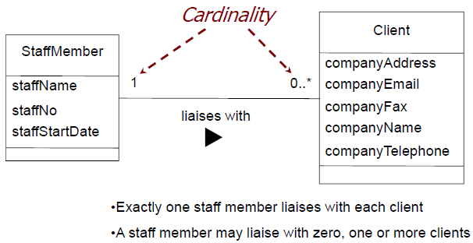
Class Diagram: Association cardinality

Slide 29
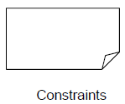
Class Diagrams: Constraints
Not all domain properties can be shown graphically:
e.g., it should be impossible to double-book a table.
Constraints add information to models:
written in a note connected to the model element being constrained.

Slide 30
Generalization Relationship
A generalization connects a subclass to its superclass. It denotes an inheritance of attributes and behavior from the superclass to the subclass and indicates a specialization in the subclass of the more general superclass.
“is kind of” relationship.
Supertype
Subtype1
Subtype2

Slide 31
Generalization
A sub-class inherits from its super-class
Attributes
Operations
Relationships
A sub-class may
Add attributes and operations
Add relationships
Refine (override) inherited operations
A generalization relationship may not be used to model interface implementation.

Slide 32
Generalization Relationships
UML permits a class to inherit from multiple super classes, although some programming languages (e.g., Java) do not permit multiple inheritance.
Student
Employee
TeachingAssistant

Slide 33
Class relationships: Generalization
Consider the following example:
A company has personal customers and corporate customers
There are differences between these two types of customers
There are also many similarities between these customers
UML recommends the use of "generalization" to model situations like in the example above

Slide 34
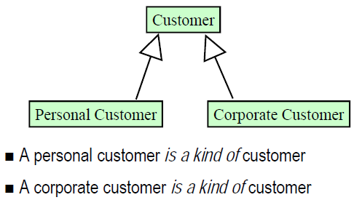
Class diagram: Generalization

Slide 35
Aggregation
A special form of association that models a whole-part relationship between an aggregate (the whole) and its parts.
A directional association between objects.
When an object ‘has-a’ another object, then we have got an aggregation between them.
Direction between them specified which object contains the other object.
It is also called ‘Has-a’ relationship.

Slide 36

Class diagram : Aggregation
When modelling we often find the need to capture "whole-part" relationships
An office room has furniture
A type of association called aggregation can be used to capture whole-part relationships
Aggregation is modelled as a hollow diamond in UML

Slide 37
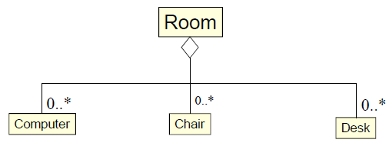
Aggregation example
An office room has furniture

Slide 38
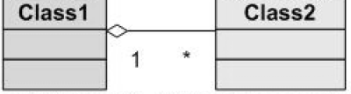
Aggregation
Class2 is part of Class1.
Many instances (denoted by the *) of Class2 can be associated with Class1.
Objects of Class1 and Class2 have separate lifetimes.

Slide 39
Aggregation
Note:
If we delete the parent object, even then the child object may exist.
One object can contain the other, but there is no restriction that the composed object has to exist in order to have existence of child object.

Slide 40
Composition
A variation on the simple aggregation – that adds some extra semantics (meaning/rules)
Strong ownership
Coincident lifetime as part of the whole
Parts may be created after the composite itself
But once born, they live & die with the whole
These parts may be removed before the death of the whole
An object may be a part of only one composite at a time

Slide 41
Composition
A strong form of aggregation
In a more specific manner, a restricted aggregation is called composition.
The whole is the sole owner of its part.
The part object may belong to only one whole
The life time of the part is dependent upon the whole.
The composite must manage the creation and destruction of its parts.

Slide 42
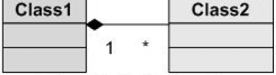
Composition
Objects of Class2 live and die with Class1.
Class2 cannot stand by itself.

Slide 43
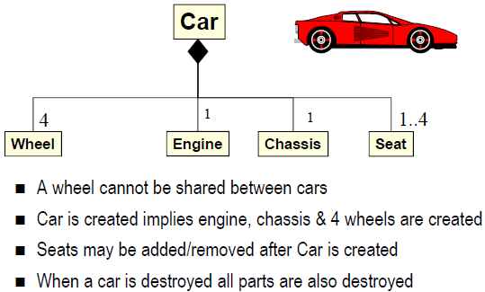
Composition Example

Slide 44
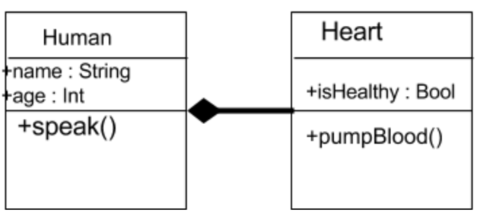
Composition Example
Notes:
A human needs a heart to live and a heart needs a human body to function on. In other words when the classes (entities) are dependent on each other and their life span are same (if one dies then another one too) then its a composition.
44

Slide 45


Composition
A class contains students. A student cannot exist without a class. There exists composition between class and students.

Slide 46
Difference between aggregation and composition
Composition is more restrictive. When there is a composition between two objects, the composed object cannot exist without the other object.
This restriction is not there in aggregation. Though one object can contain the other object, there is no condition that the composed object must exist. The existence of the composed object is entirely optional.

Slide 47
Building a class diagram
The Noun/Verb approach is the most widely used technique to help identify candidate classes and potential operations -- Textual analysis
The idea is to look for nouns and noun phrases in the narrative or use cases

Slide 48
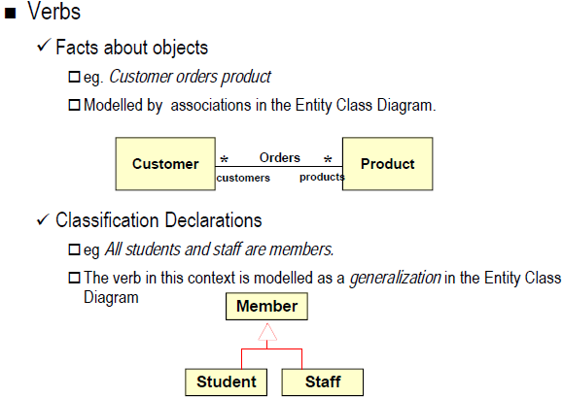
Noun / Verb approach

Slide 49

Noun / Verb approach
Verbs
Actions involving objects may become operations on objects.
These are best modelled during design.
e.g. Customer cancels product

Slide 50
Example of Relations
A manager is a type of employee.
Manager uses a swipe card to enter company premises.
He has many workers under him.
Manager uses a car which contains an engine and four wheels.

Slide 51
Example of Relations
A manager is a type of employee.
Manager uses a swipe card to enter company premises.
He has many workers under him.
Manager uses a car which contains an engine and four wheels.
Inheritance
Employee
Manager
Notes:
1. Employee is a parent class of manager
51

Slide 52
Example of Relations
A manager is a type of employee.
Manager uses a swipe card to enter company premises.
He has many workers under him.
Manager uses a car which contains an engine and four wheels.
Association
Employee
1 1
Manager
Swipe_Card
Notes:
1. Employee is a parent class of manager
52

Slide 53
Example of Relations
A manager is a type of employee.
Manager uses a swipe card to enter company premises.
He has many workers under him.
Manager uses a car which contains an engine and four wheels.
Aggregation
Employee
1…* 1
1 1
Worker
Manager
Swipe_Card
Notes:
3. Manager is like owner of the employees. Employees will report to manager.
53

Slide 54
Example of Relations
A manager is a type of employee.
Manager uses a swipe card to enter company premises.
He has many workers under him.
Manager uses a car which contains an engine and four wheels.
Association
Composition
Employee
1…* 1
1 1
Worker
Manager
Swipe_Card
1
1 1
1
1 4
Engine
Car
Wheel
Notes:
3. Manager is like owner of the employees. Employees will report to manager.
54

Slide 55
Example of Relations
A manager is a type of employee.
Manager uses a swipe card to enter company premises.
He has many workers under him.
Manager uses a car which contains an engine and four wheels.

