Slide 1
CSE-304
Computer Graphics Lab
Lab: OpenGL Installation
Md. Rafsan Jani
Assistant Professor
Department of Computer Science and Engineering
Jahangirnagar University

Slide 2
OpenGL Installation
MinGW: For MinGW, we need to install GLUT separately.
Download and Unzipn freeglut from the following link
https://www.transmissionzero.co.uk/files/software/development/GLUT/freeglut-MinGW.zip
Copy header files from "include\GL" to "<MINGW_HOME>\include\GL";
Copy the libraries from "lib" to "<MINGW_HOME>\lib", and
Copy the dll files from "bin" to "<MINGW_HOME>\bin" (which should be included in the PATH environment variable).
Notes of the headers and libraries:
Headers: the OpenGL header "gl.h", GLU header "glu.h" and GLUT header "glut.h" (or "freeglut.h") are kept in "<MINGW_HOME>\include\GL" directory. Since "<MINGW_HOME>\include" is in the implicit include-path. We can include the headers as <GL/glut.h>, <GL/glt.h>, and <GL/gl.h>.
Libraries: the OpenGL library "libopengl32.a", GLU library "libglu32.a" and GLUT library "libfreeglut.a" are kept in "<MINGW_HOME>\lib" directory. This directory is in the implicit library-path.
Nonetheless, we need to include these libraries in linking. They shall be referred to as "opengl32", "glu32", "freeglut" without the prefix "lib" and suffix ".a".

Slide 3
OpenGL in CodeBlocks
Create a new project:
File ⇒ New ⇒ Project... ⇒ Console Application ⇒ GO ⇒ C++ ⇒ In "Project title", enter “First_Project" ⇒ Next ⇒ Finish.
Configure the libraries:
Right-click on the project ⇒ Build Option...
⇒ Linker Settings ⇒ In "Link Libraries" ⇒ Add ⇒ enter "freeglut" ⇒ Add ⇒ enter "glu32" ⇒ Add ⇒ enter "opengl32".
Search Directories ⇒Compiler ⇒ Add ⇒ C:\Program Files\CodeBlocks\MinGW\include
Build (right-click on the project ⇒ Build) and Run (Select "Build" menu ⇒ Run).

Slide 4
OpenGL in CodeBlocks
Open main.cpp and update using the following code snippets.
Build (right-click on the project ⇒ Build) and Run (Select "Build" menu ⇒ Run).
/* * GL01Hello.cpp: Test OpenGL C/C++ Setup */
#include <windows.h> // For MS Windows
#include <GL/glut.h> // GLUT, includes glu.h and gl.h
/* Handler for window-repaint event. Call back when the window first appears and whenever the
window needs to be re-painted. */
void display() {
glClearColor(0.0f, 0.0f, 0.0f, 1.0f); // Set background color to black and opaque glClear(GL_COLOR_BUFFER_BIT); // Clear the color buffer
// Draw a Red 1x1 Square centered at origin
glBegin(GL_QUADS); // Each set of 4 vertices form a quad
glColor3f(1.0f, 0.0f, 0.0f); // Red
glVertex2f(-0.5f, -0.5f); // x, y
glVertex2f( 0.5f, -0.5f);
glVertex2f( 0.5f, 0.5f);
glVertex2f(-0.5f, 0.5f);
glEnd();
glFlush(); // Render now
}
/* Main function: GLUT runs as a console application starting at main() */
int main(int argc, char** argv) {
glutInit(&argc, argv); // Initialize GLUT
glutCreateWindow("OpenGL Setup Test"); // Create a window with the given title
glutInitWindowSize(320, 320); // Set the window's initial width & height
glutInitWindowPosition(50, 50); // Position the window's initial top-left corner
glutDisplayFunc(display); // Register display callback handler for window re-paint
glutMainLoop(); // Enter the infinitely event-processing loop
return 0;
}

Slide 5
OpenGL Basics
We need the following sets of libraries in programming OpenGL:
Core OpenGL (GL): consists of hundreds of functions, which begin with a prefix "gl" (e.g., glColor, glVertex, glTranslate, glRotate). The Core OpenGL models an object via a set of geometric primitives, such as point, line, and polygon.
OpenGL Utility Library (GLU): built on-top of the core OpenGL to provide important utilities and more building models (such as qradric surfaces). GLU functions start with a prefix "glu" (e.g., gluLookAt, gluPerspective)
OpenGL Utilities Toolkit (GLUT): provides support to interact with the Operating System (such as creating a window, handling key and mouse inputs); and more building models (such as sphere and torus). GLUT functions start with a prefix of "glut" (e.g., glutCreatewindow, glutMouseFunc).
OpenGL Extension Wrangler Library (GLEW): "GLEW is a cross-platform open-source C/C++ extension loading library. GLEW provides efficient run-time mechanisms for determining which OpenGL extensions are supported on the target platform." Source and pre-build binary available at http://glew.sourceforge.net/.
Notes:
Quoting from the opengl.org: "GLUT is designed for constructing small to medium sized OpenGL programs. While GLUT is well-suited to learning OpenGL and developing simple OpenGL applications, GLUT is not a full-featured toolkit so large applications requiring sophisticated user interfaces are better off using native window system toolkits. GLUT is simple, easy, and small.“ Alternative of GLUT includes SDL, ....

Slide 6
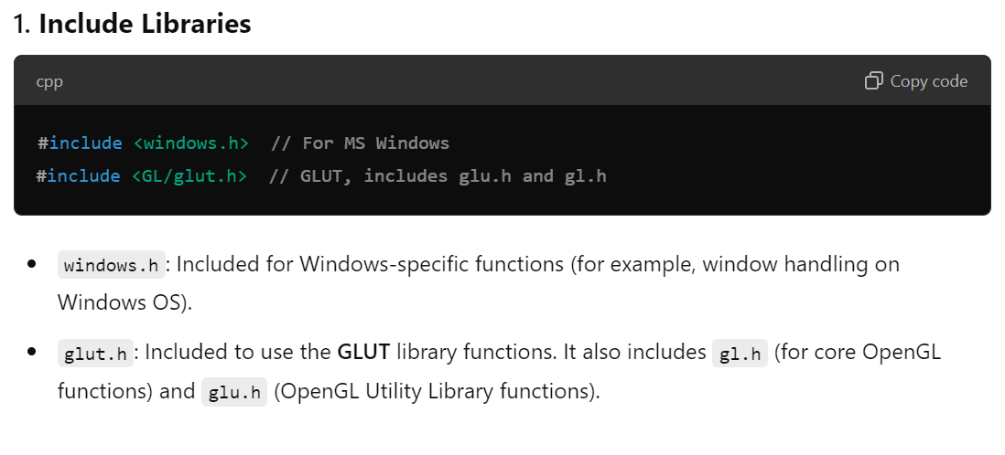
OpenGL Structure
Notes:
Quoting from the opengl.org: "GLUT is designed for constructing small to medium sized OpenGL programs. While GLUT is well-suited to learning OpenGL and developing simple OpenGL applications, GLUT is not a full-featured toolkit so large applications requiring sophisticated user interfaces are better off using native window system toolkits. GLUT is simple, easy, and small.“ Alternative of GLUT includes SDL, ....

Slide 7
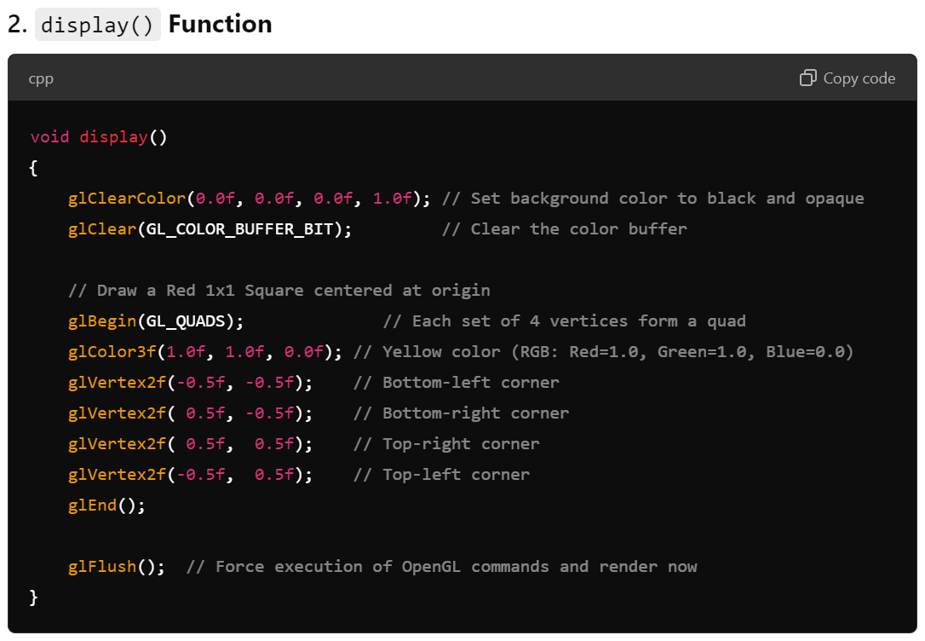
OpenGL Structure
Notes:
Quoting from the opengl.org: "GLUT is designed for constructing small to medium sized OpenGL programs. While GLUT is well-suited to learning OpenGL and developing simple OpenGL applications, GLUT is not a full-featured toolkit so large applications requiring sophisticated user interfaces are better off using native window system toolkits. GLUT is simple, easy, and small.“ Alternative of GLUT includes SDL, ....

Slide 8
OpenGL Structure
glClearColor(0.0f, 0.0f, 0.0f, 1.0f): Sets the background color to black with an opacity of 1.0 (fully opaque). The parameters are (red, green, blue, alpha).
glClear(GL_COLOR_BUFFER_BIT): Clears the color buffer, filling it with the color specified by glClearColor(). This essentially clears the screen to the background color.
glBegin(GL_QUADS): Starts drawing a quadrilateral (quad) shape. The four subsequent vertices defined by glVertex2f() form a rectangle.
glColor3f(1.0f, 1.0f, 0.0f): Sets the current drawing color to yellow. The parameters represent (red, green, blue), and the color (1.0, 1.0, 0.0) is a bright yellow.
glVertex2f(x, y): Specifies the 2D coordinates for each corner of the square. The values define a square centered at the origin, extending from (-0.5, -0.5) to (0.5, 0.5).
glEnd(): Marks the end of the drawing. All the vertices specified after glBegin() are used to form the shape (quad).
glFlush(): Ensures that all OpenGL commands are executed immediately. It forces the drawn content to appear on the screen.
Notes:
Quoting from the opengl.org: "GLUT is designed for constructing small to medium sized OpenGL programs. While GLUT is well-suited to learning OpenGL and developing simple OpenGL applications, GLUT is not a full-featured toolkit so large applications requiring sophisticated user interfaces are better off using native window system toolkits. GLUT is simple, easy, and small.“ Alternative of GLUT includes SDL, ....

Slide 9
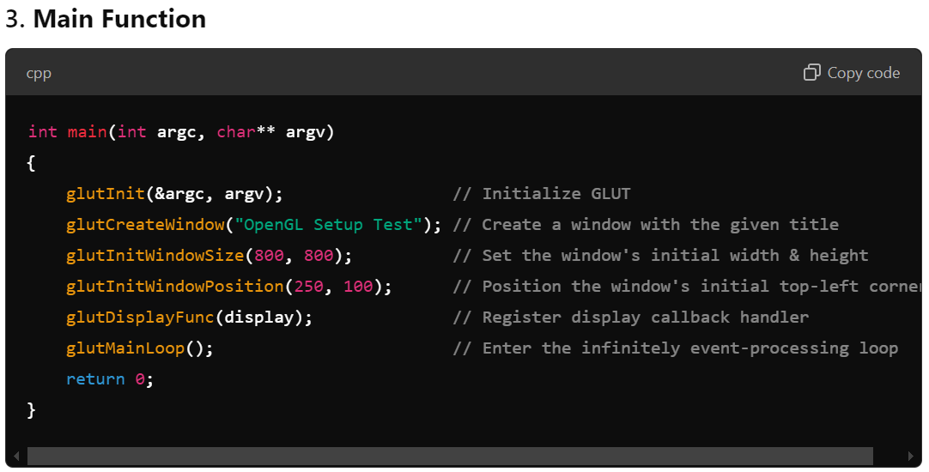
OpenGL Structure
Notes:
Quoting from the opengl.org: "GLUT is designed for constructing small to medium sized OpenGL programs. While GLUT is well-suited to learning OpenGL and developing simple OpenGL applications, GLUT is not a full-featured toolkit so large applications requiring sophisticated user interfaces are better off using native window system toolkits. GLUT is simple, easy, and small.“ Alternative of GLUT includes SDL, ....

Slide 10
OpenGL Structure
glutInit(&argc, argv): Initializes GLUT. It must be called before any other GLUT functions. It processes any command-line arguments passed to the program (though none are used here).
glutCreateWindow("OpenGL Setup Test"): Creates a window with the title "OpenGL Setup Test". This opens a window where all the OpenGL rendering will occur.
glutInitWindowSize(800, 800): Sets the initial size of the window to 800 x 800 pixels.
glutInitWindowPosition(250, 100): Positions the window's top-left corner at (250, 100) on the screen.
glutDisplayFunc(display): Registers the display() function as the callback function for the window-paint event. This means that whenever the window needs to be redrawn (e.g., when it first appears or is resized), the display() function will be called to draw the contents.
glutMainLoop(): Enters the event-processing loop. This function keeps the program running and continuously listens for events (like window resizing, refreshing, etc.). It ensures that the display() function is called whenever necessary.
Notes:
Quoting from the opengl.org: "GLUT is designed for constructing small to medium sized OpenGL programs. While GLUT is well-suited to learning OpenGL and developing simple OpenGL applications, GLUT is not a full-featured toolkit so large applications requiring sophisticated user interfaces are better off using native window system toolkits. GLUT is simple, easy, and small.“ Alternative of GLUT includes SDL, ....

Slide 11
Resources
https://www3.ntu.edu.sg/home/ehchua/programming/opengl/CG_Introduction.html
https://www3.ntu.edu.sg/home/ehchua/programming/opengl/HowTo_OpenGL_C.html#mingw_glut
https://www.transmissionzero.co.uk/computing/using-glut-with-mingw/

