Slide 1
Model-View-Controller
Model – data model
View – presentation of the model
Controller – controls the flow / interactions of the view and model

Slide 2
Model-View-Controller
The model-view-controller (MVC) design pattern specifies that an application consist of a data model, presentation information, and control information.
The pattern requires that each of these be separated into different objects.

Slide 3
Model-View-Controller
The model (for example, the data information) contains only the pure application data; it contains no logic describing how to present the data to a user.
The view (for example, the presentation information) presents the model's data to the user. The view knows how to access the model's data, but it does not know what this data means or what the user can do to manipulate it.
Finally, the controller (for example, the control information) exists between the view and the model. It listens to events triggered by the view and executes the appropriate reaction to these events. In most cases, the reaction is to call a method on the model.

Slide 4
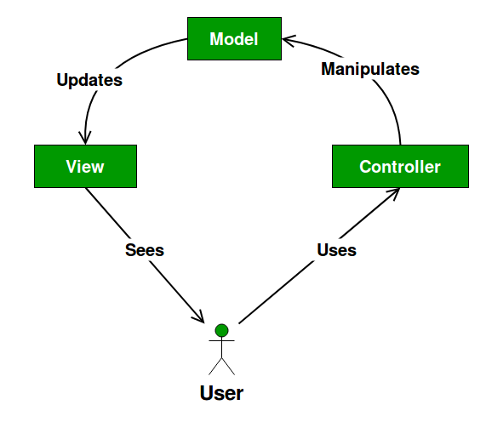
Model-View-Controller

Slide 5
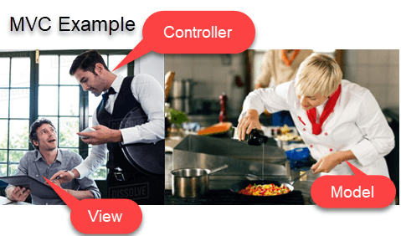

Model-View-Controller

Slide 6
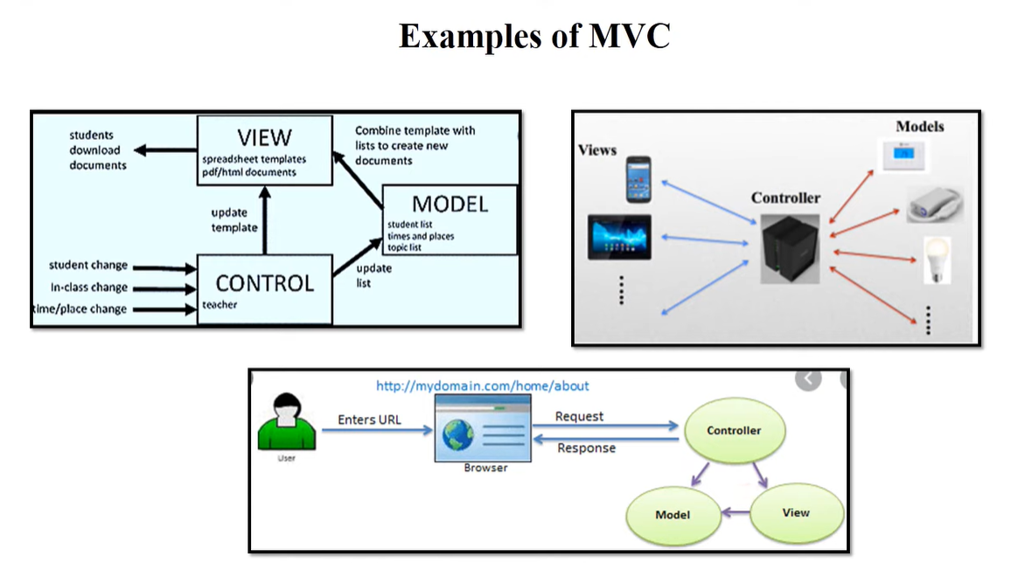
Model-View-Controller

Slide 7
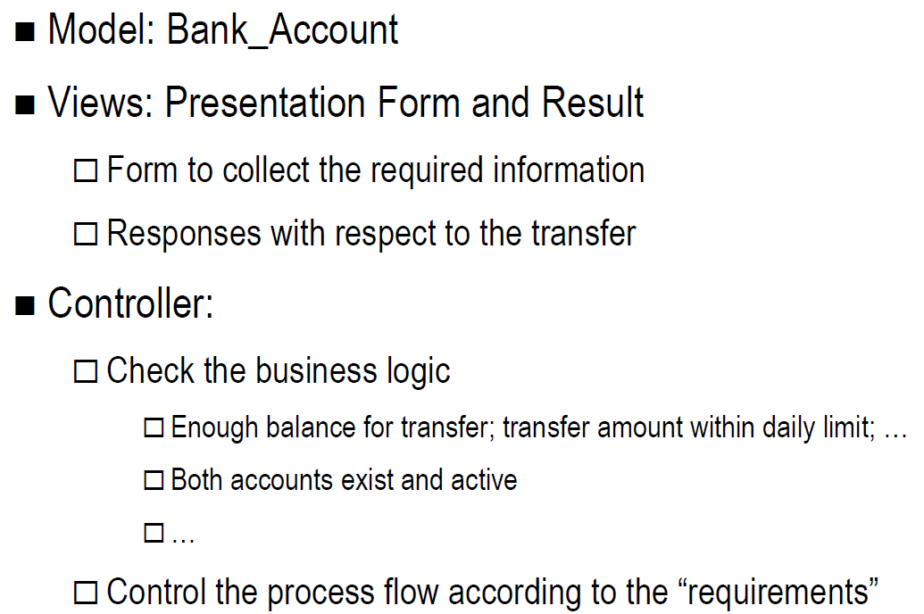
MVC – Example – Balance Transfer

Slide 8
Layered Architecture: Advantages
Layers aim to insulate a system from the effects of change.
For example, user interfaces often change:
  but the application layer does not use the presentation layer.
  so changes to system should be restricted to presentation layer classes.
Similarly, details of persistent data storage are separated from the application logic.

Slide 9
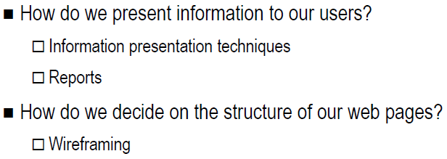
Interface design – Wireframing

Slide 10
Wireframing
Basic visual guide used in web design to suggest the structure of a website and relationships between its pages
A Wireframe is a illustration of the layout of fundamental elements in an interface.
Because of this, wireframes are often completed before any artwork is developed. When completed correctly they will provide a visual reference upon which to structure each page

Slide 11
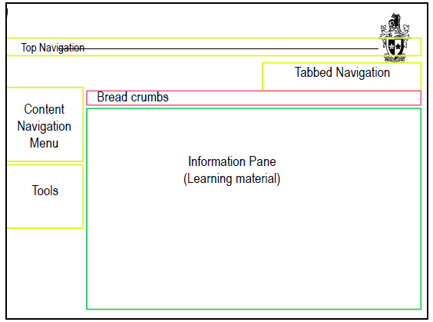
Wire framing - Bare bones

Slide 12
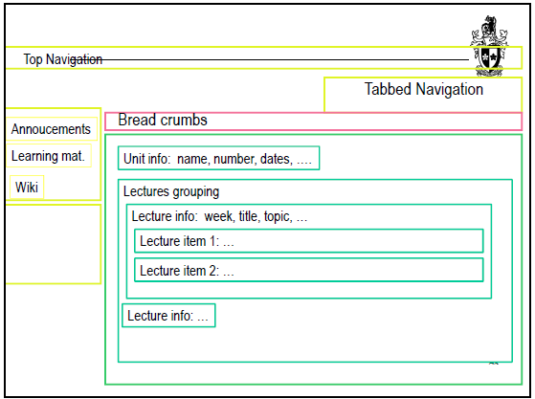
Wire framing – Fleshing out items

Slide 13
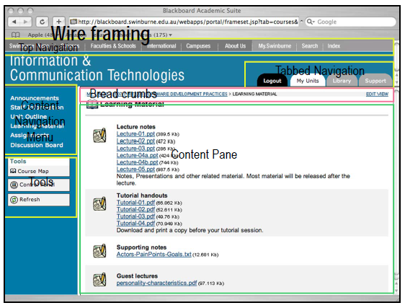


Slide 14
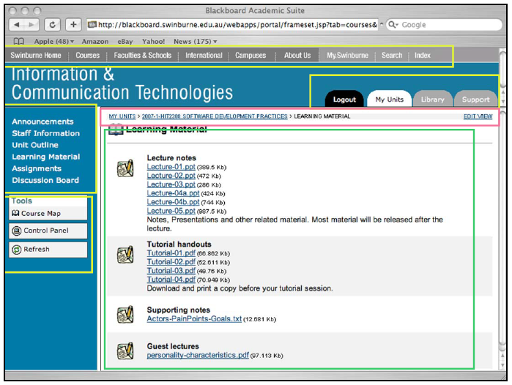

Slide 15
