Slide 1
Software Project Management
Recommended Books for the Slides:
Lan Sommerville. Software Engineering, 5th/6th/7th/8thedition
Roger S. Pressman. Software Engineering

Slide 2
Project Management
Projects need to be managed because professional software engineering is always subject to organizational budget and schedule constraints.
The project manager’s job is to ensure that the software project meets and overcomes these constraints as well as delivering high-quality software.
Bad management usually results in project failure: the software may be delivered late, cost more than originally estimated, or fail to meet the expectations of customers.
Management activities
Project planning
Project scheduling
Risk management

Slide 3
Software Project Management Activities
Proposal writing
Project planning and scheduling
Project cost
Project monitoring and reviews
Managing the people: Personnel selection and evaluation
Report writing and presentations

Slide 4
Risk Management
Risk management is one of the most important jobs for a project manager.
Risk management involves anticipating risks that might affect the project schedule or the quality of the software being developed, and then taking action to avoid these risks.
Risks may threaten the project, the software that is being developed, or the organization.
3 categories of risks:
Project risks: Risks that affect the project schedule or resources
Product risks: Risks that affect the quality or performance of the software being developed.
Business risks: Risks that affect the organization developing or procuring the software.

Slide 5
Project Planning
The project plan sets out the resources available to the project, the work breakdown and a schedule for carrying out the work Most plans include the following:
Introduction
Project organization
Risk analysis
Hardware and software resource requirements
Work breakdown
Project schedule
Monitoring and reporting mechanisms

Slide 6
Milestones and Delivarables
When planning a project, you need to establish a series of milestones
A milestone is a recognizable end-point of a software process activity. At each milestone, there should be a formal output, e.g., a report for management.
A deliverable is a project result that is delivered to the customer. It is delivered at the end of some major phase, e.g. specification or design.
Deliverables are usually milestones, but milestones need not be deliverables.

Slide 7
Project Scheduling
Project scheduling involves separating the total work involved in a project into separate activities and judging the time required to complete these activities. Some of the works may be done in parallel.
Bar charts and activity networks are used to illustrate the project schedule.
Bar charts show who is responsible for each activity and when the activity is scheduled to begin and end.
Activity networks show the dependencies between the different activities making up a project.

Slide 8
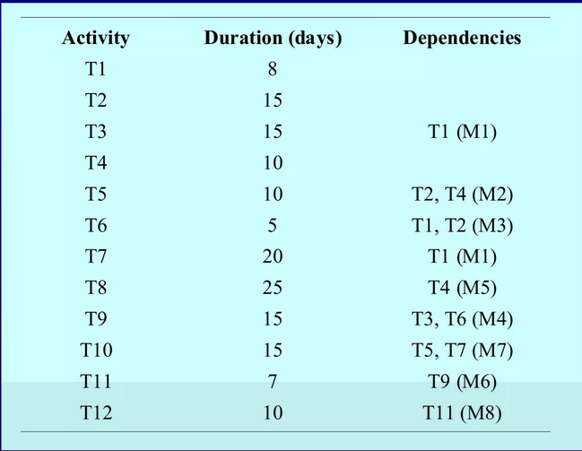
Activities, their duration and activity interdependencies

Slide 9
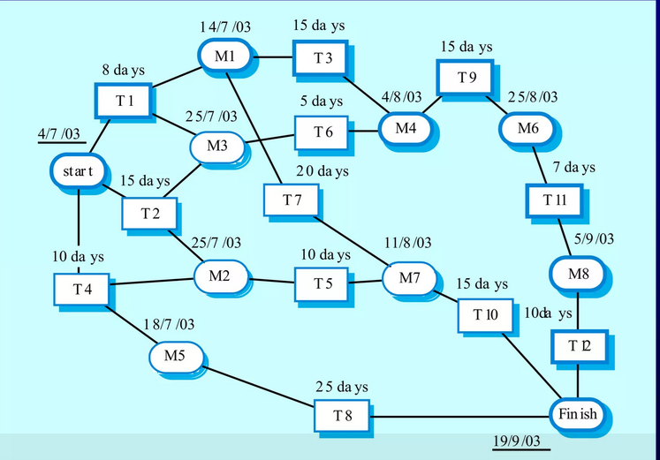
Activity network
Activities are shown in rectangles, Milestones and project deliverables are shown in rounded corners
Activity T9 can start when T3 and T6 are finished.

Slide 10
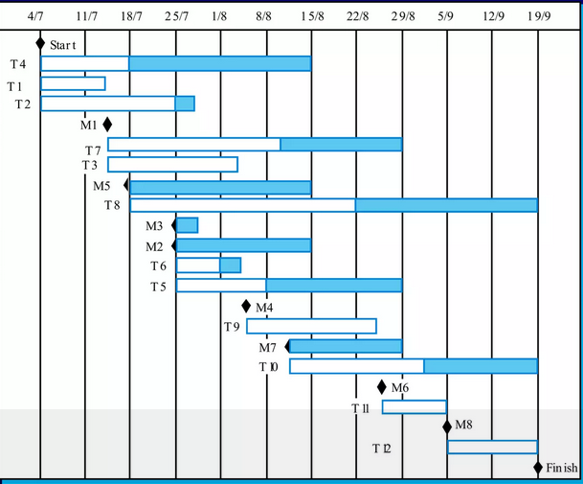
Bar chart (Gantt chart)

