Slide 1
Mobile Ad-Hoc Networks

Slide 2
Overview of Wireless Ad-Hoc Networks
Wireless mobile ad-hoc network (MANET) technology is designed for the establishment of a network anywhere and anytime, without any fixed infrastructure to support the mobility of the users in the network.
In other words, a wireless ad-hoc network is a collection of mobile nodes with a dynamic network infrastructure forming a temporary network. Such networks no central server or base station for providing connectivity, and all network intelligence must be placed inside the mobile user devices (User Nodes).

Slide 3
Fig.1gives overview of an ad-hoc network, where wireless mobile nodes have formed a network, with one node too far to reach.
F
D
E
G
Weak signal to reach
B
A
C
H
Node too far to reach
Fig.1 Overview of Ad-Hoc Networks
Minimum number of hop from source to destination.

Slide 4
For example, fig.2 illustrates an ad hoc network with three wireless mobile hosts. Node 3 is not within the range of node 1’s wireless transmitter (indicated by the circle around node 1) and vice versa. If node 1 and node 3 wish to exchange packets, they must enlist the services of node 2 to forward packets for them, since node 2 is within the range overlap between node 1 and node 3.
1
2
3
Fig.2: Ad hoc network of three wireless mobile hosts

Slide 5
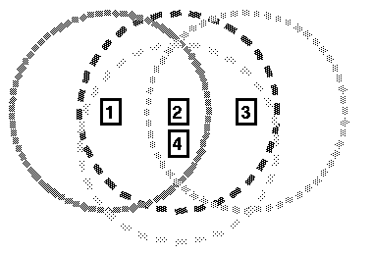
The situation in fig. of previous slide becomes more complicated with the addition of more nodes. The addition of just one node, as illustrated in fig.3 below, results in multiple paths existing between nodes 1 and 3; packets may travel the path 1 - 2 - 3, 1 - 4 - 3, or even 1 - 4 - 2 - 3. An ad hoc routing protocol must be able to decide on a single "best" path between any two nodes.
Fig.3: Ad hoc network with four wireless nodes

Slide 6
Another situation unique to wireless networks is illustrated in fig.4 below. In this example, node 1 has a large enough range to transmit packets directly to node 3.
However, node 3 has a much smaller range and must enlist the help of node 2 in order to return packets to node 1.
This makes the link between node 1 and node 3 appear as a one-way or unidirectional link. In wired networks, links are almost always bidirectional if node A can send to node B, then B can send back to A. But in wireless ad-hoc networks, this assumption does not always hold:
1
2
3
Fig.4: Ad hoc network with a one-way link

Slide 7
Why This is a Problem
Most conventional routing protocols (like RIP, OSPF, and even many MANET protocols like DSDV) assume symmetric links.
Bidirectional communication is often required for:
Route discovery and acknowledgment (e.g., in AODV/DSR).
Link reliability checks — protocols often test if a path works both ways.
Loop prevention — sequence numbers and distance checks assume symmetric behavior.
If the protocol assumes bidirectional links but the actual network has unidirectional ones, routing can fail or become unstable.

Slide 8
Unidirectional links are common in wireless networks due to different transmission powers, environmental conditions, or asymmetric antenna gains. While most traditional routing protocols assume bidirectional links, ad-hoc network protocols need extra mechanisms to detect and properly utilize one-way links.

Slide 9
In such an environment, each mobile user acts as a routing node, and a packet is routed from a source to its destination by incorporating of other network users.
Since the topology of an ad-hoc network can change quickly and unpredictably, it should be adaptable to changes, such as when a link breaks, a node leaves the network, or a new node is attached to the network.
Thus, unlike routing algorithm for regular networks, if a node leaves an ad-hoc network, all affected nodes can discover new routes.
Ad-hoc networks have several types of applications.

Slide 10
Rescue operations. In an emergency public disaster, such as an earthquake, ad-hoc networks can beset up at a location where no infrastructure is present. Ad-hoc networks can be used to support network connectivity when no fixed network is available.
Military. Ad-hoc networks can be used in a battle zone, for a military command and mobile units.
Law enforcement and security operations. An ad-hoc network can be used in a temporary security operation, acting as a mobile surveillance network.
Home networks. An ad-hoc network can be used to support seamless (continuous) connectivity among various devices.
Conferencing. Ad-hoc networks can be set up for a presentation. An audience can download a presentation, browse the slides on a portable device, print them on the local printer, or e-mail the presentation to an absent colleague.

Slide 11
Routing in Ad-Hoc Networks
The lack of a backbone infrastructure makes packet routing in ad-hoc networks a challenging task. A routing protocol should be able to automatically recover from any problem in a finite amount of time without human intervention.
Identification of mobile terminals and correct routing of packets to and from each terminal while moving are certainly challenging. Here we will consider two routing protocols:
1. Destination-Sequenced Distance Vector (DSDV) Protocol
2. Cluster-Head Gateway Switch Routing Protocol

Slide 12
1. The Destination-Sequenced Distance Vector (DSDV) protocol is a table-driven routing protocol
Routing Tables
In addition to the destination address and next hop address, routing tables maintain the route metric (for example number of hops) and the route sequence number.
Periodically, or immediately when network topology changes are detected, each node will broadcast a routing table update packet. The update packet starts out with a metric of one. This signifies to each receiving neighbor they are one hop away from the node. The neighbors will increment this metric (in this case, to two) and then retransmit the update packet including its own address.

Slide 13
This process repeats until every node in the network has received a copy of the update packet with a corresponding metric. If a node receives duplicate update packets, the node will only pay attention to the update packet with the smallest metric or larger sequence number otherwise ignore the paging packet.

Slide 14
If the new address has a higher sequence number, the node chooses the route with the higher sequence number (higher sequence number reflects the presents topology of the network) and discards the old sequence number.
If the incoming sequence number is identical to the one belonging to the existing route, a route with the least cost metric (number of hop) is chosen.

Slide 15
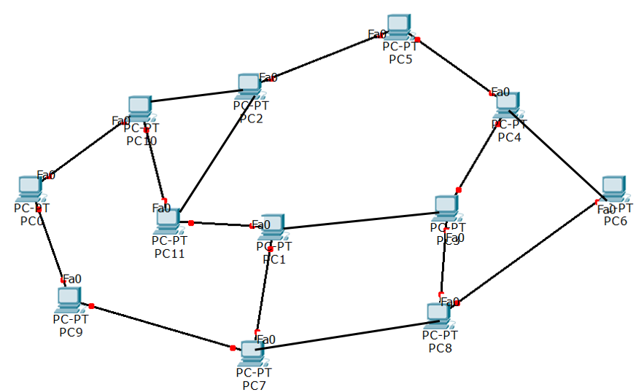
PC0- hop 1- 112
PC0 transmits the paging packet with hop 1 and sequence 112. The sequence number gives the nodes an idea, how latest the paging message is.

Slide 16
PC0- hop 1- 112
PC0- hop 1- 112
PC-9 and PC-10 receives the packet and update their routing table as PC0- hop 1- 112.

Slide 17
PC0- PC10-hop 2- 112
PC0- PC 9-hop 2- 112
PC-9 and PC-10 transmits the packet including their own address with hop 2 and same sequence number 112.

Slide 18
PC0- PC 10-hop 2- 112
PC0- PC 10-hop 2- 112
PC0- PC 9- hop 2- 112
PC 2, PC 7 and PC 11 receive the packets and update their routing table.

Slide 19
PC0- PC 2-hop 3- 112
PC0- PC 11-hop 3- 112
PC0- PC 7- hop 3- 112
PC 2, PC 11 and PC 7 transmit the packet including their own address with hop 3 and sequence 112.

Slide 20
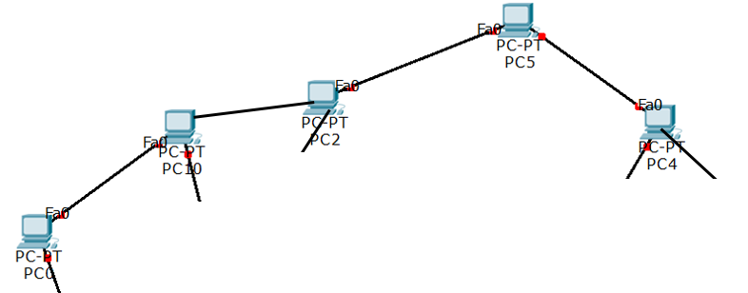
PC0- PC2-hop 3- 112
PC0- hop 1- 112
PC0- PC10-hop 2- 112
PC0- PC5-hop 4- 112
Routing table of PC10, PC 2, PC5 and PC 4.

Slide 21
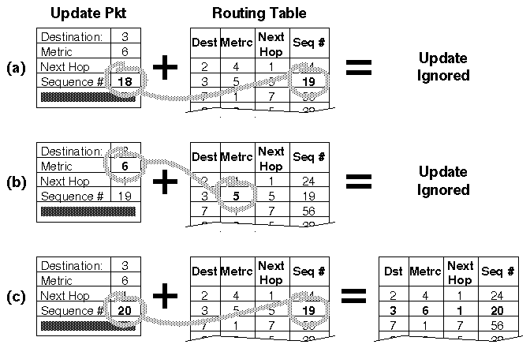
If a node receives an update packet from another node, the sequence number must be equal to or greater than the sequence number already in the routing table; otherwise the update packet is stale and ignored.
If the sequence number matches the sequence number in the routing table, then the metric is compared and updated as previously discussed.
Fig.5 : A node receiving three update packets

Slide 22
(a) Update Packet Sequence Number is Lower
Update Packet: Destination = 3, Metric = 6, Seq# = 18
Routing Table: Already has Destination = 3, Metric = 5, Seq# = 19
🔹 Here, the update packet has an older sequence number (18) compared to the table entry (19). ➡️ Since newer information (Seq# 19) is already present, this update is ignored.
(b) Update Packet Sequence Number is Same, but Metric is Worse
Update Packet: Destination = 3, Metric = 6, Seq# = 19
Routing Table: Destination = 3, Metric = 5, Seq# = 19
🔹 Sequence numbers are the same, so the decision depends on the metric (hop count).
Existing route metric = 5 (better, fewer hops)
New update metric = 6 (worse, more hops)
➡️ Since the current route is better, the update is again ignored.

Slide 23
(c) Update Packet Sequence Number is Higher
Update Packet: Destination = 3, Metric = 6, Seq# = 20
Routing Table: Destination = 3, Metric = 5, Seq# = 19
🔹 Now the update has a newer sequence number (20) compared to the table’s 19. ➡️ Routing table entry is updated to: Destination = 3, Metric = 6, Seq# = 20.
Summary Rule (DSDV Update Logic):
If update has an older sequence number → Ignore.
If update has the same sequence number but a worse metric → Ignore.
If update has a newer sequence number → Accept and update the table.

Slide 24


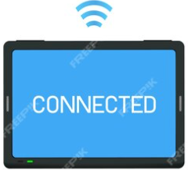
Fig. below shows a routing table for node 2, whose neighbors are nodes 1, 6, and 7. The dashed lines indicate no communications between any corresponding pair of nodes. Therefore, node 10 has no information about node 8.
10
1
7
2
A DSDV routing table of node-2
8
5
Destination | Next hop | Metric | Sequence number
1 | 1 | 1 | 2234
2 | 0 | 0 | 3390
3 | 6 | 2 | 4784
4 | 6 | 3 | 2245
5 | 7 | 2 | 1234
6 | 6 | 1 | 4567
7 | 7 | 1 | 2790
8 | 7 | 2 | 2351
9 | 6 | 3 | 2458
10 | 7 | INF | 5434
3
6
9
4
Ex. Draw the routing table of node 5

Slide 25
The packet overhead of the DSDV protocol increases with the total number of nodes in the ad-hoc network. This fact makes DSDV suitable for small networks. In large ad-hoc networks, the mobility rate and therefore the overhead increase, making the network unstable to the point that updated packets might not reach nodes on time.

Slide 26
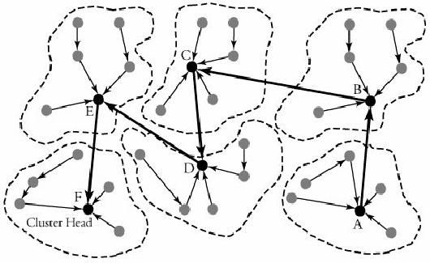
2. Cluster-Head Gateway Switch Routing Protocol
The Cluster-Head Gateway Switch Routing (CGSR) protocol is a table-driven routing protocol. In a clustering system each predefined number of nodes are formed into a cluster, controlled by a cluster head.
Cluster head can be frequently replaced by another node for two reasons: (i) lower-level energy left in the node (ii) node moves out of the contact

Slide 27
Intracluster Communication: If the source and destination are in the same cluster, the data packet can be transmitted directly or relayed by cluster head.

Slide 28
Intercluster Communication: If the source and destination are in the different clusters, the source sends a REQ (request) message to its attached cluster head and then the cluster head will broadcast this REQ to its adjacent cluster head and the process will continue until the REQ arrives at the cluster which belongs to the destination node. Finally, the cluster head including the destination sends a REP (responding) message back along the discovered path.

Slide 29
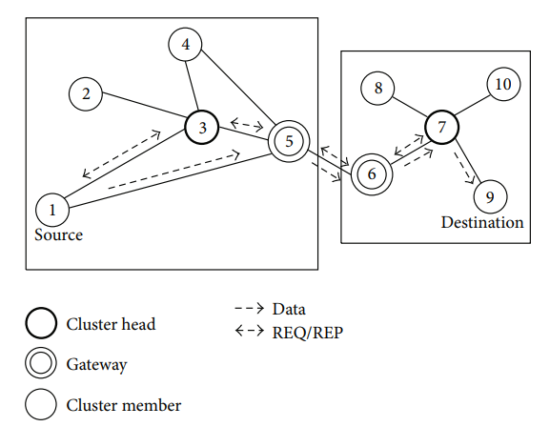
In practical network each CH is connected to a router. Here CH-3 connected to router 5 and CH-7 is connected to the router 6.
3
7
For example, in above Figure, source node 1 wants to send data to destination 9. It must send a REQ to its attached cluster head 3 firstly and then node 3 sends the message to node 7 through gateway nodes 5 and 6.
Next, node 9 sends a REP along the discovered path to node 1. Finally, node 1 gets the shortest route to node 9 (1→5→6→7→9)
After the path is established, data packets flow from source (1) to destination (9) along this shortest path.

Slide 30
This approach reduces overhead because:
Normal nodes don’t flood the network (only CHs communicate across clusters).
It ensures scalability since only cluster heads handle intercluster routing.
Limitations:
Cluster head failure can break communication.
Delay may increase if clusters are large or the path between cluster heads is long.

