Slide 1
Intermediate Representation (IR)
Translation to intermediate code

Slide 2
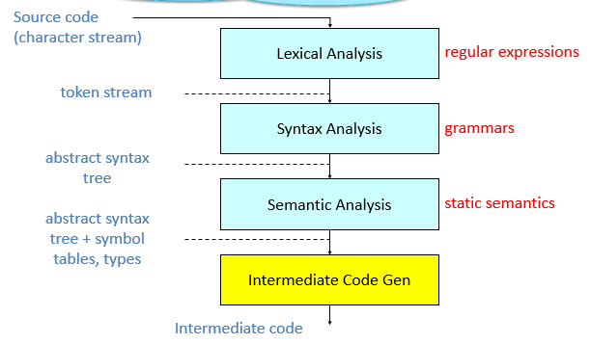
Where we are………
Notes:
2

Slide 3
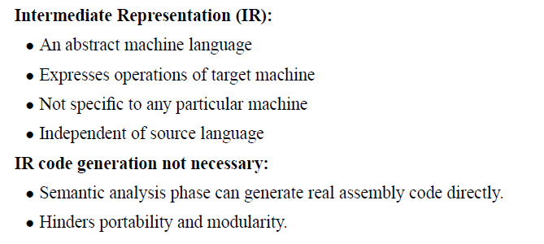
Translation to Intermediate code

Slide 4
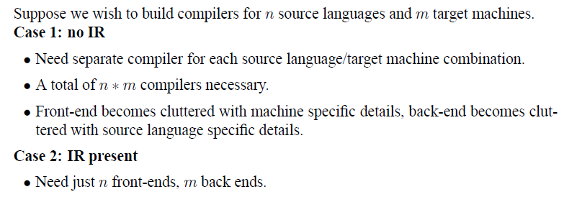
Translation to Intermediate code

Slide 5
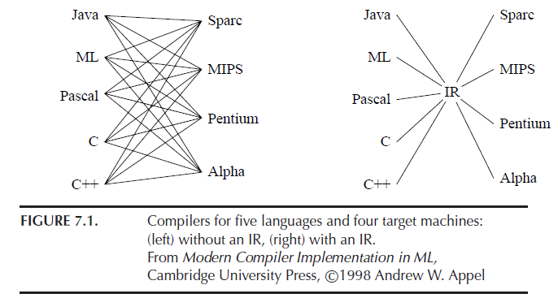
Intermediate Representation

Slide 6
Intermediate Representation
Intermediate codes can be represented in a variety of ways and they have their own benefits.
High Level IR
High-level intermediate code representation is very close to the source language itself.
They can be easily generated from the source code and we can easily apply code modifications to enhance performance.
But for target machine optimization, it is less preferred.
Low Level IR
This one is close to the target machine, which makes it suitable for register and memory allocation, instruction set selection, etc. It is good for machine-dependent optimizations.

Slide 7
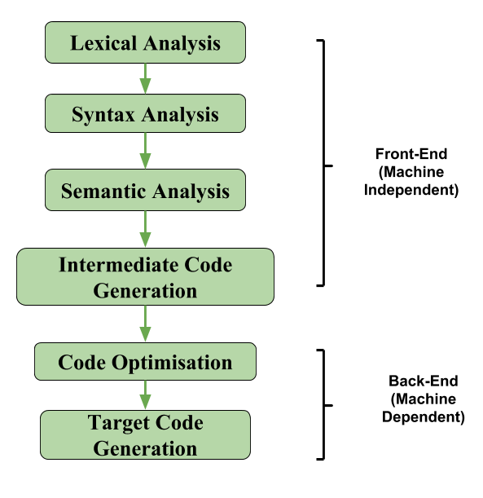
Intermediate Representation
If we generate machine code directly from source code, then for n target machine we will have n optimizers and n code generators but if we will have a machine independent intermediate code, we will have only one optimizer.
Intermediate code can be either language specific (e.g., Byte Code for Java) or language independent (three-address code).

Slide 8
Intermediate Representation Formats
(1) Postfix Notation
The ordinary (infix) way of writing the sum of a and b is with operator in the middle : a + b. The postfix notation for the same expression places the operator at the right end as ab +.
In general, if e1 and e2 are any postfix expressions, and + is any binary operator, the result of applying + to the values denoted by e1 and e2 is postfix notation by e1e2 +.
No parentheses are needed in postfix notation because the position and arity (number of arguments) of the operators permit only one way to decode a postfix expression. In postfix notation the operator follows the operand.
Example – The postfix representation of the expression (a – b) * (c + d) + (a – b) is : ab – cd + *ab -+.
Notes:
8

Slide 9

Intermediate Representation Formats
(2) Three-Address Code
A type of intermediate code which is easy to generate and can be easily converted to machine code.
It makes use of at most three addresses and one operator to represent an expression and the value computed at each instruction is stored in temporary variable generated by compiler.
The compiler decides the order of operation given by three address code.
General representation –
Where a, b or c represents operands like names, constants or compiler generated temporaries and op represents the operator
Notes:
9

Slide 10
Intermediate Representation Formats
(2) Three-Address Code
Example:
a = b + c * d
The intermediate code generator will try to divide this expression into sub-expressions and then generate the corresponding code
t1 = c * d;
t2 = b + t1;
a = t2
t1,t2 are temporary variables
A three-address code has at most three address locations to calculate the expression.
A three-address code can be represented in two forms : quadruples and triples.

Slide 11
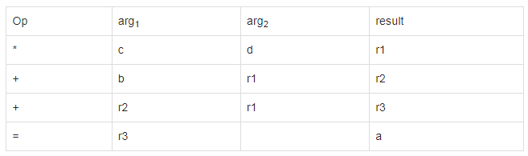
Intermediate Representation Formats
Implementation of Three-Address Code
Quadruples
Each instruction in quadruples presentation is divided into four fields: operator, arg1, arg2, and result. The above example is represented below in quadruples format:
Advantage –
Easy to rearrange code for global optimization.
One can quickly access value of temporary variables using symbol table.
Disadvantage –
Contain lot of temporaries.
Temporary variable creation increases time and space complexity.

Slide 12
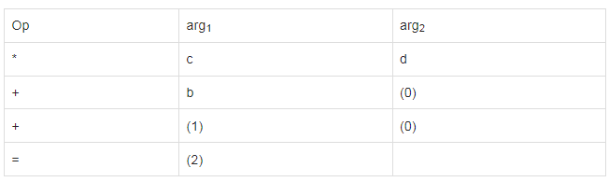
Intermediate Representation Formats
Implementation of Three-Address Code
Triples
Each instruction in triples presentation has three fields : op, arg1, and arg2. The results of respective sub-expressions are denoted by the position of expression. Triples represent similarity with DAG and syntax tree. They are equivalent to DAG while representing expressions.

Slide 13
Intermediate Representation Formats
Implementation of Three-Address Code
Triples
Advantage –
This representation doesn’t make use of extra temporary variable to represent a single operation instead when a reference to another triple’s value is needed, a pointer to that triple is used
Disadvantage –
Temporaries are implicit and difficult to rearrange code.
It is difficult to optimize because optimization involves moving intermediate code. When a triple is moved, any other triple referring to it must be updated also. With help of pointer one can directly access symbol table entry.

Slide 14
Intermediate Representation Formats
Implementation of Three-Address Code
Indirect Triples
This representation is an enhancement over triples representation.
It uses pointers instead of position to store results.
This enables the optimizers to freely re-position the sub-expression to produce an optimized code.

Slide 15
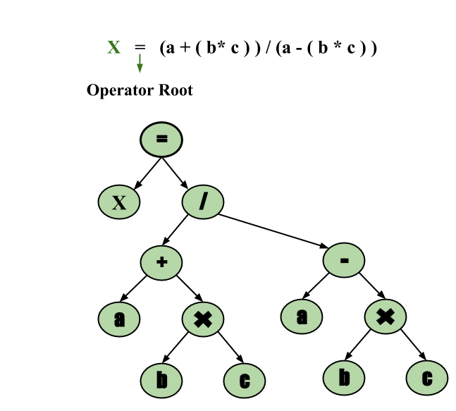
Intermediate Representation Formats
(3) Syntax Tree –
Syntax tree is nothing more than condensed form of a parse tree.
The operator and keyword nodes of the parse tree are moved to their parents and a chain of single productions is replaced by single link in syntax tree. The internal nodes are operators and child nodes are operands.
To form syntax tree put parentheses in the expression, this way it's easy to recognize which operand should come first.
Example – x = (a + b * c) / (a – b * c)

Slide 16
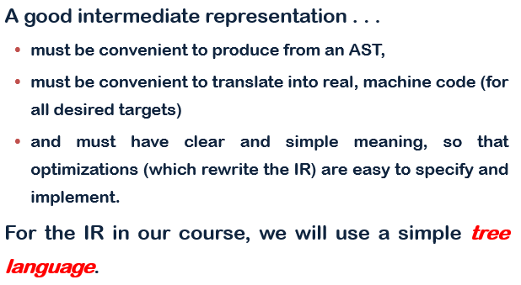
Good IR properties

Slide 17
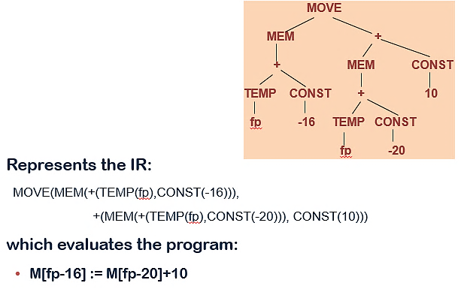
IR Expression Tree

Slide 18
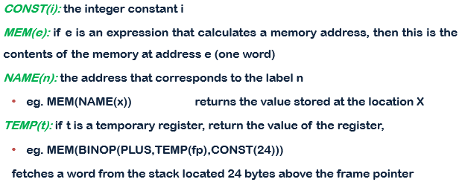
IR Expressions
**
** Note that when MEM is used as the left child of a MOVE, it means “store”, but anywhere it means else it means “fetch”

Slide 19
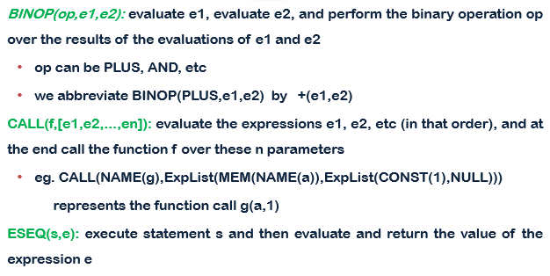
IR Expressions

Slide 20
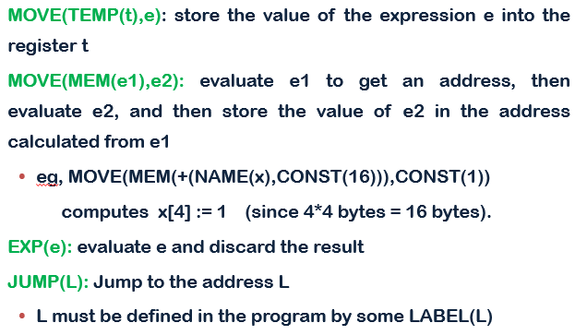
IR statements

Slide 21
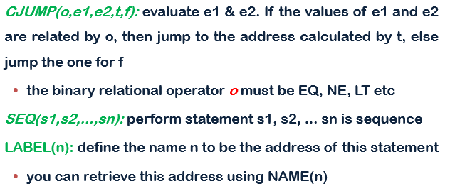
IR statements
EQ=Equal
NE = Not Equal
LT=Less Than
GT=Greater Than

Slide 22
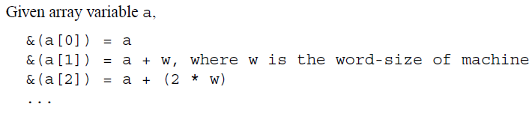
Array accesses
Contents of array a at i^{th} index =
MEM(+(NAME(a), CONST(i*w)))
MEM(BINOP(PLUS, NAME(a), CONST(i*w)))

Slide 23
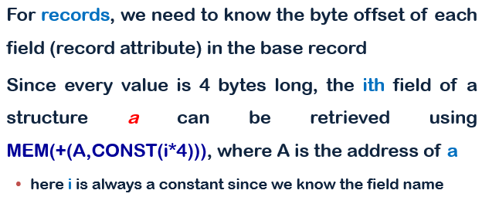
Records

Slide 24
Example
for i := 0 to 9 do V[i] := 5
Assume, every value in the array V requires 4 bytes
SEQ(MOVE(i, CONST(0)),
CJUMP(GT, i, CONST(9), done, loop),
LABEL(loop),
MOVE(MEM(+(Name(V), CONST(i*4))),const(5)),
MOVE(i,+(i,CONST(1))),
CJUMP(GT, i, CONST(9), done, loop),
LABEL(done))

Slide 25
Example
If( i < 10) then y := 0 else i:=i-1
SEQ( CJUMP(LT, i, CONST(10), trueL, falseL),
LABEL(trueL),
MOVE(y, CONST(0)),
JUMP(exit),
LABEL(falseL),
MOVE(i, - (i,CONST(1))),
JUMP(exit),
LABEL(exit))

Slide 26
The End

