Slide 1
Textbook
Compilers: Principles, Techniques, and Tools
Aho, Lam, Sethi, Ullman
Modern Compiler Implementation in C (The Tiger Book).
Andrew W. Appel

Slide 2
Grading Policy
Attendance 10
Class Test 20% (Best two of three)
(includes exercises and lecture materials)
==========================================================
Total 40%
Final Exam 60%
(includes exercises and lecture materials)

Slide 3
Language Processor
A computer understands instructions in machine code, i.e. in the form of 0s and 1s. It is a tedious task to write a computer program directly in machine code.
The programs are written mostly in high level languages like Java, C++, Python etc. and are called source code. These source code cannot be executed directly by the computer and must be converted into machine language to be executed.
Hence, a special translator system software is used to translate the program written in high-level language into machine code is called Language Processor and the program after translated into machine code (object program / object code).
The language processors can be any of the following three types:
1. Compiler
2. Interpreter
3. Assembler

Slide 4
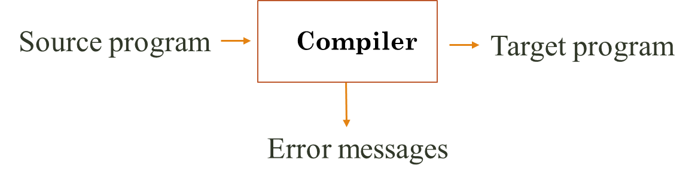

Language Processor: Compiler
A compiler is a program that reads the whole program written in a source language/high level language as a whole in one go and translates it into an equivalent program in a target language.
Notes:
Programming problems are easier to solve in high-level languages
An important role of the compiler
is to report any errors in the
source program that it detects
during the translation process.
Languages closer to the level of the problem domain, e.g.,
SmallTalk: OO programming
JavaScript: Web pages
Solutions are usually more efficient (faster, smaller) when written in machine language
Language that reflects to the cycle-by-cycle working of a processor
Compilers are the bridges:
Tools to translate programs written in high-level languages to efficient executable code
A program that reads a program written in one language and translates it into another language.
As an important part of this translation process, the compiler reports to its user the presence of errors in the source program.
Traditionally, compilers go from high-level languages to low-level languages.

Slide 5
Language Processor: Interpreter
An interpreter is another common kind of language processor.
Instead of producing a target program as a translation, an interpreter appears to directly execute the operations specified in the source program on inputs supplied by the user.
Source program
Interpreter
Output
Input
Error messages

Slide 6
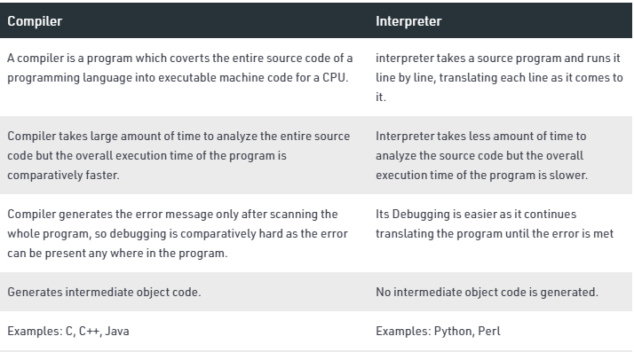
Compiler vs. Interpreter
Notes:
Translation mechanism
Compiler reads entire source code and translates to machine language at once. If any error is generated during compilation, it terminates the entire process without executing single instruction.
Whereas interpreters translate instruction-by-instruction. It reads single instruction at a time. Translates it to machine language and executes it. This process continues till the last instruction. If any error is generated during the interpretation, it terminates the execution of further instructions.
Translation time
Compilers reads entire source code at once. It pre-processes, parses, analyses the source code and translates it to machine code at once. Hence, it requires more translation time than interpreters.
Interpreters reads single instruction of source code at a time. Unlike compilers, it doesn’t translate entire source code to machine code at once. Rather it translates the source code, instruction by instruction. Hence, requires less translation time.
Program speed
Compilers translate entire source code at once. After the compilation process, it generates an executable file containing complete instruction set of the program in binary language. Hence, it doesn’t require any further translation which enhances the program execution speed.
Interpreters translate the source code instruction by instruction. It translates single instruction then executes it. Each time before executing an instruction, it must first translate it to machine language. Which increases the overhead of interpretation, hence decreases the program execution speed.
Memory consumption
Compilers usually generate an intermediate code called object code, during the compilation process. Hence it requires more memory than interpreters.
Unlike compilers, interpreters do not generate any intermediate code, during the interpretation process. Thus, interpreters are memory efficient.
Debugging
Compilers continues to process entire source code also if it contains errors. It generates list of all error messages (if any) at the end of the compilation process. Which makes debugging a little difficult.
Interpreters stops the interpretation process if an error is encountered. It generates the error message as the error is met during the interpretation process.
Deployment
Compilers generate an executable file of the source code. This executable file is deployed instead of source code. Which increases the security, by hiding the source code from others.
Interpreters do not generate any executable file of the source code. Therefore, in the case of interpreter’s entire source code needs to be deployed. Causing a security concern as the source code is visible to everyone.

Slide 7
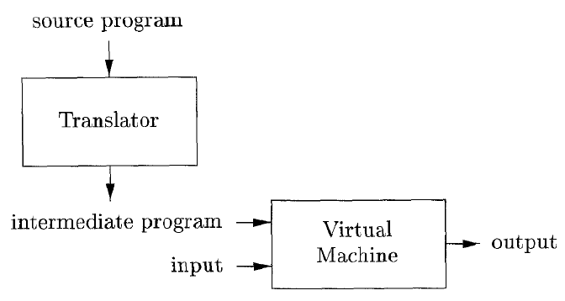
Hybrid Compiler
Java language processors combine compilation and interpretation.

Slide 8
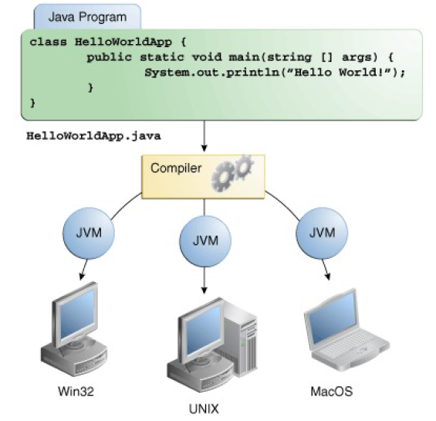
Hybrid Compiler
A Java source program may first be compiled into an intermediate
form called bytecodes.
The bytecodes are then interpreted by a virtual machine.
A benefit of this arrangement is that bytecodes compiled
on one machine can be interpreted on another machine,
perhaps across a network.
In order to achieve faster processing of inputs to outputs,
some Java compilers, called just-in-time compilers,
translate the bytecodes into machine language
immediately before they run the intermediate program to
process the input.

Slide 9
Language Processor: Assembler
The Assembler is used to translate the program written in Assembly language into machine code. Assembly language is machine dependent yet mnemonics that are being used to represent instructions in it are not directly understandable by machine and high level language is machine independent.
Assembler

Slide 10
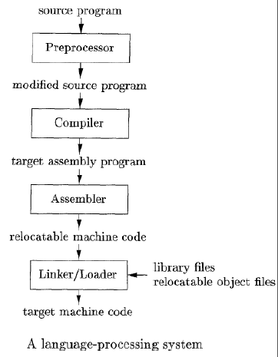
Other Language Processors:

Slide 11
Compilation task is full of variety ??
Thousands of source languages
Fortran, Pascal, C, C++, Java, ……
Thousands of target languages
Some other lower level language (assembly language), machine language
Compilation process has similar variety
Single pass, multi-pass, load-and-go, debugging, optimizing….
Variety is overwhelming……
Good news is:
Few basic techniques is sufficient to cover all variety
Many efficient tools are available

Slide 12
Job of Compiler
We will study compilers that take as input programs in a high-level programming language and give as output programs in a low-level assembly language.
Such compilers have 3 jobs:
TRANSLATION
VALIDATION
OPTIMIZATION

Slide 13
Why Study Compiler?
To be more effective users of compilers ... instead of treating a compiler as a “black box”.
To apply compiler techniques to typical SE tasks that require reading input and taking action.
To see how your core CS courses fit together, giving you the knowledge to construct a compiler.
To participate in R&D of high-level programming languages and optimizing compilers.
Notes:
Compilers are important
Responsible for many aspects of system performance
Attaining performance has become more difficult over time
Compilers are interesting
Compilers include many applications of theory to practice
Writing a compiler exposes algorithmic & engineering issues
Compilers are everywhere
Many practical applications have embedded languages Commands, macros, formatting tags

Slide 14
Challenges of Compiler Construction
Compiler construction poses challenging and interesting problems:
Compilers must process large inputs, perform complex algorithms, but also run quickly
Compilers have primary responsibility for run-time performance
Compilers are responsible for making it acceptable to use the full power of the programming language
Computer architects perpetually create new challenges for the compiler by building more complex machine
Compilers must hide that complexity from the programmer
A successful compiler requires mastery of the many complex interactions between its constituent parts

Slide 15
Compiler and other areas
Compiler construction involves ideas from different parts of computer science
Artificial intelligence: Greedy algorithms, Heuristic search techniques
Algorithms: Graph algorithms, Dynamic programming
Theory of Automata: DFAs & PDAs, pattern matching, regular expressions
Architecture: Pipelining and Instruction set use

Slide 16
Requirement
In order to translate statements in a language, one needs to understand both
Structure of the language: the way “sentences" are constructed in the language
Meaning of the language: what each “sentence" stands for.
Terminology:
Structure ≡ Syntax
Meaning ≡ Semantics

Slide 17
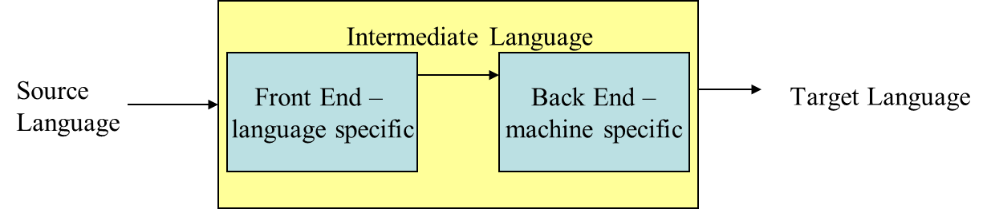
Analysis-Synthesis model of compilation
Two major parts --
Analysis: an intermediate representation is created from the given source program.
Lexical Analyzer, Syntax Analyzer and Semantic Analyzer
Synthesis: the equivalent target program is created from this intermediate representation
Intermediate Code Generator, Code Optimizer, and Code Generator
Notes:
Analysis
Breaks up the source program into constituents and creates an intermediate representation of the source program
Synthesis
Constructs the target program from the intermediate representation

Slide 18
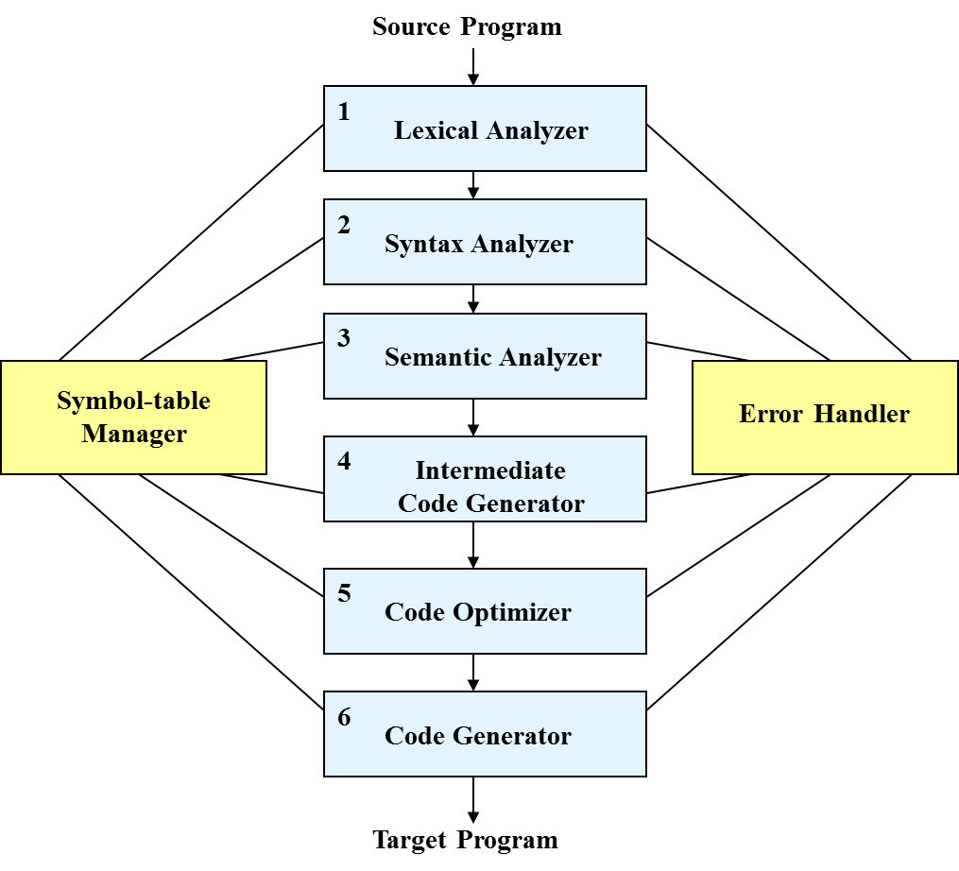
Phases of Compiler

Slide 19
Compilation Steps/Phases
Lexical Analysis: Generates the “tokens” in the source program
Syntax Analysis: Recognizes “sentences" in the program using the syntax of the language
Semantic Analysis: Infers information about the program using the semantics of the language
Intermediate Code Generation: Generates “abstract” code based on the syntactic structure of the program and the semantic information
Optimization: Refines the generated code using a series of optimizing transformations
Final Code Generation: Translates the abstract intermediate code into specific machine instructions

Slide 20
Lexical Analysis
Convert the stream of characters representing input program into a meaningful sequences called lexemes.
For each lexeme, the lexical analyzer produces as output
A token of the form:
< token-name, attribute-value >
token-name 🡪 an abstract symbol that is used during syntax analysis
attribute-value🡪 points to an entry in the symbol table for this token
Example:
Input: “*x++" Output: three tokens 🡪 “*", “x", “++"
Input: “static int" Output: two tokens: 🡪 “static" , “int"
Removes the white spaces, comments

Slide 21
Lexical Analysis
Input: result = a + b * 10
Tokens :
‘result’, ‘=‘, ‘a’, ‘+’, ‘b’, ‘*’, ‘10’
identifiers
operators

Slide 22
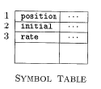

Lexical Analysis
Input:
Output: Sequence of tokens
In this representation, the token names =, +, and * are abstract symbols for the assignment, addition, and multiplication operators, respectively.

Slide 23
Syntax Analysis (Parsing)
Build a tree called a parse tree that reflects the structure of the input sentence.
A syntax tree in which each interior node represents an operation and the children of the node represent the arguments of the operation.
Example:
The Phrase : x = +y
Four Tokens 🡪 “x", “=“ ,“+" and “y“
Structure x = (x+(y)) i.e., an assignment expression
Notes:
, the phrase “x = +y", which is recognized as four tokens, representing “x", “=“ and “+" and “y", has the structure =(x,+(y)), i.e., an assignment expression, that operates on “x" and the expression “+(y)".

Slide 24
Syntax Analysis: Grammars
Expression grammar
Exp Exp ‘+’ Exp
| Exp ‘*’ Exp
| ID
| NUMBER
Notes:
, the phrase “x = +y", which is recognized as four tokens, representing “x", “=“ and “+" and “y", has the structure =(x,+(y)), i.e., an assignment expression, that operates on “x" and the expression “+(y)".

Slide 25
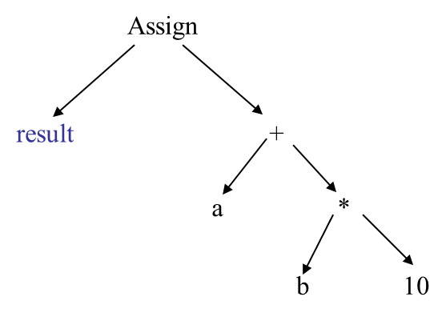
Syntax Analysis: Syntax Tree
Input: result = a + b * 10
Notes:
, the phrase “x = +y", which is recognized as four tokens, representing “x", “=“ and “+" and “y", has the structure =(x,+(y)), i.e., an assignment expression, that operates on “x" and the expression “+(y)".

Slide 26
Semantic Analysis
Check the source program for semantic errors
It uses the hierarchical structure determined by the syntax-analysis phase to identify the operators and operands of expressions and statements
Performs type checking
Operator operand compatibility
Example:
The compiler must report an error if a floating-point number is used to index an array.

Slide 27
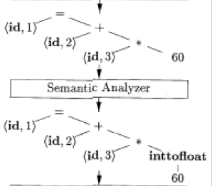
Semantic Analysis
The language specification may permit some type conversions
called coercions.
Example:
The compiler may convert or coerce
the integer into a floating-point number.

Slide 28
Intermediate Code Generation
Translate each hierarchical structure decorated as tree into intermediate code
A program translated for an abstract machine
Properties of intermediate codes
Should be easy to produce
Should be easy to translate into the target program
Intermediate code hides many machine-level details, but has instruction-level mapping to many assembly languages
Main motivation: portability
One commonly used form is “Three-address Code”

Slide 29
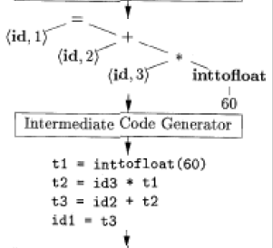
Intermediate Code Generation
We consider an intermediate form called “three-address code”.
Like the assembly language for a machine in which every memory
location can act like a register.
Three-address code consists of a
sequence of instructions,
each of which has at most three operands.

Slide 30
Code Optimization
Apply a series of transformations to improve the time and space efficiency of the generated code.
Peephole optimizations: generate new instructions by combining/expanding on a small number of consecutive instructions.
Global optimizations: reorder, remove or add instructions to change the structure of generated code
Consumes a significant fraction of the compilation time
Optimization capability varies widely
Simple optimization techniques can be vary valuable

Slide 31
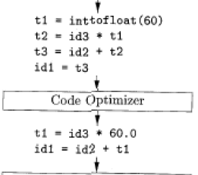
Code Optimization

Slide 32
Code Generation
Map instructions in the intermediate code to specific machine instructions.
Memory management, register allocation, instruction selection, instruction scheduling, …
Generates sufficient information to enable symbolic debugging.

Slide 33
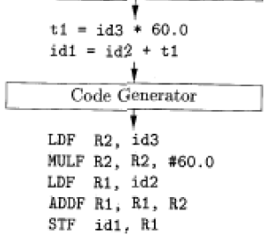
Code Generation
For example, using registers R1 and R2, the intermediate code might get translated into the machine code

Slide 34
Symbol Table
Records the identifiers used in the source program
Collect information about various attributes of each identifier
Variables: type, scope, storage allocation
Procedure: number and types of arguments, method of argument passing
It’s a data structure containing a record for each identifier
Different fields are collected and used at different phases of compilation
When an identifier in the source program is detected by the lexical analyzer, the identifier is entered into the symbol table

Slide 35
Symbol Table
It is built in lexical and syntax analysis phases and It is used by compiler to achieve compile time efficiency.
The information is collected by the analysis phases of compiler and is used by synthesis phases of compiler to generate code.
Items stored in Symbol table:
Variable names and constants
Procedure and function names
Literal constants and strings
Compiler generated temporaries
Labels in source languages

Slide 36
Symbol Table
Information used by compiler from Symbol table:
Data type and name
Declaring procedures
Offset in storage
If structure or record then, pointer to structure table.
For parameters, whether parameter passing by value or by reference
Number and type of arguments passed to function
Base Address

Slide 37
Symbol Table
It is used by various phases of compiler as follows :-
Lexical Analysis: Creates new table entries in the table, example like entries about token.
Syntax Analysis: Adds information regarding attribute type, scope, dimension, line of reference, use, etc in the table.
Semantic Analysis: Uses available information in the table to check for semantics i.e. to verify that expressions and assignments are semantically correct(type checking) and update it accordingly.
Intermediate Code generation: Refers symbol table for knowing how much and what type of run-time is allocated and table helps in adding temporary variable information.
Code Optimization: Uses information present in symbol table for machine dependent optimization.
Target Code generation: Generates code by using address information of identifier present in the table.

Slide 38
Error Detection, Recovery and Reporting
Each phase can encounter error.
The tasks of the Error Handling process are to detect each error, report it to the user, and then make some recover strategy and implement them to handle error.
Specific types of error can be detected by specific phases
Lexical Error : int abc, 1num ;
Syntax Error: total = capital + rate year;
Semantic Error: value = myarray [realIndex];
Should be able to proceed and process the rest of the program after an error detected
Should be able to link the error with the source program

Slide 39
Error Detection, Recovery and Reporting
Types or Sources of Error –
There are two types of error: Run-time and Compile-time error:
A Run-time error is an error which takes place during the execution of a program, and usually happens because of adverse system parameters or invalid input data.
The lack of sufficient memory to run an application or a memory conflict with another program
Logical error is another example. Logic errors, occur when executed code does not produce the expected result. Logic errors are best handled by meticulous program debugging.

Slide 40
Error Detection, Recovery and Reporting
Types or Sources of Error –
There are two types of error: Run-time and Compile-time error:
A Compile-time error rises at compile time, before execution of the program. Syntax error or missing file reference that prevents the program from successfully compiling is the example of this.
Classification of Compile-time error –
Lexical : This includes misspellings of identifiers, keywords or operators
Syntactical : missing semicolon or unbalanced parenthesis
Semantical : incompatible value assignment or type mismatches between operator and operand
Logical : code not reachable, infinite loop.

Slide 41
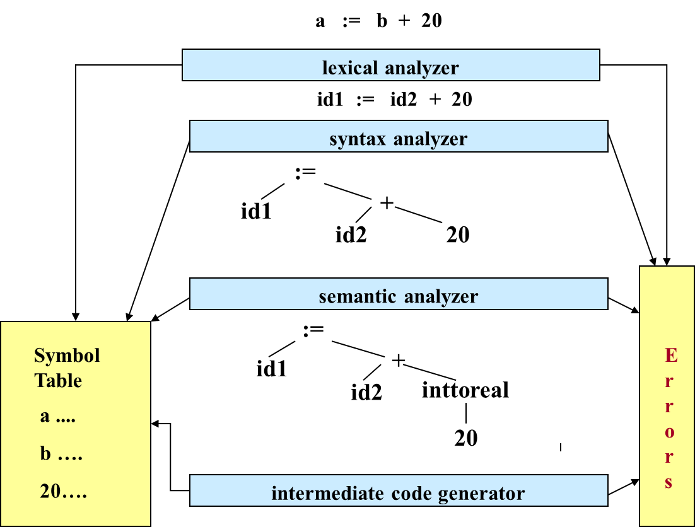
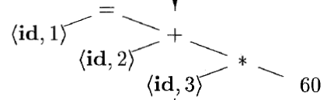
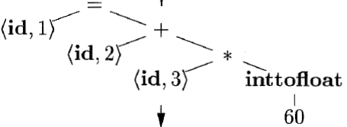
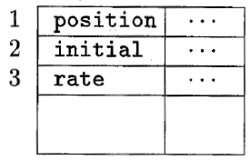
Reviewing the Entire Process

Slide 42
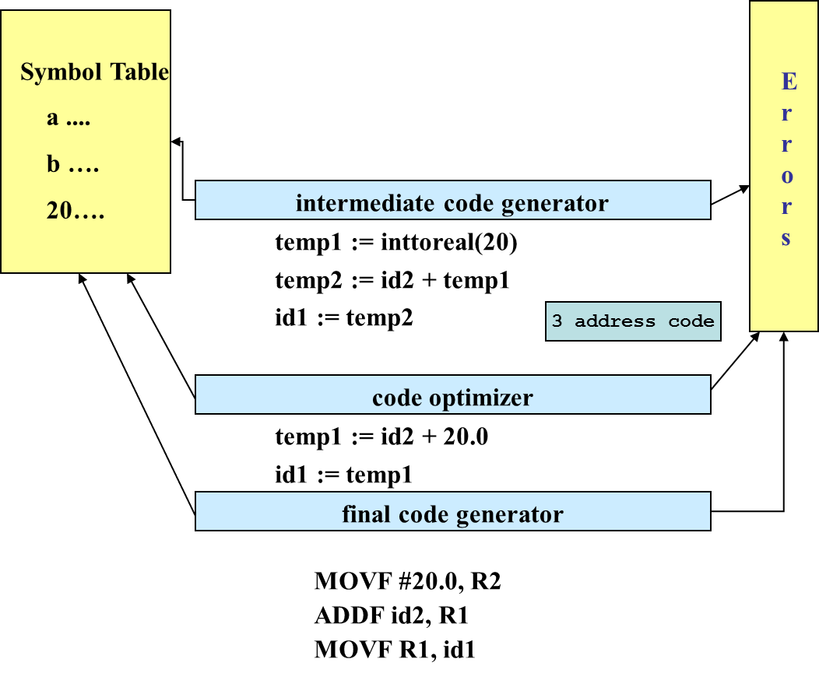
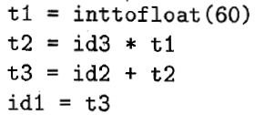

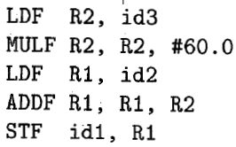
Reviewing the Entire Process

Slide 43
Compiler Construction Tools
Parser generators: It produces syntax analyzers (parsers) from the input that is based on a grammatical description of programming language or on a context-free grammar.
Scanner generators: It generates lexical analyzers from the input that consists of regular expression description based on tokens of a language. It generates a finite automaton to recognize the regular expression.
Syntax-directed translation engines: It generates intermediate code with three address format from the input that consists of a parse tree. These engines have routines to traverse the parse tree and then produces the intermediate code.

Slide 44
Compiler Construction Tools
Code-generator: It generates the machine language for a target machine.
Data-flow analysis engines: A key part of the code optimization that gathers the information, that is the values that flow from one part of a program to another.
Compiler-construction toolkits: It provides an integrated set of routines that aids in building compiler components or in the construction of various phases of compiler.

Slide 45
Reading Materials
Chapter -1 of your Text book:
Compilers: Principles, Techniques, and Tools
https://www.geeksforgeeks.org/compiler-design-tutorials/

Slide 46
The End

