Slide 1
Run-Time Environment

Slide 2
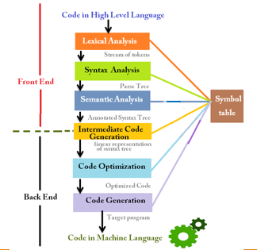
Compiler design phases

Slide 3
Runtime Environment
A program as a source code is merely a collection of text (code, statements etc.) and to make it alive, it requires actions to be performed on the target machine.
A program needs memory resources to execute instructions. A program contains names for procedures, identifiers etc., that require mapping with the actual memory location at runtime.
By runtime, we mean a program in execution. Runtime environment is a state of the target machine, which may include software libraries, environment variables, etc., to provide services to the processes running in the system.
Runtime support system is a package, mostly generated with the executable program itself and facilitates the process communication between the process and the runtime environment.
It takes care of memory allocation and de-allocation while the program is being executed.
Notes:
‹#›

Slide 4
Activation Record
A program is a sequence of instructions combined into a number of procedures.
Instructions in a procedure are executed sequentially.
A procedure has a start and an end delimiter and everything inside it is called the body of the procedure.
The procedure identifier and the sequence of finite instructions inside it make up the body of the procedure.
The execution of a procedure is called its activation.
An activation record contains all the necessary information required to call a procedure.
Notes:
‹#›

Slide 5
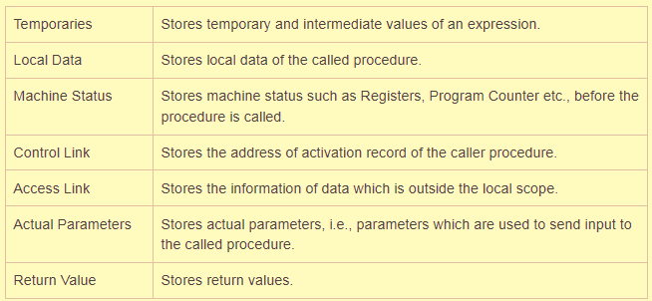
Activation Record
An activation record may contain the following units:
(depending upon the source language used)
Notes:
‹#›

Slide 6
Activation Record
Whenever a procedure is executed, its activation record is stored on the stack, also known as control stack
When a procedure calls another procedure, the execution of the caller is suspended until the called procedure finishes execution. At this time, the activation record of the called procedure is stored on the stack
We assume that the program control flows in a sequential manner and when a procedure is called, its control is transferred to the called procedure
When a called procedure is executed, it returns the control back to the caller.
A procedure is recursive if a new activation begins before an earlier activation of the same procedure has ended.
Notes:
‹#›

Slide 7
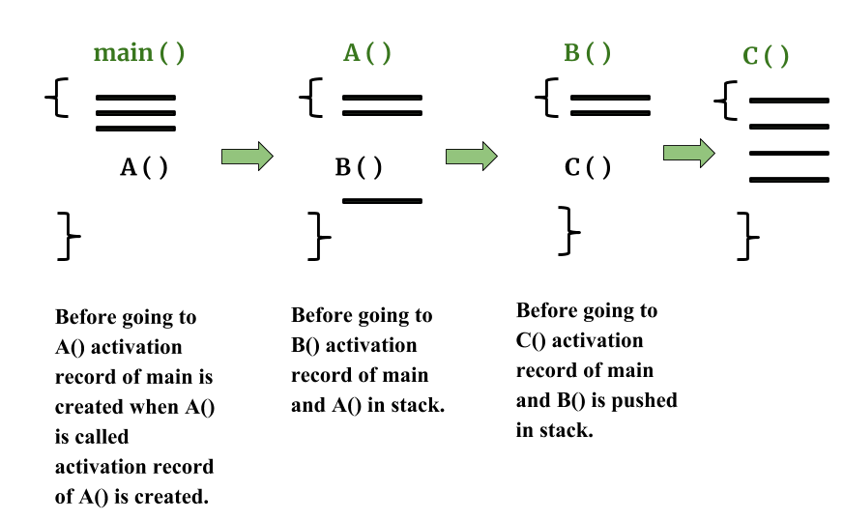
Example of Activation Records:
Notes:
‹#›

Slide 8
Activation Trees
An activation tree shows the way control enters and leaves activations.
This type of control flow makes it easier to represent a series of activations in the form of a tree, known as the activation tree.
Properties of Activation trees are :-
Each node represents an activation of a procedure.
The root shows the activation of the main function.
The node for procedure ‘x’ is the parent of node for procedure ‘y’ if and only if the control flows from procedure x to procedure y.
Notes:
‹#›

Slide 9
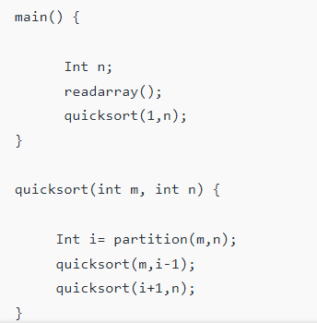
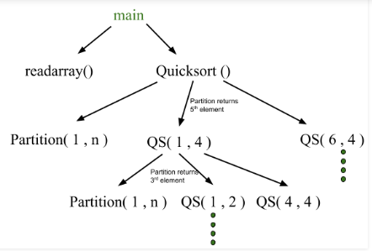
Activation Trees
Example – Consider the following program of Quicksort
The activation tree for this program will be:
The flow of control in a program corresponds to the depth
first traversal of activation tree which starts at the root.
Notes:
First main function as root then main calls readarray and quicksort. Quicksort in turn calls partition and quicksort again. The flow of control in a program corresponds to the depth first traversal of activation tree which starts at the root.
‹#›

Slide 10
CONTROL STACK AND ACTIVATION RECORDS
Control stack or runtime stack is used to keep track of the live procedure activations i.e the procedures whose execution have not been completed.
A procedure name is pushed on to the stack when it is called (activation begins) and it is popped when it returns (activation ends).
Information needed by a single execution of a procedure is managed using an activation record or frame.
When a procedure is called, an activation record is pushed into the stack and as soon as the control returns to the caller function the activation record is popped.
Notes:
‹#›

Slide 11
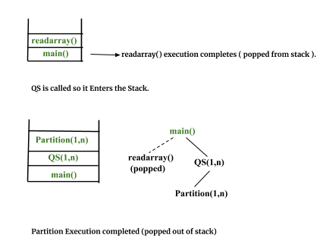
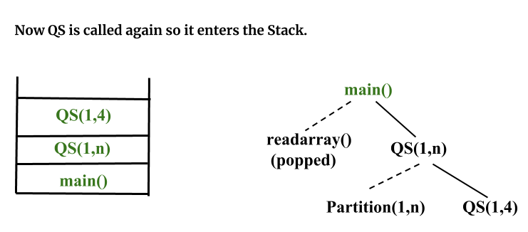
Control stack for the quicksort example:
Notes:
‹#›

Slide 12
SUBDIVISION OF RUNTIME MEMORY
Runtime environment manages runtime memory requirements for the following entities:
Code : It is known as the text part of a program that does not change at runtime. Its memory requirements are known at the compile time.
Procedures : Their text part is static but they are called in a random manner.
That is why, stack storage is used to manage procedure calls and activations.
Variables : Variables are known at the runtime only, unless they are global or constant. Heap memory allocation scheme is used for managing allocation and de-allocation of memory for variables in runtime.
Notes:
‹#›

Slide 13
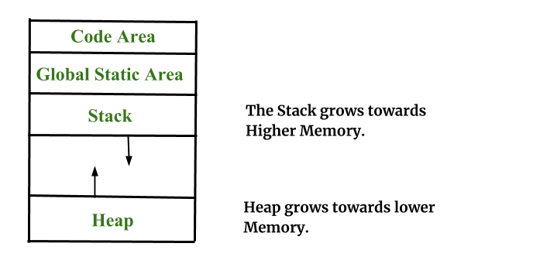


SUBDIVISION OF RUNTIME MEMORY
In the image, the text part of the code is allocated a fixed amount of memory.
Stack and heap memory are arranged at the extremes of total memory allocated to the program. Both shrink and grow against each other.
Notes:
https://www.geeksforgeeks.org/memory-layout-of-c-program/
https://www.geeksforgeeks.org/stack-vs-heap-memory-allocation/
‹#›

Slide 14
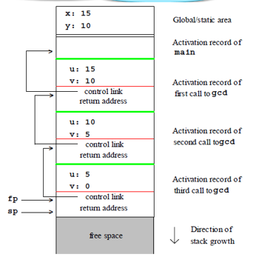
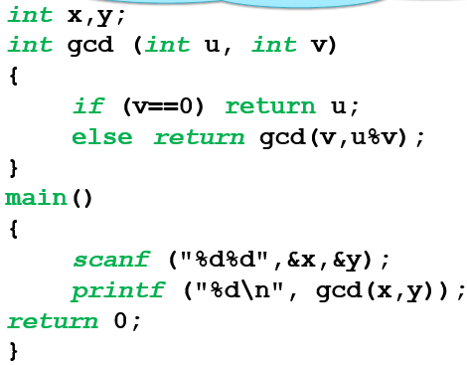
Example: SUBDIVISION OF RUNTIME MEMORY
Call Structure on Input: 15,10
Example Program in C

Slide 15
STORAGE ALLOCATION TECHNIQUES
Static Storage Allocation
For any program if we create memory at compile time, memory will be created in the static area and only once
It don’t support dynamic data structure i.e memory is created at compile time and deallocated after program completion.
The drawback with static storage allocation is recursion is not supported.
Another drawback is size of data should be known at compile time
Eg- FORTRAN was designed to permit static storage allocation.
Notes:
‹#›

Slide 16
STORAGE ALLOCATION TECHNIQUES
II. Stack Storage Allocation
Storage is organized as a stack and activation records are pushed and popped as activation begin and end respectively.
Locals are contained in activation records so they are bound to fresh storage in each activation.
Recursion is supported in stack allocation
Notes:
‹#›

Slide 17
STORAGE ALLOCATION TECHNIQUES
II. Heap Storage Allocation
Memory allocation and de-allocation can be done at any time and at any place depending on the requirement of the user
Heap allocation is used to dynamically allocate memory to the variables and claim it back when the variables are no more required.
Recursion is supported.
Notes:
‹#›

Slide 18
Parameter Passing
The communication medium among procedures is known as parameter passing.
The values of the variables from a calling procedure are transferred to the called procedure by some mechanism
Basic terminology :
R- value: The value of an expression is called its r-value. The value contained in a single variable also becomes an r-value if its appear on the right side of the assignment operator. R-value can always be assigned to some other variable.
L-value: The location of the memory(address) where the expression is stored is known as the l-value of that expression. It always appears on the left side if the assignment operator.

Slide 19

Parameter Passing
For example:
From this example, we understand that constant values like 1, 7, 12, and variables like day, month all have r-values.
Only variables have l-values as they also represent the memory location assigned to them.
For example: 7 = x + y;
The equation is an l-value error, as the constant 7 does not represent any memory location.

Slide 20
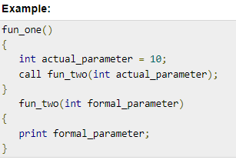
Parameters
i. Formal Parameter:
Variables that take the information passed by the caller procedure are called formal parameters. These variables are declared in the definition of the called function.
ii. Actual Parameter:
Variables whose values and functions are passed to the called function are called actual parameters. These variables are specified in the function call as arguments.
***Formal parameters hold the information of the actual parameter, depending upon the parameter passing technique used. It may be a value or an address.

Slide 21
Different ways of passing the parameters to the procedure
Pass by Value
In pass by value mechanism, the calling procedure passes the r-value of actual parameters and the compiler puts that into the called procedure’s activation record. Formal parameters then hold the values passed by the calling procedure. If the values held by the formal parameters are changed, it should have no impact on the actual parameters.
Pass by Reference
In pass by reference mechanism, the l-value of the actual parameter is copied to the activation record of the called procedure. This way, the called procedure now has the address (memory location) of the actual parameter and the formal parameter refers to the same memory location. Therefore, if the value pointed by the formal parameter is changed, the impact should be seen on the actual parameter as they should also point to the same value.

Slide 22
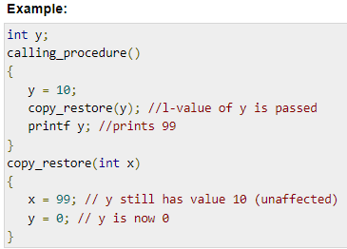
Different ways of passing the parameters to the procedure
Pass by Copy-restore
This parameter passing mechanism works similar to ‘pass-by-reference’ except that the changes to actual parameters are made when the called procedure ends. Upon function call, the values of actual parameters are copied in the activation record of the called procedure. Formal parameters if manipulated have no real-time effect on actual parameters (as l-values are passed), but when the called procedure ends, the l-values of formal parameters are copied to the l-values of actual parameters.
When this function ends, the l-value of formal parameter x
is copied to the actual parameter y.
Even if the value of y is changed before the procedure ends,
the l-value of x is copied to the l-value of y making it behave
like call by reference.

Slide 23
Different ways of passing the parameters to the procedure
Pass by Name
Languages like Algol provide a new kind of parameter passing mechanism that works like preprocessor in C language.
In pass by name mechanism, the name of the procedure being called is replaced by its actual body.
Pass-by-name textually substitutes the argument expressions in a procedure call for the corresponding parameters in the body of the procedure so that it can now work on actual parameters, much like pass-by-reference.
Notes:
‹#›

Slide 24
Lecture Materials
https://www.tutorialspoint.com/compiler_design/compiler_design_runtime_environment.htm
https://www.geeksforgeeks.org/runtime-environments-in-compiler-design/?ref=lbp
‘Chapter 7: Run-Time Environments’ of the Text Book:
“Compilers: Principles , Techniques and Tools”
Notes:
‹#›

Slide 25
The End

