Slide 1
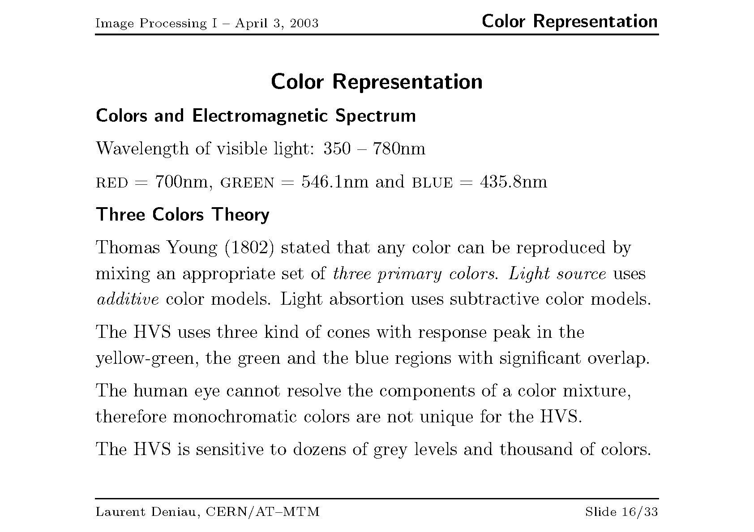

Slide 2
Color Models
Color models attempt to mathematically describe the way that humans perceive color
The human eye combines 3 primary colors (using the 3 different types of cones) to discern all possible colors.
Colors are just different light frequencies
red – 700nm wavelength
green – 546.1 nm wavelength
blue – 435.8 nm wavelength
Lower frequencies are cooler colors

Slide 3
Primary Colors
Primary colors of light are additive
Primary colors are red, green, and blue
Combining red + green + blue yields white
Primary colors of pigment are subtractive
Primary colors are cyan, magenta, and yellow
Combining cyan + magenta + yellow yields black

Slide 4
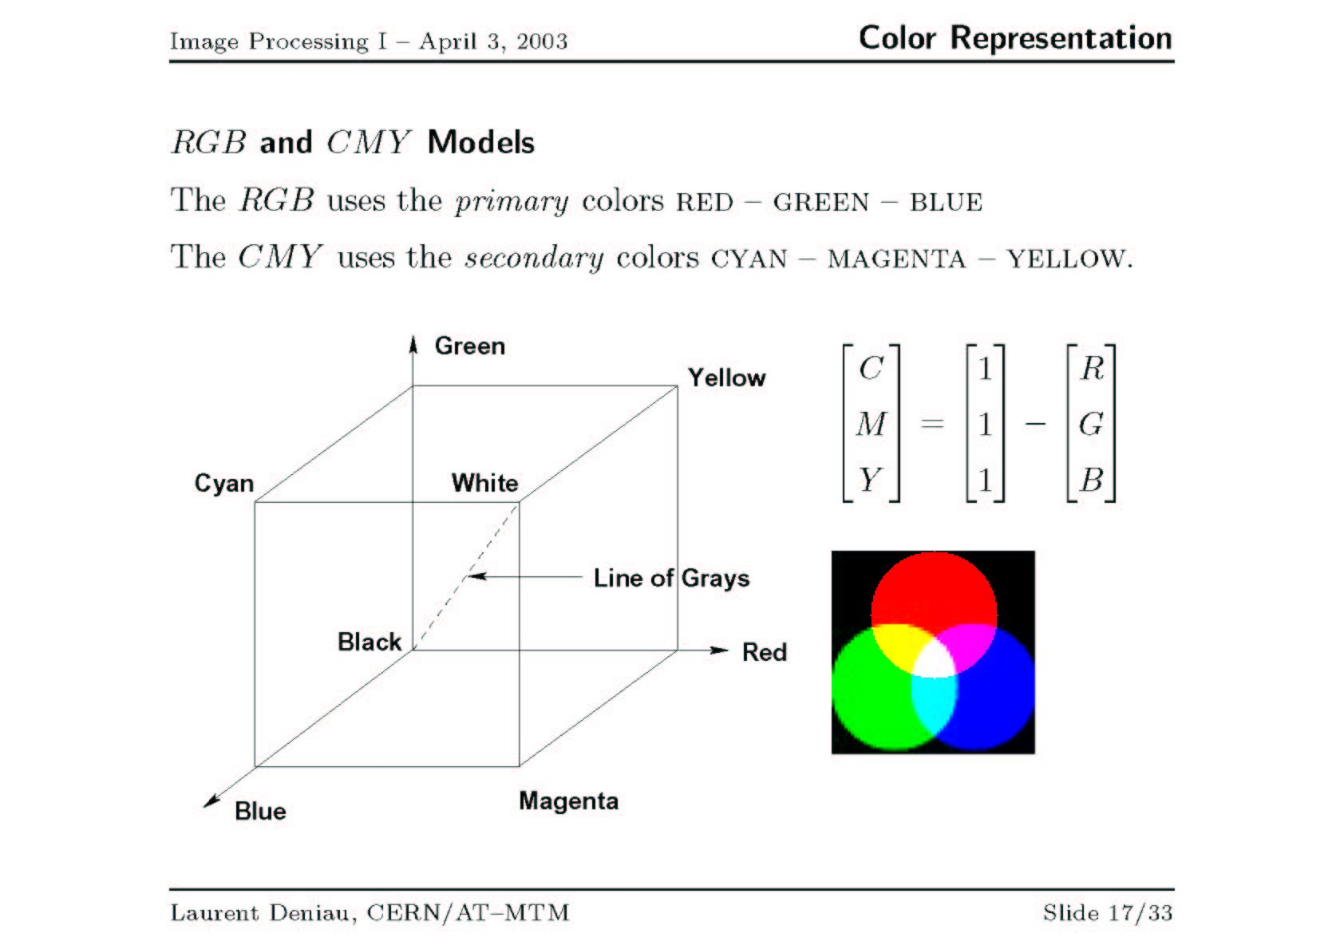

Slide 5
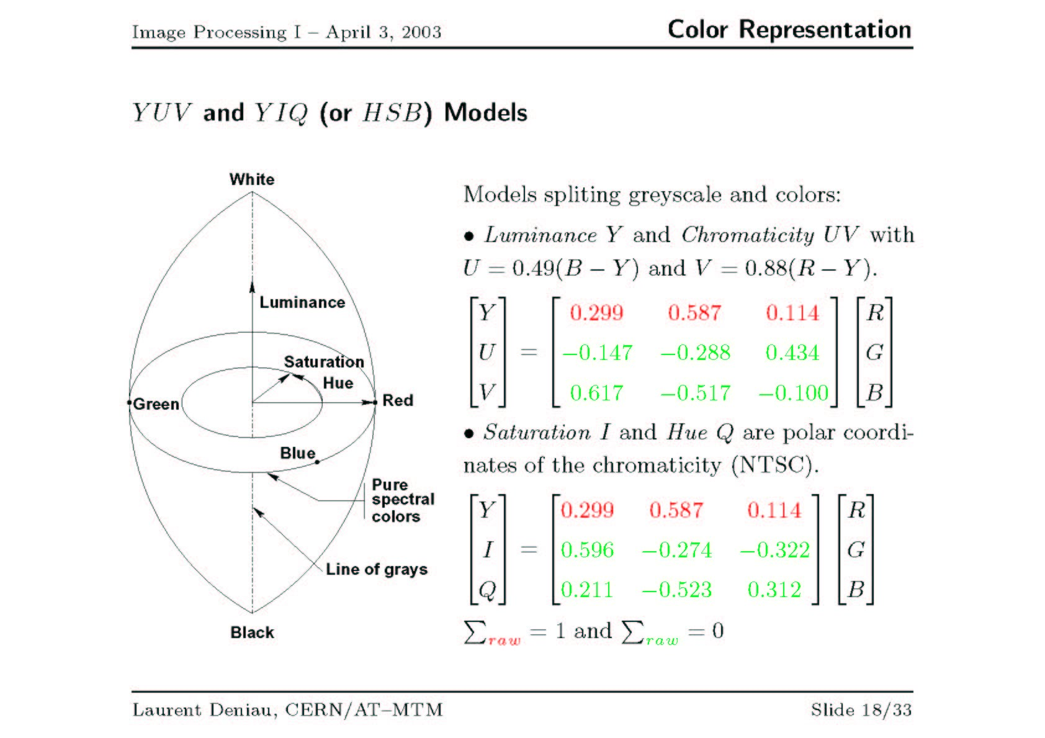
PAL: Phase Alteration by Line (British)
NTSC: National Television System Committee (USA)
Y = 0.30R + 0.59G + 0.11B

Slide 6
YIQ Color Model
Luminance (Y), Inphase (I), and Quadrature (Q)
Used for TV broadcasts – backward compatible with monochrome TV standards
Luminance is BW component
Human visual system is more sensitive to changes in intensity than in color.
In NTSC, bandwidth allocation of YIQ is 4MHz, 1.5 MHz, and 0.6 MHz respectively.
Y 0.299 0.587 0.144 R
I = 0.596 -.275 -.321 G
Q 0.212 -.528 0.311 B

Slide 7
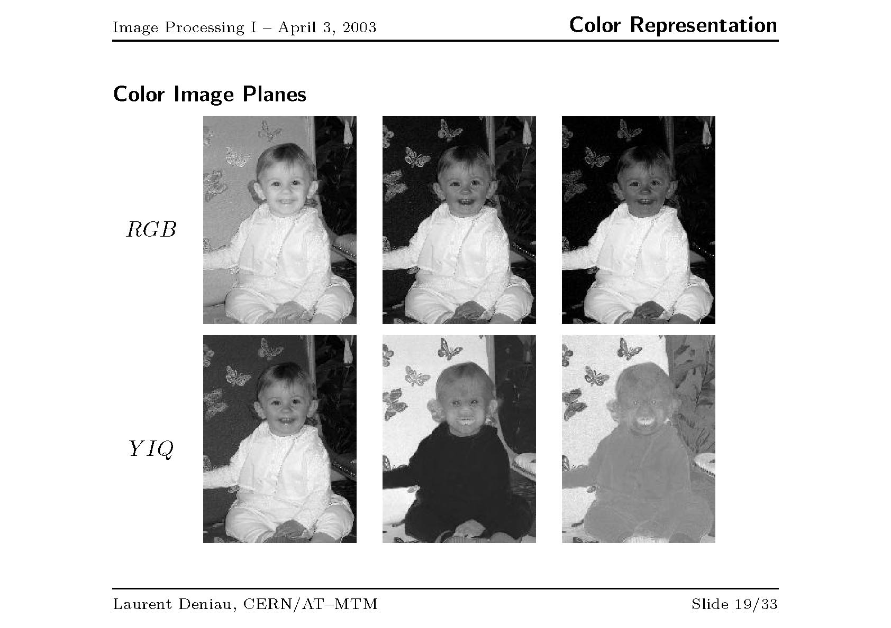

Slide 8
HSI Color Model
Based on human perception of colors. Color is “decoupled” from intensity.
HUE
A subjective measure of color
Average human eye can perceive ~200 different colors
Saturation
Relative purity of the color. Mixing more “white” with a color reduces its saturation.
Pink has the same hue as red but less saturation
Intensity
The brightness or darkness of an object

Slide 9
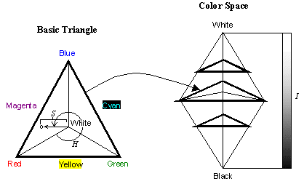
HSI Color Model
In color image processing, RGB images are often converted to HSI and then the I component is manipulated. The image is then converted back to RGB.

Slide 10
HSI Color Model
Hue is defined as an angle
0 degrees is RED
120 degrees is GREEN
240 degrees is BLUE
Saturation is defined as the percentage of distance from the center of the HSI triangle to the pyramid surface.
Values range from 0 to 1 (0 is achromatic and 1 is fully saturated)
Intensity is denoted as the distance “up” the axis from black.
Values range from 0 to 1

Slide 11
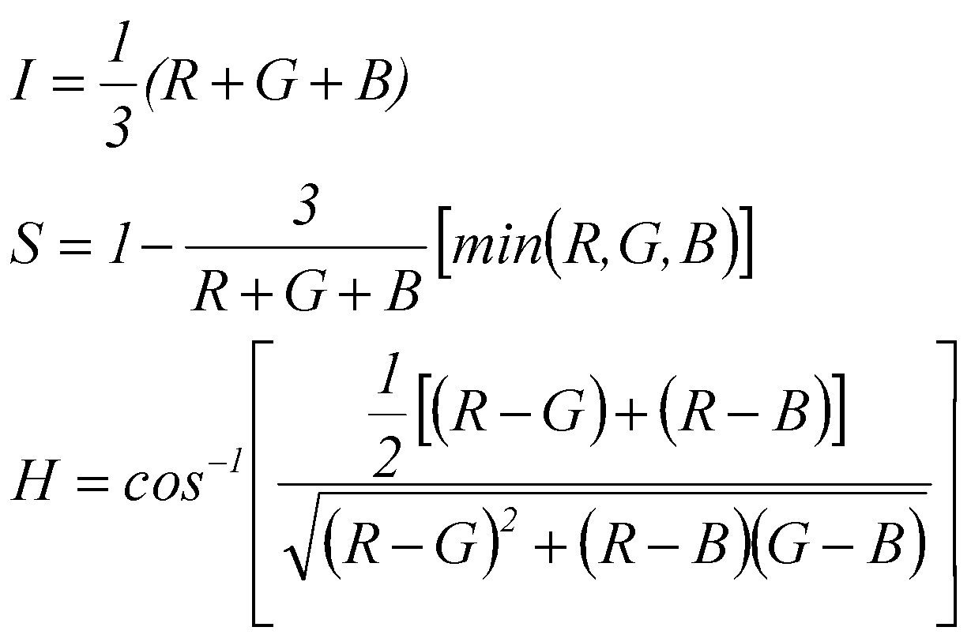
Converting between RGB and HSI
I = L = Y = V
If B is greater than G, then H = 360⁰ – H.

Slide 12
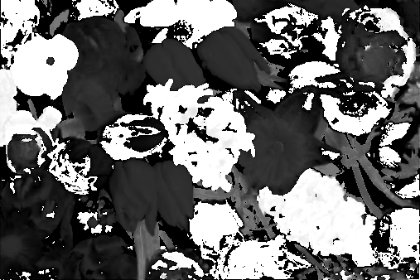
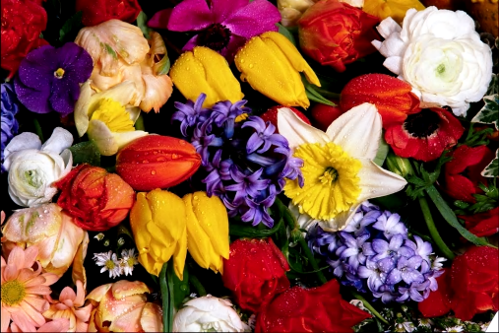
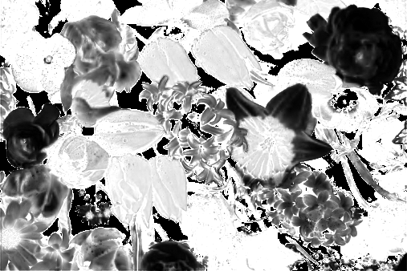
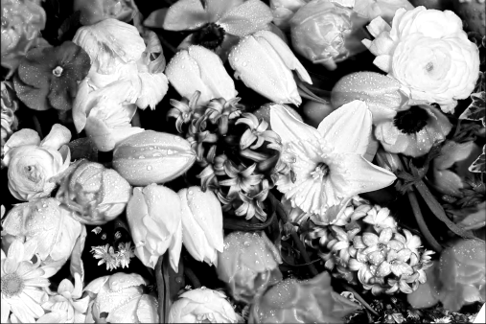
HSI Color Model
H
S
I

