Slide 1
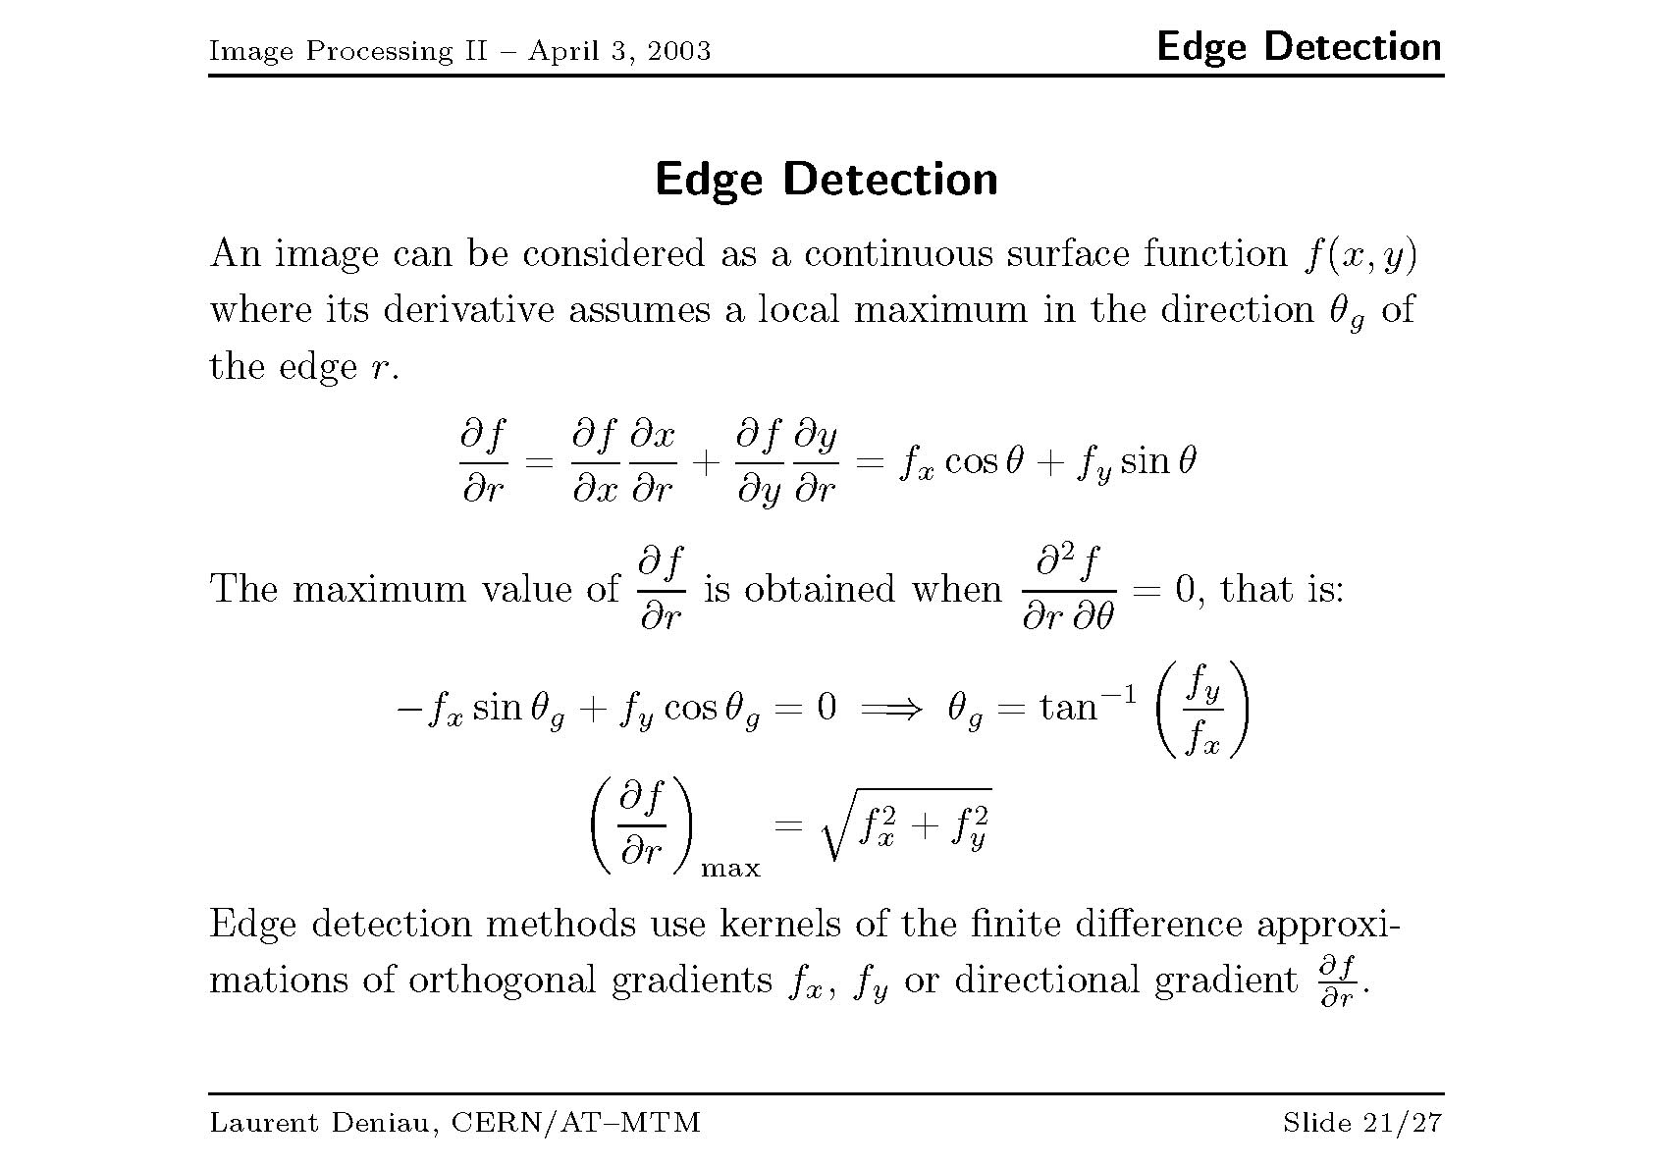

Slide 2
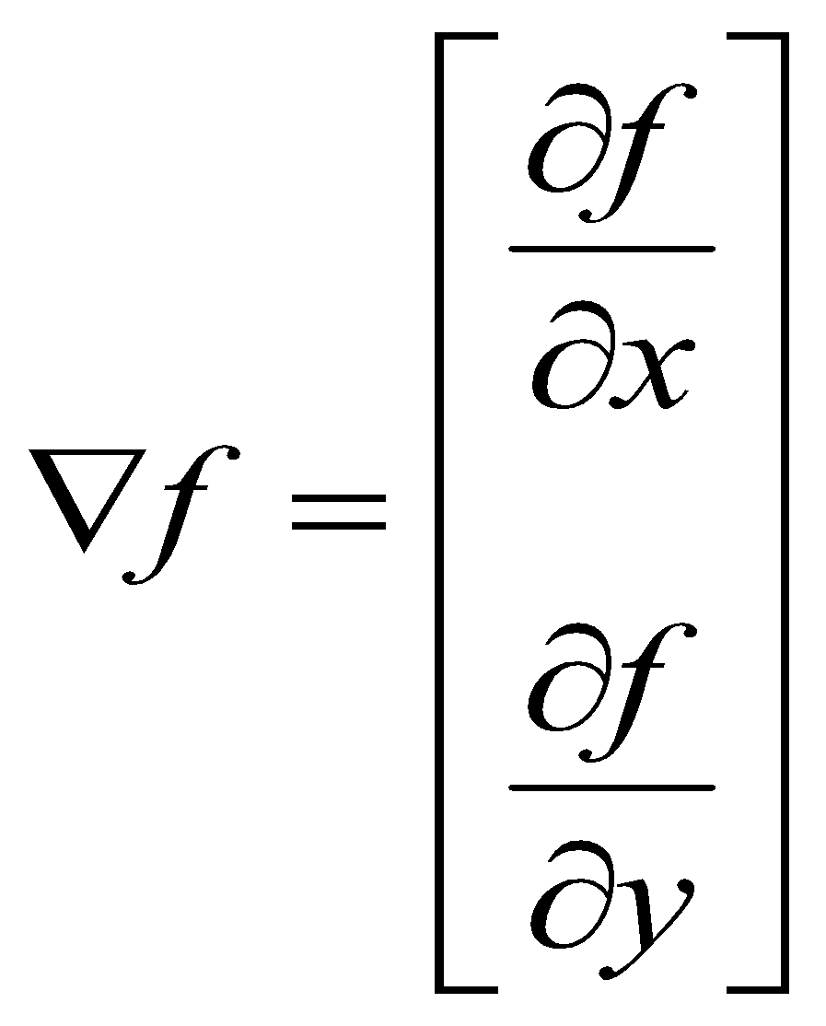
Derivative Filters (Edge Detection)
Averaging pixels is analogous to integration while sharpening is analogous to differentiation.
Derivative filters are usually used for edge detection.
The most common method is via the gradient operator.

Slide 3
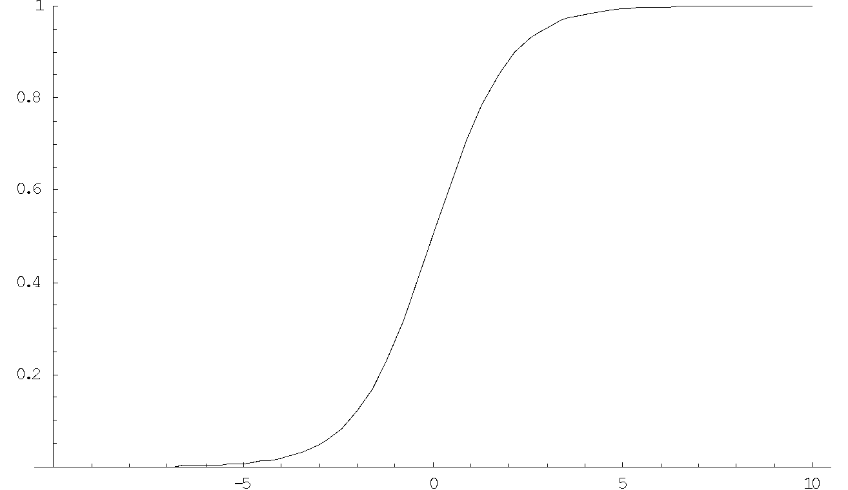
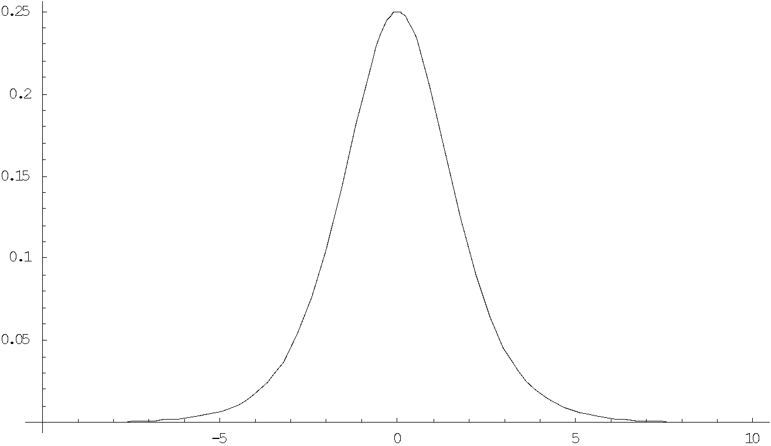
Edge Detection
An “edge” viewed as a one dimensional function.
The derivative of the edge shows a spike at the edge boundary.
Derivative filters produce images with high intensity at edges and low intensity at homogenous regions.

Slide 4
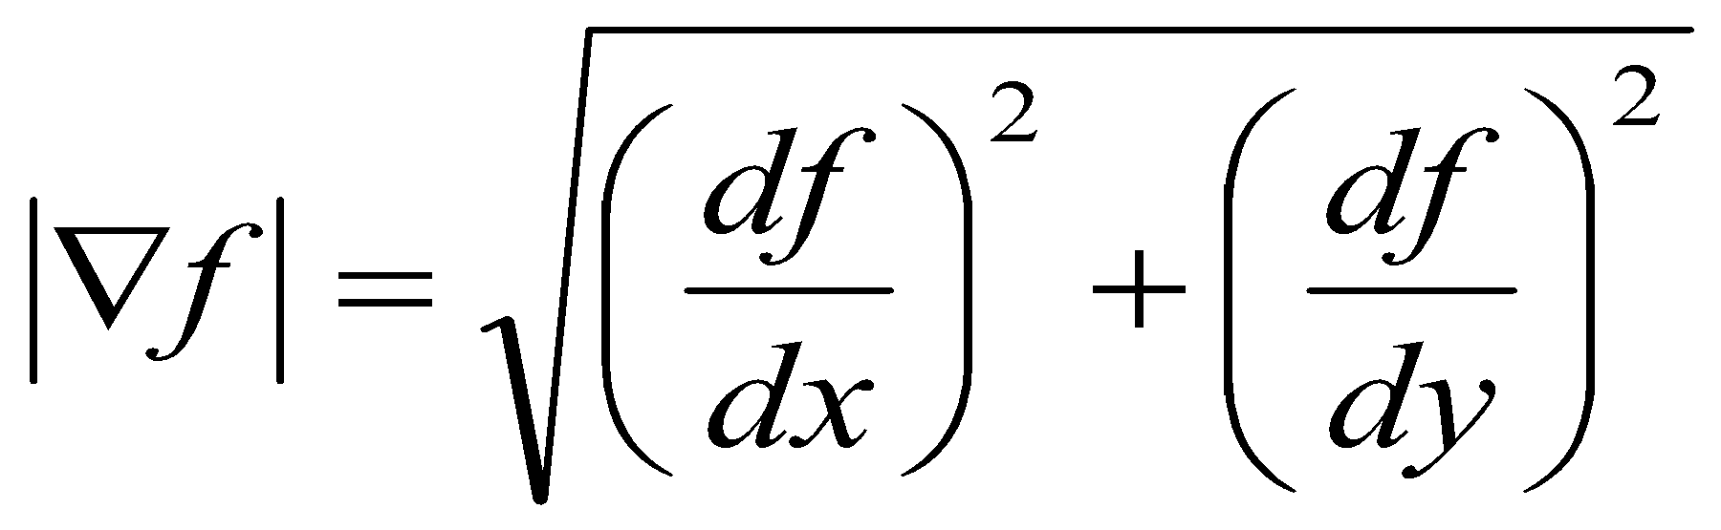
Derivative Filters (Edge Detection)
The gradient is a vector with magnitude given as
Given a an image f(x,y) we can approximate the gradient. Consider the 3x3 region shown below and approximate the gradient at Z5.
Z1 | Z2 | Z3
Z4 | Z5 | Z6
Z7 | Z8 | Z9
df/dx  Z5 – Z6
df/dy  Z5 – Z8

Slide 5
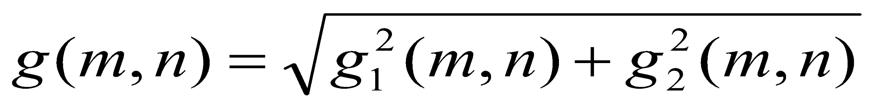
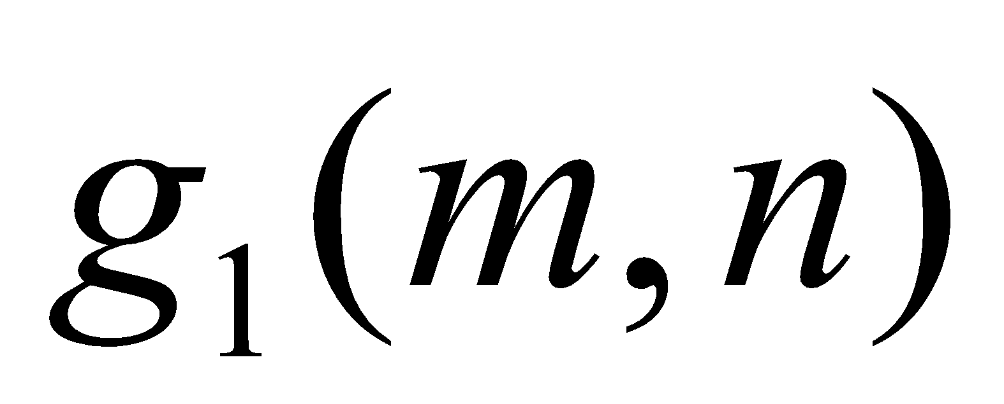
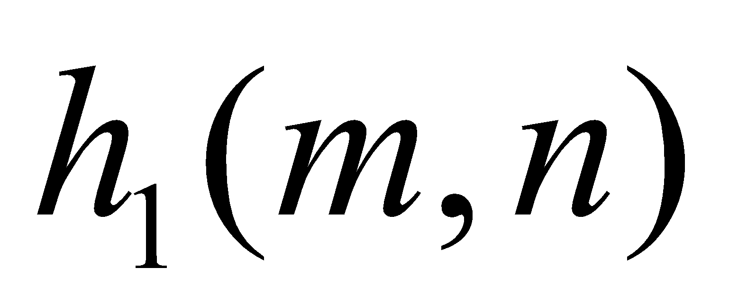
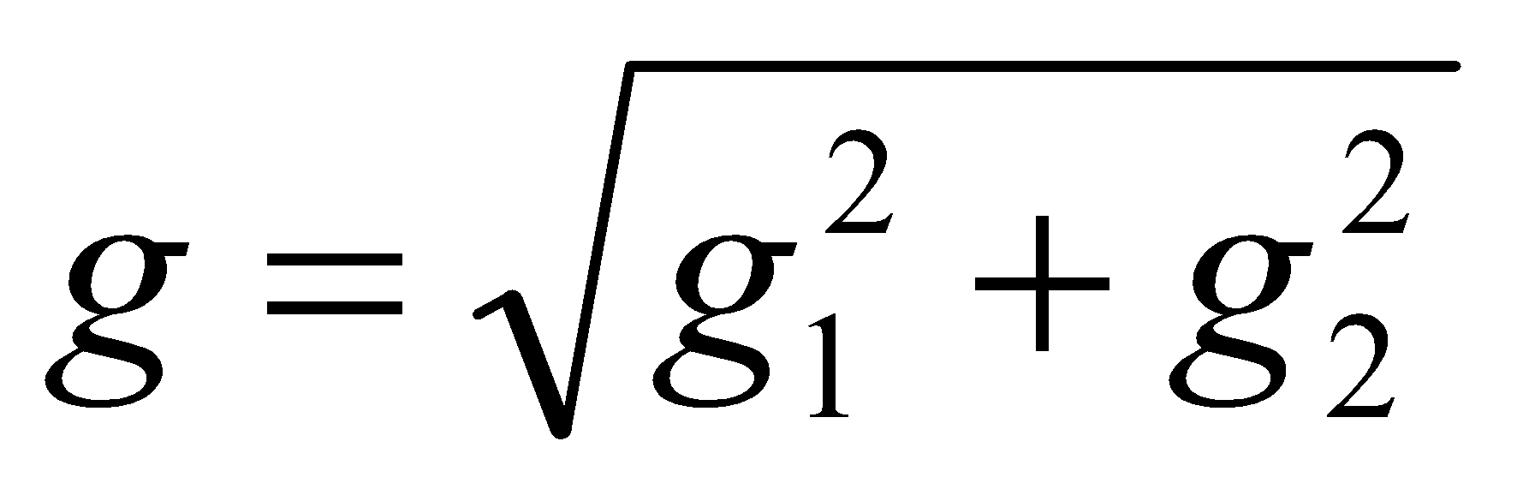
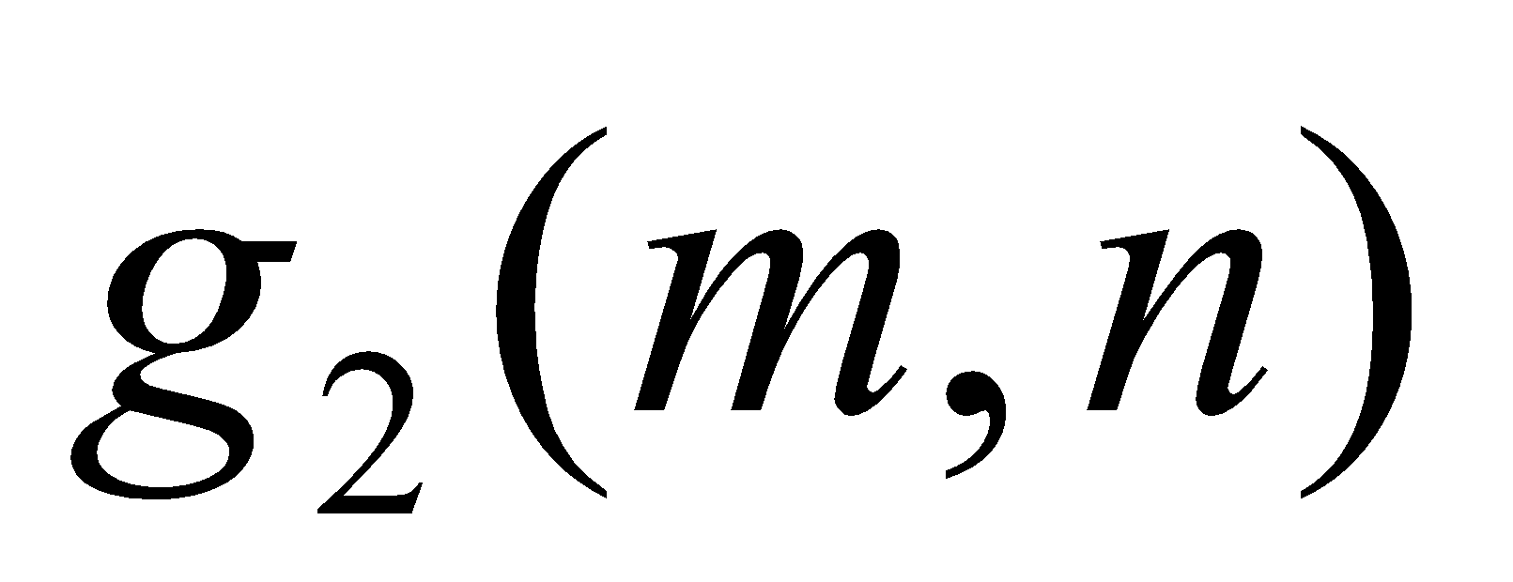
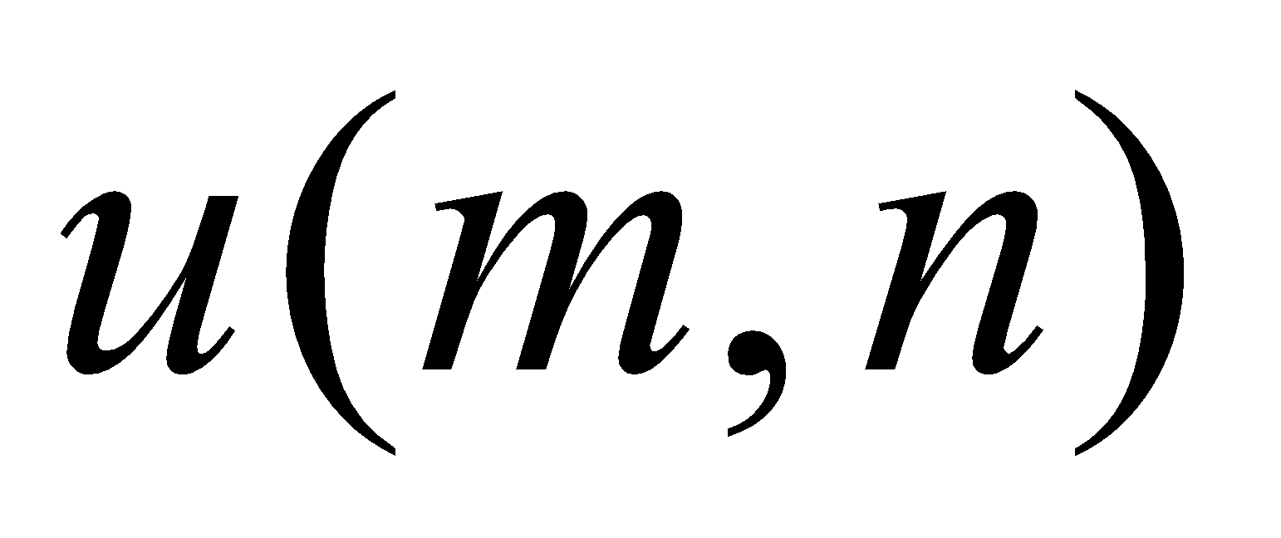
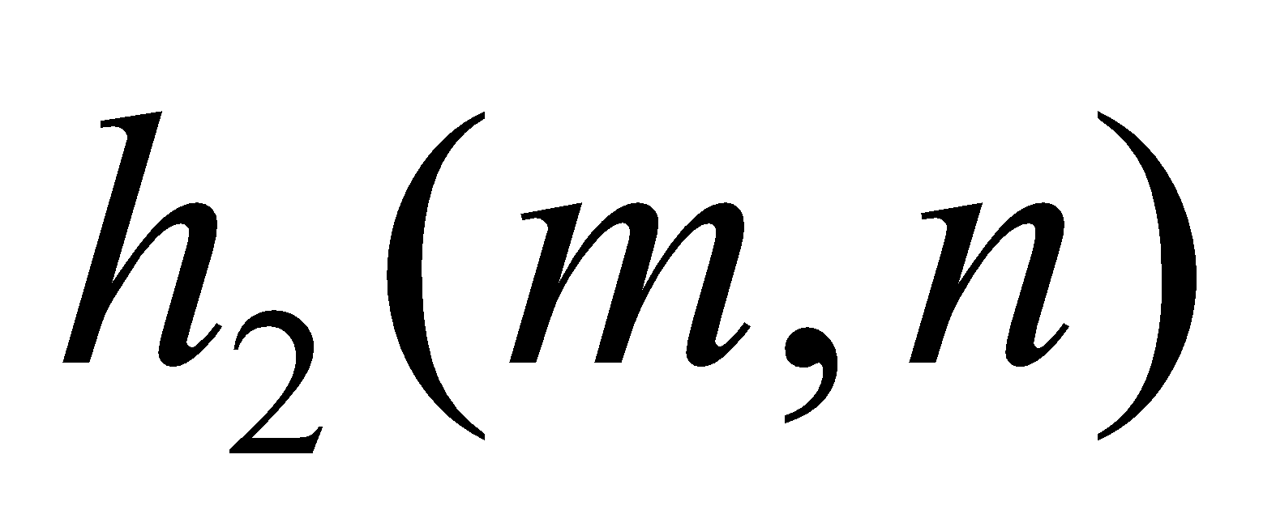
Edge Detection (Gradient Operators)
Edge detection is a fundamental problem in image analysis. Edge points in binary images as black pixels with at least one white nearest neighbor.
The gradient is a vector with magnitude given as
1
-1
0
0
Z1 | Z2 | Z3
Z4 | Z5 | Z6
Z7 | Z8 | Z9
1
0
Threshold
Input Image
-1
0
Edge map

Slide 6
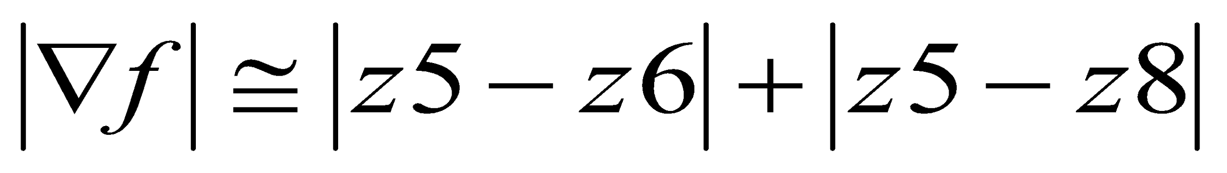
Derivative Filters (Edge Detection)
Roberts Operator
Define a kernel to implement the gradient approximation
1
-1
Absolute
Value
0
0
Z1 | Z2 | Z3
Z4 | Z5 | Z6
Z7 | Z8 | Z9
+
1
0
Absolute
Value
Input Image
-1
0

Slide 7
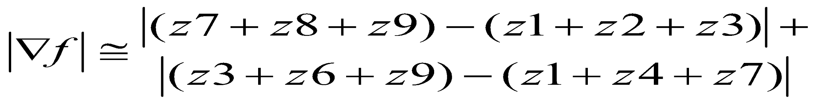
Derivative Filters (Edge Detection)
Prewitt Operator
Even-sized masks are awkward to implement. We can again approximate the magnitude of the gradient at the center of a 3x3 region as
-1
-1
-1
Absolute
Value
0
0
0
Z1
Z2
Z3
1
1
1
Z4
Z5
Z6
+
Z7
Z8
Z9
-1
0
1
-1
0
1
Absolute
Value
Input Image
-1
0
1

Slide 8
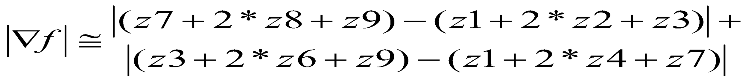
Derivative Filters (Edge Detection)
Sobel Operator
Derivative filters are terribly sensitive to noise. The Sobel filter (shown below) both blurs and differentiates an image providing good noise-resistant edge detection.
-1
-2
-1
Absolute
Value
0
0
0
Z1
Z2
Z3
1
2
1
Z4
Z5
Z6
+
Z7
Z8
Z9
-1
0
1
-2
0
2
Absolute
Value
Input Image
-1
0
1

Slide 9
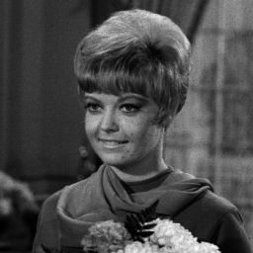
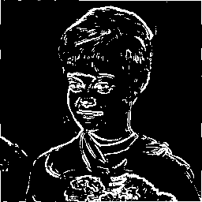
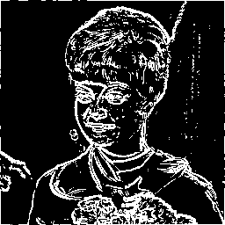
Edge Detection
Threshold=125
Original
image
Edge detection
Prewitt Operator
Edge detection
Sobel Operator

Slide 10
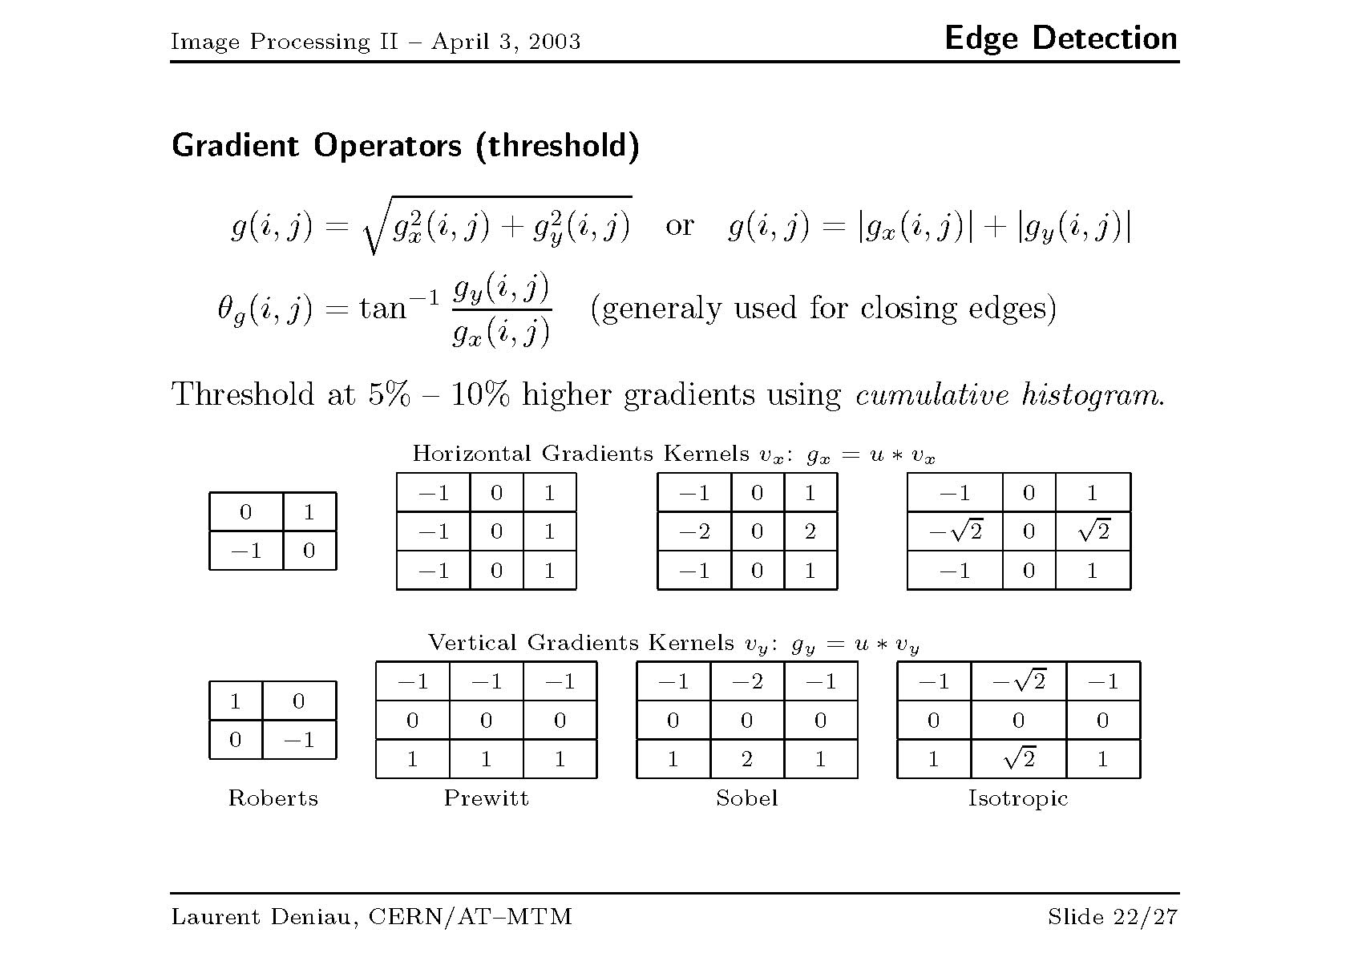

Slide 11
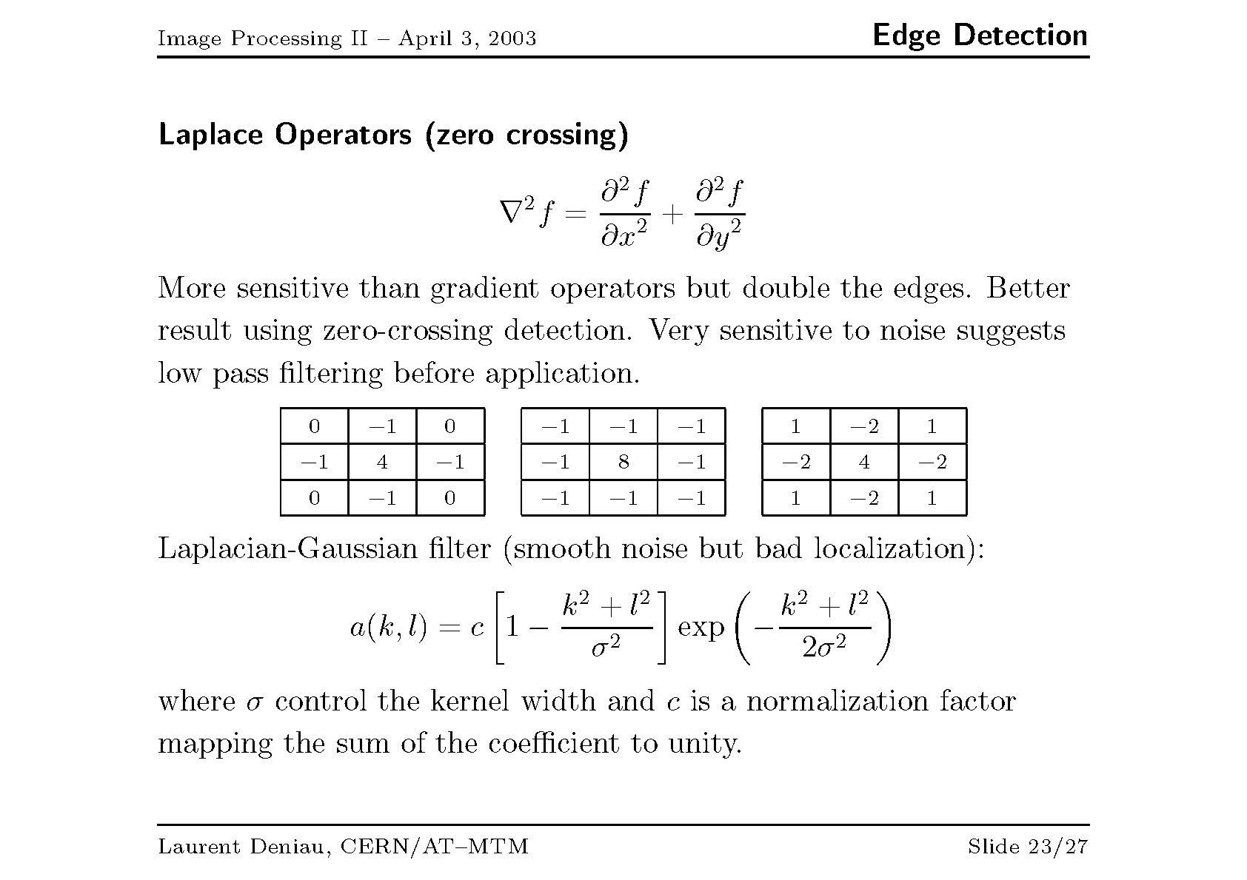

Slide 12
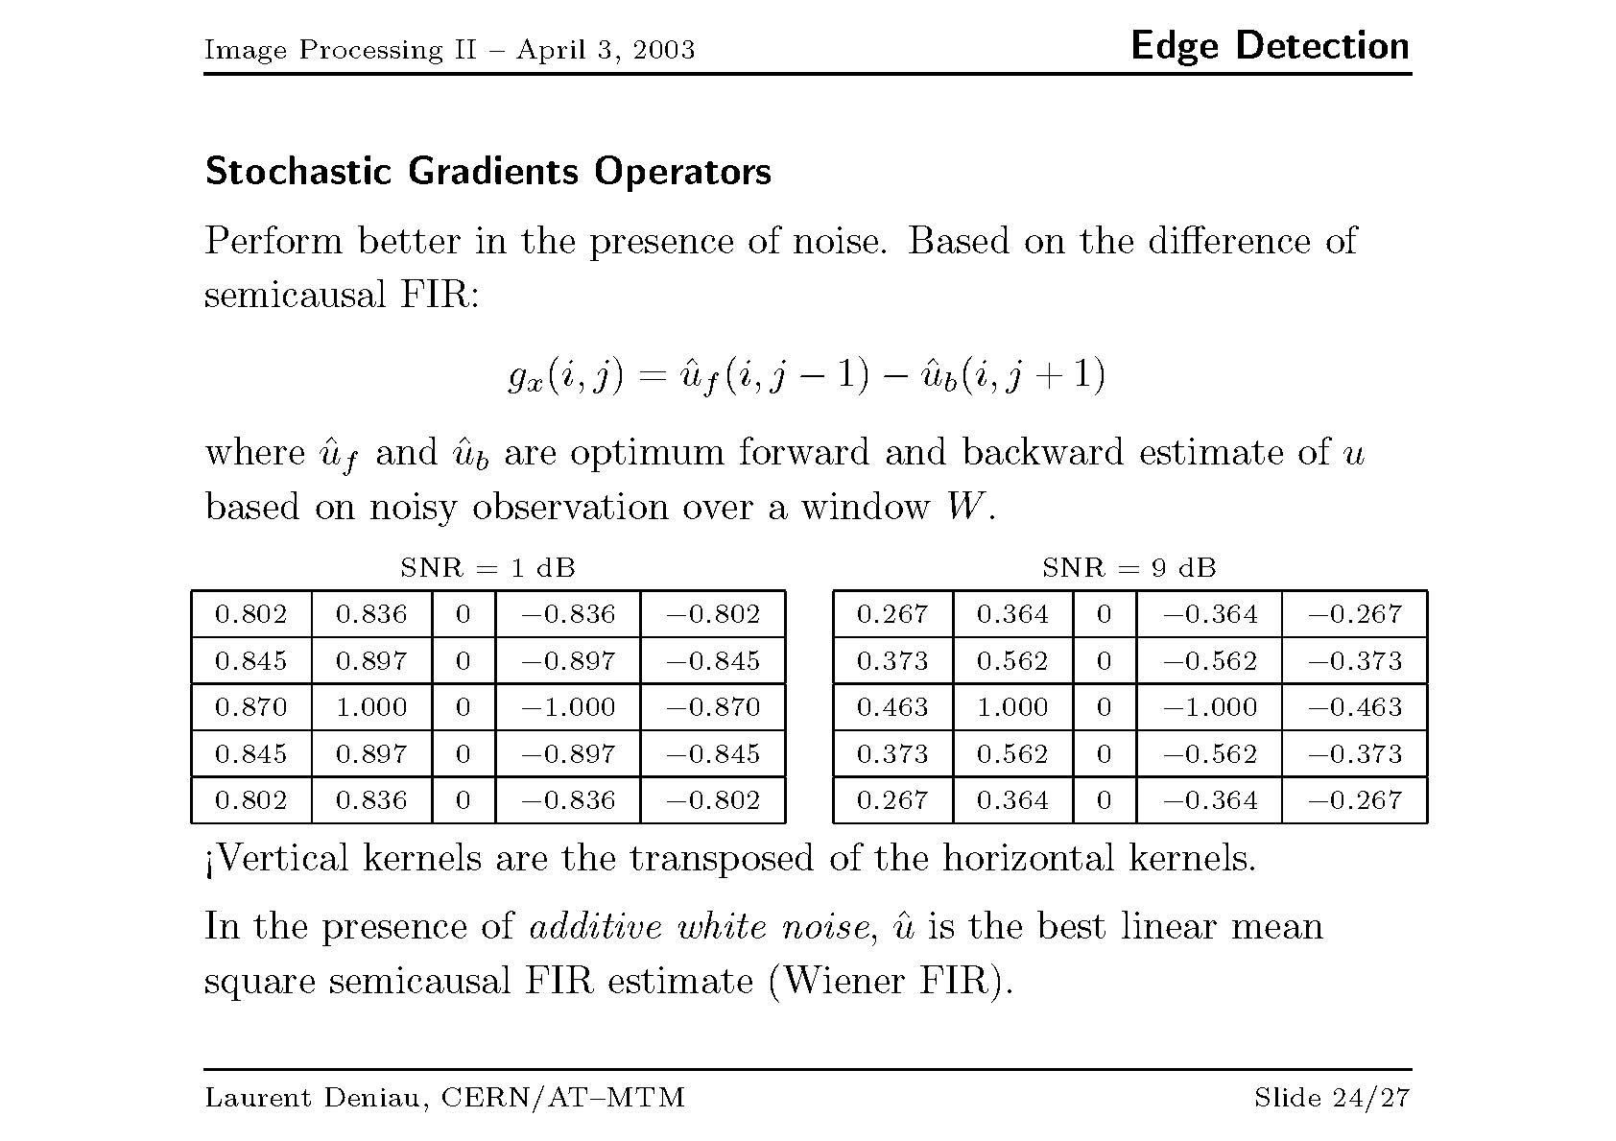

Slide 13
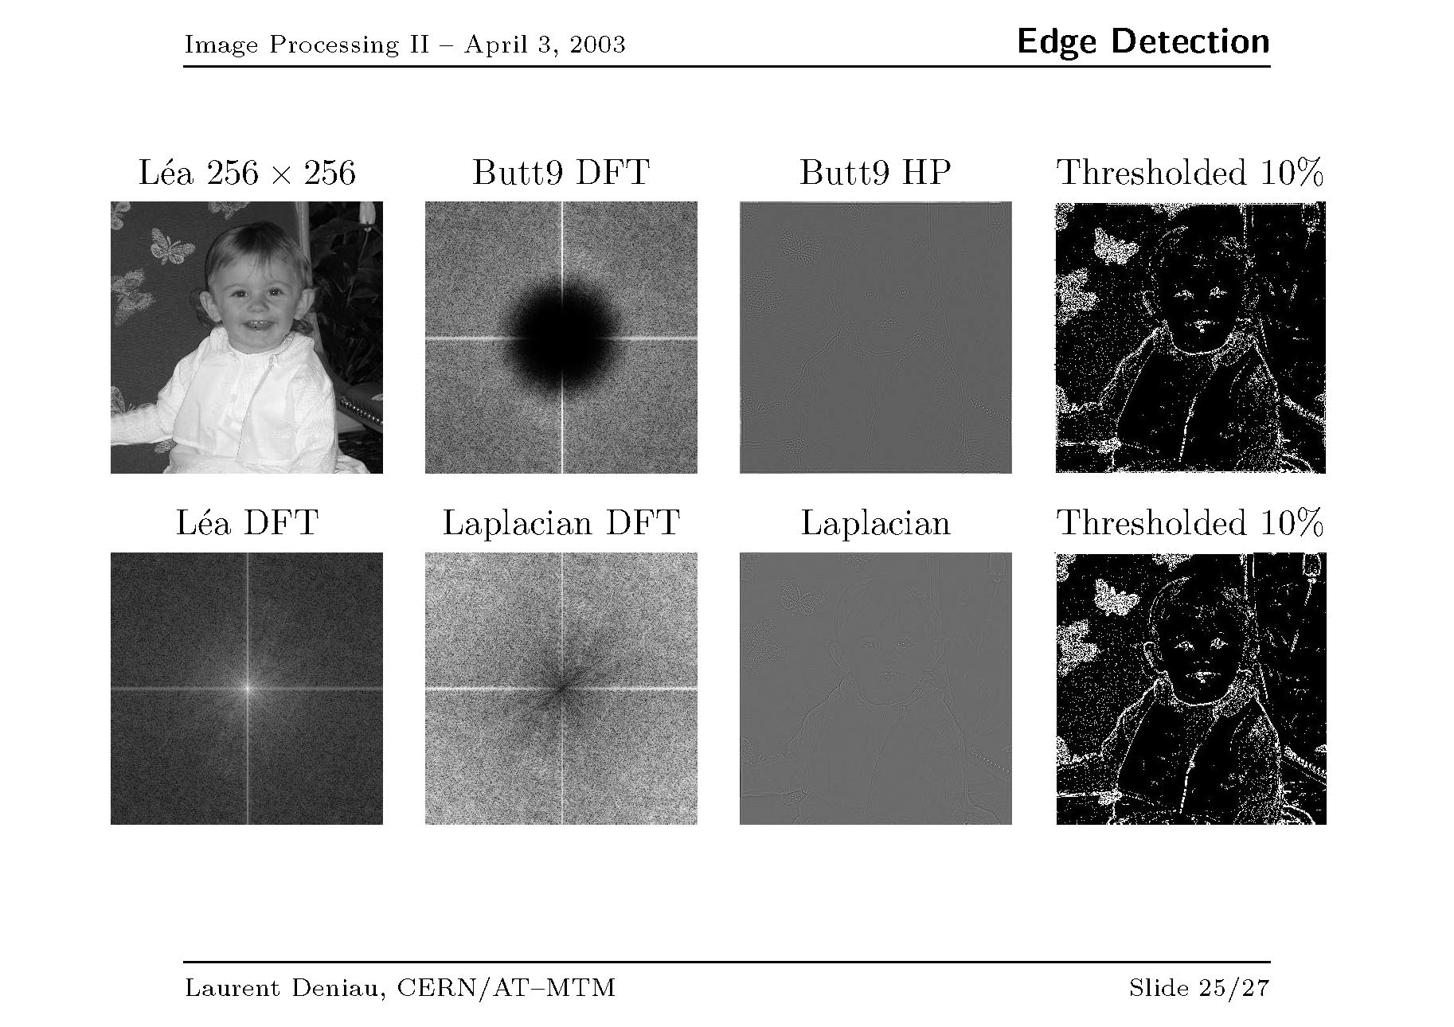

Slide 14
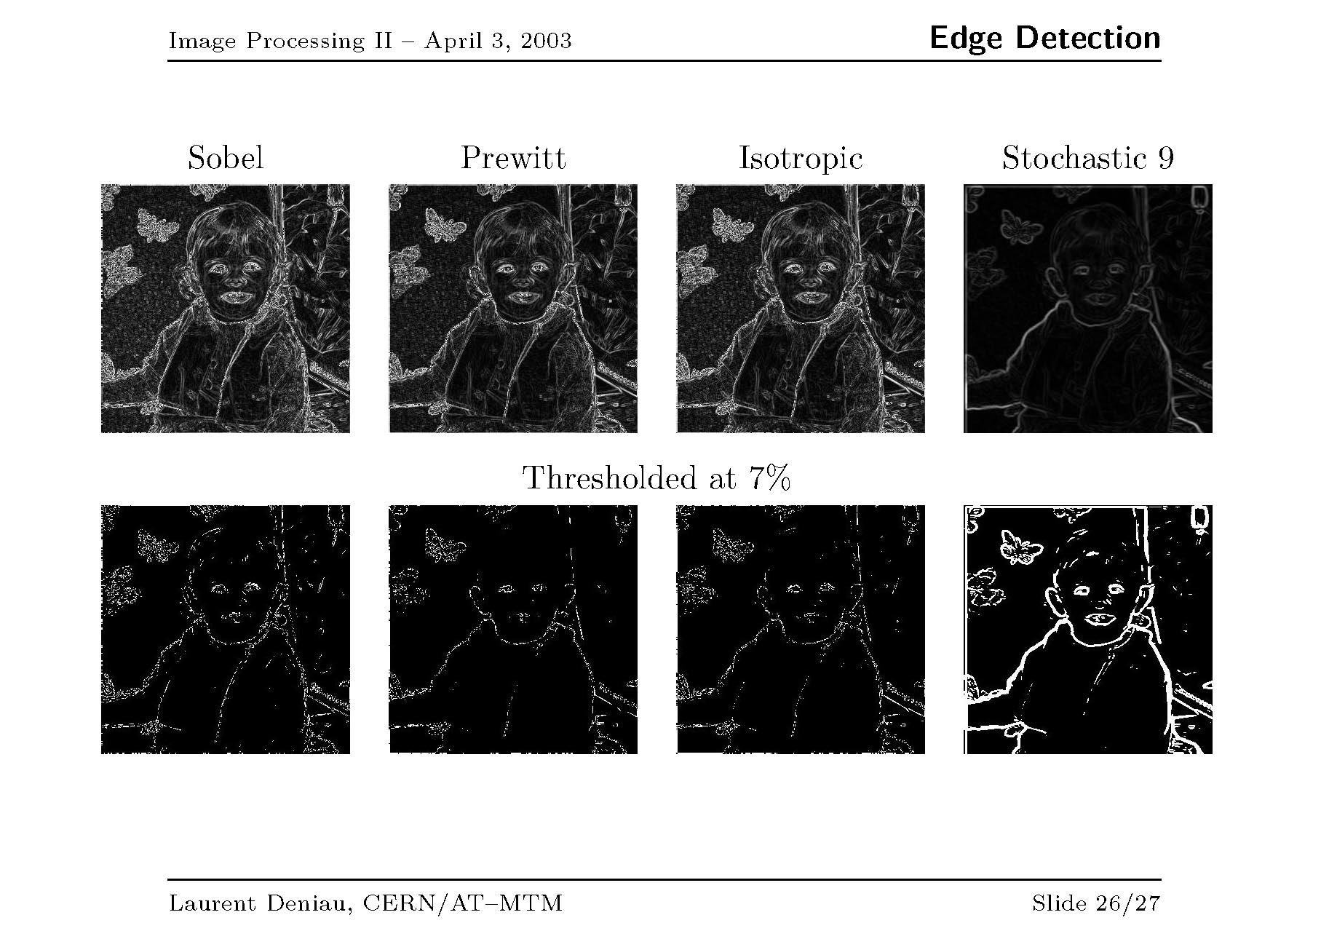

Slide 15
