Slide 1
Hough Transform
Reading
Watt, 10.3-10.4

Slide 2
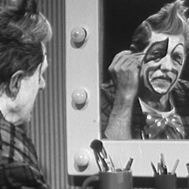
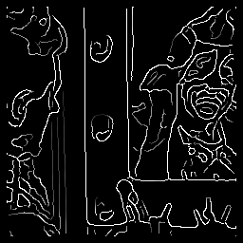
An edge is not a line...
How can we detect lines ?

Slide 3
Finding lines in an image
Option 1:
Search for the line at every possible position/orientation
What is the cost of this operation?
Option 2:
Use a voting scheme: Hough transform

Slide 4

Finding lines in an image
y
b
b₀
x
m₀
m
image space
Hough space
Connection between image (x,y) and Hough (m,b) spaces
A line in the image corresponds to a point in Hough space
To go from image space to Hough space:
given a set of points (x,y), find all (m,b) such that y = mx + b

Slide 5

Finding lines in an image
y
b
y₀
x₀
x
m
image space
Hough space
Connection between image (x,y) and Hough (m,b) spaces
A line in the image corresponds to a point in Hough space
To go from image space to Hough space:
given a set of points (x,y), find all (m,b) such that y = mx + b
What does a point (x₀, y₀) in the image space map to?
A: the solutions of b = -x₀m + y₀
this is a line in Hough space

Slide 6

Hough transform algorithm
Typically use a different parameterization
d is the perpendicular distance from the line to the origin
θ is the angle this perpendicular makes with the x axis
Why?

Slide 7
Hough transform algorithm
Typically use a different parameterization
d is the perpendicular distance from the line to the origin
θ is the angle this perpendicular makes with the x axis
Why?
Basic Hough transform algorithm
Initialize H[d, θ]=0
for each edge point I[x,y] in the image
for θ = 0 to 180
H[d, θ] += 1
Find the value(s) of (d, θ) where H[d, θ] is maximum
The detected line in the image is given by
What’s the running time (measured in # votes)?
Hough line demo

Slide 8
Extensions
Extension 1: Use the image gradient
same
for each edge point I[x,y] in the image
compute unique (d, θ) based on image gradient at (x,y)
H[d, θ] += 1
same
same
What’s the running time measured in votes?
Extension 2
give more votes for stronger edges
Extension 3
change the sampling of (d, θ) to give more/less resolution
Extension 4
The same procedure can be used with circles, squares, or any other shape

Slide 9
Extensions
Extension 1: Use the image gradient
same
for each edge point I[x,y] in the image
compute unique (d, θ) based on image gradient at (x,y)
H[d, θ] += 1
same
same
What’s the running time measured in votes?
Extension 2
give more votes for stronger edges
Extension 3
change the sampling of (d, θ) to give more/less resolution
Extension 4
The same procedure can be used with circles, squares, or any other shape
Hough circle demo

