Slide 1
Hough Transform
Jeremy Wyatt

Slide 2
The story so far
We know how to find edges by convolving with the derivative of a Gaussian filter in two directions
We then align the resulting images and calculate the magnitude of the intensity change
We can threshold this intensity change magnitude
x = conv2(shakey,first_order_gaussian_filter_1d_length5,'valid');
y = conv2(shakey,first_order_gaussian_filter_1d_length5','valid');
[x,y] = clip(x,y);
m = magnitude(x,y);
figure(1)
show_image(shakey)
figure(2)
show_image(m>20)

Slide 3
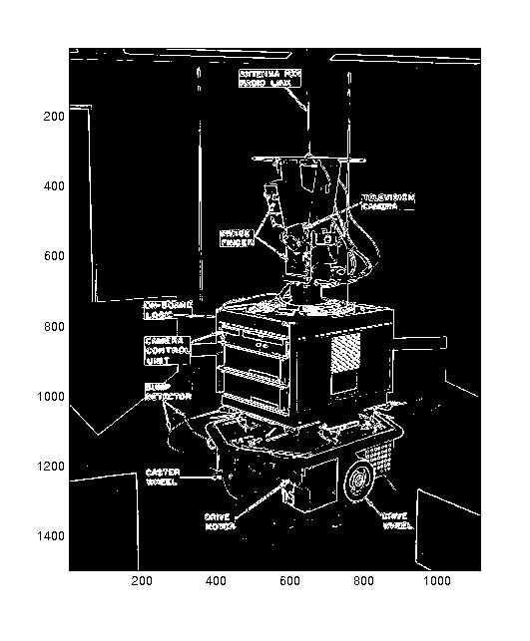
Finding edge features
But we haven’t found edge segments, only edge points
How can we find and describe more complex features?
The Hough transform is a common approach to finding parameterised line segments (here straight lines)

Slide 4
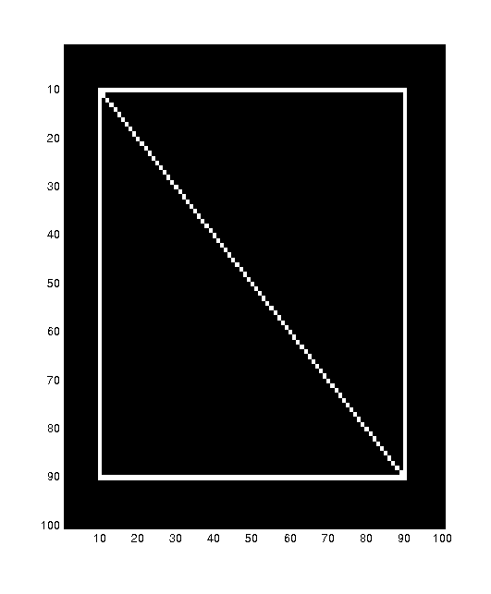
The basic idea
Each straight line in this image can be described by an equation
Each white point if considered in isolation could lie on an infinite number of straight lines

Slide 5
The basic idea
Each straight line in this image can be described by an equation
Each white point if considered in isolation could lie on an infinite number of straight lines
In the Hough transform each point votes for every line it could be on
The lines with the most votes win

Slide 6
How do we represent lines?
Any line can be represented by two numbers
Here we will represent the yellow line by (w,φ)
In other words we define it using
- a line from an agreed origin
- of length w
- at angle φ to the horizontal
φ
w

Slide 7
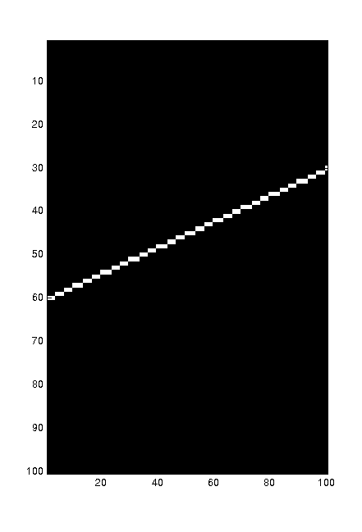
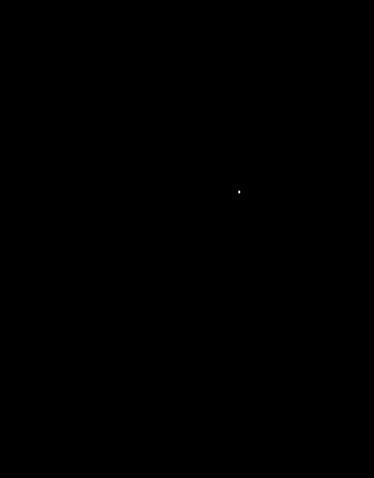
Hough space
φ
w
Since we can use (w,φ) to represent any line in the image space
We can represent any line in the image space as a point in the plane defined by (w,φ)
This is called Hough space
φ=0
φ=180
w=0 w=100

Slide 8
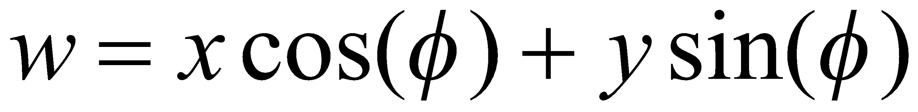
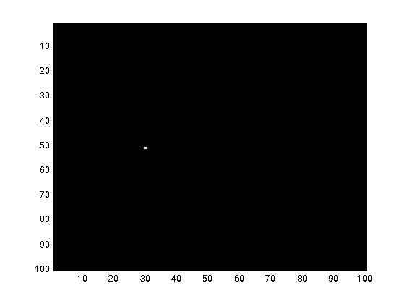
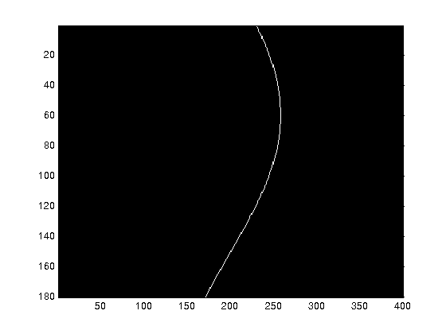
How does a point in image space vote?
φ
φ=0
w
φ=180
w=0 w=100

Slide 9
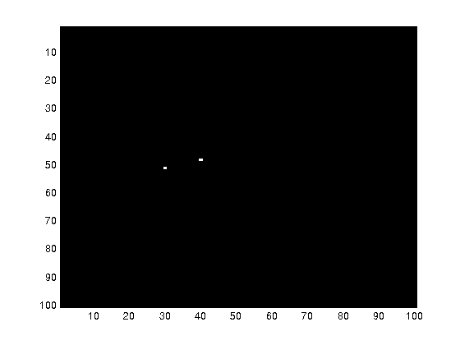
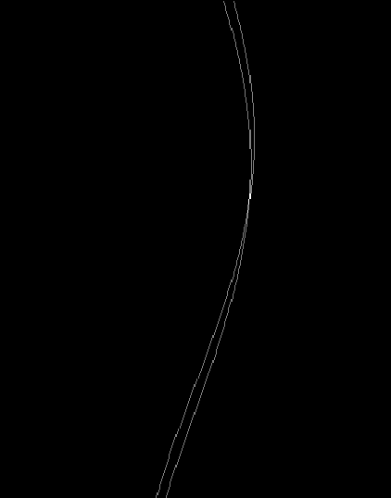
How do multiple points prefer one line?
One point in image space corresponds to a sinusoidal curve in image space
Two points correspond to two curves in Hough space
The intersection of those two curves has “two votes”.
This intersection represents the straight line in image space that passes through both points

Slide 10
Hough Transform
Create φ and w for all possible lines
Create an array A indexed by φ and w
for each point (x,y)
for each angle φ
w = x*cos(φ)+ y*sin(φ)
A[φ,w] = A[φ,w]+1
end
end
where A > Threshold return a line

Slide 11
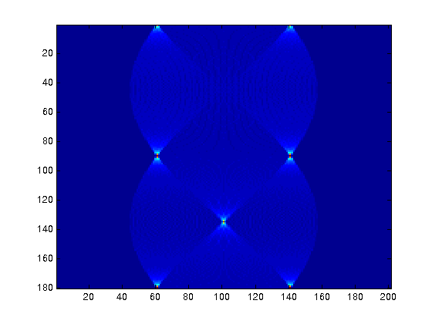
A simple example
φ
w

Slide 12
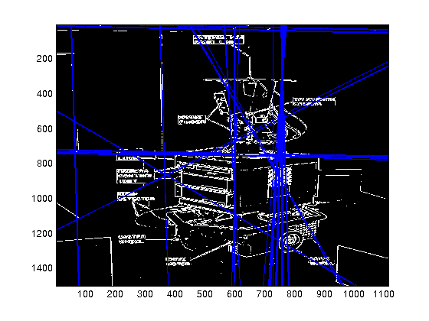
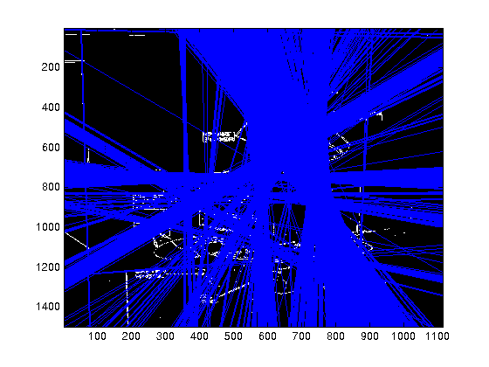
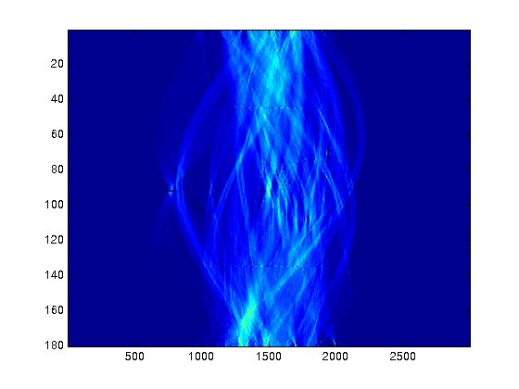

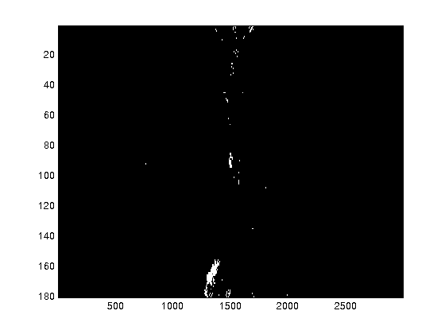

Slide 13
Hough Transform
There are generalised versions for ellipses, circles
For the straight line transform we need to supress non-local maxima
The input image could also benefit from edge thinning
Single line segments not isolated
Will still fail in the face of certain textures

