Slide 1

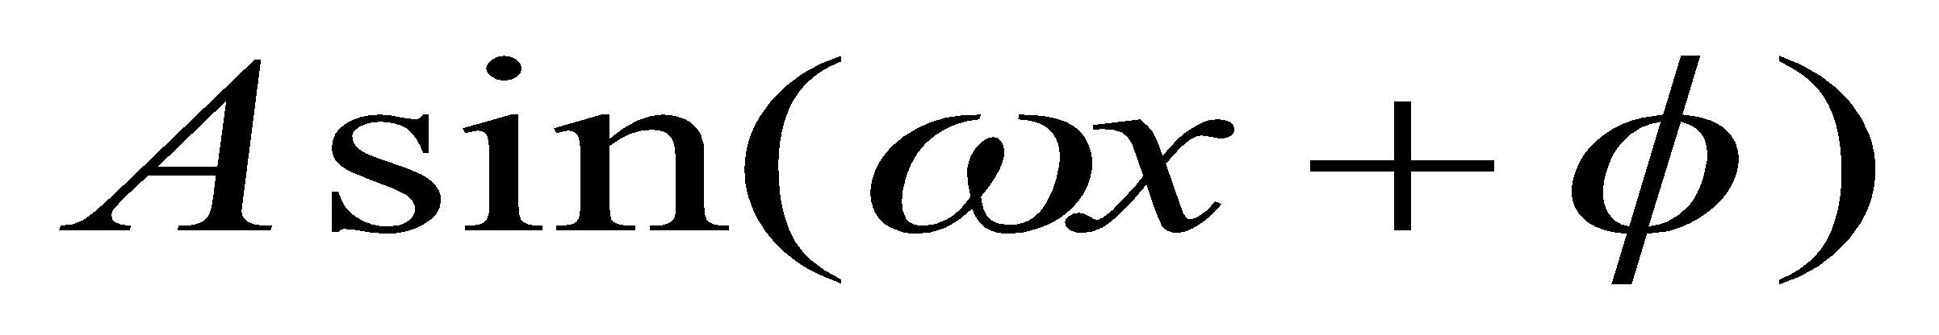
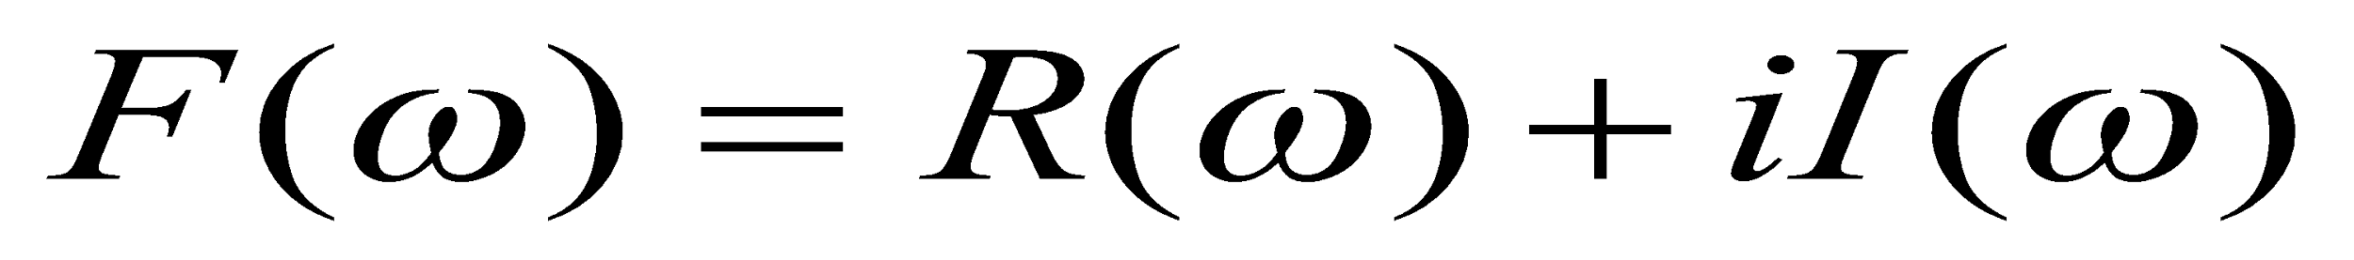
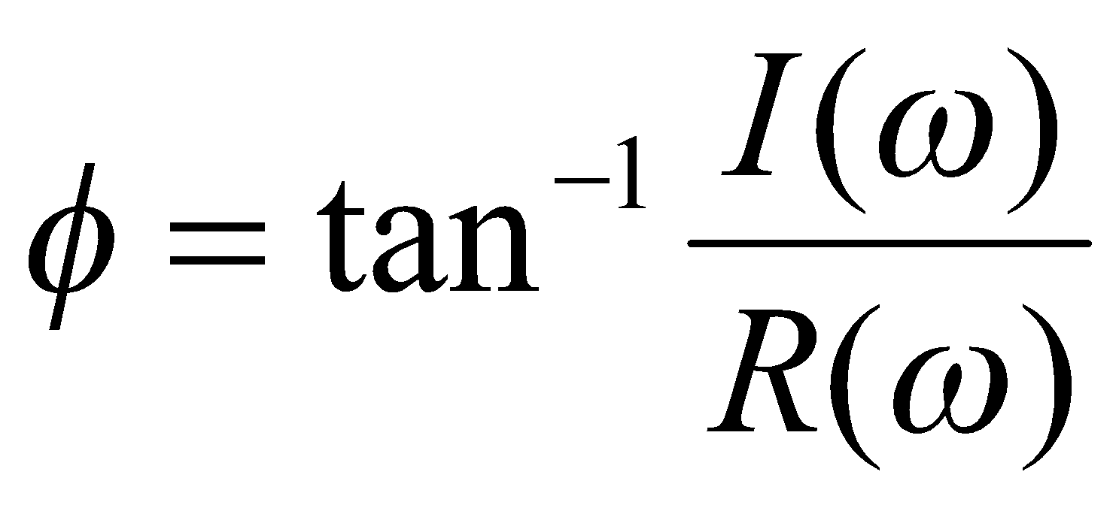
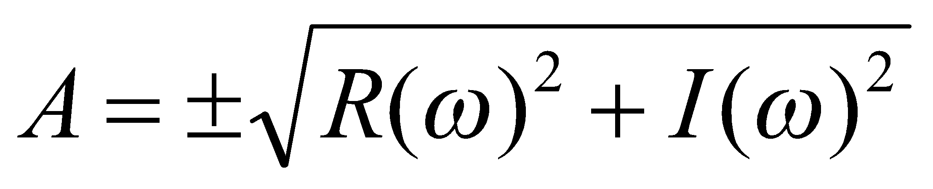
Fourier Transform
We want to understand the frequency w of our signal. So, let’s reparametrize the signal by w instead of x:
f(x)
Fourier
Transform
F(ω)
For every w from 0 to ∞, F(w) holds the amplitude A and phase Φ of the corresponding
We can always go back:
F(ω)
Inverse Fourier
Transform
f(x)

Slide 2
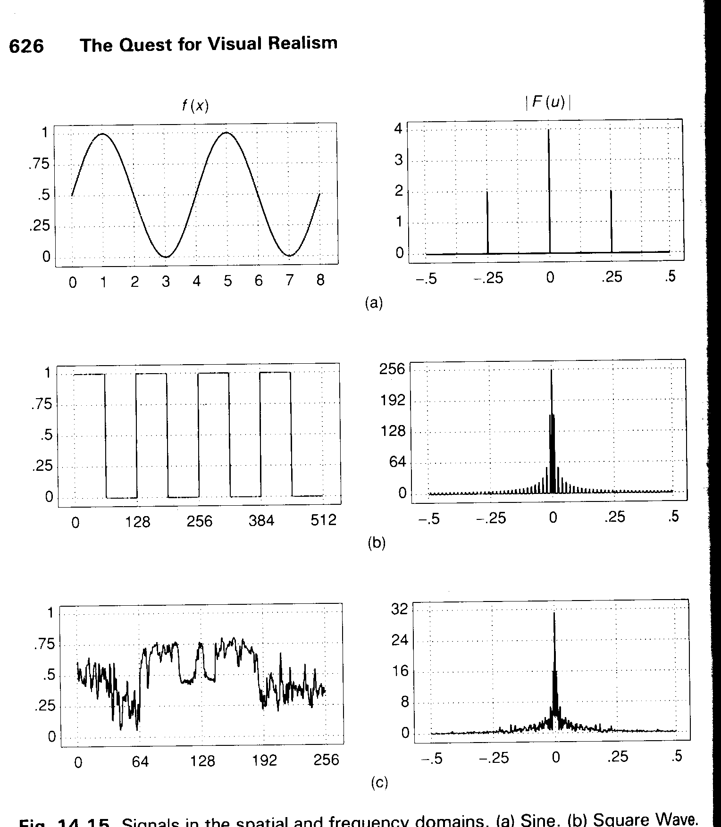
Frequency Spectra

Slide 3
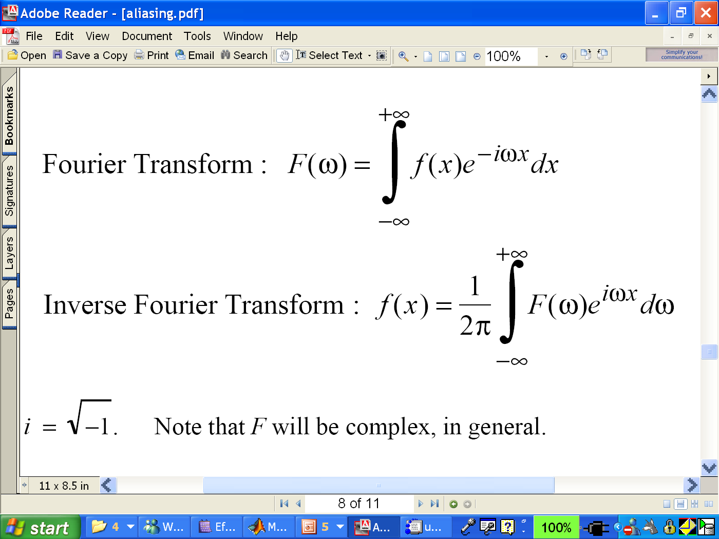
Fourier Transform

Slide 4
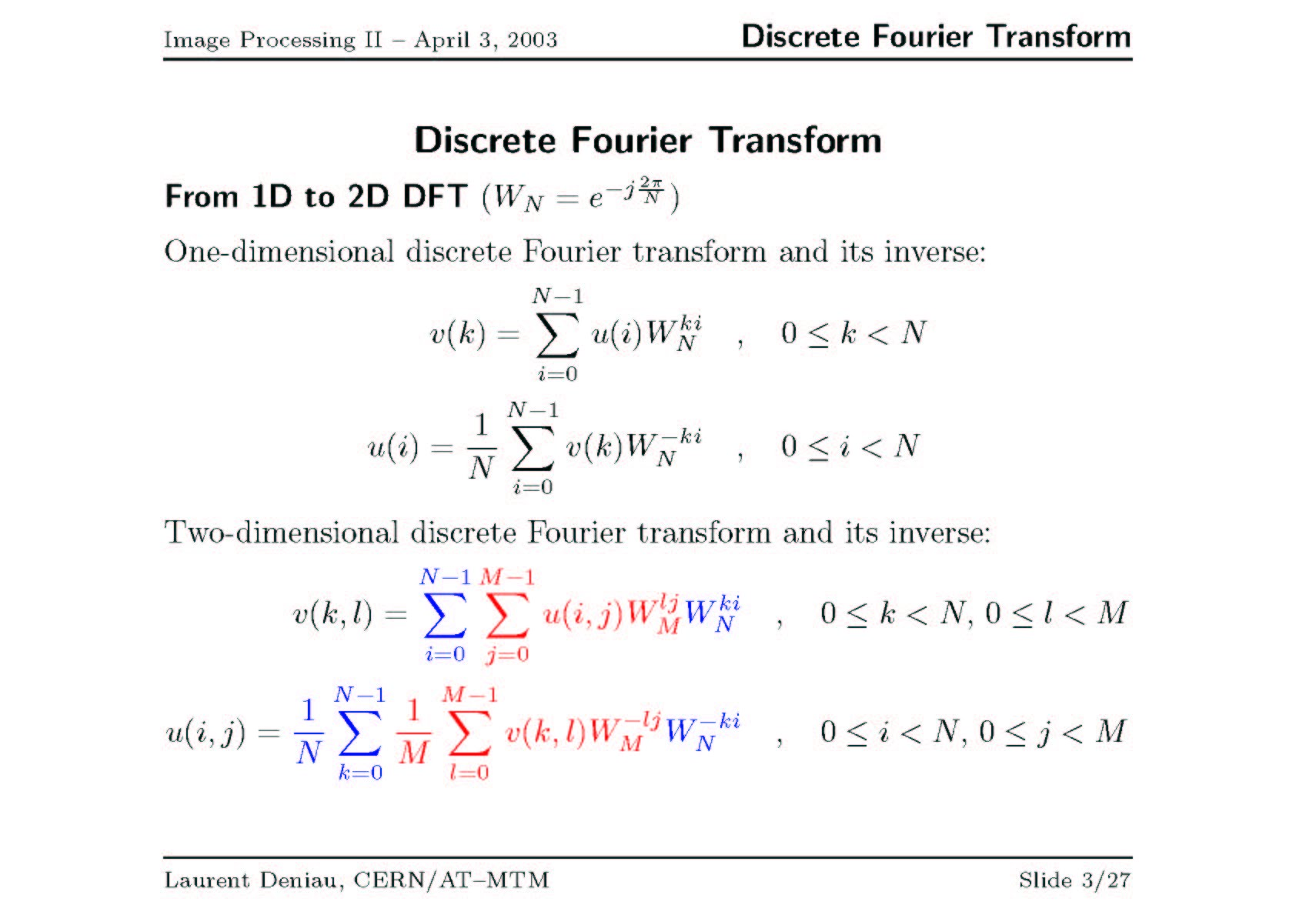

Slide 5
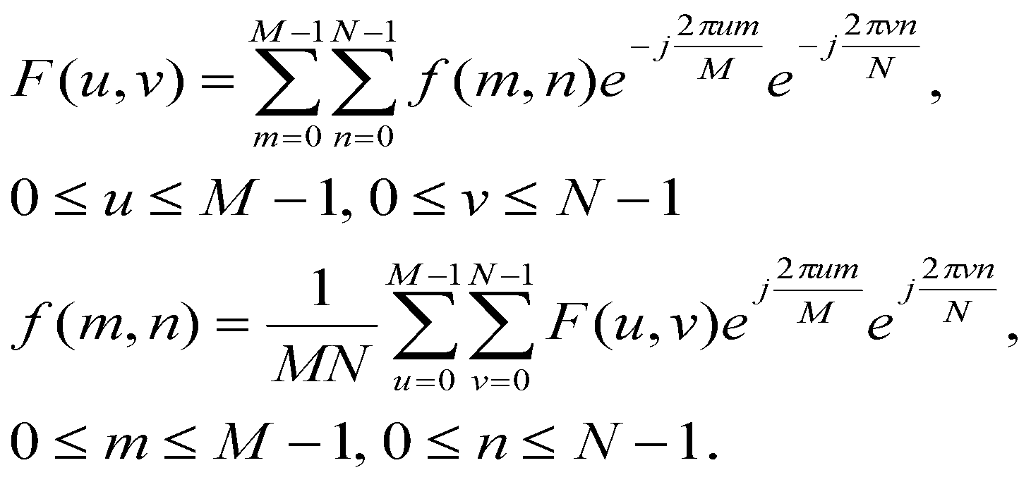
DFT/FFT of an Image
2D Discrete Fourier Transform (DFT)
The input and output of the DFT are both discrete, which makes it convenient for computer manipulations.
There is a fast algorithm for computing the DFT known as the fast Fourier transform (FFT).

Slide 6
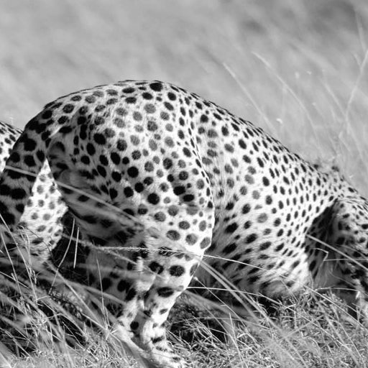
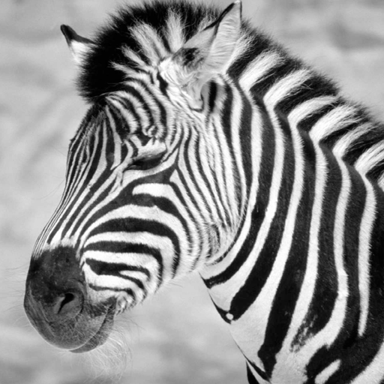
FFT Example
Cheetah
Zebra

Slide 7
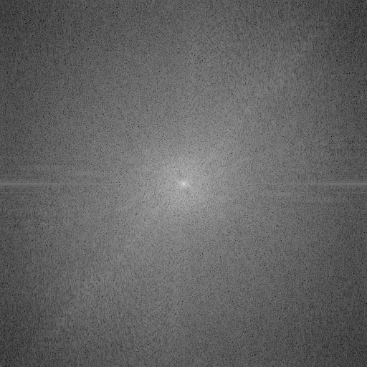
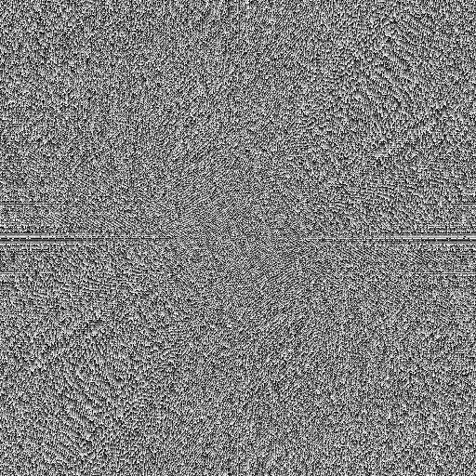
FFT Example
Magnitude transform of the Cheetah image
Phase transform of the Cheetah image

Slide 8
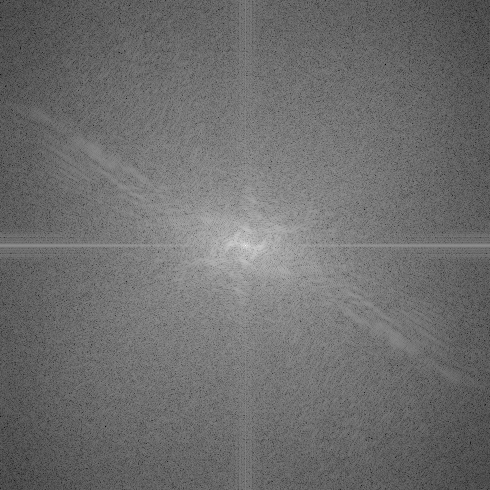
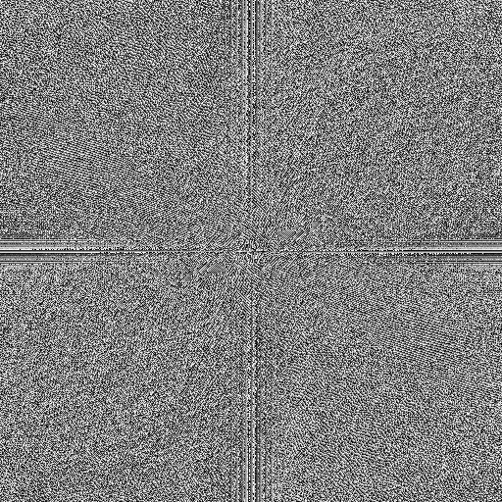
FFT Example
Magnitude transform of the Zebra image
Phase transform of the Zebra image

Slide 9
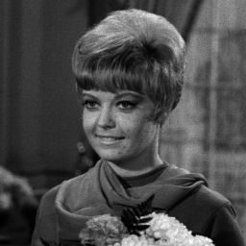
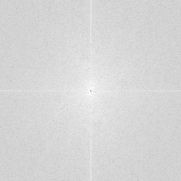
FFT Example
“Girl” image (image size: 256×256) and its FFT (magnitude centered)

Slide 10
Curious things about FT on images
The magnitude spectra of all natural images are quite similar
Heavy on low-frequencies, falling off in high frequencies
Will any image be like that, or is it a property of the world we live in?
Most information in the image is carried in the phase, not the amplitude
Seems to be a fact of life
Not quite clear why

Slide 11
