Slide 1
Image Compression
Image compression deals with specific ways of representing an image in order to conserve space and/or time.
Benefits
Bandwidth and Storage cost
Allows image transmission over low-bandwidth channels
Allows archival of large images using small capacity devices
‹#›

Slide 2
Image Compression
Applications
Video-conferencing
Streaming video (MPEG)
Remote sensing (e.g. use of satellite imagery)
Document processing
Medical imaging
FAX transmission
‹#›

Slide 3
Image Compression Issues
How small can we make it?
compression ratio
bits per pixel
How long does it take to compress/decompress?
usually willing to take time to compress but not decompress
How closely does the decompressed image resemble the original?
aesthetic and/or statistical measurements
lossy vs. lossless techniques
‹#›

Slide 4
Redundancy
Compression involves eliminating data redundancy.
An image file contains data (constructed of units or datum)
Some datum contain no relevant information
The datum itself would be known even if it weren’t provided
Irrelevant datum are redundant
Let n₁ and n₂ denote the number of datum in two different representations of the same image. The relative data redundancy R_{d} of the first representation is defined as
R_{d} = 1-(1/C_{r}) where C_{r} = n₁/n₂
‹#›

Slide 5
Redundancy
Let n₁ and n₂ denote the number of datum in two different representations of the same image. The relative data redundancy R_{d} of the first representation is defined as
R_{d} = 1-(1/C_{r}) where C_{r} = n₁/n₂
If n₂ << n₁ then
C_{r} → ∞
R_{d} → 1
If n₁ << n₂ then
C_{r} → 0
R_{d} → - ∞
‹#›

Slide 6
Sources of Data Redundancy
Coding redundancy
Arithmetic coding
Huffman coding
Interpixel redundancy
Pixels typically don’t change too fast – can usually “guess” the value of a pixel by knowing near-by pixels
Spatial redundancy, geometric redundancy, and spatial coherence
Psycho-Visual redundancy
Certain image information is less relevant for human perception
Certain information can be eliminated without noticeable effect
Quantization (lossy technique)
‹#›

Slide 7
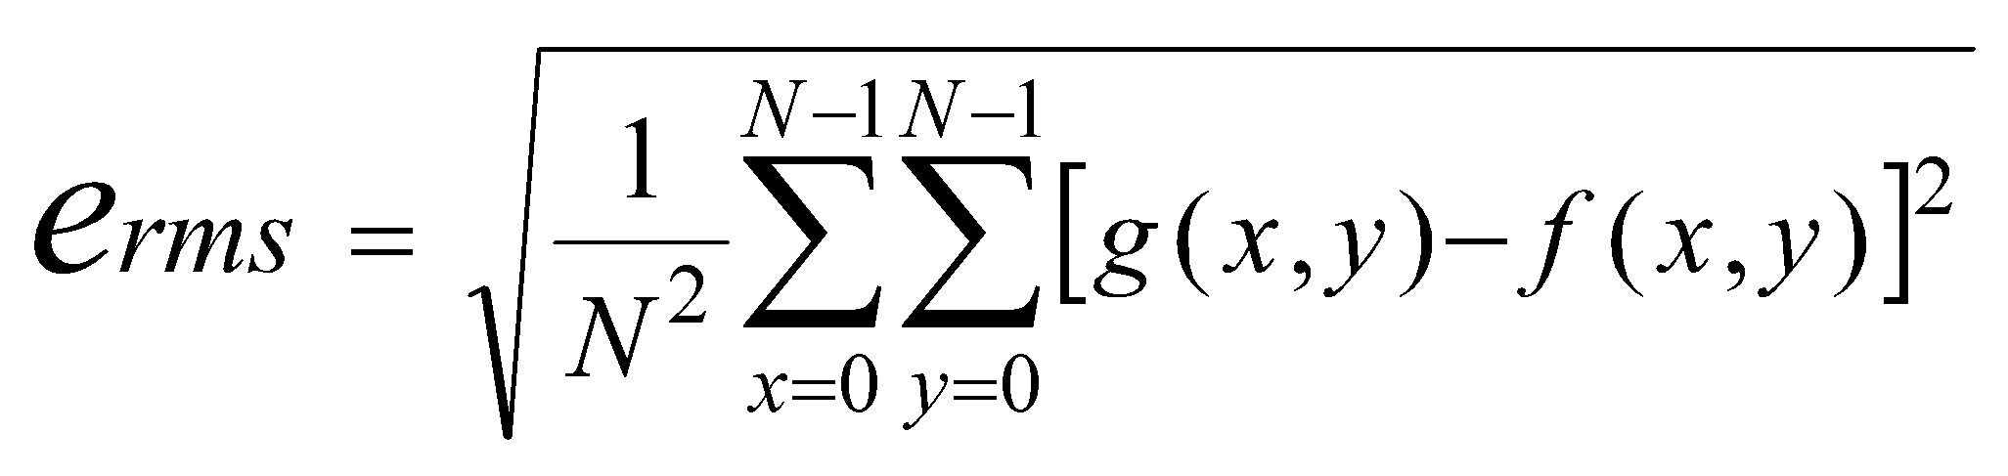
Fidelity Criterion
A function measuring “how closely the decompressed image resemble the original” is called an objective fidelity criterion.
Example. Let g(x,y) be an NxN image reconstructed from the compressed f(x,y) original.
Objective functions may not capture the aesthetic appearance of an image with respect to the original.
‹#›

Slide 8
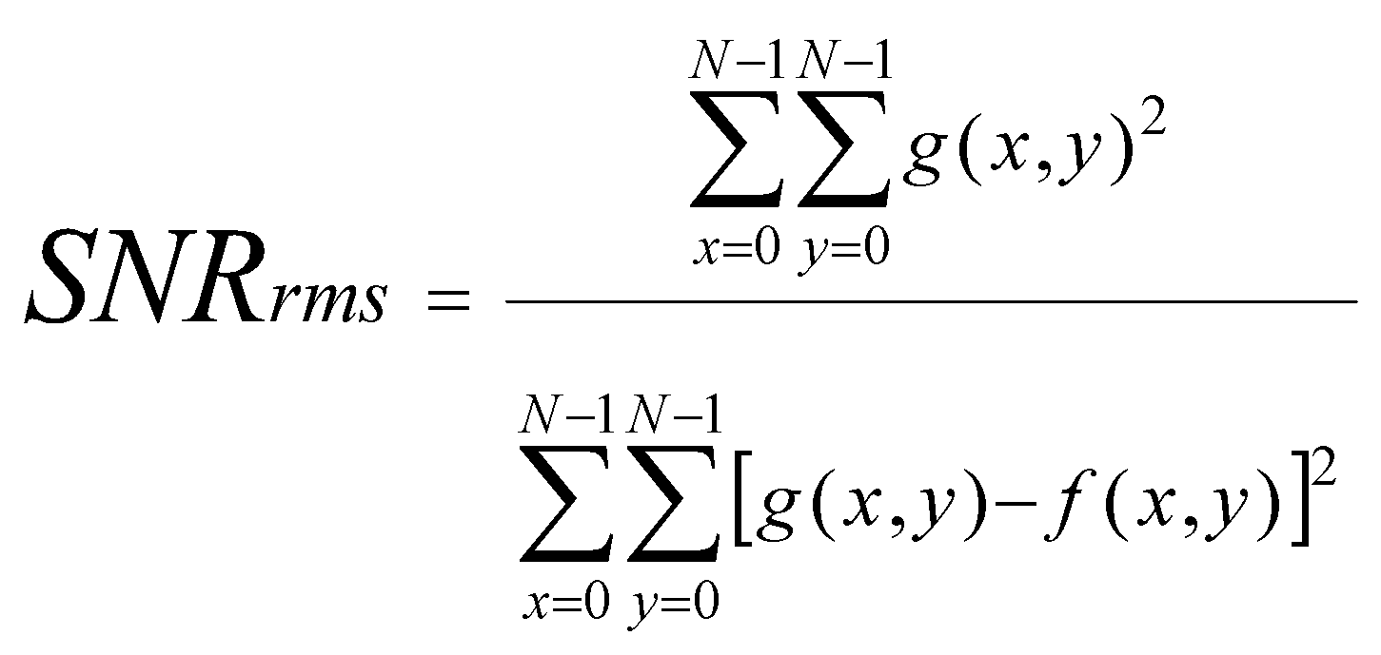
Signal to Noise Ratio
Decompressed image g can be written as g(x,y) = f(x,y) + noise(x,y)
Root-mean-square signal to noise ratio (not an objective fidelity criteria but related) is defined as:
Large SNR values indicate???
Small SNR values indicate???
‹#›

Slide 9
General Compression Model
Most compression techniques eliminate coding redundancy, interpixel redundancy, and psycho-visual redundancy
A compression scheme can generally be modeled as shown below
f(x,y)
Source
Encoder
Channel
Encoder
Channel
Decoder
Source
Decoder
g(x,y)
Transmission
Eliminates data redundancies
Increases Noise
Immunity
Omitted if the images aren’t meant for transmission
‹#›

Slide 10
General Compression Model
The source encoder is typically modeled as shown:
Source Encoder
f(x,y)
To channel encoder
Mapper
Quantizer
Symbol Encoder
Changes image representation
(RLE, DFT, DCT)
Truncates image information
(lossy)
Eliminates coding redundancy
(huffman)
‹#›

Slide 11
Run Length Encoding
Lossless compression scheme
used by BMP, JPEG, and other formats
Each datum of the encoded representation represents a run of like-valued pixels
algorithm runLengthEncode(Image)
INPUT: Binary image Image
OUTPUT: run-length-encoded file
write width and height of image to the output file
maxIndex = maximum index of the Image
scanIndex = 0
TYPE = WHITE
while scanIndex < maxIndex
count = length of the next run of TYPE pixels
write count to the output file
scanIndex = scanIndex + count
if TYPE = WHITE then TYPE = BLACK
else TYPE = WHITE
end
‹#›

Slide 12
Run Length Encoding
0 | 1 | 2 | 3 | 4 | 5 | 6 | 7 | 8 | 9 | 10 | 11 | 12 | 13 | 14 | 15 | 16 | 17 | 18 | 19
0 | 0 | 0 | 0 | 0 | 1 | 1 | 1 | 1 | 0 | 0 | 0 | 0 | 0 | 0 | 0 | 0 | 1 | 1 | 1
0 | 0 | 0 | 0 | 0 | 0 | 1 | 1 | 1 | 1 | 0 | 0 | 0 | 0 | 0 | 0 | 0 | 0 | 0 | 1
0 | 0 | 0 | 0 | 1 | 1 | 1 | 1 | 1 | 1 | 0 | 0 | 0 | 0 | 0 | 0 | 0 | 0 | 1 | 1
0 | 0 | 0 | 1 | 1 | 1 | 1 | 1 | 1 | 0 | 0 | 0 | 0 | 0 | 0 | 0 | 1 | 1 | 1 | 1
0 | 0 | 1 | 1 | 1 | 1 | 1 | 1 | 1 | 1 | 1 | 0 | 0 | 0 | 0 | 0 | 0 | 0 | 1 | 1
Consider the binary image above. Determine the RLE representation using a top-down l-r-l alternating scan.
Assume the initial type is ‘0’
5
4
8
4
9
4
10
6
8
6
7
6
5
9
7
2
How many pixels are required by each representation?
100 pixels times 1 bit-per-pixel = 100 bits
16 runs times 4 bits per-pixel (4 bits to represent 10) = 64 bits
Compression ratio = 64/100 or 60%
Are there issues with implementation? Assume that each datum is one byte – what are the implications?
‹#›

Slide 13
Run Length Encoding
Can we extend this approach to encode
Gray-scale images?
Color images?
Yes – use bit-planes!
Each pixel of an m-bit gray-scale image can be viewed as a polynomial of the form
(duh) this is just a binary number where each coefficient a is either 0 or 1.
Define the K^{th} bit-plane as A_{k} for each pixel location X,Y
‹#›

Slide 14
Bit Planes
127
128
130
1 | 0 | 0
0 | 1 | 1
least significant plane
1 | 0 | 0
0 | 1 | 0
128
127
129
1 | 0 | 0
0 | 1 | 0
Decimal Representation
1 | 0 | 0
0 | 1 | 0
Bit Plane Representation
1 | 0 | 0
0 | 1 | 0
1 | 0 | 0
0 | 1 | 0
01111111
10000000
10000010
1 | 0 | 0
0 | 1 | 0
10000000
01111111
10000001
0 | 1 | 1
1 | 0 | 1
most significant plane
Binary Representation
‹#›

Slide 15
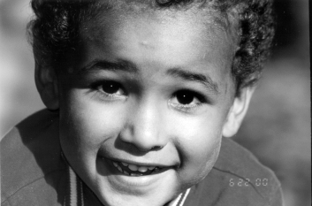
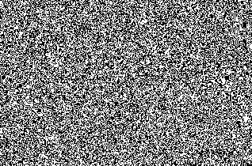
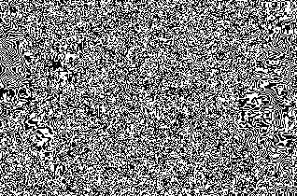
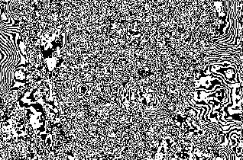
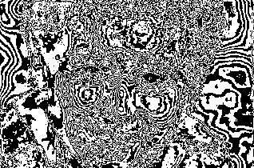
Bit Planes
A | B
C | D
A) plane 0
B) plane 1
C) plane 2
D) plane 3
‹#›

Slide 16
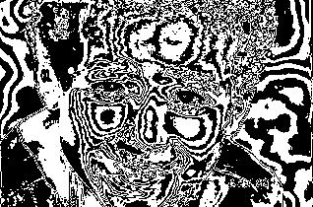
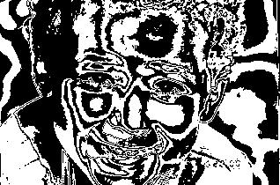
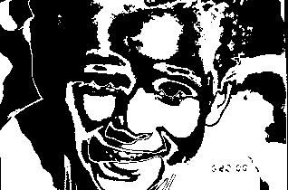
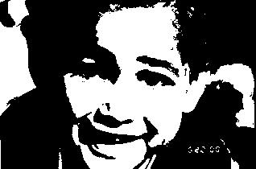
Bit Planes
A | B
C | D
A) plane 4
B) plane 5
C) plane 6
D) plane 7
‹#›

Slide 17
Run Length Encoding
algorithm runLengthEncode(Image)
INPUT: Gray-scale image Image
OUTPUT: run-length-encoded file
write width and height of the image to the output file
maxIndex = maximum index of the Image
for every bit-plane K of image
scanIndex = 0
TYPE = WHITE
while scanIndex < maxIndex
count = length of the next run of TYPE pixels from bit-plane K
write count to the output file
scanIndex = scanIndex + count
if TYPE = WHITE then TYPE = BLACK
else TYPE = WHITE
end
end
‹#›

Slide 18
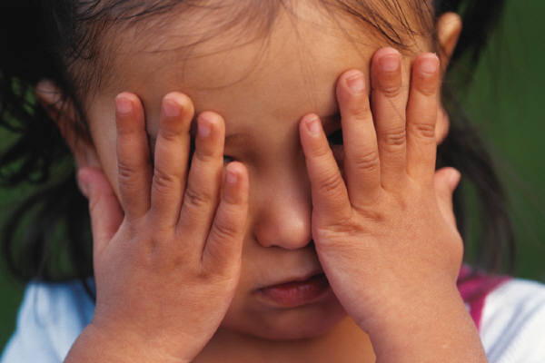
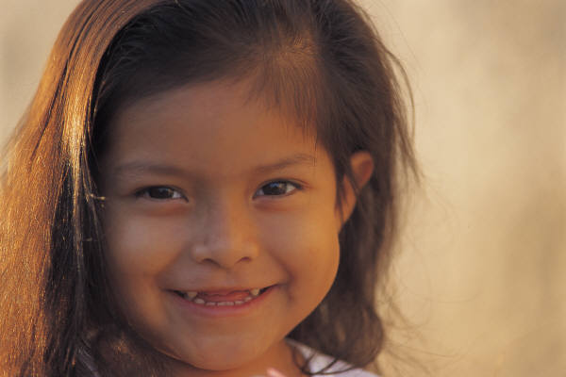
Run Length Encoding
Problem: least-significant-planes are “almost” random.
Example: consider adjacent pixels 128 and 127
128 = 1000000
127 = 0111111
Every bit on every plane changes – thus eliminating any runs
Answer: Use Gray Codes (instead of binary coding)
Gray code ensures that only one bit changes between adjacent values
‹#›

Slide 19
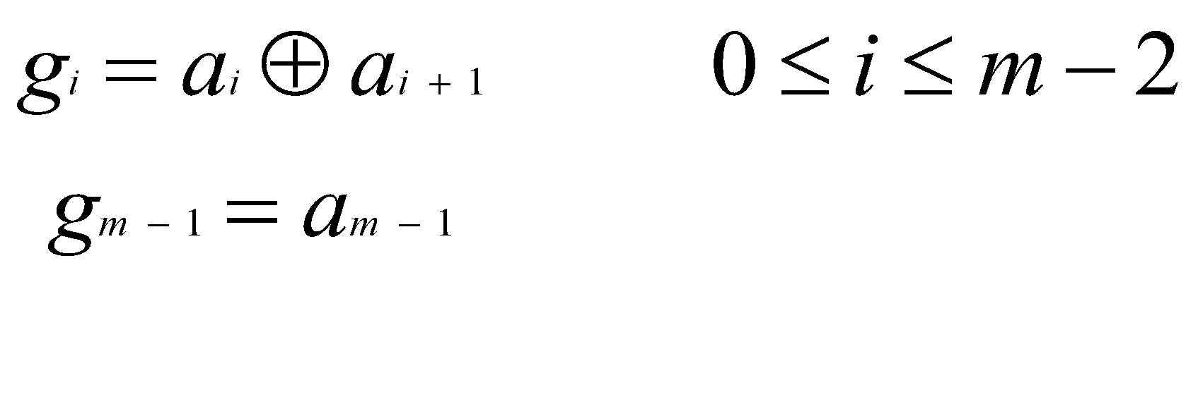
Run Length Encoding and Gray Codes
Gray code of an m-bit value can be computed from the binary representation as:
Where ⊕ indicates the exclusive or operation
Binary
Gray Code
00000000
00000000
00000001
00000001
00000010
00000011
00000011
00000010
00000100
00000110
00000101
00000111
00000110
00000101
‹#›

Slide 20
Gray Codes
Gray code of an m-bit value can be computed from the binary representation as:
short value = a;
short grayCode = value ^ (value >> 1);
‹#›

Slide 21
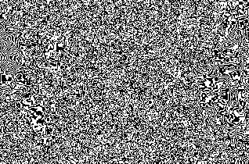
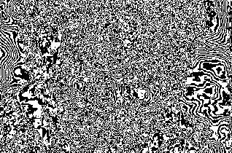
Bit Planes
A | B
C | D
A) binary 0
B) gray 0
C) binary 1
D) gray 1
‹#›

Slide 22
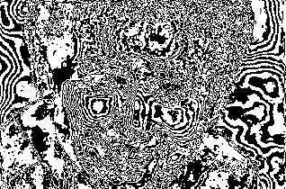
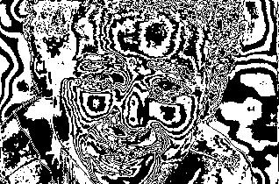
Bit Planes
A | B
C | D
A) binary 2
B) gray 2
C) binary 3
D) gray 3
‹#›

Slide 23
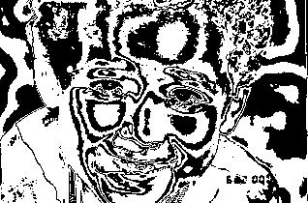
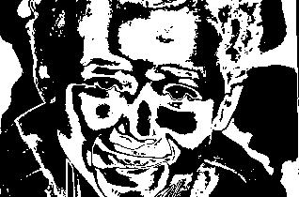
Bit Planes
A | B
C | D
A) binary 4
B) gray 4
C) binary 5
D) gray 5
‹#›

Slide 24
Bit Planes
A | B
C | D
A) binary 6
B) gray 6
C) binary 7
D) gray 7
‹#›

Slide 25
Constant Area Coding
CAC coding is essentially a 2D extension of RLE.
Represent a “block” of pixels as either
ALL white or
NOT all white
Assume that the block size is 16x16.
A ‘1’ bit indicates that the block is all white
A ‘0’ bit indicates that the block is not all white
The block is divided into 4 quadrants and encoded recursively
The “base case” is a ‘0’ or ‘1’ when the block size is 1 pixel.
‹#›

Slide 26
CAC Encoding Example
Given the 16x16 binary image shown at left, represent the image using CAC encoding with an 8x8 block size.
Compression Ratio:
N1 = 16 * 16 = 256
N2 = 60
N1/N2 = 256/60 = 4.2
Bit per Pixel:
binary encoded = 1
CAC = .24
1
0
1
1
1
0
1
1
0
0
0
0
0
1
0
1
0
1
1
0
1
0
1
0
0
0
0
0
0
1
1
0
0
1
1
0
0
0
0
0
0
0
0
0
0
0
0
0
0
0
0
1
0
0
0
0
0
1
1
1
‹#›

Slide 27
CAC Decoding Example
Given the binary input shown below, reconstruct the 16x16 image it represents. The block size is known to be 8x8.
0 | 1 | 1 | 1 | 0 | 1 | 1 | 0 | 0 | 0 | 0 | 0 | 1 | 0 | 1 | 1 | 0 | 1 | 1 | 0
0 | 0 | 0 | 0 | 1 | 1 | 0 | 1 | 0 | 0 | 0 | 0 | 0 | 0 | 0 | 1 | 1 | 0 | 0 | 0
0 | 0 | 0 | 0 | 1 | 1 | 1 | 0 | 0 | 0 | 0 | 0 | 0 | 0 | 0 | 1 | 1 | 1 | 0 | 0
0 | 0 | 0 | 0 | 0 | 0 | 1 | 0 | 1 | 0 | 1 | 1 | 1
‹#›

Slide 28
CAC Wrap Up
Could CAC be used on
Gray-scale images?
Color photo images?
What kind of images would CAC be most useful for?
Scanned Text (lots of white space)
Line/CAD drawings (lots of white space)
‹#›

Slide 29
Lossless Predictive Coding
Doesn’t require binary images
Attempt to predict the “next” pixel given the previous “n” pixels
Encode only the difference between the predicted value and the actual value
Input
Image

−
Symbol Encoder
(huffman)
Compressed
Image
Nearest
Integer
Predictor
‹#›

Slide 30
Lossless Predictive Coding
In the simplest case, the predicted value is the last value seen
134 | 138 | 192 | 195 | 200
129 | 133 | 179 | 188 | 201
129 | 120 | 143 | 177 | 198
115 | 120 | 135 | 133 | 138
P
134
138
192
195
200
201
188
179
133
129
129
120
143
177
198
138
133
135
135
120
115
P~
---
134
138
192
195
200
201
188
179
133
129
129
120
143
177
198
138
133
135
135
120

134
4
54
3
5
1
-13
-9
-46
-4
0
-9
23
34
21
-60
-5
2
0
-15
-5
Compression Analysis:
The input image required 8 bits per pixel
The output image has a dynamic range of 54 – (-60) = 114 so can use 7 bits. 12% compression
HOWEVER the output is well suited to huffman encoding since MOST information is located around zero +/- some small amount.
‹#›

Slide 31
Lossy Predictive Coding
Reduce the accuracy of the saved image for increased compression
One of the simplest lossy predictive coding schemes is known as Delta Modulation
Big Idea:
1) Select a Delta value (say 6.5)
2) Predicted value is the last predicted value +/- Delta
3) If actual value > predicted value then record a ‘+’
4) If actual value < predicted value then record a ‘-’
‹#›

Slide 32
Delta Modulation Example
P | 14 | 15 | 14 | 15 | 13 | 15 | 15 | 14 | 20 | 26 | 27 | 28 | 27 | 27 | 29 | 37 | 47 | 62 | 75 | 77 | 78 | 79 | 80 | 81 | 81
P~ | None | 14 | 20.5 | 14 | 20.5 | 14 | 20.5 | 14 | 7.5 | 14 | 20.5 | 27 | 33.5 | 27 | 20.5 | 27 | 33.5 | 40 | 46.5 | 53 | 59.5 | 66 | 72.5 | 79 | 85.5
Out | 14 | + | - | + | - | + | - | - | + | + | + | + | - | - | + | + | + | + | + | + | + | + | + | + | -
Compression Analysis:
The input image required 8 bits per pixel
The output image requires one byte to begin the row (or image) and 1 bit per pixel thereafter
N1 = N*8
N2 = 8+(N-1)*1
N1/N2 = 8N / (N-7) ~ 8
Compression ratio of 8:1
‹#›

Slide 33
Delta Modulation Example
P | 14 | 15 | 14 | 15 | 13 | 15 | 15 | 14 | 20 | 26 | 27 | 28 | 27 | 27 | 29 | 37 | 47 | 62 | 75 | 77 | 78 | 79 | 80 | 81 | 81
P~ | None | 14 | 20.5 | 14 | 20.5 | 14 | 20.5 | 14 | 7.5 | 14 | 20.5 | 27 | 33.5 | 27 | 20.5 | 27 | 33.5 | 40 | 46.5 | 53 | 59.5 | 66 | 72.5 | 79 | 85.5
Out | 14 | + | - | + | - | + | - | - | + | + | + | + | - | - | + | + | + | + | + | + | + | + | + | + | -
‹#›

Slide 34
Delta Modulation Example
A | B
C | D
A) original
B) delta 6.5
C) delta 13
D) delta 19.5
‹#›

Slide 35

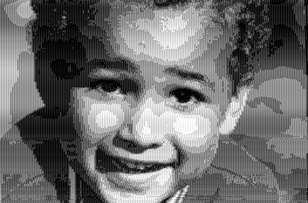
Delta Modulation Example
A | B
C | D
A) original
B) delta 26
C) delta 32.5
D) delta 39
‹#›

Slide 36
Lossy Hierarchical Coding
Represent an image as a quad-tree
An adaptive lossy technique similar to CAC
Each node has zero or 4 children
Each node represents a rectangular block of the original image
Let the root node T represent the entire image
compute the average pixel value
compute an error measure
if the error is too large then
subdivide into 4 quadrants and repeat
else
output the average pixel value as the value
of that node/block
‹#›

Slide 37
Hierarchical Coding Example
10 | 12 | 14 | 14 | 10 | 9 | 11 | 10
11 | 13 | 13 | 16 | 10 | 9 | 15 | 9
13 | 15 | 12 | 17 | 72 | 72 | 12 | 9
14 | 13 | 13 | 14 | 83 | 78 | 83 | 11
15 | 15 | 13 | 88 | 84 | 85 | 91 | 9
16 | 13 | 12 | 15 | 88 | 82 | 15 | 8
12 | 10 | 12 | 16 | 17 | 83 | 78 | 9
12 | 9 | 13 | 12 | 15 | 84 | 18 | 10
Average = 28
RMS error = 29.01
Code the image above using a “quality” value of 5.0
‹#›

Slide 38
Hierarchical Coding Example
10 | 12 | 14 | 14 | 10 | 9 | 11 | 10
11 | 13 | 13 | 16 | 10 | 9 | 15 | 9
13 | 15 | 12 | 17 | 72 | 72 | 12 | 9
14 | 13 | 13 | 14 | 83 | 78 | 83 | 11
15 | 15 | 13 | 88 | 84 | 85 | 91 | 9
16 | 13 | 12 | 15 | 88 | 82 | 15 | 8
12 | 10 | 12 | 16 | 17 | 83 | 78 | 9
12 | 9 | 13 | 12 | 15 | 84 | 18 | 10
Average = 13
RMS error = 1.73
‹#›

Slide 39
Hierarchical Coding Example
10 | 12 | 14 | 14 | 10 | 9 | 11 | 10
11 | 13 | 13 | 16 | 10 | 9 | 15 | 9
13 | 15 | 12 | 17 | 72 | 72 | 12 | 9
14 | 13 | 13 | 14 | 83 | 78 | 83 | 11
15 | 15 | 13 | 88 | 84 | 85 | 91 | 9
16 | 13 | 12 | 15 | 88 | 82 | 15 | 8
12 | 10 | 12 | 16 | 17 | 83 | 78 | 9
12 | 9 | 13 | 12 | 15 | 84 | 18 | 10
Average = 31
RMS error = 31.28
‹#›

Slide 40
Hierarchical Coding Example
10 | 12 | 14 | 14 | 10 | 9 | 11 | 10
11 | 13 | 13 | 16 | 10 | 9 | 15 | 9
13 | 15 | 12 | 17 | 72 | 72 | 12 | 9
14 | 13 | 13 | 14 | 83 | 78 | 83 | 11
15 | 15 | 13 | 88 | 84 | 85 | 91 | 9
16 | 13 | 12 | 15 | 88 | 82 | 15 | 8
12 | 10 | 12 | 16 | 17 | 83 | 78 | 9
12 | 9 | 13 | 12 | 15 | 84 | 18 | 10
Average = 10
RMS error = .71
‹#›

Slide 41
Hierarchical Coding Example
10 | 12 | 14 | 14 | 10 | 9 | 11 | 10
11 | 13 | 13 | 16 | 10 | 9 | 15 | 9
13 | 15 | 12 | 17 | 72 | 72 | 12 | 9
14 | 13 | 13 | 14 | 83 | 78 | 83 | 11
15 | 15 | 13 | 88 | 84 | 85 | 91 | 9
16 | 13 | 12 | 15 | 88 | 82 | 15 | 8
12 | 10 | 12 | 16 | 17 | 83 | 78 | 9
12 | 9 | 13 | 12 | 15 | 84 | 18 | 10
Average = 11
RMS error = 2.29
‹#›

Slide 42
Hierarchical Coding Example
10 | 12 | 14 | 14 | 10 | 9 | 11 | 10
11 | 13 | 13 | 16 | 10 | 9 | 15 | 9
13 | 15 | 12 | 17 | 72 | 72 | 12 | 9
14 | 13 | 13 | 14 | 83 | 78 | 83 | 11
15 | 15 | 13 | 88 | 84 | 85 | 91 | 9
16 | 13 | 12 | 15 | 88 | 82 | 15 | 8
12 | 10 | 12 | 16 | 17 | 83 | 78 | 9
12 | 9 | 13 | 12 | 15 | 84 | 18 | 10
Average = 76
RMS error = 4.6
‹#›

Slide 43
Hierarchical Coding Example
10 | 12 | 14 | 14 | 10 | 9 | 11 | 10
11 | 13 | 13 | 16 | 10 | 9 | 15 | 9
13 | 15 | 12 | 17 | 72 | 72 | 12 | 9
14 | 13 | 13 | 14 | 83 | 78 | 83 | 11
15 | 15 | 13 | 88 | 84 | 85 | 91 | 9
16 | 13 | 12 | 15 | 88 | 82 | 15 | 8
12 | 10 | 12 | 16 | 17 | 83 | 78 | 9
12 | 9 | 13 | 12 | 15 | 84 | 18 | 10
Average = 29
RMS error = 31.34
‹#›

Slide 44
Hierarchical Coding Example
10 | 12 | 14 | 14 | 10 | 9 | 11 | 10
11 | 13 | 13 | 16 | 10 | 9 | 15 | 9
13 | 15 | 12 | 17 | 72 | 72 | 12 | 9
14 | 13 | 13 | 14 | 83 | 78 | 83 | 11
15 | 15 | 13 | 88 | 84 | 85 | 91 | 9
16 | 13 | 12 | 15 | 88 | 82 | 15 | 8
12 | 10 | 12 | 16 | 17 | 83 | 78 | 9
12 | 9 | 13 | 12 | 15 | 84 | 18 | 10
Average = 18
RMS error = 18.26
‹#›

Slide 45
Hierarchical Coding Example
10 | 12 | 14 | 14 | 10 | 9 | 11 | 10
11 | 13 | 13 | 16 | 10 | 9 | 15 | 9
13 | 15 | 12 | 17 | 72 | 72 | 12 | 9
14 | 13 | 13 | 14 | 83 | 78 | 83 | 11
15 | 15 | 13 | 88 | 84 | 85 | 91 | 9
16 | 13 | 12 | 15 | 88 | 82 | 15 | 8
12 | 10 | 12 | 16 | 17 | 83 | 78 | 9
12 | 9 | 13 | 12 | 15 | 84 | 18 | 10
Average = 15
RMS error = 1.12
‹#›

Slide 46
Hierarchical Coding Example
10 | 12 | 14 | 14 | 10 | 9 | 11 | 10
11 | 13 | 13 | 16 | 10 | 9 | 15 | 9
13 | 15 | 12 | 17 | 72 | 72 | 12 | 9
14 | 13 | 13 | 14 | 83 | 78 | 83 | 11
15 | 15 | 13 | 88 | 84 | 85 | 91 | 9
16 | 13 | 12 | 15 | 88 | 82 | 15 | 8
12 | 10 | 12 | 16 | 17 | 83 | 78 | 9
12 | 9 | 13 | 12 | 15 | 84 | 18 | 10
Average = 32
RMS error = 32.35
‹#›

Slide 47
Hierarchical Coding Example
10 | 12 | 14 | 14 | 10 | 9 | 11 | 10
11 | 13 | 13 | 16 | 10 | 9 | 15 | 9
13 | 15 | 12 | 17 | 72 | 72 | 12 | 9
14 | 13 | 13 | 14 | 83 | 78 | 83 | 11
15 | 15 | 13 | 88 | 84 | 85 | 91 | 9
16 | 13 | 12 | 15 | 88 | 82 | 15 | 8
12 | 10 | 12 | 16 | 17 | 83 | 78 | 9
12 | 9 | 13 | 12 | 15 | 84 | 18 | 10
Average = 11
RMS error = 1.33
‹#›

Slide 48
Hierarchical Coding Example
10 | 12 | 14 | 14 | 10 | 9 | 11 | 10
11 | 13 | 13 | 16 | 10 | 9 | 15 | 9
13 | 15 | 12 | 17 | 72 | 72 | 12 | 9
14 | 13 | 13 | 14 | 83 | 78 | 83 | 11
15 | 15 | 13 | 88 | 84 | 85 | 91 | 9
16 | 13 | 12 | 15 | 88 | 82 | 15 | 8
12 | 10 | 12 | 16 | 17 | 83 | 78 | 9
12 | 9 | 13 | 12 | 15 | 84 | 18 | 10
Average = 13
RMS error = 1.66
‹#›

Slide 49
Hierarchical Coding Example
10 | 12 | 14 | 14 | 10 | 9 | 11 | 10
11 | 13 | 13 | 16 | 10 | 9 | 15 | 9
13 | 15 | 12 | 17 | 72 | 72 | 12 | 9
14 | 13 | 13 | 14 | 83 | 78 | 83 | 11
15 | 15 | 13 | 88 | 84 | 85 | 91 | 9
16 | 13 | 12 | 15 | 88 | 82 | 15 | 8
12 | 10 | 12 | 16 | 17 | 83 | 78 | 9
12 | 9 | 13 | 12 | 15 | 84 | 18 | 10
Average = 48
RMS error = 36.07
‹#›

Slide 50
Hierarchical Coding Example
10 | 12 | 14 | 14 | 10 | 9 | 11 | 10
11 | 13 | 13 | 16 | 10 | 9 | 15 | 9
13 | 15 | 12 | 17 | 72 | 72 | 12 | 9
14 | 13 | 13 | 14 | 83 | 78 | 83 | 11
15 | 15 | 13 | 88 | 84 | 85 | 91 | 9
16 | 13 | 12 | 15 | 88 | 82 | 15 | 8
12 | 10 | 12 | 16 | 17 | 83 | 78 | 9
12 | 9 | 13 | 12 | 15 | 84 | 18 | 10
Average = 85
RMS error = 2.18
‹#›

Slide 51
Hierarchical Coding Example
10 | 12 | 14 | 14 | 10 | 9 | 11 | 10
11 | 13 | 13 | 16 | 10 | 9 | 15 | 9
13 | 15 | 12 | 17 | 72 | 72 | 12 | 9
14 | 13 | 13 | 14 | 83 | 78 | 83 | 11
15 | 15 | 13 | 88 | 84 | 85 | 91 | 9
16 | 13 | 12 | 15 | 88 | 82 | 15 | 8
12 | 10 | 12 | 16 | 17 | 83 | 78 | 9
12 | 9 | 13 | 12 | 15 | 84 | 18 | 10
Average = 31
RMS error = 34.89
‹#›

Slide 52
Hierarchical Coding Example
10 | 12 | 14 | 14 | 10 | 9 | 11 | 10
11 | 13 | 13 | 16 | 10 | 9 | 15 | 9
13 | 15 | 12 | 17 | 72 | 72 | 12 | 9
14 | 13 | 13 | 14 | 83 | 78 | 83 | 11
15 | 15 | 13 | 88 | 84 | 85 | 91 | 9
16 | 13 | 12 | 15 | 88 | 82 | 15 | 8
12 | 10 | 12 | 16 | 17 | 83 | 78 | 9
12 | 9 | 13 | 12 | 15 | 84 | 18 | 10
Average = 50
RMS error = 34.02
‹#›

Slide 53
Hierarchical Coding Example
10 | 12 | 14 | 14 | 10 | 9 | 11 | 10
11 | 13 | 13 | 16 | 10 | 9 | 15 | 9
13 | 15 | 12 | 17 | 72 | 72 | 12 | 9
14 | 13 | 13 | 14 | 83 | 78 | 83 | 11
15 | 15 | 13 | 88 | 84 | 85 | 91 | 9
16 | 13 | 12 | 15 | 88 | 82 | 15 | 8
12 | 10 | 12 | 16 | 17 | 83 | 78 | 9
12 | 9 | 13 | 12 | 15 | 84 | 18 | 10
Average = 29
RMS error = 28.65
‹#›

Slide 54
Hierarchical Coding Example
10 | 12 | 14 | 14 | 10 | 9 | 11 | 10
11 | 13 | 13 | 16 | 10 | 9 | 15 | 9
13 | 15 | 12 | 17 | 72 | 72 | 12 | 9
14 | 13 | 13 | 14 | 83 | 78 | 83 | 11
15 | 15 | 13 | 88 | 84 | 85 | 91 | 9
16 | 13 | 12 | 15 | 88 | 82 | 15 | 8
12 | 10 | 12 | 16 | 17 | 83 | 78 | 9
12 | 9 | 13 | 12 | 15 | 84 | 18 | 10
13 | 13 | 13 | 13 | 10 | 10 | 11 | 11
13 | 13 | 13 | 13 | 10 | 10 | 11 | 11
13 | 13 | 13 | 13 | 76 | 76 | 12 | 9
13 | 13 | 13 | 13 | 76 | 76 | 83 | 11
15 | 15 | 13 | 88 | 85 | 85 | 91 | 9
15 | 15 | 12 | 15 | 85 | 85 | 15 | 8
11 | 11 | 13 | 13 | 17 | 83 | 78 | 9
11 | 11 | 13 | 13 | 15 | 84 | 18 | 10
Comparison between the original image and the de-compressed image with an error limit of 5 gray-levels per pixel.
Original: 8x8 = 64 bytes (uncompressed)
Coded: [NODE [13, NODE[10, 11, 76, NODE[12, 9, 83, 11]], NODE[15, NODE[13, 88, 12, 15], 11, 13], NODE[85, NODE[91, 9, 15, 8], NODE[17, 83, 15, 84], NODE[78, 9, 18, 10]]]
This consists of 37 bytes (which is amenable to huffman compression)
‹#›

Slide 55
Huffman Code
What is the huffman code?
A data compression scheme
Used in many compression formats (JPG, MPG, MP3, etc…)
Uses a variable-length encoding scheme (vs. fixed length)
Uses a prefix encoding scheme (no code is a prefix of another code)
Based on an analysis of the symbol frequencies in the input file
Many compression schemes use huffman coding as the final stage in the source encoder
Source Encoder
f(x,y)
To channel encoder
Mapper
Quantizer
Symbol Encoder
‹#›

Slide 56
Fixed vs. Variable Length Codes
Symbol Frequency Table and Encoding Schemes
Symbol | a | b | c | d | e | f
frequency | 45k | 13k | 12k | 16k | 9k | 5k
fixed-length | 000 | 001 | 010 | 011 | 100 | 101
variable | 0 | 101 | 100 | 111 | 1101 | 1100
Total Bits:
Fixed: 3 bits * 100,000 = 300,000 bits
Variable: 45k*1+13k*3+12k*3+16k*3+9k*4+5k*4 = 224,000 bits
76k bits / 300k bits is a 25% compression ratio
‹#›

Slide 57
Fixed Length Codes
Fixed Length Encoding
Symbol | a | b | c | d | e | f
fixed-length | 000 | 001 | 010 | 011 | 100 | 101
Decode the following fragment:
001100000011
algorithm fixedLengthDecode(InputStream)
for every 3 bit “byte” B in the InputStream
lookup the symbol corresponding to B and print it out
001100000011
b e a d
‹#›

Slide 58
Variable Length Codes
Variable Length Encoding
Symbol | a | b | c | d | e | f
fixed-length | 0 | 101 | 100 | 111 | 1101 | 1100
Decode the following fragment:
10111010111
algorithm fixedLengthDecode(InputStream)
W is a vector of “BITS”
for every bit B in the InputStream
append B to W
lookup the symbol S corresponding to W
print S if found and clear W
10111010111
b ea d
‹#›

Slide 59
Variable Length Codes
Imagine a binary tree where each leaf represents a symbol and the path from root to leaf represents its variable-length binary encoding! No path would be a prefix of another symbol!
a
Decode the following fragment
10111010111
algorithm variableLengthDecode(InputStream)
N is the root node of the “encoding tree”
for every bit B in the InputStream
if B is zero then
N = left child of N
else
N = right child of N
if N is a leaf then
print the leaf value
set N = root
c
b
d
f
e
‹#›

Slide 60
Huffman Tree
The huffman tree serves as the key to both encoding (compressing) and decoding (uncompressing) a file. How is the huffman tree constructed?
algorithm Huffman(V)
Input: A vector V of characters with frequency f
Output: The huffman tree
Let Q be a priority queue
while V is not empty
C = v.remove(0)
f = frequency of C
Q.insert(f, Binary tree rooted at C with no children)
while Q contains more than 1 item
f1 = Q.minKey()
T1 = Q.remove()
f2 = Q.minKey()
T2 = Q.remove()
Q.insert(f1+f2, Binary tree with left child of t1 and right child of t2)
return Q.remove()
‹#›

Slide 61
Huffman Coding
When coding two “kinds” of information it is sometimes useful to use two separate huffman tables in a single bit-stream
Run length encoding of a binary image usually results in significantly different statistical characteristics between white runs and black runs
Encode the black/white runs using different huffman tables
‹#›

Slide 62
Huffman Coding Example
White Runs
RunLength | Freq
255 | 79
152 | 32
141 | 24
130 | 21
122 | 41
32 | 6
21 | 4
6 | 3
Black Runs
RunLength | Freq
41 | 3
32 | 25
21 | 31
8 | 15
6 | 16
Compute the number of bits required to encode the information in the tables at left using separate huffman table for black and white
‹#›

Slide 63
Huffman Coding Example
White Runs
RunLength | Freq | Code | Size | Total
255 | 79 | 0 | 1 | 79
152 | 32 | 101 | 3 | 96
141 | 24 | 100 | 3 | 72
130 | 21 | 1101 | 4 | 84
122 | 41 | 111 | 3 | 123
32 | 6 | 11000 | 5 | 30
21 | 4 | 110011 | 6 | 24
6 | 3 | 110010 | 6 | 18
Black Runs
RunLength | Freq | Code | Size | Total
41 | 3 | 010 | 3 | 9
32 | 25 | 10 | 2 | 50
21 | 31 | 11 | 2 | 62
8 | 15 | 011 | 3 | 45
6 | 16 | 00 | 2 | 32
Total bits required:
White + Black = 526 + 198 = 724
‹#›

Slide 64
Huffman Coding Example
Runs
RunLength | Freq
255 | 79
152 | 32
141 | 24
130 | 21
122 | 41
41 | 3
32 | 31
21 | 35
8 | 15
6 | 19
Code | Bits | Freq
10 | 2 | 158
001 | 3 | 96
1111 | 4 | 96
1110 | 4 | 84
110 | 3 | 123
01100 | 5 | 15
000 | 3 | 96
010 | 3 | 105
01101 | 5 | 60
0111 | 4 | 76
Compute the number of bits required to encode the information in the tables at left using a single huffman table for both black and white runs
Total bits required: 909!
‹#›

Slide 65
Huffman Code for JPEG
JPEG compression uses huffman coding as the final compression step.
The JPEG standard uses a canonical representation in order to compactly and unambigously store the huffman tree.
The following definition is taken from the standard
Huffman tables are specified in terms of a 16-byte list giving the number of codes for each code length from 1 to 16. This is followed by a list of the 8-bit symbol values, each of which is assigned a Huffman code. The symbol values are placed in the list in order of increasing code length. Code lengths greater than 16 are not allowed. In addition, the codes shall be generated such that the all-1-bits code word of any length is reserved as a prefix for longer code words.
JPEG Huffman Table Example
1 | 0 | 2 | 3 | 2 | 0 | 0 | 0 | 0 | 0 | 0 | 0 | 0 | 0 | 0 | 0 | a | _ | n | l | m | p | c | .
‹#›

Slide 66
JPEG Huffman Representation
How to construct the huffman codes from the given information?
JPEG Huffman Table Example
1 | 0 | 2 | 3 | 2 | 0 | 0 | 0 | 0 | 0 | 0 | 0 | 0 | 0 | 0 | 0 | a | _ | n | l | m | p | c | .
algorithm lengthCountToSymbolCodeLengths(lengthCounts)
Input: An array of 16 ints representing # of symbols with bit-lengths of size i
Output: An array that contains the bit-length of each encoded symbol
Let symbolCodeLengths be an array of size NUMBER_OF_SYMBOLS_IN_TABLE
k = 0
for i=0 to lengthCounts-1
for j=0 to lengthCounts[i]-1
symbolCodeLengths[k] = i+1;
k++
end
end
return symbolCodeLengths
‹#›

Slide 67
JPEG Huffman Representation
The flowchart on the right is slightly modified from the JPEG standard. It generates the actual huffman codes from the code length information.
K=0
CODE=0
SI=CODE_LENGTHS(0)
HUFFCODE(K) = CODE
CODE = CODE + 1
K = K + 1
K == NUMBER_CODES?
Symbol | Code Lengths | Code
a | 1 | 0
_ | 3 | 100
n | 3 | 101
l | 4 | 1100
m | 4 | 1101
p | 4 | 1110
c | 5 | 11110
. | 5 | 11111
Yes
No
CODE_LENGTHS(K) = SI?
Yes
Done
No
CODE = CODE << 1
SI = SI + 1
CODE_LENGTHS(K) = SI?
Yes
No
‹#›

