Slide 1
Neighborhood (Spatial) Operations
Neighborhood operations modify pixel values based on the values of nearby pixels. Convolution and Correlation are fundamental neighborhood operations.
Convolution is used to filter images for specific reasons – to remove noise, to remove motion blur, to enhance image features, etc…
Correlation is used to determine the similarity of regions of an image to other regions of interest. Used in pattern recognition, motion analysis and image registration.

Slide 2
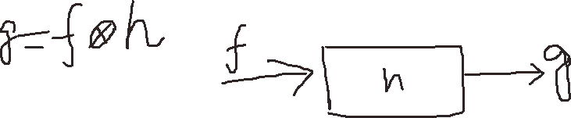
4-point neighbor
8-point neighbor
X
(x-1,y-1) | (x,y-1) | (x+1,y-1)
(x-1,y) | (x,y) | (x+1,y)
(x-1,y+1) | (x,y+1) | (x+1,y+1)
Y

Slide 3
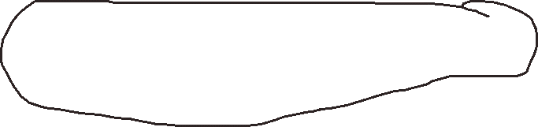
Convolution
The value of a pixel is determined by computing a weighted sum of nearby pixels.
72
53
60
-1 0 +1
76
56
65
-1
0
1
88
78
82
+1 0 -1
-2
0
2
-1
0
1
Compute the new value of the center pixel by “overlaying” the kernel and computing the weighted sum,f
Given a “kernel” of weights to be centered on the pixel of interest, h
Kernel, Window, Filter, Mask

Slide 4
Boundary Problem: Implementation Issues
Operation at image boundaries or borders
Ignore pixels where the kernel (mask or window)“falls off” the image. That means, output pixels may be set to zero at borders. Or, it can be done by using “circular” or “reflected” indexing.
Reflected Indexing
Pretends the image is “tiled” at each border by a mirror
Imagine a mirror vertically placed at each border that “reflects” the image back upon itself
Reflection of X component
Let M be the width of the image
if x < 0 then
x = -x-1
else if x >= M then
x = 2M-x-1
end

Slide 5
Boundary Problem: Implementation Issues (Cont.)
Circular Indexing
Pretends the image is infinitely repeated at each border
Sometimes a good theoretical reason for doing this
Circular indexing of X component
Let M be the width of the image
if x < 0 then
x = x+M
else if x >= M then
x = x-M
end

Slide 6
Filtering
Convolution will have different effects depending upon the values of the Kernel.
Filtering is a way of tuning image frequencies – much like a graphic equalizer
Low Pass Filtering: allows only the “low-frequency signals through’"
High Pass Filtering: allows only the “high-frequency signals through”

Slide 7
Low-Pass Filtering
Any kernel (window) having all positive coefficients will act as a low-pass filter
1 | 1 | 1
1 | 1 | 1
1 | 1 | 1
1/9 ×
Normal average filter
1 | 3 | 1
3 | 5 | 3
1 | 3 | 1
Gaussian (weighted average) filter
1/21 ×
The center pixel becomes the average of all neighboring pixels. Also known as a mean filter.

Slide 8
Low-Pass Filtering
Any kernel (window) having all positive coefficients will act as a low-pass filter
1 | 1 | 1
1 | 1 | 1
1 | 1 | 1
Max or Min or Median filter

Slide 9
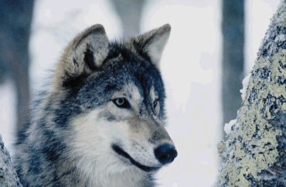
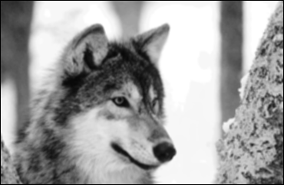
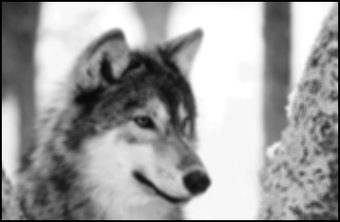

Mean Filter Example
Original Image
3x3 Mean Kernel
5x5 Mean Kernel
7x7 Mean Kernel

Slide 10
Gaussian Filter
The Gaussian filter is a 2-D convolution operator that is used to `blur' images and remove detail and noise much like the mean filter
It is similar to the mean filter, but it uses a different kernel that represents the shape of a Gaussian (`bell-shaped') hump. This kernel has some special properties which are detailed below.
The degree of smoothing is determined by the standard deviation of the Gaussian.
Larger standard deviation Gaussians, of course, require larger convolution kernels in order to be accurately represented.
The Gaussian outputs a `weighted average' of each pixel's neighborhood, with the average weighted more towards the value of the central pixels.
This is in contrast to the mean filter's uniformly weighted average.
A Gaussian provides gentler smoothing and preserves edges better than an identically sized mean filter.

Slide 11
Gaussian Filter
The gaussian kernel is separable and symmetric.
To construct the kernel we must sample and quantize!
The kernel below is an example where sigma = 1
1 | 4 | 7 | 4 | 1
4 | 16 | 28 | 16 | 4
7 | 28 | 49 | 28 | 7
4 | 16 | 28 | 16 | 4
1 | 4 | 7 | 4 | 1

Slide 12



Gaussian Filtering Example
Original Image
3x3 Gaussian Kernel
5x5 Gaussian Kernel
7x7 Gaussian Kernel

Slide 13
Comparison Between Gaussian and Mean Filtering
5x5 Gaussian Kernel
5x5 Mean Kernel

Slide 14
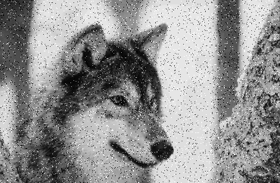
Noise Reduction
Gaussian and mean filters are usually used to reduce “noise” in images
The above image has been corrupted by impulse (binary) noise.

Slide 15


Noise Reduction
5x5 Gaussian Kernel
5x5 Mean Kernel

Slide 16
Median Filtering
Median filter: The value of the output pixel is the value of the “median” pixel.

Slide 17

Median Filtering
Original Image (impulse noise)
Median Filtered Image (3x3)
Median Filters are great at preserving edges and eliminating impulse noise!

Slide 18
Sharpening Filters
These filters highlight fine image detail or de-blur an image.
Highpass filter: allows only high-frequency information to retain.
Main feature is a positive center coefficient and negative perimeter values.
The sum of the coefficients is zero which means that areas of constant intensity are completely eliminated.
-1 | -1 | -1
-1 | 8 | -1
-1 | -1 | -1
A Laplacian Kernel

Slide 19
HighPass (Sharpening) Filtering Example
Image #1
Image #2
Kernel
120 | 120 | 120 | 120 | 120 | 120
120 | 120 | 120 | 120 | 120 | 120
120 | 120 | 120 | 120 | 120 | 120
120 | 120 | 120 | 120 | 120 | 120
120 | 120 | 120 | 120 | 120 | 120
120 | 120 | 120 | 120 | 120 | 120
255 | 255 | 255 | 120 | 120 | 120
255 | 255 | 255 | 120 | 120 | 120
255 | 255 | 255 | 120 | 120 | 120
255 | 255 | 255 | 120 | 120 | 120
255 | 255 | 255 | 120 | 120 | 120
255 | 255 | 255 | 120 | 120 | 120
-1 | -1 | -1
-1 | 8 | -1
-1 | -1 | -1
0 | 0 | 0 | 0
0 | 0 | 0 | 0
0 | 0 | 0 | 0
0 | 0 | 0 | 0
0 | 405 | -405 | 0
0 | 405 | -405 | 0
0 | 405 | -405 | 0
0 | 405 | -405 | 0

Slide 20

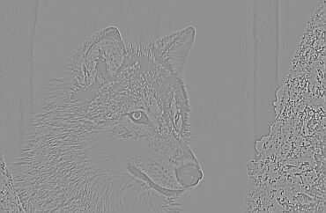
HighPass (Sharpening) Filtering Example
A HighPass filtered image can be computed as the difference between the original and the low-frequency components
HighPass = Original – LowPass

Slide 21
Image Resizing
Magnification by:
Replication Method
Linear Interpolation Method
Non-linear interpolation
Reduction by:
Pixel skipping Method
Replication Method:
Replication is a zero-order hold where each pixel along a scan line is repeated once and then each scan line is repeated. This is equivalent to taking an (M × N) image and interlacing it rows and columns of zeros to obtain a (2M × 2N) matrix and convolving the result with an array of

Slide 22
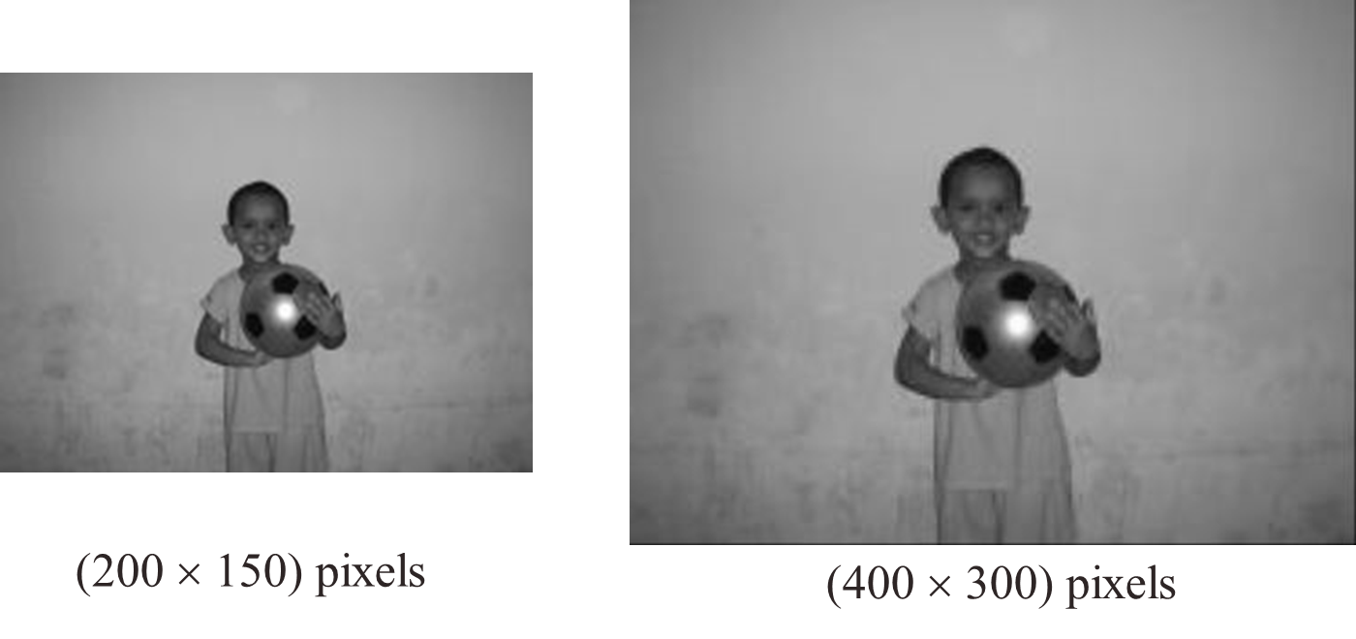
Image Resizing (Cont.)
Replication Method:

Slide 23
Image Resizing (Cont.)
Linear Interpolation Method:
Linear interpolation is a 1st-order hold where a straight line is first fitted in between pixels along a row, then similar operation is done along a column. For a 2 × 2 magnification, linear interpolation along rows gives
Then, linear interpolation along columns using the previous results gives

Slide 24
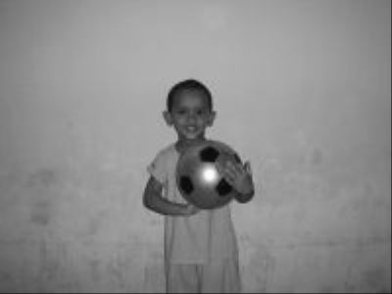

Image Resizing (Cont.)
(200 × 150) pixels
(400 × 300) pixels

Slide 25

Image Resizing (Cont.)
Pixel Skipping Method:
An (M × N) image can be reduced to (M/2 × N/2) size by skipping at first every odd or even pixels along each row and then along each column.
(200 × 150) pixels
(100 × 75) pixels

