Slide 1
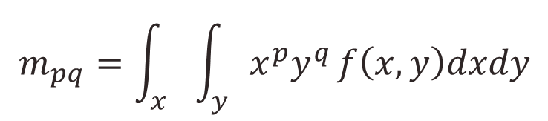
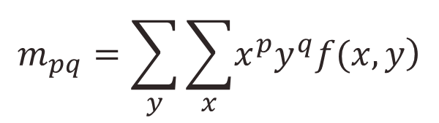
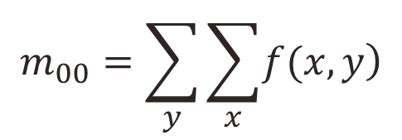
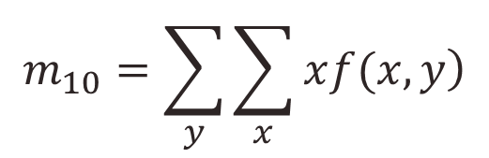
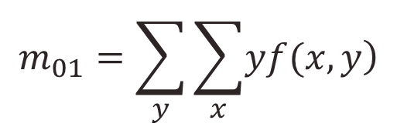
Image Moments
Moment is a shape parameter, and it is used to estimate the length, area, volume, etc. as well as for object recognition.
(p+q)th order moments of an image f(x,y) can be defined as
In discrete form,

Slide 2
Image Moments (2)
Moments are used to determine properties of a component
Area is the 0th moment
Center of mass is the 1st moment
Orientation is defined with respect to the 2nd moment
Center of mass
Axis of orientation

Slide 3
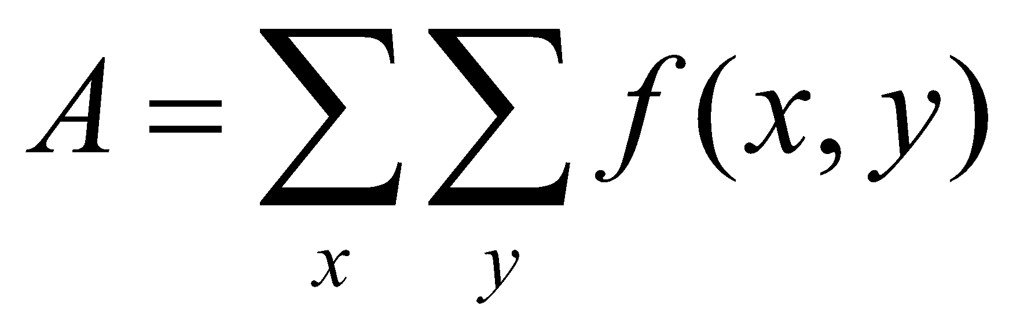

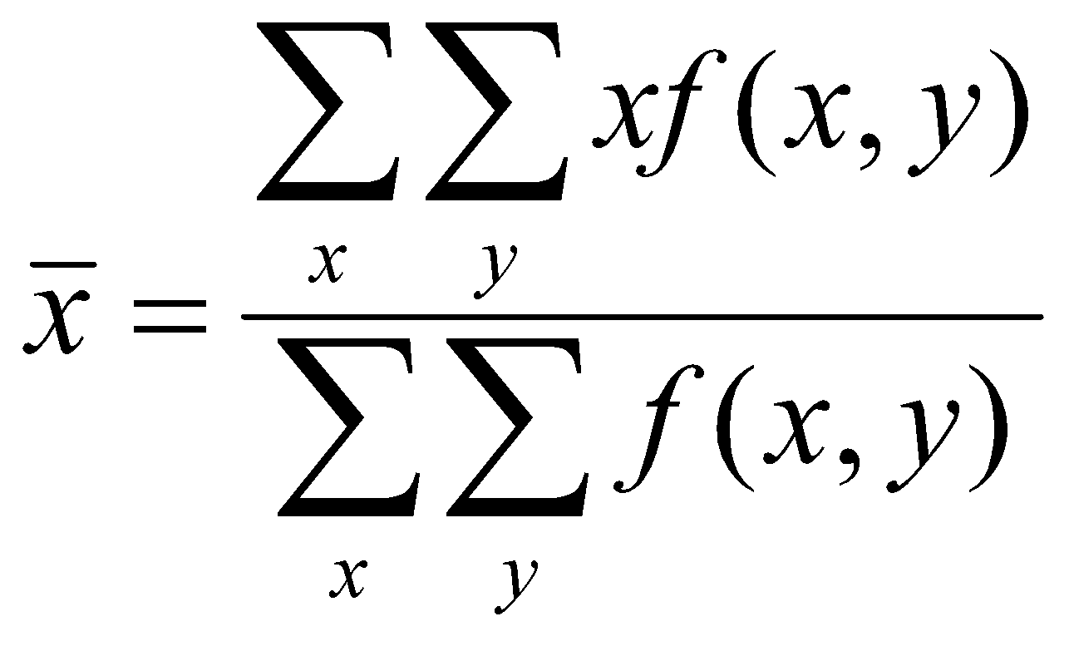
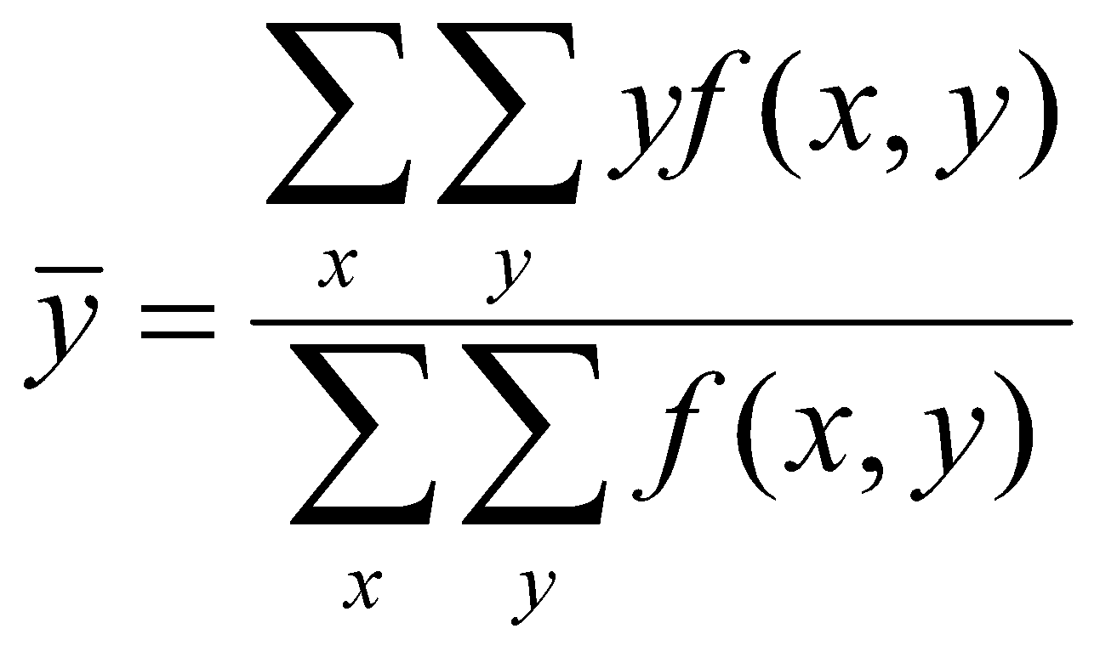
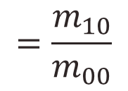
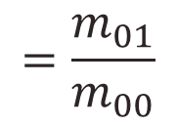
Image Moments (3)
Given a binary image f containing a single connected component.
f(x,y) = 1 if the pixel at location x,y belongs to the component
f(x,y) = 0 everywhere else
Center of mass (centroid) is given by the 1st moment

Slide 4
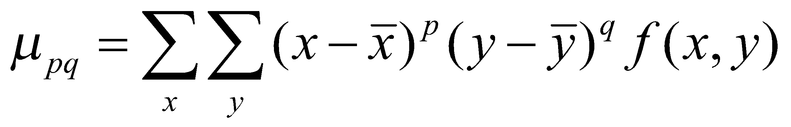
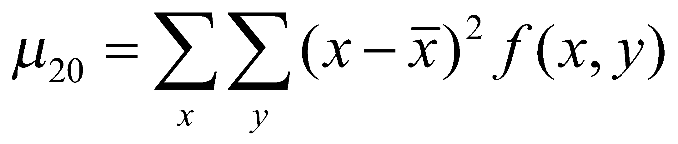
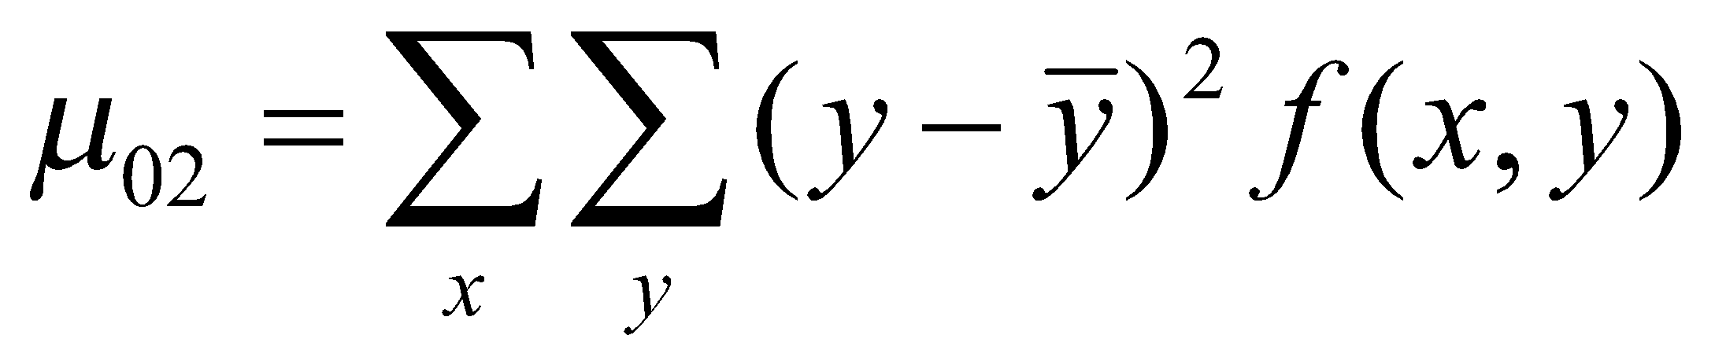
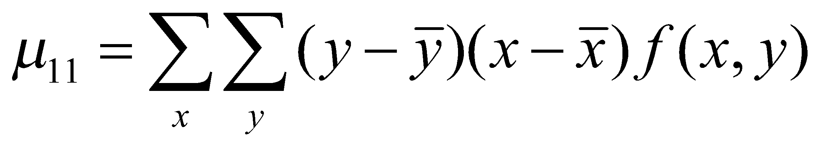
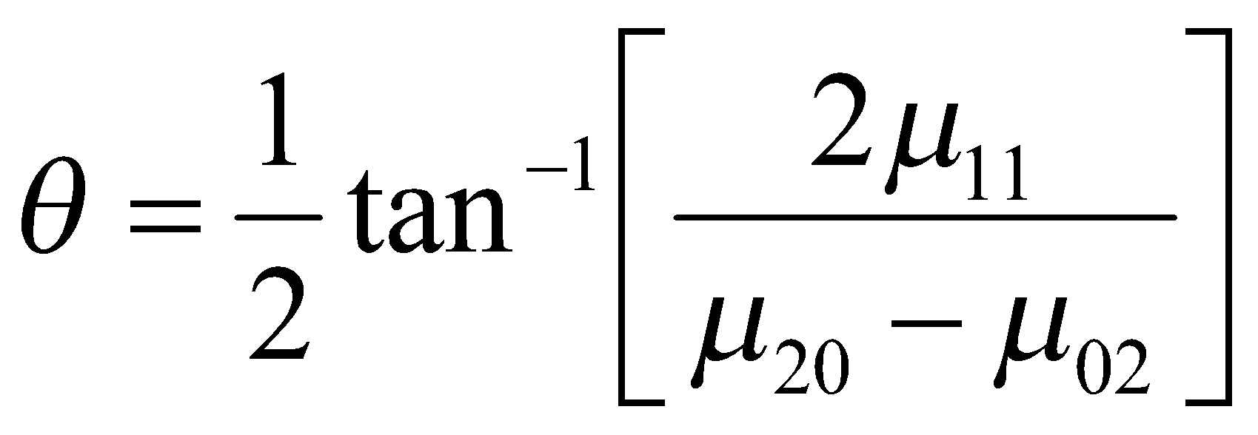
Central Moments
Orientation is determined by the second moments.
second moments
orientation

Slide 5
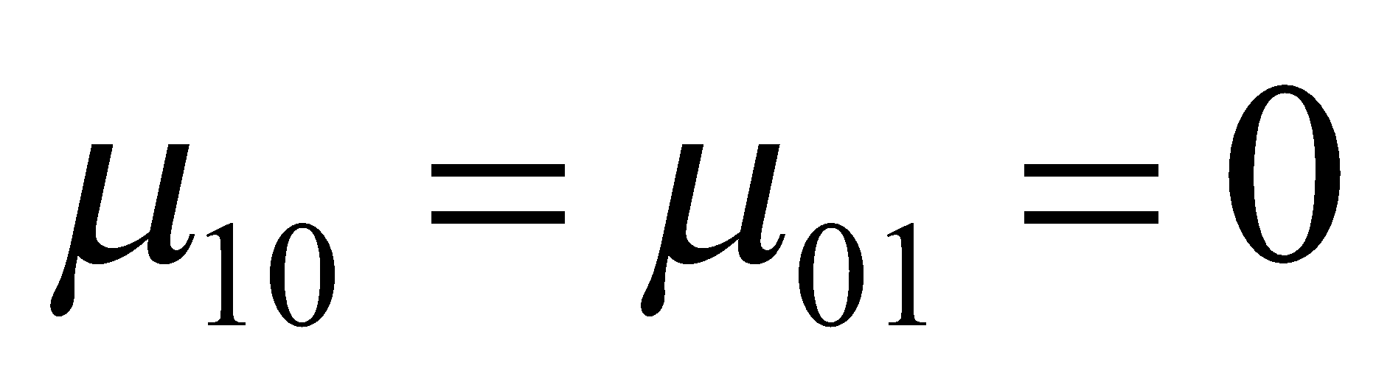
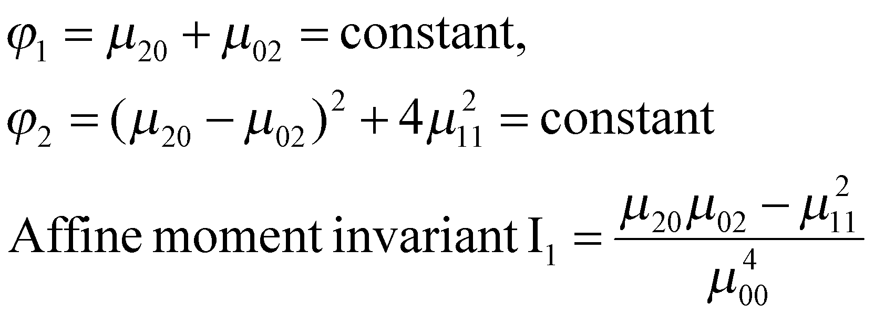
Moment Invariants
Certain function of moments, which are invariant to geometric transformation such as translation, scaling, and rotation. Such features are useful in identification of objects with unique shapes regardless of their location, size, and orientation.
1st order moment invariant:
2nd order moment invariant:

Slide 6
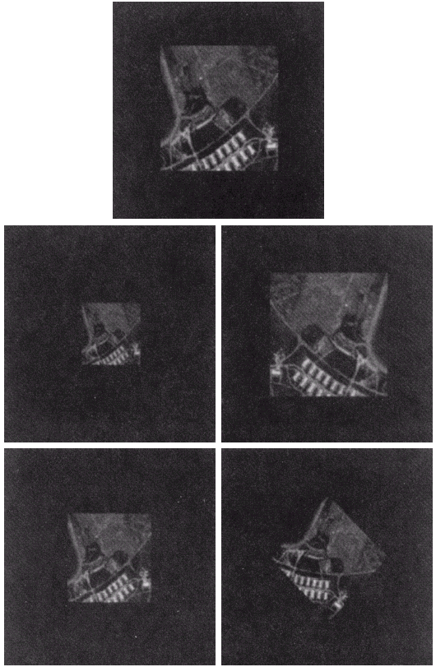
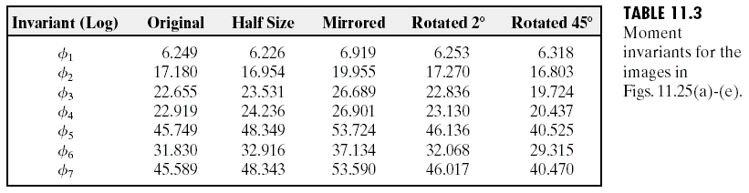
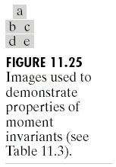
Moment Invariants
Courtesy: Gonzalez and Woods, Digital Image Processing, Chap. 11, 2nd ed., 2002

Slide 7
Texture
Texture is observed in the structural patterns of surfaces of objects such as wood, grain, sand, grass, and cloth. The term texture generally refers to repetition of basic texture elements called texels. A texels contains several pixels, whose placement could be periodic, quasi-periodic or random. Natural textures are generally random, whereas artificial textures are often deterministic or periodic. Texture may be coarse, fine, smooth, granulated, rippled, regular, irregular, or linear. In image analysis, texture is broadly estimated by: statistical and structural metrics.

Slide 8
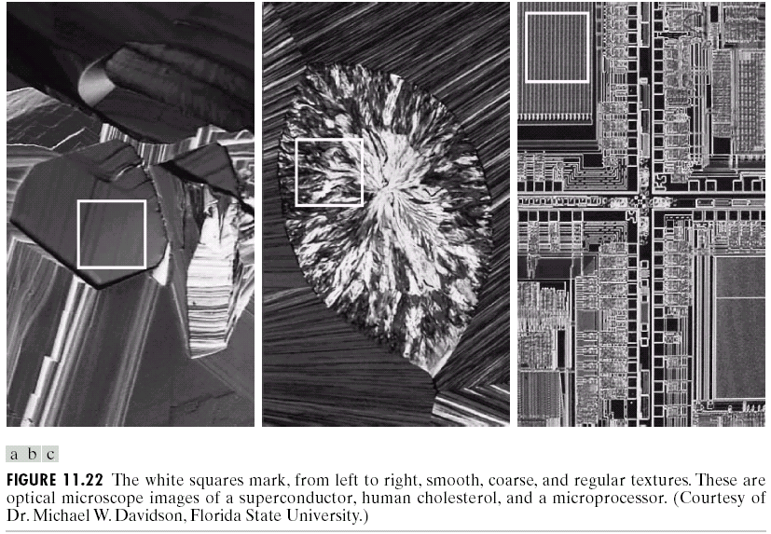
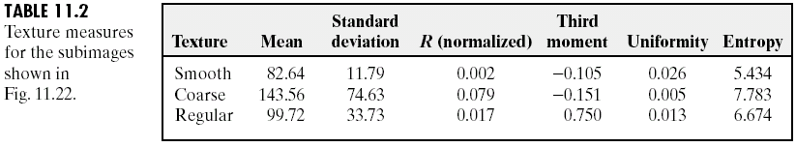
Texture
Courtesy: Gonzalez and Woods, Digital Image Processing, Chap. 11, 2nd ed., 2002

Slide 9
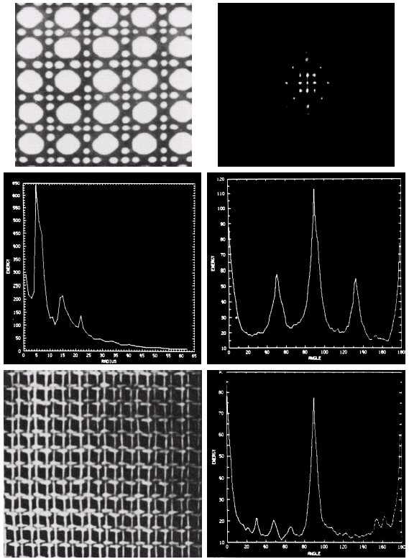

Texture
Courtesy: Gonzalez and Woods, Digital Image Processing, Chap. 11, 2nd ed., 2002

Slide 10
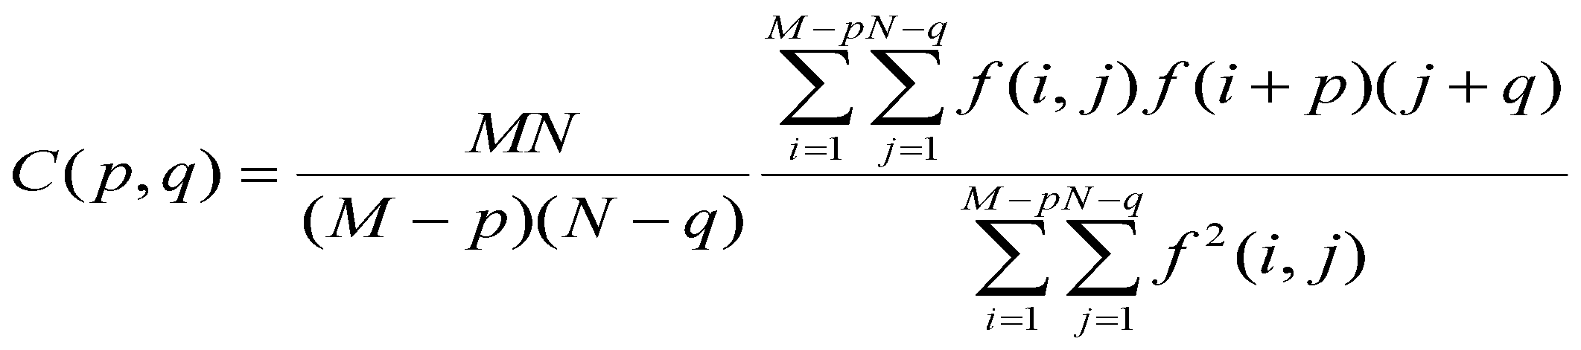
Statistical Texture Description
Measuring spatial frequencies is the basis of a large group of texture recognition methods. Textural character is in direct relation to the spatial size of the texture primitives; coarse textures are built from large primitives, fine textures from small primitives. Fine textures are characterized by higher spatial frequencies, coarse textures by lower spatial frequencies.
Spatial frequency methods evaluate the autocorrelation function of a texture:
Autocorrelation coefficients for several different values of parameters p, q are given by:
Where p, q is the position difference in the i, j direction, and M, N are the image dimensions.

Slide 11
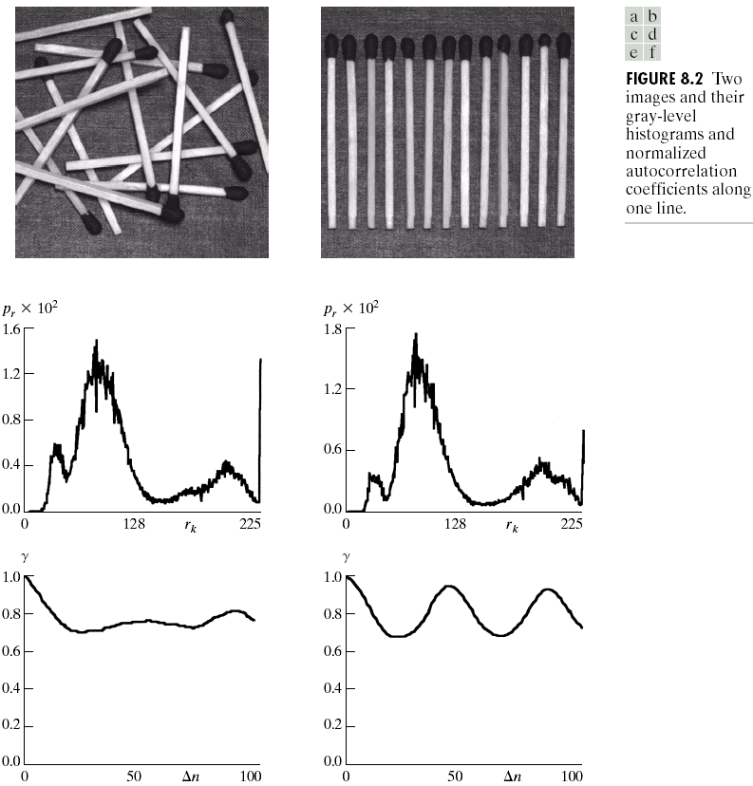
Texture
Courtesy: Gonzalez and Woods, Digital Image Processing, Chap. 8, 2nd ed., 2002

Slide 12
Texture Applications
Localization of diseased forests from remotely sensed data, automatic diagnosis of lung diseases from X-ray images, recognition of cloud types from meteorological satellite data, texture recognition of roads, road crossings, buildings, agricultural regions, and natural objects, etc., are examples of texture recognition applications.

