Slide 1
Morphology
Morphology -“shape” feature
Morphology relates to the “shape” of a connected component
Morphological operations modify the shape of a component or give information about the shape of a component
erosion/dilation (shrinking/expansion of a component)
opening/closing (eliminate “boundary” noise)
thinning (determining the “skeletal structure”)/thickening
concave/convex hulls (determining the boundary)

Slide 2
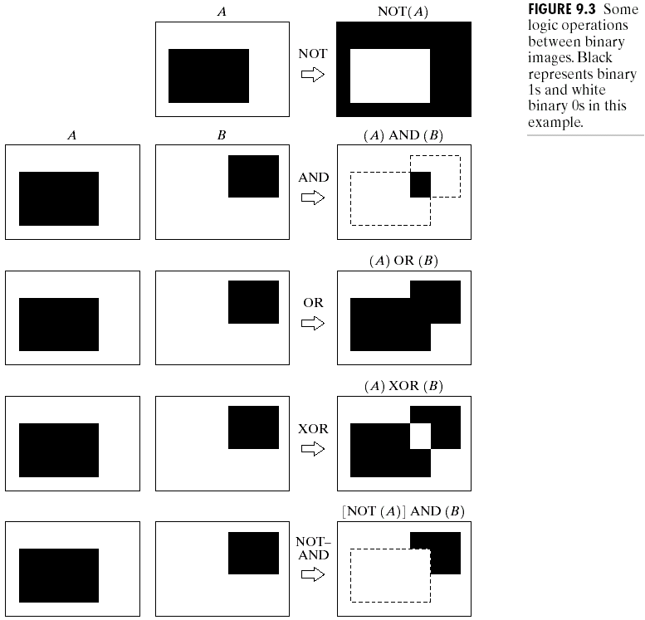
Morphological Image Processing

Slide 3
Structuring Elements
1 | 1 | 1
1 | 1 | 1
1 | 1 | 1
0 | 1 | 0
1 | 1 | 1
0 | 1 | 0
Square-size structuring element
Cross-size structuring element

Slide 4
Fitting and Hitting
Fitting: A structuring element is said to fit an image if, for each of its pixels that is set to 1, the corresponding image pixel is also 1.
Hitting: A structuring element is said to intersect or hit, an image if, for any of its pixels that is set to 1, the corresponding image pixel is also 1.
In both cases, we ignore image pixels for which the corresponding structuring element pixel is 0.

Slide 5
Dilation
Used to increase the area of a component.
Adds pixels around the boundaries
fills interior holes
An image is processed by applying a structuring element
center the structuring element S on pixel P
if P is OFF then set it to ON if any part of S overlaps an ON image pixel
This process can only turn pixels from OFF to ON
The component can only grow

Slide 6
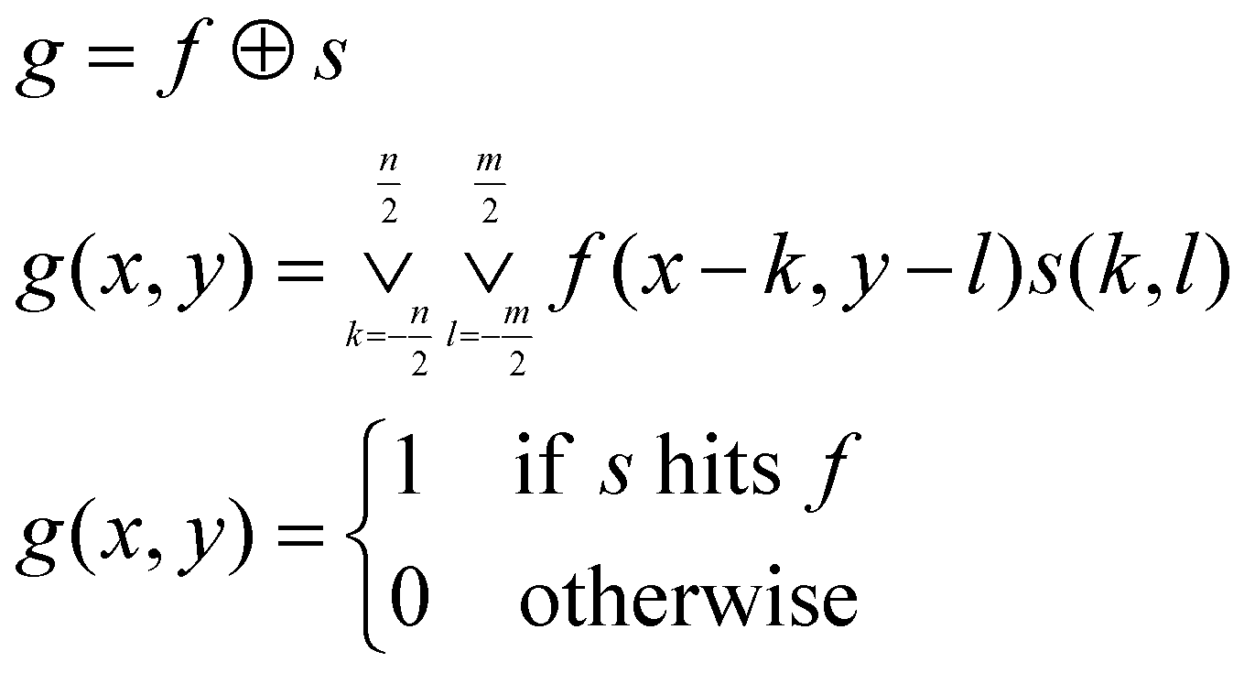
Dilation
Given binary image f and structuring element s the dilated image g can be described as:

Slide 7
Dilation
0 | 0 | 0 | 0 | 0 | 0 | 0
0 | 1 | 1 | 0 | 0 | 0 | 1
0 | 1 | 0 | 0 | 0 | 0 | 1
0 | 1 | 0 | 0 | 0 | 0 | 1
0 | 1 | 1 | 1 | 1 | 1 | 1
0 | 0 | 0 | 1 | 1 | 1 | 0
0 | 0 | 0 | 0 | 0 | 0 | 0
1 | 1 | 1 | 1 | 0 | 1 | 1
1 | 1 | 1 | 1 | 0 | 1 | 1
1 | 1 | 1 | 1 | 0 | 1 | 1
1 | 1 | 1 | 1 | 1 | 1 | 1
1 | 1 | 1 | 1 | 1 | 1 | 1
1 | 1 | 1 | 1 | 1 | 1 | 1
0 | 0 | 1 | 1 | 1 | 1 | 1
1 | 1 | 1
1 | 1 | 1
1 | 1 | 1
Square-size structuring element

Slide 8
Dilation
0 | 0 | 0 | 0 | 0 | 0 | 0
0 | 1 | 1 | 0 | 0 | 0 | 1
0 | 1 | 0 | 0 | 0 | 0 | 1
0 | 1 | 0 | 0 | 0 | 0 | 1
0 | 1 | 1 | 1 | 1 | 1 | 1
0 | 0 | 0 | 1 | 1 | 1 | 0
0 | 0 | 0 | 0 | 0 | 0 | 0
0 | 1 | 1 | 0 | 0 | 0 | 1
1 | 1 | 1 | 1 | 0 | 1 | 1
1 | 1 | 1 | 0 | 0 | 1 | 1
1 | 1 | 1 | 1 | 1 | 1 | 1
1 | 1 | 1 | 1 | 1 | 1 | 1
0 | 1 | 1 | 1 | 1 | 1 | 1
0 | 0 | 0 | 1 | 1 | 1 | 0
0 | 1 | 0
1 | 1 | 1
0 | 1 | 0
Cross-size structuring element

Slide 9
Erosion
Used to decrease the area of a component.
Removes pixels around the boundaries
Enlarges interior holes
An image is processed by applying a structuring element
center the structuring element S on pixel P
if P is ON then set it to OFF if any part of S overlaps an OFF image pixel
This process can only turn pixels from ON to OFF
The component can only shrink

Slide 10
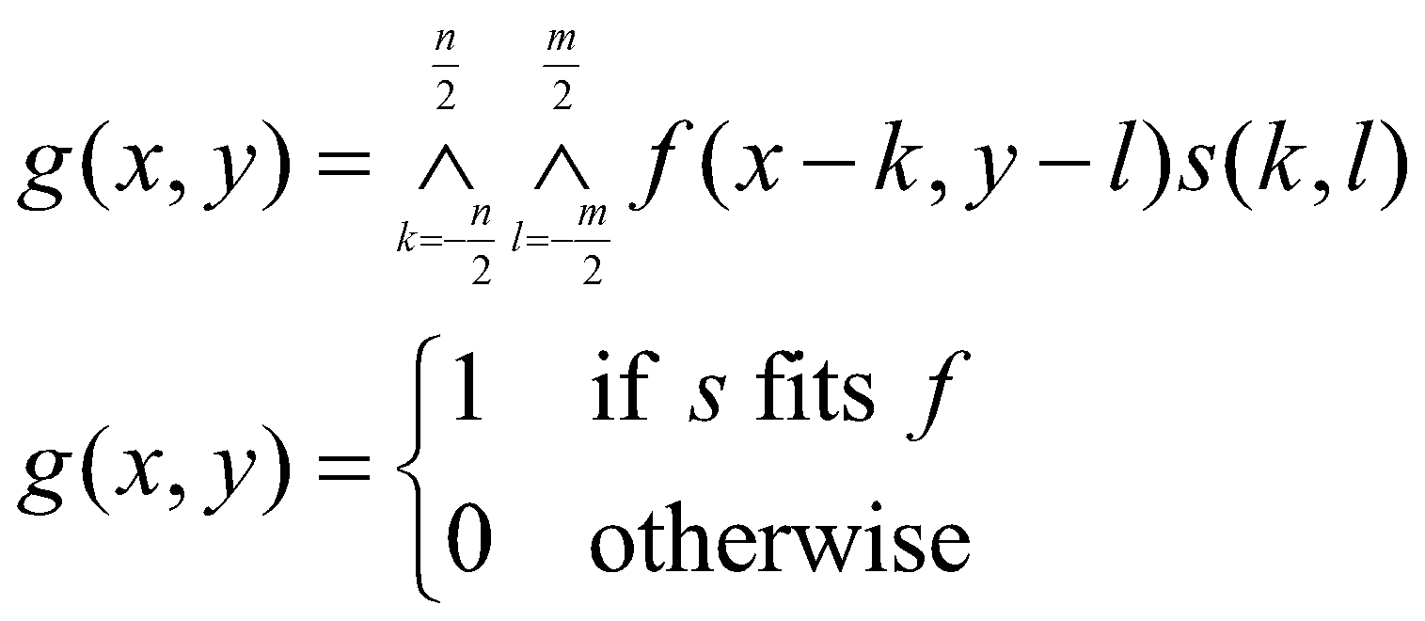
Erosion
Given binary image f and structuring element s the errotted image g can be described as:
g = f s

Slide 11
Erosion
0 | 1 | 1 | 0 | 0 | 0 | 1
1 | 1 | 1 | 1 | 0 | 1 | 1
1 | 1 | 1 | 0 | 0 | 1 | 1
1 | 1 | 1 | 1 | 1 | 1 | 1
1 | 1 | 1 | 1 | 1 | 1 | 1
0 | 1 | 1 | 1 | 1 | 1 | 1
0 | 0 | 0 | 1 | 1 | 1 | 0
0 | 0 | 0 | 0 | 0 | 0 | 0
0 | 0 | 0 | 0 | 0 | 0 | 0
0 | 1 | 0 | 0 | 0 | 0 | 0
0 | 1 | 0 | 0 | 0 | 0 | 0
0 | 0 | 1 | 1 | 1 | 1 | 0
0 | 0 | 0 | 0 | 1 | 0 | 0
0 | 0 | 0 | 0 | 0 | 0 | 0
1 | 1 | 1
1 | 1 | 1
1 | 1 | 1
Square-size structuring element

Slide 12
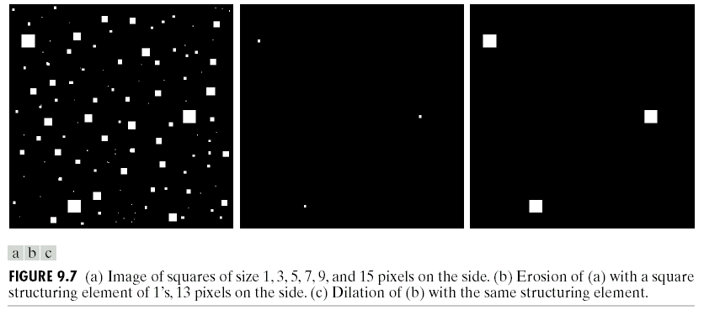
Erosion and Dilation

Slide 13
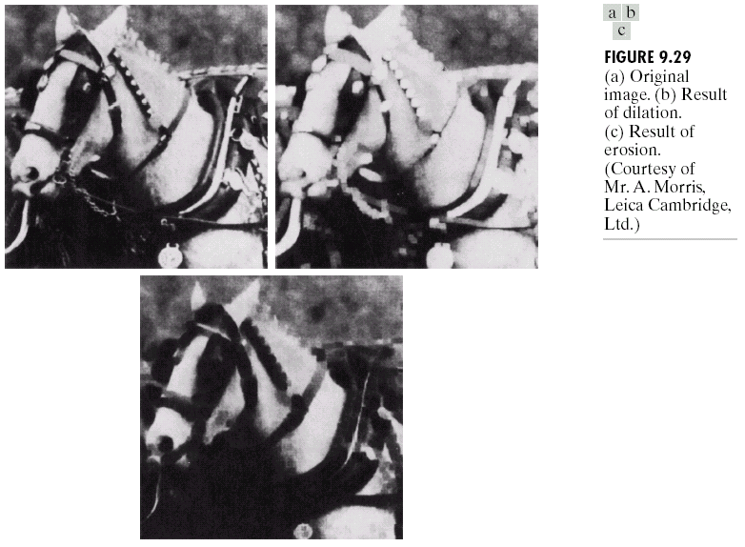
Morphological Image Processing

Slide 14
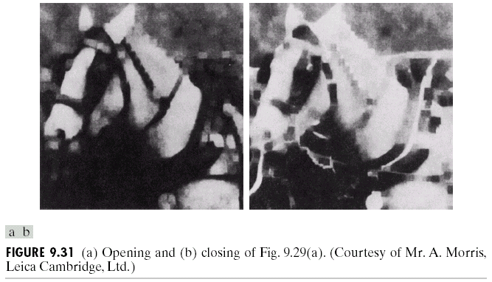
Morphological Image Processing

Slide 15
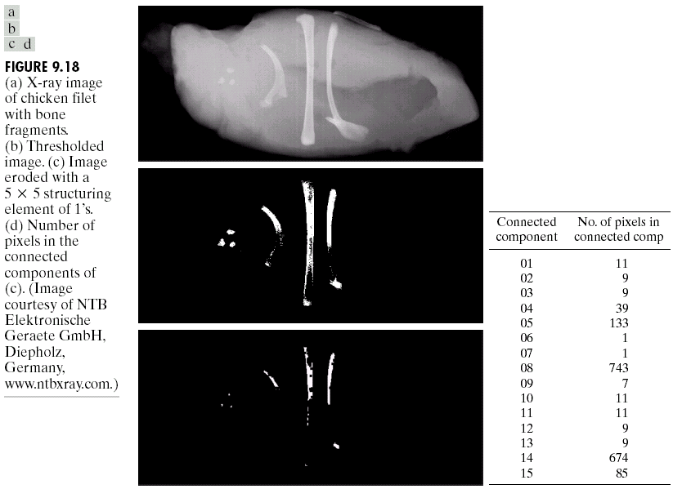
Morphological Image Processing

Slide 16
Opening and Closing Operations
The open operation is defined as a dilation followed by an erosion
smoothens boundaries
enlarges narrow gaps
eliminates “spikes”
The close operation is defined as an erosion followed by a dilation
fills narrow gaps
eliminates small holes and breaks
Repeated applications of either “open” or “close” have no effect

Slide 17
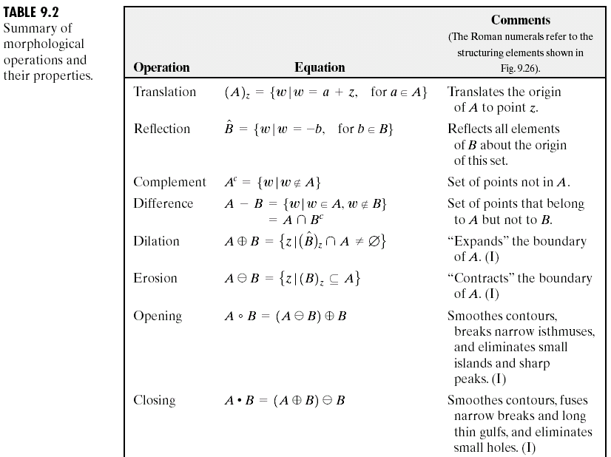
Morphological Image Processing

Slide 18
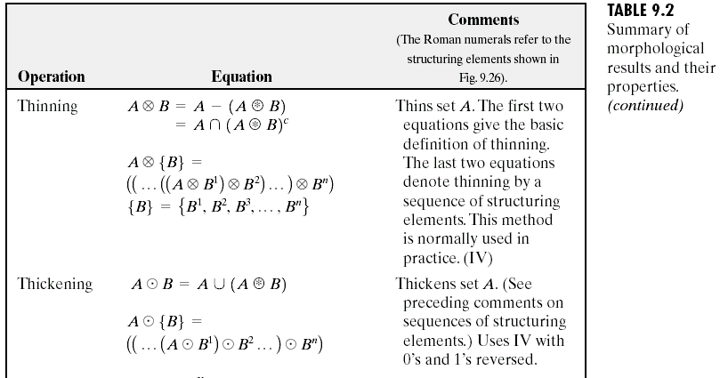
Morphological Image Processing

Slide 19
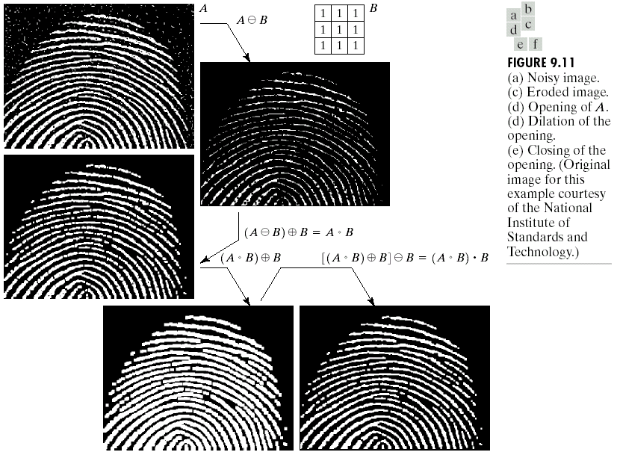
Morphological Image Processing

Slide 20
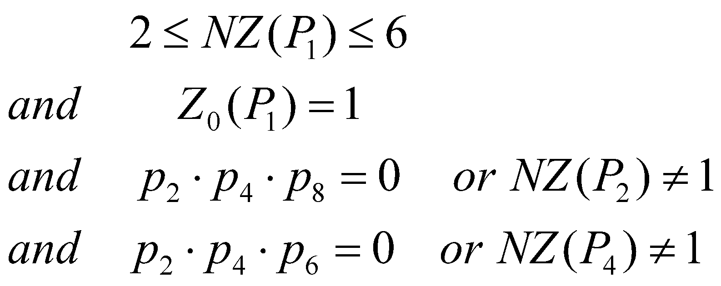
Thinning Algorithms
Thinning transform an object to a set of simple digital arcs, which lie roughly along their medial axes.
Let Z₀(P₁) be the number of zero to nonzero transitions in the ordered set p₂, p₃, p₄, …,P₉,P₂. Let NZ(P₁) be the number of nonzero neighbors of P₁. Then P₁ is deleted if
The procedure is repeated until no further changes occur in the image.

Slide 21
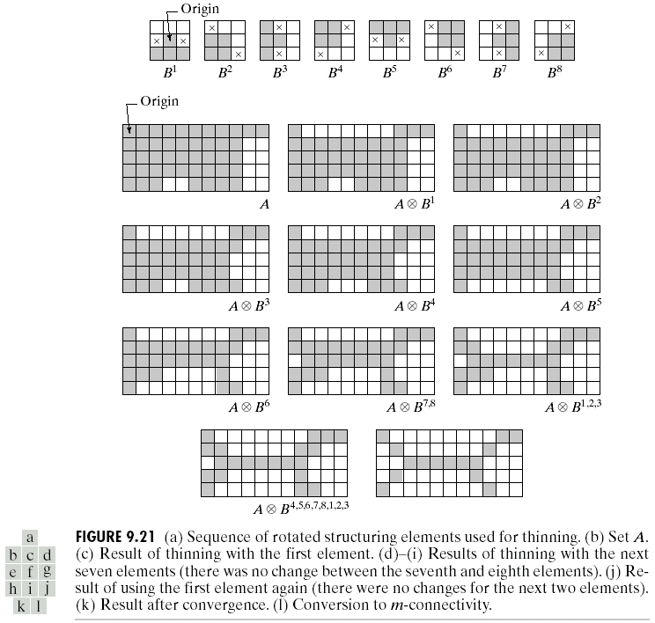
Morphological Image Processing

