Slide 1
Pseudocoloring
Artifical coloring (PseudoColoring) can often enhance the presentation of image information
Replaces the gray-scale levels by an arbitrarily selected palette or color bar

Slide 2
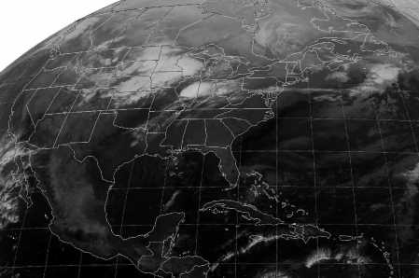
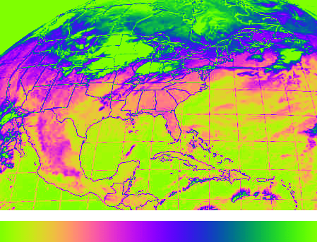
Pseudo Coloring Example
Weather satellite image. Note the way the colorized image brings out certain details that are difficult to distinguish in the original.

