Slide 1
Reference Books
1) Systems Analysis and Design
Author: Elias M. Awad
2) Software Engineering, ^{6th} edition
Author: Lan Sommerville
3) Software Engineering
Author: Roger S. Pressman

Slide 2
System engineering process
- Many different engineering disciplines may be involved in
system engineering.
- It involves the following phases:
i) Requirements definition ii) System design
iii) Sub-system development iv) System integration
v) System installation vi) System operation
vii) System evolution viii) System decommissioning
Fig. 2.6

Slide 3
Information Desk
New Account Open
Cash Counter
Cheque Processing
Debit and Credit Services
FDR
Savings Certificates
Loan Service
Electronic Card Processing
IT Management
Electronic Banking
      ATM Card and ATM Booth
      Debit Card
      Credit Card

Slide 4
System Design
It is concerned with how the system functionality is to be provided by the different components of the system.
The following activities are involved:
    Partition requirements: The requirements are analyzed and collected into groups.
    Identify subsystems: Different sub-systems that can individually or collectively meet the requirements are identified.
    Assign requirements to sub-systems: The requirements are assigned to subsystems.
    Specify sub-system functionality: The specific functions provided by each subsystem are specified.
    Define sub-system interfaces: It defines the interfaces that are provided and required by each subsystem.
Fig. 2.8

Slide 5
System decommissioning
- It means taking the system out of service after its operational
lifetime.
- The system engineering activity should anticipate decommissioning
and dispose the materials which are damaging to the environment.
Software Requirements
Requirements
- The description of the services and constraints are the requirements for the system.
Requirements Engineering
- It is the process of finding out, analyzing, documenting, and checking these services and constraints is called requirements engineering.
Software design specification
- It is an abstract description of the software design. The specification add further detail to the system requirements specification.

Slide 6
Software system requirements are:
Functional requirements
For a system, it describes the functionality or services that the system is expected to provide.
The functional requirements specification of a system should be both complete and consistent.
Example:
Problem Statement : Functional requirements of a University Library System to allow students and faculties to order books and documents from other libraries.
Specification:
The user shall be able to search a subset or all of the book
database
The system should provide appropriate viewers to read
documents
Every order shall be allocated a unique identifier.
Software Requirements Specification (SRS)

Slide 7
Non-functional requirements
These are not directly concerned with the specific functions delivered by the system.
They may relate to emergent system properties: reliability, response time and store occupancy.
They may define constraints of the system: capability, store occupancy etc.
Different types: i) Product requirement ii) Organizational and iii) External requirements.
Domain Requirements
These are derived from the application domain of the system
e.g. constrain existing functional requirements or set out how particular computations must be carried out.
Library system domain requirements
Because of copyright restrictions, some documents must be deleted immediately on arrival.

Slide 8
User requirements
They describe the functional and non-functional requirements to be understandable by the system users.
The requirements must be written using natural language, forms and simple diagrams.
e.g., A user requirement for an editor grid
Grid facilities: To control the positioning of entities on a diagram, the grid can be turned on either in cm or inches. The number of grid lines can be reduced to avoid filling the smaller diagram with grid lines.
System Requirements
It is a complete and consistent specification of the whole system
System Requirement Specification (SRS) may include different models of the system, e.g., object model, data-flow model etc.
It states what the system should do

Slide 9
System Requirements Specification
System Requirements Specification (SRS)
It may be a written documents
A set of graphical models
A formal mathematical model
A collection of usage scenarios
A prototype or any combination of these
Requirements Engineering Tasks
Inception
Elicitation
Elaboration
Negotiation
Requirements management
Eliciting Requirements
Collaborative requirement gathering
Quality function deployment
User scenarios
Elicitation work products

Slide 10
Elicitation Work Products
Elicitation Work Products
The work products are produced as a consequence of requirements elicitation.
The work products include:
A statement of need and feasibility
Bounded statement of scope for the system or product
A list of customers, users, and stakeholders who participate in requirements elicitation
Description of the systems technical environment
List of requirements and domain constraints
A set of usage scenarios
Any prototype developed to define requirements

Slide 11
Software Requirements Analysis Process
Requirements Analysis Process
It results in the specification of software’s operational characteristics, indicates software’s interface with other system elements and establishes constraints that software must meet.
Allows to elaborate basic requirements, build models of user scenarios, functional activities, problem classes and their relationships, system and class behavior, and the flow of data.
Provides the software designer with a representation of information, function and behavior, that can be translated to architectural, interface, and component level designs.
Analyst should model what is known and use that model as the basis for design of the software.
Models of a System
Different types of models: i) analysis model ii) design model iii) construction model

Slide 12
Analysis Model
Objectives: i) Describes what the customer requires ii) establishes a basis for the creation of a software design iii) to define a set of requirements.
It bridges the gap between a system-level description and a software design.
See Fig. 8.1
All elements of the analysis model are directly traceable to parts of the design model. (Fig. 8.3)
Two types of analysis: i) domain analysis ii) application analysis
Domain Analysis (OO)
It is the identification, analysis, and specification of common, reusable capabilities within a specific application domain, in terms of common objects, classes, subassemblies, and frameworks.
Example domains: Banking, aircraft control system, video games etc.
See Fig. 8.2
Analysis Modeling Approaches
Two types: i) Structured analysis ii) Object-oriented (OO) analysis
See Fig. 8.3

Slide 13
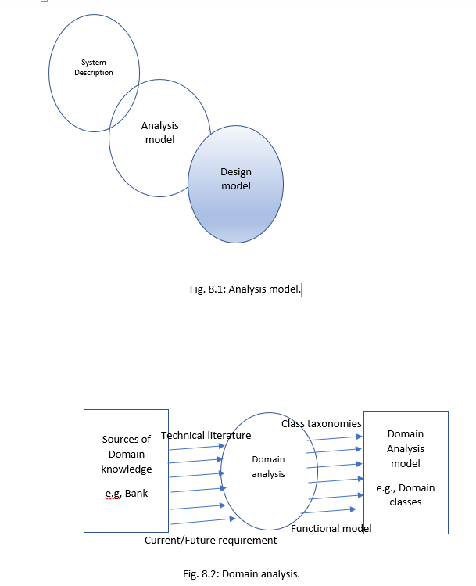

Slide 14
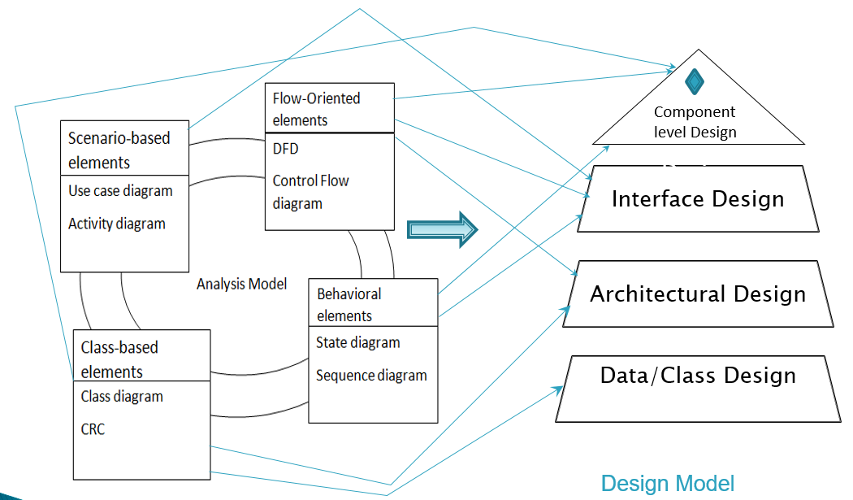
Fig. 8.3

Slide 15
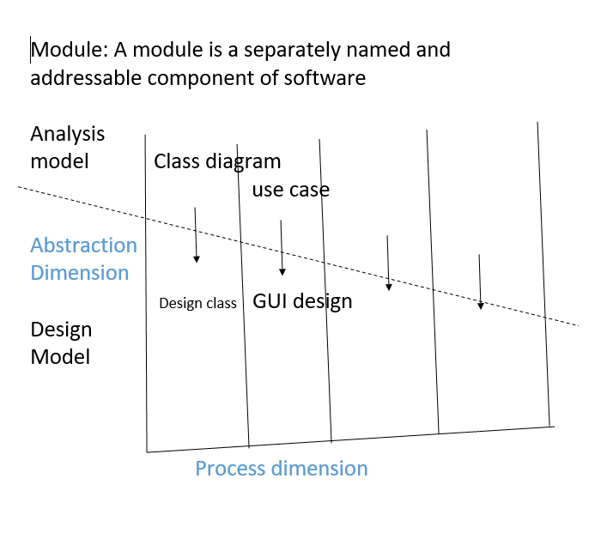

Slide 16
Structured analysis
Considers data and the processes that transform data as separate entities.
Data objects are modeled to define their attributes and relationships.
Processes are modeled so that they show how they transform data as data objects flow through the system.
OO analysis
Focuses on the definition of classes and the manner in which they collaborate with one another to effect customer requirements.
Data modeling
Software engineer or analyst defines all data objects that are processed within the system, the relationships between the data objects and other information.

Slide 17
Data Modeling
Data Objects
It is a representation of any composite information having a number of different properties or attributes, understood by software.
e.g. dimension (height, width and depth).
Encapsulates data only, no reference to operations
Objectives
Data modeling tools can be used to represent data objects, their characteristics and their relationships.
Tools provide an automated means for creating entity-relationship (ER) diagram, data object dictionaries, and related models.
Tools
AllFusion ERWin
ER/Studio
Oracle Designer
Edraw

