Slide 1
4G Mobile Communications (WiMAX and LTE)
Dr. Md. Imdadul Islam
Professor, Department of Computer Science and Engineering
Jahangirnagar University
https://www.juniv.edu/teachers/imdad

Slide 2


History
In March 2008, the International Telecommunications Union-Radio communications (ITU-R) specified a set of requirements for 4G standards, named the International Mobile Telecommunications Advanced (IMT-Advanced).
IMT-Advanced requires peak speed of 300 Mbit/s for high mobility communication (such as from trains and cars) and 1Gbit/s for low mobility communication (such as pedestrians and stationary users).
IMT is standard/template proposed by ITU for broadband mobile service against a generation.
IMT-2000 (3G)
IMT-Advanced (4G)
IMT-2020 (5G)

Slide 3
Mobile WiMAX (first used in South Korea in 2007) and LTE (in Oslo, Norway and Stockholm, Sweden since 2009) support much less than 1 Gbit/s peak bit rate, they are not fully IMT-Advanced compliant, but are often branded 4G by service providers.
On December 6, 2010, ITU-R recognized that these two technologies, as well as other beyond-3G technologies that do not fulfill the IMT-Advanced requirements, could nevertheless be considered "4G", provided they represent forerunners to IMT-Advanced compliant versions.
During the spring 2011 above two system provide their advanced version as: Mobile WiMAX Release 2 (also known as Wireless MAN-Advanced or IEEE 802.16m') and LTE Advanced (LTE-A, Based on UMTS 3G technology) and promising speeds in the order of 1 Gbit/s in 2013.

Slide 4
Some Key Challenges
Coverage
Spectrum
Capacity
Coverage
To increase the coverage area the transmit power needs to be increased. High transmit power will create interference with surroundings at the same time fading affect increases due to longer length of wireless link, hence limits the capacity of the network.
Capacity
Because of huge interferences and fading the wireless link has limited peak data rate. To enhance capacity the length wireless link need to be reduced i.e. coverage of cell should be reduced again.
Spectrum
Lower carrier frequencies (< 5 GHz) are best for wide-area coverage and mobility. The higher frequency carrier (spectrum of high frequency) experiences heavy path loss and scattering hence limits the cell size (coverage).
Notes:
4

Slide 5
WiMAX

Slide 6
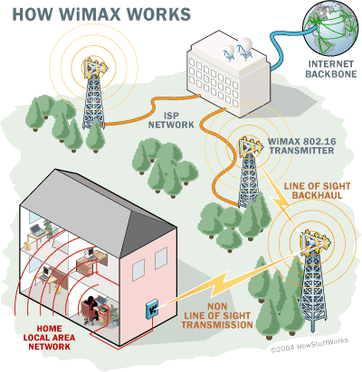
WiMAX
Wi-MAX : The Worldwide Interoperability for Microwave Access, is a technology aimed at providing wireless data over long distances. It is based on the IEEE 802.16 standard.
Fig.1

Slide 7
Some important features of WiMAX
OFDM in physical layer: The access technique used in physical layer of WiMAX is OFDM; where the high speed serial data is converted to low rate parallel streams and each stream is modulated by separate carrier each one is known as subcarrier. Subcarriers are mutually orthogonal and deals with low data rate hence can protect ISI resulting from multipath propagation.
Very high peak data rates: The data rate of WMAX is 70Mbps under the channel of bandwidth of 20 MHz. The rate can be further increased using space division multiplexing i.e. incorporation of multiple antennas.

Slide 8
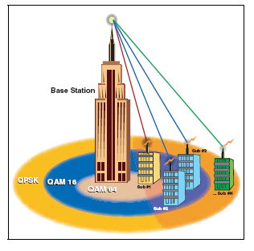
Adaptive Modulation and Coding: The IEEE 802.16e standard changes modulation and channel coding scheme based on received SNR. For example a SS (Subscriber Station) close to the BS can use a high modulation scheme (more bits per symbol) i.e. the system can get more capacity but when the SS is at the cell boarder the system permits lower modulation scheme (increased signal space on orthogonal basis function coordinate system) to avoid huge symbol error rate.
Ψ₂(t)
Ψ₂(t)
QPSK
16-QAM
Ψ₁(t)
Ψ₁(t)
Lower Modulation Scheme
(2 bits/symbol)
Upper Modulation Scheme
(4 bits/symbol)

Slide 9
The system can overcome the time selective fading (the channel condition is better at some instant than other) using adaptive modulation scheme. To reduce BER at cell boundary, a complex channel coding is used to detect or correct erroneous symbols.
Linear block code
Convolutional code
R-S Code
CRC code

Slide 10
Error Correction/Detection Techniques: WiMAX incorporates two types of strong error correction techniques: FEC (Forward Error Correction) for multimedia traffic and ARQ (Automatic Repeat Request) for data traffic to improve throughput.
Linear block code
Convolutional code
R-S Code
FEC
ARQ
CRC code

Slide 11
Support for TDD and FDD: Like mobile cellular communication it supports both FDD (Frequency division duplexing) and TDD (Time division duplexing), as well as a half-duplex FDD. Above features provide the flexibility of using same or different carriers for up and down link.
Time Division Duplexing
Time division duplexing (TDD) refers to transmission and reception of data on the same carrier frequency. A common frequency is shared between the upstream and downstream, but different time slot is allocated for them.
Frequency Division Duplexing
Frequency division duplexing (FDD) refers to the simultaneous transmission and reception of data over separate carrier frequencies, allowing for bidirectional full-duplex communications.

Slide 12
Three common types of BW allocation algorithms are: Dedicated Resource Allocation (Unsolicited Grand Service known as UGS Algorithm) where fixed amount of BW is allocated to each user hence possibility of waste of BW when a user needs to data send data at low rate; Polling-Based Resource Allocation (Real-Time Polling Service called rtPS Algorithm) where BS allocates the BW dynamically therefore incurs some protocol overhead and delay; Hybrid Resource Allocation Algorithm is the combination of above two.

Slide 13
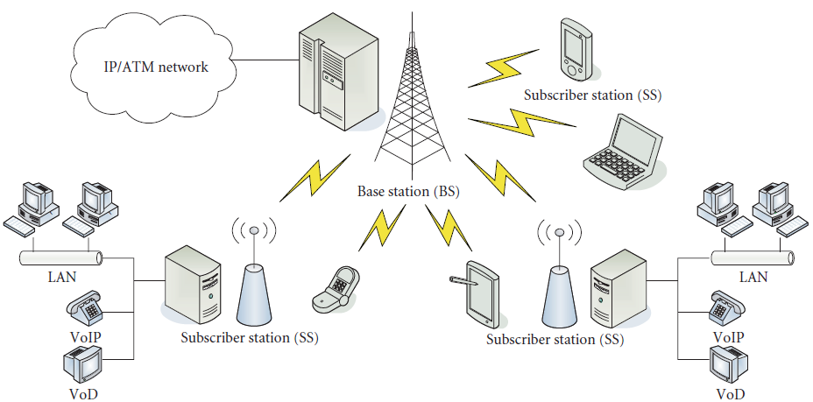
IEEE 802.16 general architecture

Slide 14
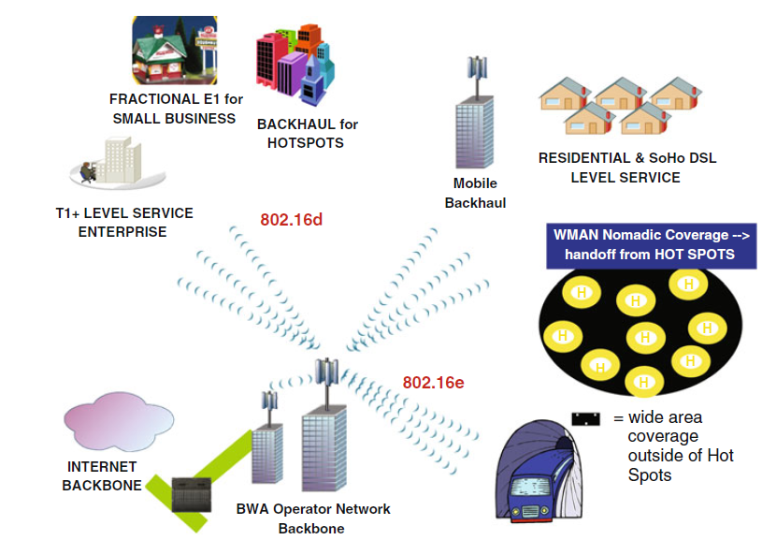
WiMAX applications and missions
BWA (Broadband Wireless Access)

Slide 15
Wireless Technology Evolution to 3.9G
CDMA
GSM/UMTS
IEEE Cellular
IEEE LAN
CDMA
(IS-95A)
GSM
TDMA
IS-136
IEEE
802.16
IEEE
802.11
2G
CDMA
(IS-95B)
GPRS
802.11g
2.5G
cdma
2000
E-GPRS
EDGE
WCDMA
FDD/TDD
TD-SCDMA
LCR-TDD
802.11a
3G
3.5G
1xEV-DO
Rev 0/A/B
HSDPA
FDD/TDD
HSUPA
FDD/TDD
Fixed WiMAX
802.16d
WiBRO
802.11g
UMB
802.20
LTE
E-UTRA
HSPA+
Mobile WiMAX
802.16e
802.11n
3.9G
UMB (Ultra Mobile Broadband) was the brand name for a project within 3GPP2 to improve the CDMA 2000 mobile phone standard for next generation applications and requirements. No carrier had announced plans to adopt UMB, and most CDMA carriers in Australia, USA, Canada, China, Japan and South Korea have already announced plans to adopt either WiMAX or LTE as their 4G technology.

Slide 16
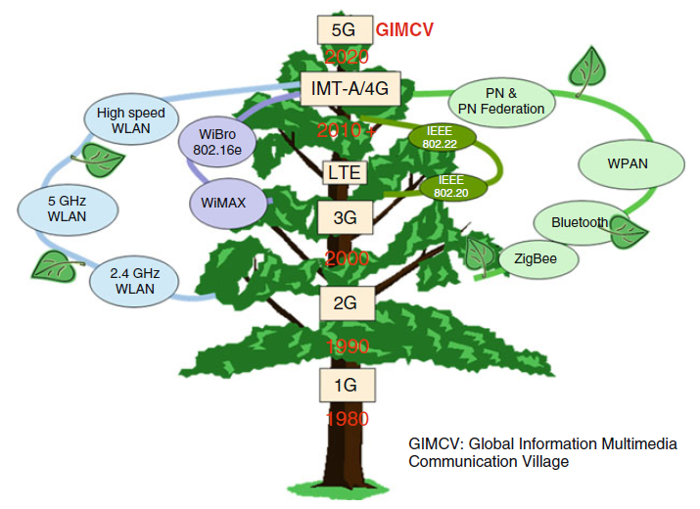
The progress tree for communication technology

Slide 17
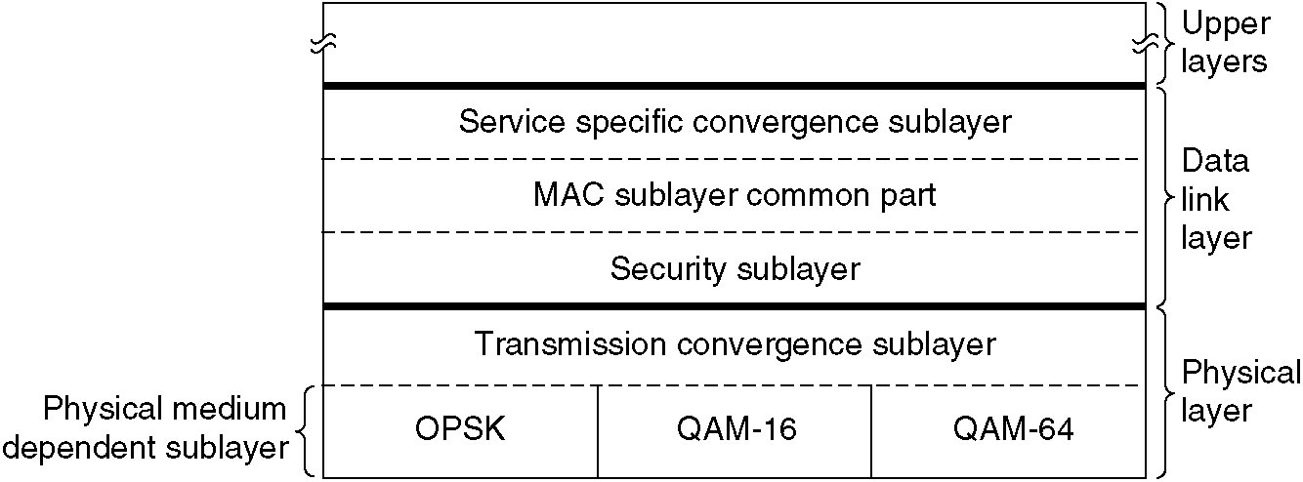
The 802.16 Protocol Stack
The 802.16 protocol stack

Slide 18
Layers of WiMAX
Upper layers
Data link layer
Service specific convergence layer
Physical layer
MAC sub-layer
Security sub-layer
Transmission convergence sub-layer
QPSK
16-QAM
64-QAM
Fig.5 The 802.16 protocol stack

Slide 19
802.16 PHY
Physical layer of WiMAX supports Adaptive Modulation and Coding scheme.
Modulation QPSK, 16-QAM, 64-QAM
The IEEE 802.16e supports both time division duplexing (TDD) and frequency division duplexing (FDD) modes.
It enables dynamic allocation of downlink (DL) and uplink (UL) radio resources to effectively support asymmetric DL/UL traffic that is common in Internet applications.
It supports link adaptation, multi-input-multi-output (MIMO) techniques, and closed loop advanced antenna technique such as beam-forming.

Slide 20
The TCS (Transmission convergence sub-layer) is located between the MAC and PHY Layers. If the TCS is enabled, the TCS converts MAC PDUs of variable size into proper-length FEC blocks, called TC PDU.

Slide 21
Data link layer
From the reference model as illustrated in Figure 5, there are three sub-layers in the data link layer composed of i) a security sub-layer, ii) a MAC common part sub-layer, and iii) a convergence sub-layer. It provides only connection oriented service
Fig.5 The 802.16 protocol stack

Slide 22
Service Specific Convergence Sub-layer (CS):
The CS, which is the interface between the MAC layer and layer 3 of the network, receives data packets from the higher layer. These higher layer packets are known as service data unit (SDU).
The CS is responsible for performing all operations that are dependent on the nature of higher-layer protocol, such a header compression and address mapping. The CS can be viewed as an adaptation layer that masks the higher-layer protocol.
SDU
MAC service data units (MSDUs)
MAC protocol data units (MPDUs)

Slide 23
Packet header suppression (PHS): At the transmitter it involves removing the repetitive part of the header of each SDU. For example, if the SDUs delivered to the CS are IP packets, the source and destination addresses contained in the header of each IP packet do not change from one packet to the next and thus can be removed before being transmitted over the air. Similarly at the receiver: the repetitive part of the header can be reinserted into the SDU before being delivered to the higher layer.
SDU
MAC service data units (MSDUs)
MAC protocol data units (MPDUs)

Slide 24
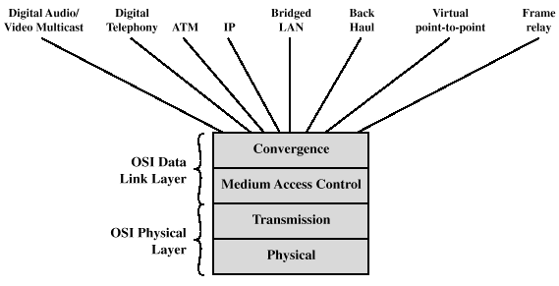
CS is also responsible for the mapping the higher layer address, such as IP address, of the SDUs into the identity of the PHY and MAC connections to be used for its transmission. The WiMAX MAC layer is connection oriented and identifies a logical connection between the BS and the MS by a unidirectional connection identifier (CID). The CID for UP and DL connections are different.

Slide 25
MAC Common Part Sublayer
The MAC layer takes packets from the upper layer (CS) and these packets are called MAC service data units (MSDUs) and organize them into MAC protocol data units (MPDUs) for transmission over the air.
The WiMAX MAC uses a variable length MPDU and offer a lot of flexibility to allow for their efficient transmission. For example multiple MPDUs of same or different lengths may be arranged into a single burst when they are destined to the same receiver.
SDU
MAC service data units (MSDUs)
MAC protocol data units (MPDUs)

Slide 26
Similarly, multiple MSDUs from the same higher-layer service may be concatenated into a single MPDU to save MAC header overhead.
When an SDU is fragmented, the position of each fragment within the SDU is tagged by a sequence number. The sequence number enables the MAC layer at the receiver to assemble the SDU from its fragments in the correct order.
SDU
MAC service data units (MSDUs)
MAC protocol data units (MPDUs)

Slide 27
WiMAX has two types of MPDUs, each with a very different header structure.
The generic MAC PDU is used for carrying data and MAC-layer signaling messages.
The bandwidth request PDU is used by the MS to indicate to the BS that more BW is required in UL, due to pending data transmission. A bandwidth request PDU consists only of a bandwidth-request header, with no payload or CRC.

Slide 28
Each MAC frame is prefixed with GMH (generic MAC header).
Field (in SH) to indicate whether the payload is encrypted or not. If the payload is encrypted then the encryption key is also given.
Header CRC field is a checksum over the header only using the generator polynomial x⁸+x²+x+1. The length of this field is 8bits.
GMH
Other
SH
Packed fixed size MSDU
…….
Packed fixed size MSDU
CRC
Fig.6 MAC PDU frame carrying several-fixed length MSDUs packed together
GMH → Generic MAC Header (used for carrying data and MAC-layer signaling messages)
SH → Sub-header

Slide 29
LEN
H
E
Type (6 bits)
rs
C
EKS
rs
msb
T
C
v
I
(2)
v
(3)
LEN lsb (8)
CID msb (8)
CID lsb (8)
HCS (8)
Generic MAC Header Fields
Field | Length | description
HT | 1 | Header type (set 0 for such header)
EC | 1 | Encryption control (0 = payload not encrypted; 1 = payload encrypted
Type | 6 | type
ESF | 1 | (1 = ES present; 0 = ES not present)
CI | 1 | CRC indicator (1=CRC included; 0=CRC not included)
EKS | 2 | Encryption key sequence (index of the traffic encryption key and the initialization vector used to encrypt the payload)
Rsv | 1 | Reserved
LEN | 11 | Length of MAC PDU in bytes, including the header)
CID | 16 | Connection identifier on which the payload is to be sent
HCS | 8 | Header check sequence; generation polynomial x8+x2+x+1

Slide 30
H
E
Type (3 bits)
BW Req.
T
C
msb (11)
BWS Req. lsb (8)
CID msb (8)
CID lsb (8)
HCS (8)
Bandwidth Request MAC Header Fields
Field | Length | Description
HT | 1 | Header type (set 1 for such header)
EC | 1 | Encryption control (set 0 for such header)
Type | 3 | type
BR | 19 | BW request ( the number of bytes of UL BW requested by the SS for the given CID)
LEN | 11 | Length of MAC PDU in bytes, including the header
CID | 16 | Connection identifier
HCS | 8 | Header check sequence

Slide 31
GMH
Other
SH
FSH
MSDU Fragment
CRC
Fig.7 MAC PDU frame carrying a single fragmented MSDU
GMH
Other
SH
PSH
Variable size MSDU or
Fragment
PSH
Variable size MSDU or
Fragment
…
CRC
Fig.8 MAC PDU frame carrying several variable length MSDUs packed together
FSH → Fragmentation Sub-header
PSH → Packing Sub-header
The type of payload is identified by the sub-header immediately precedes it. For example FSH or PSH of above figure.

Slide 32
Privacy (or Security) Sub-layer:
Supporting authentication, secure key exchange, and encryption.

Slide 33
Long Term Evolution (LTE)
Long-term evolution (LTE) standard is one of the newly developed fourth generation (4G) standards for mobile communications.

Slide 34
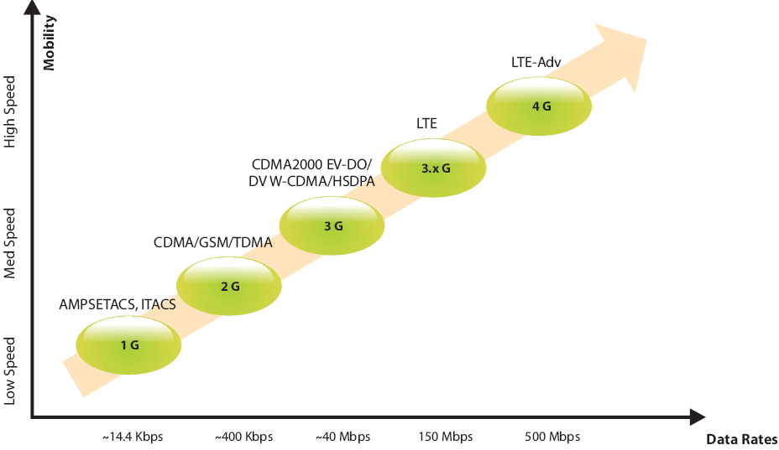
Evolution of LTE
5G network:
gNB →Next generation Node B
RBS BTS Node-B (NB) Evolve Node-B (eNB)

Slide 35
Features of LTE
The LTE- Advanced (Long Term Evolution- Advanced) is 4G wireless service proposed by 3GPP (Third generation Partnership Project). In 2009 4G LTE started its commercial service in Scandinavia. Three important features of LTE are:
Femtocell Deployment
OFDMA-based physical layer access
MIMO

Slide 36
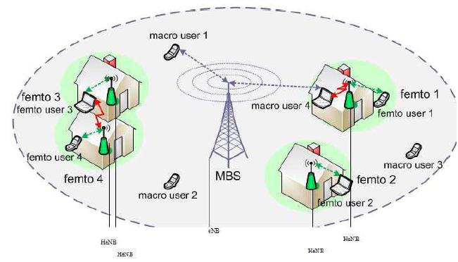
Femtocell Deployment
The FBS (Femto BS) is named as Home evolved Node-B (HeNB) in LTE-A placed in public places to provide higher data rate and improve resource usage to a number of users.
Femtocells are different in the sense that they are installed by customers in an ad hoc fashion without any RF planning. Objective of eNodeB Femtocells lies in off-loading of traffic.
Femtocell is for indoor coverage and microcell is for outdoor coverage.
Femto Base Station
eNB
Macro Base Station

Slide 37
OFDMA-based Physical Layer Access
Subcarrier-0
Δ τ ɛ …
S/P
Or
D
M
U
X
MOD
Σ
Noise
Subcarrier-1
Δ O … ↗ τ × … τ ɛ Ψ…Φ
x(t)
O × Ψ …
Channel
………
MOD
Subcarrier-11
↗ τ Φ …
MOD
Subcarrier-0
Δ τ ɛ …
P/S
Or
MUX
D-MOD
Subcarrier-1
r(t)
Δ O … ↗ τ × … τ ɛ Ψ…Φ
O × Ψ …
D-MOD
Subcarrier-11
↗ τ Φ …
D-MOD

Slide 38
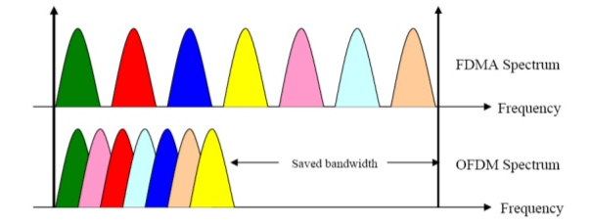
LTE provides OFDMA-based physical layer access where:
OFDMA minimizes separation between carriers compared to FDMA hence save in BW. This means more carriers can fit within the same frequency band.
High speed serial data is converted to parallel hence low speed symbols are less affected by ISI.
Different modulation scheme can be used on different subcarriers depending on the noise level of individual sub-bands (the symbol periods are kept the same).
Carrier orthogonality leads to frequency domain spacing ∆f =1/T, where T is the symbol time. For example, in LTE carrier spacing is 15KHz and message part of the symbol is 66.7 microsec.

Slide 39
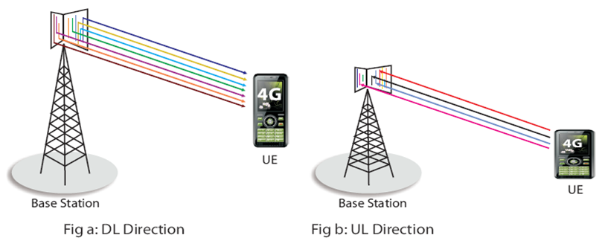
Multiple Input Multiple Output (MIMO)
The multiple antennas in a system, ensures different propagation paths between Tx and Rx. We may choose to send data across the different propagation (spatial) paths hence improves reliability of communication system. This is called spatial diversity or simply diversity.
Space diversity of MIMO increases SNR and channel capacity.
BS
MS

Slide 40
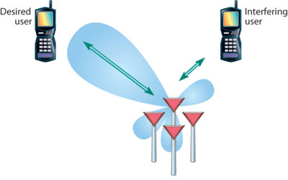
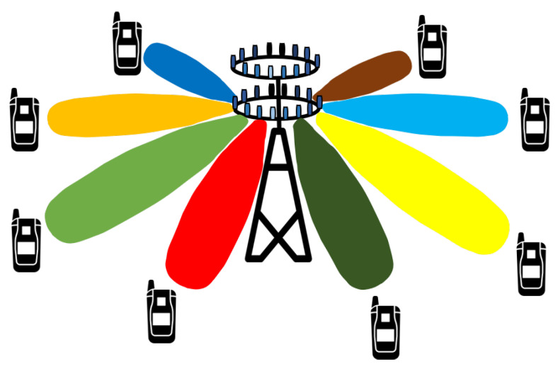
Adaptive beam forming can make directional beam, which increases path gain and reduces interference / fading of channel. The users of cell boundary is heavily benefited in context of SINR.
Due lower interference the throughput (message /sec) of the users is increased.
Electronic tracking beam system (in moving eNB of 5G) can be implemented using adaptive algorithm of beam forming.

Slide 41
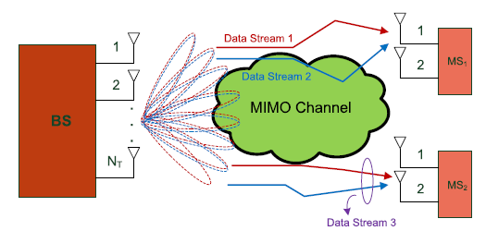
MIMO communication takes place between eNB and UE. LTE standard requires support for:
eNB can have maximum 4/8 antennas
UE can have maximum 2/4 antennas

Slide 42
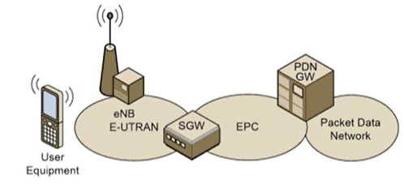
Architecture of LTE
Long Term Evolution (LTE) has been designed to support only packet-switched (instead of previous circuit switch of 2G or combination of circuit and packet switch of 3G) services.
It aims to provide seamless Internet Protocol (IP) connectivity between user equipment (UE) and the worldwide packet data network (PDN), without any disruption to the end users applications during mobility.

Slide 43
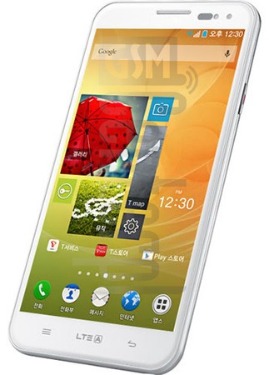
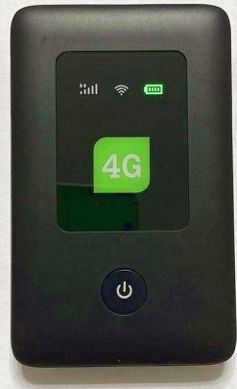



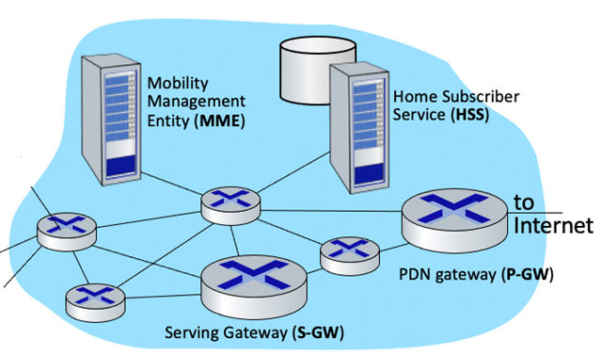
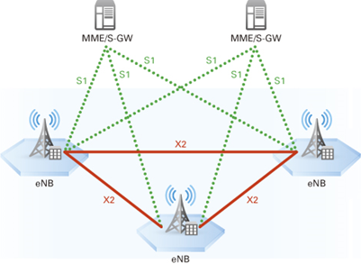
General Architecture of LTE
The architecture of LTE consists of three major parts:
User Equipment (UE)
E-UTRAN (Evolved Universal Terrestrial Radio Access Network)
EPC (Evolved Packet Core)
Interconnected switches and databases
Interconnected eNBs

Slide 44
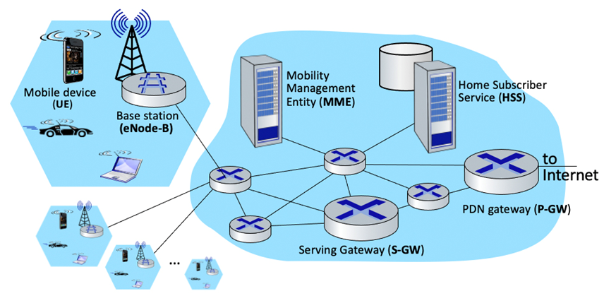
Current user database under tracking area like VLR
Entire user database like HLR
Evolved Packet Core
Radio Access Network
(E-UTRAN)

Slide 45
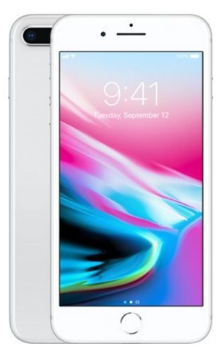
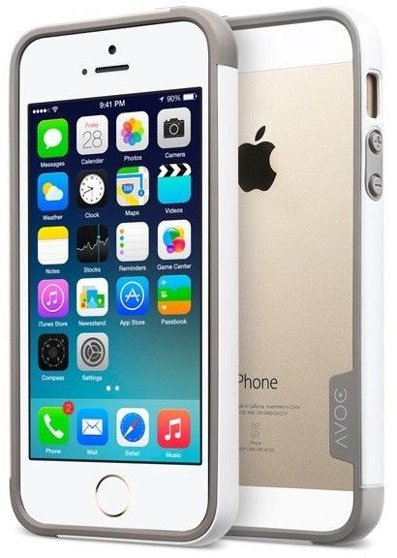
The architecture of LTE consists of three major parts:
User Equipment (UE),
E-UTRAN (Evolved Universal Terrestrial Radio Access Network)
EPC (Evolved Packet Core)
EPC
S-GW and MME
HSS
P-GW or
PDN-GW
ePDG
Macro
Femto
UE
Un-trusted non 3GPP access
Trusted external network
E-UTRAN
UE
Fig.1 Architecture of LTE

Slide 46
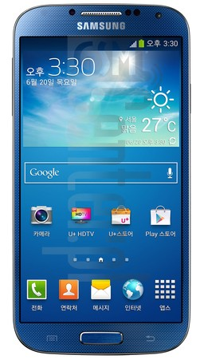
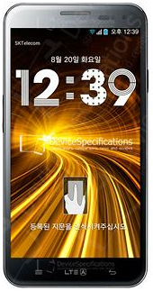
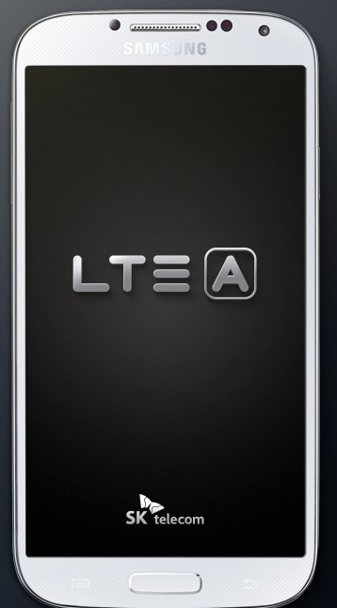
User Equipment (UE)
The UE may take several forms; it can be a mobile phone, a tablet, or a data card used by a computer/notebook.
Similar to all other 3GPP systems, the UE consists of two main entities: a SIM-card or what is also known as User Service Identity Module (USIM), and the actual equipment known as Terminal Equipment (TE).
SIM-card carries the necessary information provided by the operator for user identification and authentication procedures. The terminal equipment on the other hand provides the users with the necessary hardware (e.g., processing, storage, operating system) to run their applications and utilize the LTE system services. It also contains International Mobile Equipment Identity (IMEI) number. Dial *#06# to get your IMEI.
Android OS, Apple iOS, Blackberry OS, …

Slide 47
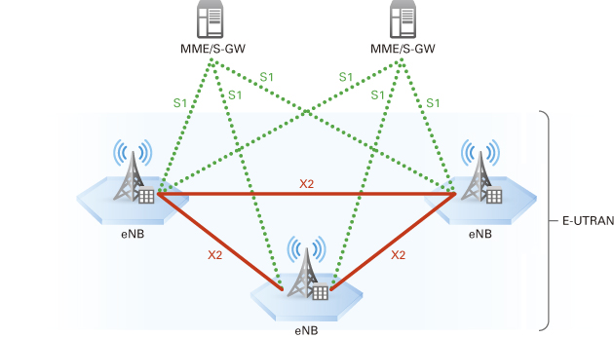
Evolved UTRAN (E-UTRAN)
The E-UTRAN in LTE consists of directly interconnected eNBs which are connected to each other through the X2 interface and to the core network through the S1 interface.
This eliminates one of the biggest drawbacks of the former 3G systems (UMTS): the need to connect and control the NBs through the Radio Network Controller (RNC), which make the system vulnerable to RNC failures.
The LTE E-UTRAN architecture can be seen in Figure below.

Slide 48
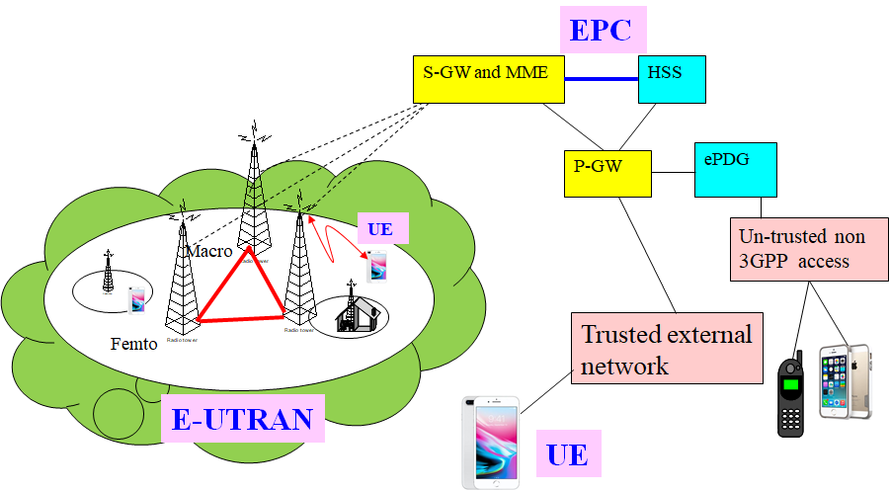
Evolved Packet Core (EPC)
The EPC (also known as the LTE core network) consists of three main entities: Mobility Management Entity (MME), Serving Gateway (S-GW) and the Packet Data Network Gateway (PDN-GW or P-GW). In addition, there are some other logical entities like the Home Subscriber Server (HSS) and Policy and Charging Rules Function (PCRF).
Home Subscriber Server (HSS) is like the combination of HLR and AUC of UMTS or GSM

Slide 49
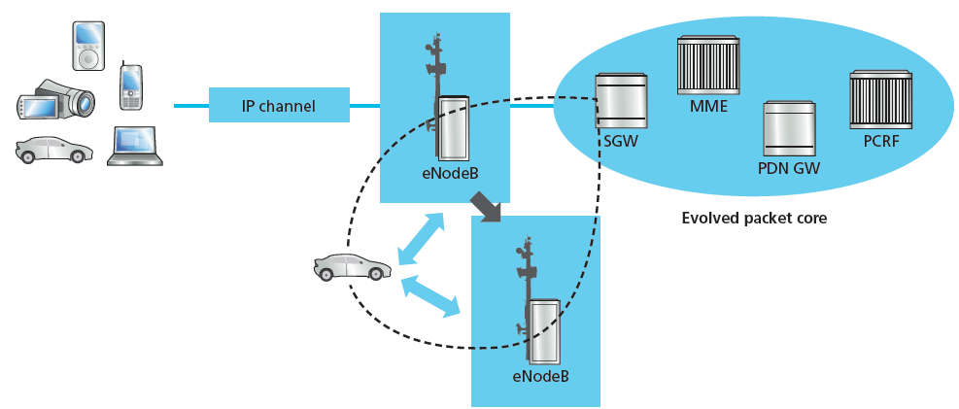
The serving gateway (S-GW)
The S-GW connects E-UTRAN and Evolved Packet Core (EPC).
When terminals move across areas served by eNB elements in E-UTRAN, the S-GW serves as a local mobility anchor. This means that packets are routed through this point for intra E-UTRAN mobility (within tracking area) and mobility with other 3GPP technologies, such as 2G/GSM and 3G/UMTS.
It is also responsible for inter-eNB handovers.

Slide 50
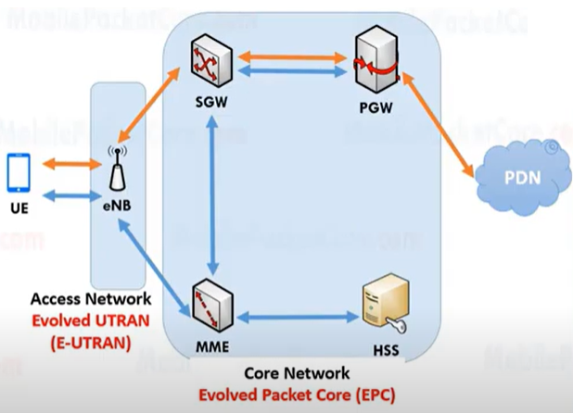
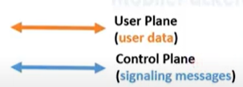
MME (Mobility Management Entity)
MME is responsible for initiating paging and authentication of the mobile device by interacting with the HSS (Home Subscriber Server). HSS has a database keeps subscription information of all users. When authentication is done then link is established between eNB and S-GW.
MME retains location information at the tracking area level for each user, which is updated with roaming of a user (A large geographical region can be divided into multiple tracking areas and each tracking area may have hundred of cells).

Slide 51
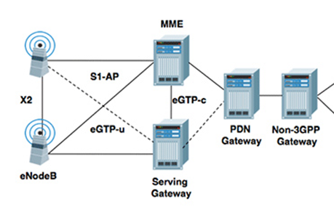
HSS
MME (Mobility Management Entity)
Based on tracking area of a UE, MME provides it the appropriate S-GW.
Assignment of network resources i.e. channel between eNB and S-GW
Security for E-UTRAN access (for example negotiation of ciphering).

Slide 52
Packet Data Network Gateway (P-GW)
Like the S-GW, the Packet Data Network Gateway (PDN GW) is the termination point of the packet data interface towards the Packet Data Network(s). As an anchor point for sessions towards the external Packet Data Networks.
ePDG (Evolved Packet Data Gateway) provides secured data transmission between UE to un-trusted non-3GPP access through EPC.

Slide 53
The Policy Control and Charging Rules Function (PCRF): The PCRF server manages the service policy like access permission of a user group, priority of some traffic, bandwidth allocation, sends QoS setting information for each user session and accounting rule information.

Slide 54
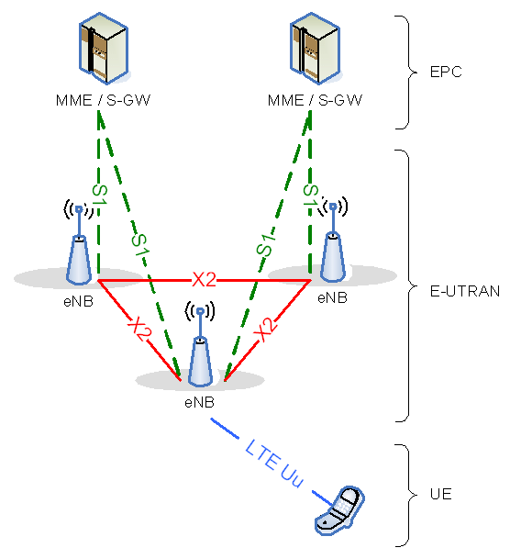
Interfaces
S1 (eNode B to SGSN)
S1 (eNode B to MME)
X2 between two eNBs (required for handover)
Uu (UE to eNode B)

Slide 55
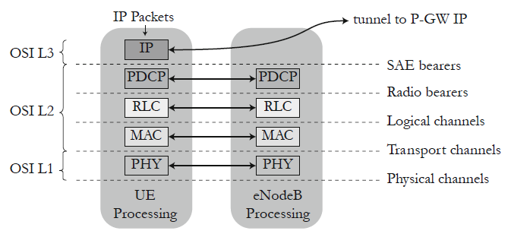
LTE Protocol Stack
PDCP → Packet Data Convergence Protocol
RLC → Radio Link Control
MAC → Medium Access Control

Slide 56
PDCP layer or layer 2 Packet Data Convergence Protocol is responsible for data ciphering and IP header compression to reduce the IP header overhead.
RLC layer or layer 2 Radio Link Control performs the data concatenation and then generates the segmentation of packets from IP-Packets of random sizes which comprise a Transport Block (TB) of size adapted to the radio transfer. The RLC layer handles a retransmission scheme of lost data through a first level of Automatic Repeat reQuests (ARQ).

Slide 57
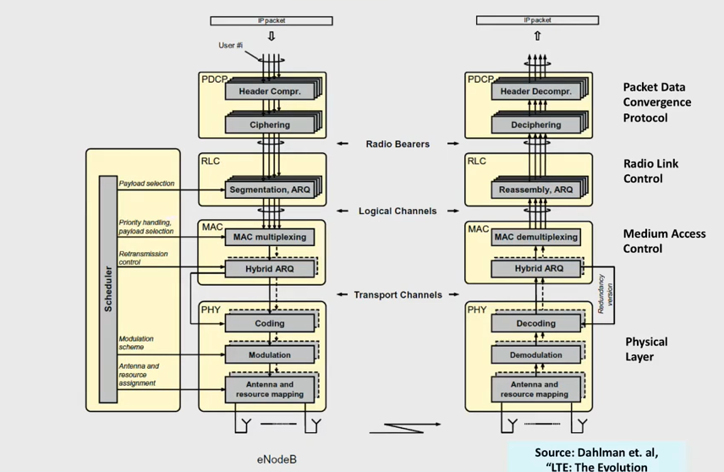

Slide 58
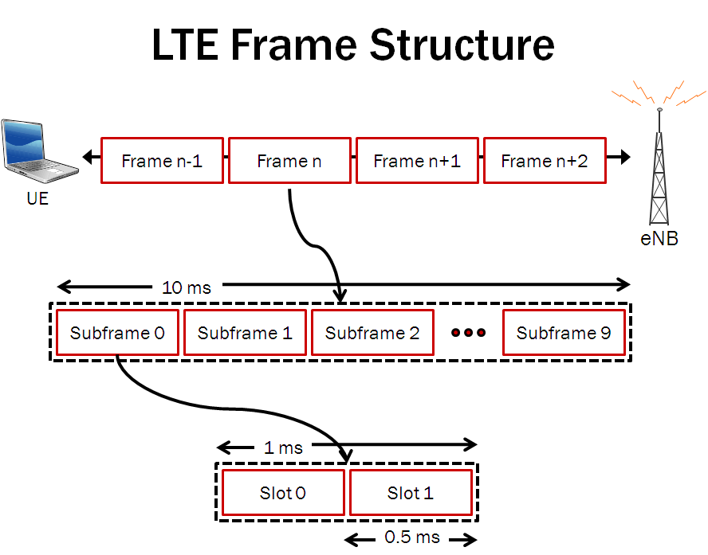
LTE Frame Structure
There are two types of LTE frame structure:
Type 1: used for the LTE FDD mode systems.
Type 2: used for the LTE TDD systems.
Type 1 LTE Frame Structure
The duration of one LTE radio frame is 10 ms. One frame is divided into 10 subframes of 1 ms each, and each subframe is divided into two slots of 0.5 ms each.

Slide 59

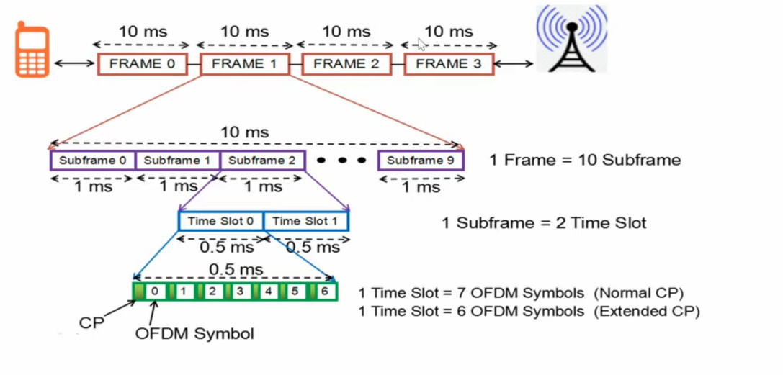

Slide 60
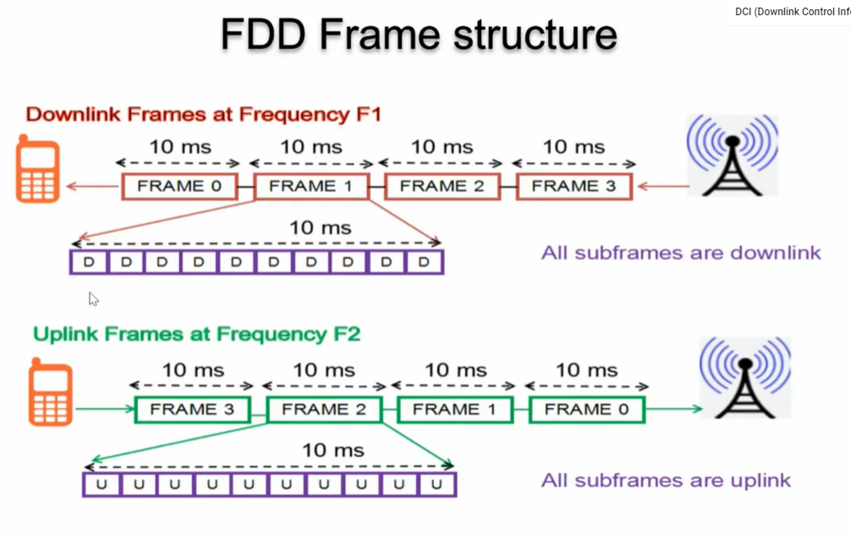

Slide 61
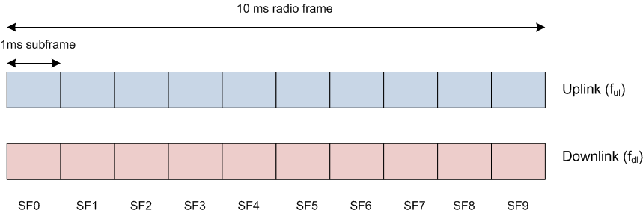
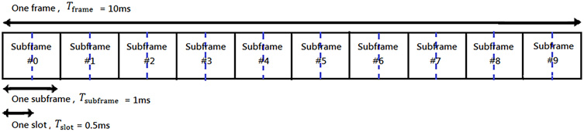

Slide 62
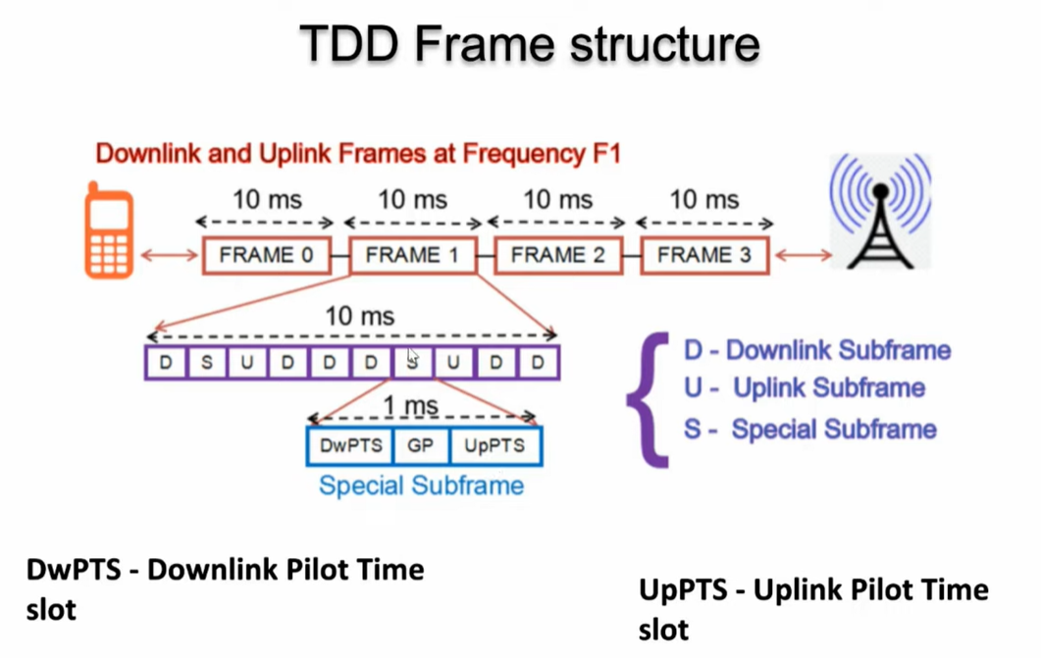

Slide 63
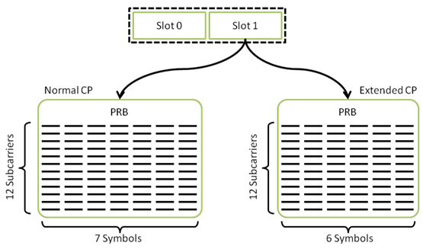
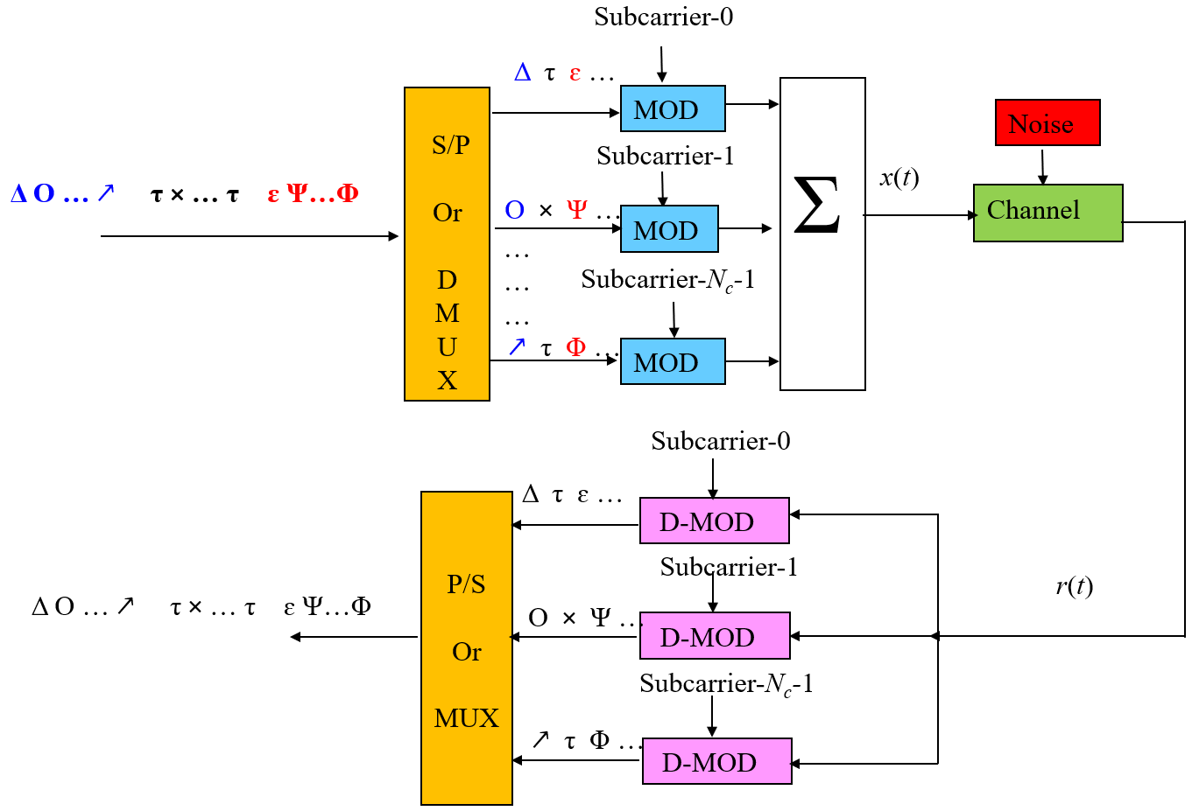
Each slot contains either six or seven OFDM symbols, depending on the Cyclic Prefix (CP) length. In LTE-A the separation between subcarrier Δf =15KHz. The useful symbol time is 1/15 kHz = 66.6 mircosec. Since normal CP is about 4.69 microsec long, seven OFDM symbols can be placed in the 0.5-ms slot as each symbol occupies (66.6 + 4.69) = 71.29 microseconds.
Frequency
Time
Physical Resource Blocks (PRB)
66.66μs
4.69μs
Now, 71.29 ×7 = 500 microseconds = 0.5ms = Length of slot

Slide 64
When extended CP (=16.67 microsec) is used the total OFDM symbol time is (66.6 + 16.67) = 83.27 microseconds. Six OFDM symbols can then be placed in the 0.5-ms slot. Now, 83.27 ×6 = 500 microseconds = 0.5ms = Length of slot
66.66μs
16.67 μs

Slide 65
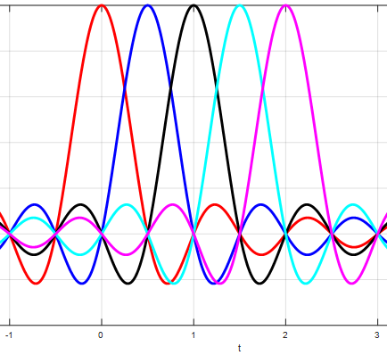
Subcarrier-1, f_{c}
f_{c}
f_{c}+2/τ
f_{c}+4/τ
Subcarrier-2, f_{c}+1/τ
Subcarrier-3, f_{c}+2/τ
f_{c}+1/τ
f_{c}+3/τ
Only 5 spectrum are shown out of 12 spectrum. The figure shows the spectrum of modulated subcarriers of OFDMA
Subcarrier-4, f_{c}+3/τ
The separation between subcarrier,
Δf = 1/τ= 15KHz
Therefore the duration of symbol will be,
1/Δf = τ = 66.6 μs
= duration of modulated wave or symbol
Subcarrier-5, f_{c}+4/τ
τ

Slide 66
Basic of Cyclic Prefix

Slide 67
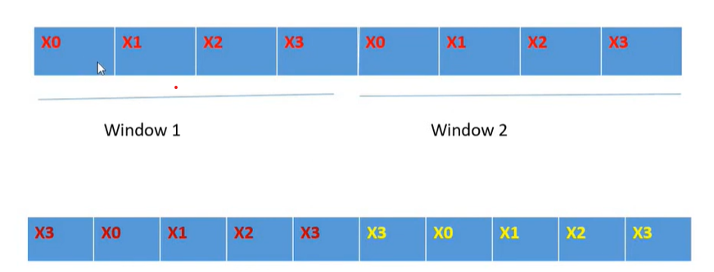

Slide 68
Let us consider a modulated wave of a symbol and it propagates along two paths.
S₁(t) = Acos(2πf_{c}t+α)
Path-1
S′₁(t) = Ccos(2πf_{c}t+β)
Path-2
The received signal on the range of continuous part of waves,
S_{1r}(t)= Acos(2πf_{c}t+α)+ Ccos(2πf_{c}t+β)
= Dcos(2πf_{c}t+θ), where only amplitude and phase angle is changed
hence it is linear distortion, which can be eliminated by equalizer.

Slide 69
In OFDM, the subcarrier signal is extended by cyclic prefix is also called guard interval T_{G} i.e. duration of practical symbol becomes T_{s}+T_{G}. This guard interval is provided to avoid ISI which occurs due to multipath channels.
At receiver the guard interval is removed and only the time interval of symbol is evaluated. The guard interval is a pure system overhead.
Path-1
Path-2
T_{G}
T_{S}
Superposition
T_{S}

Slide 70
In CP tail of the wave (one or more cycle) is copied on the head of the wave for each symbol then the length of wave against each symbol is extended (T_{G}+T_{S}) but the range of linear distortion becomes equal to the width of symbol (T_{S}) of 7 cycles. The phenomenon is shown in next slide.
Now the length of discontinuous part becomes less significant compared to continuous part of previous case, the receiver becomes less panelized in detection of symbol.
Copied
Copied
Path-1
Path-2
Range of linear distortion
Range of linear distortion

Slide 71
Now the common continuous part is 7 cycles as the length of symbol (T_{S}). The duration of head of the wave to be copied depends on delay difference of multipath environment.
Copied
Copied
Path-1
Path-2
Range of linear distortion
Range of linear distortion
If the user is at the cell boundary then delay difference is high and has to used extended CP, whereas user at the vicinity of the eNB use normal CP because of low delay difference is experienced by the user.

Slide 72
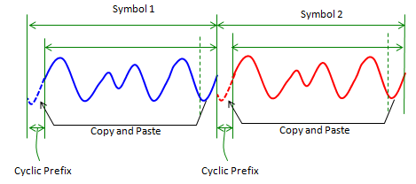
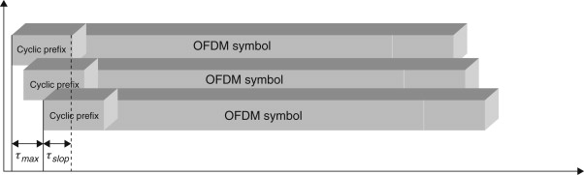
The purpose of the cyclic prefix is to combat ISI, where same content is transmitted twice as the CP is a copy of the tail of a symbol (modulated wave) placed at its beginning. Consider combined signal of 12 subcarrier (output of IDFT) as shown in fig. below.
The duration of the cyclic prefix is chosen such that it is longer than the maximum delay spread τ_{max} caused by the multipath channel.

Slide 73
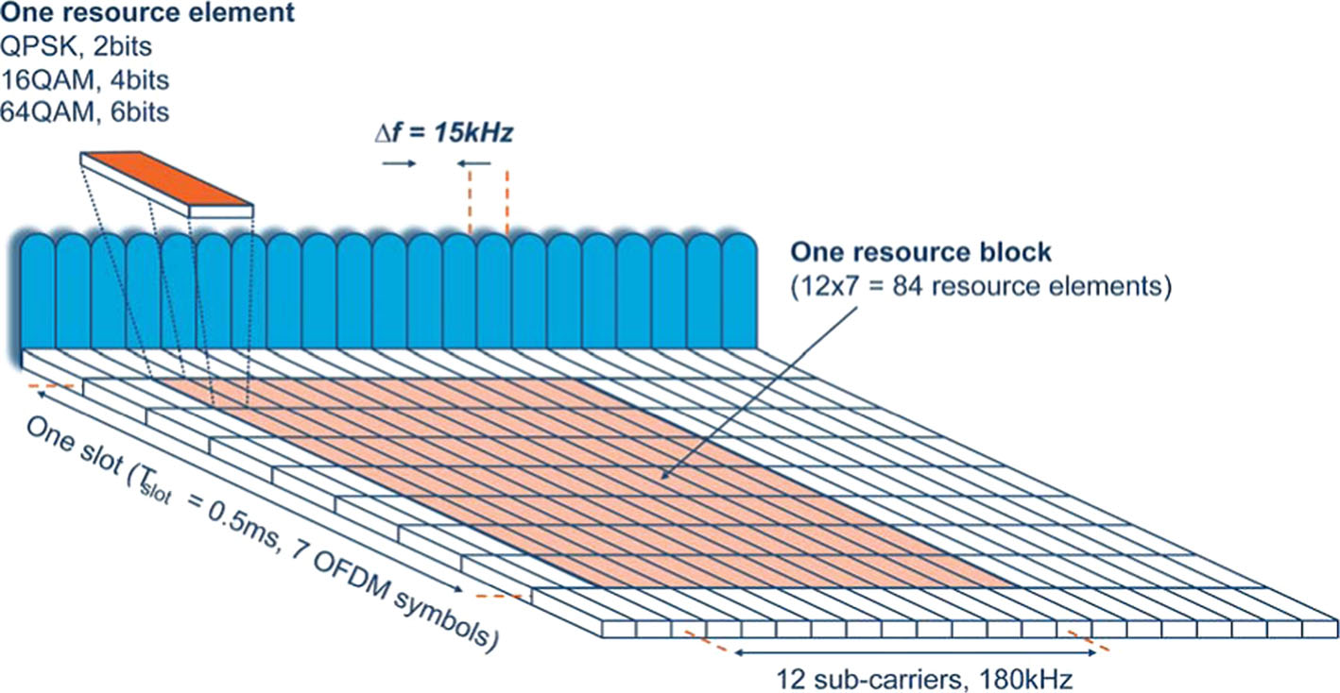
In LTE, radio resources are allocated in units of Physical Resource Blocks (PRBs). Each PRB contains 12 subcarriers and one slot.
Time
Frequency

Slide 74
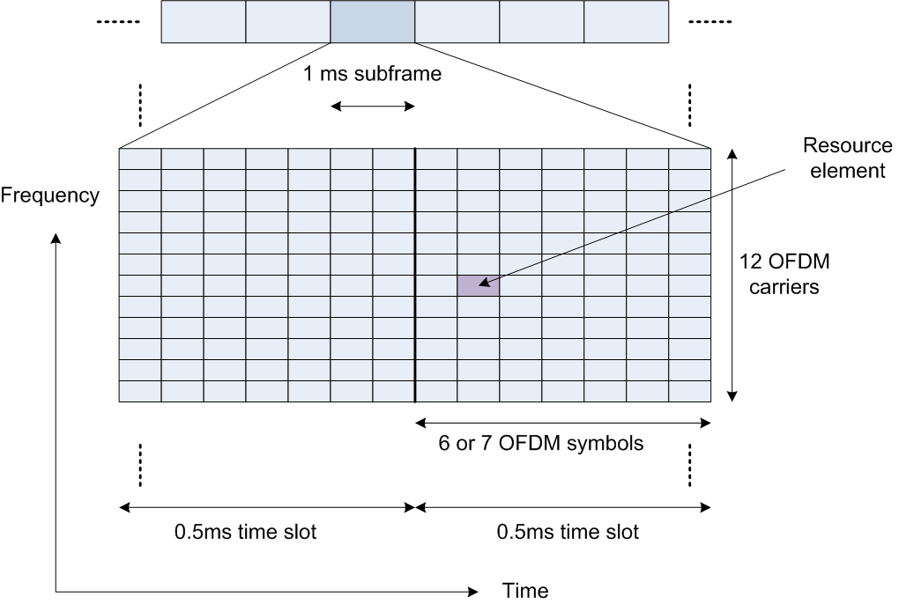
LTE – radio resource = “time-frequency chunk”
Resource Block (RB) = 12 subcarriers in one TS (12*15KHz x 0.5ms)
Time domain
1 frame = 10 sub-frames
1 subframe = 2 slots
1 slot = 7 (or 6) OFDM symbols
Frequency domain
1 OFDM carrier = 15KHz

Slide 75
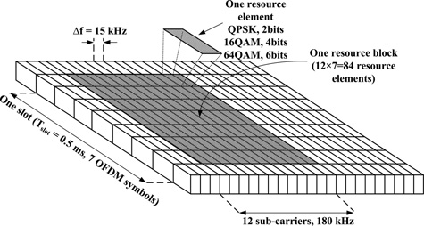
Time Unit Value
Frame 10 ms
Half-frame 5 ms
Subframe 1 ms
Slot 0.5 ms
Symbol (0.5 ms) / 7 for normal CP
(0.5 ms) / 6 for extended CP
Basic timing unit: T_{s} 1/(15000 * 2048) sec » 32.6 ns
FFT size =2048 , Subcarrier spacing 15kHZ.

Slide 76
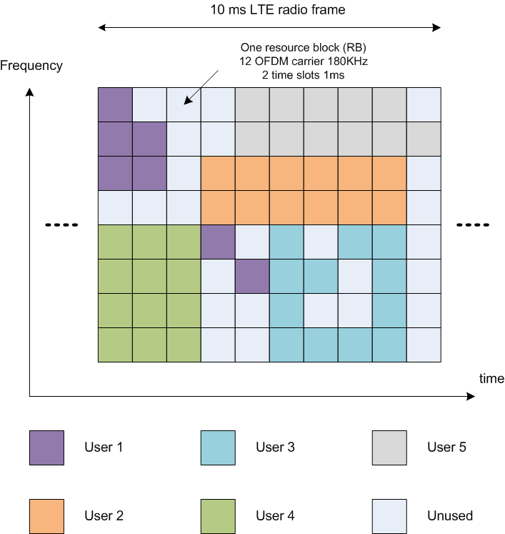
OFDMA time-frequency scheduling
Minimum allocate-able resource in LTE is Resource Block pair
Resource block pair is 12 subcarriers wide in frequency domain and lasts for two time slots (1ms)
Depending on the length of cyclic prefix RB pair may have 14 or 12 OFDM symbols
PHY channels consist of certain number of allocated RB pairs
Overhead channels are typically in a predetermined location in time frequency domain
Allocation of the radio block is done by scheduler at eNode B

Slide 77

Type 2 LTE Frame Structure
The frame structure for the type 2 frames used on LTE TDD is somewhat different. The 10 ms frame comprises two half frames, each 5 ms long. The LTE half-frames are further split into five subframes, each 1ms long.
The subframes may be divided into standard subframes of special subframes.
The special subframes consist of three fields;
DwPTS - Downlink Pilot Time Slot
GP - Guard Period
UpPTS - Uplink Pilot Time Stot.

Slide 78

Downlink Reference Signals
RB-1
RB-2
Cell specific reference signals
Cell specific reference signal (at physical layer) is not for delivering any specific information. The purpose of this Reference Signal is to deliver the reference point for the downlink power.
Therefore, there are four reference symbols within each Resource Block for single antenna communication. Figure shows the resource elements of reference signal where three sub-carriers separation is maintained between the first and second reference symbols. .

Slide 79


To allow for coherent demodulation at the user equipment, reference symbols (or pilot symbols) are inserted in the OFDM time-frequency grid to allow for channel estimation.
In case of two transmit antennas, reference signals are inserted from each antenna where the reference signals on the second antenna are offset in the frequency domain by three sub-carriers. To allow the user equipment to accurately estimate the channel coefficients, nothing is transmitted on the other antenna at the same time-frequency location of reference signals.
Single antenna case

Slide 80




DL transmission may use up to four antennas
Each antenna port has its own pattern of reference signals
Reference signals are transmitted at higher power in multi-antenna case
Reference signals introduce overhead
4.8% for 1 antenna port
9.5% for 2 antenna ports
14.3 % for 4 antenna ports
Reference symbols vary from position to position and from cell to cell.
Period of the sequence is one frame
Two port TX
One port TX
Four port TX

Slide 81


UE Specific Reference Signal RS
In addition to the Cell-specific RS, the base station may transmit UE-specific RS in RBs allocated to the PDSCH (Physical Downlink Shared Channel, which carries user data) of a UE.
UE specific RS – used for beam forming
Provided in addition to cell specific RS
Note: additional reference signals increase overhead. One of the most beneficial use of beam forming is at the cell edge – improves SNR

Slide 82

Uplink Reference Signal
There are two types of reference signals for uplink in LTE.
The first is Demodulation Reference Signals (DM-RS) which are used to enable coherent signal demodulation at the eNodeB.
The second is Sounding Reference Signal (SRS) transmitted by UE to report the channel quality of over all bandwidth (frequency selective channel case). It is typically transmitted in the last SC-FDMA symbol of a 1 ms subframe and using this information eNB assign the resource (to UE for uplink transmission) has better channel quality comparing to other bandwidth region.

Slide 83

Relays and Repeaters
Relaying is used in order to deploy cells in areas where no (or very expensive) wired backhaul exists. It is often used to improve the coverage and throughput, for example, in urban, and rural scenarios. Figure below shows a typical scenario where a Relay Node (RN) is connected to an eNodeB wirelessly. The eNodeB that the RN is connected to is called in that case, a Donor eNodeB (DeNB).

