Slide 1
A PREDICTIVE MODEL FOR EARLY DETECTION OF PREGNANCY MISCARRIAGE AND DEMENTIA USING MACHINE LEARNING METHODS
Rimi Akter
Exam Roll no.: 220516
Reg. no.: 46298
Session: 2021-2022
Amina Khatun
Associate Professor
Department of CSE
Jahangirnagar University
Tuesday, 17 September, 2024
Notes:
‹#›

Slide 2
Slide Outline
Overview/Introduction
Motivation/Objective
Literature Review / Related Work
Contribution
Problem Definition
Used Algorithms/System Model
Experimental Results
Conclusion & Future Scope
‹#›
Notes:
‹#›

Slide 3
Introduction
Dementia is a growing global health concern, characterized by cognitive decline and loss of independence.
Early prediction is critical for improving patient outcomes and slowing disease progression.
This research explores machine learning techniques to develop models for predicting dementia, utilizing clinical data to enable early diagnosis and intervention.
‹#›

Slide 4
Introduction (Continued)
Miscarriage, the spontaneous loss of pregnancy, affects a significant portion of women, yet its causes remain poorly understood.
Identifying and predicting the risk factors is crucial for reducing its incidence.
This study aims to develop predictive models by analyzing clinical data, contributing to better prenatal care and risk management.
‹#›

Slide 5
Motivation or Objective
The objective of this research is to develop a reliable predictive model for early dementia diagnosis with higher accuracy.
Motivated by the increasing prevalence of dementia and the need for early interventions to slow disease progression and improve patient quality of life.
To assess miscarriage risk early in pregnancy, aiming to enhance prenatal care and reduce pregnancy loss.
‹#›

Slide 6
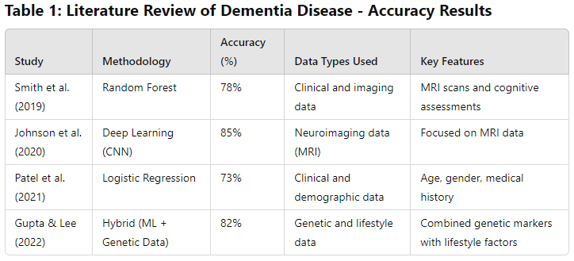
Literature Review
‹#›

Slide 7
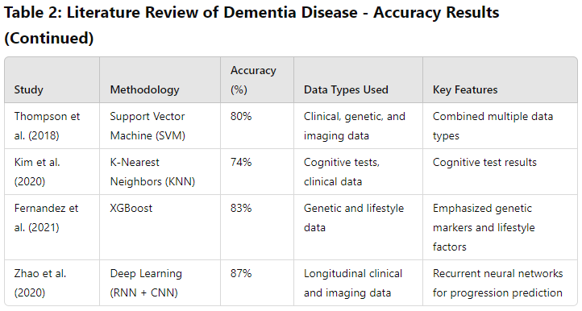
Literature Review
‹#›

Slide 8
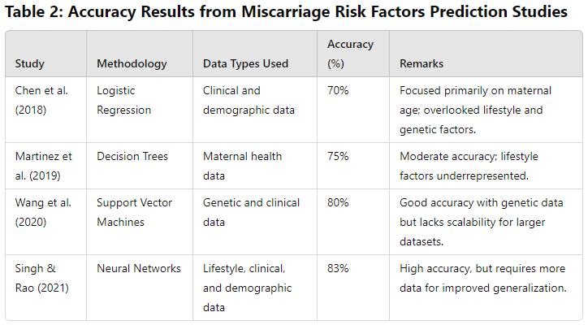
Literature Review
‹#›

Slide 9
Contribution
This research uses the novel machine learning models to enhance the accuracy of dementia risk prediction.
The model provides earlier and more reliable predictions with higher accuracy, supporting preventive measures and personalized interventions for at-risk individuals.
The study contributes new insights into previously underexplored factors associated with miscarriage.
‹#›

Slide 10
Problem Definition
Dementia is a progressive neurodegenerative disorder that impairs memory, thinking, and decision-making.
Developing predictive models to identify individuals at risk of dementia using clinical data for early diagnosis and intervention.
Predicting key risk factors contributing to miscarriage using clinical data to improve early risk assessment and prenatal care.
‹#›

Slide 11
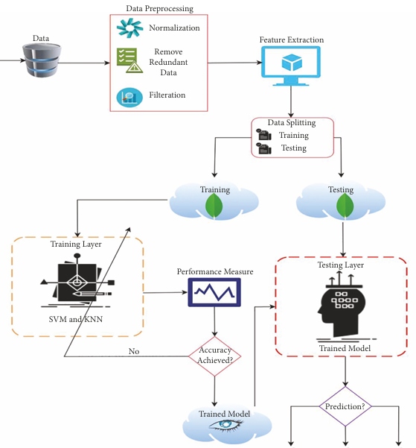
Models and Methodology
‹#›

Slide 12
Data Collection
We acquired information from Kaggle for miscarriage data.
Has extensive medical records with details like age, location, stress level, BPM, and BMI.
Also for dementia dataset features are described in next pages.
‹#›

Slide 13
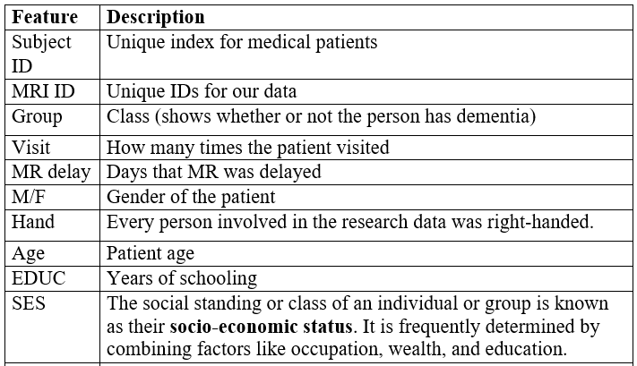
Data Descriptions
‹#›

Slide 14
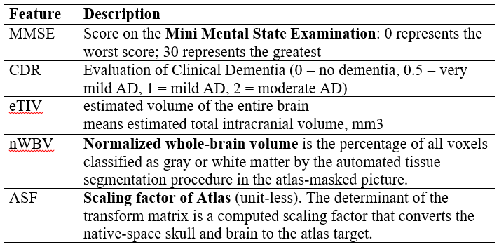
Data Descriptions (Continued)
‹#›

Slide 15

Data Pre-processing
This study included several critical data preprocessing operations.
Data normalization, outlier detection, and management of missing information.
Data preprocessing for min-max normalization is given in equation.
‹#›

Slide 16
Data Pre-processing (Continued)
A method called imputation (column mean or median) is used to fill in the missing data (numerical values).
Mean: The average of all the values in the column. Used when data is normally distributed (no extreme outliers).
Median: The middle value when the data is sorted in ascending or descending order. It is preferred if the data has outliers.
‹#›

Slide 17
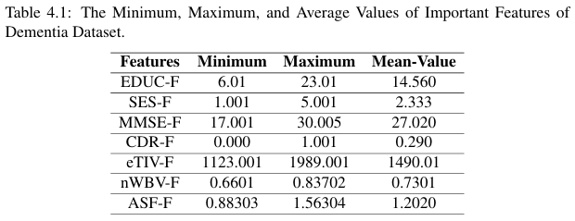
Data Pre-processing (Continued)
‹#›

Slide 18
Exploratory Data Analysis (EDA)
We have used tools like scatter plots, graphs, histograms, and more for visualization
Histograms: A tool for seeing how numerical features are distributed.
Scatter Plots: Examined connections between numerical feature pairs.
‹#›

Slide 19
Selecting Models
Various ML models have been used.
SVM, DT, NB, KNN, LR, LR/imputation, LR/dropna, AdaBoost.
Extra Trees Calssifier, XGB, ANN, SGD.
RF classifier, The no-ML model.
‹#›

Slide 20
Selecting Models (Continued)
ExtraTrees has found that when it comes to dementia prediction, SES is the least significant component.
When predicting dementia, CDR is the most significant factor.
The RF indicates that visits are the least significant factor in dementia prediction.
According to XGBoost, AES is the least significant component in dementia prediction.
‹#›

Slide 21
SVM Model
SVM is a supervised algorithm that finds the optimal hyperplane to separate data into classes.
Effective in high-dimensional spaces and with complex data patterns.
May struggle with very large datasets and requires careful tuning of parameters.
‹#›

Slide 22
Decision Tree Classifier
Splitting data into branches based on feature values, leading to a decision node or leaf.
Easy to interpret and visualize; handles both numerical and categorical data.
Prone to overfitting with complex datasets; may not generalize well to unseen data.
‹#›

Slide 23
Naïve Bayes Model
Assumes that features are independent. It calculates the probability of dementia given the features.
Assumes independence between features, which may not reflect real-world data relationships.
NB with Gaussian assumes features are normally distributed.
Calculates probabilities based on Gaussian distribution to classify dementia status.
‹#›

Slide 24
KNN Classifier
KNN classifies a data point based on the majority class among its K nearest neighbors in the feature space.
Predicts dementia status based on proximity to known patient data points with similar features.
Effective with well-defined feature spaces, but requires careful choice of K and distance metric.
‹#›

Slide 25
Logistic Regression Model
LR models the probability of dementia (binary outcome) using a logistic function to estimate the likelihood of class membership.
Assumes a linear relationship between features and the log-odds of the outcome.
Performance can be limited with highly imbalanced datasets.
‹#›

Slide 26
LR w-Imputation
LR with Imputation handles missing data by filling in missing values before applying LR.
Predicts dementia likelihood by first imputing missing values, then applying LR.
Allows use of incomplete datasets.
Imputation may introduce bias if not handled carefully.
Performance depends on the quality of imputation.
‹#›

Slide 27
LR w-dropna
LR with Dropna removes records with missing values before applying the LR model.
Discarding any patient data with missing values and then fitting the LR model to the remaining data.
Simplifies the model by using only complete cases.
May lead to loss of valuable data and reduce sample size.
Can introduce selection bias.
‹#›

Slide 28
Model Training and Evaluation
Train/Test Split: To assess the model's performance on untested data, the dataset was divided into training and testing sets at a ratio of 70/30.
Metrics: Various evaluation metrics were employed to evaluate the performance of the model.
Verify the validity & dependability of the predictions.
Cautious model selection, in-depth exploratory analysis, thorough data gathering, careful pre-processing, and rigorous evaluation.
‹#›

Slide 29
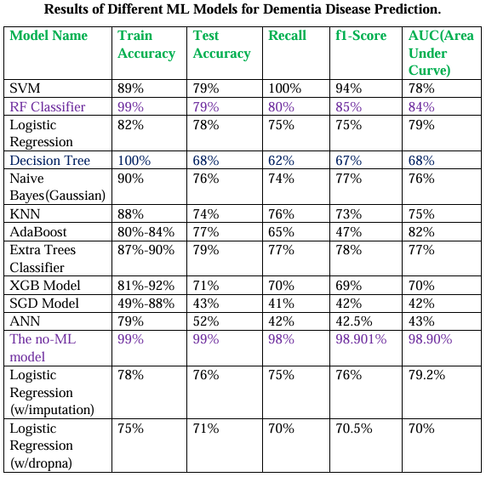
Experimental Results
‹#›

Slide 30
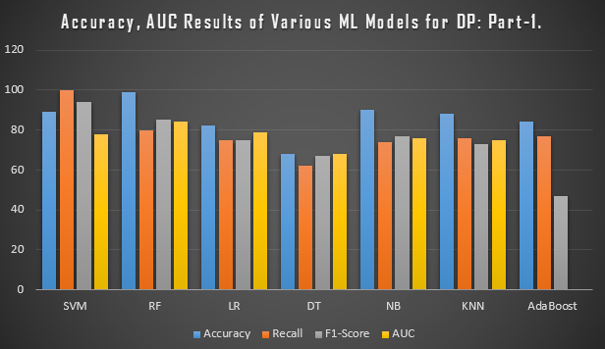
Experimental Results
‹#›

Slide 31
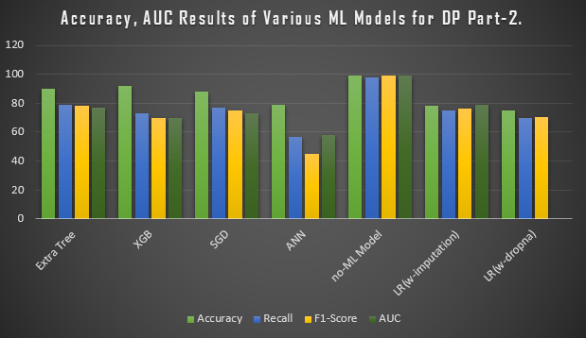
Experimental Results
‹#›

Slide 32
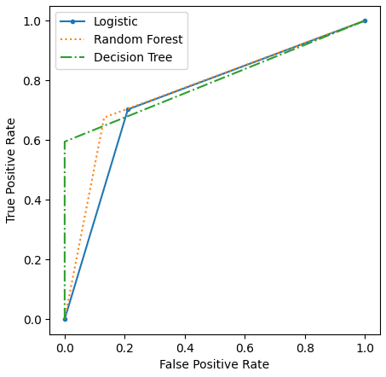
Experimental Results
The ROC and AUC measure for Dementia Prediction.
‹#›

Slide 33
Threshold Independent Measure
It is significant and evident that the measurement made by confusion metrics is altered when the threshold value changes.
ROC measure is typically used to determine the threshold independent measure.
We typically use the AUC value because we need a metric that can tell us how good our model is across a range of thresholds.
Classifier’s performance increases with its higher AUC value. AUC values vary from 0 to 1.
‹#›

Slide 34
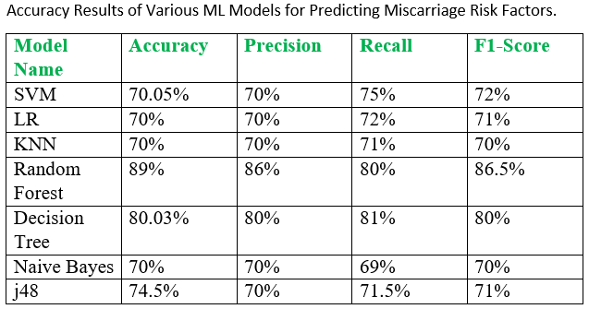
Experimental Results
‹#›

Slide 35
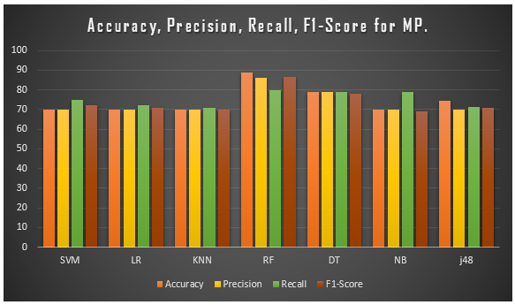
Experimental Results
‹#›

Slide 36
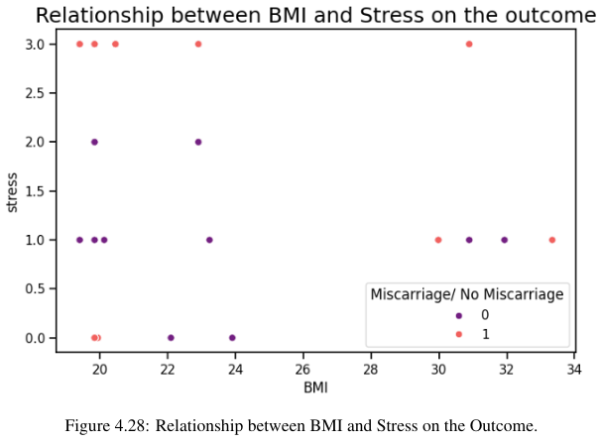
Experimental Results
‹#›

Slide 37

System App GUI-DP
‹#›

Slide 38
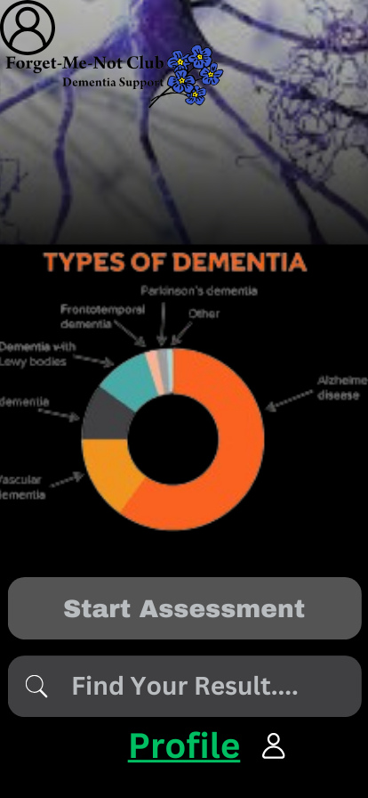
System App GUI-DP
‹#›

Slide 39
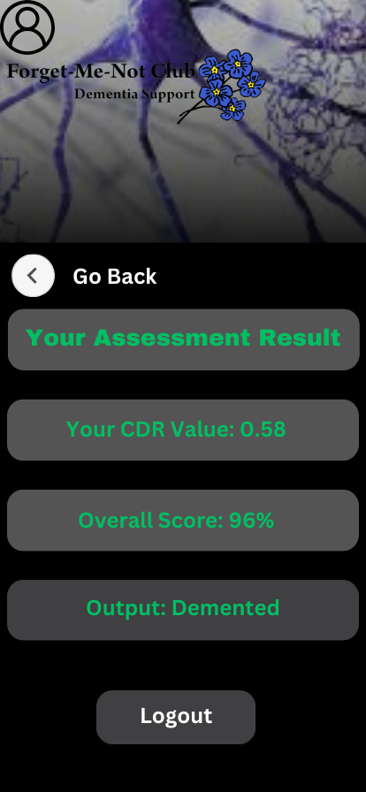
System App GUI-DP
‹#›

Slide 40
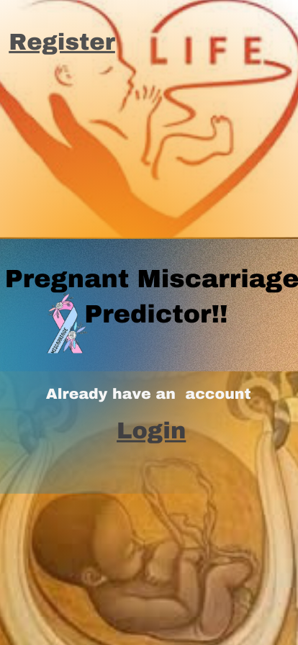
System App GUI-MP
‹#›

Slide 41

System App GUI-MP
‹#›

Slide 42
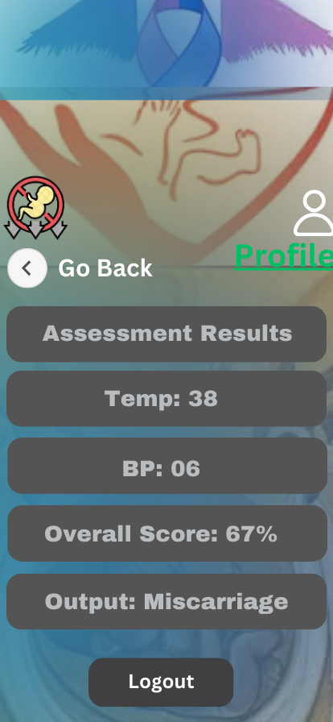
System App GUI-MP
‹#›

Slide 43
Conclusion and Future Scope
Models demonstrated effective early detection of dementia, with high accuracy using data.
Predictive models accurately assessed miscarriage risk factors using clinical data.
Expand datasets, include lifestyle factors, and explore advanced ML, DL techniques.
Incorporate more variables, broaden datasets, and enhance model personalization.
‹#›

Slide 44
Thank You
‹#›

Slide 45
AdaBoost Model
AdaBoost (Adaptive Boosting) combines multiple weak classifiers (e.g., decision trees) to create a strong classifier by focusing on errors of previous classifiers.
Enhances prediction of dementia by iteratively adjusting weights of misclassified instances and combining the outputs of multiple weak models.
Improves model accuracy and reduces overfitting; handles complex datasets well.
‹#›

Slide 46
Extra-Trees Classifier
Extra Trees (Extremely Randomized Trees) builds multiple decision trees using random subsets of features and data, making decisions based on majority voting.
Predicts dementia by averaging the predictions from numerous highly randomized decision trees.
Reduces overfitting; fast and effective for large datasets.
Less interpretable; may require tuning for optimal performance.
‹#›

Slide 47
XGBoost Model
XGBoost (Extreme Gradient Boosting) builds an ensemble of decision trees using gradient boosting to improve prediction accuracy by minimizing errors iteratively.
Enhances dementia prediction by combining weak models into a strong predictor, focusing on correcting errors from previous trees.
High accuracy; handles missing data well; effective for large datasets.
Requires careful tuning of hyperparameters; can be complex to interpret.
‹#›

Slide 48
SGD Model
SGD (Stochastic Gradient Descent) is an optimization algorithm used for training linear classifiers by updating weights incrementally using a subset of data.
Predicts dementia by iteratively adjusting model weights to minimize classification errors based on feature data.
Requires careful tuning of learning rate.
‹#›

Slide 49
ANN Model
ANN models use interconnected layers of nodes (neurons) to learn complex patterns in data through nonlinear activation functions.
Predicts dementia by training on clinical, imaging, and genetic data to capture intricate relationships and patterns.
Requires large datasets; computationally intensive; less interpretable.
ANN classifies miscarriage risk by learning from patterns in risk factors using multiple layers of neurons to make predictions.
Enhances prediction accuracy by capturing non-linear relationships between features and miscarriage risk.
‹#›

Slide 50
Imbalanced Dataset
An imbalanced dataset refers to a dataset where the classes are not represented equally. One class (often the majority class) significantly outnumbers the other (minority class).
Solutions: Resampling: Techniques like oversampling (duplicating minority class instances) or undersampling (reducing majority class instances).; less interpretable.
Evaluation Metrics: Using metrics like Precision, Recall, F1-Score, AUC-ROC, which provide more insight than accuracy in imbalanced datasets.
‹#›

Slide 51
Data Pre-processing
Categorical Data: The most common category or a new category designating missing data was used to fill in the missing categorical values.
Feature Scaling: To guarantee that numerical features have comparable magnitudes and contribute equitably to the model, they were scaled using standardization (z-score normalization).
Encoding Categorical Variables: Using label encoding, categorical variables were transformed into numerical representations, with a distinct number allocated to each category.
‹#›

