Slide 1

A CNN-BASED Medical Image Processing and Tissue Classification Using Explainable Artificial Intelligence(XAI)
Presented By
Supervised By
Ikramul Islam Emon
Exam Roll : 220532
Reg. No : 46325
Dr. Md. Abul Kalam Azad
Professor
MSc. Final Thesis Presentation, Session 2021-22
Department of Computer Science and Engineering
Jahangirnagar University

Slide 2

Outlines
Introduction
Literature Review
Proposed System
Implementation and evaluation
Conclusion and future Scopes
References
Jahangirnagar University
Department of Computer Science and Engineering

Slide 3


What is Medical Image Processing with CNN?
Medical Image Processing: Refers to techniques used to analyze and manipulate medical images
Purpose: Enhances image quality, extracts valuable information,
Convolutional Neural Networks (CNNs): A type of deep learning model well-suited for medical imaging.
Application: Involves computer algorithms to improve clarity, extract quantitative information, and aid healthcare professionals in image interpretation
Jahangirnagar University
Department of Computer Science and Engineering

Slide 4
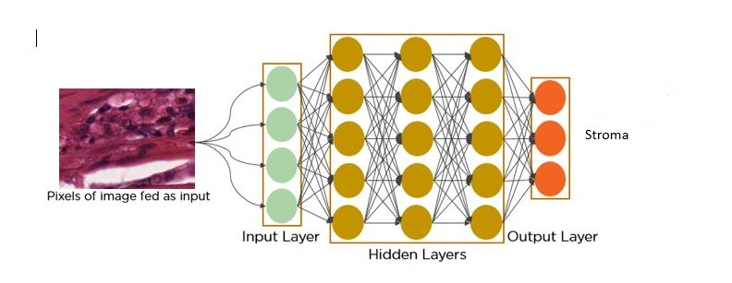
What is CNN?
Convolutional Neural Network (CNN): A deep learning model designed for processing structured grid data like images.
Success in Computer Vision: Highly effective in tasks such as:
Image classification
Object detection
Image segmentation
Jahangirnagar University
Department of Computer Science and Engineering

Slide 5
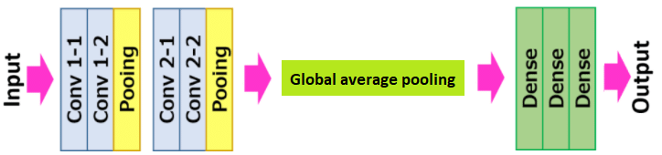
Visual Geometric Group(VGG7)
VGG-7: A variant of the VGG (Visual Geometry Group) network
Architecture: Consists of 7 layers, 5 convolutional layers, and 2 fully connected layers.
Convolutional Layers: Each is followed by ReLU activation function.
Max-Pooling Layers: May be included after convolutional layers to reduce the spatial dimensions of feature maps.
Jahangirnagar University
Department of Computer Science and Engineering

Slide 6
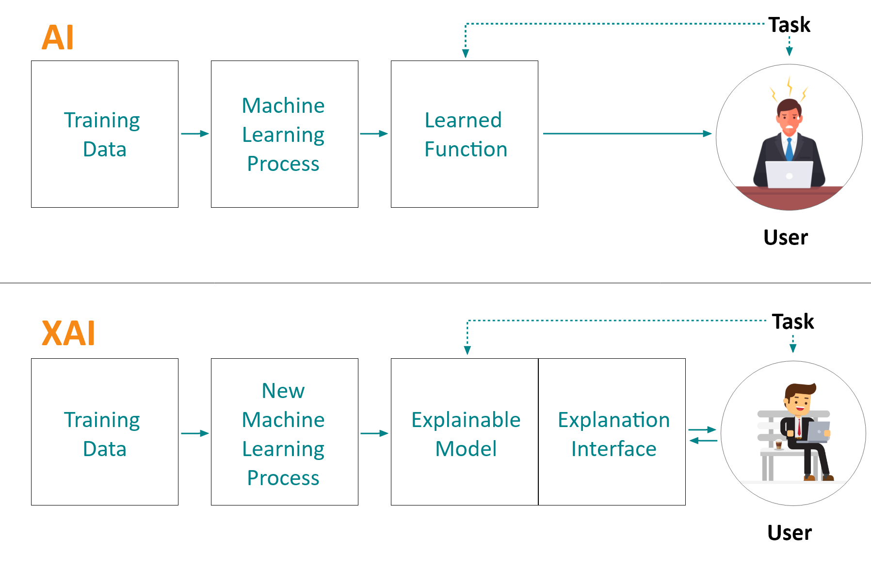
What is Explanable AI(XAI)?
Explainable Artificial Intelligence (XAI) refers to techniques and methods that make AI systems behavior and predictions understandable to humans.
XAI Methods Used:
GradCAM (Gradient Class Activation Map): Visualizes the regions in an image that are important for a model's decision.
IntGRAD (Integrated Gradient): Attributes the prediction of a model to its input features by integrating gradients.
Jahangirnagar University
Department of Computer Science and Engineering

Slide 7



Problem Statement
The accurate and efficient diagnosis of medical conditions from imaging data is critical in modern healthcare. Traditional methods for analyzing medical images, such as HMT, and histopathological slides, often rely on subjective human interpretation, which can lead to inconsistencies and diagnostic errors.
The key features include:
Developing a robust CNN architecture for accurate tissue classification
Integrating XAI techniques to visualize and explain model decisions effectively
Ensuring that the model maintains a balance between interpretability and predictive performance to be clinically useful.
CNN have demonstrated significant potential in automating image analysis and tissue classification, but their "black-box" nature poses challenges in trustworthiness.
There is a need for developing a CNN-based framework for medical image processing and tissue classification that integrates (XAI) techniques to enhance interpretability, reliability, and acceptance among healthcare professionals
Jahangirnagar University
Department of Computer Science and Engineering

Slide 8
Outlines
Introduction
Literature Review
Proposed System
Implementation and evaluation
Conclusion and future Scopes
References
Jahangirnagar University
Department of Computer Science and Engineering

Slide 9
Literature Review
Author | Title | Findings
A. W. Salehi, S. Khan, G. Gupta, B. I. Alabduallah, A. Almjally, H. Alsolai, T. Siddiqui, and A. Mellit | “A study of CNN and transfer learning in medical imaging: Advantages, challenges, future scope. ^{[1]} | This paper reviews : the advantages of CNN and transfer learning in medical imaging, include improved accuracy, reduced time and resource requirements, and the ability to address class imbalances
A. Adadi and M. Berrada, | Peeking inside the black-box: a survey on explainable artificial intelligence (XAI). ^{[2]} | review the existing approaches regarding the topic, discuss trends surrounding its sphere, and present major research trajectories of XAI.
S. Munquad, T. Si, S. Mallik, A. B. Das, and Z. Zhao, | A deep learning–based framework for supporting clinical diagnosis of glioblastoma subtypes. ^{[3]} | develop a biologically interpretable and highly efficient deep learning framework based on a convolutional neural network for subtype identification
Jahangirnagar University
Department of Computer Science and Engineering

Slide 10
Literature Review
Author | Title | Findings
K. Simonyan and A. Zisserman | Very deep convolutional networks for large-scale image recognition^{[1]} | evaluates networks with increasing depth, using architectures with small (3×3) convolution filters
C. Chen, O. Li, D. Tao, A. Barnett, C. Rudin, and J. K. Su, | Deep learning for interpretable image recognition,” Advances in neural information processing systems, vol. 32, 2019.. ^{[2]} | introduce a deep network architecture -- prototypical part network (ProtoPNet) But Machine Learning approach or intelligent decision is absent.
P. Costa, T. Ara´ujo, G. Aresta, A. Galdran, A. M. Mendonc，a, A. Smailagic, and A. Campilho, | Structural compression of convolutional neural networks,^{[3]} | demonstrate the interpretability of CAR-compressed CNNs by showing that our algorithm prunes filters with visually redundant functionalities such as color filters
Jahangirnagar University
Department of Computer Science and Engineering

Slide 11
Outlines
Introduction
Literature Review
Proposed System and Methodolgy
Implementation and evaluation
Conclusion and future Scopes
References
Jahangirnagar University
Department of Computer Science and Engineering

Slide 12
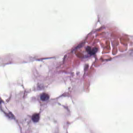
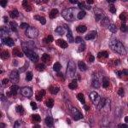
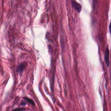

Case Study
Adipose
Complex
Debris
Empty
Jahangirnagar University
Department of Computer Science and Engineering

Slide 13
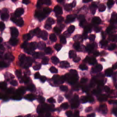
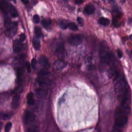
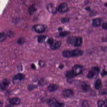
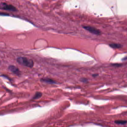
Case Study
Lympho
Mucosa
Stroma
Tumor
Jahangirnagar University
Department of Computer Science and Engineering

Slide 14
Proposed System Flow
Problem Statement
Image
Preprocessing
Train CNN Model
(VGG7)
Transfer CNN model and
Implementation
Model’s Output Evaluation
Apply XAI Model
(GradCAM)
Testing
Jahangirnagar University
Department of Computer Science and Engineering

Slide 15
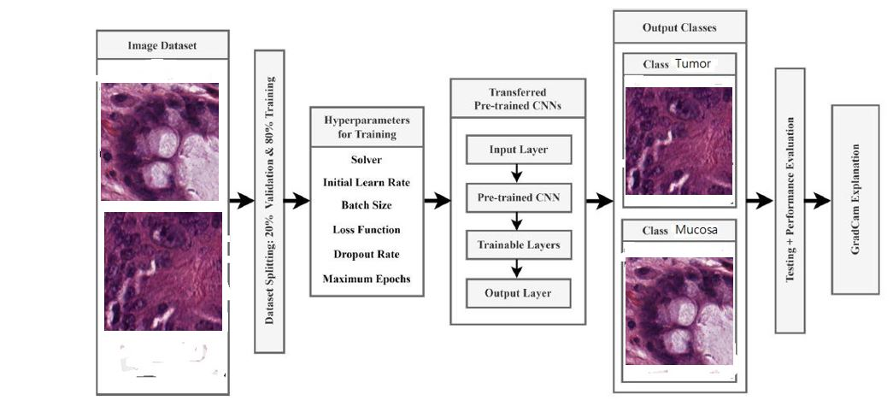
Working Pipelines
Jahangirnagar University
Department of Computer Science and Engineering

Slide 16
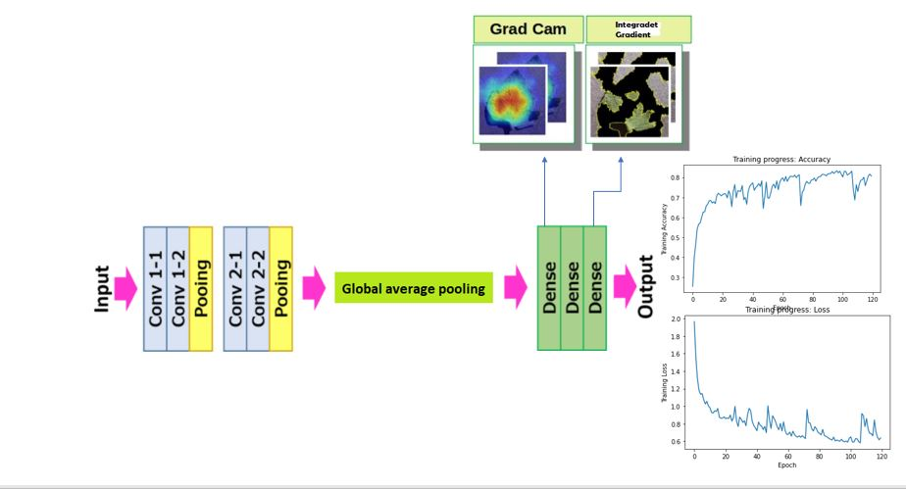
Proposed Method
Jahangirnagar University
Department of Computer Science and Engineering

Slide 17
Outlines
Introduction
Literature Review
Proposed System
Implementation and evaluation
Conclusion and future Scopes
References
Jahangirnagar University
Department of Computer Science and Engineering

Slide 18
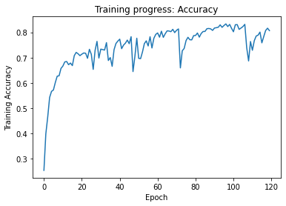
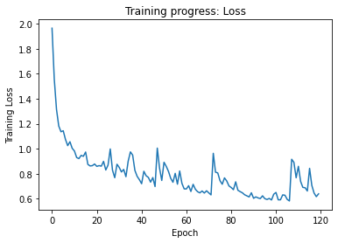
Experimental Result
Jahangirnagar University
Department of Computer Science and Engineering

Slide 19
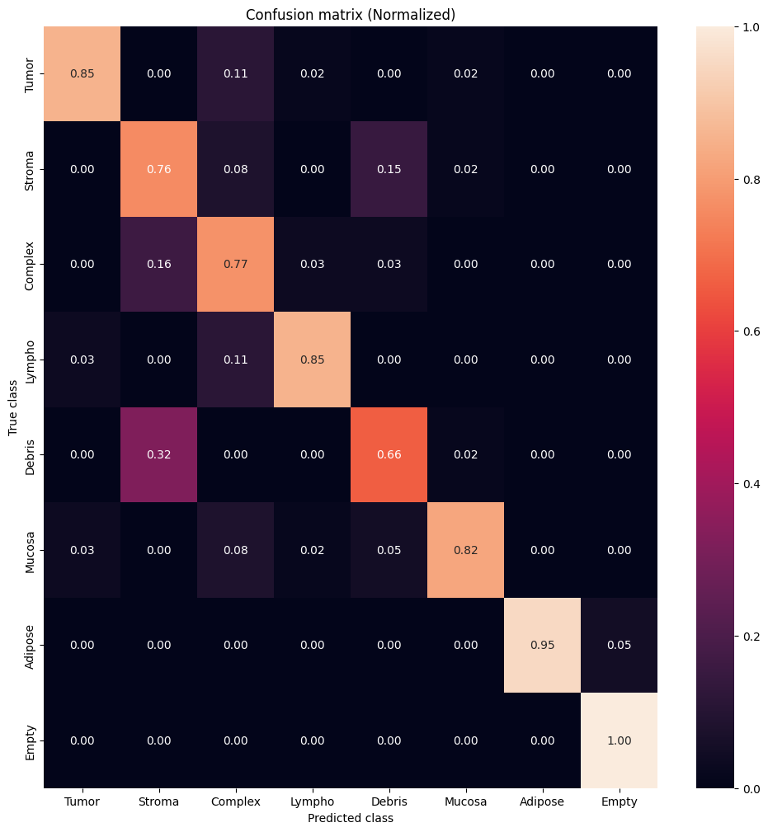
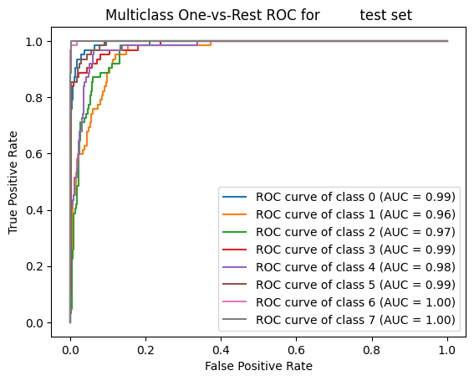
Jahangirnagar University
Department of Computer Science and Engineering

Slide 20
Precision, recall, and F1-score
Classes | Precision | Recall | F1-Score
0.Tumor | 0.93 | 0.85 | 0.89
1. Stroma | 0.81 | 0.76 | 0.86
2.Complex | 0.67 | 0.77 | 0.72
3.Lympho | 0.93 | 0.85 | 0.89
4.Debris | 0.75 | 0.66 | 0.70
5.Mucosa | 0.94 | 0.82 | 0.88
6.Adipose | 1.00 | 0.95 | 0.98
7.Empty | 0.95 | 1.00 | 0.98
Jahangirnagar University
Department of Computer Science and Engineering

Slide 21
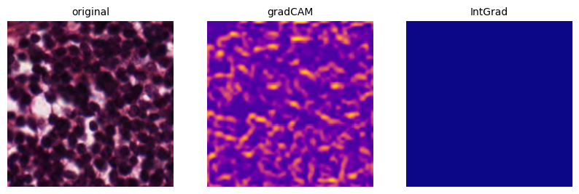
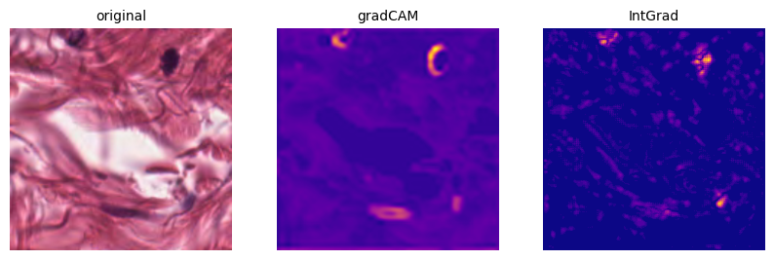
Some Sample of Output
Lymphocyte
Debris
Jahangirnagar University
Department of Computer Science and Engineering

Slide 22
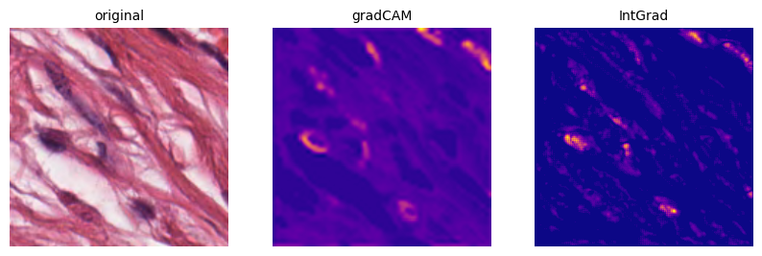
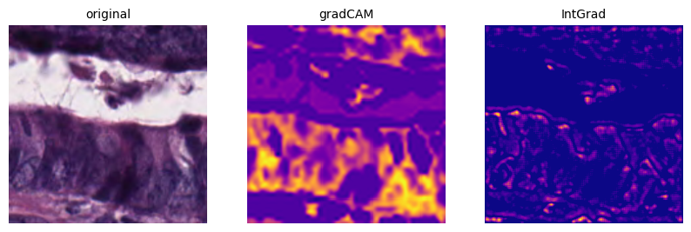
Some Sample of Output
Stroma
Tumor
Jahangirnagar University
Department of Computer Science and Engineering

Slide 23
Outlines
Introduction
Literature Review
Proposed System
Implementation and evaluation
Conclusion and future Scopes
References
Jahangirnagar University
Department of Computer Science and Engineering

Slide 24
Conclusion
Use CNN for better categorization of tissues
Use XAI technique to visualize the output
GradCAM and IntGrad explain the model’s decision
Decreases reliance on human.
Shows a high accuracy rate that helps to gain the trust of medical experts
Ensures reliability of AI-assisted diagnostic tools
Jahangirnagar University
Department of Computer Science and Engineering

Slide 25
Future Scope
Multiple CNN model can be used for comparing
XAI approaches such as SHAP and LIME may give more interpretability and application.
Developing user-friendly interfaces that integrate these CNN models
Developing user-friendly interfaces that integrate these XAI models
Jahangirnagar University
Department of Computer Science and Engineering

Slide 26
Outlines
Introduction
Literature Review
Proposed System
Implementation and evaluation
Conclusion and future Scopes
References
Jahangirnagar University
Department of Computer Science and Engineering

Slide 27
Reference
[1] A. W. Salehi, S. Khan, G. Gupta, B. I. Abdullah, A. Almjally, H. Alsolai, T. Siddiqui, and A. Mellit, “A study of cnn and transfer learning in medical imaging: Advantages, challenges, future scope,” Sustainability, vol. 15, no. 7, p. 5930,
2023.
[2] A. Adadi and M. Berrada, “Peeking inside the black-box: a survey on explainable artificial intelligence (xai),” IEEE access, vol. 6, pp. 52 138–52 160, 2018.
[3] F. Doshi-Velez and B. Kim, “Towards a rigorous science of interpretable machine learning,” arXiv preprint arXiv:1702.08608, 2017.
[4] S. Munquad, T. Si, S. Mallik, A. B. Das, and Z. Zhao, “A deep learning–based framework for supporting clinical diagnosis of glioblastoma subtypes,” Frontiers in Genetics, vol. 13, p. 855420, 2022.
[5] K. Simonyan and A. Zisserman, “Very deep convolutional networks for large-scale image recognition,” arXiv preprint arXiv:1409.1556, 2014.
[6] R. Abbasi-Asl and B. Yu, “Structural compression of convolutional neural networks,” arXiv preprint arXiv:1705.07356, 2017.
[7] C. Chen, O. Li, D. Tao, A. Barnett, C. Rudin, and J. K. Su, “This looks like that: deep learning for interpretable image recognition,” Advances in neural information processing systems, vol. 32, 2019.
[8] P. Costa, T. Ara´ujo, G. Aresta, A. Galdran, A. M. Mendonc，a, A. Smailagic, and A. Campilho, “Eyewes: weakly supervised pre-trained convolutional neural networks for diabetic retinopathy detection,” in 2019 16th international conference on machine vision applications (MVA). IEEE, 2019, pp. 1–6.
Jahangirnagar University
Department of Computer Science and Engineering

Slide 28

Jahangirnagar University
Department of Computer Science and Engineering

