Slide 1
FEDERATED LEARNING AND NLP FOR ADVANCED EMAIL FORENSICS: A PRIVACY-PRESERVING APPROACH
Nazma Sarker
Reg. no.: 46289
Session: 2021-2022
Dr. Abu Sayed Md. Mostafizur Rahaman
Professor
Department of CSE
17 September, 2024
Notes:
‹#›

Slide 2
Slide Outline
Overview
Problem Statement
Objective
Related Work
Contribution
Proposed Methodology
Experimental Results
Conclusion
Future Scope
Reference
‹#›
Notes:
‹#›

Slide 3
Overview
Email forensics is essential for detecting unlawful activities in personal and professional exchanges.
Sophisticated methods are needed to analyze vast volumes of emails and detect malware, fraud, suspicious behavior, or anomalies.
Natural Language Processing and file analysis help uncover hidden threats in email content.
Adaptive approaches are crucial to keep pace with evolving threats.
Federated learning and Teaching Learning Based Optimization (TLBO) enhance threat detection while protecting privacy.
‹#›
Notes:
‹#›

Slide 4
Problem Statement
Erroneous patterns in email communication may indicate security threats like phishing.
Unusual attachments, suspicious links, and inconsistent language or tone are key warning signs.
Unexpected requests for sensitive information are strong indicators of phishing attempts.
Verifying unexpected emails and being cautious with links or attachments is essential for security.
User education and robust email security protocols can reduce the risk of email-based attacks.
‹#›

Slide 5
Objectives
The objectives of this thesis are to:
Develop a framework for forensic analysis of email content using Natural Language Processing (NLP) techniques to extract valuable information.
Integrate federated learning with Teaching learning based optimization (TLBO) for decentralized and efficient learning in distributed environments
Leverage federated learning and XAI (i.e LIME) to ensure privacy while providing transparent and interpretable model predictions.
Improve the detection and understanding of intricate threats in email content, enhancing cybersecurity.
‹#›

Slide 6
Related Work
Reference | Description | Used Techniques | Advantages | Limitation
[1] | Nlp-based digital forensic investigation platform for online communications | NLP, Machine learning | This study uses real world dataset and includes comparative study | This study used an imbalance Dataset and the performance is not very satisfactory
[2] | Nlp-based digital forensic analysis for online social network based on system security | Blockchain, Machine Learning, NLP | In this study, security is improved and performance is very satisfactory | This study lacks comparative analysis for different research.
[3] | Using machine learning and nlp techniques for efficient spam email detection | Machine learning, NLP, Neural Network | This study shows better performance with similar technology | This study includes smaller and not so diverse dataset
[4] | Spam Email Categorization with NLP and using Federated Deep Learning | Federated deep learning, NLP, Machine Learning | This study performs better and use a privacy preserving technique | This study has limited discussion on feature selection
‹#›

Slide 7
Contributions
A privacy-preserving email forensic framework using federated learning and Teaching-Learning-Based Optimization (TLBO) to ensure decentralized data processing.
Robust forensic analysis using NLP techniques to enable more accurate anomaly detection in email content.
Explainable AI techniques to enhance interpretability of forensic models, ensuring transparency in decision-making.
Improved scalability and robustness by combining federated learning with TLBO, making models more resilient to adversarial attacks across diverse datasets.
‹#›

Slide 8
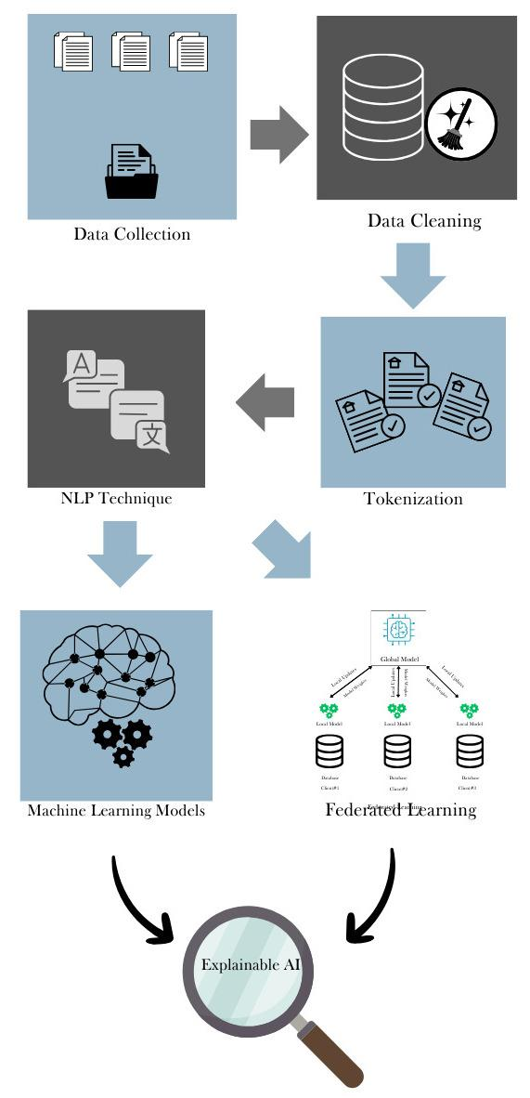
Proposed Methodology
Fig. Overview of Email Forensic using Federated Learning and NLP
‹#›

Slide 9
Proposed Methodology (Cont. )
Dataset Collection
Enron email dataset which includes sender, recipient, date, subject, body and label.
Publicly available in both Kaggle and CS Data Repository.
Around 500k emails from the 150 employees of Enron, including the executives.
The dataset is guaranteed to comply with data usage agreements and ethical issues.
‹#›

Slide 10
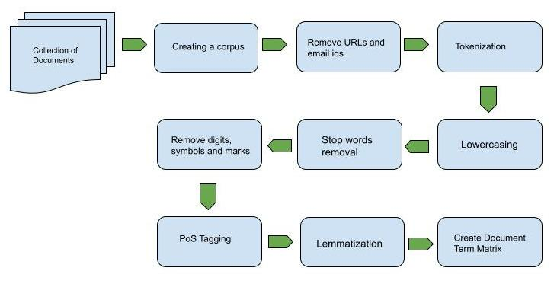
Proposed Methodology (Cont. )
Data Preprocessing
Fig. Text Pre-processing Techniques for NLP
‹#›

Slide 11
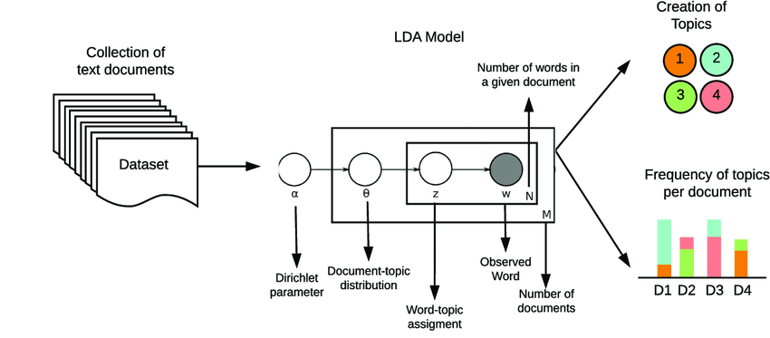
Proposed Methodology (Cont. )
Topic Modeling using Latent Dirichlet Allocation (LDA)
Fig. Latent Dirichlet Allocation for Topic modeling
‹#›

Slide 12
Proposed Methodology (Cont. )
Topical Feature
The probability distributions over topics for each document
Topic distribution reflects the proportion of a document assigned to various topics.
For T topics, each document gets a T-dimensional feature vector.
Used as input features for tasks like classification.
‹#›

Slide 13
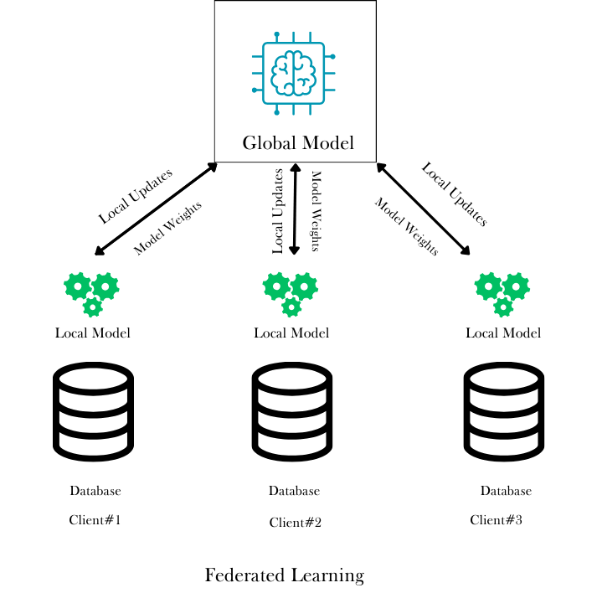
Proposed Methodology (Cont. )
System Model
Global Model
Local Model
‹#›

Slide 14
Proposed Methodology (Cont. )
Global Model
A neural network model with three fully connected layers, designed in PyTorch.
Input Layer: Takes input with 15 features and maps to 256 neurons.
Hidden Layer: Maps 256 neurons to 128 neurons.
Output Layer: Maps 128 neurons to 2 output classes.
Trained using TLBO (Teaching-Learning Based Optimization), where multiple teacher models are trained on local data, and the best-performing teacher model is used to update the global model's weights.
‹#›

Slide 15
Proposed Methodology (Cont. )
Teaching Learning Based Optimization
Initialize a random population
Teacher phase – the best solution (teacher) updates the rest of the population
Learner phase – students improve by learning from each other.
Continue until a good solution is found or stopping criteria are met.
‹#›

Slide 16
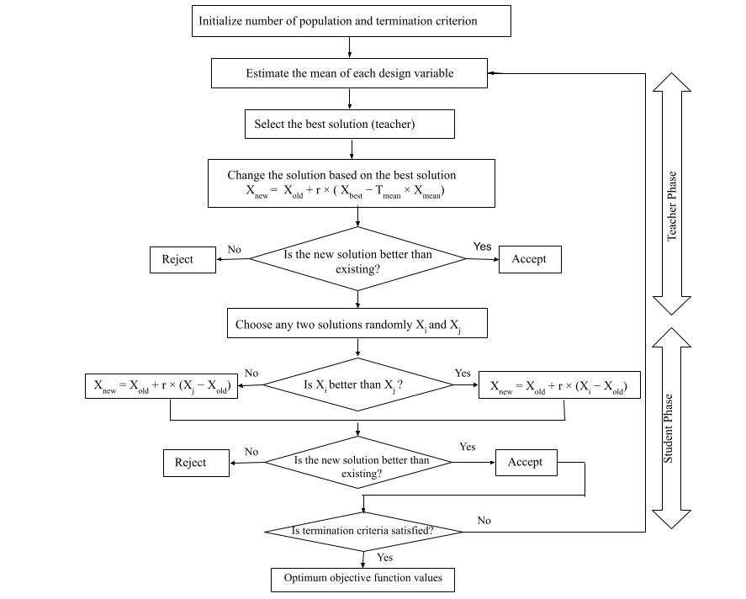
Proposed Methodology (Cont. )
Teaching Learning based Optimization Flowchart
‹#›

Slide 17
Proposed Methodology (Cont. )
Local Model
Multiple instances of the neural network architecture.
A local dataset that is never shared with other clients or the server.
Individual models that train independently and are evaluated at each iteration.
The local model is trained on the client’s own data for a set number of epochs
Local model updates are computed.
After training, instead of sending the raw data, each client sends its local model parameters or gradients (model updates) to a central server.
‹#›

Slide 18
Proposed Methodology (Cont. )
Update Global Model
After the aggregation of the updates from all clients, the global model gets updated.
The updated global model is sent back to all clients
Repeat the process to refine the model further with local training.
Continue until the global model converges to a desirable accuracy.
‹#›

Slide 19
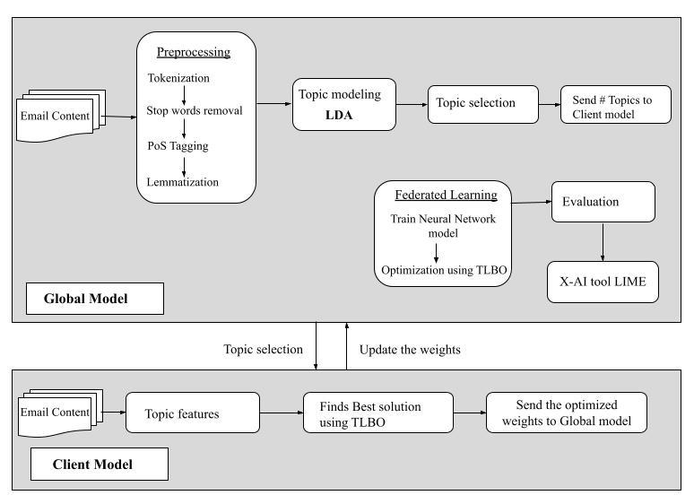
Proposed Methodology (Cont. )
Workflow of the System
‹#›

Slide 20
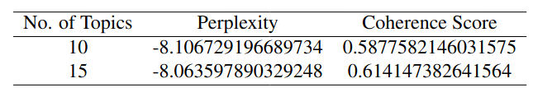
Experimental Result
Optimal Number of Topic
Perplexity Score: Measures how well a language model predicts the next word in a sequence. Lower perplexity means the model is better at predicting the words.
Coherence Score: Evaluates the quality of topics in topic modeling (e.g., LDA). Higher coherence means the topics are more interpretable and the words within each topic make more sense together.
Table: Computed perplexity score & coherence score for different # topic
‹#›

Slide 21

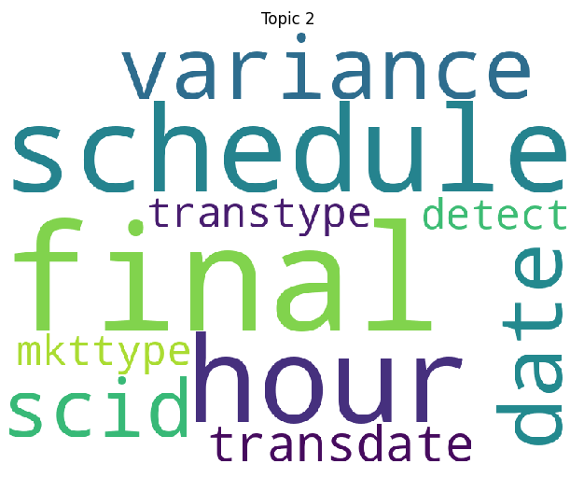
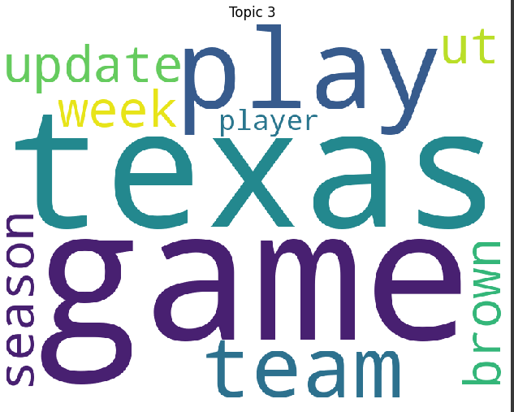
Experimental Result (Cont.)
Topic Extraction
‹#›

Slide 22
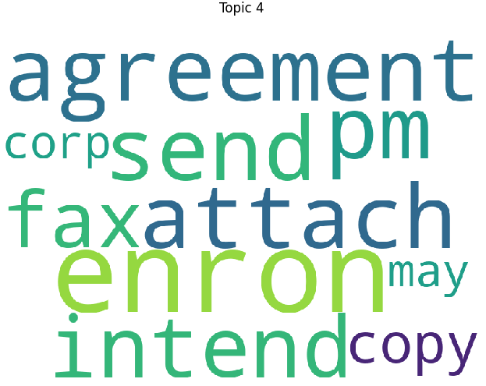
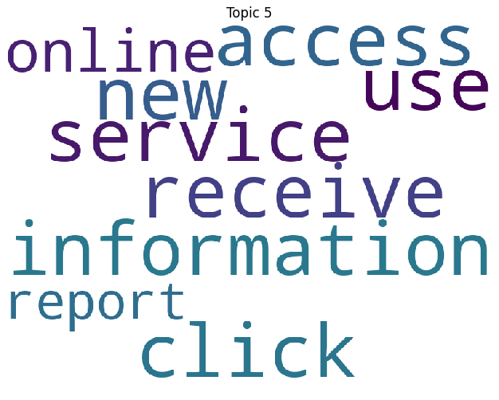
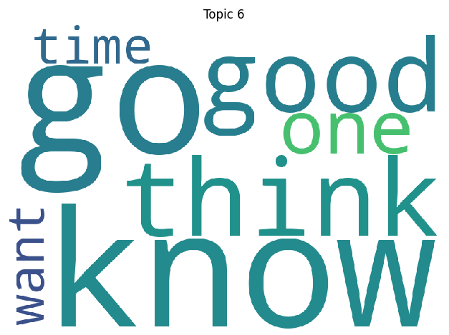
Experimental Result (Cont.)
Topic Extraction
‹#›

Slide 23
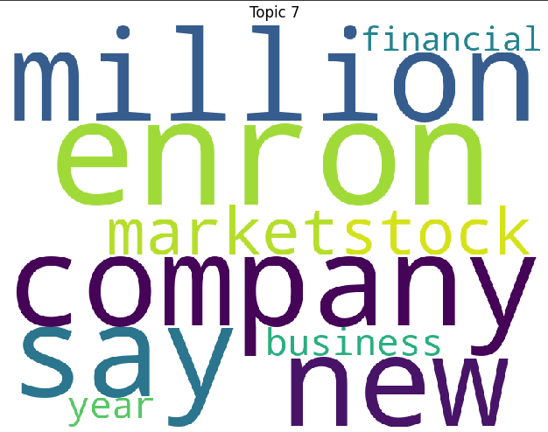
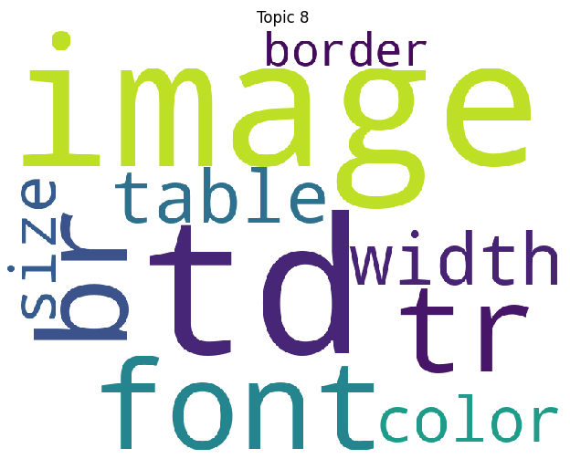
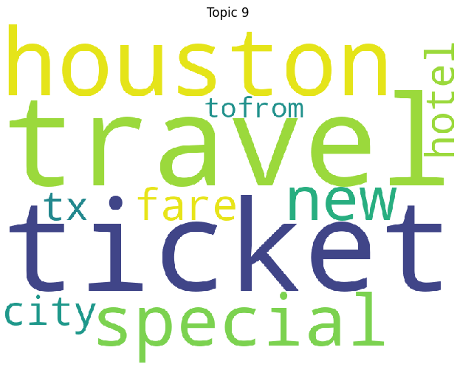
Experimental Result (Cont.)
Topic Extraction
‹#›

Slide 24
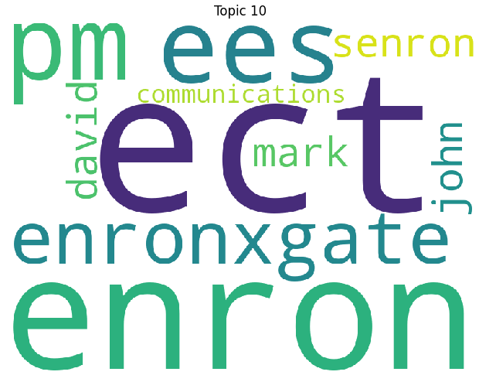
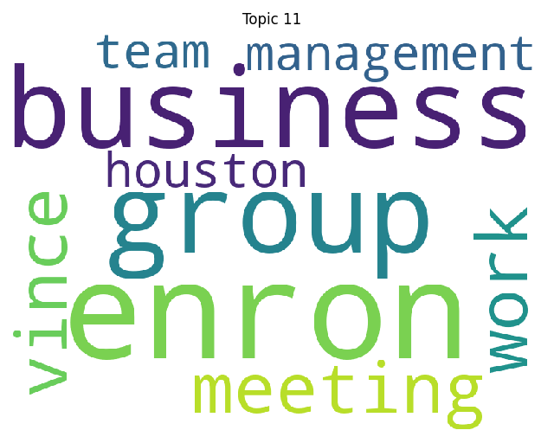
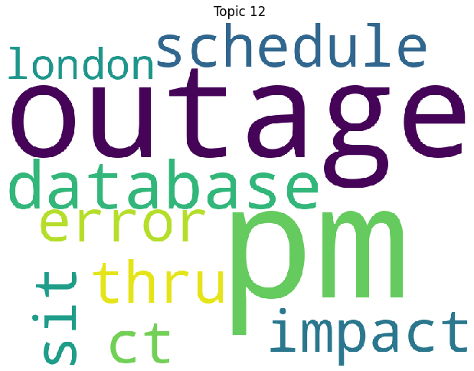
Experimental Result (Cont.)
Topic Extraction
‹#›

Slide 25
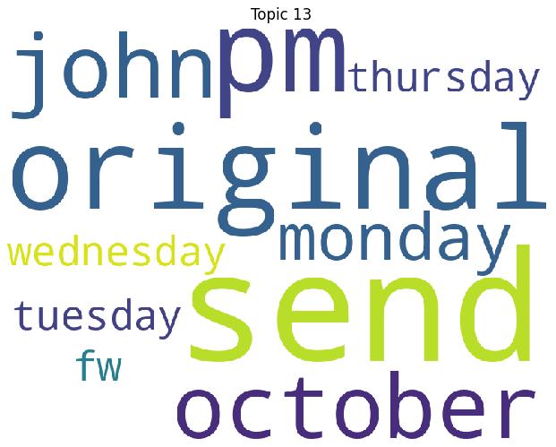
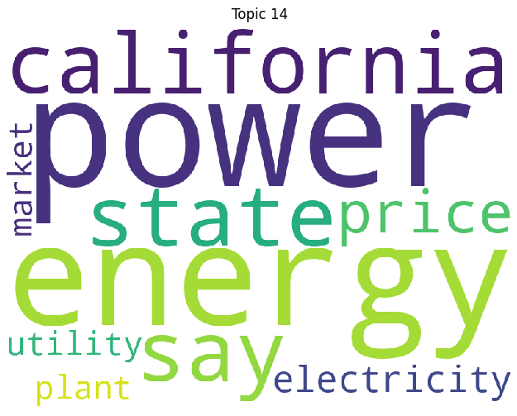
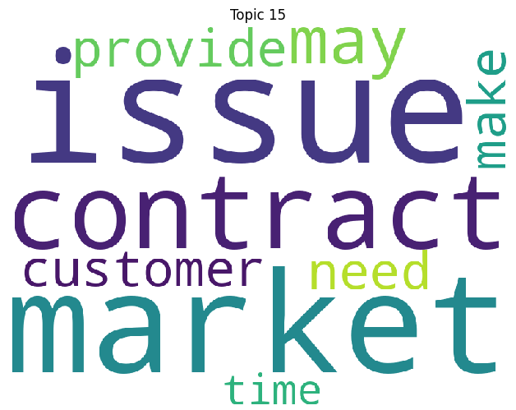
Experimental Result (Cont.)
Topic Extraction
‹#›

Slide 26
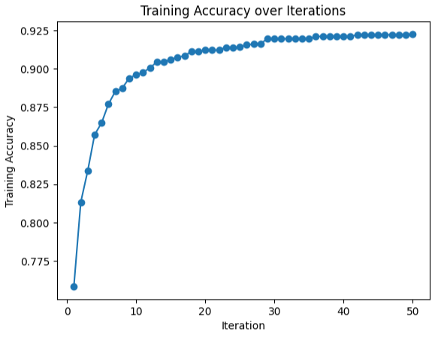
Experimental Result (Cont.)
Federated Learning with TLBO Training Accuracy
‹#›

Slide 27
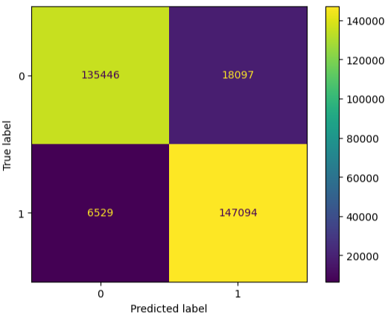
Experimental Result (Cont.)
Confusion Matrix
‹#›

Slide 28
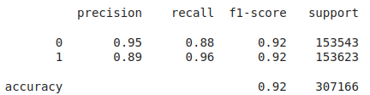
Experimental Result (Cont.)
Federated Learning Models Classification Report
‹#›

Slide 29
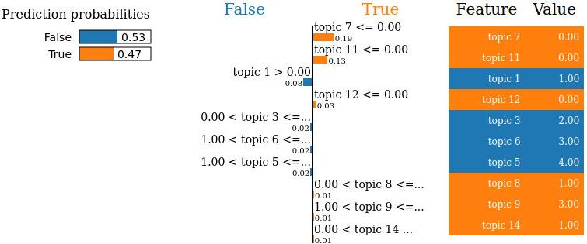
Experimental Result (Cont.)
LIME result of Federated Learning Model
Fig. LIME explanation of an instance using Federated Learning
‹#›

Slide 30
Conclusion
NLP-based email forensics with federated learning enhances privacy by decentralizing sensitive data.
Combining neural networks and TLBO automates classification tasks while improving model performance.
Federated learning provides better data security compared to traditional machine learning.
XAI techniques like LIME are essential for improving interpretability and building trust in model decisions.
‹#›

Slide 31
Future scope
Integration of email attachments into forensic analysis, enhancing cybersecurity by providing a more comprehensive approach to detecting and classifying suspicious emails.
Enhancement of the models' application in cybersecurity and digital forensics by using advanced NLP techniques.
The combination of TLBO, federated learning, and advanced NLP will make email forensics safer, more effective, and transparent.
‹#›

Slide 32
Reference
[1] D. Sun, X. Zhang, K.-K. R. Choo, L. Hu, and F. Wang, “Nlp-based digital forensic investigation platform for online communications,” computers & security, vol. 104, p. 102210, 202
[2] Z. Shahbazi and Y.-C. Byun, “Nlp-based digital forensic analysis for online social network based on system security,” International Journal of Environmental Research and Public Health, vol. 19, no. 12, p. 7027, 2022.
[3] K. S. Babu, G. Murali, and P. J. Maddala, “Using machine learning and nlp techniques for efficient spam email detection,” 2023
[4] I. Ul Haq, P. Black, I. Gondal, J. Kamruzzaman, P. Watters, and A. Kayes, “Spam email categorization with nlp and using federated deep learning,” in International Conference on Advanced Data Mining and Applications. Springer, 2022, pp.15–27.
‹#›

Slide 33
Thank You
‹#›

