Slide 1
Cyberbullying Detection in Bangla Facebook Comments Using Pre-Trained Transformer Models
Rama Kundu Prova
Reg. no.: 47832
Session: 2021-2022
Sarnali Basak
Associate Professor
Department of CSE
Tuesday, 17 September, 2024
Notes:
‹#›

Slide 2
Introduction
Hate comments and bullying on Facebook is a common scenario.
Cyberbullying is defined as willful and repeated harm inflicted through the medium of electronic text.[1]
To detect cyberbullying in Bangla we propose two pre-trained transformer models Bangla BERT Base and Mixed Distil BERT.
We used a balanced dataset of 10,000 data labeled with five classes.
‹#›

Slide 3
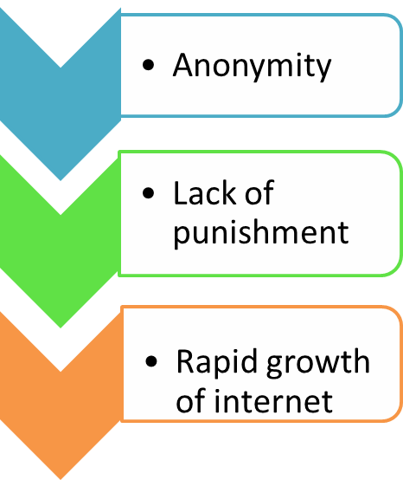
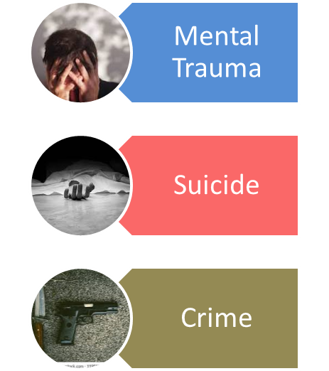
Problem Statement
Causes
Victims
Consequences
Teenager
Young Adults
Women
Public Figure
‹#›

Slide 4
Related Work
Author- Emon et al. [2]
Methods used -Bangla BERT, Bengali Distil BERT, XLM Roberta
Dataset- 44,001 Bangla Facebook comments labeled with 5 classes
Performance - Accuracy of 85% with XLM Roberta, 82.64% with Bangla Bert, 82.73% with Bengali DistilBERT
Limitation- Imbalanced dataset. Hence accuracy is biased.
Comparison with our study- We manually curated a balanced dataset from the imbalanced dataset they used.
‹#›

Slide 5
Related Work
Author- Aurpa et al. [3]
Methods used –BERT and ELECTRA
Dataset- 44,001 Bangla Facebook comments labeled with 5 classes
Performance - Accuracy of 85% with BERT
Limitation- Imbalanced dataset. Hence accuracy is biased.
Comparison with our study- We manually curated a balanced dataset from the imbalanced dataset they used.
‹#›

Slide 6
Related Work
Author- Khalid et al. [4]
Methods used – Bangla BERT
Dataset- Balanced dataset with 34,422 data
Performance - Accuracy of 88.04%
Limitation- Limited Category
Comparison with our study- They did binary classification of texts unlike multiclass classification in our study
‹#›

Slide 7
Research Questions
1
2
3
What are the existing models for cyberbullying detection in Bengali, and what are their limitations?
Why unbiased evaluation is needed?
How do the proposed models overcome the limitations of existing models?
‹#›

Slide 8
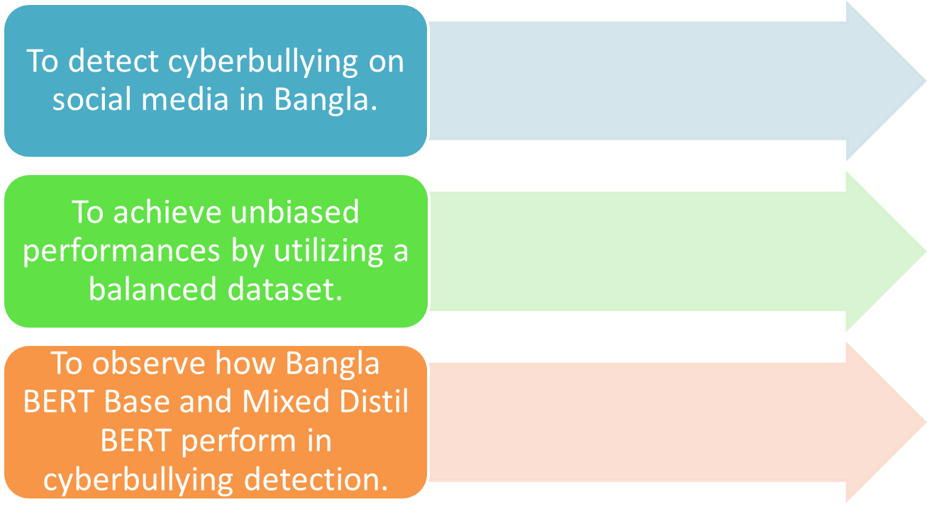
Objectives
‹#›

Slide 9
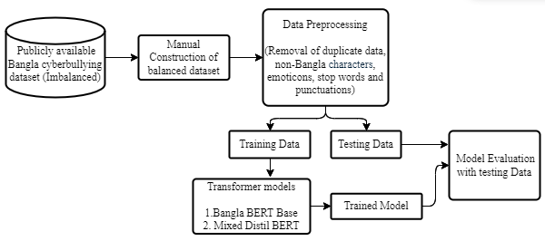
Methodology
Proposed Approach
‹#›

Slide 10
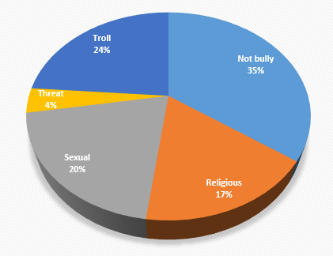
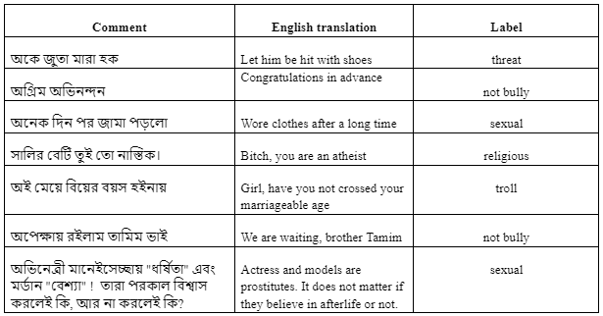
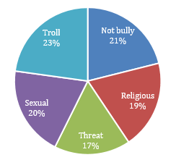
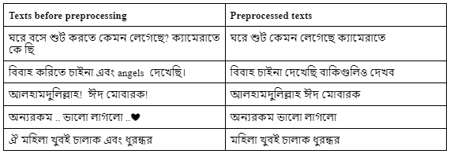
Methodology
Example of Bangla bullying texts
Class distribution in imbalanced dataset
Original and Preprocessed Texts
Class distribution in balanced dataset
‹#›

Slide 11
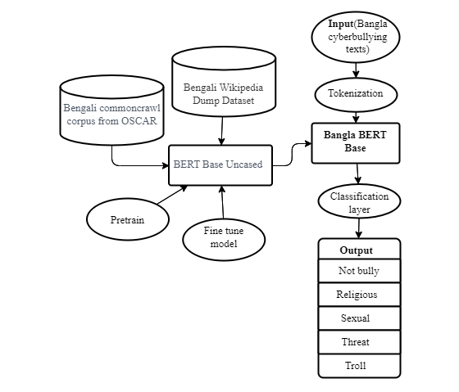
Methodology
Architecture and classification technique of Bangla BERT Base
‹#›

Slide 12
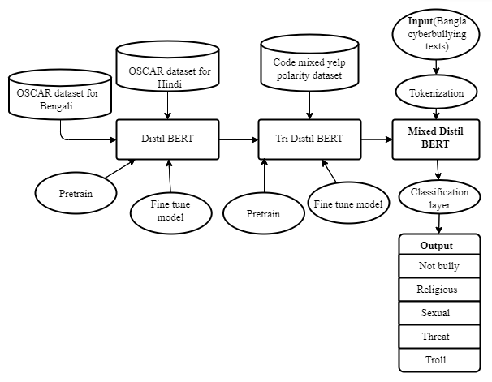
Methodology
Architecture and classification technique of Mixed Distil BERT
‹#›

Slide 13
Experimental Results
Model tuning parameter values
Training time of models
Parameter | Value
Epochs | 6
Number of batches | 8
Learning rate | 5e-5
Weight decay | 0.01
Maximum sequence length | 128
Model | Training Time
Bangla BERT BASE | 9.7 hours
Mixed Distil BERT | 5.24 hours
‹#›

Slide 14
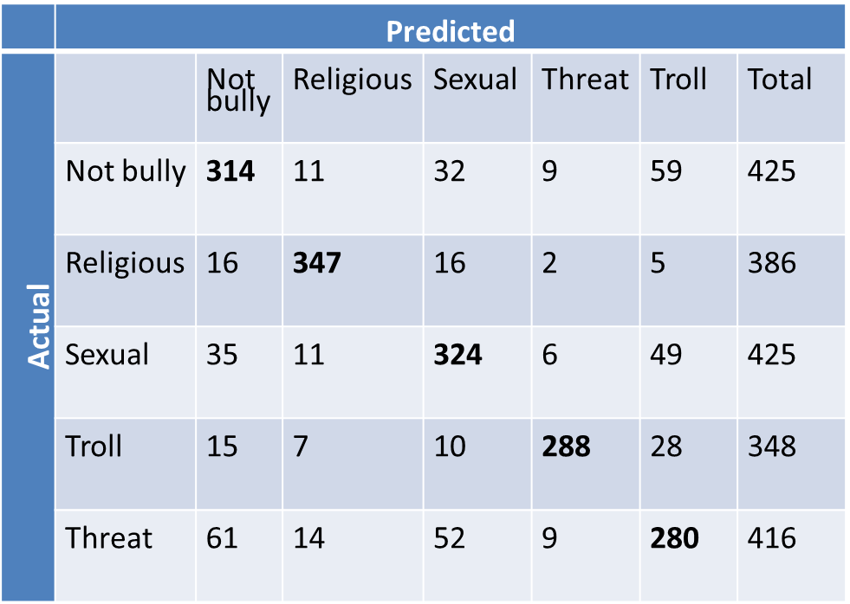
Experimental Results
Confusion matrix of test results using Bangla BERT Base
‹#›

Slide 15
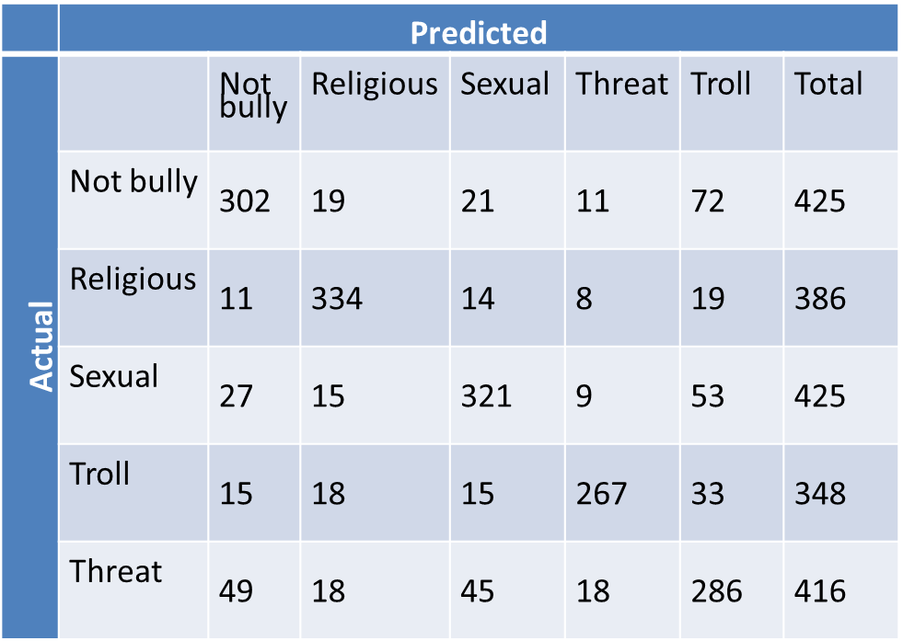
Experimental Results
Confusion matrix of test results using Mixed Distil BERT
‹#›

Slide 16
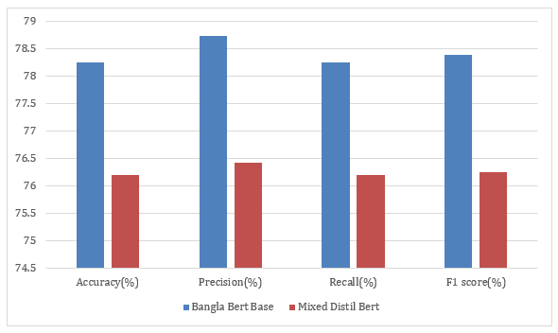
Experimental Results
Classification report of Bangla BERT Base and Mixed Distil BERT
Model | Accuracy(%) | Precision(%) | Recall(%) | F1score(%)
Bangla BERT Base | 78.25 | 78.74 | 78.25 | 78.39
Mixed Distil BERT | 76.2 | 76.43 | 76.2 | 76.25
Classification result comparison between Bangla BERT Base and Mixed Distil BERT
‹#›

Slide 17
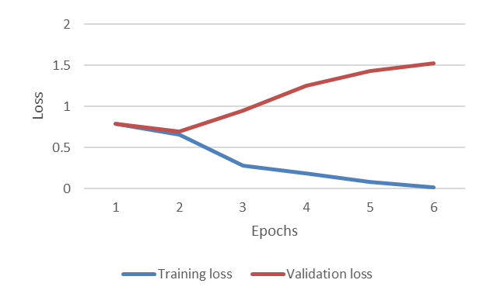
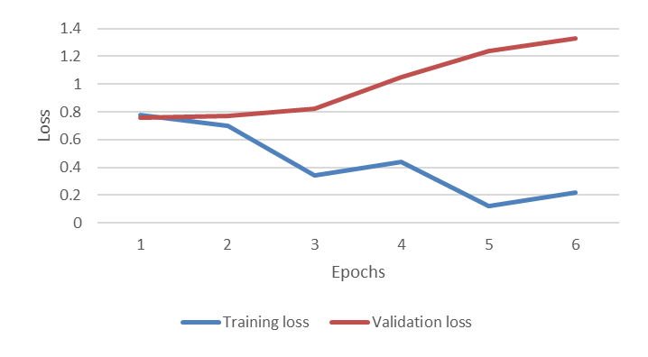
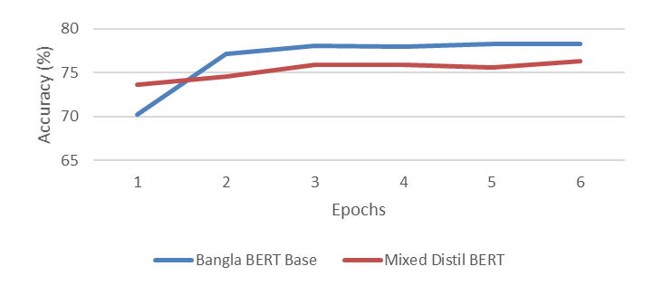
Experimental Results
Epochs vs loss curve for training and validation of Bangla BERT Base
Epochs vs loss curve for training and validation of Mixed Distil BERT
Sign of overfitting after epoch 3
Solution of overfitting: Reducing number of epochs
Epochs vs test accuracy curve of Bangla BERT Base and Mixed Distil BERT
‹#›

Slide 18
Contribution
A balanced dataset comprising 10,000 samples is constructed manually from a publicly available Bangla cyberbullying dataset.
We reviewed several existing researches on cyberbullying detection in Bangla and assessed the limitations.
We focused on how Bangla BERT Base and Mixed Distil BERT perform on a balanced Bangla cyberbullying dataset.
‹#›

Slide 19
Conclusion
To ensure unbiased evaluation, a balanced dataset is manually constructed.
Our dataset consists of 10,000 data labeled with five classes- bully, not bully, religious, sexual, threat, and troll.
Rigorous preprocessing is applied.
We experimented with two transformer models Bangla BERT Base and Mixed Distil BERT.
Both models demonstrated comparable and satisfactory performance on our dataset.
‹#›

Slide 20
Future Research Direction
To pre-train a transformer-based model with a huge Bangla cyberbullying corpus and tune the model for meticulous identification of cyberbullying in Bangla.
To implement a transformer-based detection model on Facebook.
‹#›

Slide 21
References
Patchin, J.W., Hinduja, S.: Bullies move beyond the schoolyard: A preliminary look at cyber-bullying. Youth Violence and Juvenile Justice 4(2), 148–169 (2006)
Emon, M.I.H., Iqbal, K.N., Mehedi, M.H.K., Mahbub, M.J.A., Rasel, A.A. Detection of Bangla Hate Comments and Cyberbullying in Social Media Using NLP and Transformer Models. In: Singh, M., Tyagi, V., Gupta, P.K., Flusser, J., Ören, T. (eds) Advances in Computing and Data Sciences. ICACDS 2022. Communications in Computer and Information Science, vol 1613. Springer, Cham (2022)
Aurpa, T. T., Sadik, R., Ahmed, M. S..: Abusive Bangla comments detection on Facebook using transformer-based deep learning models. Soc. Netw. Anal. Min. 12, 24 (2022)
Saifullah, K., Khan, M. I., Jamal, S., Sarker, I. H.: Cyberbullying Text Identification based on Deep Learning and Transformer-based Language Models. EAI Endorsed Transactions on Industrial Networks and Intelligent Systems, 11(1), e5 (2024)
‹#›

Slide 22

Publication
A paper on this research has been accepted for presentation at the MIET 2024 and for publication in the conference proceedings published by Springer Nature Book Series: Lecture Notes in Networks and Systems (LNNS). This series is indexed in DBLP, EI Compendex, INSPEC, SCImago, and Scopus.
‹#›

Slide 23
Any Question?
‹#›

Slide 24
Thank You
‹#›

