Slide 1
Object Recognition
A wise robot sees as much as he ought, not as much as he can
Search for objects that are important
lamps
outlets
wall corners
doors
wall plugs
A mobile robot should be self-sufficient in power finding

Slide 2
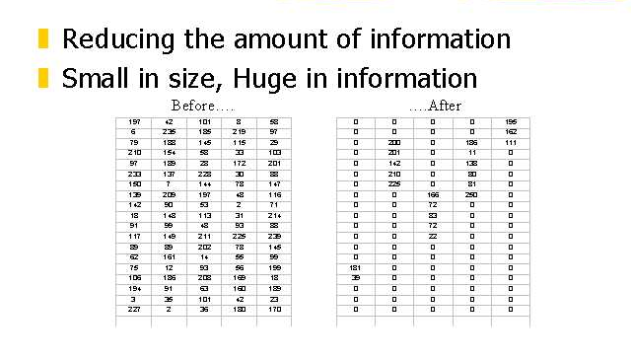
In any case, we need information reduction

Slide 3
Segmentation - Review
Segmentation
Roughly speaking, segmentation is to partition the images into meaningful parts that are relatively homogenous in certain sense

Slide 4
Segmentation by Fitting a Model
One view of segmentation is to group pixels (tokens, etc.) belong together because they conform to some model
In many cases, explicit models are available, such as a line
Also in an image a line may consist of pixels that are not connected or even close to each other

Slide 5
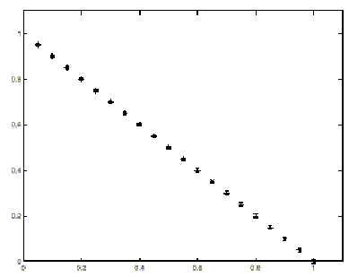
Segmentation by Fitting a Model – cont.

Slide 6
Why?
Image Processing
Canny Edge Detection
Hough Transforms
Monitor power level in robot’s batteries
When power goes low, interrupt actions
Search for the wall plug
Traverse over to it
Plug itself to it in.

Slide 7
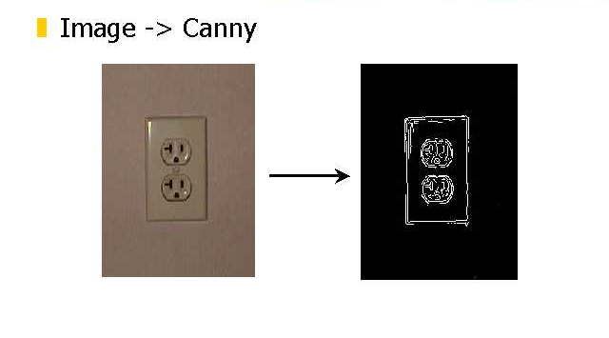
Canny and Hough Together

Slide 8
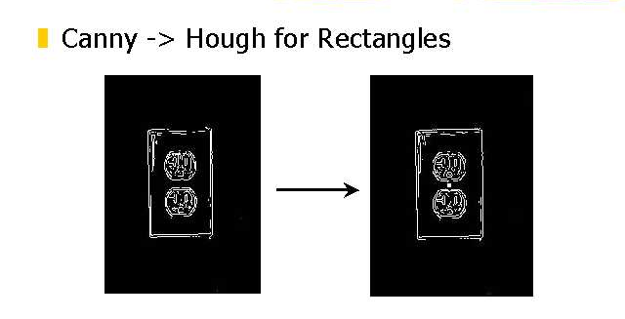
Canny and Hough Together
Canny and Hough Together

Slide 9
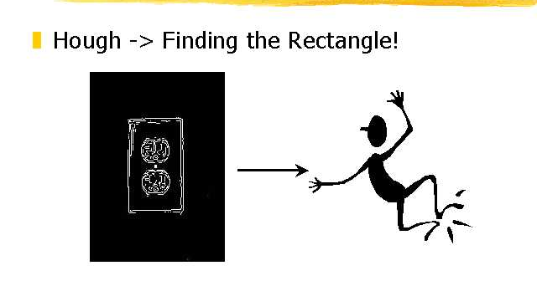
Canny and Hough Together
Canny and Hough Together

Slide 10
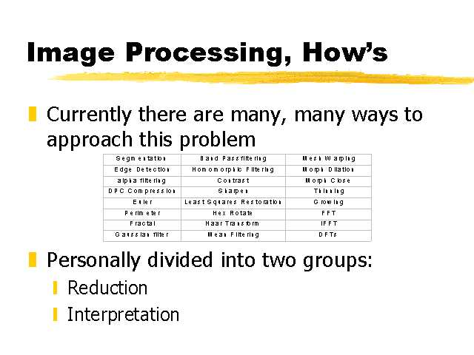
How to design a n image processing system to solve this problem
How to design a n image processing system to solve this problem

Slide 11
Hough Transform
Denoted by HT
denoted by Standard HT, or SHT

Slide 12
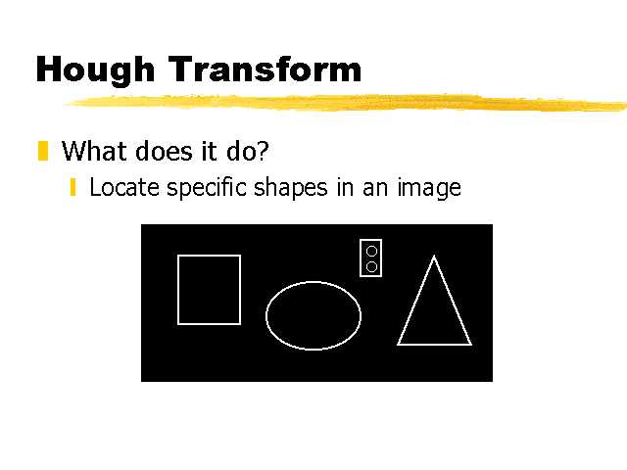
Hough Transform
It locates straight lines
It locates straight line intervals
It locates circles
It locates algebraic curves
It locates arbitrary specific shapes in an image
But you pay progressively for complexity of shapes by time and memory usage

Slide 13
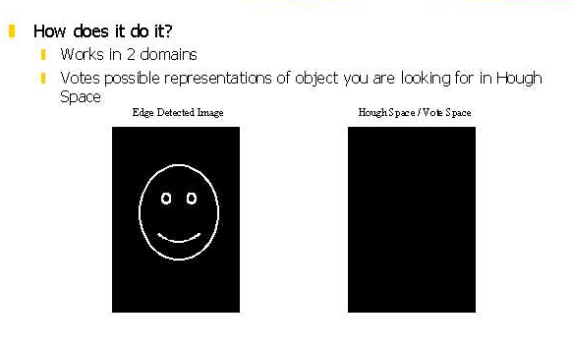
Hough Transform for circles
*
You need three parameters to describe a circle
*
*
*
*
*
*
Vote space is three dimensional

Slide 14
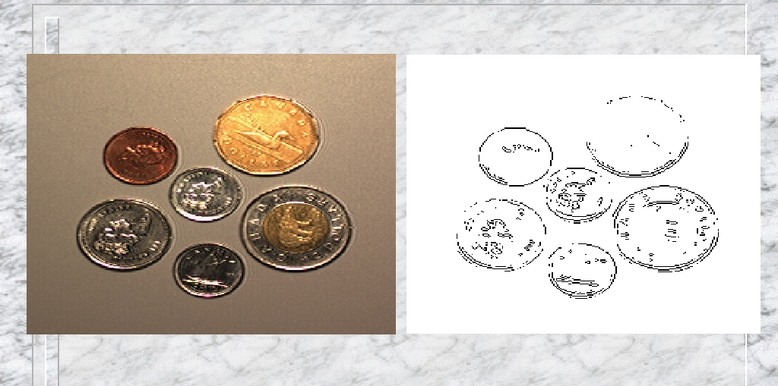
Motivation for Hough Transform - Example

Slide 15
Contours: Lines and Curves
Edge detectors find “edgels” (pixel level)
To perform image analysis :
edgels must be grouped into entities such as contours (higher level).
Canny does this to certain extent: the detector finds chains of edgels.

Slide 16
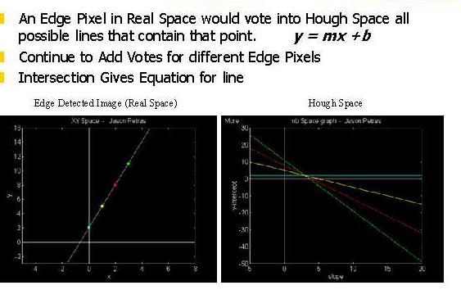
First Parameterization of Hough Transform for lines

Slide 17
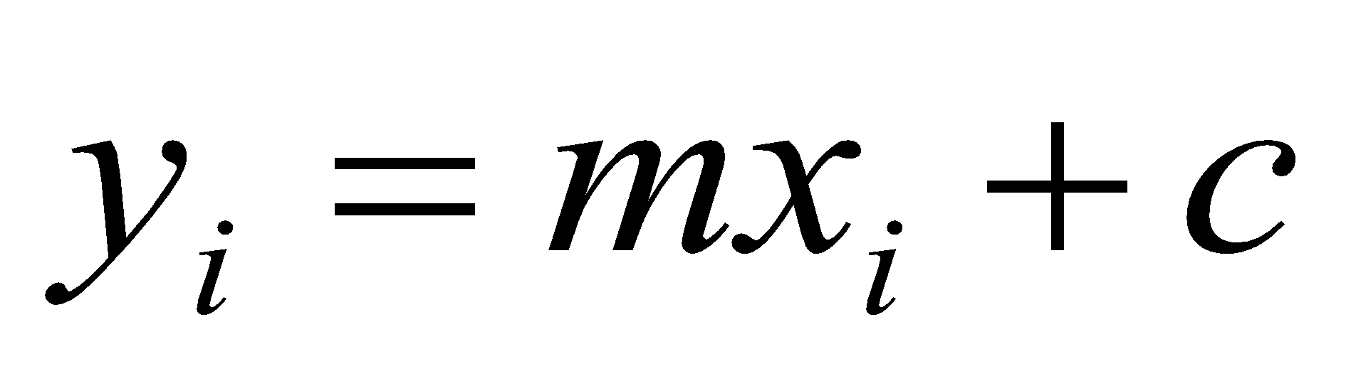
Hough Transform – cont.
Straight line case
Consider a single isolated edge point (x_{i}, y_{i})
There are an infinite number of lines that could pass through the points
Each of these lines can be characterized by some particular equation

Slide 18
Line detection
Mathematical model of a line:
y
Y = mx + n
Y₁=m x₁+n
Y₂=m x₂+n
P(x₁,y₁)
P(x₂,y₂)
x
Y_{N}=m x_{N}+n

Slide 19
Image and Parameter Spaces
y
Y = mx + n
slope
Y₁=m x₁+n
Y = m’x + n’
m’
Y₂=m x₂+n
n
n’
intercept
x
m
Y_{N}=m x_{N}+n
Image Space
Parameter Space
Line in Img. Space ~ Point in Param. Space

Slide 20
Hough Transform Technique
Given an edge point, there is an infinite number of lines passing through it (Vary m and n).
These lines can be represented as a line in parameter space.
slope
y
n = (-x) m + y
n
P(x,y)
intercept
m
x
Parameter Space

Slide 21
Hough Transform Technique
Given a set of collinear edge points, each of them have associated a line in parameter space.
These lines intersect at the point (m,n) corresponding to the parameters of the line in the image space.

Slide 22
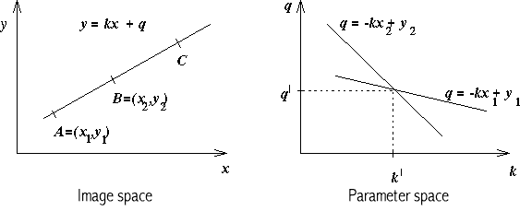
Hough Transform slope-intercept parametrization
An Edge Pixel in Real Space would vote into Hough Space all possible lines that contain that point
y = kx + q
Continue to Add Votes for different Edge Pixels
Intersection gives Equation for line
Edge Detected Image (real space)
Hough Space

Slide 23
HT - parametric representation
y = kx + q
(x,y) - co-ordinates
k - gradient
q - y intercept
Any straight line is characterized by k & q
use : ‘slope-intercept’ or (k,q) space not (x,y) space
(k,q) - parameter space
(x,y) - image space
can use (k,q) co-ordinates to represent a line

Slide 24
Looking at it backwards …
Image space
Fix (m,n), Vary (x,y) - Line
Y = mx + n
Fix (x₁,y₁), Vary (m,n) – Lines thru a Point
Y₁=m x₁+n
y
P(x₁,y₁)
x

Slide 25
Looking at it backwards …
Parameter space
Y₁=m x₁+n
Can be re-written as:
n = -x₁ m + Y₁
Fix (-x₁,y₁), Vary (m,n) - Line
n = -x₁ m + Y₁
slope
m’
n
n’
intercept
m

Slide 26
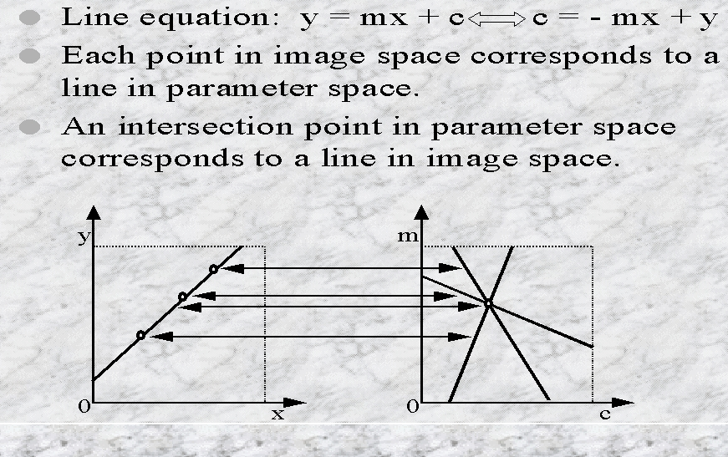
Hough Transform for lines

Slide 27
Image Parameter Spaces
Image Space
Lines
Points
Collinear points
Parameter Space
Points
Lines
Intersecting lines

Slide 28
Hough Transform Philosophy
H.T. is a method for detecting straight lines, shapes and curves in images.
Main idea:
Map a difficult pattern problem into a simple peak detection problem

Slide 29
Hough Transform Technique
At each point of the (discrete) parameter space, count how many lines pass through it.
Use an array of counters
Can be thought as a “ parameter image”
The higher the count, the more edges are collinear in the image space.
Find a peak in the counter array
This is a “bright” point in the parameter image
It can be found by thresholding

Slide 30
HT properties
Original HT designed to detect straight lines and curves
Advantage - robustness of segmentation results
segmentation not too sensitive to imperfect data or noise
better than edge linking
works through occlusion
Any part of a straight line can be mapped into parameter space

Slide 31
Accumulators
Each edge pixel (x,y) votes in (k,q) space for each possible line through it
i.e. all combinations of k & q
This is called the accumulator
If position (k,q) in accumulator has n votes
n feature points lie on that line in image space
Large n in parameter space, more probable that line exists in image space
Therefore, find max n in accumulator to find lines

Slide 32
Hough Transform
There are three problems in model fitting
Given the points that belong to a line, what is the line?
Which points belong to which line?
How many lines are there?
Hough transform is a technique for these problems
The basic idea is to record all the models on which each point lies and then look for models that get many votes

Slide 33
Hough Transform – cont.
Hough transform algorithm
1. Find all of the desired feature points in the image
2. For each feature point
For each possibility i in the accumulator that passes through the feature point
Increment that position in the accumulator
3. Find local maxima in the accumulator
4. If desired, map each maximum in the accumulator back to image space

Slide 34
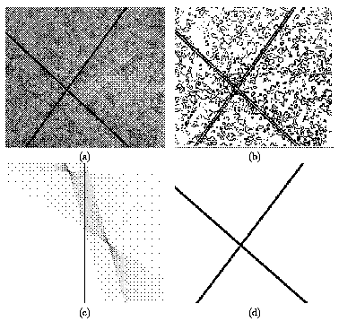
HT Algorithm
Find all desired feature points in image space
i.e. edge detect (low pass filter)
Take each feature point
increment appropriate values in parameter space
i.e. all values of (k,q) for give (x,y)
Find maxima in accumulator array
Map parameter space back into image space to view results

Slide 35
Practical Issues with This Hough Parameterization
The slope of the line is -∞<m<∞
The parameter space is INFINITE
The representation y = mx + n does not express lines of the form x = k

Slide 36
Solution:
Use the “Normal” equation of a line:
y
Y = mx + n
ρ = x cosθ+y sinθ
P(x,y)
θ Is the line orientation
y
ρ
ρ Is the distance between
the origin and the line
θ
x
x

Slide 37
Consequence:
A Point in Image Space is now represented as a SINUSOID
ρ = x cosθ+y sinθ

Slide 38
New Parameter Space for Hough based on trigonometric functions
Use the parameter space (ρ, θ)
The new space is FINITE
0 < ρ < D , where D is the image diagonal.
0 < θ < π
The new space can represent all lines
Y = k is represented with ρ = k, θ=90
X = k is represented with ρ = k, θ=0

Slide 39
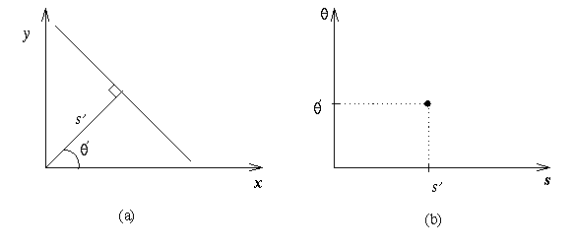
Alternative line representation in (ρ,θ) space
‘slope-intercept’ space has problem
verticle lines k -> infinity q -> infinity
Therefore, use (ρ,θ) space
ρ = xcos θ + y sin θ
ρ = magnitude
drop a perpendicular from origin to the line
θ = angle perpendicular makes with x-axis

Slide 40
ρ,θ space
In (k,q) space
point in image space == line in (k,q) space
In (ρ,θ) space
point in image space == sinusoid in (ρ,θ) space
where sinusoids overlap, accumulator = max
maxima still = lines in image space
Practically, finding maxima in accumulator is non-trivial
often smooth the accumulator for better results

Slide 41
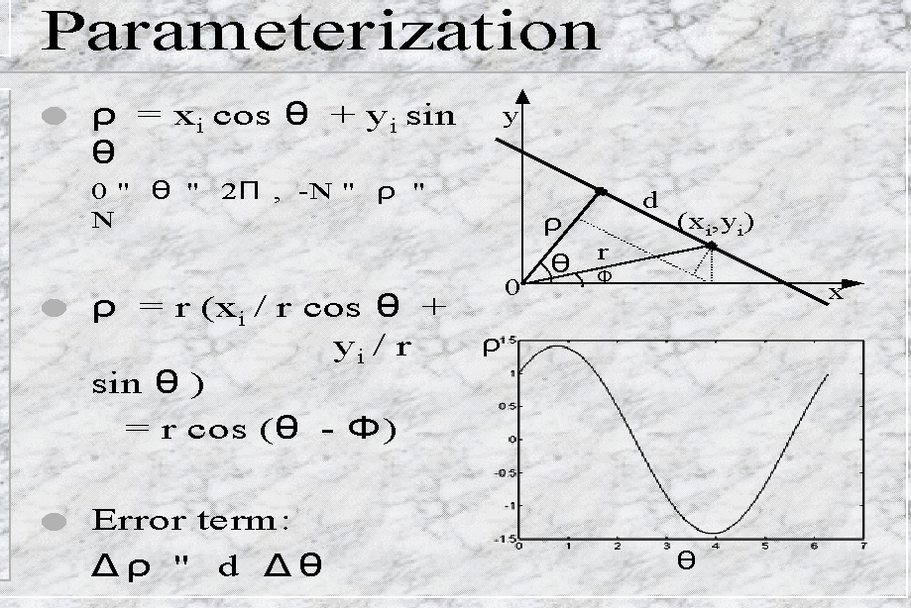
Normal Line Parametrization

Slide 42
Hough Transform Algorithm
Input is an edge image (E(i,j)=1 for edgels)
Discretize θ and ρ in increments of dθ and dρ. Let A(R,T) be an array of integer accumulators, initialized to 0.
For each pixel E(i,j)=1 and h=1,2,…T do
ρ = i cos(h * dθ ) + j sin(h * dθ )
Find closest integer k corresponding to ρ
Increment counter A(h,k) by one
Find local maxima in A(R,T)

Slide 43
Hough Transform Speed Up
If we know the orientation of the edge – usually available from the edge detection step
We fix theta in the parameter space and increment only one counter!
We can allow for orientation uncertainty by incrementing a few counters around the “nominal” counter.

Slide 44
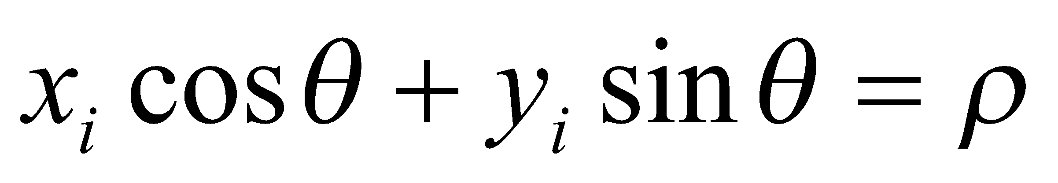

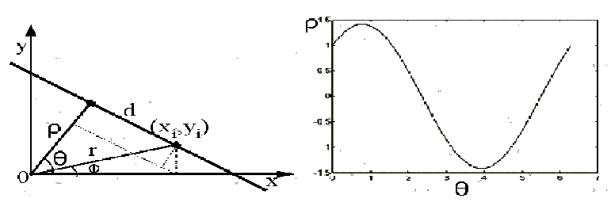
Hough Transform – cont.
A better way of expressing lines for Hough transform

Slide 45
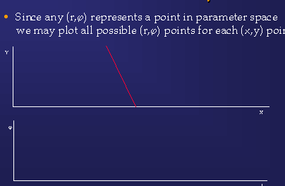
SHT: Another Viewpoint

Slide 46
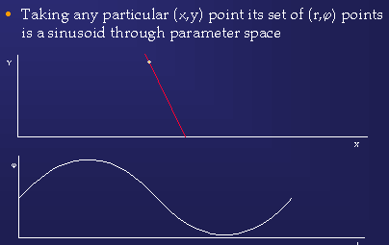

Slide 47
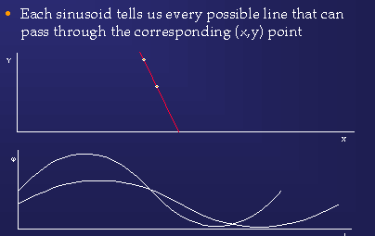

Slide 48
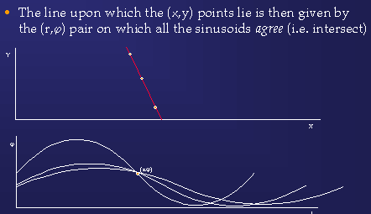

Slide 49
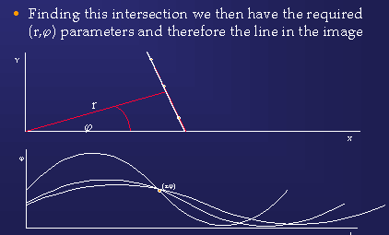

Slide 50
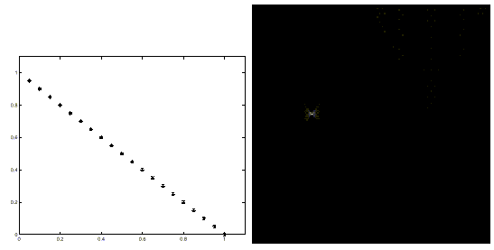
Hough Transform – cont.

Slide 51
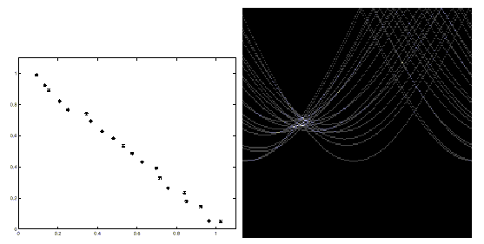
Hough Transform – cont.

Slide 52
Hough Transform is a voting neural network
One of the most popular utilizations of a voting mechanism
A kind of structured Neural Network
A transformation from an image space to a parameter space (vote space, Hough space).
Voting is performed in the parameter space
This transform can be also treated as template matching

Slide 53
Hough Transform Generalizations
It locates straight lines (SHT) - standard, simple HT
It locates straight line intervals
It locates circles
It locates algebraic curves
It locates arbitrary specific shapes in an image
But you pay progressively for complexity of shapes by time and memory usage

Slide 54
Gradient Information
Edge gradient in image space can be used in Hough Transform to reduce one dimension in incrementing the accumulator array
For line detection the gradient is @, and so need only to vote for one cell (p,@) where p is
p = x_{i} cos @ + y_{i} sin @
For circle detection the gradient is @, and so need only to vote along a line given by the equations
a=x + r cos @, b = y + r sin @

Slide 55
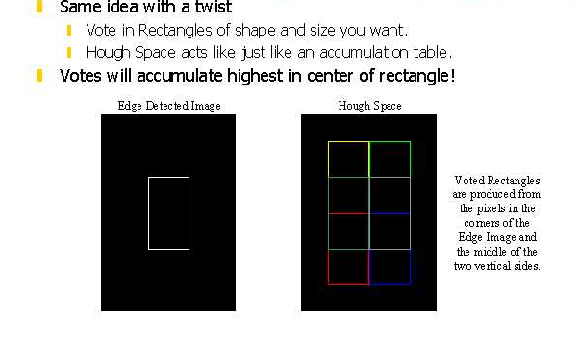
Hough Transform for Rectangles
Now votes for rectangles!

Slide 56
HT for Circles
Extend HT to other shapes that can be expressed parametrically
Circle, fixed radius r, centre (a,b)
(x₁-a)² + (x₂-b)² = r²
accumulator array must be 3D
unless circle radius, r is known
re-arrange equation so x₁ is subject and x₂ is the variable
for every point on circle edge (x,y) plot range of (x₁,x₂) for a given r

Slide 57
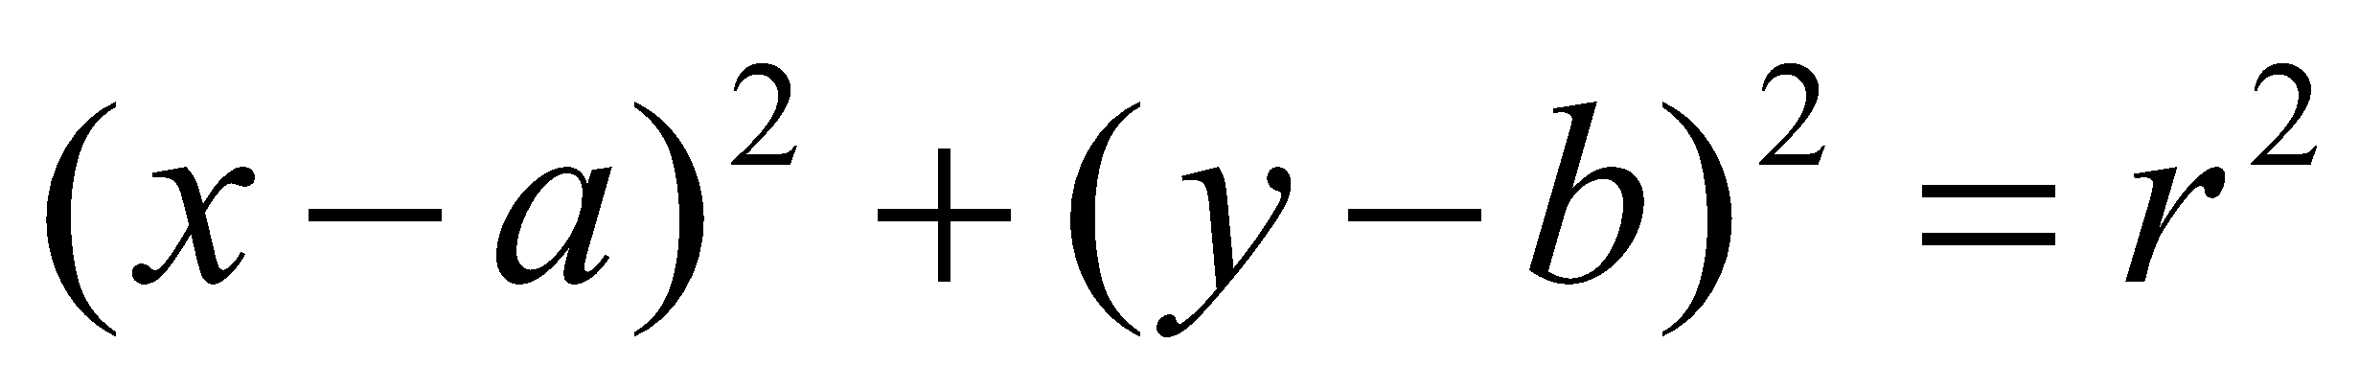
Hough Transform – cont.
Circles
Hough transform can also be used for circles

Slide 58
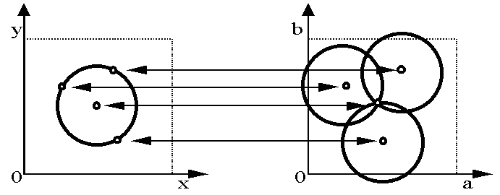
Hough Transform – cont.
Here the radius is fixed

Slide 59
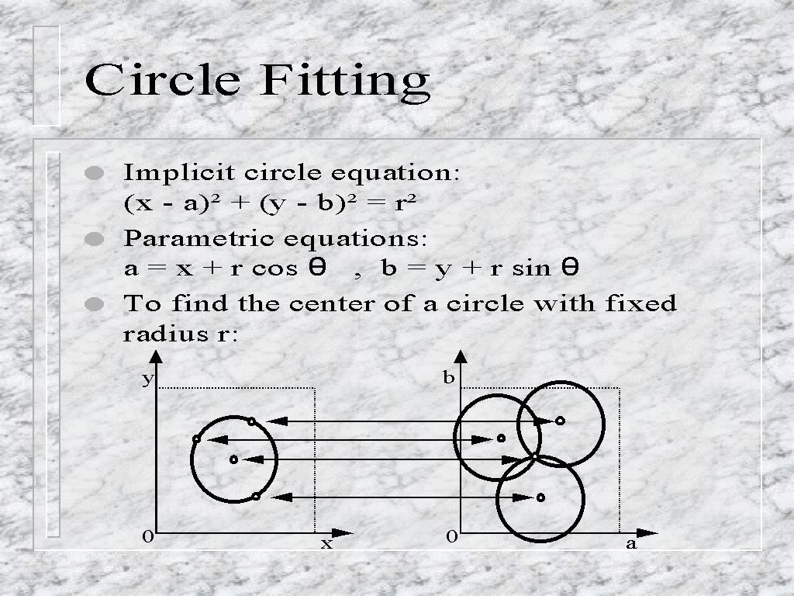
Hough circle Fitting

Slide 60
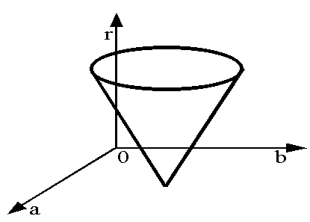
Hough Transform – cont.
A 3-dimensional parameter space for circles in general

Slide 61
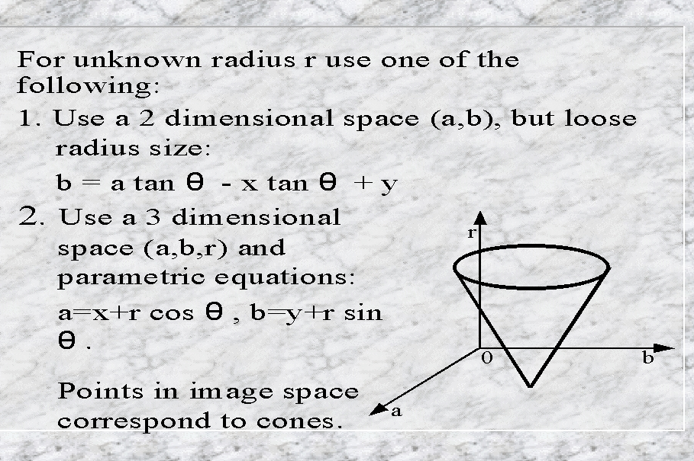
Hough circle Fitting

Slide 62
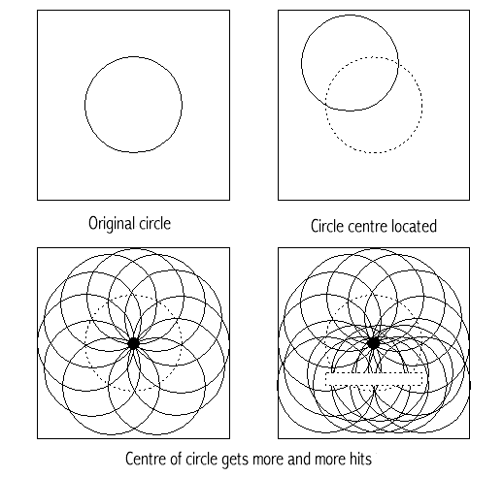
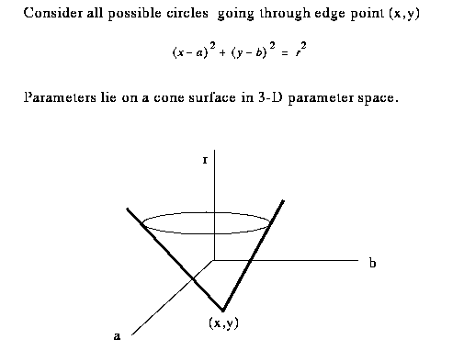
Hough circle example
Point of max intersections is the centre of the original circle

Slide 63
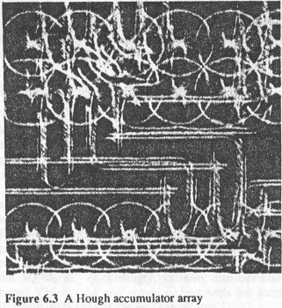
Hough Transform

Slide 64
General Hough Properties
Hough is a powerful tool for curve detection
Exponential growth of accumulator with parameters
Curve parameters limit its use to few parameters
Prior info of curves can reduce computation
e.g. use a fixed radius
Without using edge direction, all accumulator cells A(a) have to be incremented
Can be applied to images without edge direction information

Slide 65

Optimization HT
With edge direction
edge directions are quantized into 8 possible directions
only 1/8 of circle needs take part in accumulator
Using edge directions
a & b can be evaluated from
θ = edge direction in pixel x
delta θ = max anticipated edge direction error
Also weight contributions to accumulator A(a) by edge magnitude

Slide 66
HOUGH ALGORITHM
Choose an analytic form f(x,y,a1,a2,…,an) and choose a range of values for parameters a1, a2, a3,….,an.
Create accumulator array A(a1,a2,…,an) which represents direct match of f(x,y,a1,a2,…,an) with binary image.
Local for local maximum which exceeds certain threshold.

Slide 67
Hough Transform – cont.
More complicated shapes
As you can see, the Hough transform can be used to find shapes with arbitrary complexity as long as we can describe the shape with some fixed number of parameters
The number of parameters required indicates the dimensionality of the accumulator

Slide 68
Generalized Hough Transform
Some shapes may not be easily expressed using a small set of parameters
In this case, we explicitly list all the points on the shape
This variation of Hough transform is known as generalized Hough transform

Slide 69
Hough Transform – cont.
Implementation issues
Quantization of the accumulator space
Utilization of additional information
For line-matching Hough transform, the orientation of an edge point from the Canny edge detector can be used to limit the votes in the accumulator space
Smoothing the accumulator
To reduce the effects of noise
Gray-level voting

Slide 70
Hough Transform – cont.
Implementation issues - continued
Refining the accumulator
Find a maximum and vote only near the maximum with a higher resolution of the parameter space
Randomized Hough transform

Slide 71
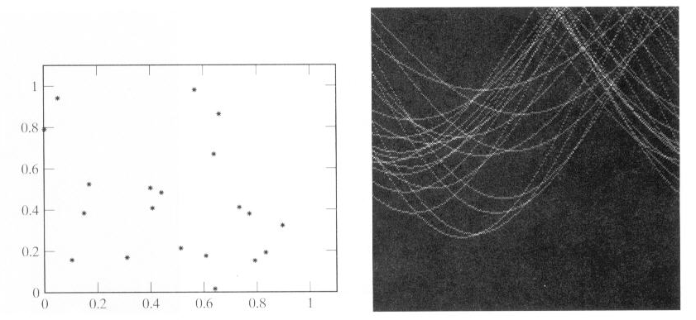
Problems with Hough Transform

Slide 72
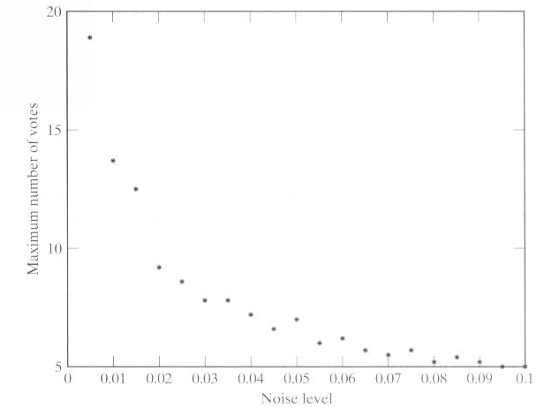
Problems with Hough Transform – cont.

Slide 73
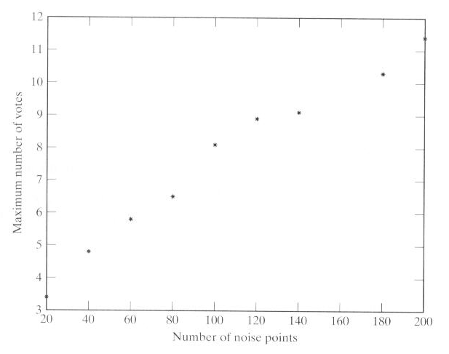
Problems with Hough Transform – cont.

Slide 74
The standard Hough Transform for lines can be generalized
Example: Parametric equation of a line
x cos @ + y sin @ = r
Generalization:
Technique to isolate curves of a given shape in an image
Curve specified by parametric equation

Slide 75
Generalized Hough Transform

Slide 76
General Hough Transform
algorithm
Find all desired points in image
For each feature point
for each pixel i on target boundary
get relative position of reference point from i
add this offset to position of i
increment that position in accumulator
Find local maxima in accumulator
Map maxima back to image to view

Slide 77
Hough Transform for Curves
The H.T. can be generalized to detect any curve that can be expressed in parametric form:
Y = f(x, a1,a2,…ap)
a1, a2, … ap are the parameters
The parameter space is p-dimensional
The accumulating array is LARGE!

Slide 78
Generalizing the H.T.
The H.T. can be used even if the curve has not a simple analytic form!
Pick a reference point (x_{c},y_{c})
For i = 1,…,n :
Draw segment to P_{i} on the boundary.
Measure its length r_{i}, and its orientation α_{i}.
Write the coordinates of (x_{c},y_{c}) as a function of r_{i} and α_{i}
Record the gradient orientation φ_{i} at P_{i.}
Build a table with the data, indexed by φ_{i} .
(x_{c},y_{c})
r_{i}
φ_{i}
α_{i}
P_{i}
x_{c} = x_{i} + r_{i}cos(α_{i})
y_{c} = y_{i} + r_{i}sin(α_{i})

Slide 79
Generalizing the H.T.
Suppose, there were m different gradient orientations:
(m <= n)
φ₁
φ₂
.
.
.
φ_{m}
(r¹₁,α¹₁),(r¹₂,α¹₂),…,(r¹_{n1},α¹_{n1})
(r²₁,α²₁),(r²₂,α¹₂),…,(r²_{n2},α¹_{n2})
.
.
.
(r^{m}₁,α^{m}₁),(r^{m}₂,α^{m}₂),…,(r^{m}_{nm},α^{m}_{nm})
φ_{j}
α_{j}
r_{j}
(x_{c},y_{c})
φ_{i}
r_{i}
α_{i}
P_{i}
x_{c} = x_{i} + r_{i}cos(α_{i})
y_{c} = y_{i} + r_{i}sin(α_{i})
H.T. table

Slide 80
Generalized H.T. Algorithm:
Finds a rotated, scaled, and translated version of the curve:
Form an A accumulator array of possible reference points (x_{c},y_{c}), scaling factor S and Rotation angle θ.
For each edge (x,y) in the image:
Compute φ(x,y)
For each (r,α) corresponding to φ(x,y) do:
For each S and θ:
x_{c} = x_{i} + r(φ) S cos[α(φ) + θ]
y_{c} = y_{i} + r(φ) S sin[α(φ) + θ]
A(x_{c},y_{c},S,θ) ++
Find maxima of A.
α_{j}
φ_{j}
Sr_{j}
θ
P_{j}
φ_{i}
Sr_{i}
α_{i}
θ
(x_{c},y_{c})
P_{i}
φ_{i}
Sr_{k}
α_{k}
θ
P_{k}
x_{c} = x_{i} + r_{i}cos(α_{i})
y_{c} = y_{i} + r_{i}sin(α_{i})

Slide 81
H.T. Summary
H.T. is a “voting” scheme
points vote for a set of parameters describing a line or curve.
The more votes for a particular set
the more evidence that the corresponding curve is present in the image.
Can detect MULTIPLE curves in one shot.
Computational cost increases with the number of parameters describing the curve.

Slide 82
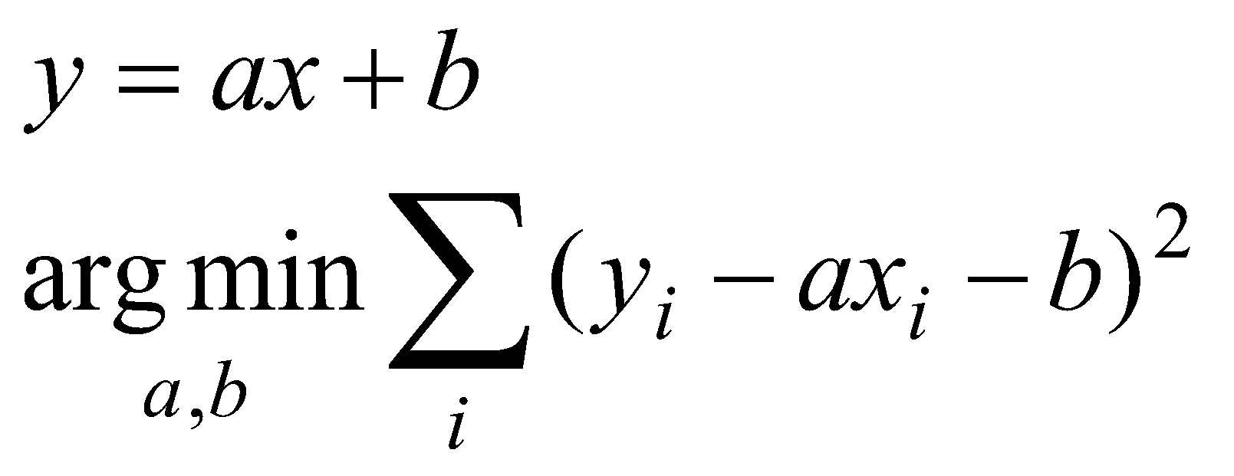
Fitting Lines
Fitting lines are useful
Many objects are characterized by the presence of straight lines
Line fitting with least squares

Slide 83
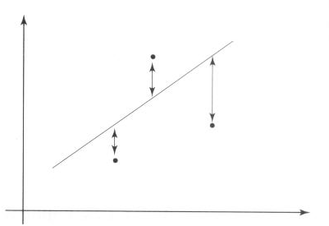
Fitting Lines with Least Squares

Slide 84
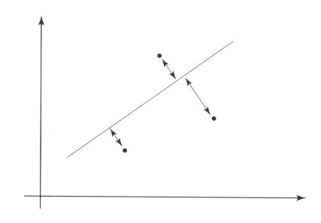
Total Least Squares

Slide 85
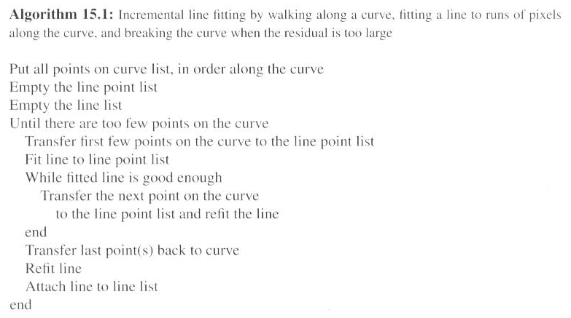
Incremental Fitting

Slide 86
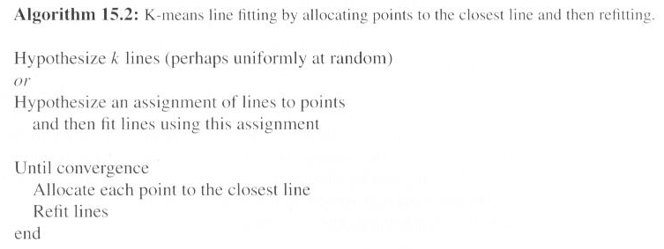
K-means Line Fitting

Slide 87
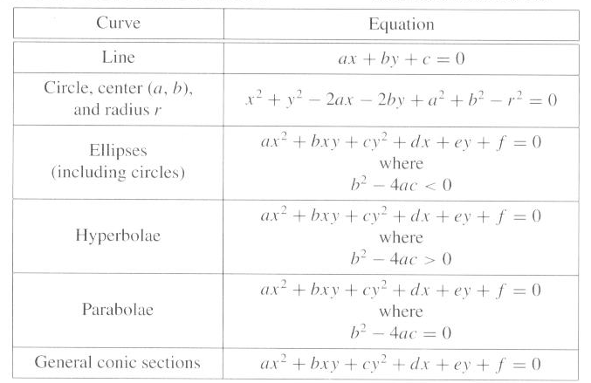
Fitting Curves

Slide 88
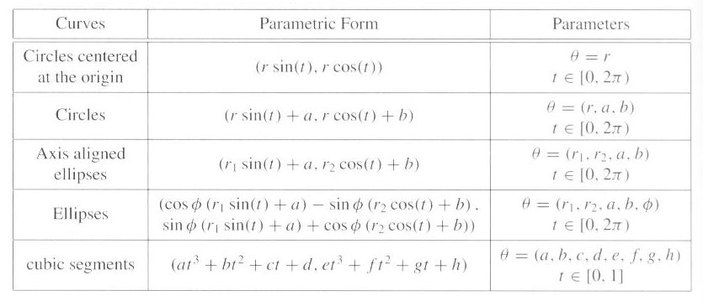
Fitting Curves – cont.

Slide 89


Fitting as a Probabilistic Inference Problem
Generative model
The measurements are generated by a line with additive Gaussian noise
The likelihood function given by
Maximum likelihood

Slide 90
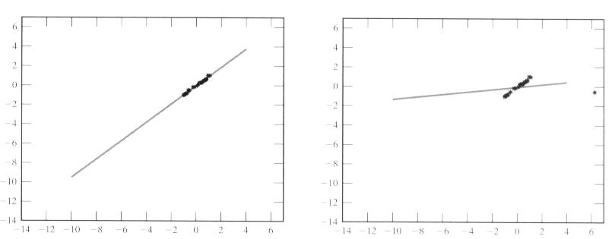
Fitting as a Probabilistic Inference Problem – cont.

Slide 91
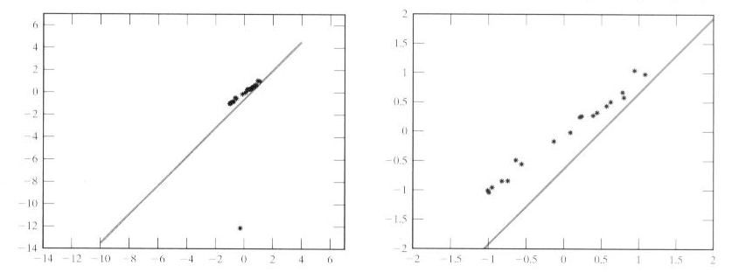
Fitting as a Probabilistic Inference Problem – cont.

Slide 92



M-estimators
An M-estimator estimates the parameters by minimizing

Slide 93
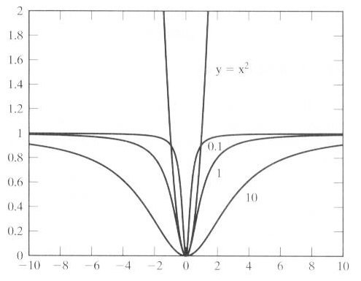
M-estimators – cont.

Slide 94
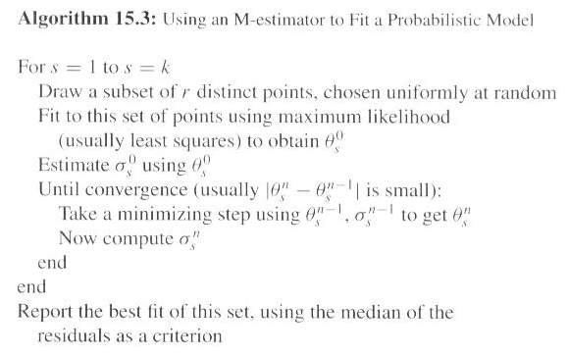
M-estimators – cont.

Slide 95
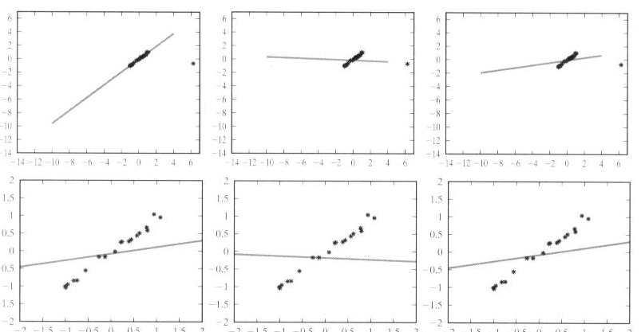
M-estimators – cont.

Slide 96
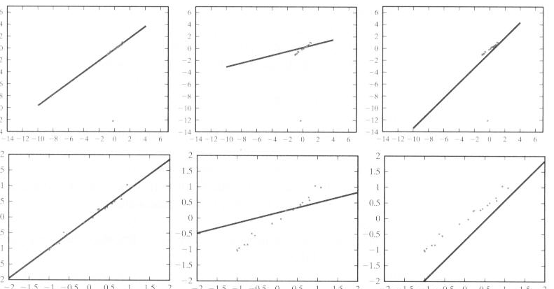
M-estimators – cont.

Slide 97

RANSAC

Slide 98
slope
y
n = (-x1) m + y1
p
n = (-x2) m + y2
n
q
P(x1,y1)
intercept
Q(x2,y2)
m
x
Parameter Space

Slide 99
Parameter space
q = y - kx
a set of values on a line in the (k,q) space == point passing through (x,y) in image space
OR
every point in image space (x,y) == line in parameter space

