Slide 1
Digital Image Processing
Any 2D mathematical function that bears information can be represented as an image. A digital image is an array of real or complex numbers represented by a finite number of bits.
Digital image processing generally refers to processing of a 2D picture by a digital computer.
Image enhancement (defect removal: lighting, noise, etc. )
Image Segmentation, ROI extraction
Image understan-ding/ Recognitio-n
Imaging system
Feature extraction
Image analysis
Low-level Image processing
Mid-level Image processing
High-level Image processing
A typical digital image processing sequence
Image processing objectives:
To design and develop good visualization mechanisms.
To design and develop image-based automation systems.

Slide 2
Digital Image Processing Applications
Digital image processing has a broad spectrum of applications, such as
Remote sensing via satellites: geographical mapping, prediction of agricultural crops and urban growth, weather forecasting, flood and fire control and military applications.
Image transmission and storage: TV broadcasting, CCTV-based security monitoring systems, facsimile, teleconferencing etc.
Medical imaging: X-ray, CT scan, MRI, ultrasonic scan, detection and monitoring of tumors and other diseases.
Radar and sonar imaging: in aircraft guidance and target detection, missile monitoring and navigation systems.
Robot vision: inside and outside robot navigation, automatic inspection of industrial process, pattern recognition etc.

Slide 3
Digital Image Processing Problems
Image representation and modeling:
An image could represent luminances of objects in a scene (image taken by camera), the absorption characteristics of the body tissue or material particles (X-ray imaging), radar cross-section of a target (radar imaging), the temperature profile of a region (infrared imaging), the gravitational field in an area (geophysical imaging).
Image enhancement:
The goal of image enhancement is to emphasize certain image features for subsequent analysis or for image display. It deals with contrast manipulation, edge detection, pseudocoloring, noise filtering, sharpening, and magnifying.
Image restoration:
It refers to removal or minimization of known degradation in an image. This includes deblurring of images degraded by the limitations of sensors or environment, noise filtering, and correction of geometric distortions. Weiner and Kalman filtering techniques are common tools used in image restoration.

Slide 4
Digital Image Processing Problems
Image analysis:
It is concerned with making quantitative measurements from an image to produce a description of it. Image analysis technique deals with extraction of certain features that aid in identification of the object, navigation and tracking of objects. It is the main tools used in computer vision.
Image reconstruction:
Image reconstruction from projections is a special class of image restoration problems where two- (or higher) dimensional object is reconstructed from several one-dimensional projections. For example, in medical imaging, each projection is obtained by projecting a parallel X-ray beam through the object.
Image data compression:
Image data compression techniques are concerned with reduction of the number of bits required to store or transmit images without any appreciable loss of information.

Slide 5
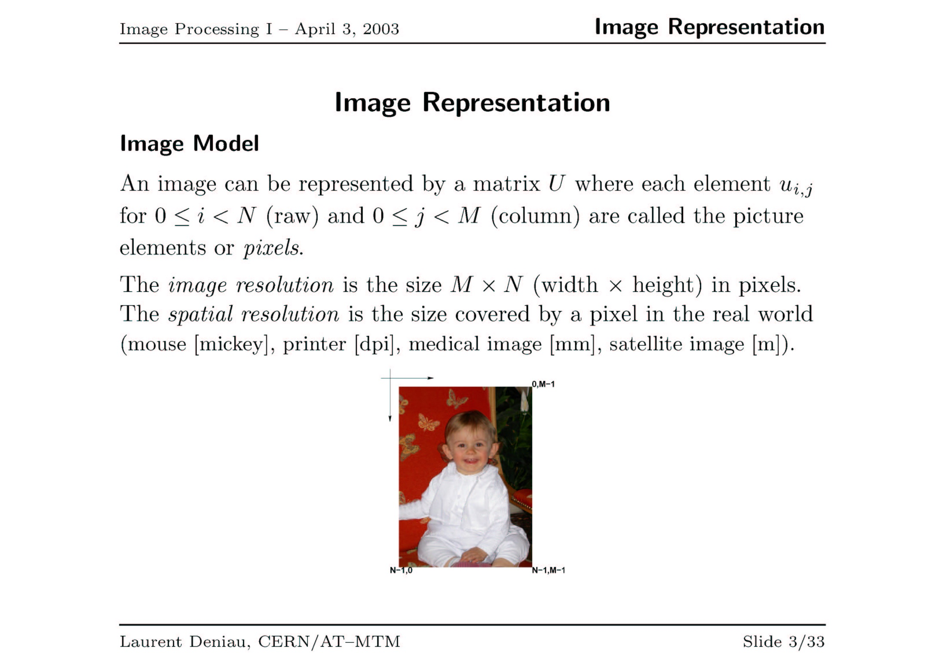

Slide 6
Simple Image Representation
0
(width-1)
0
Picture Element (pixel)
(height-1)
Represent an image as a 2D array.
Indices represent the spatial location
Values represent light intensity
VGA=640 × 480 pixels, HD=1280 × 720 pixels, FHD=1920 × 1080 pixels
4K=3840 × 2160 pixels, 8K=7680 × 4320 pixels, 16K=17280 × 8640 pixels

Slide 7
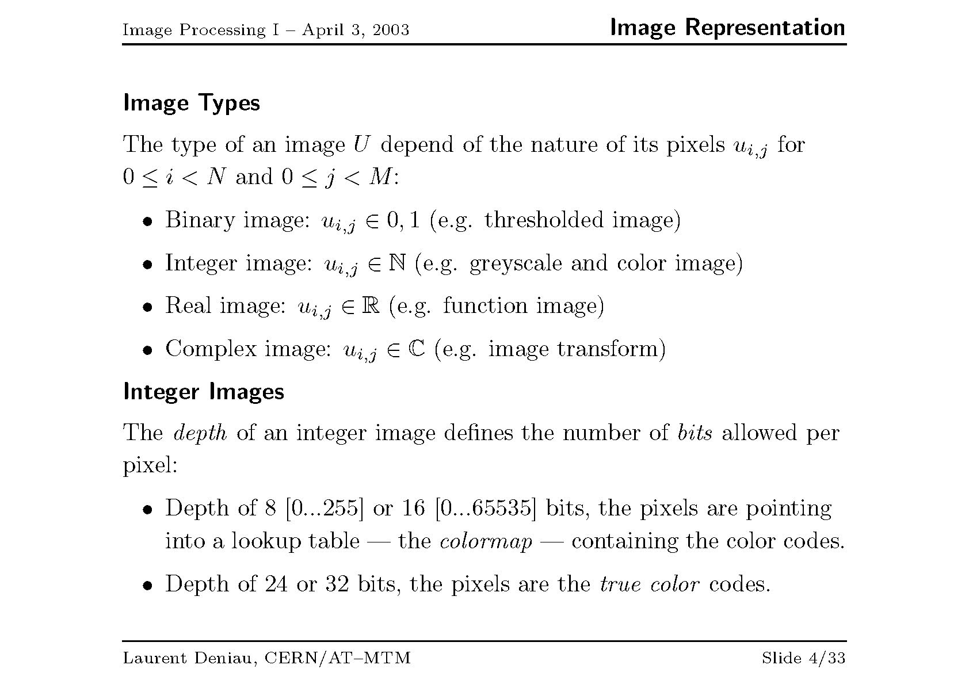

Slide 8
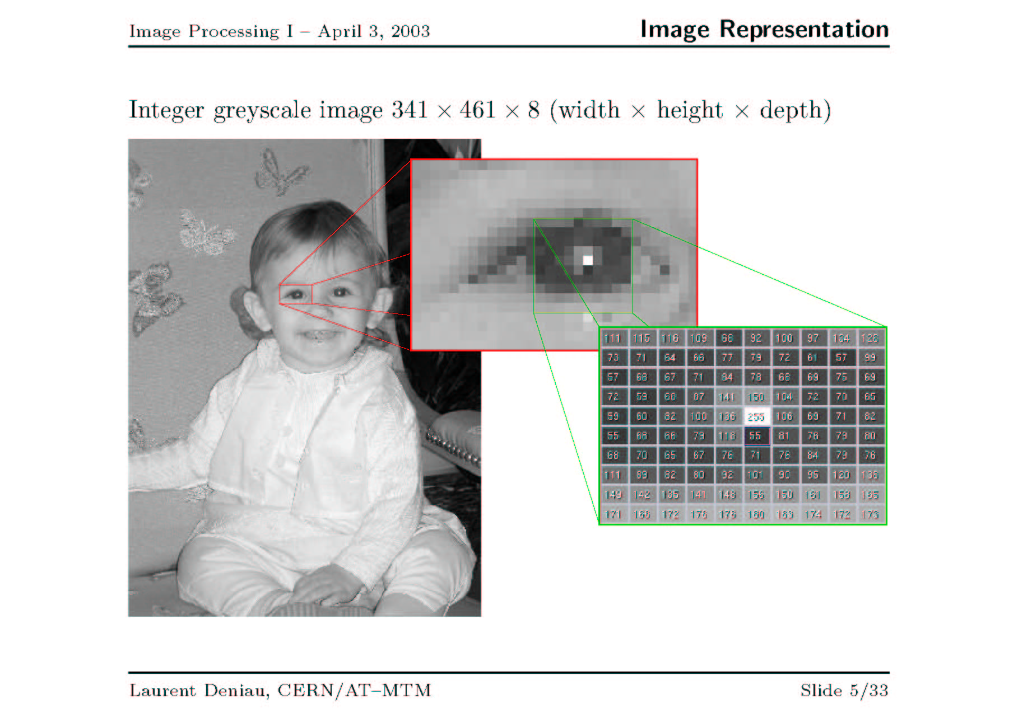

Slide 9



Sinusoidal Image Generation
Image size = (width × height) = (M × N) = (128 × 64) pixels

Slide 10
Imaging
Imaging means “image acquisition”
The process of sensing our surroundings and then representing the measurements that are made in the form of an image

Slide 11
Active and Passive Imaging
Imaging can be active or passive
Passive: No external source is required. Uses the energy sources already present in the scene.
Cameras without a flash
Night vision goggle
Active: External source is required.
MRI
X-Rays
Radar
Scanner
Cameras with a flash

Slide 12
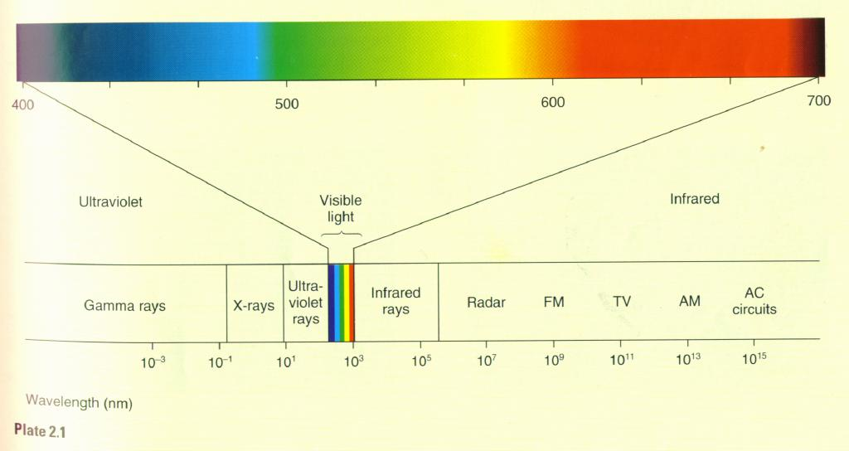
Electromagnetic Radiation Spectrum
Source: http://zeus.rutgers.edu/~ikovacs/SandP/Perception.html

Slide 13
Camera Optics
f
D₀
D₁
1/f = 1/D₀ + 1/ D₁
Magnification = ImageSize/ObjectSize
Magnification = D_{1/} D₀
As an object moves closer (than infinity) it focuses “behind” the focal point distance.

Slide 14
Sampling and Quantization Example
Problem: Sample a 1D continuous function (usually of time)
f(t)
Quantization (how accurately can a signal be measured)
t
Sampling rate (how often is a signal measured)

Slide 15
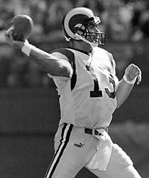


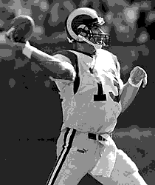
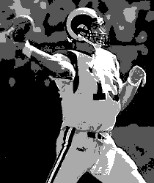
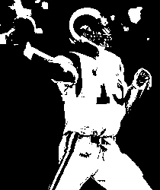
Effect of Quantization
A | B | C
D | E | F
Number of Gray Levels
A: 256
B: 32
C: 16
D: 8
E: 4
F: 2
Each image is 210 x 250
For a VGA size image:
Binary= 640×480×1 bits
Grayscale=640×480×8 bits
Color= 640×480×24 bits

Slide 16
PBM, PGM, PPM
These formats are simple and easy to encode/decode. The ASCII variants are ideal for image transmission.
Magic Number | Image Type | Storage
P1 | binary | ASCII
P2 | grayscale | ASCII
P3 | RGB | ASCII
P4 | binary | native
P5 | grayscale | native
P6 | RGB | native

Slide 17
PGM ASCII Format
magic number
P2
# small little image
7 7 255
120 120 120 120 120 120 120
120 120 120 33 120 120 120
120 120 120 33 120 120 120
120 33 33 33 33 33 120
120 120 120 33 120 120 120
120 120 120 33 120 120 120
120 120 120 120 120 120 120
comment
width height max_value
pixel values

Slide 18
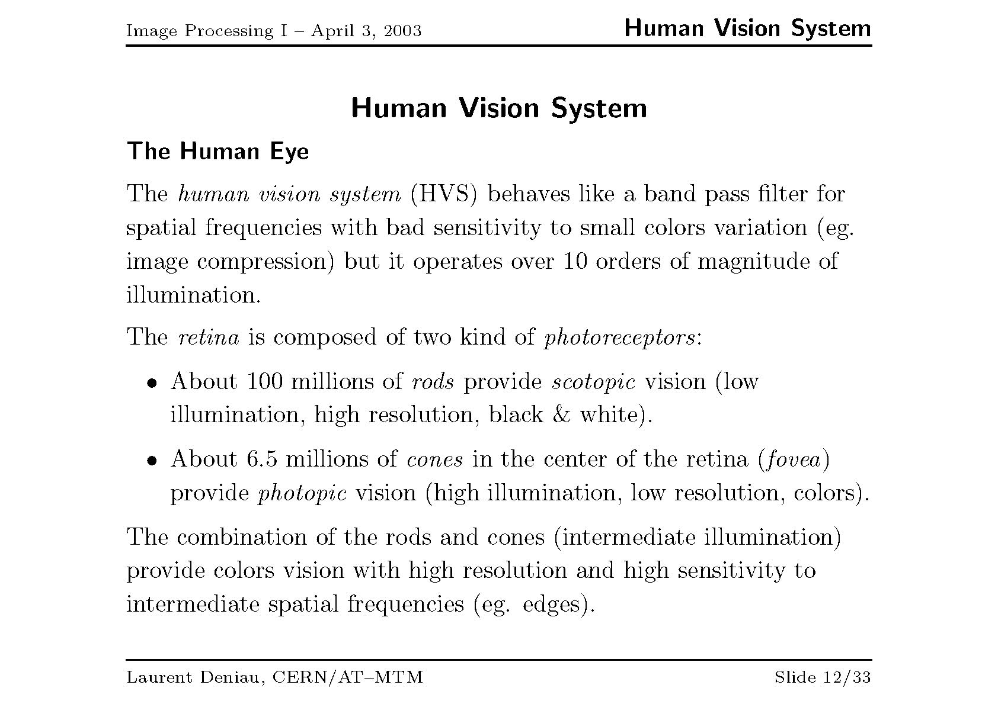

Slide 19
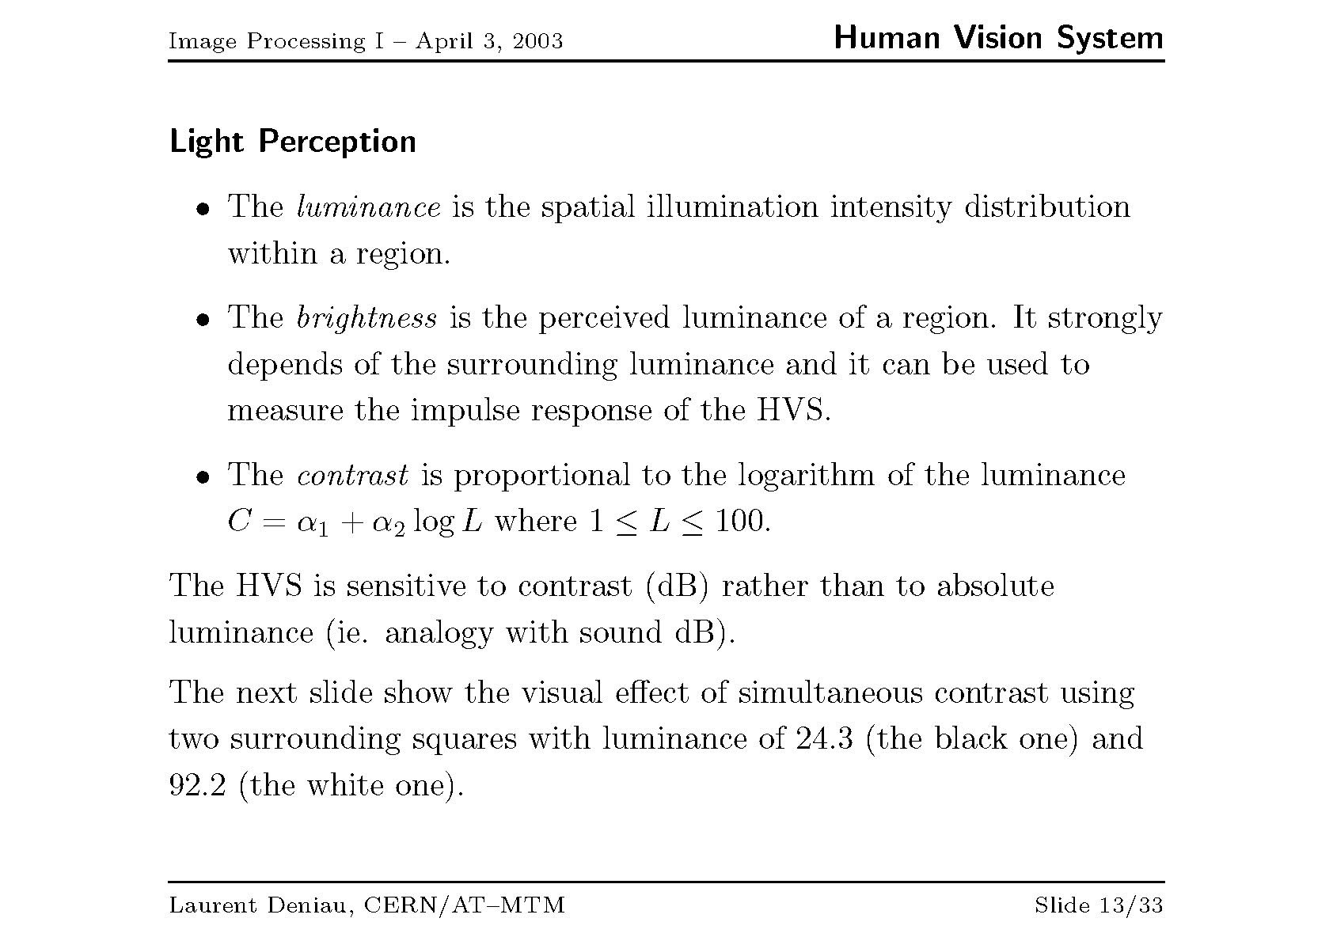

Slide 20
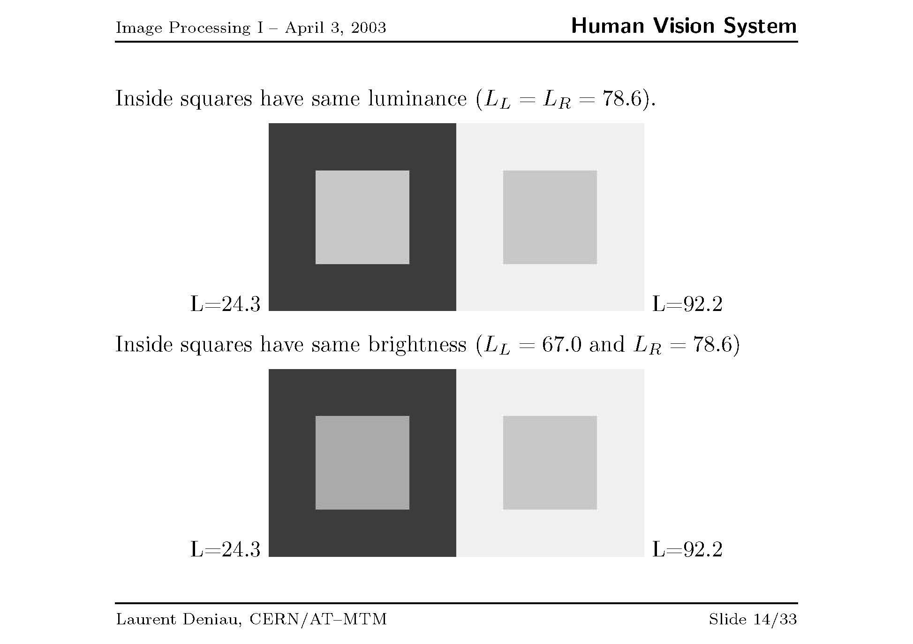

Slide 21
Image Enhancement
The goal of image enhancement is to emphasize certain image features for subsequent analysis or for image display. It deals with contrast manipulation, edge detection, pseudocoloring, noise filtering, sharpening, and magnifying.
Common image enhancement techniques are:
Point operations:
noise clipping, window slicing contrast stretching, histogram equalization and modeling.
Spatial operations:
noise smoothing, mean and median filtering, low-pass, high-pass, and band-pass filtering
Transform operations:
linear filtering, root filtering etc.
Pseudocoloring:
false coloring

Slide 22
Image Enhancements
Point processing involves the transformation of individual pixels independently of other pixels in the image.
These simple operations are typically used to correct for defects in image acquisition hardware. For example, to compensate for under/over exposed images.
Examples:
Linear mapping

Slide 23
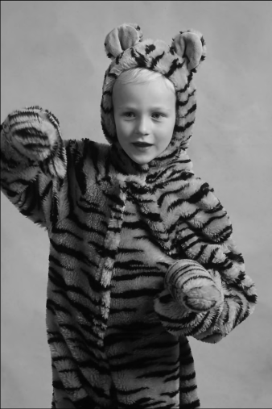
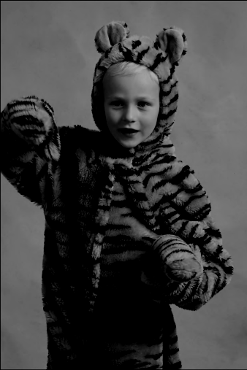
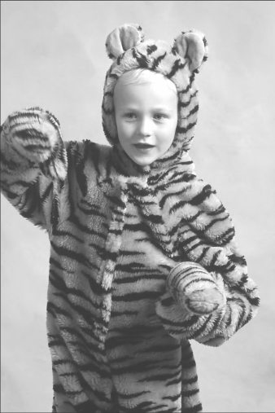
Linear Mapping
A grayscale image f(x,y) can be transformed into image g(x,y) using a linear function given as
g(x,y) = f(x,y) + b
If b > 0 the image is made brighter else the image is darkened.
b is known as “bias.”
Original
bias = +55
bias = -55

Slide 24
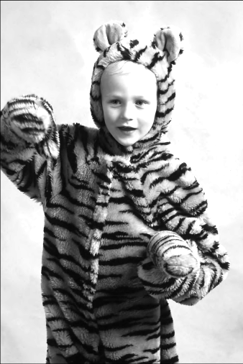
Linear Mapping
A grayscale image f(x,y) can be transformed into image g(x,y) using a linear gain function given as
g(x,y) = a * f(x,y)
If a > 1 the image is made brighter else the image is darkened.
a is known as “gain.”
Original
gain = +1.5
gain = -2.0

Slide 25
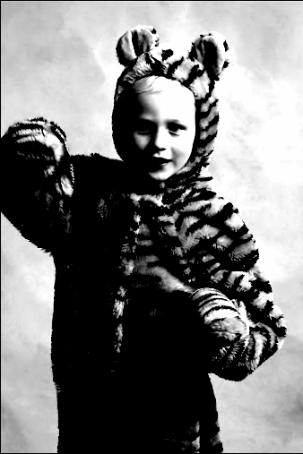
Linear Mapping Example

Slide 26

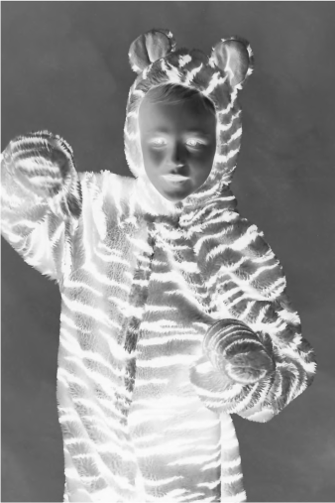
Linear (Inverse) Mapping Example Digital Negative
Digital Negative

Slide 27
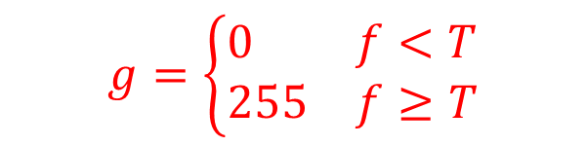
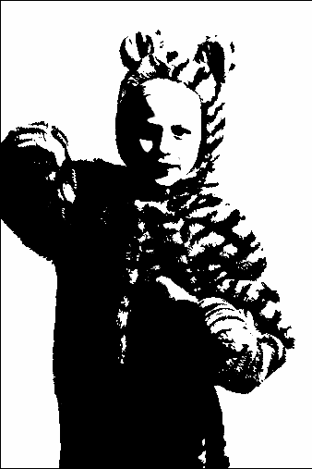
Linear Mapping (Thresholding)
Binarization
T
Grayscale image
binary image
Bilevel (binary) threshold mapping

Slide 28


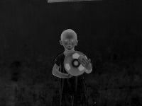

Image Subtraction (Change Detection)

Slide 29
Non-Linear Mapping
A grayscale image f(x,y) can be transformed into image g(x,y) using various non-linear mappings.
Require any mapping to be true a function. For any pixel f(x,y), T(x,y) results in a unique deterministic value.
Common non-linear gray-scale mappings include
log compression: enhances the contrast of darker areas
exponential mapping: enhances the contrast of brighter areas

Slide 30
Log (dynamic range) Compression
Log compression takes a range of values and “boosts” the lower end.
Notice that the higher end is “compressed” into a small range of output values.

Slide 31
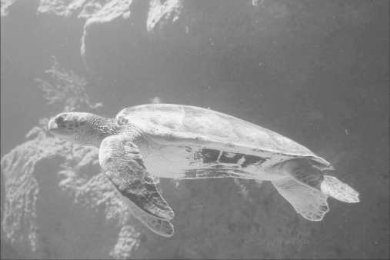
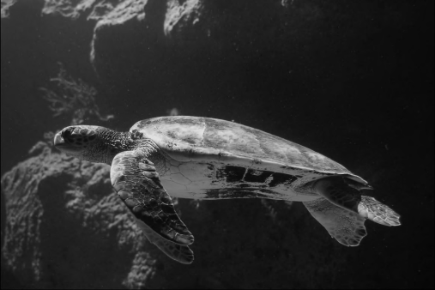
Log Compression
Notice how the darker areas appear brighter and contain more easily viewed details. The brighter areas loose some detail but remain largely unchanged.

Slide 32
Exponential Mapping
Exponential Mapping takes a range of values and “boosts” the upper end.
Notice that the lower range is “compressed” into a small range of output values.

Slide 33
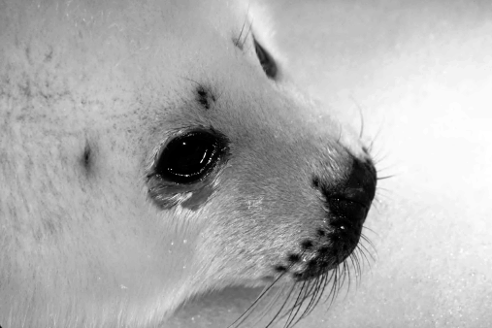

Linear Contrast Stretching
A linear mapping that enhances the contrast of an image without removing any detail.
Spreads the visual information available across a greater range of gray scale intensities.
Notice that the left image appears washed-out (most of the intensities are in a narrow band due to poor contrast). The right image maps those values to the full available dynamic range.

Slide 34
Image Histogram
The histogram of an image is a table containing (for every gray level K) the probability of level K actually occurring in the image
The histogram could also be viewed as a frequency distribution of gray level within the image.

Slide 35
Image Histogram
The histogram on the left is representative of an “under-exposed” image. It has very few “bright” pixels and doesn’t make good use of the full dynamic range available.
The histogram on the left is representative of an “over-exposed” image. It has very few “dark” pixels and doesn’t make good use of the full dynamic range available.
The histogram on the left is representative of an “poor contrast” image. It has very few “dark” and very few “light” pixels. It doesn’t make good use of the full dynamic range available.

Slide 36
Image Histogram
The histogram on the left is representative of an image with good contrast. It makes good use of the full dynamic range available.

Slide 37
Cumulative Distribution Function
The CDF of an image is a table containing (for every gray level K) the probability of a pixel of level K OR LESS actually occurring in the image
The CDF can be computed from the histogram as:

Slide 38
Cumulative Distribution Function
CDF is a monotonically increasing function.
Image histogram
Image CDF

Slide 39
Cumulative Distribution Function (CDF)
Image histogram
Image CDF
The CDF of an image having uniformly distributed pixel levels is a straight-line with slope 1 (using normalized gray levels). The derivative of the CDF is constant.
Image histogram
Image CDF
CDF Characteristics of a good contrast image:
It is always increasing throughout the dynamic range
It is nonlinear (slope is not constant)

Slide 40
Histogram Equalization
Is a process of automatically distribute pixel values evenly throughout the image
Each gray level should appear with identical probability in the image.
Often enhances an image, but not always.

Slide 41
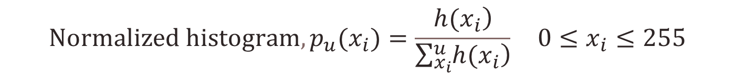


Histogram Equalization
Uniform quantization/
Rescaling

Slide 42
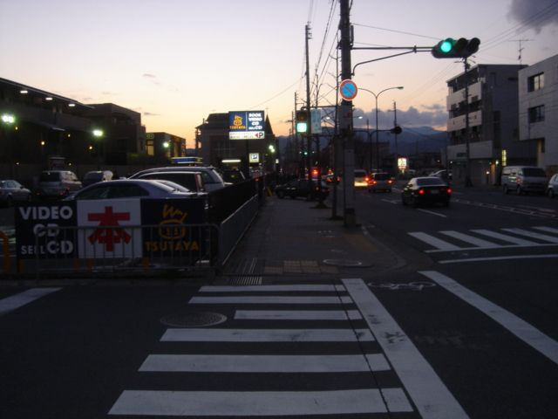
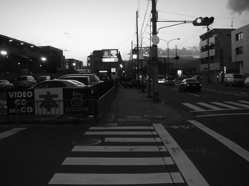
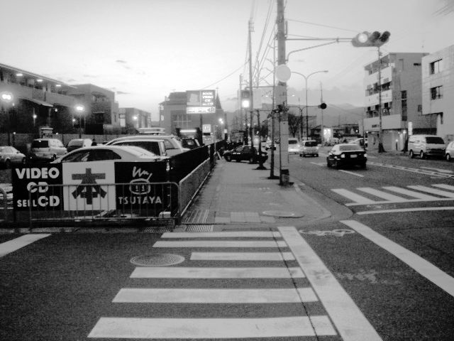
Histogram Equalization
Original image (color)
Original image (gray)
Equalized image (gray)

Slide 43
Histogram Modeling
Uniform quantization/
Rescaling
For example,

Slide 44
Histogram Specification
Histogram specification is a way to transfer lighting of one image to another. That is, convert the histogram of one image to another without changing the spatial arrangements of its pixels.

Slide 45

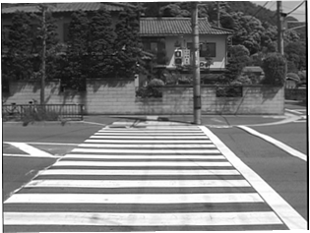
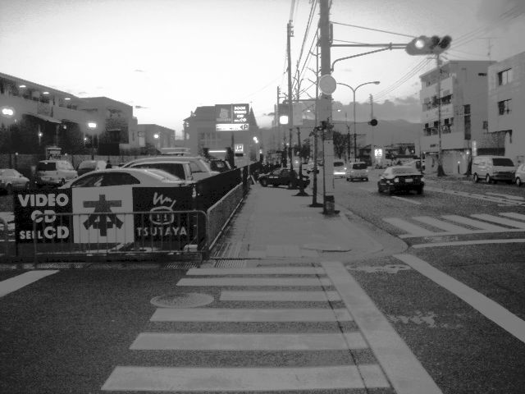
Example of Histogram Specification
Target image
Desired image
Output of histogram specification
Output of histogram equalization

