Slide 1
Image Restoration 影像復原
Spring 2005, Jen-Chang Liu

Slide 2
Preview
Goal of image restoration
Improve an image in some predefined sense
Difference with image enhancement ?
Features
Image restoration v.s image enhancement
Objective process v.s. subjective process
A prior knowledge v.s heuristic process
A prior knowledge of the degradation phenomenon is considered
Modeling the degradation and apply the inverse process to recover the original image

Slide 3
Preview (cont.)
Target
Degraded digital image
Sensor, digitizer, display degradations are less considered
Spatial domain approach
Frequency domain approach

Slide 4
Outline
A model of the image degradation / restoration process
Noise models
Restoration in the presence of noise only – spatial filtering
Periodic noise reduction by frequency domain filtering
Linear, position-invariant degradations
Estimating the degradation function
Inverse filtering

Slide 5
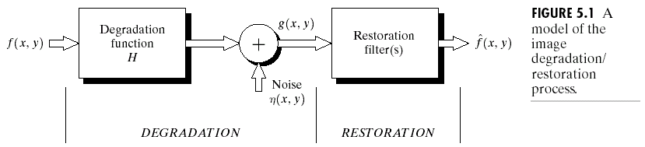
A model of the image degradation/restoration process
g(x,y)=f(x,y)*h(x,y)+η(x,y)
G(u,v)=F(u,v)H(u,v)+N(u,v)

Slide 6
Noise models 雜訊模型
Source of noise
Image acquisition (digitization)
Image transmission
Spatial properties of noise
Statistical behavior of the gray-level values of pixels
Noise parameters, correlation with the image
Frequency properties of noise
Fourier spectrum
Ex. white noise (a constant Fourier spectrum)

Slide 7
Noise probability density functions
Noises are taken as random variables
Random variables
Probability density function (PDF)

Slide 8
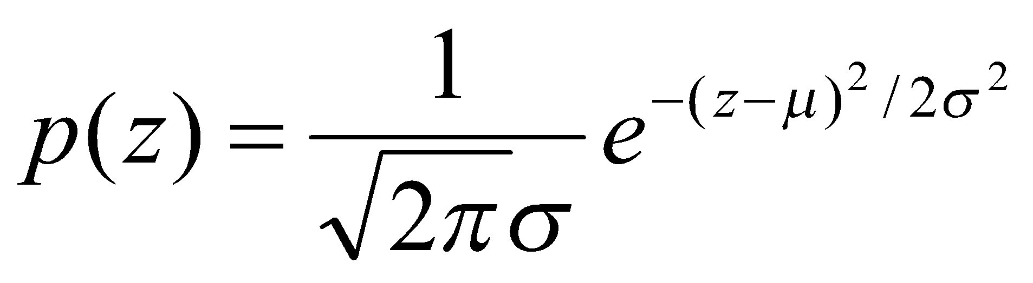
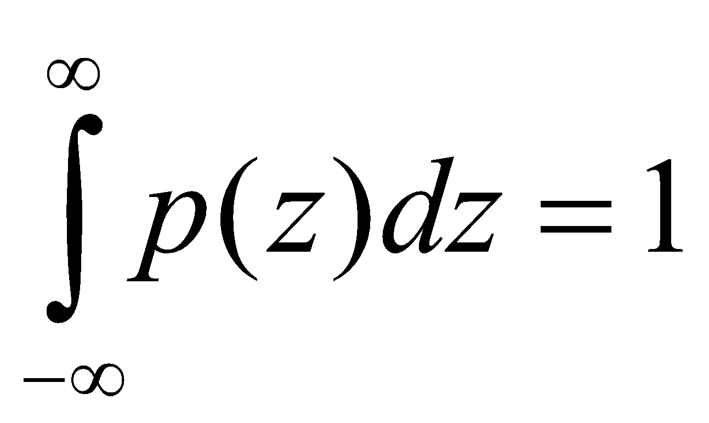
Gaussian noise
Math. tractability in spatial and frequency domain
Electronic circuit noise and sensor noise
mean
variance
Note:

Slide 9
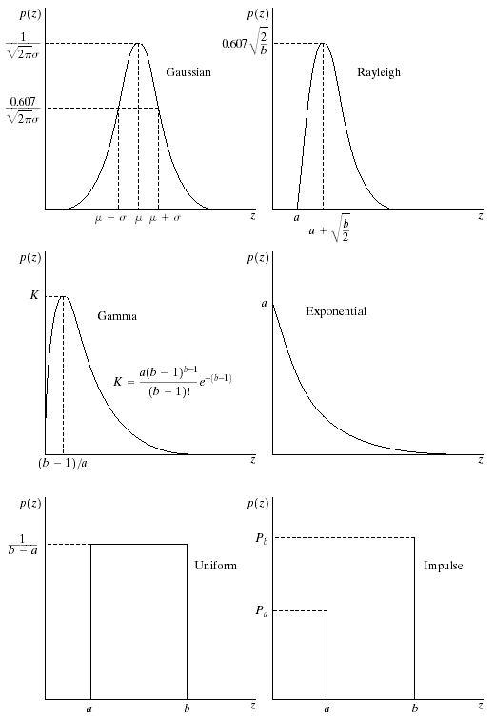
Gaussian noise (PDF)
70% in [(μ−σ), (μ+σ)]
95% in [(μ−2σ), (μ+2σ)]

Slide 10
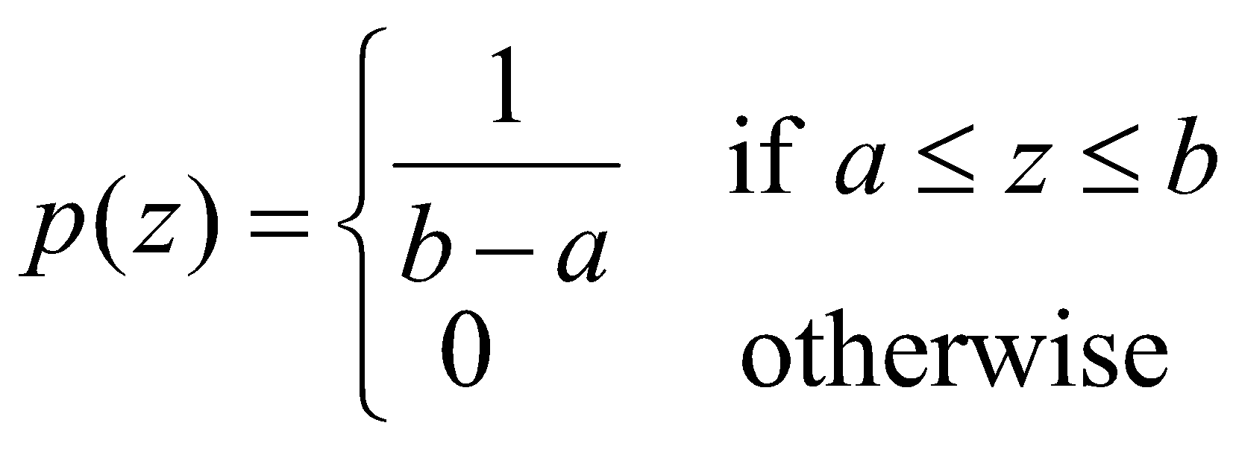
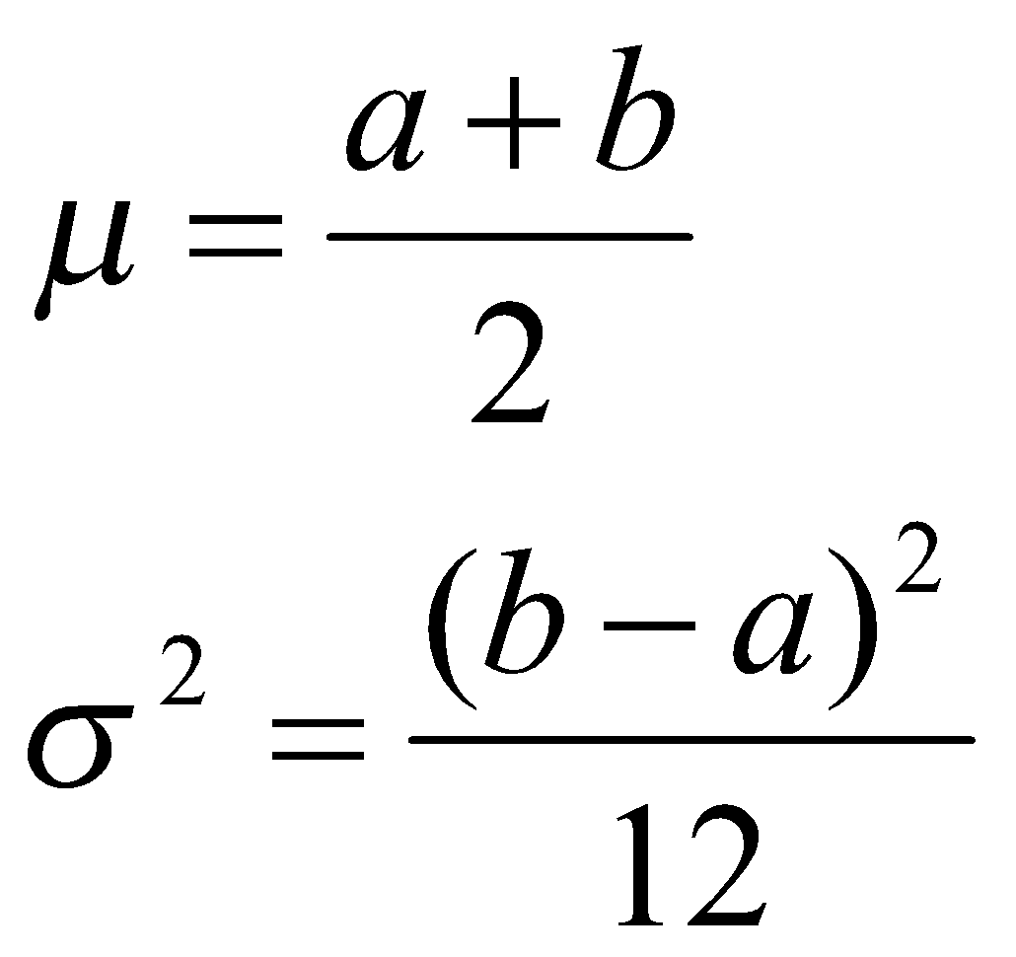
Uniform noise
Less practical, used for random number generator
Mean:
Variance:

Slide 11
Uniform PDF

Slide 12
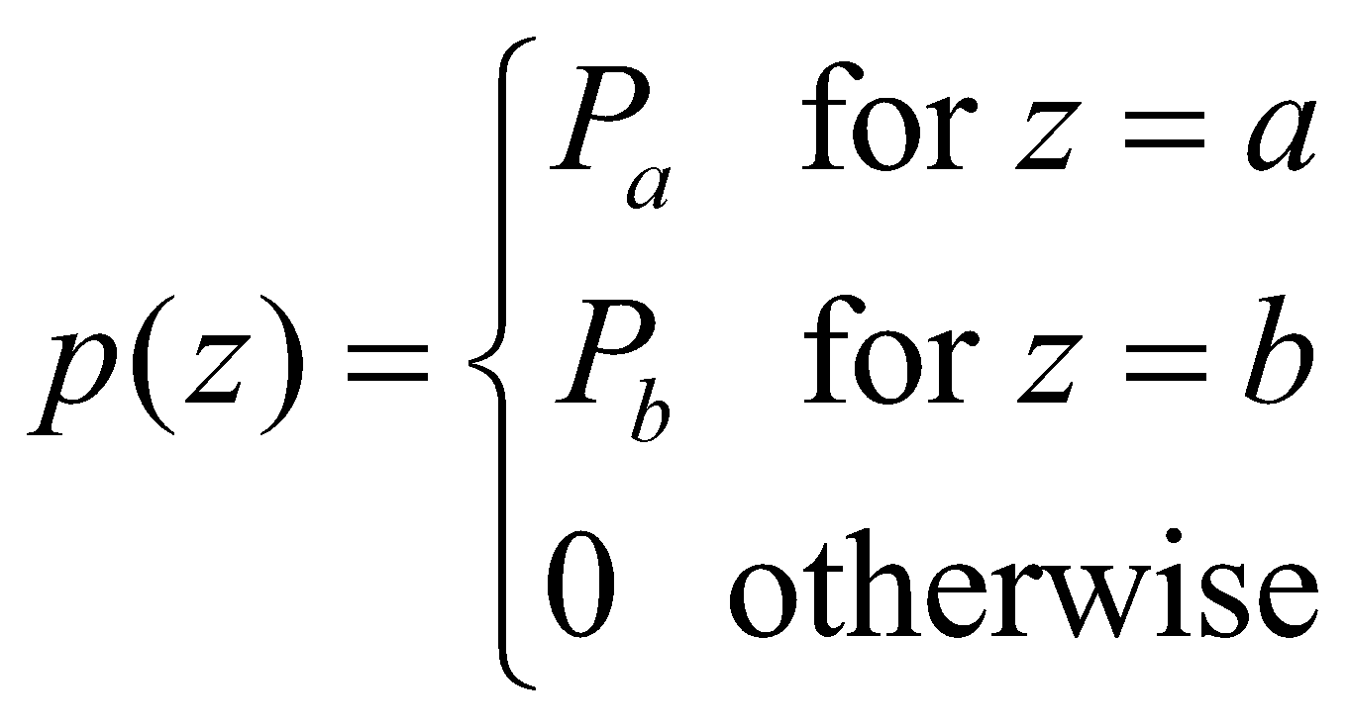
Impulse (salt-and-pepper) nosie
Quick transients, such as faulty switching during imaging
If either P_{a} or P_{b} is zero, it is called unipolar.
Otherwise, it is called bipoloar.
In practical, impulses are usually stronger than image
signals. Ex., a=0(black) and b=255(white) in 8-bit image.

Slide 13
Impulse (salt-and-pepper) nosie PDF

Slide 14
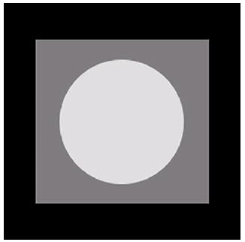
Test for noise behavior
Test pattern
Its histogram:
0
255

Slide 15
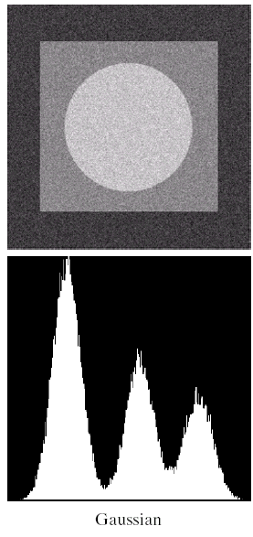
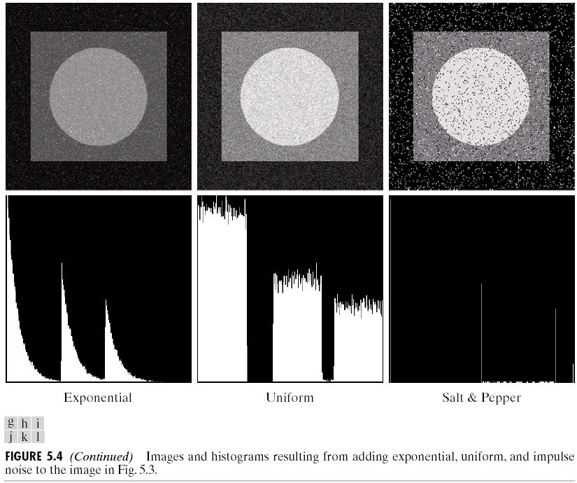

Slide 16
Periodic noise
Arise from electrical or electromechanical interference during image acquisition
Spatial dependence
Observed in the frequency domain

Slide 17
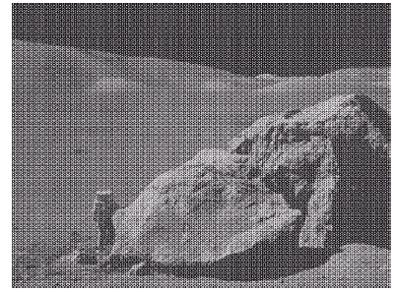

Sinusoidal noise:
Complex conjugate
pair in frequency
domain

Slide 18
Estimation of noise parameters
Periodic noise
Observe the frequency spectrum
Random noise with unknown PDFs
Case 1: imaging system is available
Capture images of “flat” environment
Case 2: noisy images available
Take a strip from constant area
Draw the histogram and observe it
Measure the mean and variance

Slide 19
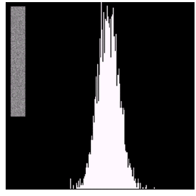

Observe the histogram
Gaussian
uniform

Slide 20
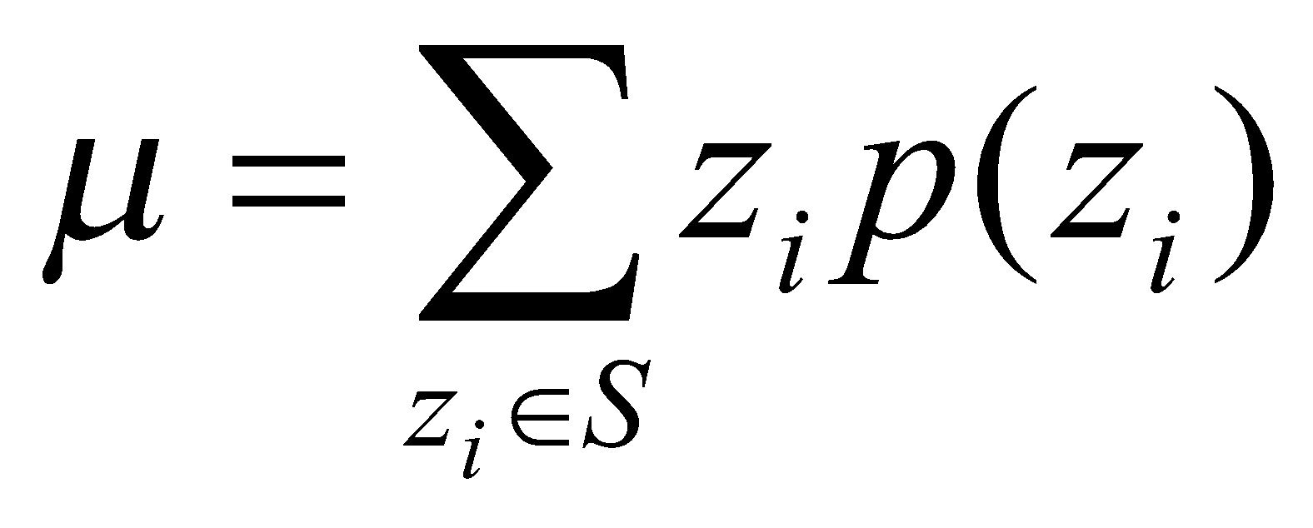
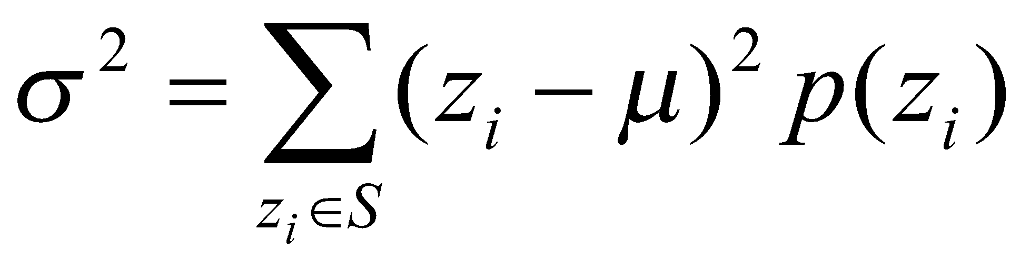
Measure the mean and variance
Histogram is an estimate of PDF
Gaussian: μ, σ
Uniform: a, b
⬄

Slide 21
Outline
A model of the image degradation / restoration process
Noise models
Restoration in the presence of noise only – spatial filtering
Periodic noise reduction by frequency domain filtering
Linear, position-invariant degradations
Estimating the degradation function
Inverse filtering

Slide 22
Additive noise only
g(x,y)=f(x,y)+η(x,y)
G(u,v)=F(u,v)+N(u,v)

Slide 23
Spatial filters for de-noising additive noise
Skills similar to image enhancement
Mean filters
Order-statistics filters
Adaptive filters

Slide 24
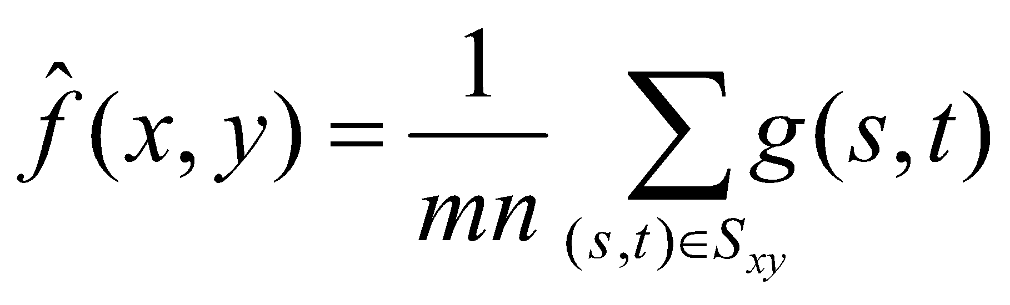
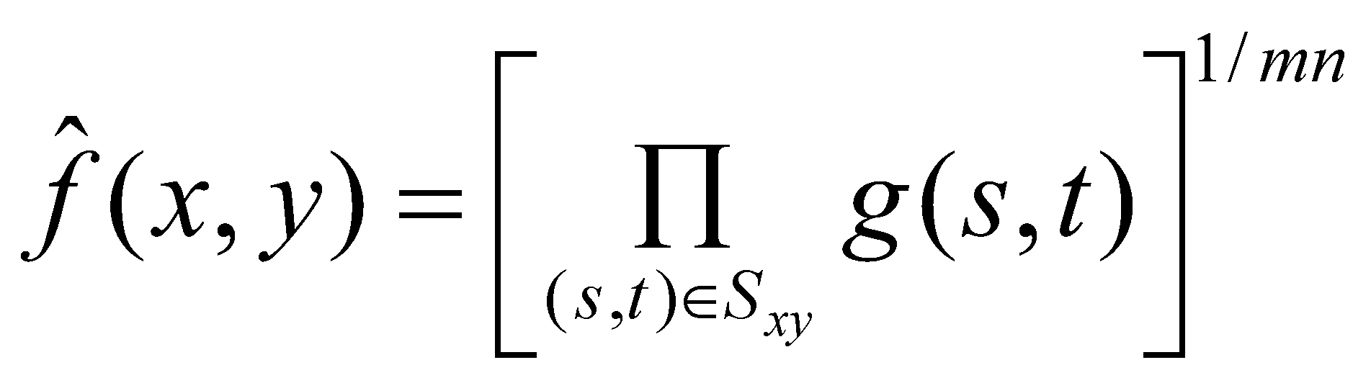
Mean filters
Arithmetic mean
Geometric mean
Window centered at (x,y)

Slide 25
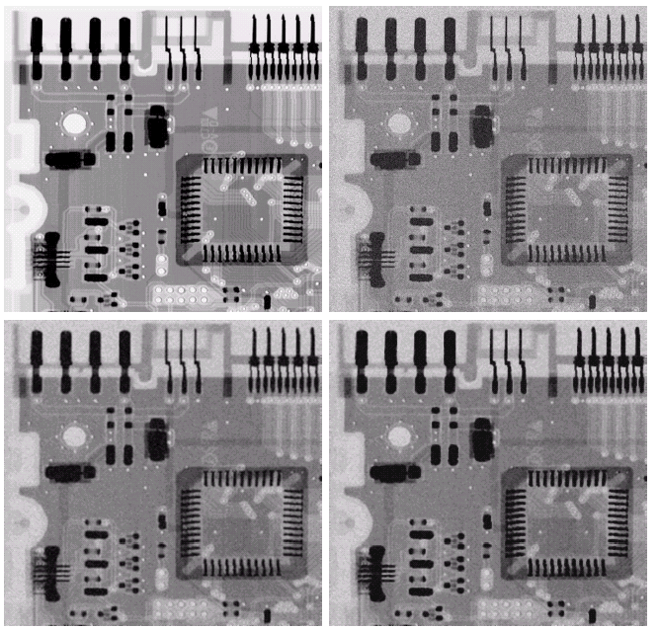
original
Noisy
Gaussian
μ=0
σ=20
Arith.
mean
Geometric
mean

Slide 26
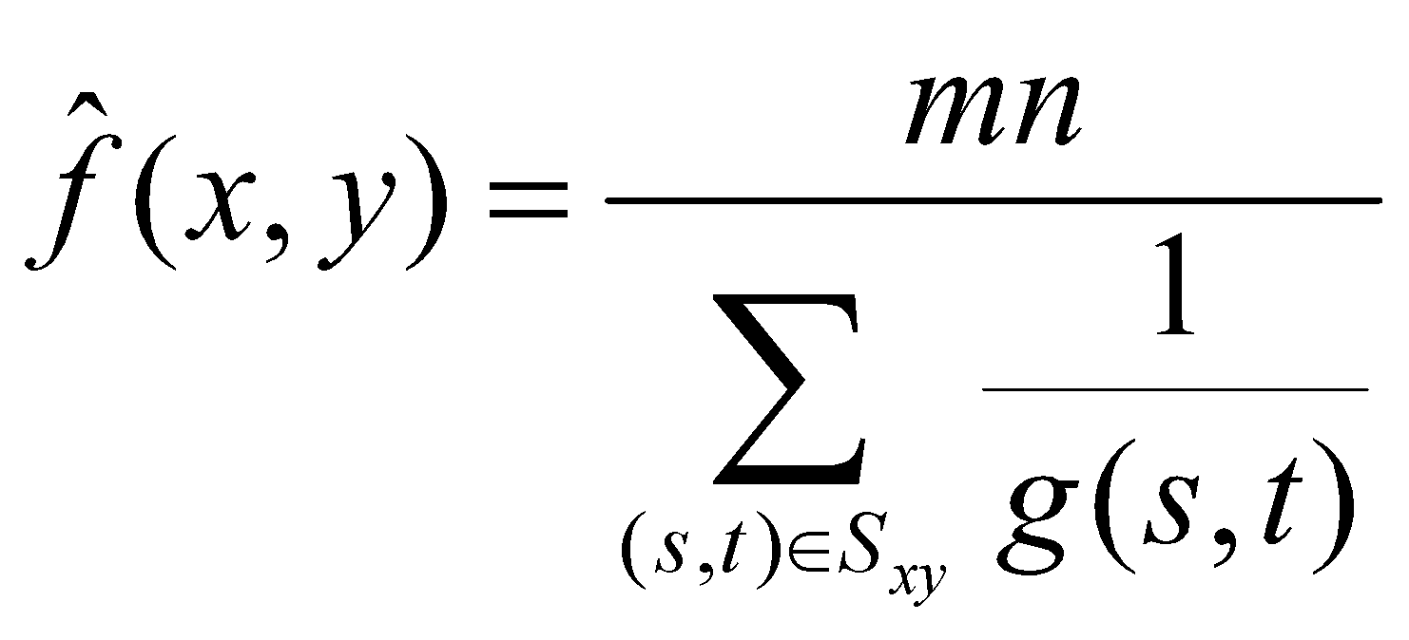
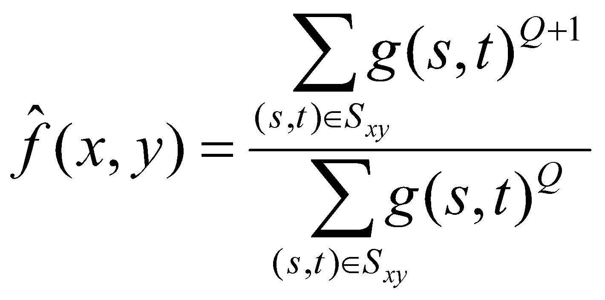
Mean filters (cont.)
Harmonic mean filter
Contra-harmonic mean filter
Q=-1, harmonic
Q=0, airth. mean
Q=+, ?

Slide 27
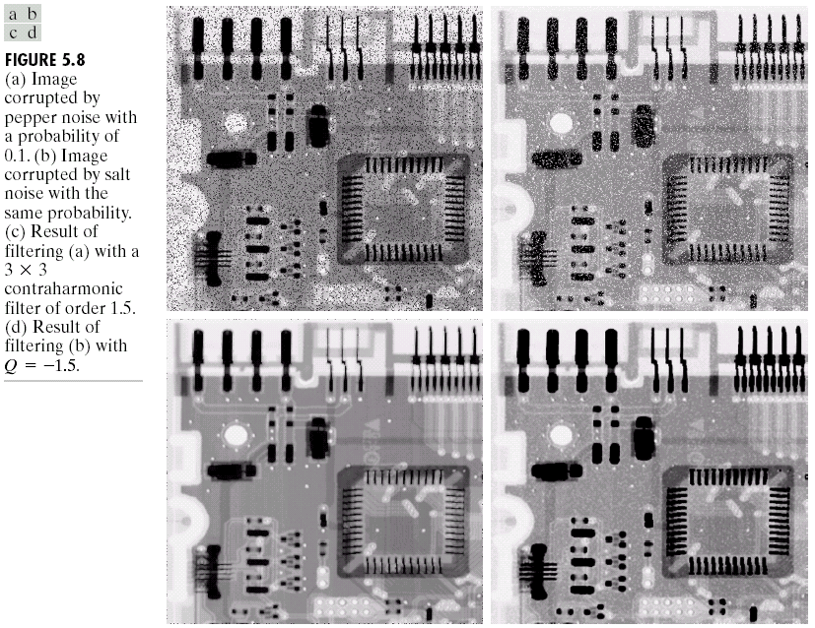
Pepper
Noise
黑點
Salt
Noise
白點
Contra-
harmonic
Q=1.5
Contra-
harmonic
Q=-1.5

Slide 28
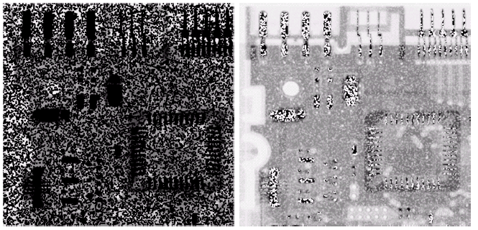
Wrong sign in contra-harmonic filtering
Q=-1.5
Q=1.5

Slide 29
Order-statistics filters
Based on the ordering(ranking) of pixels
Suitable for unipolar or bipolar noise (salt and pepper noise)
Median filters
Max/min filters
Midpoint filters
Alpha-trimmed mean filters

Slide 30
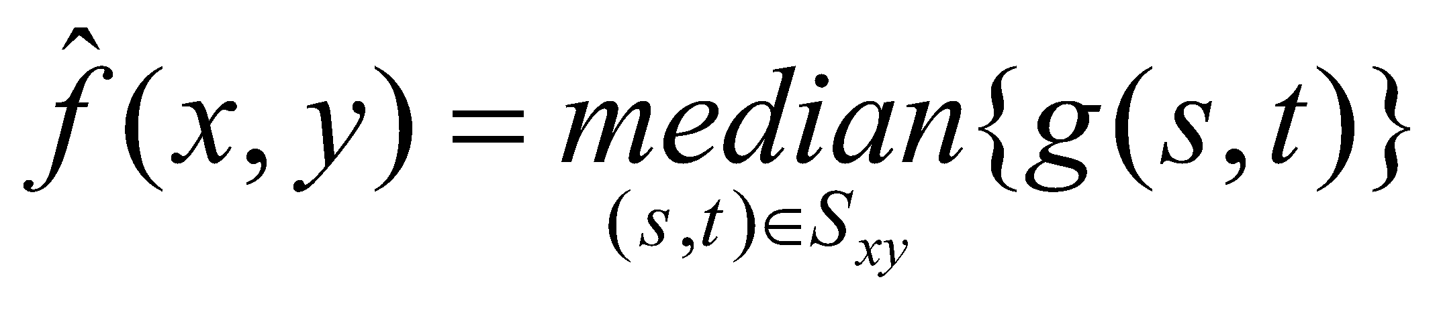
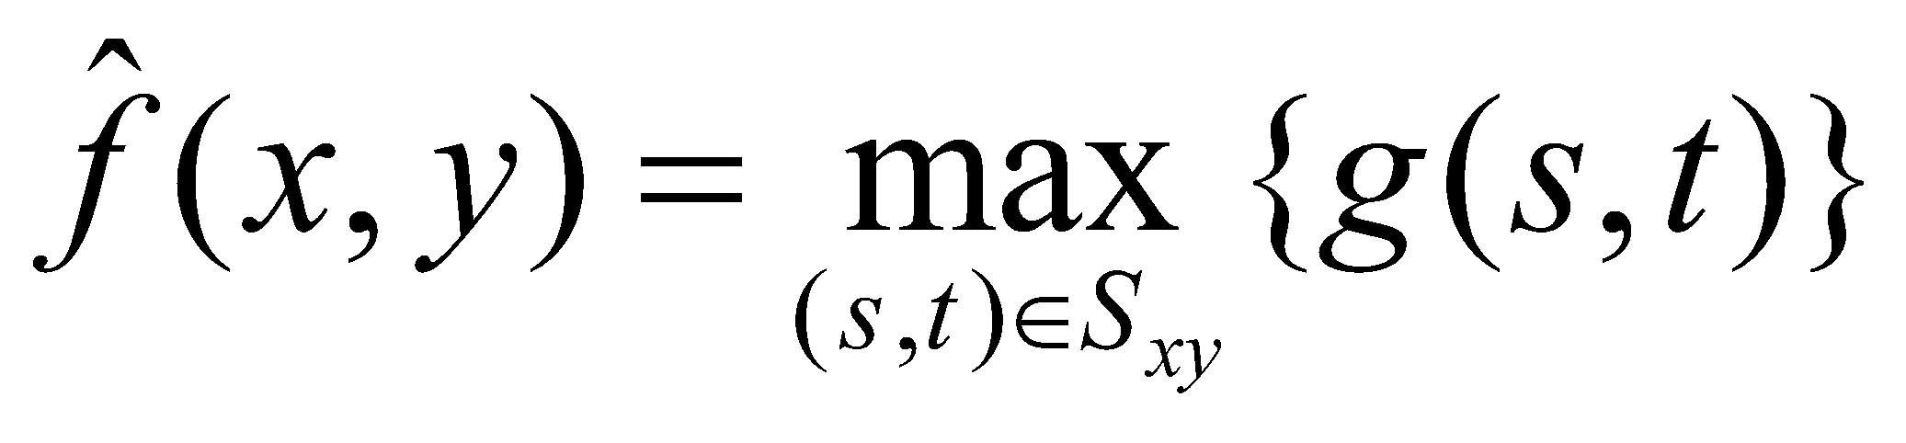
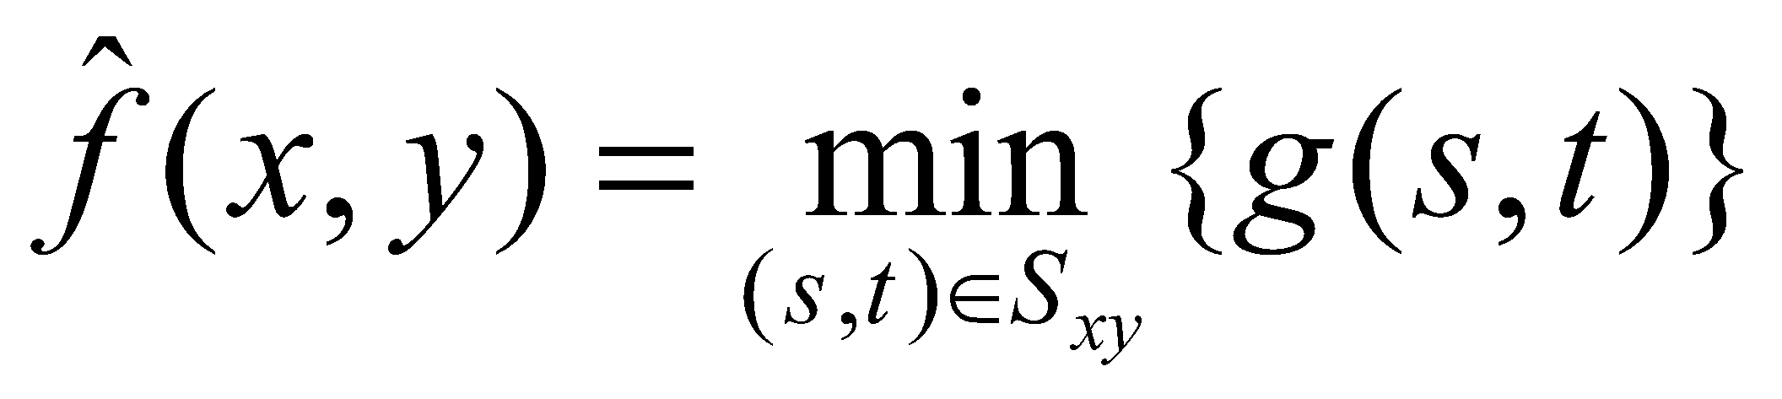
Order-statistics filters
Median filter
Max/min filters

Slide 31
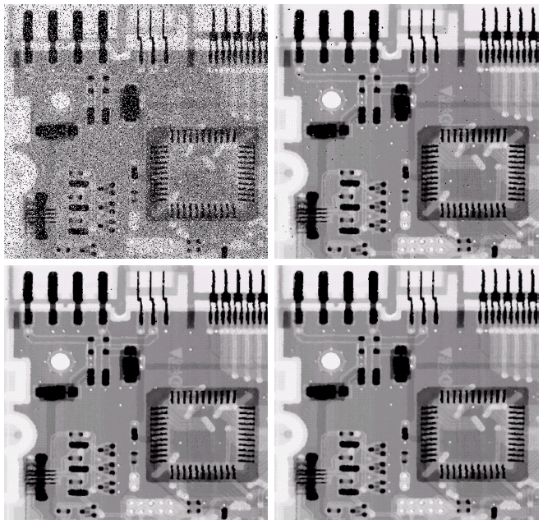
bipolar
Noise
P_{a} = 0.1
P_{b} = 0.1
3x3
Median
Filter
Pass 1
3x3
Median
Filter
Pass 2
3x3
Median
Filter
Pass 3

Slide 32
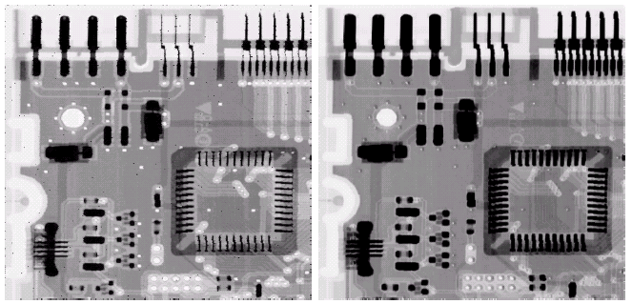
Pepper
noise
Salt
noise
Max
filter
Min
filter

Slide 33
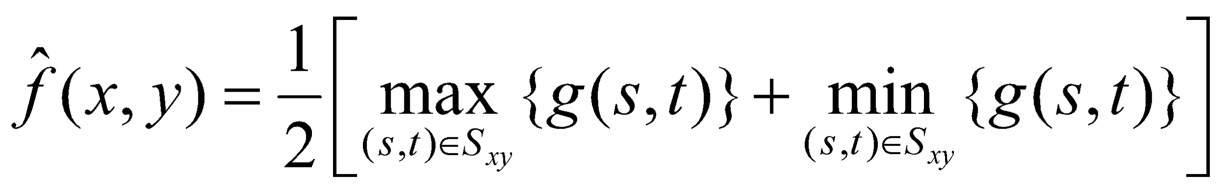
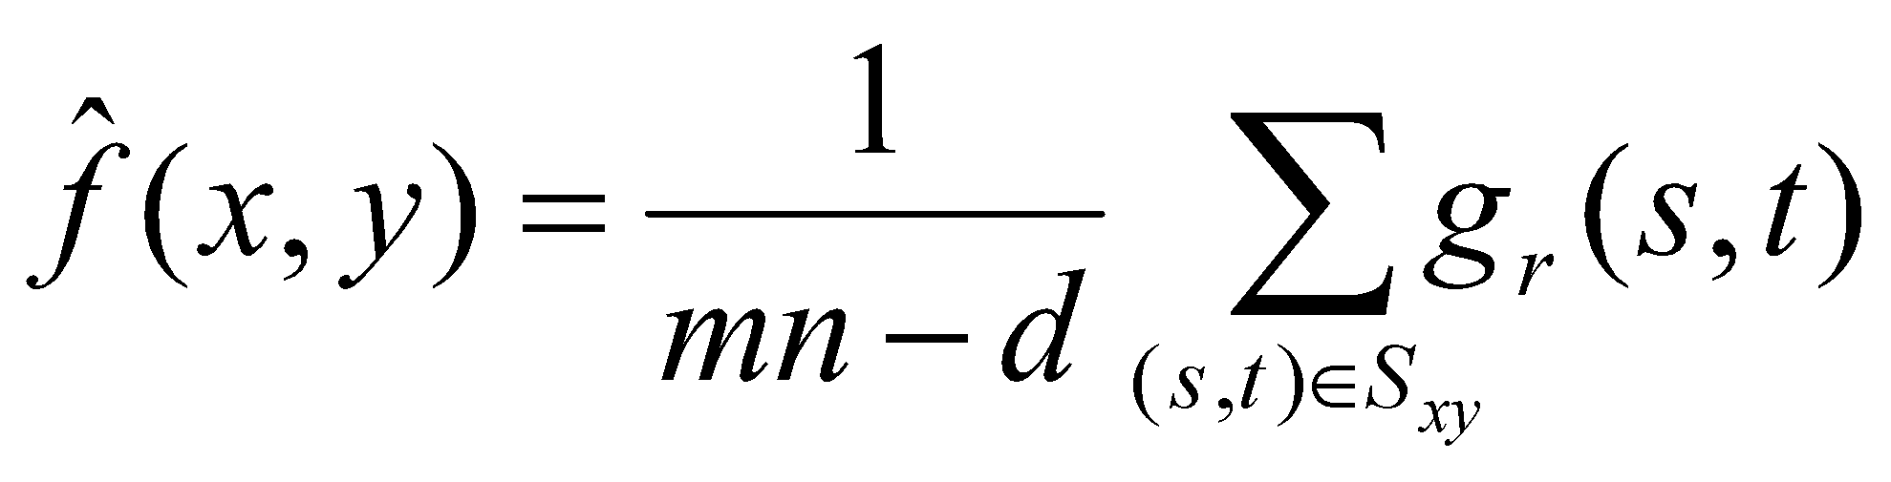
Order-statistics filters (cont.)
Midpoint filter
Alpha-trimmed mean filter
Delete the d/2 lowest and d/2 highest gray-level pixels
Middle (mn-d) pixels

Slide 34
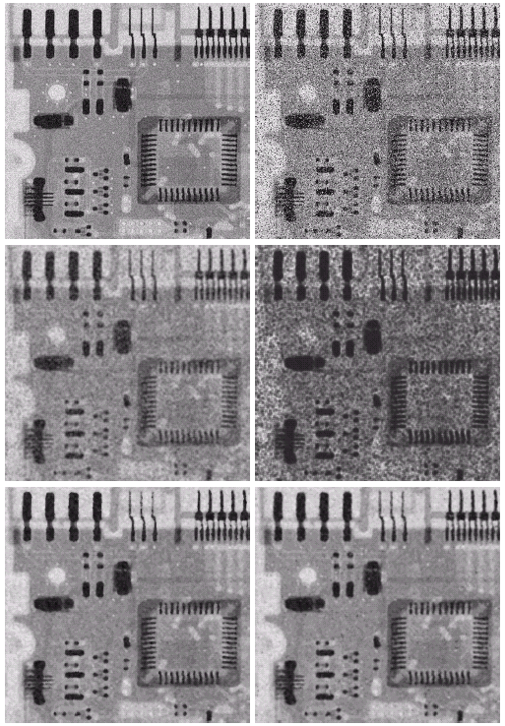
Uniform noise
Left +
Bipolar Noise
P_{a} = 0.1
P_{b} = 0.1
μ=0
σ²=800
5x5
Arith. Mean
filter
5x5
Geometric
mean
5x5
Median
filter
5x5
Alpha-trim.
Filter
d=5

Slide 35
Adaptive filters
Adapted to the behavior based on the statistical characteristics of the image inside the filter region S_{xy}
Improved performance v.s increased complexity
Example: Adaptive local noise reduction filter

Slide 36
Adaptive local noise reduction filter
Simplest statistical measurement
Mean and variance
Known parameters on local region S_{xy}
g(x,y): noisy image pixel value
σ²_{η}: noise variance (assume known a prior)
m_{L} : local mean
σ²_{L} : local variance

Slide 37
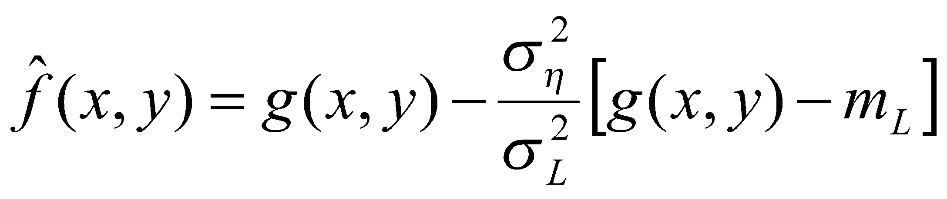
Adaptive local noise reduction filter (cont.)
Analysis: we want to do
If σ²_{η} is zero, return g(x,y)
If σ²_{L}> σ²_{η} , return value close to g(x,y)
If σ²_{L}= σ²_{η} , return the arithmetic mean m_{L}
Formula

Slide 38
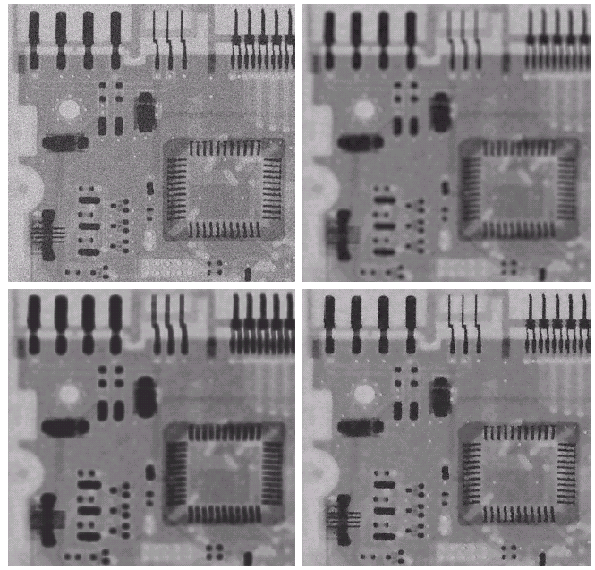
Gaussian
noise
Arith.
mean
7x7
μ=0
σ²=1000
Geometric
mean
7x7
adaptive

Slide 39
Outline
A model of the image degradation / restoration process
Noise models
Restoration in the presence of noise only – spatial filtering
Periodic noise reduction by frequency domain filtering
Linear, position-invariant degradations
Estimating the degradation function
Inverse filtering

Slide 40
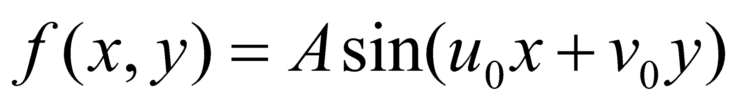
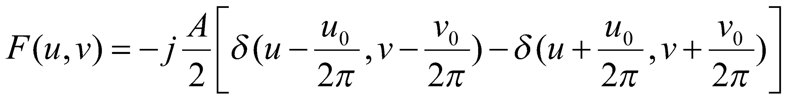
Periodic noise reduction
Pure sine wave
Appear as a pair of impulse (conjugate) in the frequency domain

Slide 41
Periodic noise reduction (cont.)
Bandreject filters
Bandpass filters
Notch filters
Optimum notch filtering

Slide 42
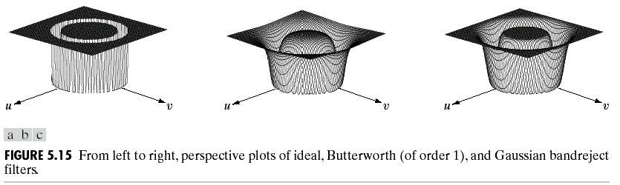
Bandreject filters
* Reject an isotropic frequency
ideal
Butterworth
Gaussian

Slide 43
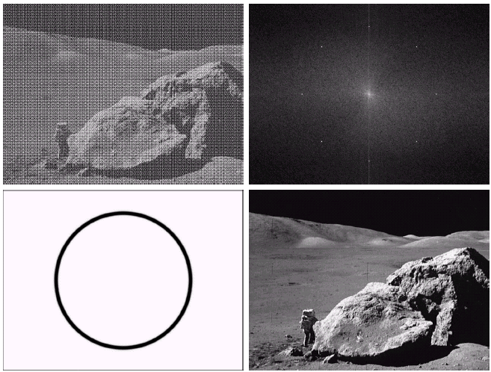
noisy
spectrum
filtered
bandreject

Slide 44
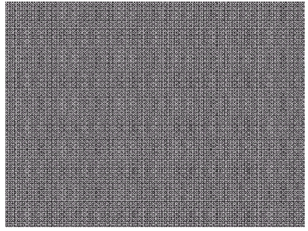
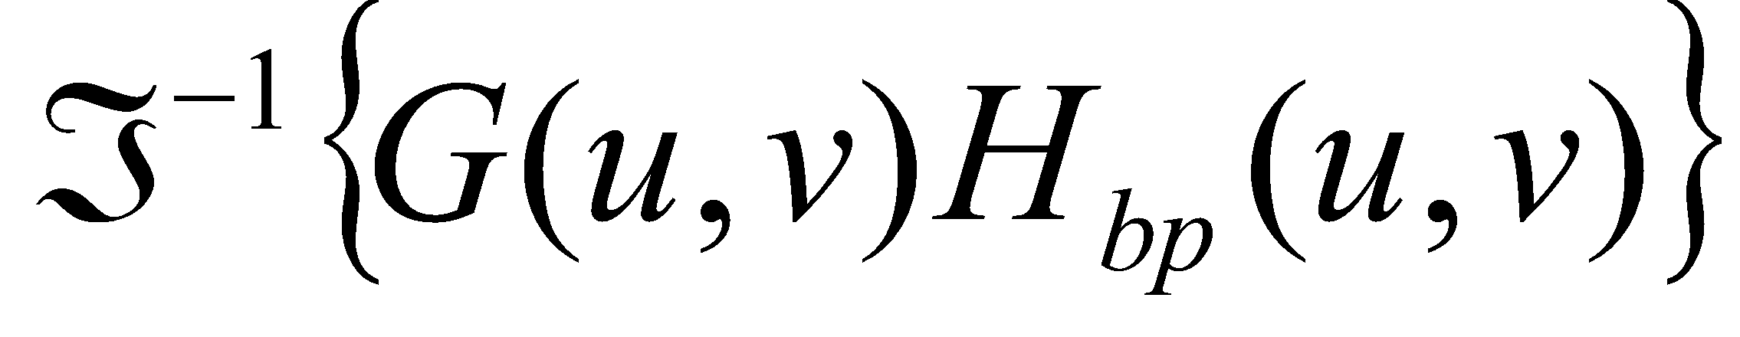
Bandpass filters
H_{bp}(u,v)=1- H_{br}(u,v)

Slide 45
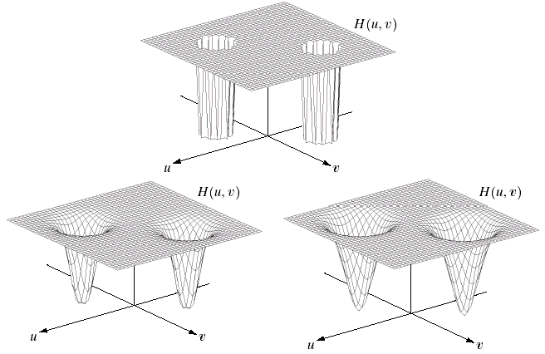
Notch filters
Reject(or pass) frequencies in predefined neighborhoods about a center frequency
ideal
Butterworth
Gaussian

Slide 46
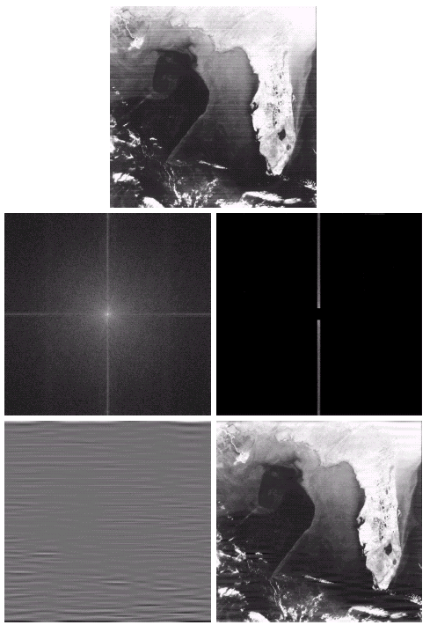
Horizontal
Scan lines
Notch
pass
DFT
Notch
pass
Notch
reject

Slide 47
Outline
A model of the image degradation / restoration process
Noise models
Restoration in the presence of noise only – spatial filtering
Periodic noise reduction by frequency domain filtering
Linear, position-invariant degradations
Estimating the degradation function
Inverse filtering

Slide 48
A model of the image degradation /restoration process
g(x,y)=f(x,y)*h(x,y)+η(x,y)
G(u,v)=F(u,v)H(u,v)+N(u,v)
If linear, position-invariant system

Slide 49
Linear, position-invariant degradation
Properties of the degradation function H
Linear system
H[af₁(x,y)+bf₂(x,y)]=aH[f₁(x,y)]+bH[f₂(x,y)]
Position(space)-invariant system
H[f(x,y)]=g(x,y)
⬄ H[f(x-α, y-β)]=g(x-α, y-β)
c.f. 1-D signal
LTI (linear time-invariant system)

Slide 50
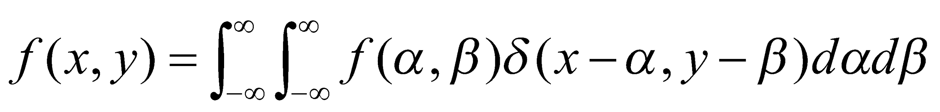
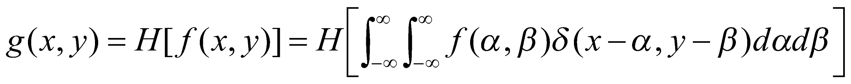
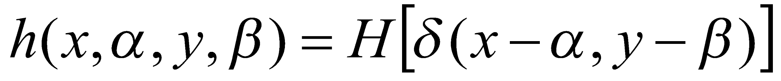
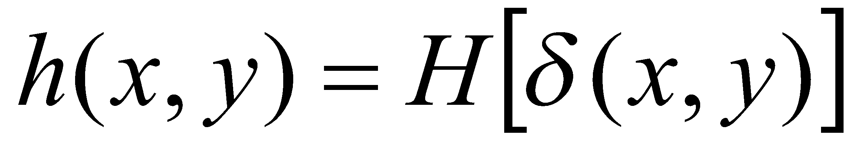
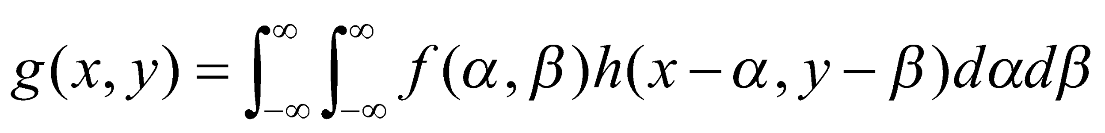
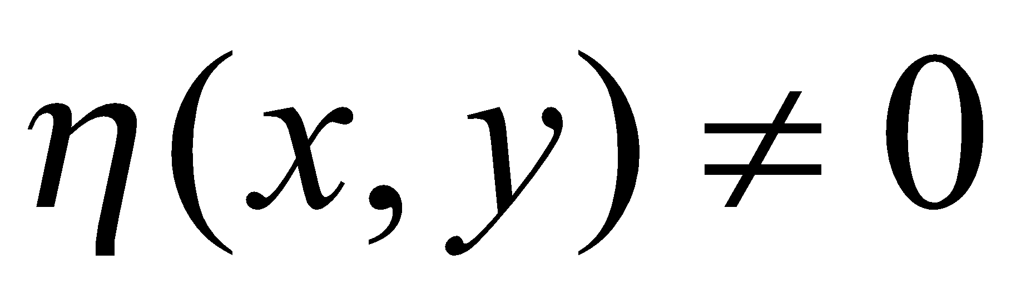
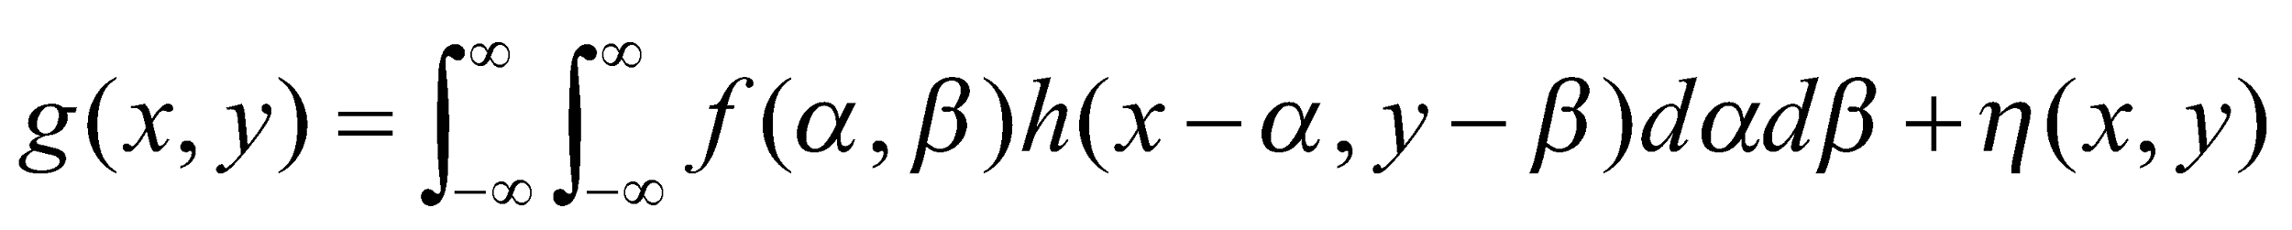
impulse
linear
Impulse response (point spread function)
If position-invariant

Slide 51
Linear, position-invariant degradation model
Linear system theory is ready
Non-linear, position-dependent system
May be general and more accurate
Difficult to solve compuatationally
Image restoration: find H(u,v) and apply inverse process
Image deconvolution

Slide 52
Estimating the degradation function
Estimation by Image observation
Estimation by experimentation
Estimation by modeling

Slide 53
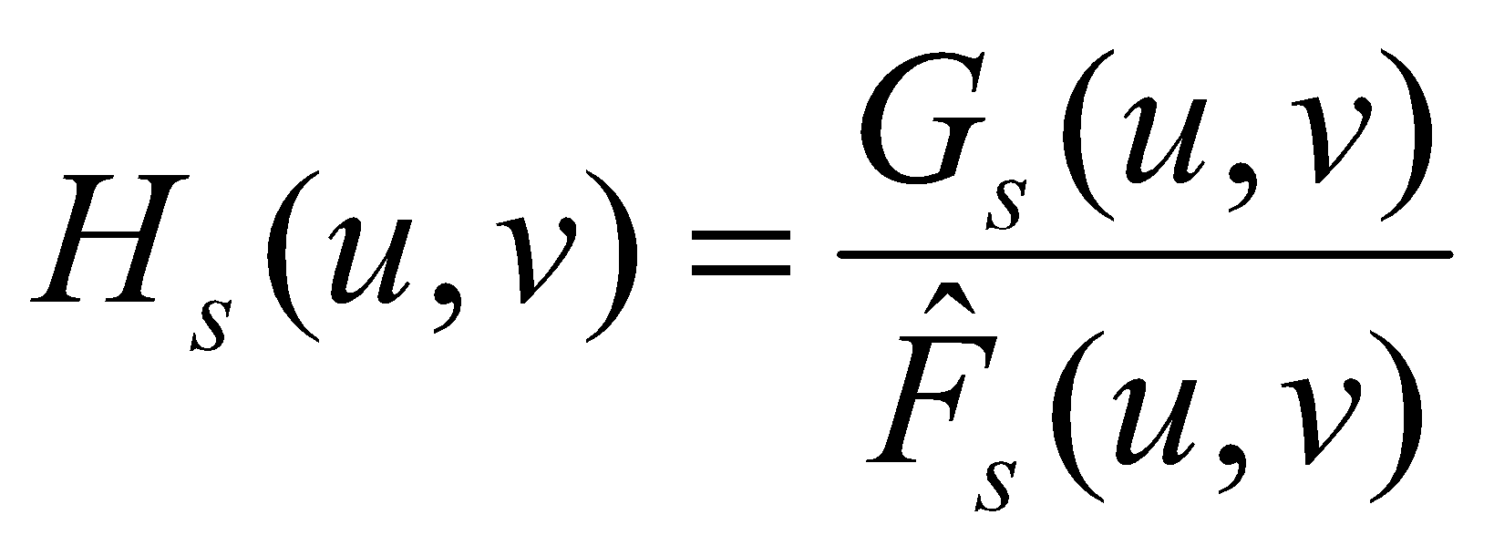
Estimation by image observation
Take a window in the image
Simple structure
Strong signal content
Estimate the original image in the window
known
estimate

Slide 54
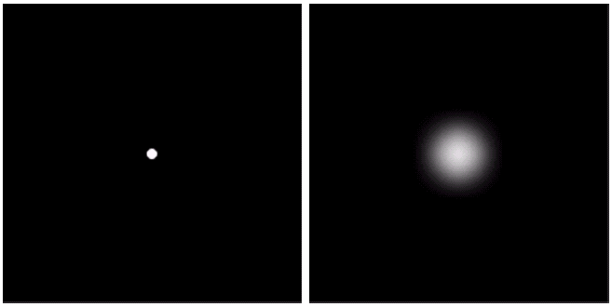
Estimation by experimentation
If the image acquisition system is ready
Obtain the impulse response
impulse
Impulse response

Slide 55
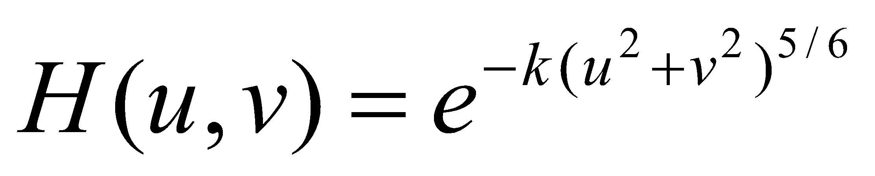
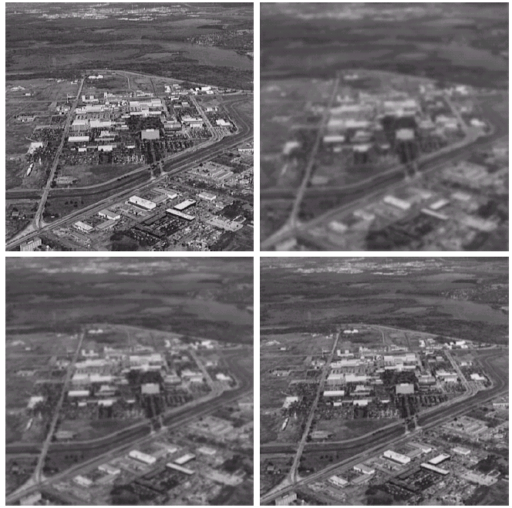
Estimation by modeling (1)
Ex. Atmospheric model
original
k=0.0025
k=0.001
k=0.00025

Slide 56


Estimation by modeling (2)
Derive a mathematical model
Ex. Motion of image
Fourier
transform
Planar motion

Slide 57

Estimation by modeling: example
original
Apply motion model

Slide 58

Inverse filtering
With the estimated degradation function H(u,v)
Unknown
noise
G(u,v)=F(u,v)H(u,v)+N(u,v)
=>
Estimate of
original image
Problem: 0 or small values
Sol: limit the frequency
around the origin

Slide 59

Full
inverse
filter
for
Cut
Outside
40%
k=0.0025
Cut
Outside
70%
Cut
Outside
85%

