Slide 1
Software Usability

Slide 2
User Interface
User interfaces should be designed to match the skills, experience and expectations of its anticipated users.
System users often judge a system by its interface rather than its functionality.
A poorly designed interface can cause a user to make catastrophic errors.
Poor user interface design is the reason why so many software systems are never used.

Slide 3
Human Factors in Interface Design
Limited short-term memory
People can instantaneously remember about 7 items of information. If you present more than this, they are more liable to make mistakes.
People make mistakes
When people make mistakes and systems go wrong, inappropriate alarms and messages can increase stress and hence the likelihood of more mistakes.
People are different
People have a wide range of physical capabilities. Designers should not just design for their own capabilities.
People have different interaction preferences
Some like pictures, and some like text.

Slide 4
What is Usability?
Usability is the ease of use and learnability of a human-made object such as a software application, website, book, tool, process, or anything a human interacts with.
Allowing intended users to accomplish their tasks in the best way possible.
How well can users use the system’s functionality?

Slide 5
Why is Usability Important?
From the user's perspective
Usability can make the difference between performing a task accurately and completely or not and enjoying the process or being frustrated.
From the developer's perspective
Usability is important because it can mean the difference between the success or failure of a system.
From a management point of view
Software with poor usability can reduce the workforce’s productivity to a performance worse than without the system. Also, it increases cost and time.

Slide 6
Why is Usability Important?
In all cases, lack of usability can cost time and effort and can greatly determine the success or failure of a system.
Given a choice, people will tend to buy more user-friendly systems.

Slide 7
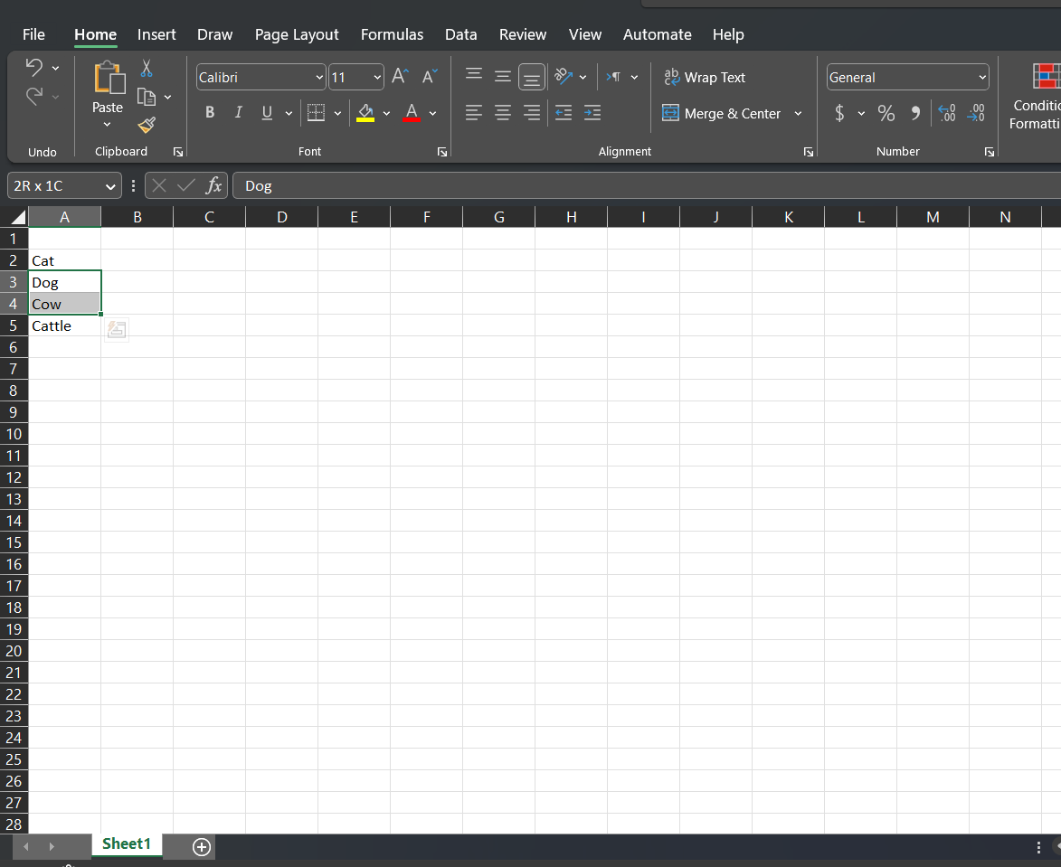
Motivational Example
Microsoft Excel
Poor error message when it cannot find an item.
Enter a spreadsheet and select more than one cell.

Slide 8
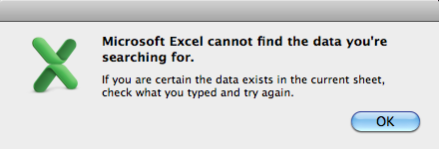
Motivational Example
Earlier versions of Excel

Slide 9
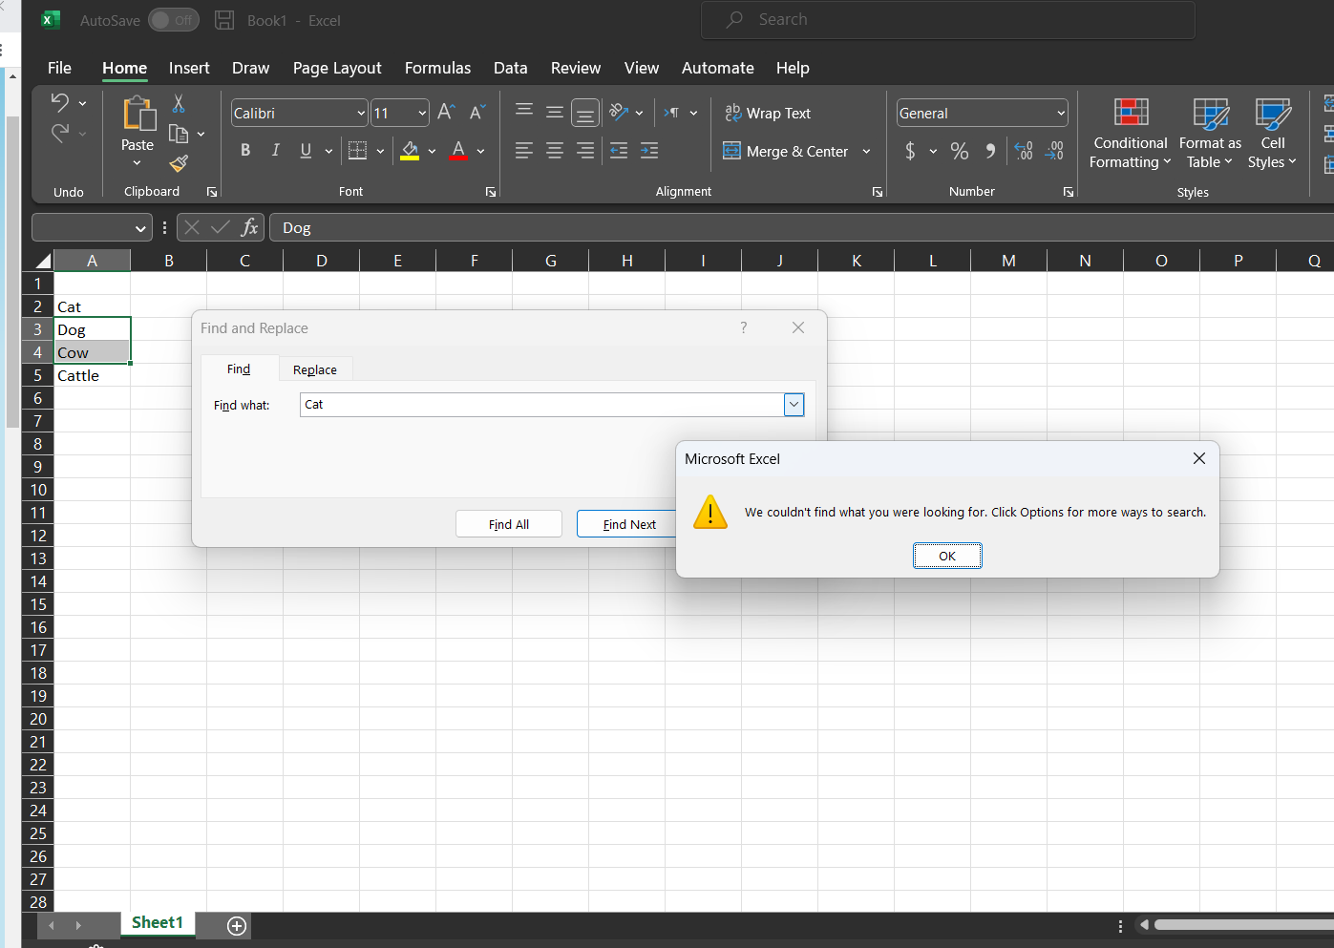
Motivational Example
Office 365

Slide 10
Motivational Example
The experts among you will say:
Excel searches only within the selection when more than one cell is selected. But this is just not usable
Beginners will not know this somewhat secret rule.
The error message gives the user false assistance. It suggests re-searching. But the user will get the same response!

Slide 11
Motivational Example
A more usable solution would be to:
Tell the user the response was not found in the selected cells, but that there is a result somewhere else (if there is) and ask if the user wants to search the entire sheet.
Not use a modal dialog in any case. The error message should appear non-modally without the user having to 'OK' it to proceed. The user should be free, for example, to immediately type some other search term, or execute any other command.

Slide 12
Usability Measures
The following usability measures lead more directly to practical evaluation:
1. Time to learn
How long does it take for typical members of the community to learn actions relevant to a set of tasks?
2. Speed of performance
How long does it take to carry out the benchmark tasks?
3. Rate of errors by users
How many and what kinds of errors are made during benchmark tasks?

Slide 13
Usability Measures
4. Retention over time
How well do users maintain their knowledge after an hour, a day, or a week?
5. Subjective satisfaction
How much did users like using various aspects of the interface? The answer can be ascertained by interviews and satisfaction scales
Trade-offs (an exchange that occurs as a compromise) in design options frequently occur.

Slide 14
Usability Measures
Changes to the interface in a new version may create consistency problems with the previous version, but the changes may introduce new needed functionality.
Design alternatives can be evaluated by designers and users via mockups or high-fidelity (quality) prototypes.
The user manuals and the online help can be written before the implementation to provide another review on the design.

Slide 15
Universal Usability
The diversity of human abilities, background, motivations, personalities, cultures, and work styles challenges interface designers.
Understanding the physical, intellectual and personality differences between users is vital for getting participation by broadest set of users
Sometimes accommodating the needs of one group benefits other groups as well.

Slide 16
Universal Usability
Users with Disabilities
Designers must plan early to accommodate users with disabilities
vision-impaired
hearing-impaired
mobility-impaired
Elderly Users
Including the elderly is fairly easy; designers should allow for variability within their applications via settings for sound, color, brightness, font sizes, etc.
If elder people can use the technology easily, we have more opportunities of knowing about their experiences
Children
Designers need attention to their limitations.
Parental control over dangerous content

Slide 17
Neilsen’s Heuristics
Notes:
https://www.nngroup.com/articles/ten-usability-heuristics/
https://www.youtube.com/watch?v=cTtc90jCULU&list=PLJOFJ3Ok_idtb2YeifXlG1-TYoMBLoG6I&index=1
https://aelaschool.com/en/interactiondesign/10-usability-heuristics-ui-design/

Slide 18
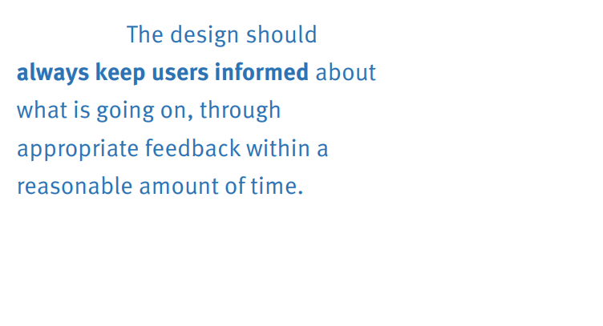
Heuristic 1: Visibility of System Status
Keep users informed with feedback, quickly
What will/would happen, and when
What step of the process are we in
What just happened
Communicate clearly

Slide 19
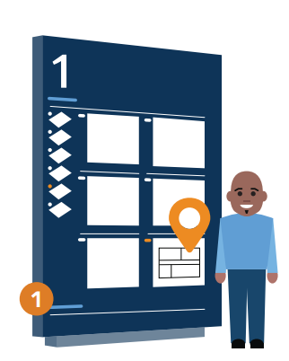
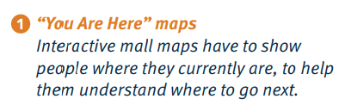
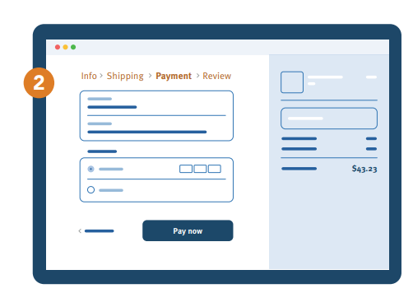
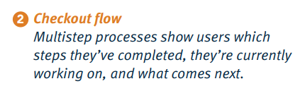
Heuristic 1: Visibility of System Status

Slide 20
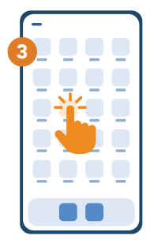
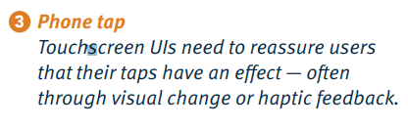
Heuristic 1: Visibility of System Status

Slide 21
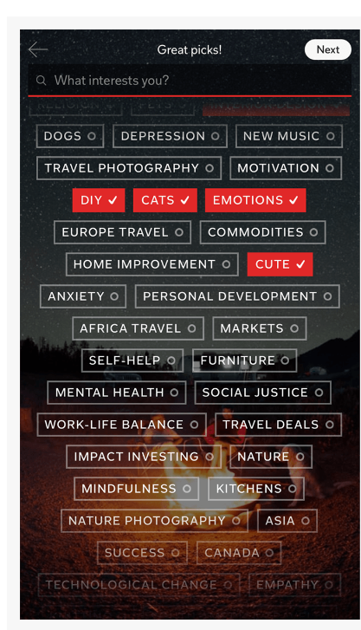
Heuristic 1: Visibility of System Status
Appropriate Feedback:
Changing the color and adding a checkmark to buttons on a selection screen communicates that the system has registered the user’s choices

Slide 22
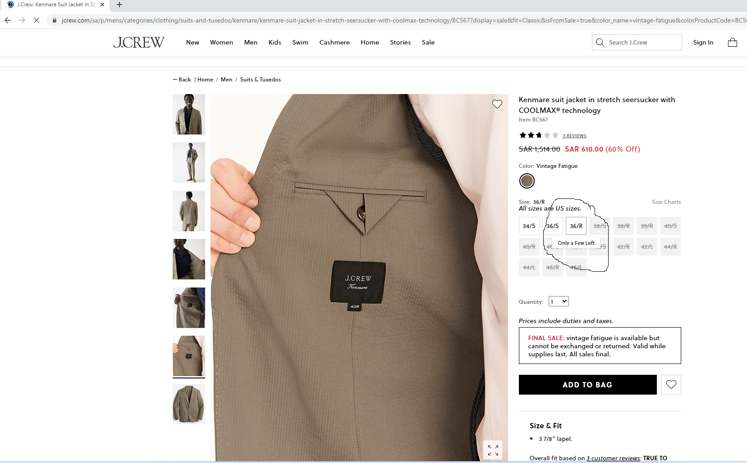
Heuristic 1: Visibility of System Status
Compel Users to Action:
The J.Crew site displays a notification that there are “Only a Few Left!” when the user moves the mouse over low-stock sizes of a product. Some sizes are already sold out, and thus shown crossed out in light gray.

Slide 23
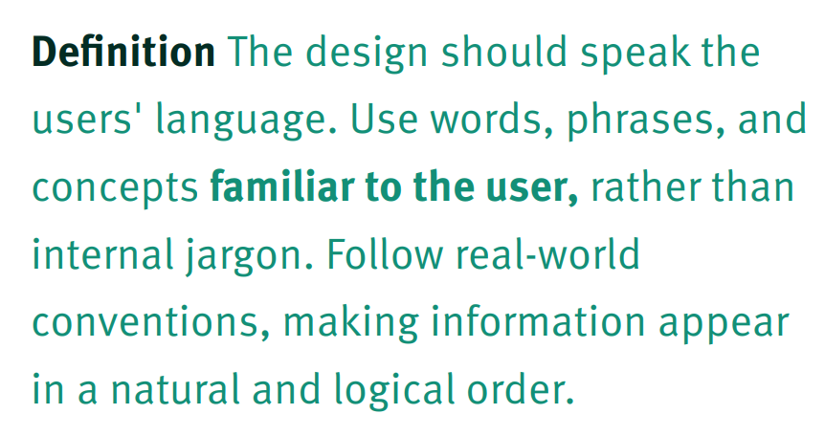
Heuristic 2: Match Between System and Real World
Speak the user’s language
Use familiar words/concepts
Users likely won’t understand things the way you do
Avoid jargon, technical terms
Consider the user’s mental model

Slide 24
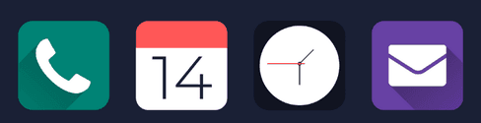
Heuristic 2: Match Between System and Real World
Always use icons and other illustrations that resonate with the real world

Slide 25
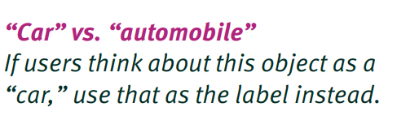
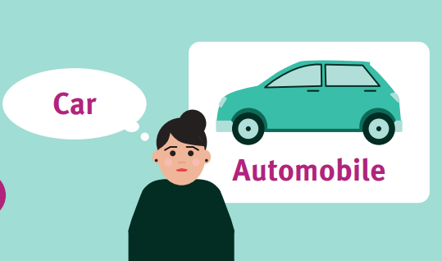
Heuristic 2: Match Between System and Real World

Slide 26
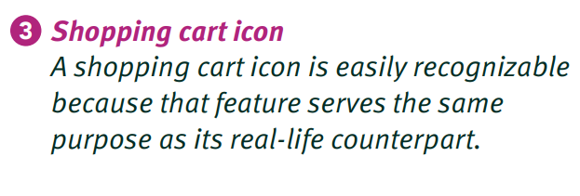
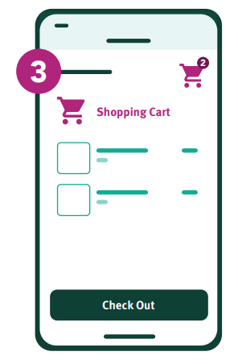
Heuristic 2: Match Between System and Real World

Slide 27
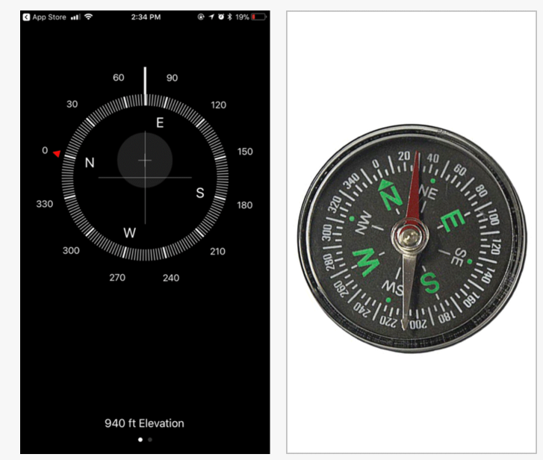
Heuristic 2: Match Between System and Real World
Leverage Familiarity with Real-World Objects and Activities
UI elements in a compass app (left) are similar to a compass in the real world (right) and make it easy for users to understand the app’s use and function

Slide 28
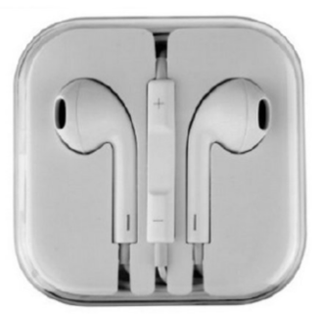
Heuristic 2: Match Between System and Real World
The volume buttons on headphones are an example of natural mapping as they are positioned in a way that corresponds to the outcome. The plus sign on top increases the volume and the minus sign on the bottom decreases the volume.

Slide 29
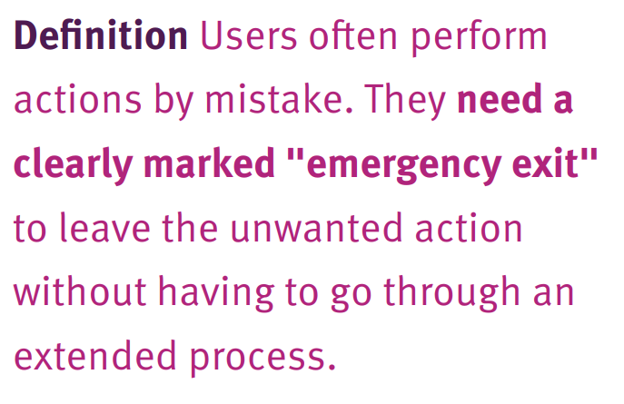
Heuristic 3: User Control & Freedom
Provide exits
Cancel button, active back button (sometimes escape key)
Provide and undo/redo (multi-level)
Help people feel confident to explore and recover from errors
Make these discoverable and ideally visible!

Slide 30
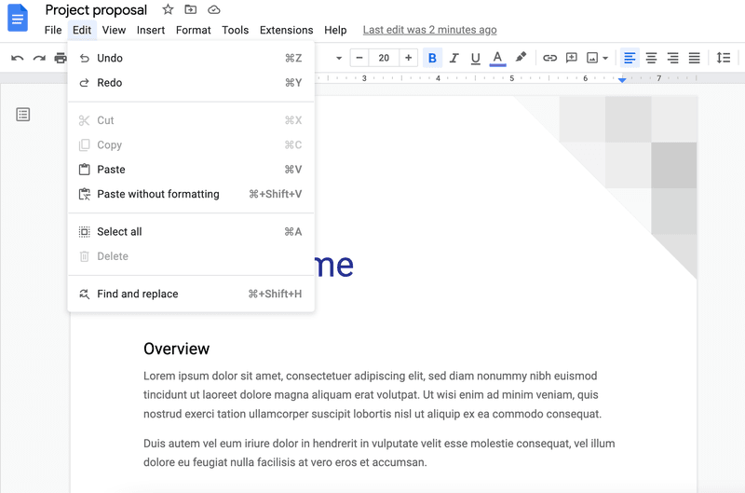
Heuristic 3: User Control & Freedom
Google Docs showing undo and redo options.

Slide 31
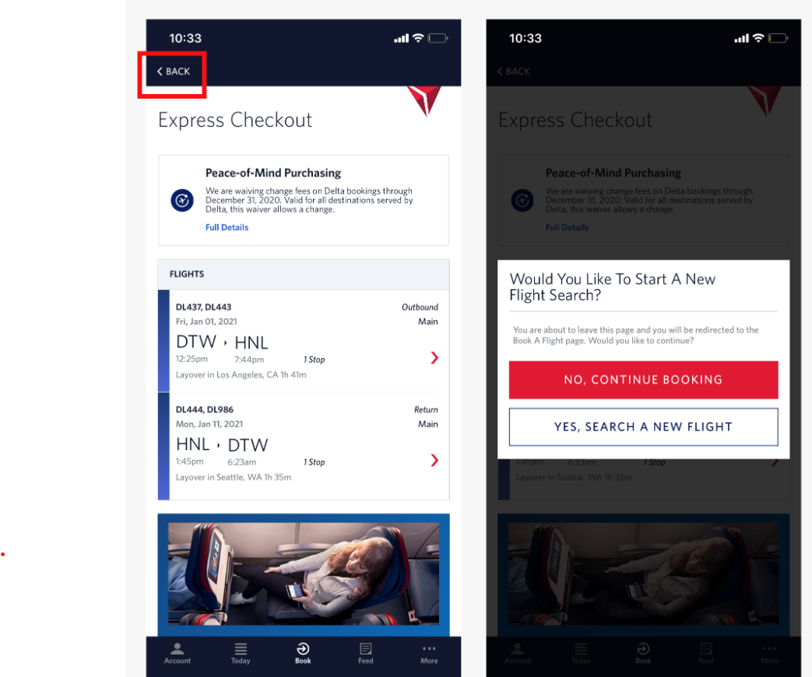
Heuristic 3: User Control & Freedom
A Back link which returns users to a previous page or screen

Slide 32
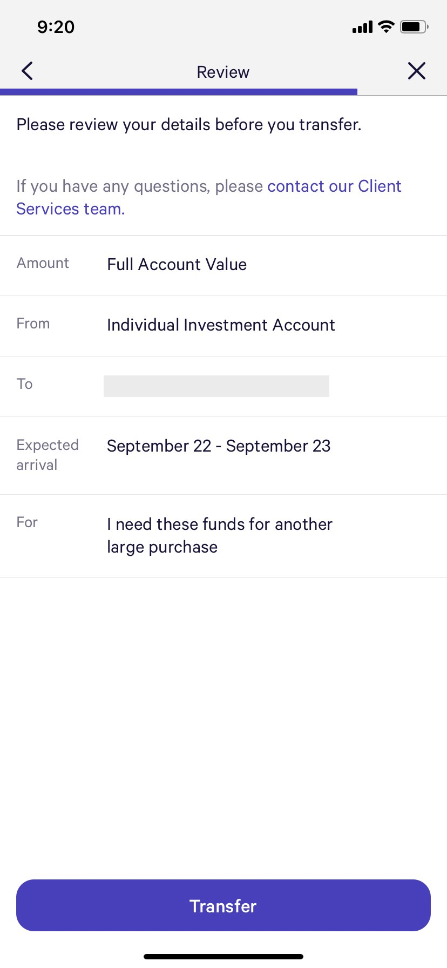
Heuristic 3: User Control & Freedom
On mobile, some designers try to save space by using the X icon, instead of Cancel. Unfortunately, sometimes X can be mistaken for Close, rather than Cancel.

Slide 33
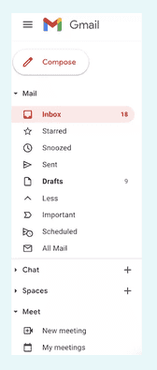
Heuristic 4: Consistency and standards
This heuristic is about keeping the same language throughout the system to avoid confusing the user.
So when users interact with a product, they should have no doubts about the meaning of words, icons, or symbols used.
Designers should create a consistent design that speaks the same language and treats similar things in the same way.

Slide 34
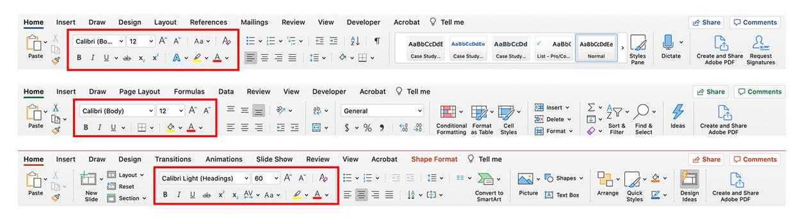
Heuristic 4: Consistency and standards
Microsoft Office utilizes a ribbon across its products that is used for accomplishing tasks within each tool.

Slide 35
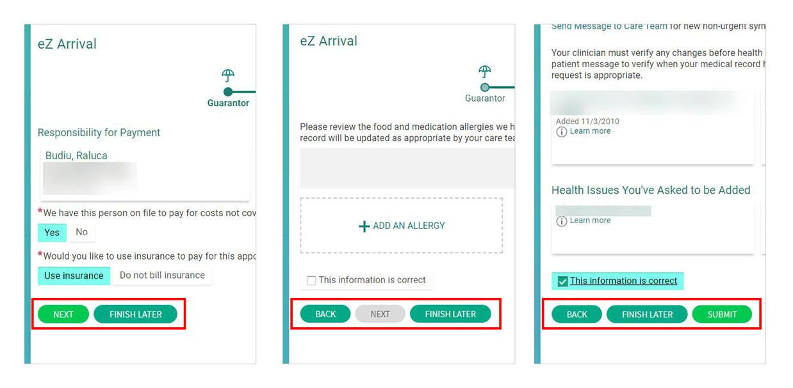
Heuristic 4: Consistency and standards
Ensure consistency in the placement of form fields and buttons, especially for multipage forms or wizards. Will you place the call-to-action on the left and the Cancel button on the right, or vice versa? How will you designate fields as required? Regardless of the answers to those questions, make sure that each form on the site is designed in the same way.

Slide 36
Heuristic 4: Consistency and standards
Whenever possible, help users enter data by designing form fields that will eliminate the need to guess how the entry should be formatted; apply these guidelines to all instances of collecting data on your site.

Slide 37
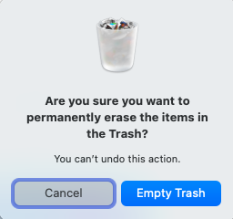
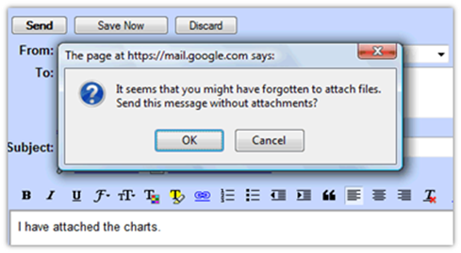
Heuristic 5: Error Prevention
This Nielsen heuristic proposes that a good design should always prevent problems from occurring.

Slide 38
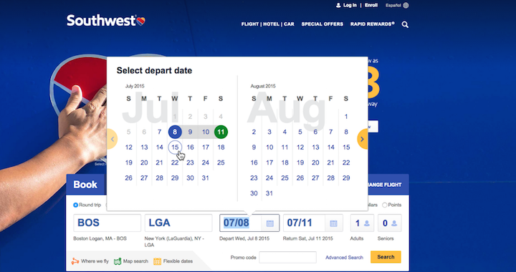
Heuristic 5: Error Prevention
Include helpful constraints.

Slide 39
Heuristic 6: Recognition Rather than Recall
Psychologists like to distinguish between two types of memory retrieval:
recognition versus recall.
Recognition refers to our ability to “recognize” an event or piece of information as being familiar, while
Recall designates the retrieval of related details from memory.

Slide 40
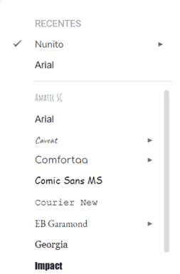
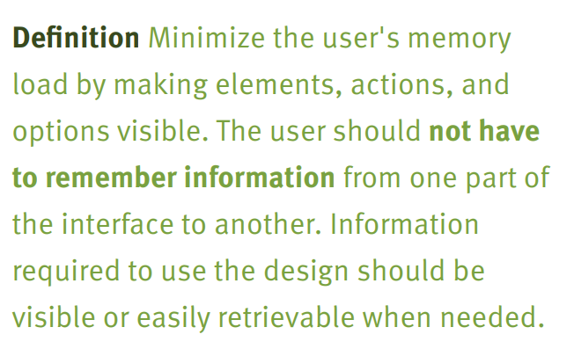
Heuristic 6: Recognition Rather than Recall

Slide 41
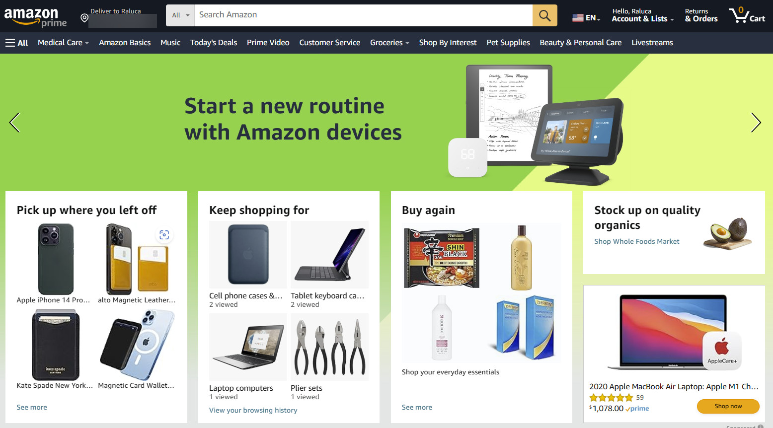
Heuristic 6: Recognition Rather than Recall

Slide 42
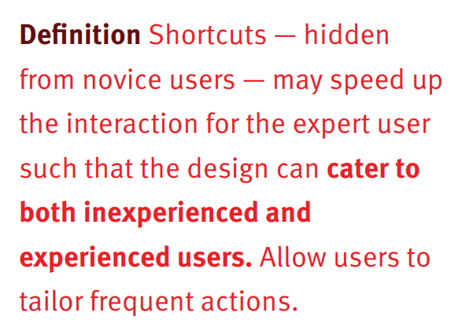
Heuristic 7: Flexibility and Efficiency of Use
Your designs should benefit both inexperienced and experienced users.

Slide 43
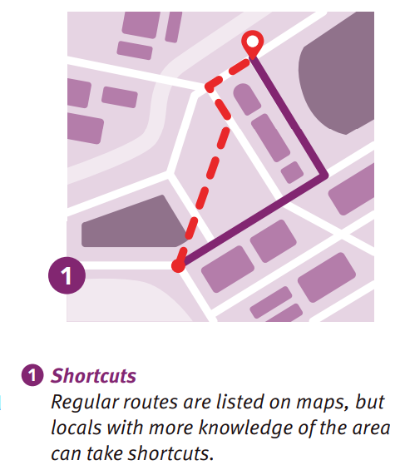
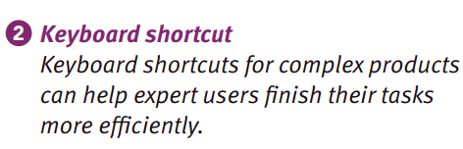
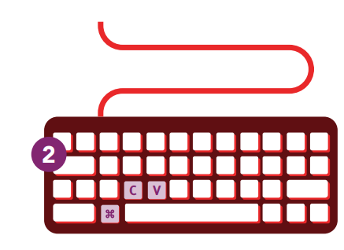
Heuristic 7: Flexibility and Efficiency of Use

Slide 44
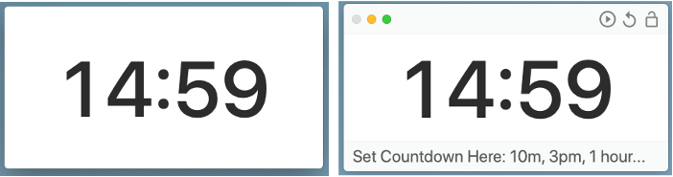
Heuristic 8: Aesthetic and Minimalist Design
Focus on essentials
Ask: what would it be like if we
Left this out
Left it to later
Put this somewhere else
Focus on the user’s primary goals
Get help from artists and graphic designers
in the idle state, the time remaining in the countdown is the only available information
in the hover state, all controls are made visible

Slide 45
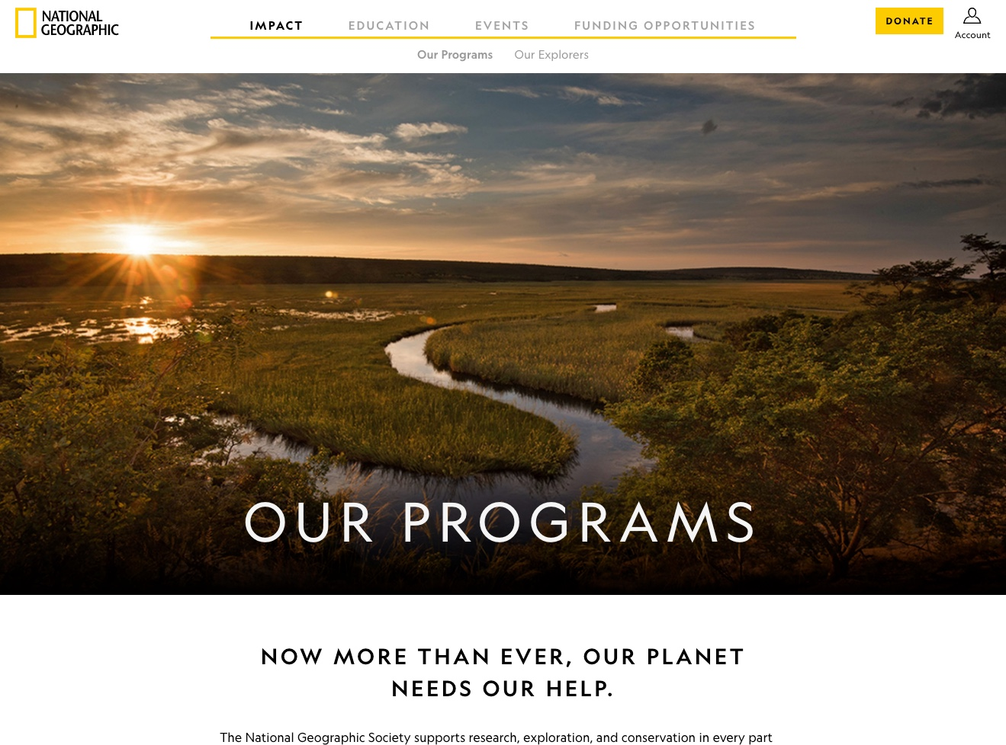
Heuristic 8: Aesthetic and Minimalist Design
There are many visual-design attributes that impact whether a design will be aesthetically pleasing

Slide 46
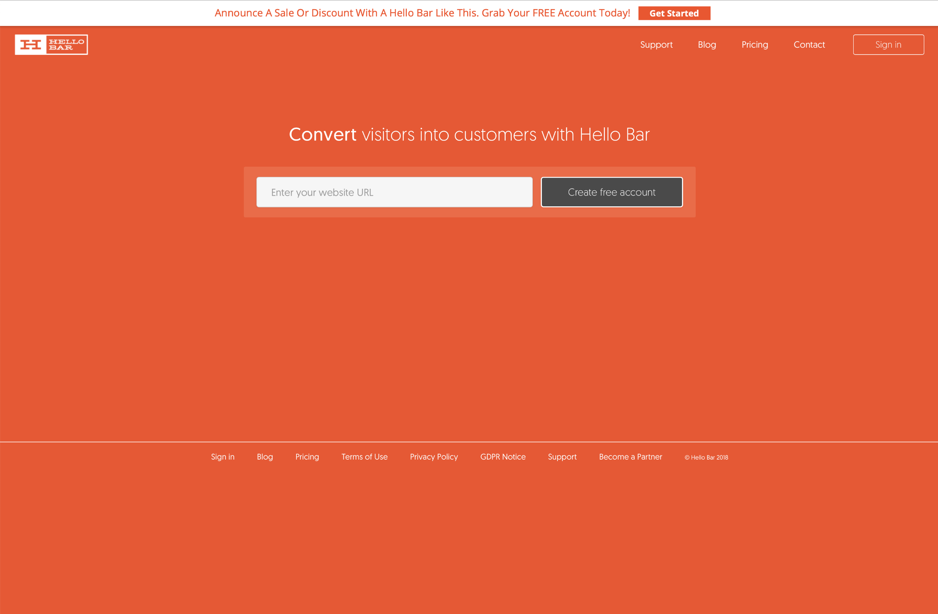
Heuristic 8: Aesthetic and Minimalist Design
Minimalist Design, Maximum Utility

Slide 47
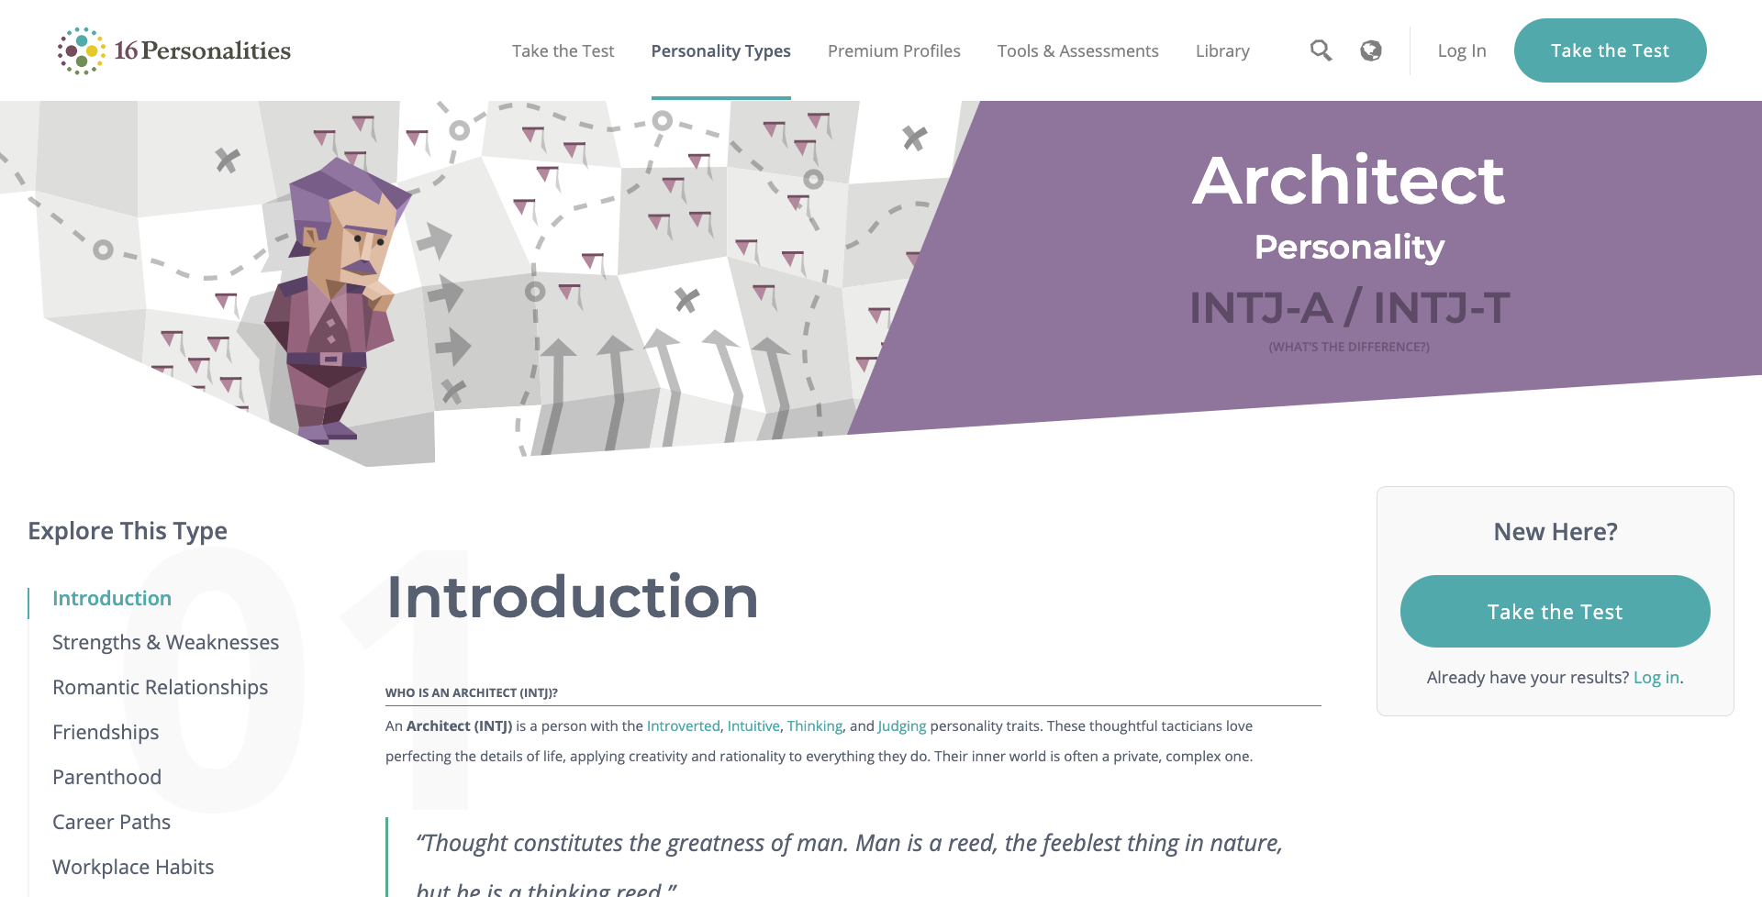
Heuristic 8: Aesthetic and Minimalist Design
Minimalist Design, Maximum Utility

Slide 48
Heuristic 9: Help Users Recognize, Diagnose & Recover from Errors
Make error messages clear and useful
Short
Easy to see
Ensure they immediately appear
Highlight the problematic data
Use simple language
Give a link to help
Give suggestions for solutions (even 1-click)
Remember the Excel Example ☺

Slide 49
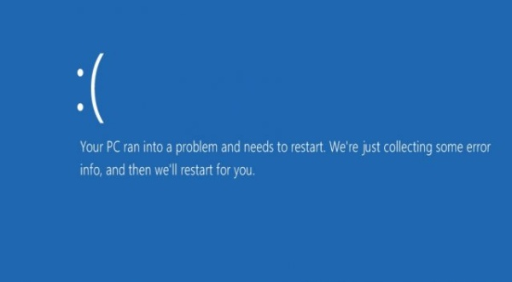
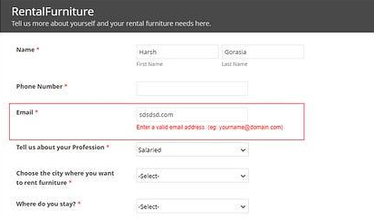
Heuristic 9: Help Users Recognize, Diagnose & Recover from Errors
Windows error messages
Guiding the user to enter the valid email address

Slide 50
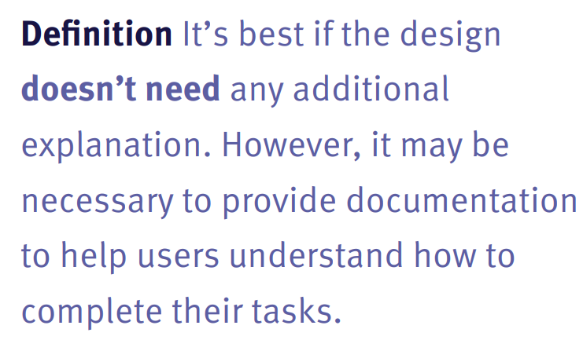
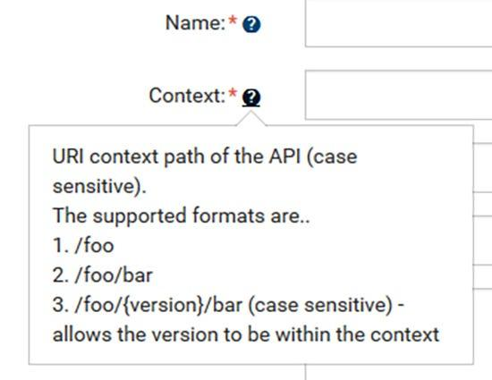
Heuristic 10: Provide Good Help and Documentation
Always deliver help documentation that is easy to search for and focused on users’ tasks. A good practice is to list concrete steps users can follow to complete a task successfully.

Slide 51
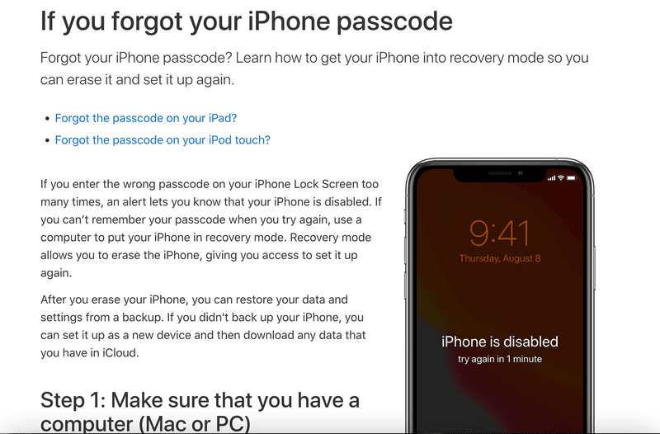
Heuristic 10: Provide Good Help and Documentation
Example of Apple’s assistance for iPhone with actionable steps.

Slide 52
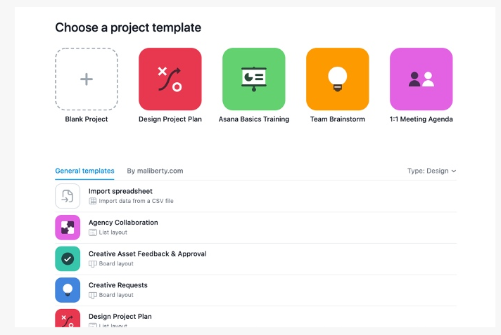
Heuristic 10: Provide Good Help and Documentation
Asana offered several templates to help users get started with common project types. Templates can be useful for both new and existing users

Slide 53
Usability Evaluation

Slide 54
Usability Evaluation
The range of evaluation plans might be from an ambitious two-year test to a few days test.
The range of costs might be from 20% of a project down to 5%.
Few years ago, evaluation was considered as “just a good idea”
Failure to perform and document testing could lead to failed projects.

Slide 55
The Five Es of Usability
Effective
The completeness and accuracy with which users achieve their goals.
Efficient
The speed (with accuracy) with which users can complete their tasks.
Engaging
The degree to which the tone and style of the interface makes the product pleasant or satisfying to use.
Error tolerant
How well the design prevents errors or helps with recovery from those that do occur.
Easy to learn
How well the product supports both initial orientation and deepening understanding of its capabilities.

Slide 56
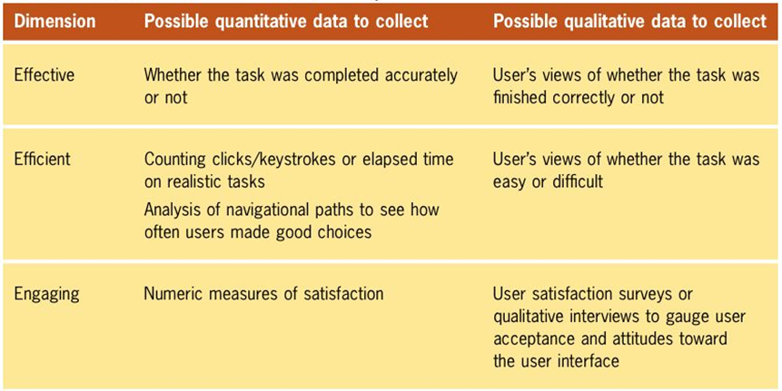
Dimensions of Usability Evaluations

Slide 57
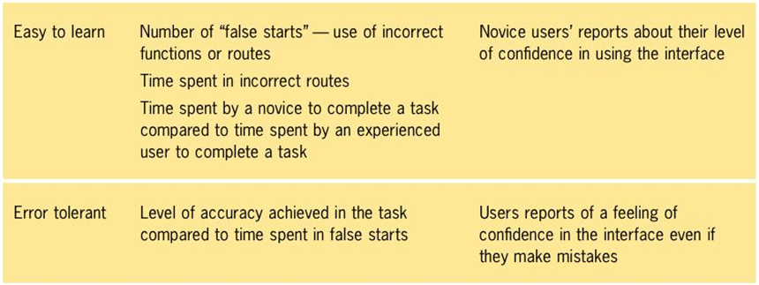
Dimensions of Usability Evaluations

Slide 58
In Class Activity
Visit the Priceline website and apply Neilsen’s Heuristics
https://www.priceline.com/?vrid=5d15f6adc2209968925f6f3c03eac0b1

Slide 59
References
Ben Shneiderman, and Catherine Plaisant, Designing the user interface, 5th Edition, Pearson Addison-Wesley, 2010
http://tims-ideas.blogspot.com/2011/06/usability-blooper-microsoft-excel.html
https://www.nngroup.com/articles/ten-usability-heuristics/
https://aelaschool.com/en/interactiondesign/10-usability-heuristics-ui-design/

