Slide 1
Software Engineering
(Documentation & Coding Standards)

Slide 2
Documentation & Coding Standards
Notes:
https://docs.oracle.com/javase/7/docs/api/
https://hg.openjdk.org/jdk8/jdk8/jdk/file/687fd7c7986d/src/share/classes/java/io/BufferedReader.java
https://github.com/minghui/Twitter-LDA
https://github.com/JU-High-Fives/Dhar-Hobe
‹#›

Slide 3
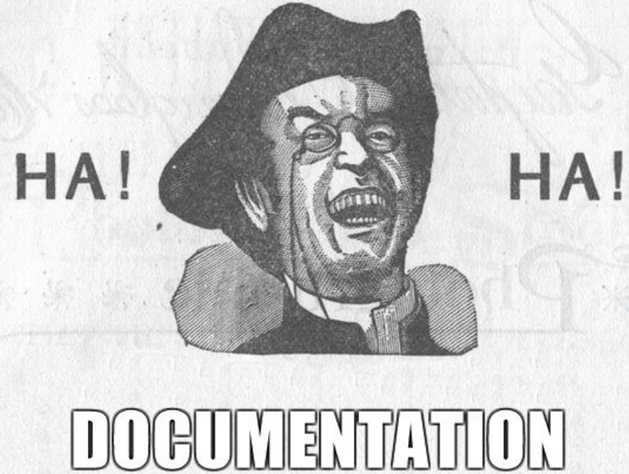

Slide 4
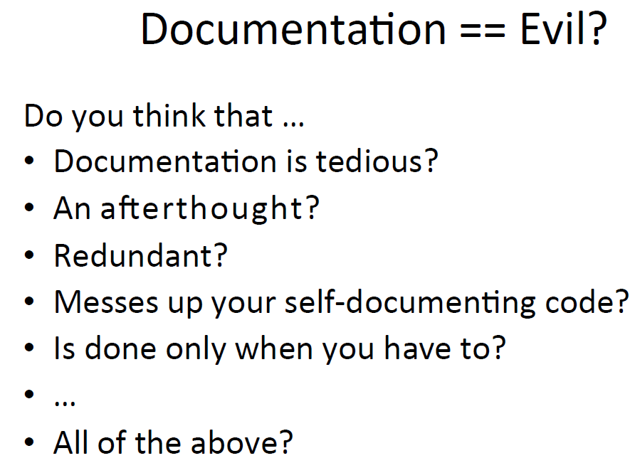

Slide 5
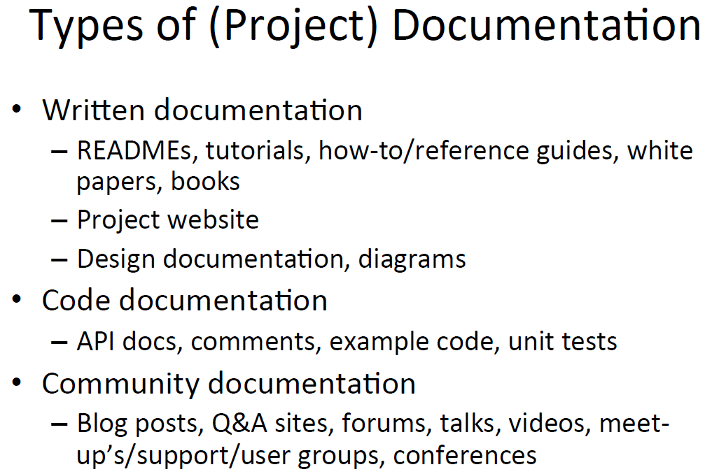

Slide 6
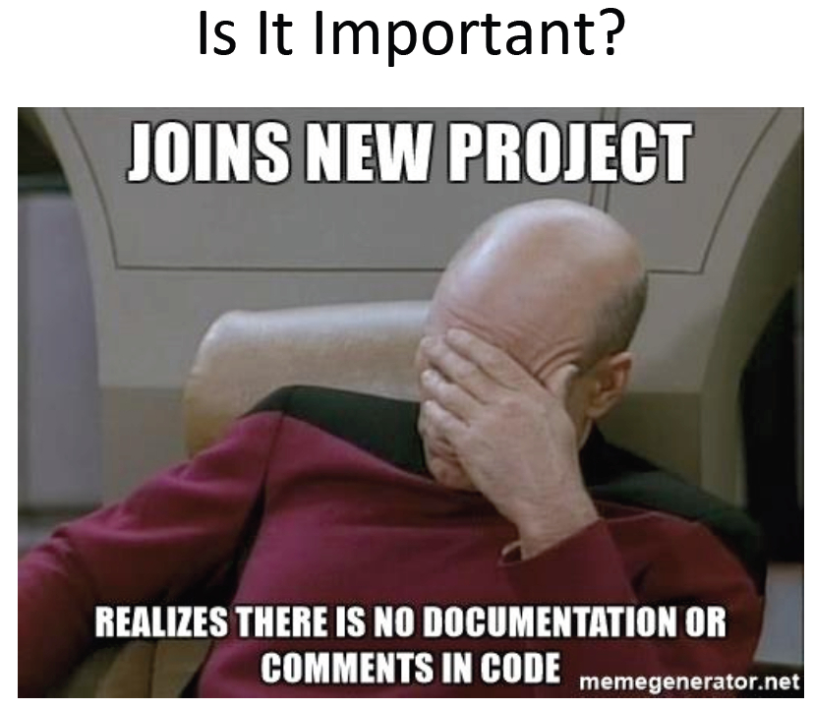

Slide 7
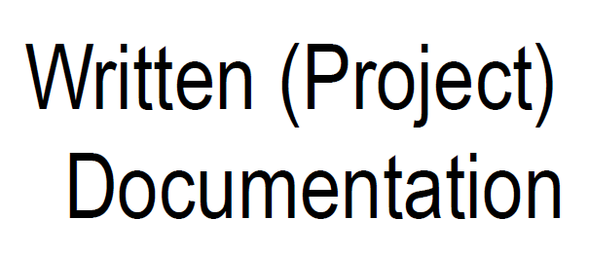

Slide 8
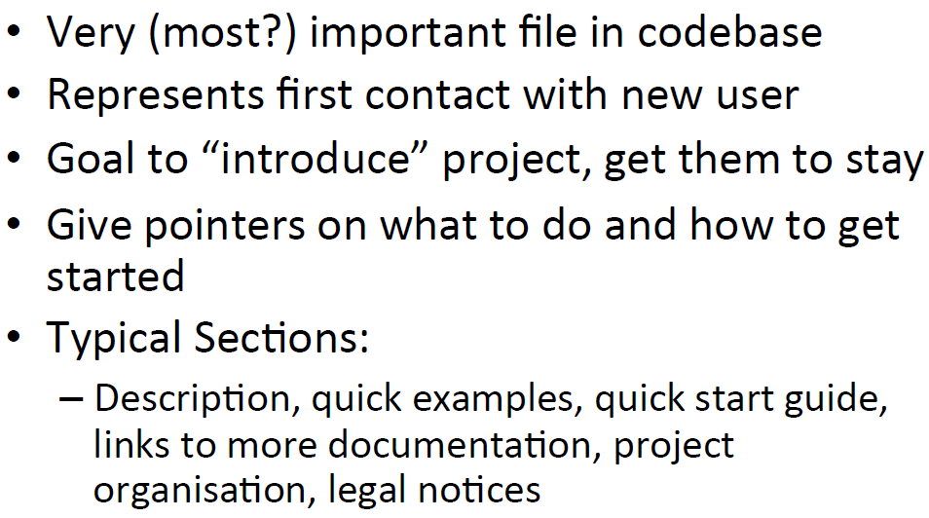
README files

Slide 9
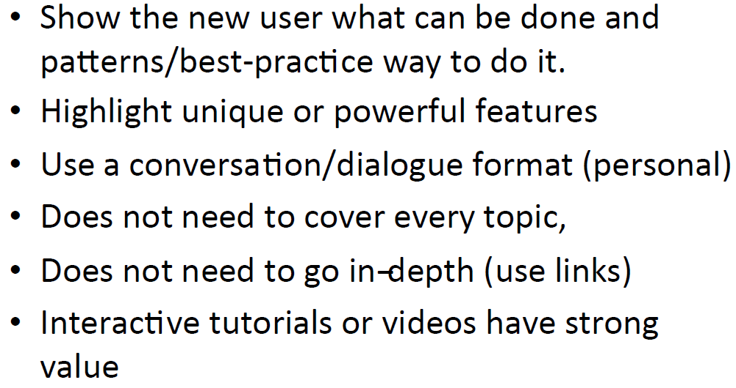
Tutorials / Guides

Slide 10
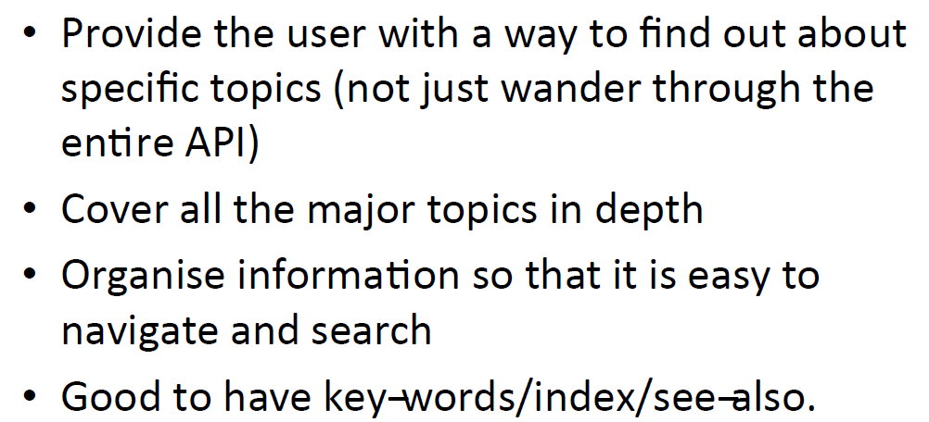
Reference Documentation

Slide 11
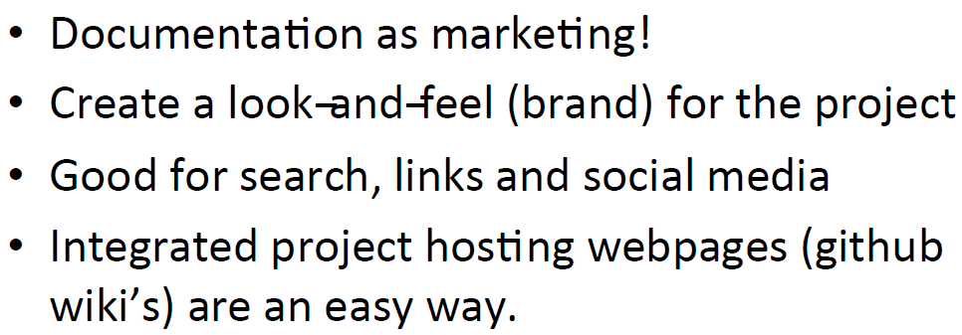
Project Website

Slide 12
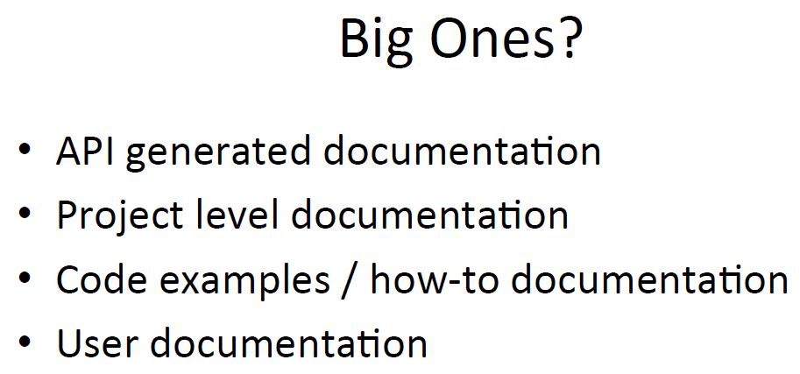

Slide 13
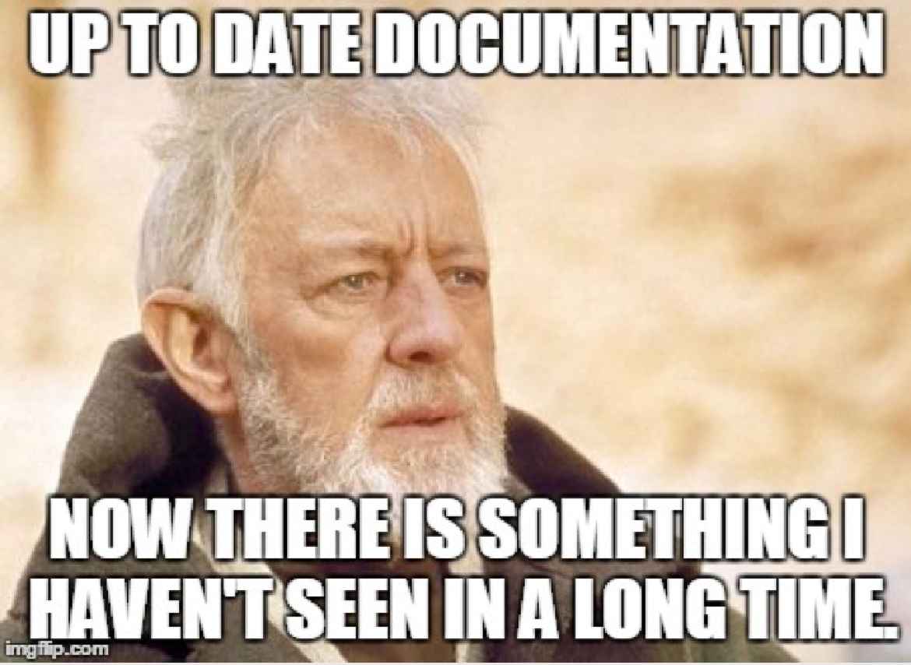

Slide 14
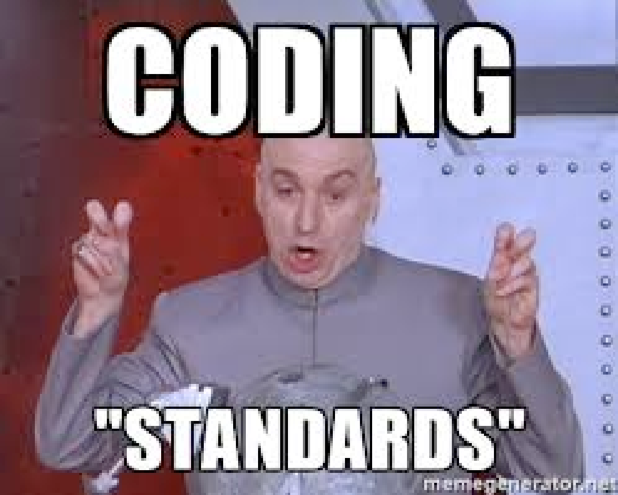
Coding Conventions & Standards

Slide 15
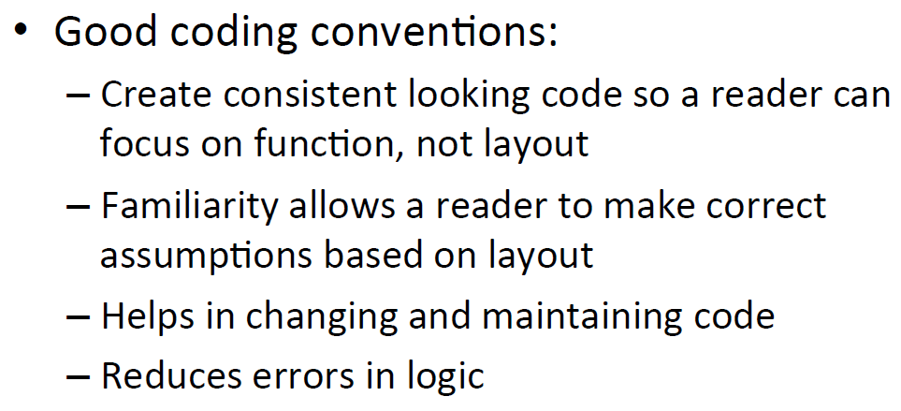
Conventions & Standards

Slide 16
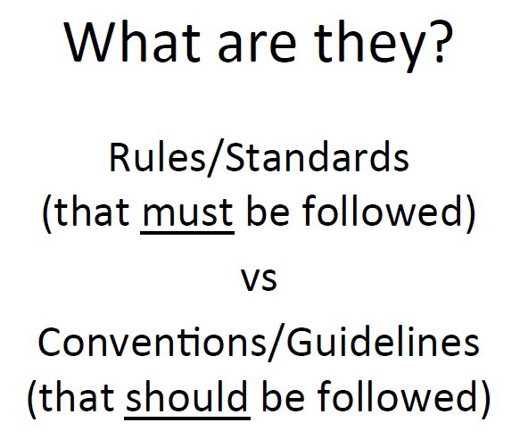

Slide 17
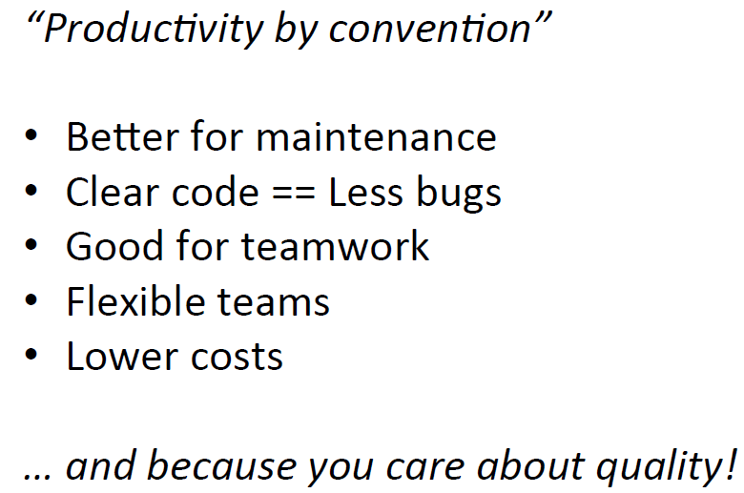
Why?

Slide 18
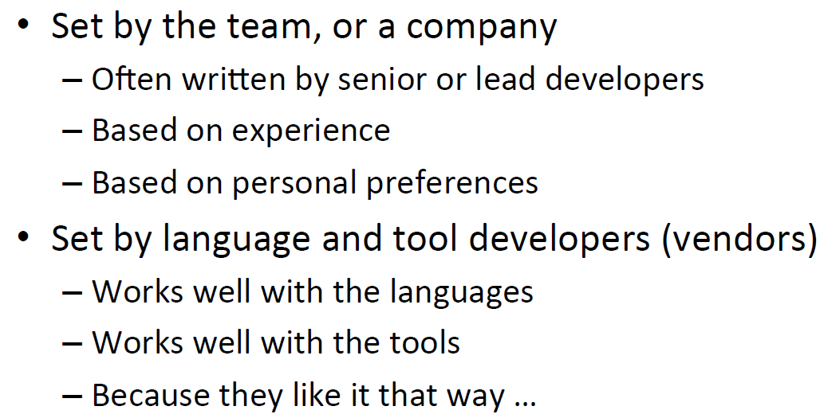
Where do they come from?

Slide 19
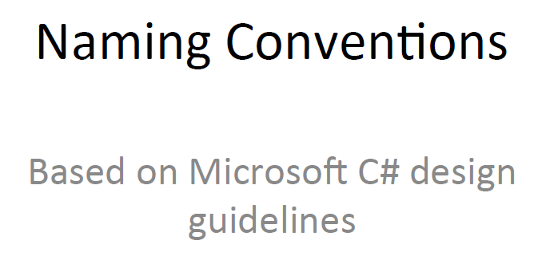

Slide 20
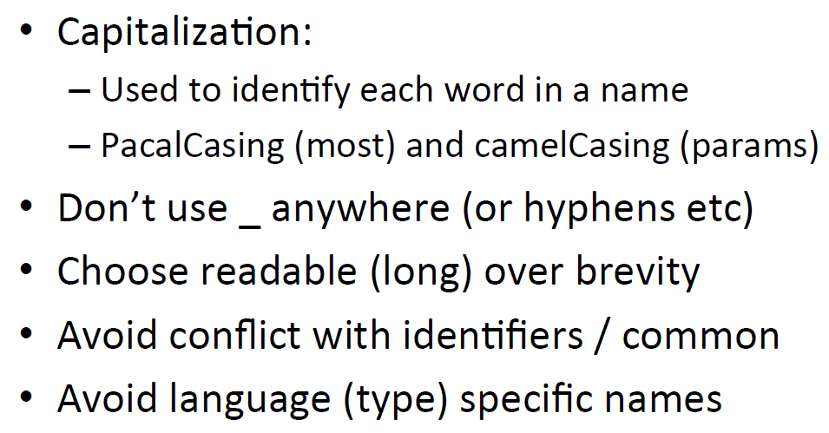
Naming Conventions

Slide 21
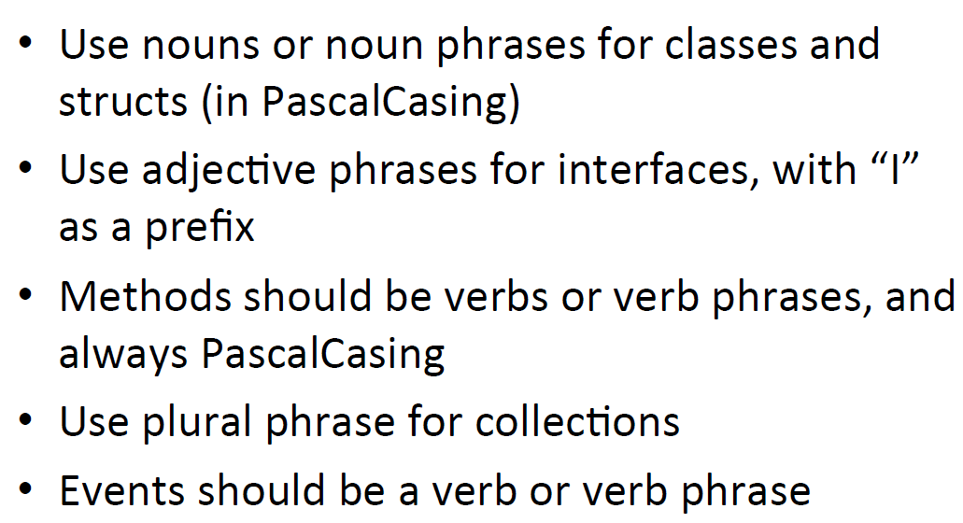
Naming Conventions

Slide 22
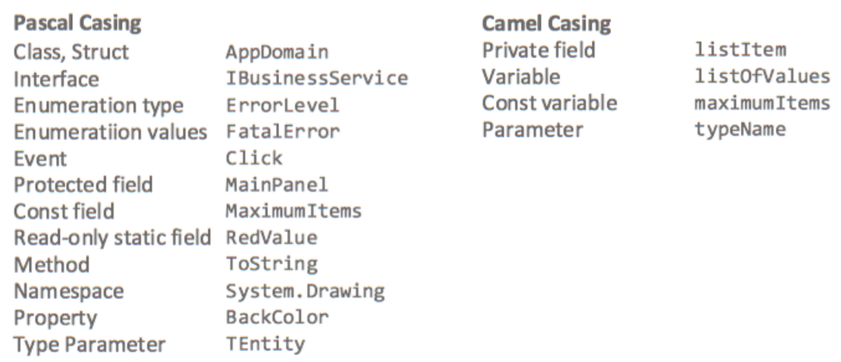
Naming Conventions

Slide 23
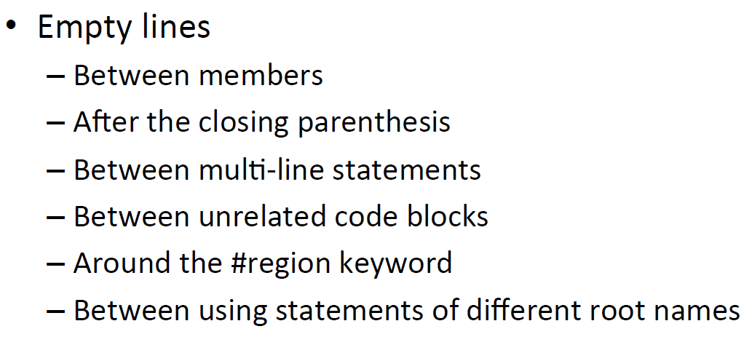
Layout Conventions

Slide 24
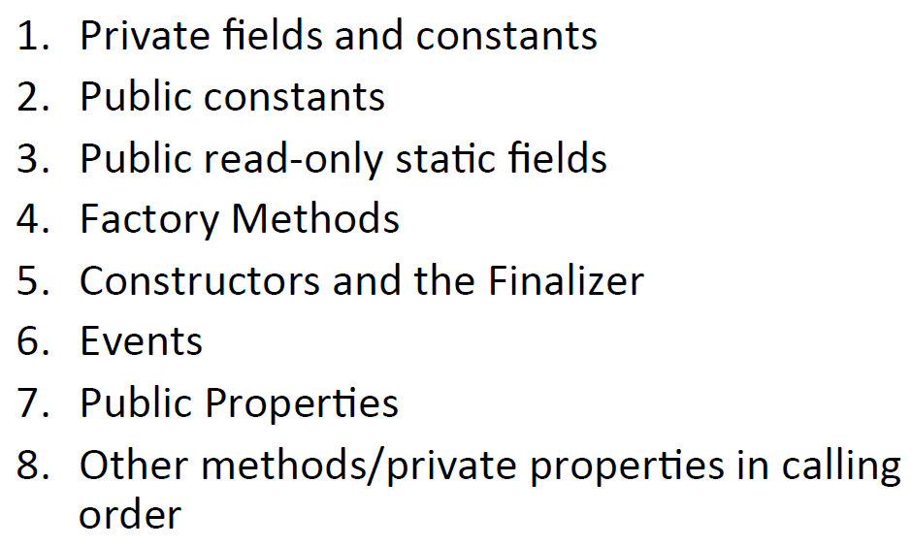
Member Order

Slide 25
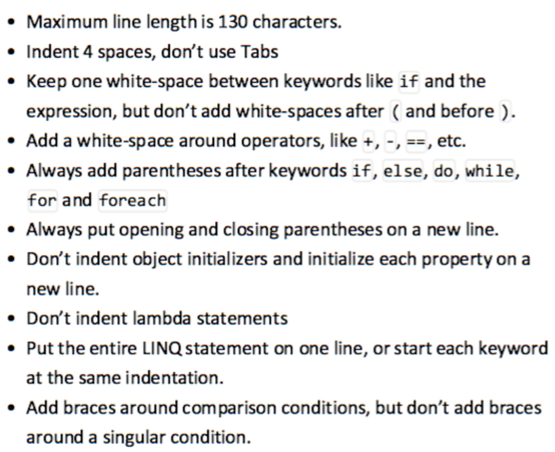
Layout Conventions

Slide 26
Code Comments

Slide 27
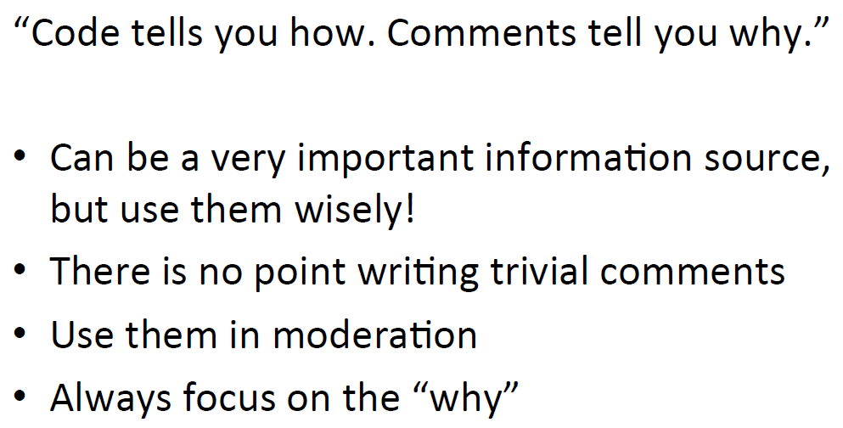
Comments

Slide 28


Slide 29
Coding Standards

Slide 30
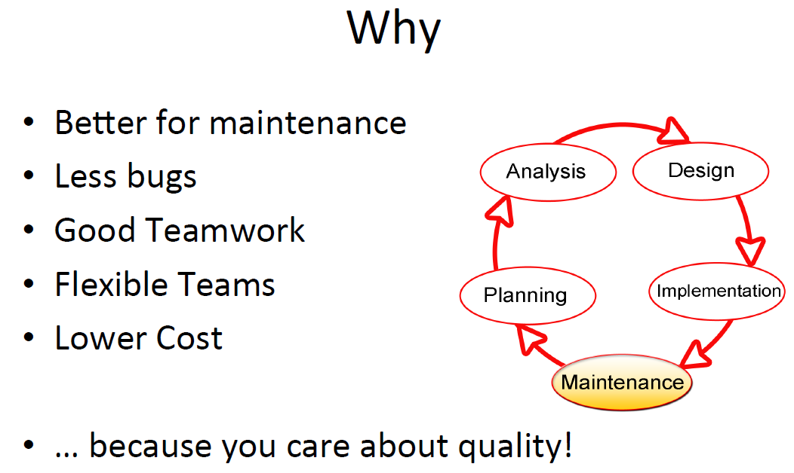

Slide 31
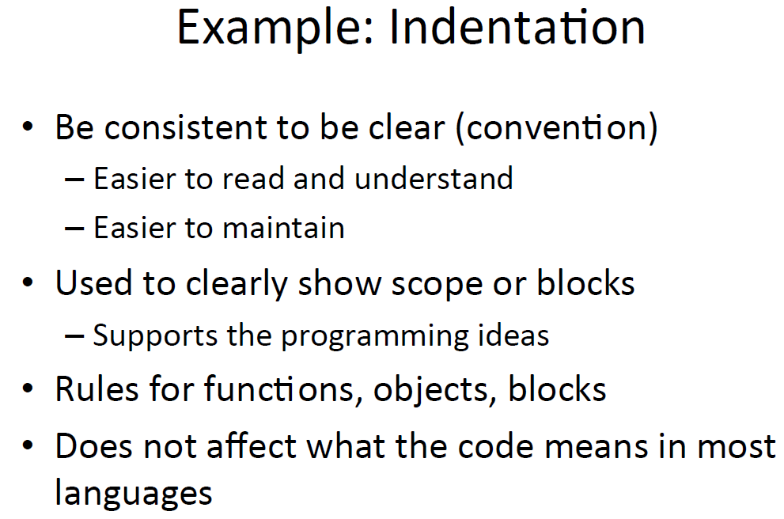

Slide 32
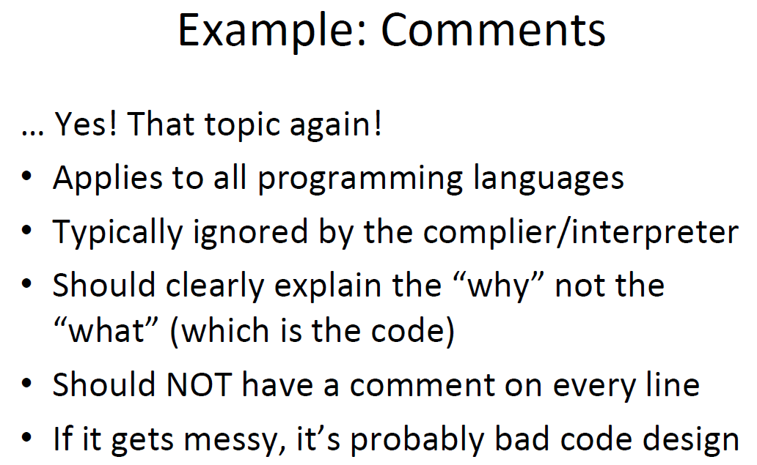

Slide 33
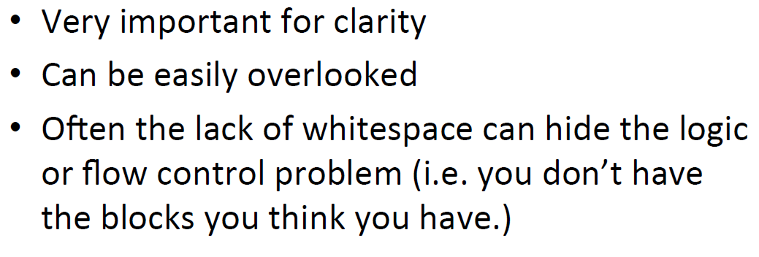
Example: Whitespace

Slide 34
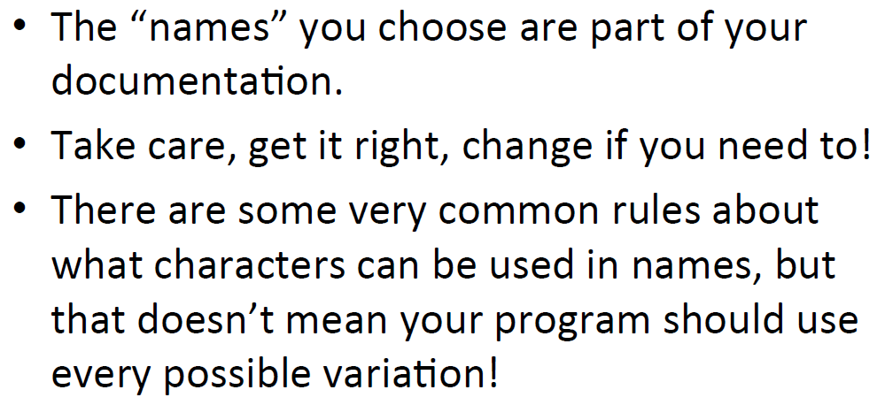
Example: Naming Convention

Slide 35
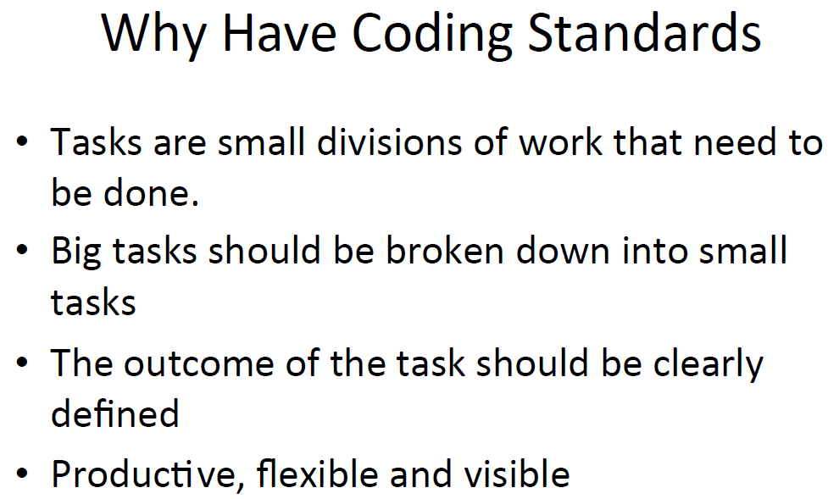

Slide 36
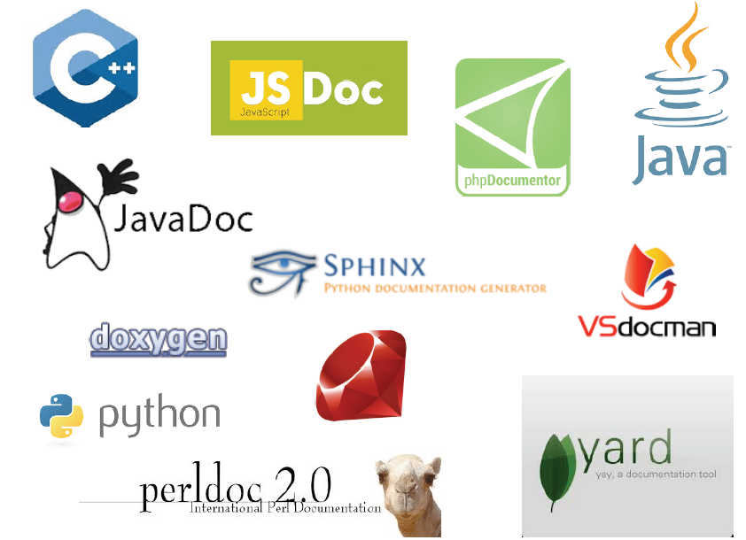
Documentation Generators

Slide 37
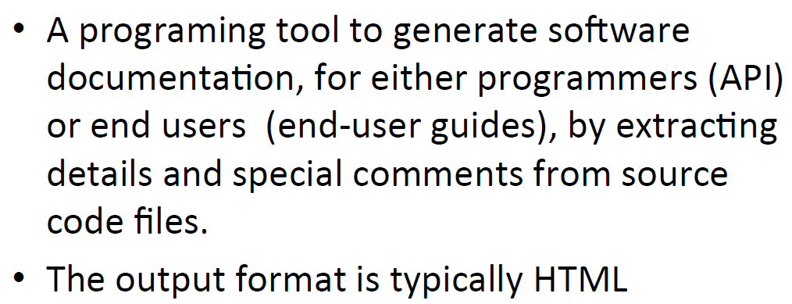
Documentation Generator

Slide 38
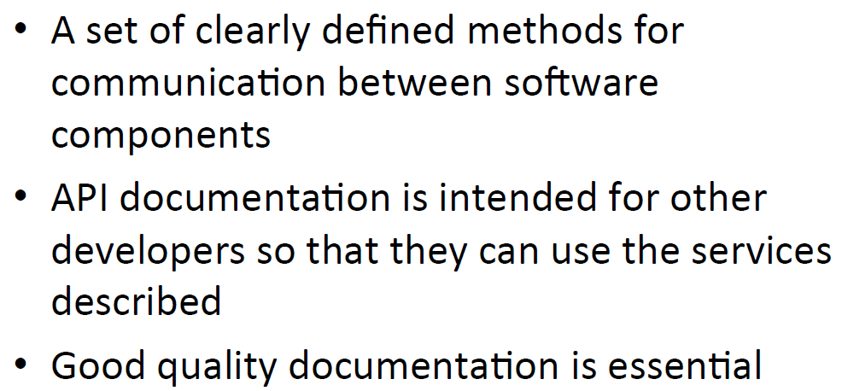
Application Programming Interface (API)

Slide 39
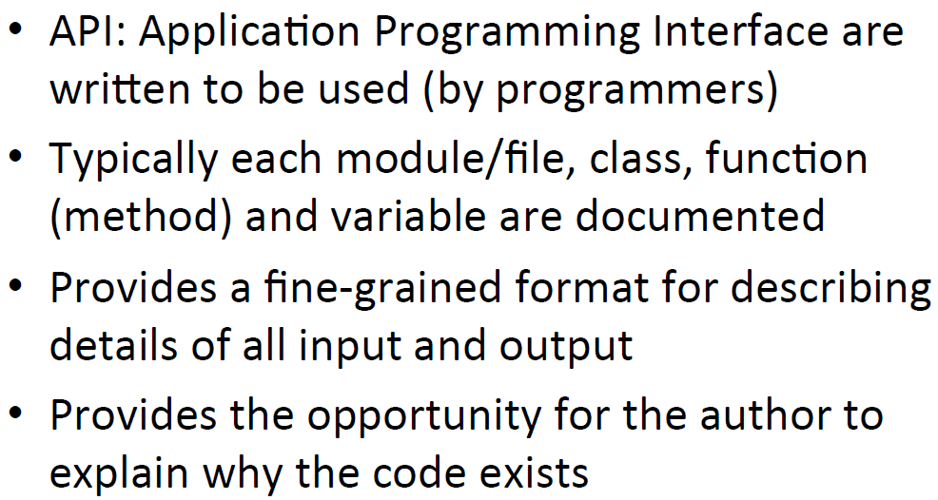
API Documentation

Slide 40
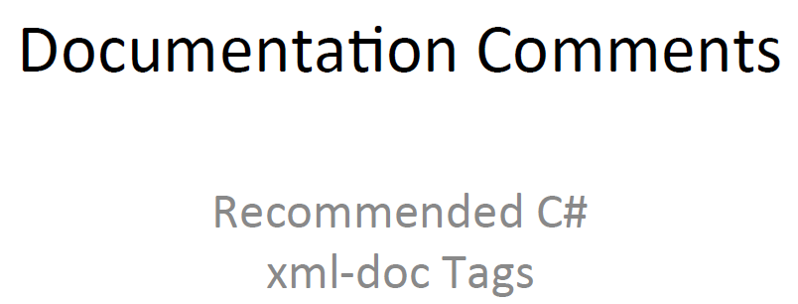

Slide 41
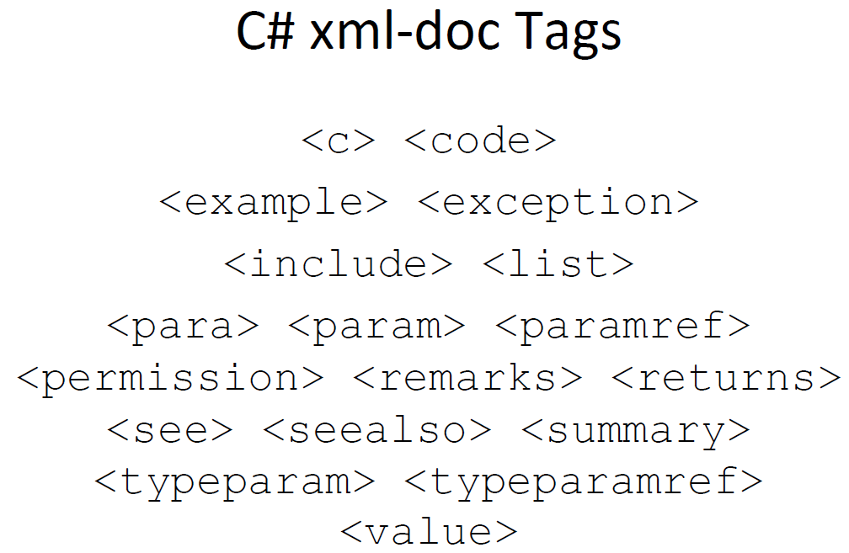

Slide 42
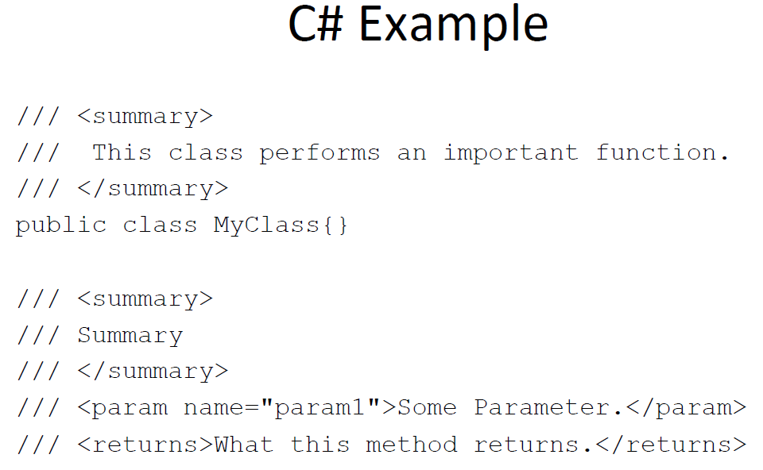

Slide 43
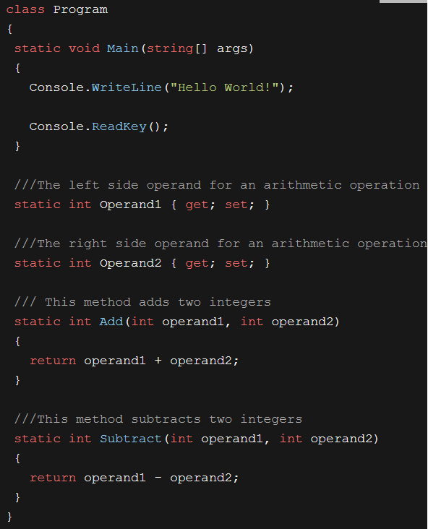

Slide 44
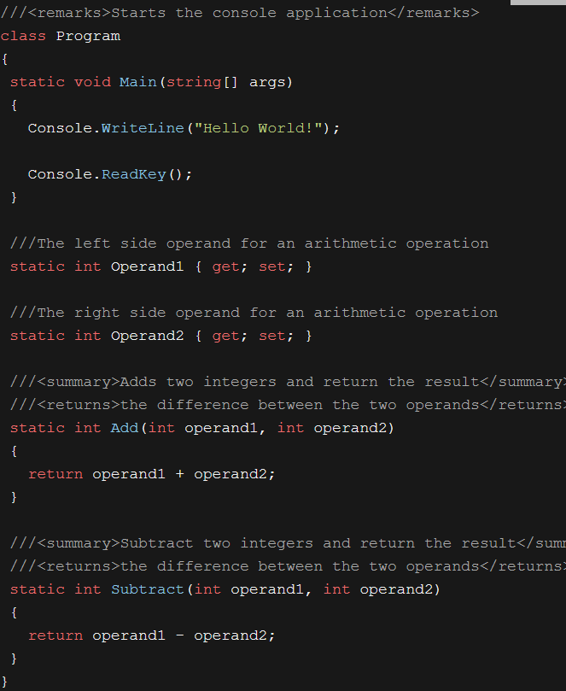

Slide 45
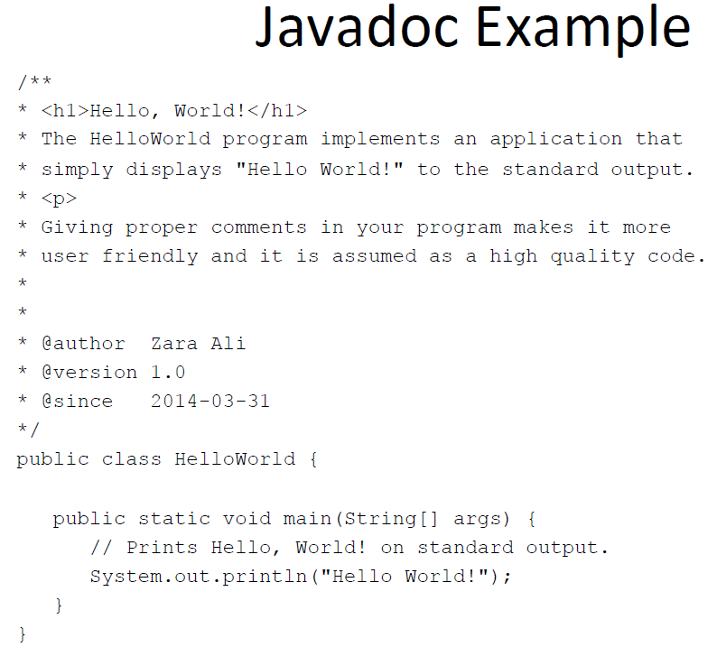

Slide 46
Community Documentation

Slide 47
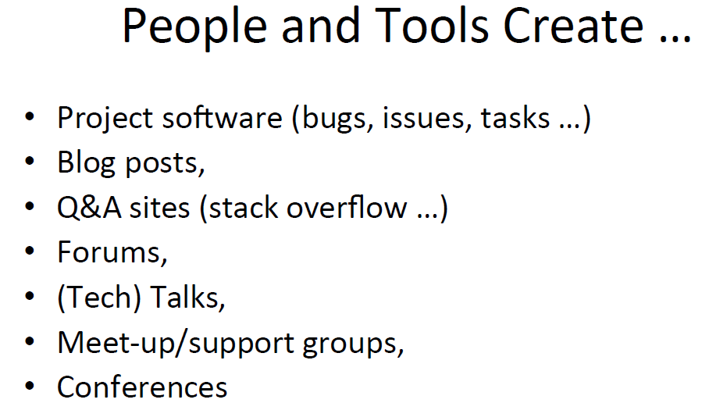

Slide 48
