Slide 1
Software Engineering
Lecture 8
(Issue/Bug Tracking)

Slide 2
Issue Tracking

Slide 3
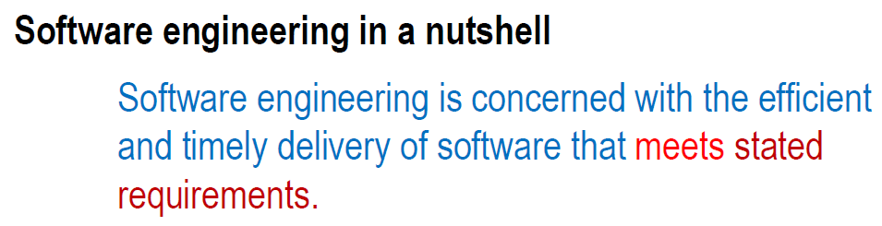
Remember

Slide 4
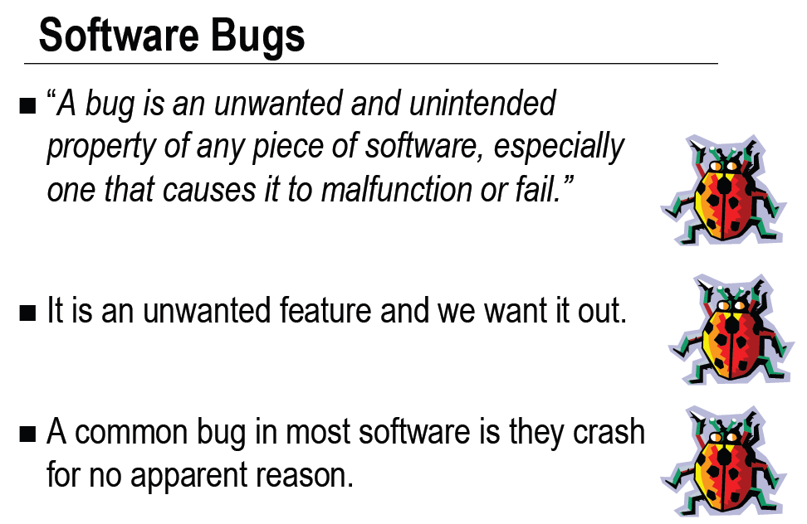

Slide 5
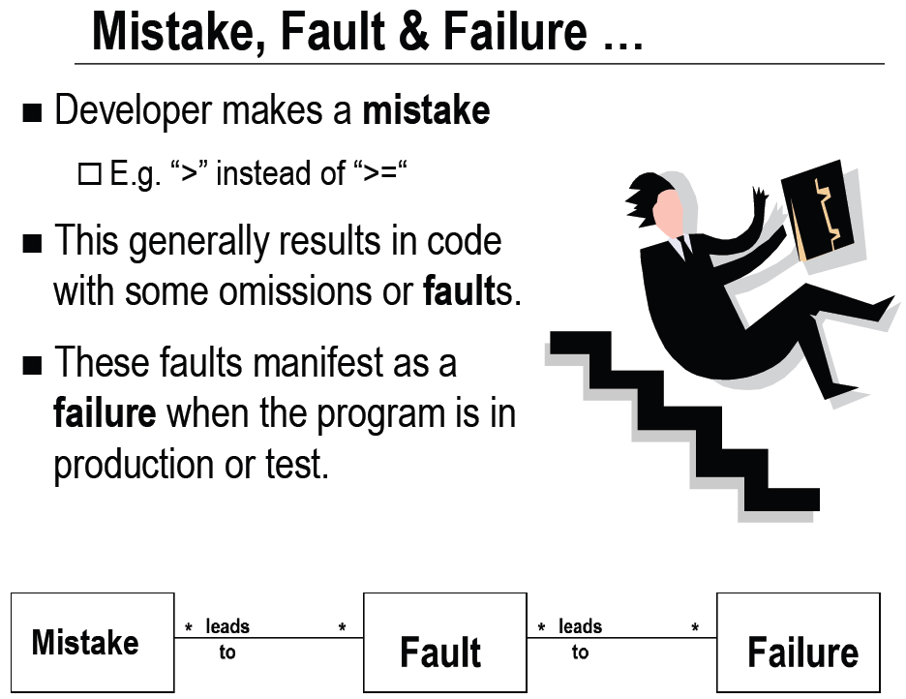


Slide 6
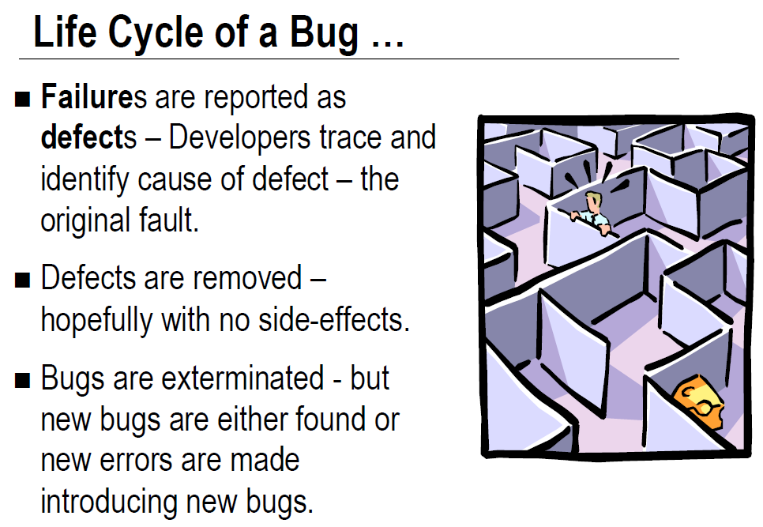

Slide 7
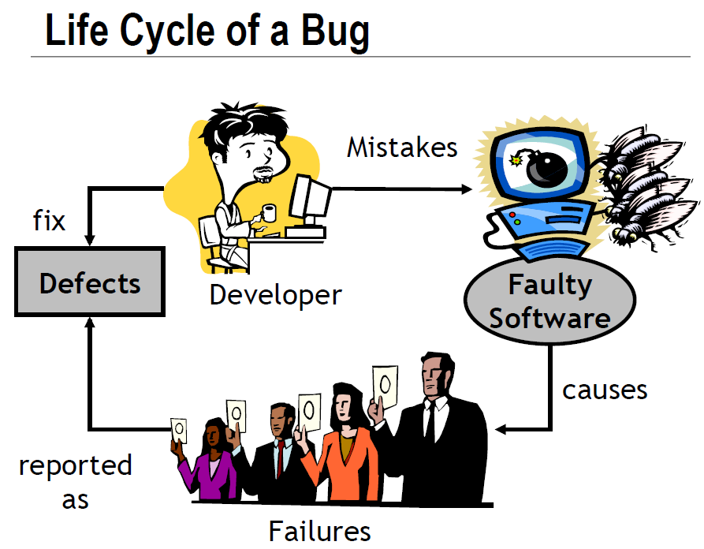

Slide 8
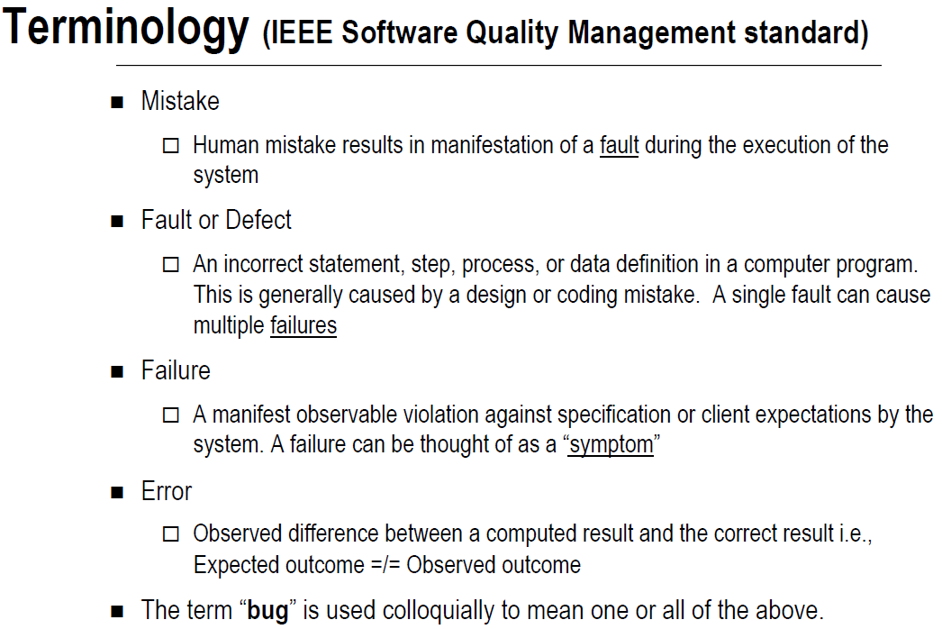

Slide 9
Terminology
Mistake
A human action that produces an incorrect result
For example, the type integer is used instead of double causing loss of information during execution.
Fault / Defect
Fault is a software defect (incorrect step, process or data definition) that causes a failure. Example, infinite program loop.
The adjudged cause of failure is called a fault. Example: A failure may be cause by a defective block of code.
Notes:
‹#›

Slide 10
Terminology
Failure
The inability of a system or component to perform its required functions within specified performance requirements .
A manifest observable violation against specification or client expectations by the system.
For example: Client requirement needs the administrator to be able to add new users, however, the system does not allow it.
Error
The difference between a computed, observed, or measured value or condition and the true, specified, or theoretically correct value or condition.
For example, if an equation should return 100 but is returning 99.95.
Notes:
‹#›

Slide 11
Terminology
Bug
A software bug is an error, failure, or fault in a computer program or system that causes it to produce an incorrect or unexpected result.
Notes:
‹#›

Slide 12
Fault and Failure Example
A patient gives a doctor a list of symptoms
Failures
The doctor tries to diagnose the root cause of the ailment
Fault
The doctor may look for anomalous internal conditions (high blood pressure, irregular heartbeat, bacteria in the blood stream)
Errors

Slide 13
Software Faults, Errors & Failures
Software Fault : A static defect in the software
Software Error : An incorrect internal state that is the manifestation of some fault
Software Failure : External, incorrect behavior with respect to the requirements or other description of the expected behavior
‹#›
Notes:
‹#›

Slide 14
A Concrete Example
Fault: Should start searching at 0, not 1
public static int numZero (int [ ] arr)
{ // Effects: If arr is null throw NullPointerException
// else return the number of occurrences of 0 in arr
int count = 0;
for (int i = 1; i < arr.length; i++)
{
if (arr [ i ] == 0)
{
count++;
}
}
return count;
}
Test 1
[ 2, 7, 0 ]
Expected: 1
Actual: 1
Error: i is 1, not 0, on the first iteration
Failure: none
Test 2
[ 0, 2, 7 ]
Expected: 1
Actual: 0
Error: i is 1, not 0
Error propagates to the variable count
Failure: count is 0 at the return statement

Slide 15
Terminology
Example:
Consider a medical doctor making a diagnosis for a patient. The patient informs the doctor with a list of symptoms (i.e. failures). The doctor then discovers the root cause (i.e. fault) of the symptoms. The doctor advises the patient to do some medical test and finds that the patient has high blood pressure, irregular heartbeat, high cholesterol etc. (which corresponds to error).
Notes:
‹#›

Slide 16
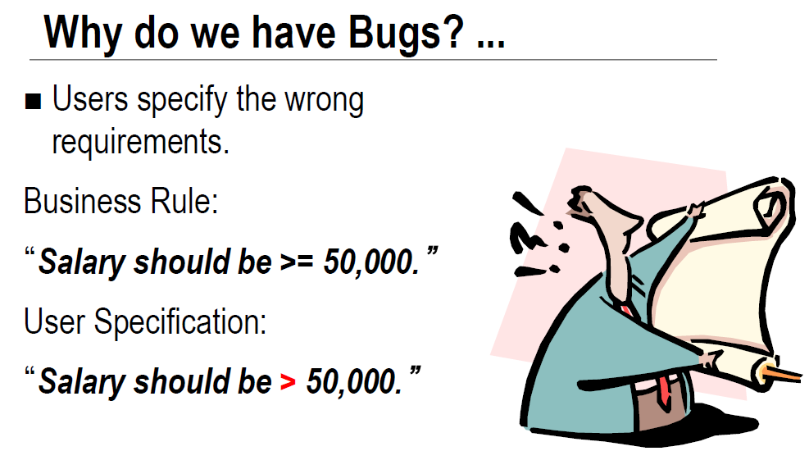

Slide 17
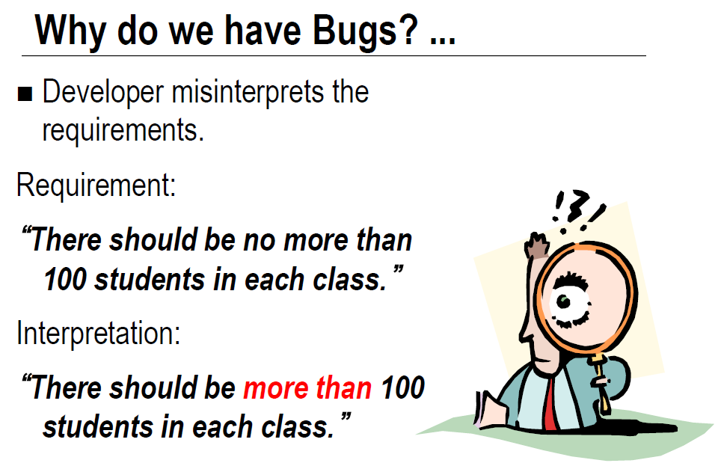

Slide 18
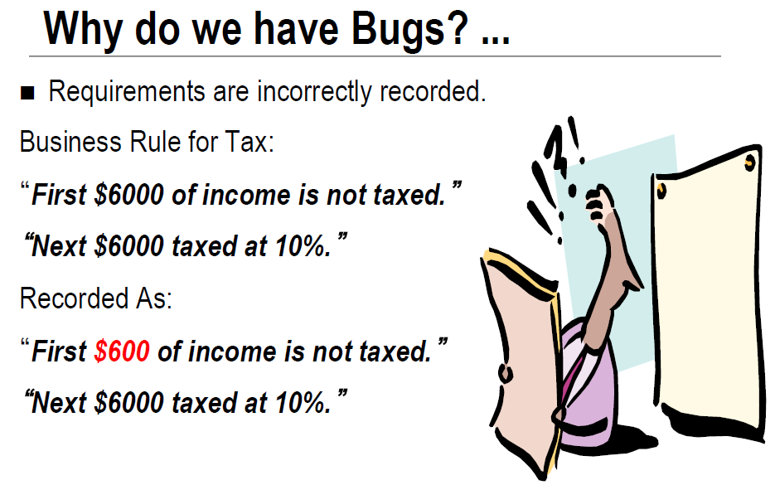

Slide 19
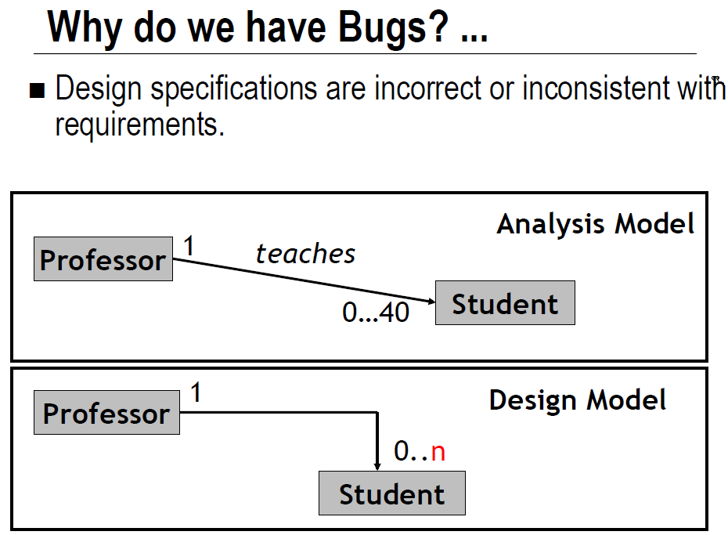

Slide 20
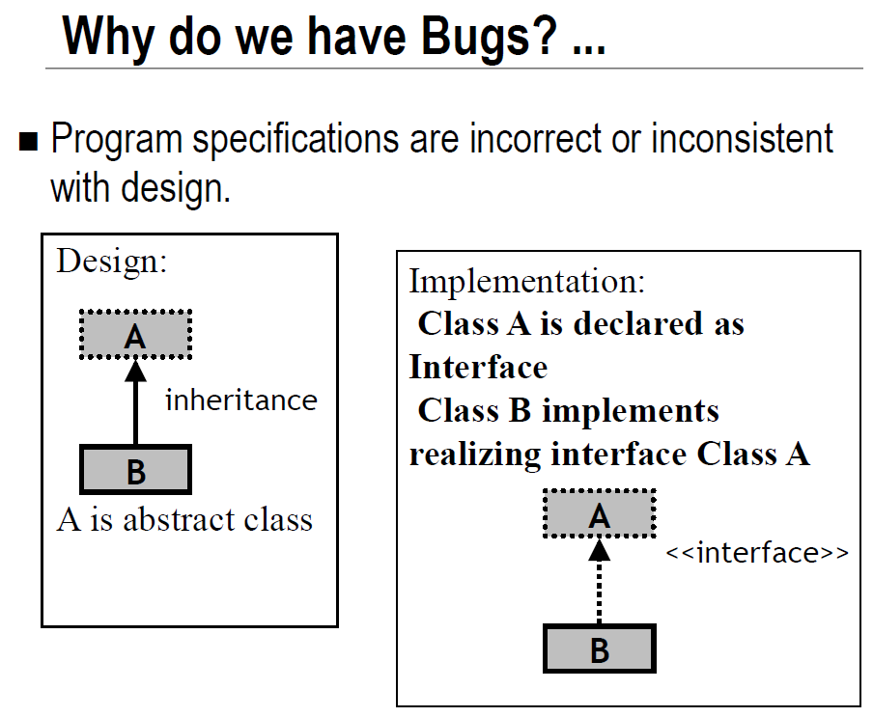

Slide 21
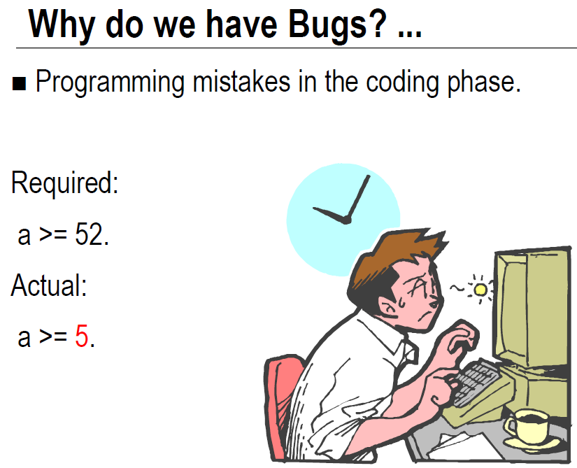

Slide 22
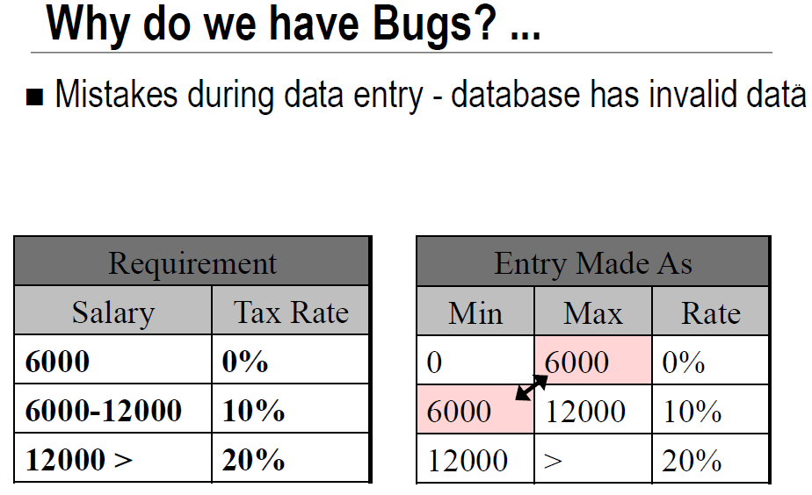

Slide 23
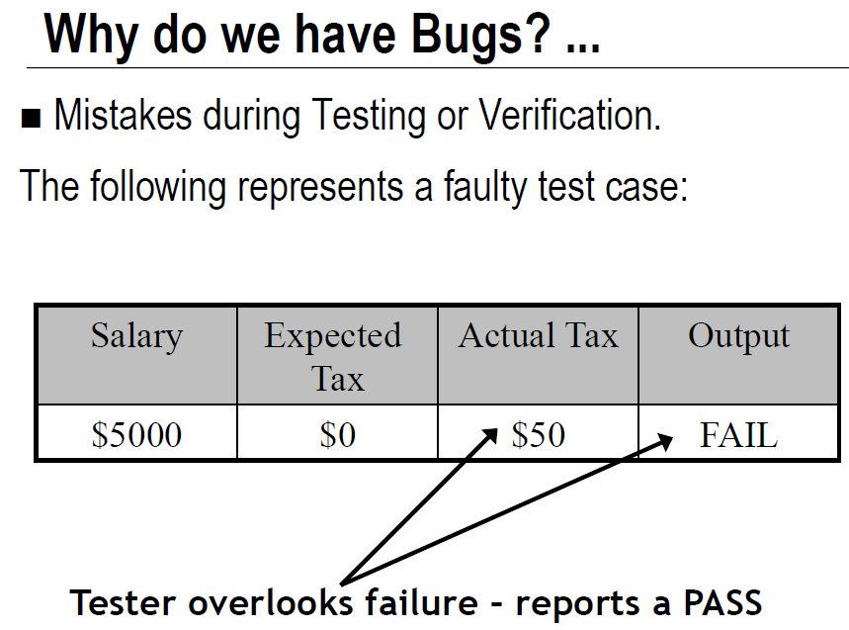

Slide 24
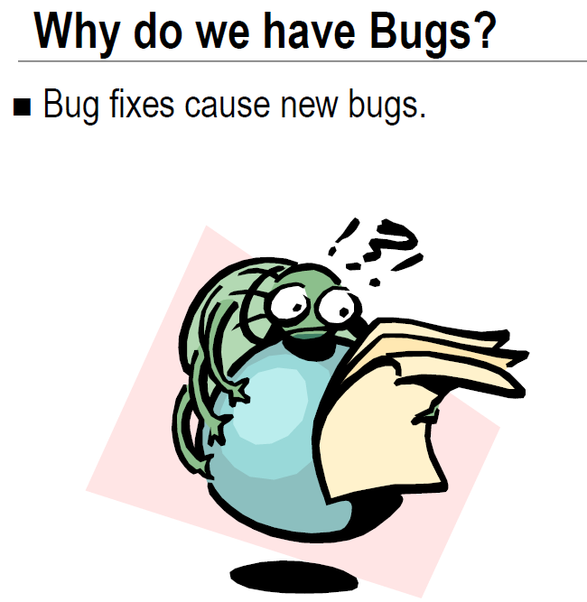

Slide 25
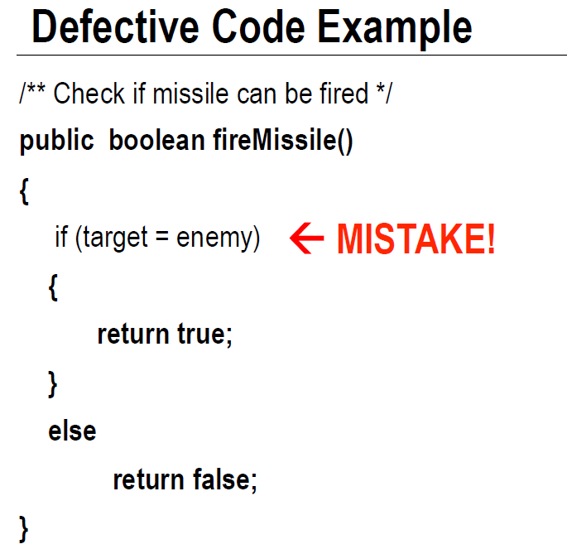

Slide 26
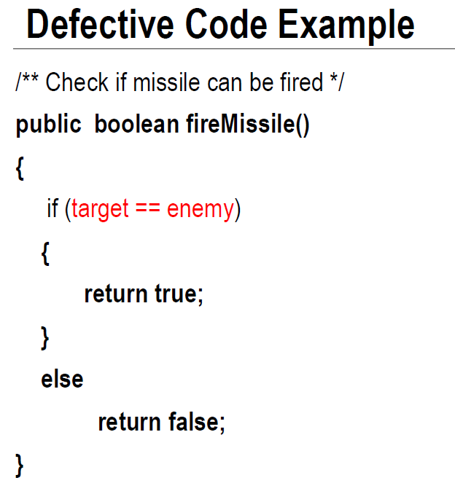

Slide 27
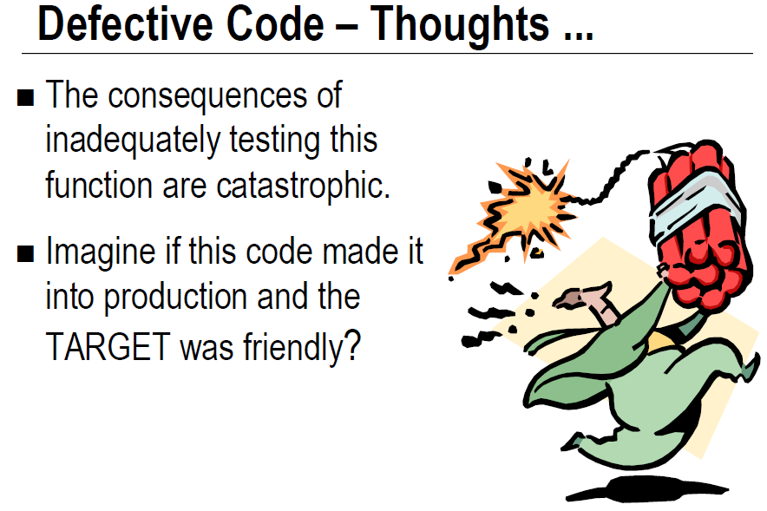

Slide 28
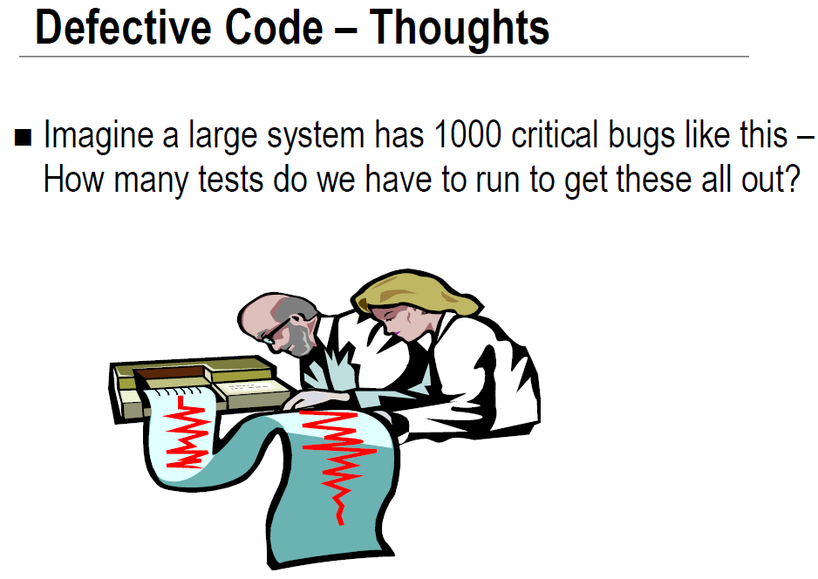

Slide 29
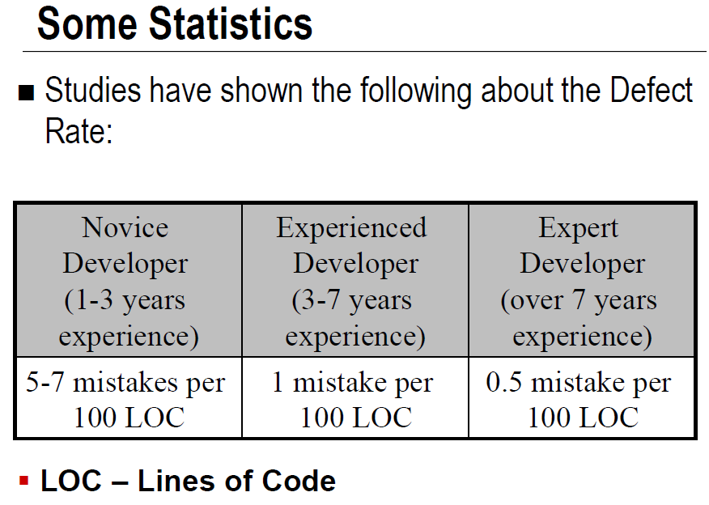

Slide 30
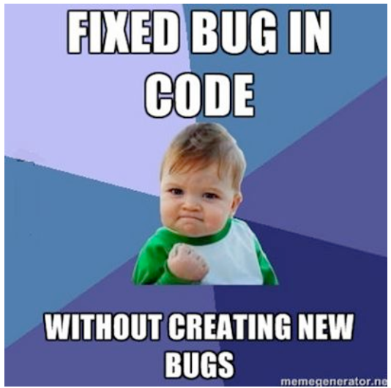

Slide 31
Software Development - Quality Control
To ensure functional and quality requirements are met we need a quality control mechanism
Verification and Validation (V&V) provides this control mechanism
Ensure high quality software
Combine preventative and corrective measures

Slide 32
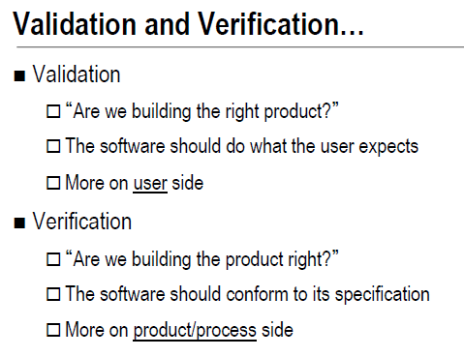

Slide 33
Verification & Validation (IEEE)
Verification : The process of determining whether the products of a given phase of the software development process fulfill the requirements established during the previous phase
Validation : The process of evaluating software at the end of software development to ensure compliance with intended usage
IV&V stands for “independent verification and validation”

Slide 34
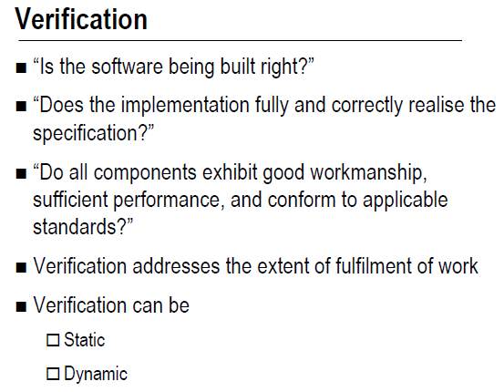

Slide 35
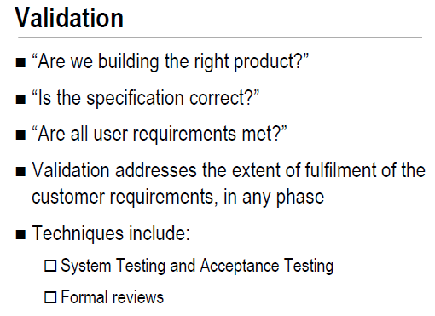

Slide 36
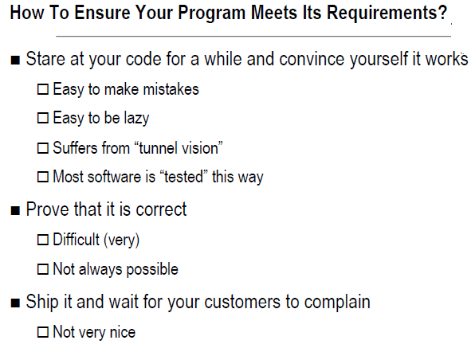

Slide 37
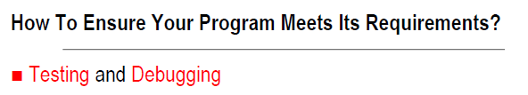
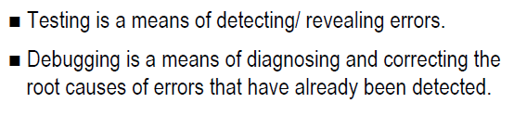

Slide 38
Terminology
Testing
Finding faults or defects in the program or system by using various inputs and conditions.
Verifying correct behaviour.
It is the process of evaluating a system with the intent to find whether it satisfies the specified requirements or not.
In simple words, testing is executing a system in order to identify any gaps, errors, or missing requirements in contrary to the actual requirements.
Debugging
Fix a specific problem of the program or the system by finding the defect and the cause of the defect.
Checks, detects and corrects errors or bugs to allow proper program operation according to set specifications.
Notes:
‹#›

Slide 39
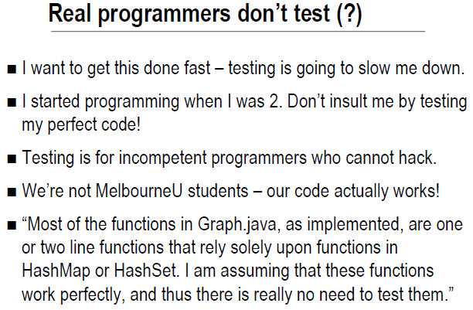

Slide 40






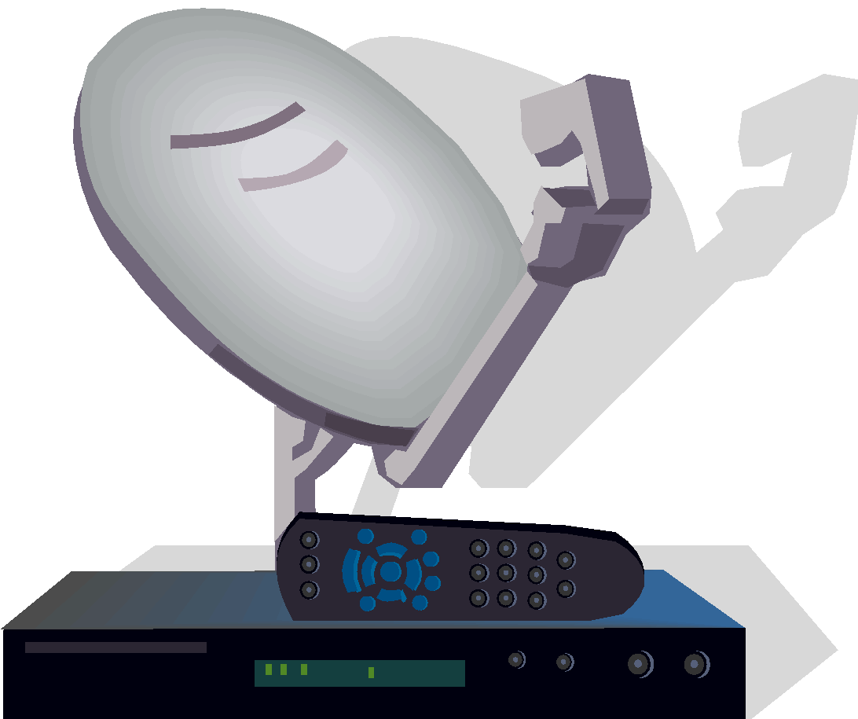
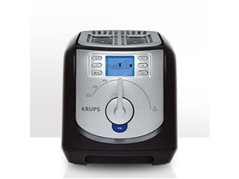




Software is a Skin that Surrounds Our Civilization
Quote due to Dr. Mark Harman
Notes:
‹#›

Slide 41
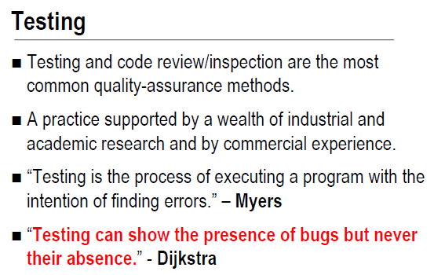

Slide 42
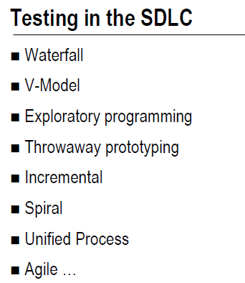

Slide 43
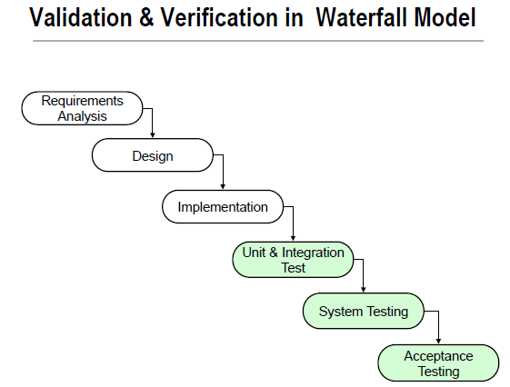

Slide 44
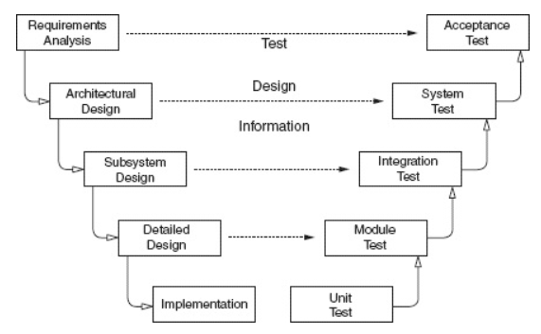
Traditional Testing Levels
Figure: Software development activities and testing levels – the “V Model”
*

Slide 45
V-Model
The requirements analysis phase of software development captures the customer’s needs.
Acceptance testing is designed to determine whether the completed software in fact meets these needs. In other words, acceptance testing probes whether the software does what the users want.
Acceptance testing must involve users or other individuals who have strong domain knowledge.

Slide 46
V-Model Cont.
The architectural design phase of software development chooses components and connectors that together realize a system whose specification is intended to meet the previously identified requirements.
System testing is designed to determine whether the assembled system meets its specifications. It assumes that the pieces work individually, and asks if the system works as a whole.
This level of testing usually looks for design and specification problems.
It is a very expensive place to find lower-level faults and is usually not done by the programmers, but by a separate testing team

Slide 47
V-Model Cont.
The subsystem design phase of software development specifies the structure and behavior of subsystems, each of which is intended to satisfy some function in the overall architecture. Often, the subsystems are adaptations of previously developed software.
Integration testing is designed to assess whether the interfaces between modules (defined below) in a subsystem have consistent assumptions and communicate correctly.
Integration testing must assume that modules work correct.
Integration testing is usually the responsibility of members of the development team.

Slide 48
V-Model Cont.
The detailed design phase of software development determines the structure and behavior of individual modules. A module is a collection of related units that are assembled in a file, package, or class.
This corresponds to a file in C, a package in Ada, and a class in C++ and Java.
Module testing is designed to assess individual modules in isolation, including how the component units interact with each other and their associated data structures.
Most software development organizations make module testing the responsibility of the programmer; hence the common term developer testing.

Slide 49
V-Model Cont.
Implementation is the phase of software development that actually produces code. A program unit, or procedure, is one or more contiguous program statements, with a name that other parts of the software use to call it.
Units are called functions in C and C++, procedures or functions in Ada, methods in Java, and subroutines in Fortran.
Unit testing is designed to assess the units produced by the implementation phase and is the “lowest” level of testing.
As with module testing, most software development organizations make unit testing the responsibility of the programmer, again, often called developer testing.

Slide 50
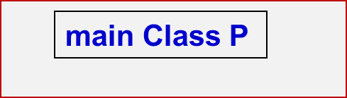
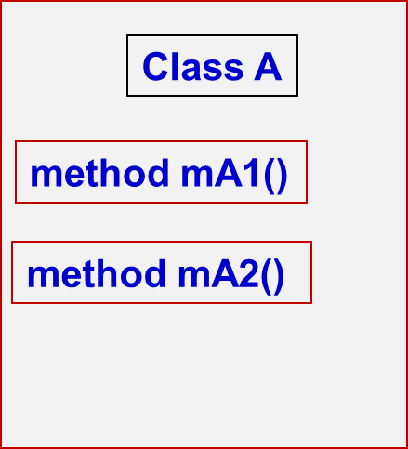
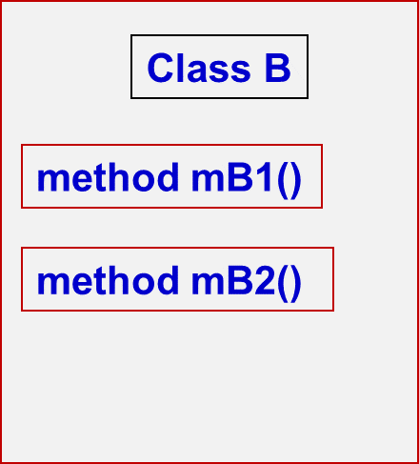
Traditional Testing Levels
Acceptance testing : Is the software acceptable to the user?
System testing : Test the overall functionality of the system
Integration testing : Test how modules interact with each other
Module testing (developer testing) : Test each class, file, module, component
Unit testing (developer testing) : Test each unit (method) individually
This view obscures underlying similarities
*
‹#›

Slide 51
Object-Oriented Testing Levels
Inter-class testing : Test multiple classes together
Class A
Class B
Intra-class testing : Test an entire class as sequences of calls
method mA1()
method mB1()
method mA2()
method mB2()
Inter-method testing : Test pairs of methods in the same class
Intra-method testing : Test each method individually
*

Slide 52
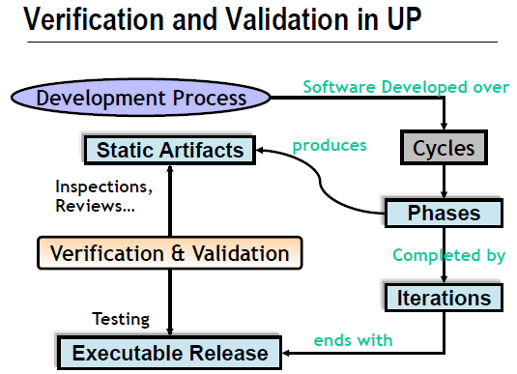

Slide 53
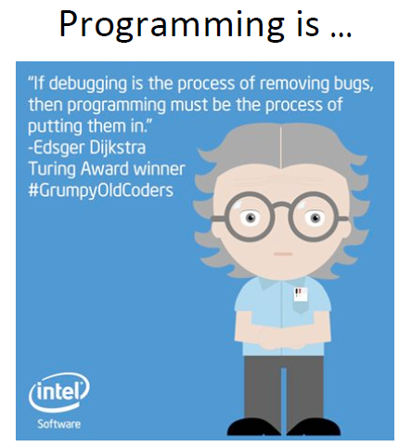

Slide 54
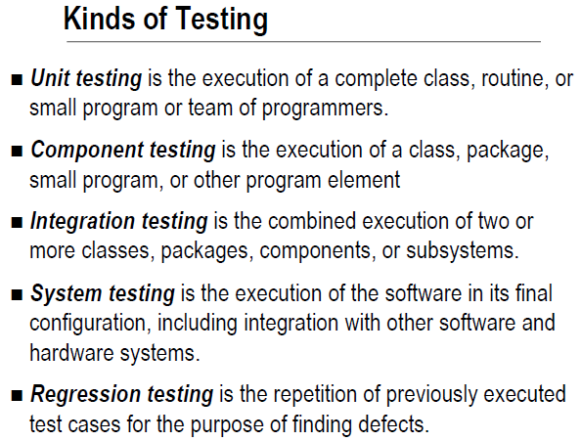

Slide 55
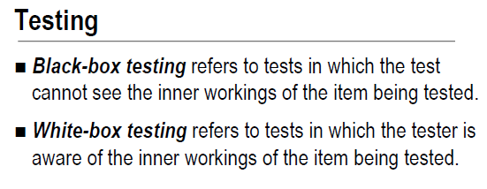

Slide 56
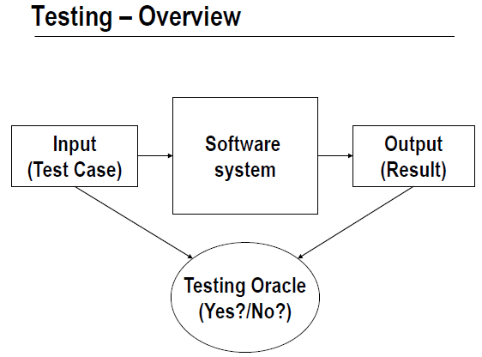

Slide 57
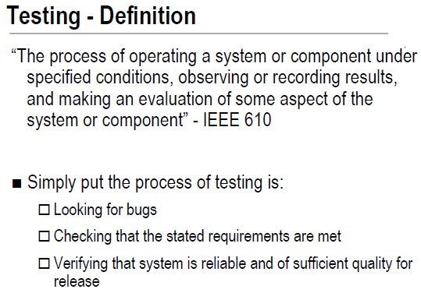

Slide 58
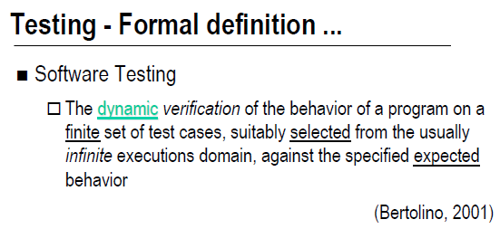

Slide 59
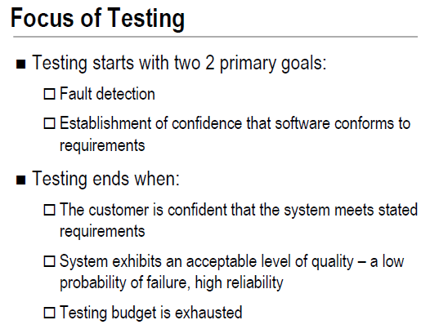

Slide 60
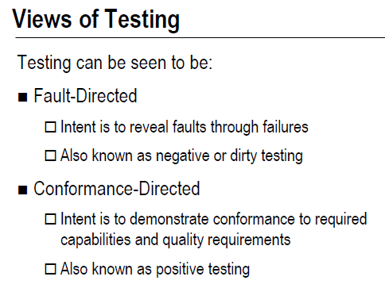

Slide 61
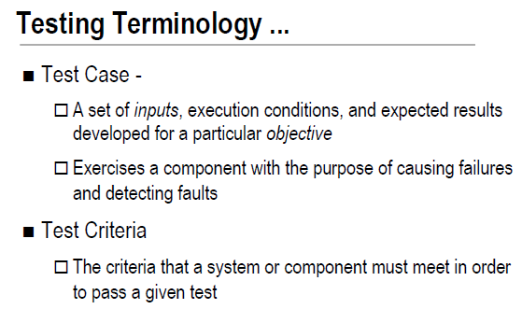

Slide 62
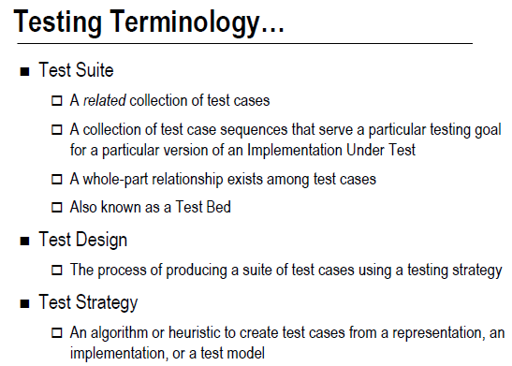

Slide 63
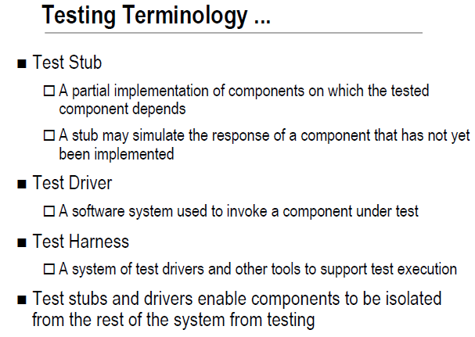

Slide 64
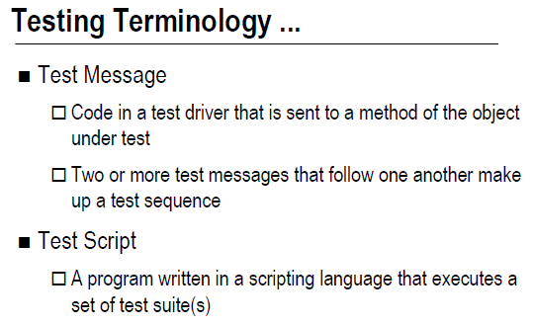

Slide 65


Slide 66


Slide 67


Slide 68


Slide 69


Slide 70


Slide 71


Slide 72


Slide 73


Slide 74


Slide 75


Slide 76


Slide 77


Slide 78


Slide 79


Slide 80


Slide 81


Slide 82


Slide 83


Slide 84


Slide 85


Slide 86


Slide 87


Slide 88


Slide 89


Slide 90


Slide 91


Slide 92


Slide 93


