Slide 1
Software Engineering (CSE 403)
Lecture 10
(White Box Testing)

Slide 2
White Box Testing
Notes:
‹#›

Slide 3
White Box Testing: Introduction
Test Engineers have access to the source code.
Typical at the Unit Test level as the programmers have knowledge of the internal logic of code.
Tests are based on coverage of:
Code statements;
Branches;
Paths;
Conditions.
Most of the testing techniques are based on Control Flow Graph (denoted as CFG) of a code fragment.
Notes:
‹#›

Slide 4
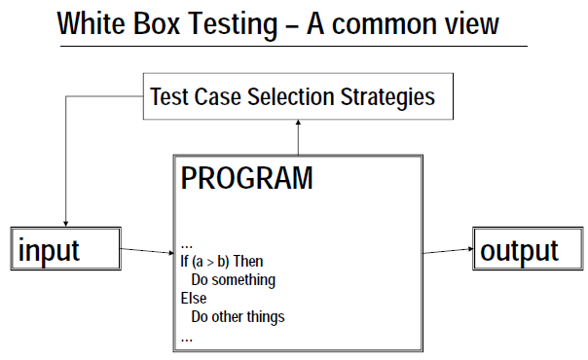

Slide 5
Control Flow Graph: Introduction
An abstract representation of a structured program/function/method.
Consists of two major components:
Node:
Represents a stretch of sequential code statements with no branches.
Directed Edge (also called arc):
Represents a branch, alternative path in execution.
Path:
A collection of Nodes linked with Directed Edges.
Notes:
‹#›

Slide 6
Simple Examples
int a;
float b;
printf("Hello World"); scanf("%d", &a);
Statement1;
Statement2;
Statement3;
Statement4;
Can be represented as one node as there is no branch.
1
CFG
Statement1;
Statement2;
if X < 10 then
Statement3;
Statement4;
1
T
3
1
2
2
3
F
4
CFG
4
Notes:
‹#›

Slide 7
More Examples
if X > 0 then
Statement1; else Statement2;
1
T
2
2
1
4
3
3
F
CFG
Notes:
‹#›

Slide 8
More Examples
if X > 0 then
Statement1; else Statement2;
1
T
2
2
1
4
3
3
F
CFG
F
while X < 10 {
Statement1; X++; }
1
2
1
2
3
4
T
3
CFG
Question: Why is there a node 4 in both CFGs?
Notes:
‹#›

Slide 9
Notation Guide for CFG
A CFG should have:
1 entry arc (known as a directed edge, too).
1 exit arc.
All nodes should have:
At least 1 entry arc.
At least 1 exit arc.
A Logical Node that does not represent any actual statements can be added as a joining point for several incoming edges.
Represents a logical closure.
Example:
Node 4 in the if-then-else example from previous slide.
Notes:
‹#›

Slide 10
Example: Minimum Element
min = A[0];
I = 1;
while (I < N) {
if (A[I] < min)
min = A[I];
I = I + 1;
}
print min
1
1
2
2
F
T
3
3
4
F
T
5
5
4
6
6
CFG
Note: The CFG is INCOMPLETE. Try to complete it
Notes:
‹#›

Slide 11
Number of Paths through CFG
Given a program, how do we exercise all statements and branches at least once?
Translating the program into a CFG, an equivalent question is:
Given a CFG, how do we cover all arcs and nodes at least once?
Since a path is a trail of nodes linked by arcs, this is similar to ask:
Given a CFG, what is the set of paths that can cover all arcs and nodes?
Notes:
‹#›

Slide 12
Example
T
3
1
2
1
F
4
CFG
CFG
Only one path is needed:
[ 1 ]
Two paths are needed:
[ 1 – 2 – 4 ]
[ 1 – 2 – 3 – 4 ]
T
2
1
4
Two paths are needed:
[ 1 – 2 – 4 ]
[ 1 – 3 – 4 ]
3
F
CFG
Notes:
‹#›

Slide 13
White Box Testing: Path Based
A generalized technique to find out the number of paths needed (known as cyclomatic complexity) to cover all arcs and nodes in CFG.
Steps:
Draw the CFG for the code fragment.
Compute the cyclomatic complexity number C, for the CFG.
Find at most C paths that cover the nodes and arcs in a CFG, also known as Basic Paths Set;
Design test cases to force execution along paths in the Basic Paths Set.
Notes:
‹#›

Slide 14
Path Based Testing: Step 1
min = A[0];
I = 1;
while (I < N) {
if (A[I] < min)
min = A[I];
I = I + 1;
}
print min
1
1
2
2
F
T
3
3
4
F
T
5
5
4
6
6
CFG
Notes:
‹#›

Slide 15
Path Base Testing: Step 2
1
Cyclomatic complexity =
The number of ‘regions’ in the graph; OR
The number of predicates + 1.
2
F
T
3
F
T
5
4
6
CFG
Notes:
‹#›

Slide 16
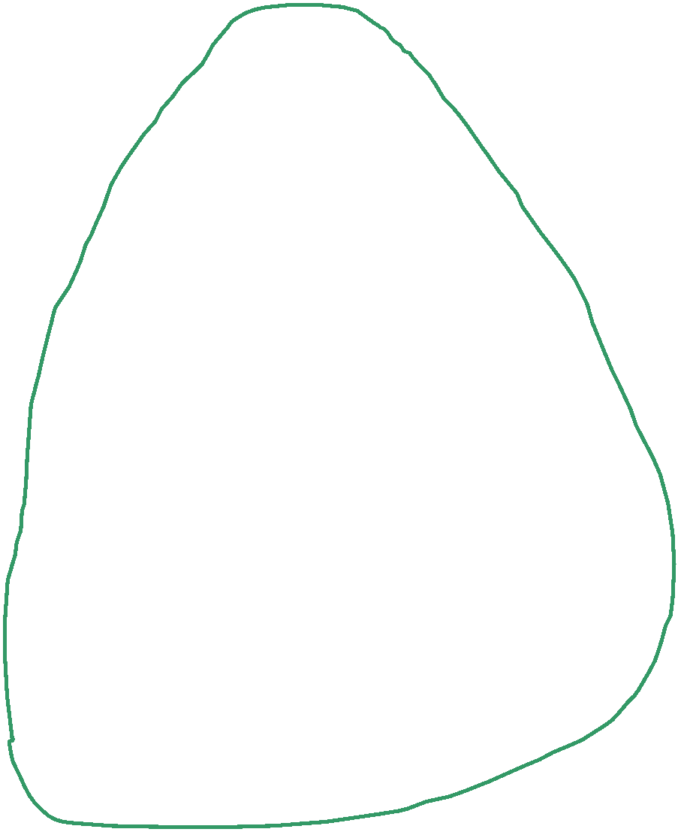

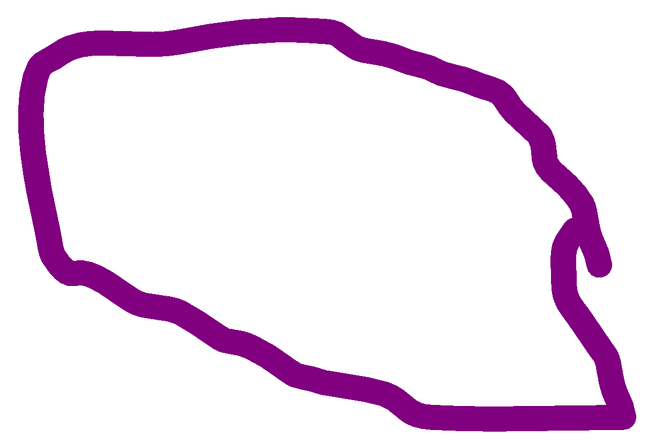
Path Base Testing: Step 2
1
Region: Enclosed area in the CFG.
Do not forget the outermost region.
In this example:
3 Regions (see the circles with different colors).
Cyclomatic Complexity = 3
Alternative way in next slide.
2
F
T
3
F
T
5
4
6
CFG
Notes:
‹#›

Slide 17
Path Base Testing: Step 2
Predicates:
Nodes with multiple exit arcs.
Corresponds to branch/conditional statement in program.
In this example:
Predicates = 2
(Node 2 and 3)
Cyclomatic Complexity
= 2 + 1
= 3
1
2
F
T
3
F
T
5
4
6
CFG
Notes:
‹#›

Slide 18
Path Base Testing: Step 3
Independent path:
An executable or realizable path through the graph from the start node to the end node that has not been traversed before.
Must move along at least one arc that has not been yet traversed (an unvisited arc).
The objective is to cover all statements in a program by independent paths.
The number of independent paths to discover <= cyclomatic complexity number.
Decide the Basis Path Set:
It is the maximal set of independent paths in the flow graph.
NOT a unique set.
Notes:
‹#›

Slide 19
Path Base Testing: Step 3
min = A[0];
I = 1;
while (I < N) {
if (A[I] < min)
min = A[I];
I = I + 1;
}
print min
1
2
3
4
1
5
2
6
F
T
Cyclomatic complexity = 3.
Need at most 3 independent paths to cover the CFG.
In this example:
[ 1 – 2 – 6 ]
[ 1 – 2 – 3 – 5 – 2 – 6 ]
[ 1 – 2 – 3 – 4 – 5 – 2 – 6]
3
F
T
5
4
6
CFG
Notes:
‹#›

Slide 20
Path Base Testing: Step 4
Prepare a test case for each independent path.
In this example:
Path: [ 1 – 2 – 6 ]
Test Case: A = { 5, …}, N = 1
Expected Output: 5
Path: [ 1 – 2 – 3 – 5 – 2 – 6 ]
Test Case: A = { 5, 9, … }, N = 2
Expected Output: 5
Path: [ 1 – 2 – 3 – 4 – 5 – 2 – 6]
Test Case: A = { 8, 6, … }, N = 2
Expected Output: 6
These tests will result a complete decision and statement coverage of the code.
Try to verify that the test cases actually force execution along a desired path.
Notes:
‹#›

Slide 21
Another Example
int average (int[ ] value, int min, int max, int N) {
int i, totalValid, sum, mean;
i = totalValid = sum = 0;
while ( i < N && value[i] != -999 ) {
if (value[i] >= min && value[i] <= max){
totalValid += 1; sum += value[i];
}
i += 1;
}
if (totalValid > 0)
mean = sum / totalValid;
else
mean = -999;
return mean;
}
Notes:
‹#›

Slide 22
Step 1: Draw CFG
int average (int[ ] value, int min, int max, int N) {
int i, totalValid, sum, mean;
i = totalValid = sum = 0;
while ( i < N && value[i] != -999 ) {
if (value[i] >= min && value[i] <= max){
totalValid += 1; sum += value[i];
}
i += 1;
}
if (totalValid > 0)
mean = sum / totalValid;
else
mean = -999;
return mean;
}
1
2
4
3
5
6
7
8
9
10
11
Notes:
‹#›

Slide 23
Step 1: Draw CFG
int average (int[ ] value, int min, int max, int N) {
int i, totalValid, sum, mean;
i = totalValid = sum = 0;
while ( i < N && value[i] != -999 ) {
if (value[i] >= min && value[i] <= max){
totalValid += 1; sum += value[i];
}
i += 1;
}
if (totalValid > 0)
mean = sum / totalValid;
else
mean = -999;
return mean;
}
1
2
T
3
T
T
4
5
T
F
F
6
F
7
F
8
T
2
9
3
F
10
8
11
Notes:
‹#›

Slide 24
Step 1: Draw CFG
int average (int[ ] value, int min, int max, int N) {
int i, totalValid, sum, mean;
i = totalValid = sum = 0;
while ( i < N && value[i] != -999 ) {
if (value[i] >= min && value[i] <= max){
totalValid += 1; sum += value[i];
}
i += 1;
}
if (totalValid > 0)
mean = sum / totalValid;
else
mean = -999;
return mean;
}
Notes:
‹#›

Slide 25
Step 1: Draw CFG
int average (int[ ] value, int min, int max, int N) {
int i, totalValid, sum, mean;
i = totalValid = sum = 0;
while ( i < N && value[i] != -999 ) {
if (value[i] >= min && value[i] <= max){
totalValid += 1; sum += value[i];
}
i += 1;
}
if (totalValid > 0)
mean = sum / totalValid;
else
mean = -999;
return mean;
}
1
3
5
2
6
4
7
8
9
10
11
Notes:
‹#›

Slide 26
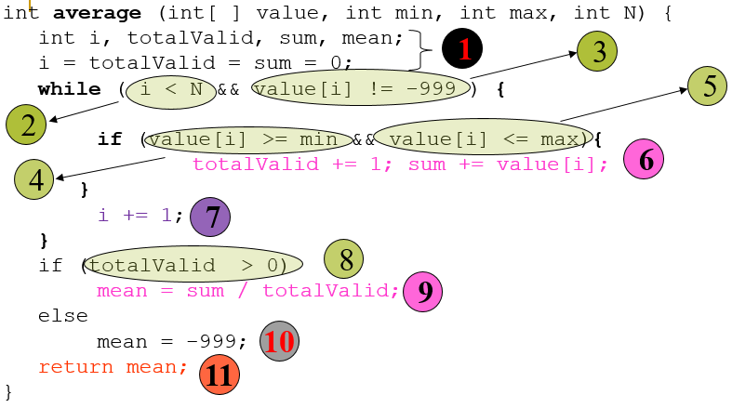

Slide 27
Step 1: Draw CFG
int average (int[ ] value, int min, int max, int N) {
int i, totalValid, sum, mean;
i = totalValid = sum = 0;
while ( i < N && value[i] != -999 ) {
if (value[i] >= min && value[i] <= max){
totalValid += 1; sum += value[i];
}
i += 1;
}
if (totalValid > 0)
mean = sum / totalValid;
else
mean = -999;
return mean;
}
1
3
5
2
6
4
7
1
2
T
3
T
4
T
5
8
T
9
F
F
6
F
F
10
11
9
7
T
8
11
F
10
CFG
Notes:
‹#›

Slide 28
Step 1: Draw CFG
int average (int[ ] value, int min, int max, int N) {
int i, totalValid, sum, mean;
i = totalValid = sum = 0;
while ( i < N && value[i] != -999 ) {
if (value[i] >= min && value[i] <= max){
totalValid += 1; sum += value[i];
}
i += 1;
}
if (totalValid > 0)
mean = sum / totalValid;
else
mean = -999;
return mean;
}
1
3
5
2
6
4
7
1
2
T
3
T
4
T
5
8
T
9
F
F
6
F
F
10
11
9
7
T
8
11
F
10
CFG
Notes:
‹#›

Slide 29
Step 1: Draw CFG
int average (int[ ] value, int min, int max, int N) {
int i, totalValid, sum, mean;
i = totalValid = sum = 0;
while ( i < N && value[i] != -999 ) {
if (value[i] >= min && value[i] <= max){
totalValid += 1; sum += value[i];
}
i += 1;
}
if (totalValid > 0)
mean = sum / totalValid;
else
mean = -999;
return mean;
}
1
3
5
2
6
4
7
1
2
T
3
T
4
T
5
8
T
9
F
F
6
F
F
10
11
9
7
T
8
11
F
10
CFG
Notes:
‹#›

Slide 30
Step 1: Draw CFG
int average (int[ ] value, int min, int max, int N) {
int i, totalValid, sum, mean;
i = totalValid = sum = 0;
while ( i < N && value[i] != -999 ) {
if (value[i] >= min && value[i] <= max){
totalValid += 1; sum += value[i];
}
i += 1;
}
if (totalValid > 0)
mean = sum / totalValid;
else
mean = -999;
return mean;
}
1
3
5
2
6
4
7
1
2
T
3
T
4
T
5
8
T
9
F
F
6
F
F
10
11
9
7
T
8
11
F
10
CFG
Notes:
‹#›

Slide 31
Step 1: Draw CFG
int average (int[ ] value, int min, int max, int N) {
int i, totalValid, sum, mean;
i = totalValid = sum = 0;
while ( i < N && value[i] != -999 ) {
if (value[i] >= min && value[i] <= max){
totalValid += 1; sum += value[i];
}
i += 1;
}
if (totalValid > 0)
mean = sum / totalValid;
else
mean = -999;
return mean;
}
1
3
5
2
6
4
7
1
2
T
3
T
4
T
5
8
T
9
F
F
6
F
F
10
11
9
7
T
8
11
F
10
CFG
Notes:
‹#›

Slide 32
Step 1: Draw CFG
int average (int[ ] value, int min, int max, int N) {
int i, totalValid, sum, mean;
i = totalValid = sum = 0;
while ( i < N && value[i] != -999 ) {
if (value[i] >= min && value[i] <= max){
totalValid += 1; sum += value[i];
}
i += 1;
}
if (totalValid > 0)
mean = sum / totalValid;
else
mean = -999;
return mean;
}
1
3
5
2
6
4
7
1
2
T
3
T
4
T
5
8
T
9
F
F
6
F
F
10
11
9
7
T
8
11
F
10
CFG
Notes:
‹#›

Slide 33
Step 1: Draw CFG
int average (int[ ] value, int min, int max, int N) {
int i, totalValid, sum, mean;
i = totalValid = sum = 0;
while ( i < N && value[i] != -999 ) {
if (value[i] >= min && value[i] <= max){
totalValid += 1; sum += value[i];
}
i += 1;
}
if (totalValid > 0)
mean = sum / totalValid;
else
mean = -999;
return mean;
}
1
3
5
2
6
4
7
1
2
T
3
T
4
T
5
8
T
9
F
F
6
F
F
10
11
9
7
T
8
11
F
10
CFG
Notes:
‹#›

Slide 34
Step 1: Draw CFG
9
T
8
11
F
F
10
F
1
2
T
3
T
4
T
5
T
6
F
F
7
CFG
Notes:
‹#›

Slide 35
Step 2: Find Cyclomatic Complexity
9
T
8
11
F
F
10
F
1
2
T
3
T
4
T
5
T
6
F
F
Regions = 6
Cyclomatic Complexity = 6
7
CFG
Notes:
‹#›

Slide 36
Step 2: Find Cyclomatic Complexity
9
T
8
11
F
F
10
F
1
2
T
3
T
4
T
5
T
6
F
F
Predicates = 5
Cyclomatic Complexity = 5 + 1 = 6
7
CFG
Notes:
‹#›

Slide 37
Step 3: Find Basic Path Set
Find at most 6 independent paths.
Usually, simpler path == easier to find a test case.
However, some of the simpler paths are not possible (not realizable):
Example: [ 1 – 2 – 8 – 9 – 11 ].
Not Realizable (i.e., impossible in execution).
Verify this by tracing the code.
Basic Path Set:
[ 1 – 2 – 8 – 10 – 11 ].
[ 1 – 2 – 3 – 8 – 10 – 11 ].
[ 1 – 2 – 3 – 4 – 7 – 2 – 8 – 10 – 11 ].
[ 1 – 2 – 3 – 4 – 5 – 7 – 2 – 8 – 10 – 11 ].
[ 1 – ( 2 – 3 – 4 – 5 – 6 – 7 ) – 2 – 8 – 9 – 11 ].
In the last case, ( … ) represents possible repetition.
Notes:
‹#›

Slide 38
Step 4: Derive Test Cases
Path:
[ 1 – 2 – 8 – 10 – 11 ]
Test Case:
value = {…} irrelevant.
N = 0
min, max irrelevant.
Expected Output:
average = -999
... i = 0;
while (i < N &&
value[i] != -999) {
......
}
if (totalValid > 0)
......
else
mean = -999;
return mean;
1
2
8
10
11
Notes:
‹#›

Slide 39
Step 4: Derive Test Cases
Path:
[ 1 – 2 – 3 – 8 – 10 – 11 ]
Test Case:
value = {-999}
N = 1
min, max irrelevant
Expected Output:
average = -999
... i = 0;
while (i < N &&
value[i] != -999) {
......
}
if (totalValid > 0)
......
else
mean = -999;
return mean;
1
2
3
8
10
11
Notes:
‹#›

Slide 40
Step 4: Derive Test Cases
Path:
[ 1 – 2 – 3 – 4 – 7 – 2 – 8 – 10 – 11 ]
Test Case:
A single value in the value[ ] array which is smaller than min.
value = { 25 }, N = 1, min = 30, max irrelevant.
Expected Output:
average = -999
Path:
[ 1 – 2 – 3 – 4 – 5 – 7 – 2 – 8 – 10 – 11 ]
Test Case:
A single value in the value[ ] array which is larger than max.
value = { 99 }, N = 1, max = 90, min irrelevant.
Expected Output:
average = -999
Notes:
‹#›

Slide 41
Step 4: Derive Test Cases
Path:
[ 1 – 2 – 3 – 4 – 5 – 6 – 7 – 2 – 8 – 9 – 11 ]
Test Case:
A single valid value in the value[ ] array.
value = { 25 }, N = 1, min = 0, max = 100
Expected Output:
average = 25
Path:
[ 1 – 2 – 3 – 4 – 5 – 6 – 7 – 2 – 3 – 4 – 5 – 6 – 7 – 2 – 8 – 9 – 11 ]
Test Case:
Multiple valid values in the value[ ] array.
value = { 25, 75 }, N = 2, min = 0, max = 100
Expected Output:
average = 50
OR
Notes:
‹#›

Slide 42
Summary: Path Base White Box Testing
A simple test that:
Cover all statements.
Exercise all decisions (conditions).
The cyclomatic complexity is an upperbound of the independent paths needed to cover the CFG.
If more paths are needed, then either cyclomatic complexity is wrong, or the paths chosen are incorrect.
Although picking a complicated path that covers more than one unvisited edge is possible all times, it is not encouraged:
May be hard to design the test case.
Notes:
‹#›

Slide 43
Summary
Test Case Design
White Box
Control Flow Graph
Cyclomatic Complexity
Basic Path Testing
Black Box
Equivalence Classes
Boundary Value Analysis
Notes:
‹#›

