Slide 1
Software Engineering (CSE 403)
Lecture 12
(Planning and Scheduling)

Slide 2
Planning, Task Scheduling

Slide 3
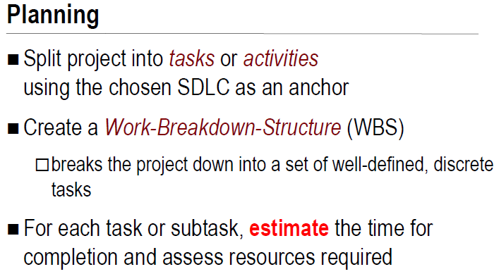

Slide 4
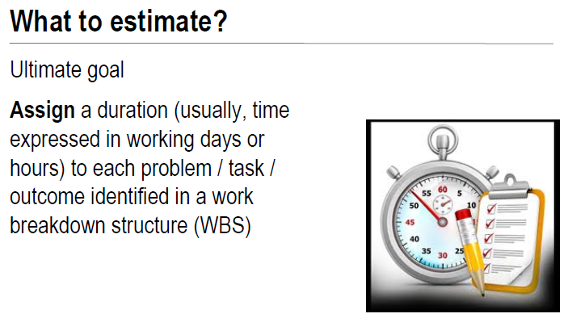

Slide 5
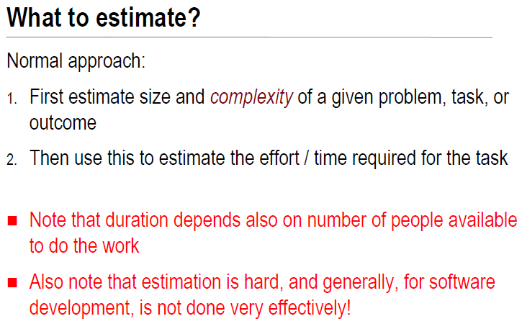

Slide 6


Slide 7
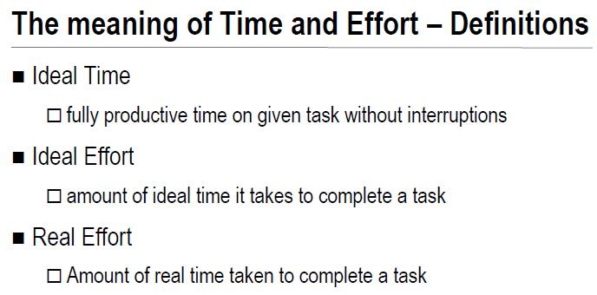

Slide 8
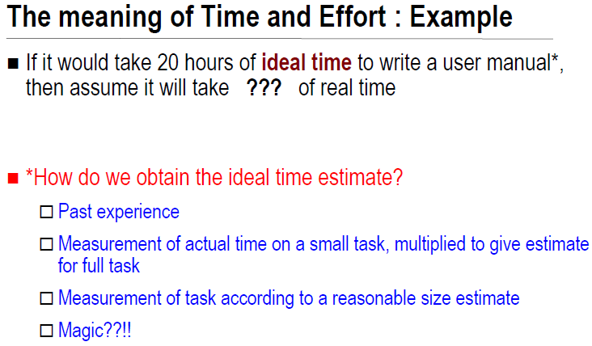

Slide 10
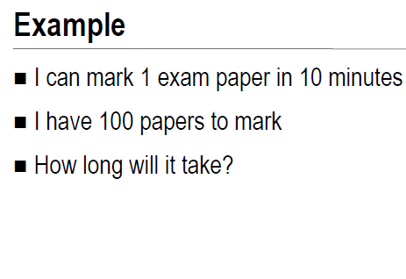


Slide 11
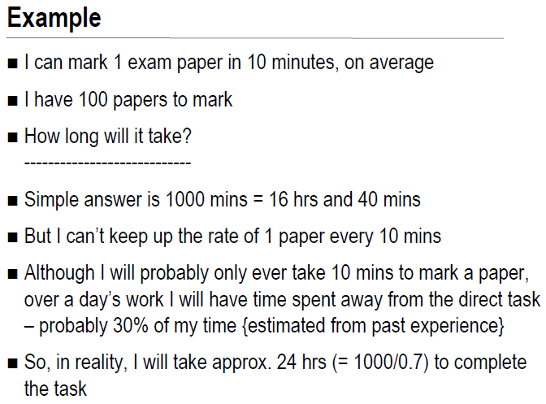

Slide 12
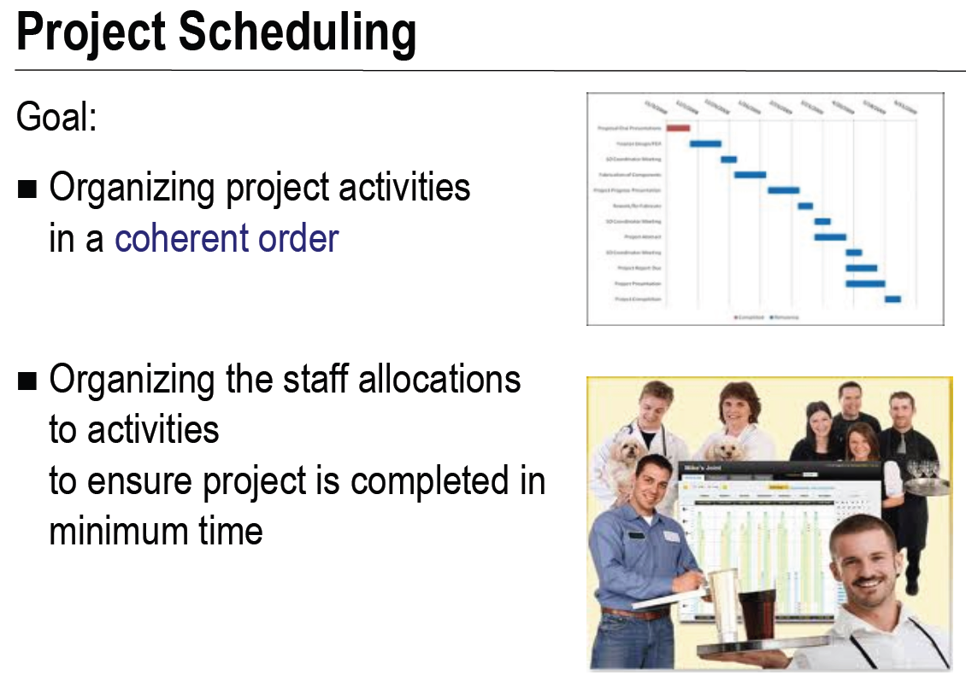

Slide 13
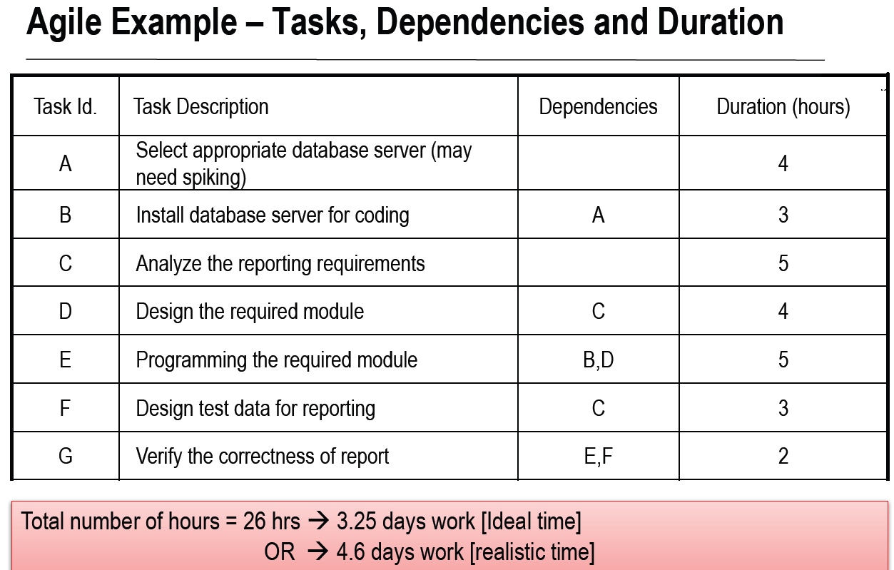

Slide 15
Task ID | Dependencies | Duration
A |  | 4
B | A | 3
C |  | 5
D | C | 4
E | B, D | 5
F | C | 3
G | E, F | 2
B
A
Start
E
End
D
C
F
G
Task ID
ES
EF
 | A
 | 4
0
Start
LS
LF
Task duration

Slide 16
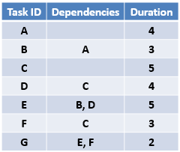
EF = ES + Task Duration
Early Start of an activity = Early Finish of predecessor activity
Early Start of an activity = Greater Early Finish time from multiple predecessor activities
ES
EF
ES
EF
 | A
 | 4
4
4
 | B
 | 3
0
7
ES
EF
0
9
16
 | E
 | 5
14
Start
LS
LF
LS
LF
End
ES
EF
ES
EF
LS
LF
0
5
9
 | C
 | 5
 | D
 | 4
5
ES
EF
14
16
 | G
 | 2
LS
LF
LS
LF
ES
EF
LS
LF
5
8
 | F
 | 3
LS
LF

Slide 17
LS = LF - Task Duration
Late Finish of an activity = Late Start of successor activity
Late Finish of an activity = Earlier (least) Late Start time from multiple successor activities
ES
EF
ES
EF
 | A
 | 4
4
4
 | B
 | 3
0
7
ES
EF
0
2
6
6
9
9
16
 | E
 | 5
14
Start
LS
LF
LS
LF
9
14
End
ES
EF
ES
EF
LS
LF
0
5
9
 | C
 | 5
 | D
 | 4
5
ES
EF
0
5
5
9
14
16
 | G
 | 2
LS
LF
LS
LF
14
16
ES
EF
LS
LF
5
8
 | F
 | 3
11
14
LS
LF

Slide 18
Float / Slack Time = (LS – ES) or (LF - EF)
Float time of Task A: (2 - 0) or (6 - 4) = 2
Float time of Task F: (11 - 5) or (14 - 8) = 6
Float time of Task D: (5 - 5) or (9 - 9) = 0
ES
EF
ES
EF
 | A
 | 4
4
4
 | B
 | 3
0
7
ES
EF
0
2
6
6
9
9
16
 | E
 | 5
14
Start
LS
LF
LS
LF
9
14
End
ES
EF
ES
EF
LS
LF
0
5
9
 | C
 | 5
 | D
 | 4
5
ES
EF
0
5
5
9
14
16
 | G
 | 2
LS
LF
LS
LF
14
16
ES
EF
LS
LF
5
8
 | F
 | 3
11
14
LS
LF

Slide 19
This network diagram has three paths from start to end. The paths and their durations are as follows:
Start -> A -> B -> E -> G -> End {duration: 14 days}
Start -> C -> D -> E -> G -> End {duration: 16 days}
Start -> C -> F -> G -> End {duration: 10 days}
Critical path is the duration of the longest path.
ES
EF
ES
EF
 | A
 | 4
4
4
 | B
 | 3
0
7
ES
EF
0
2
6
6
9
9
16
 | E
 | 5
14
Start
LS
LF
LS
LF
9
14
End
ES
EF
ES
EF
LS
LF
0
5
9
 | C
 | 5
 | D
 | 4
5
ES
EF
0
5
5
9
14
16
 | G
 | 2
LS
LF
LS
LF
14
16
ES
EF
LS
LF
5
8
 | F
 | 3
11
14
The float on the critical path is zero.
LS
LF

Slide 20
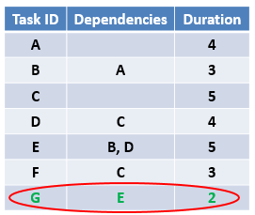

ES
EF
ES
EF
 | A
 | 4
4
4
 | B
 | 3
0
7
ES
EF
0
2
6
6
9
9
16
 | E
 | 5
14
Start
LS
LF
LS
LF
9
14
End
ES
EF
ES
EF
LS
LF
0
5
9
 | C
 | 5
 | D
 | 4
5
ES
EF
0
5
5
9
14
16
 | G
 | 2
LS
LF
LS
LF
14
16
ES
EF
LS
LF
5
8
 | F
 | 3
11
14
LS
LF

Slide 21
Late Finish of an activity = Late Start of successor activity
Late Finish of an activity = Earlier (least) Late Start time from multiple successor activities
This network diagram has three paths from start to end.
Start -> A -> B -> E -> G -> End {duration: 14 days}
Start -> C -> D -> E -> G -> End {duration: 16 days}
Start -> C -> F -> End {duration: 8 days}
ES
EF
ES
EF
 | A
 | 4
4
4
 | B
 | 3
0
7
ES
EF
0
2
6
6
9
9
16
 | E
 | 5
14
Start
LS
LF
LS
LF
9
14
End
ES
EF
ES
EF
LS
LF
0
5
9
 | C
 | 5
 | D
 | 4
5
ES
EF
0
5
5
9
14
16
 | G
 | 2
LS
LF
LS
LF
14
16
ES
EF
LS
LF
5
8
 | F
 | 3
13
16
LS
LF

Slide 22
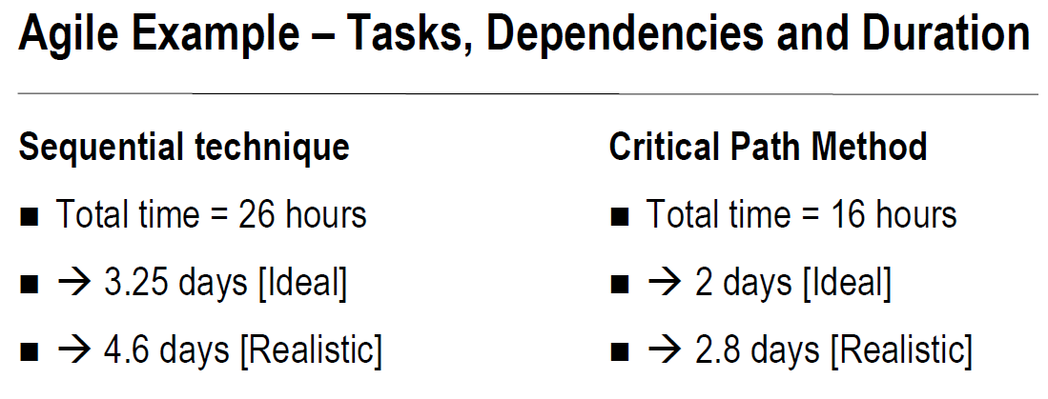

Slide 23
Critical Path Method
The Critical Path Method or CPM is a network analysis technique
concerned with planning and controlling of complex, but routine projects.
Simply, Critical path method is generally used for the projects whose time duration is known with certainty and also the amount of resources required for the completion of the project is assumed to be known.

Slide 24
Critical Path Method
Critical path schedules will...
Help you identify the activities that must be completed on time in order to complete the whole project on time.
Show you which tasks can be delayed and for how long without impacting the overall project schedule.
Calculate the minimum amount of time it will take to complete the project.
Tell you the earliest and latest dates each activity can start on in order to maintain the schedule.

Slide 25
Critical Path Method
The Critical Path Method has four key elements...
Critical Path Analysis
Float Determination
Early Start & Early Finish Calculation
Late Start & Late Finish Calculation

Slide 26
Critical Path Method
For each activity the following parameters need to be determined:
Earliest start time (ES): How early, the successor activity begins once the predecessor activity finishes.
Earliest Finish Time (EF): Earliest Start Time + duration of each activity.
Latest Finish Time (LF): The latest time within which the activity finishes without delaying the project.
Latest Start Time (LS): Latest Finish Time – Activity duration

Slide 27
Critical Path Analysis
The critical path is the sequence of activities with the longest duration. A delay in any of these activities will result in a delay for the whole project.
Float is the amount of time an activity can slip before it causes your project to be delayed. Float is sometimes referred to as slack.

