Slide 1
SW ENG & ISD (CSE 403)
Lecture 2
(User Story)

Slide 2
Types of Requirements
Functional requirements: Describe the interactions between the system and its environment independent from implementation
The watch system must display the time based on its location
Nonfunctional requirements: User visible aspects of the system not directly related to functional behavior.
The response time must be less than 1 second
The accuracy must be within a second
The watch must be available 24 hours a day except from 2:00am -2:01am and 3:00am - 3:01am
Constraints (“Pseudo requirements”): Imposed by the client or the environment in which the system will operate
The implementation language must be COBOL

Slide 3
Properties of Requirements
Correct
Complete
Consistent
Clear, unambiguous
Realistic
Verifiable
Traceable

Slide 4
Collecting data in the problem domain
To understand the problem that we are dealing with, we can adopt the following techniques
Interview
Questionnaire
Experimentation by building a prototype
Observation
Document inspection
User story

Slide 5
User Story
User Story
Users tell the stories, and developers listen, ask questions to understand context
A short description of the behaviour of the system
Generally implementation issues are not discussed
The entire system is specified through stories
Each story is short, goal oriented – testable
Can be used for usability testing
Story is descriptive, but often a diagram or a sample output page helps to explain the concept much better
As in user interface snippets, forms or reports

Slide 6
Data to be collected and analyzed
Actors - role and responsibility
Scenarios/User Stories
Source of the data that we have to deal with (reliability and accuracy, etc)
Information that actors want (output)
Software interfaces to existing actors
What cause events to happen, and what cause work to be created
Workflows and activities
Knowing what type of problem it is (solvable?)

Slide 7
What is a User Story?
A User Story is a requirement expressed from the perspective of an end-user goal.
It’s usually written out as a couple of sentences. Most user stories are written in the language of the users, so any user should be able to read a user story and immediately understand what it means.
A User Story is really just a well-expressed requirement.
User Story is only meant to describe a feature, but not describe how to implement it, meaning leaving out the technical aspect, it should describe the behavior or flow from user’s perspective.
Notes:
Card is easy for portable.
‹#›

Slide 8
What is a User Story?
The User Story format has become the most popular way of expressing requirements in Agile for a number of reasons:
It focuses on the viewpoint of a role who will use or be impacted by the solution
It defines the requirement in language that has meaning for that role
It helps to clarify the true reason for the requirement
It helps to define high level requirements without necessarily going into low level detail too early

Slide 9
User Story
User Stories are often deemed to comprise three elements - the 3C’s
Card
Conversation
Confirmation

Slide 10
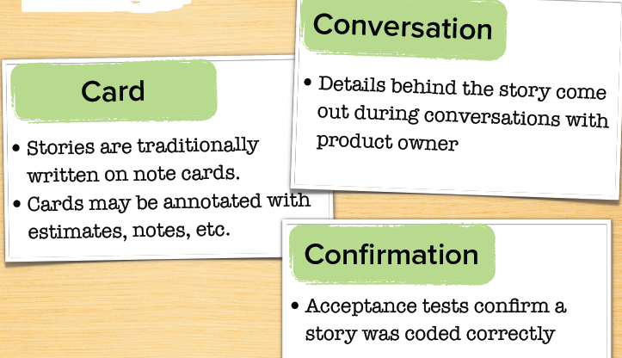
User Story
Notes:
Conversation is the most important.
Card acts as reminder.
Confirmation – Acceptance criteria to judge when a story is done
‹#›

Slide 11
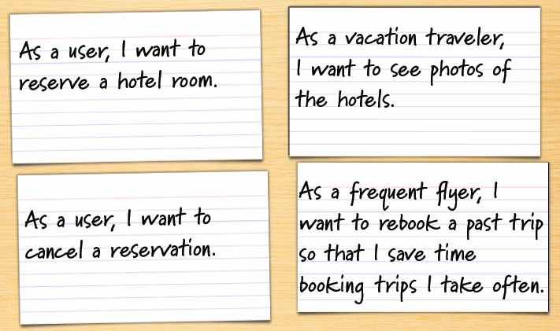
User Story
Notes:
Different type of users: normal user, vacation traveler (not as business traveler), frequent flyer who wants to book trip including air flight, hotel, transportation etc.
‹#›

Slide 12
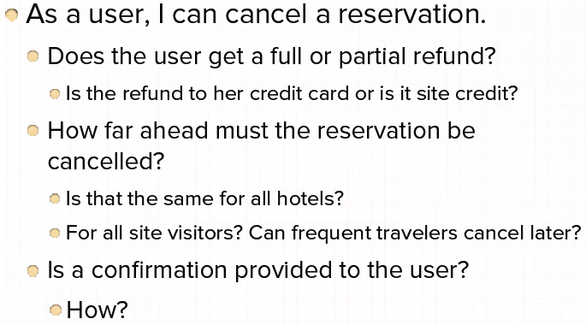
Where are the details?

Slide 13
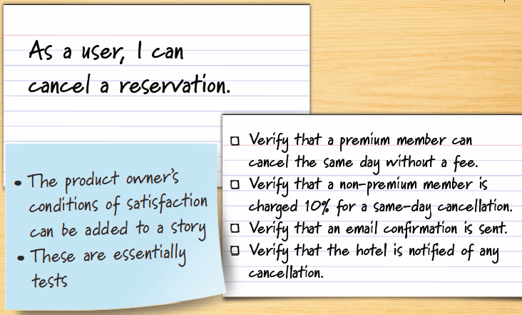
Details as conditions of satisfaction
Notes:
conditions of satisfaction are high level test cases
‹#›

Slide 14
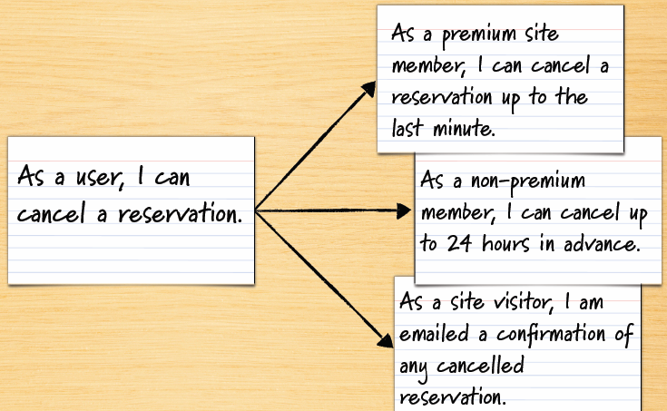
Details added in smaller sub-stories

Slide 15
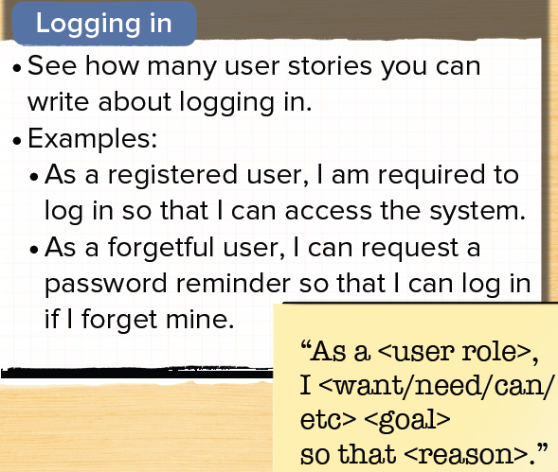
Notes:
New user logging in – as a new user, I can register to the system so that I can logging/access the system
‹#›

Slide 16
User Story format
The format of the User Story is as follows: As a < role> I need <requirement or feature> So that <goal / value>

Slide 17
User Story (Logging in)
Confirmation
1. Success – valid user logged in and refer to home page
a. “Remember me” ticked – store cookie/automatic login next time.
b. “Remember me” not ticked – force login next time.
2. Failure – display message:
a. “Email address in wrong format”
b. “Incorrect user name, please try again”
c. “Incorrect password, please try again”
d. “Service unavailable – please try again later”
e. “Account has expired – refer to account renewal page”
Notes:
‹#›

Slide 18
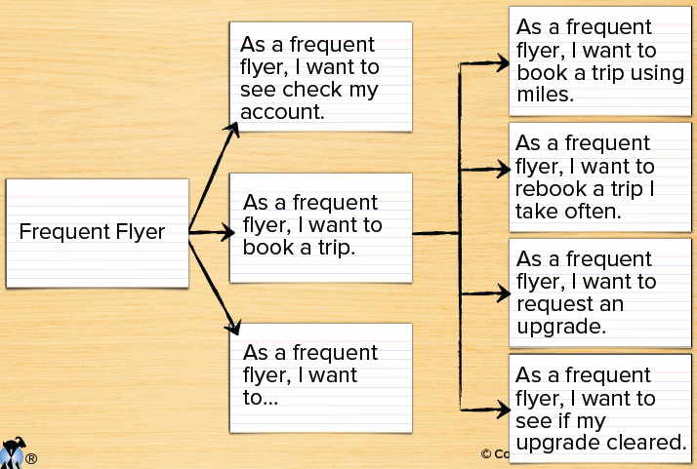

Slide 19
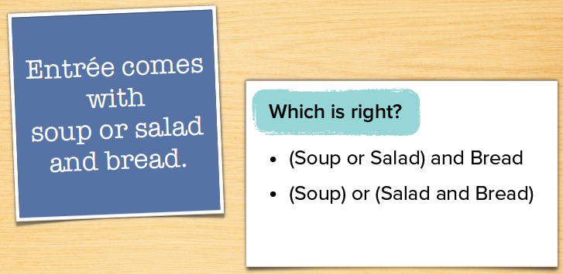
Words are imprecise

Slide 20
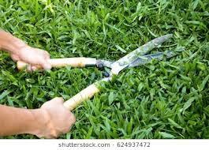
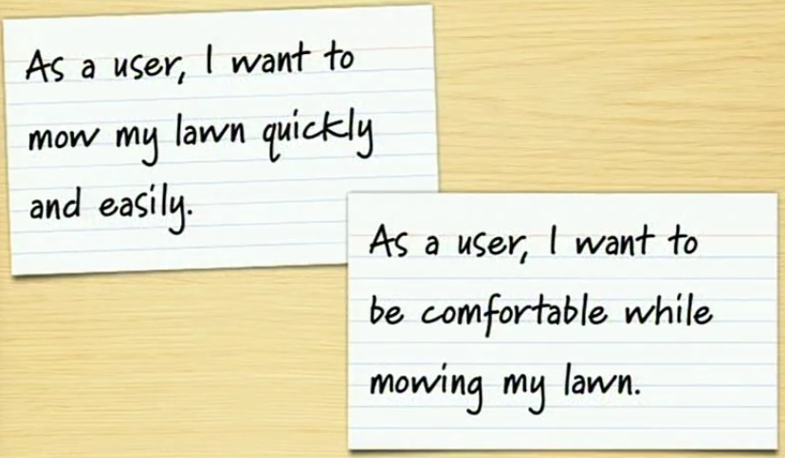
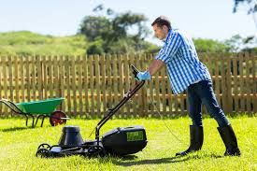
Words are imprecise

Slide 21
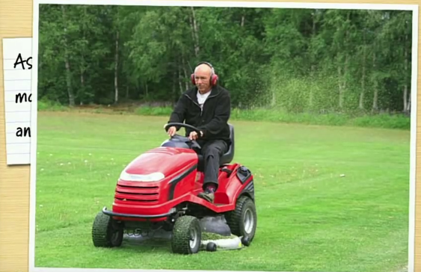
Words are imprecise
Notes:
‹#›

