Slide 1
Software Engineering
Lecture 4
(SDLC & Software
Process Model)

Slide 2
Software Process
A software process (also knows as software methodology) is a set of related activities that leads to the production of the software. These activities may involve the development of the software from the scratch, or, modifying an existing system.
Software development life cycle (SDLC) is a series of phases that provide a common understanding of the software building process. How the software will be realized and developed from the business understanding and requirements elicitation phase to convert these business ideas and requirements into functions and features until its usage and operation to achieve the business needs.

Slide 3
Software Process
Any software process must include the following four activities:
Software Specification
Software Development
Software Validation
Software Evolution
Figure : Software Development Activities/Processes

Slide 4
SDP Activities/Processes – The Breakdown
Software Specification: This activity involves stating the functionalities (operations) as well as the constraints/limitations of the software
Major Activity -> Requirements
Software Design and Development: This activity involves developing (producing) a software according to the specification outlined in the first stage of the development process.
Major Activity -> Design and Implementation

Slide 5
SDP Activities/Processes – The Breakdown
Software Validation: This activity checks the
software developed to ensure it conforms to the specification earlier concluded upon.
Major Activity -> Testing
Software Evolution: This activity ensures that
the software produced is modifiable/adjustable to meet customer and market requirements changes.
Major Activity -> Maintenance

Slide 6
SDLC Models
This refers to the existing and established frameworks for developing software.
A software process model is a simplified representation of a software process. Each model represents a process from a specific perspective.

Slide 7
Waterfall Model
The waterfall model
Plan-driven model. Separate and distinct phases of specification and development.
In the waterfall model, you must plan and schedule all of the activities before starting working on them (plan-driven process).
The reason why this method titled Waterfall is because this method follows a sequential process in software development process. The processes in this methodology are descending or downward such as Waterfall.
Waterfall’s phases are Requirements, Analysis, Design, Construction, Testing, Implementation and Maintenance.
Notes:
Plan-driven process is a process where all the activities are planned first, and the progress is measured against the plan. While the agile process, planning is incremental and it’s easier to change the process to reflect requirement changes.
‹#›

Slide 8
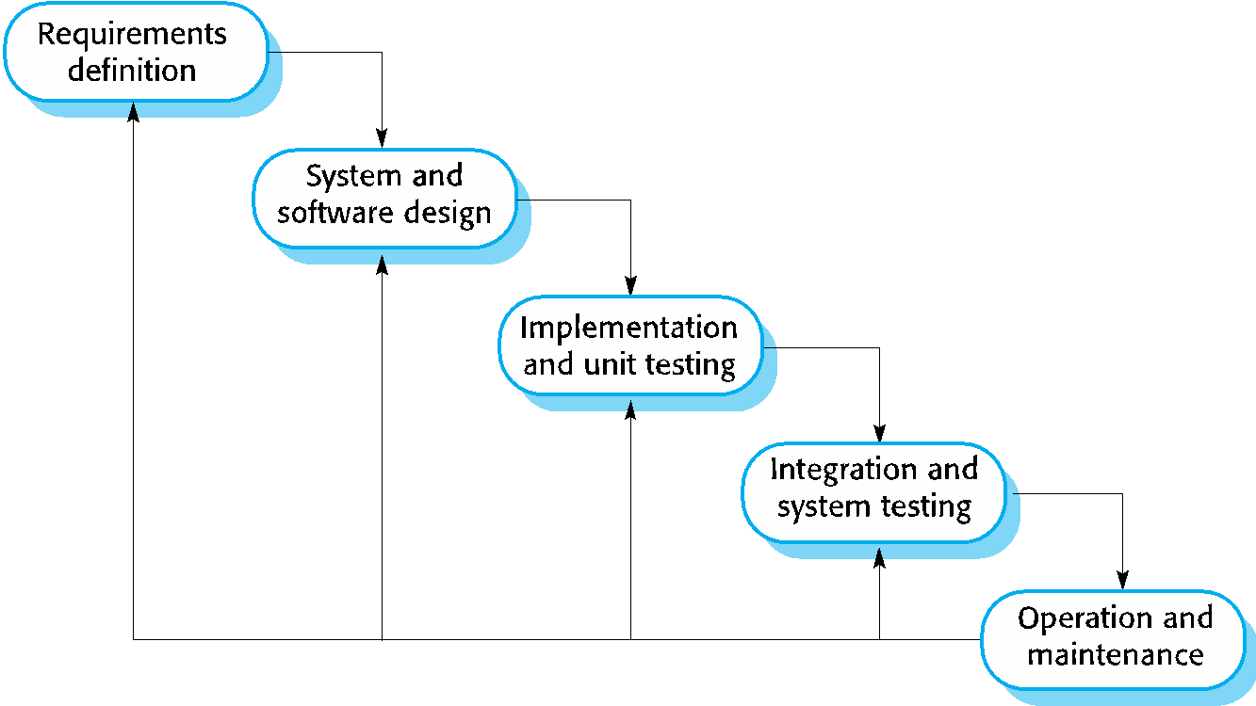
Waterfall Model
Notes:
The waterfall model is a sequential approach, where each fundamental activity of a process represented as a separate phase, arranged in linear order.
‹#›

Slide 9
Waterfall Model
It is the most well-known model and it is very simple and easy to understand. It is also called a linear model. Here, each phase begins only after the previous phase is finished and there is no overlapping in these phases.
This model can applicable to projects where:
The requirements are precisely documented
Product definition is stable
The technologies stack is predefined which makes it not dynamic
No ambiguous requirements
The project is short
This model cannot be apply to the projects where the requirements are not clearly defined and changed by time.

Slide 10
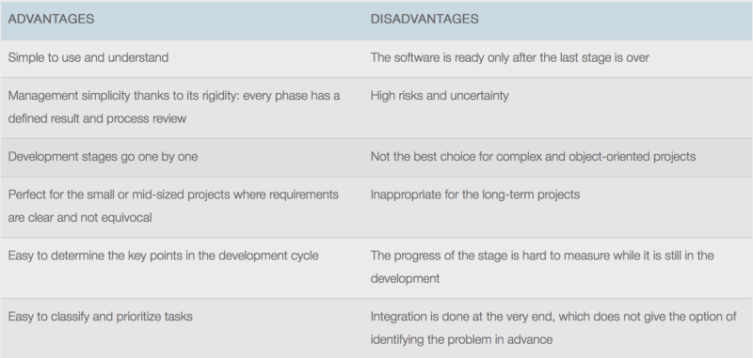
Waterfall Model

Slide 11
Incremental development
Incremental development is based on the idea of developing an initial implementation, exposing this to user feedback, and evolving it through several versions until an acceptable system has been developed.
The activities of a process are not separated but interleaved with feedback involved across those activities.
Notes:
The incremental build model is a method of software development where the product is designed, implemented and tested incrementally (a little more is added each time) until the product is finished
‹#›

Slide 12
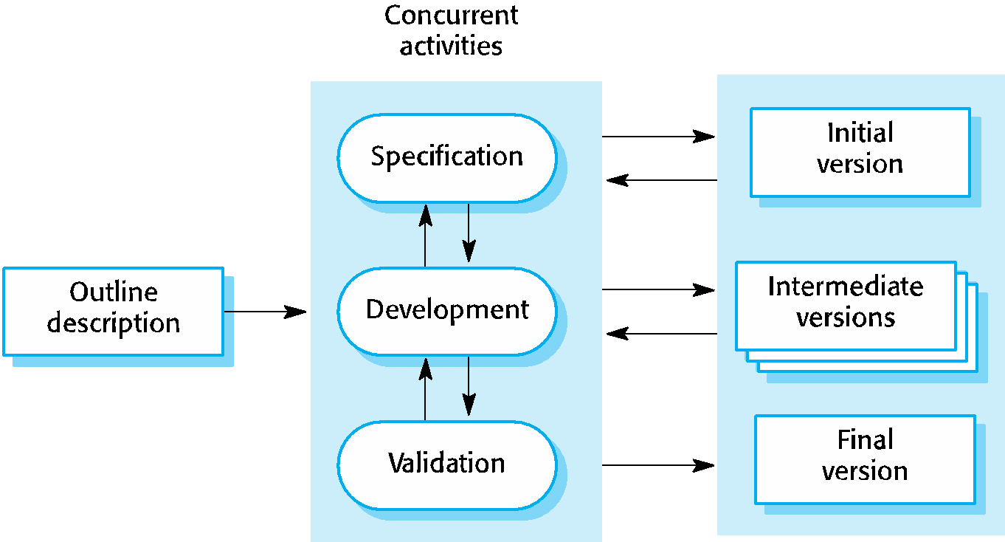
Incremental development
Notes:
Each system increment reflects a piece of the functionality that is needed by the customer. Generally, the early increments of the system should include the most important or most urgently required functionality.
This means that the customer can evaluate the system at early stage in the development to see if it delivers what’s required. If not, then only the current increment has to be changed and, possibly, new functionality defined for later increments.
‹#›

Slide 13
Incremental development
When to use
Large projects where requirements are not understood
Working in unfamiliar technical arenas
Changing the requirement due to rapidly changing technology
Business user can be moderately to heavily engaged
Need functional requirements turned into something tangible quickly

Slide 14
Iterative development
Iterative development model aims to develop a system through building small portions of all the features, across all components.
We build a product which meets the initial scope and release it quickly for customer feedback. An early version with limited features important to establish market and get customer feedback.
In each increment, a slice of system features is delivered, passing through the requirements till the deployment.

Slide 15
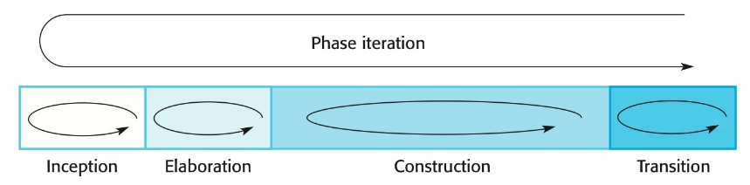
Iterative development

Slide 16
Phases
Inception Phase
Determining the scope and purpose/vision, feasibility of the project
Elaboration Phase
Capturing the requirements
Determining the structure of the system
Construction Phase
Building the system
Transition Phase
Product installation and hand over the system

Slide 17
Phases
Inception: Customer communication, project vision and planning activities (feasibility study)
Elaboration: multiple iterations that refines the requirements and models of the system
Construction: develop software code
Transition: user testing and installation
Production: operation

Slide 18
Inception Stage
Perform feasibility study …..
Identify the project vision (vision document)
Identify general business requirements
Identify project and business risks
Produce initial use-case model (10-20%)
Plan the elaboration stages
Rough architecture of the software (subsystems)
Notes:
‹#›
Feasibility Study : is it worth taking the project, rough cost?, buy or build?

Slide 19
Elaboration Stage
An iterative process where refinements are made on system requirements, system design, develop part of the code and test it.
Products from these iterations:
Refinements on use-case model
Software architecture description
Executable prototypes
Initial design model
Refinement on project risks and plan

Slide 20
Construction Stage
Translate the design into software components
Products of this stage are:
Design model
Integrated software components
Test plan and test cases
User documentation

Slide 21
Transition Stage
Deliver the software and documentation
Get user feedback from Beta tests

Slide 22
Incremental vs. Iterative
Product development example
Take the context of product development by a software team as an example. The team might develop a small increment of working, yet unrefined, functionality and then iteratively refine that over time. They will then add more features until the functionality was considered satisfactory. For example, in a team’s first iteration, a website payment engine might be coded to only allow payment with debit cards (a first increment). The second iteration might produce an increment that supports payment by credit card. Finally, the third iteration might add an increment allowing payment via PayPal.

Slide 23
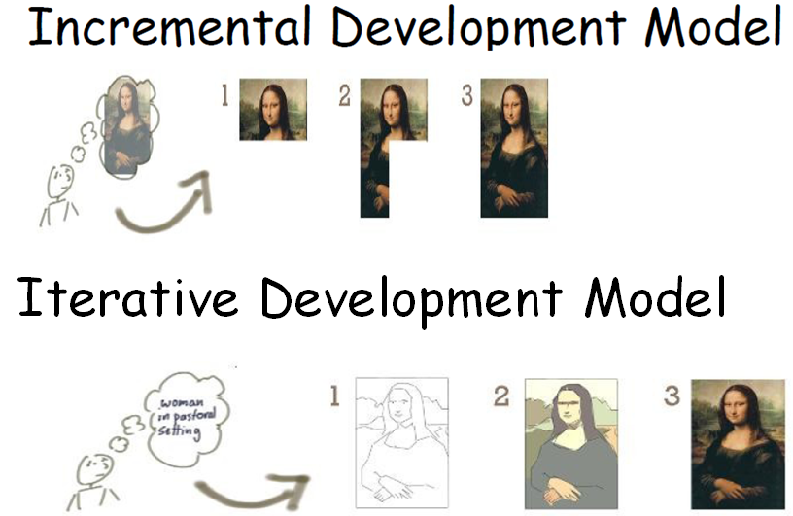
Incremental vs. Iterative

Slide 24
Prototyping
A prototype is a version of a system or part of the system that’s developed quickly to check the customer’s requirements or feasibility of some design decisions.
So, a prototype is useful when a customer or developer is not sure of the requirements, or of algorithms, efficiency, business rules, response time, etc.
In prototyping, the client is involved throughout the development process, which increases the likelihood of client acceptance of the final implementation.

Slide 25
Software prototyping
A prototype is an initial version of a system used to demonstrate concepts and try out design options.
A prototype can be used in:
The requirements engineering process to help with requirements elicitation and validation;
In design processes to explore options and develop a UI design;
In the testing process to run back-to-back tests.
Notes:
In this model, before implementation, a prototype is built to understand the requirements from the customer. Through this prototype, the customer can get a clear idea about the features of the final system (project).
‹#›

Slide 26
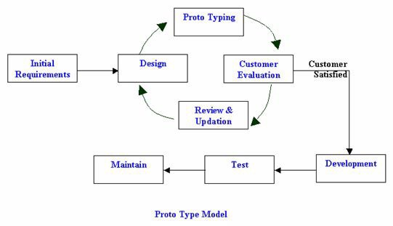
Software prototyping

Slide 27
Software prototyping
When to use
Project objectives are unclear
High pressure to implement something
Frequent requirement changes
Minimal resource constrains
No strict approval processes needed
Innovative, flexible design that need to accommodate future changes

Slide 28
Benefits of prototyping
Improved system usability.
A closer match to users’ real needs.
Improved design quality.
Improved maintainability.
Reduced development effort.

Slide 29
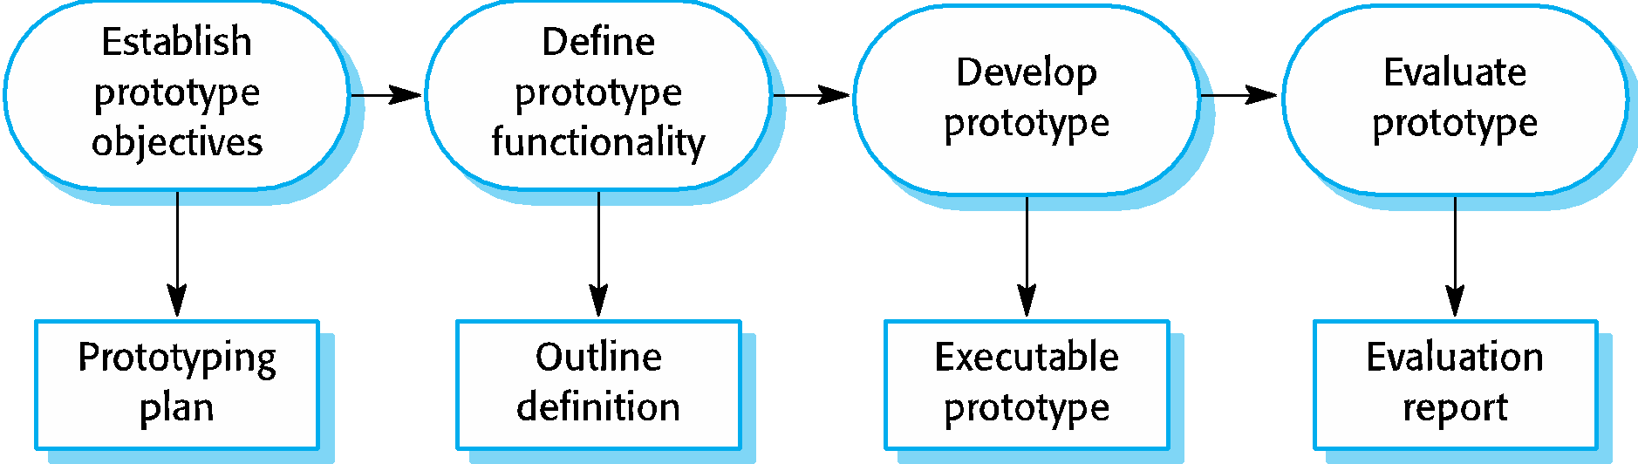
The process of prototype development

Slide 30
Prototype development
The phases of a prototype are:
Establish objectives: The objectives of the prototype should be made explicit from the start of the process. Is it to validate system requirements, or demonstrate feasibility, etc.
Define prototype functionality: Decide what are the inputs and the expected output from a prototype. To reduce the prototyping costs and accelerate the delivery schedule, you may ignore some functionality, such as response time and memory utilization unless they are relevant to the objective of the prototype.
Develop the prototype: The initial prototype is developed that includes only user interfaces.
Evaluate the prototype: Once the users are trained to use the prototype, they then discover requirements errors. Using the feedback both the specifications and the prototype can be improved. If changes are introduced, then a repeat of steps 3 and 4 may be needed.

Slide 31
Prototype development
May be based on rapid prototyping languages or tools
May involve leaving out functionality
Prototype should focus on areas of the product that are not well-understood;
Error checking and recovery may not be included in the prototype;
Focus on functional rather than non-functional requirements such as reliability and security

Slide 32
Spiral Model
The spiral model is a risk-driven where the process is represented as spiral rather than a sequence of activities.
It was designed to include the best features from the waterfall and prototyping models, and introduces a new component; risk-assessment.

Slide 33
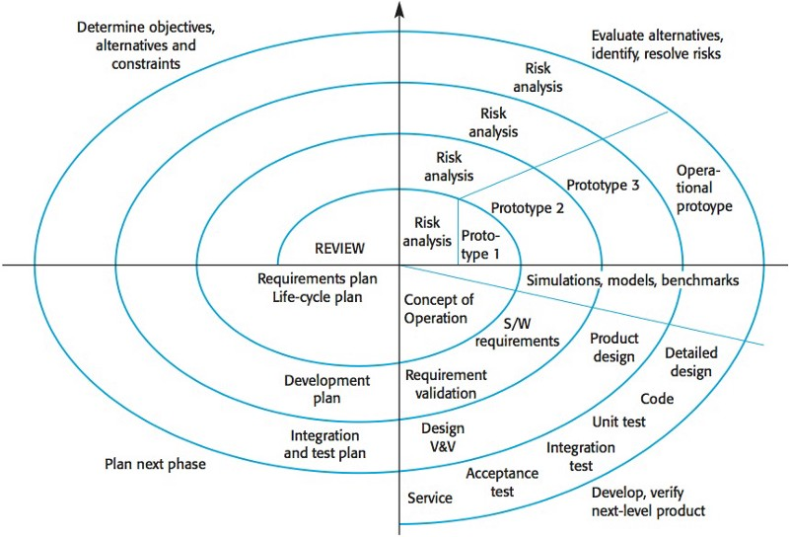
Spiral Model
Notes:
Each loop (from review till service — see figure below) in the spiral represents a phase. Thus the first loop might be concerned with system feasibility, the next loop might be concerned with the requirements definition, the next loop with system design, and so on.
‹#›

Slide 34
Spiral Model
Each loop in the spiral is split into four sectors:
Objective setting: The objectives and risks for that phase of the project are defined.
Risk assessment and reduction: For each of the identified project risks, a detailed analysis is conducted, and steps are taken to reduce the risk. For example, if there’s a risk that the requirements are inappropriate, a prototype may be developed.
Development and validation: After risk evaluation, a process model for the system is chosen. So if the risk is expected in the user interface then we must prototype the user interface. If the risk is in the development process itself then use the waterfall model.
Planning: The project is reviewed and a decision is made whether to continue with a further loop or not.

Slide 35
Spiral Model
When to use Spiral model:
When budgets and risk assessment is important
For moderate to high-risk projects
Lasting project obligation unwise because of possible changes to economic main concern
Clients are uncertain of their requirements

Slide 36
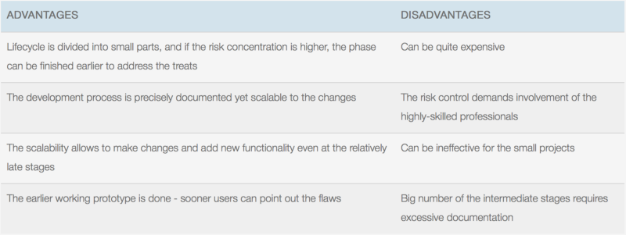
Spiral Model

Slide 37
V-Model
The V-model is a type of SDLC model where process executes in a sequential manner in V-shape.
It is also known as Verification and Validation model. It is based on the association of a testing phase for each corresponding development stage.
Development of each step directly associated with the testing phase.
The next phase starts only after completion of the previous phase i.e. for each development activity, there is a testing activity corresponding to it.

Slide 38
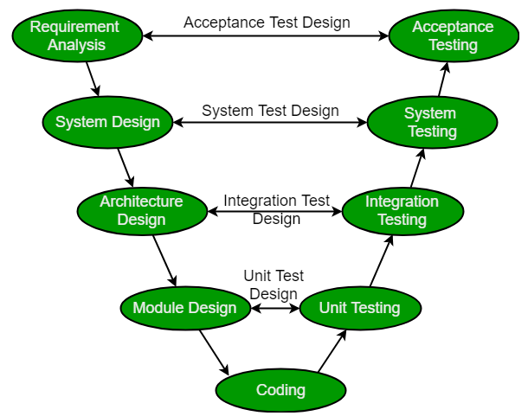
V-Model

Slide 39
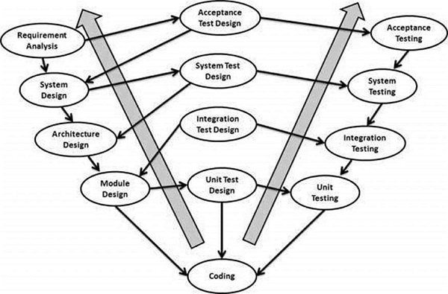
V-Model

Slide 40
V-Model
Verification: It involves static analysis technique (review) done without executing code. It is the process of evaluation of the product development phase to find whether specified requirements meet.
Validation: It involves dynamic analysis technique (functional, non-functional), testing done by executing code. Validation is the process to evaluate the software after completion of the development phase to determine whether software meets the customer expectations and requirements.
Notes:
So V-Model contains Verification phases on one side of the Validation phases on the other side. Verification and Validation phase joined by coding phase in V-shape. So it is called as V-Model.
‹#›

Slide 41
V-Model
Testing Phases:
Unit Testing: Unit Test Plans are developed during module design phase. These Unit Test Plans are executed to eliminate bugs at code level or unit level.
Integration testing: After completion of unit testing Integration testing performs. In integration testing, integrate modules and test the system. Integration testing performs on the Architecture design phase. This test verifies the communication of modules among themselves.

Slide 42
V-Model
System Testing: System testing test the complete application with their functionality, interdependency, and communication. The System Testing test the functional and non-functional requirements of developed application.
User Acceptance Testing (UAT): UAT is performed in a user environment that resembles the production environment. UAT verifies that the delivered system meets user’s requirement and system is ready for use in real time.

Slide 43
V-Model
The usage
Software requirements clearly defined and known
Software development technologies and tools are well-known

Slide 44
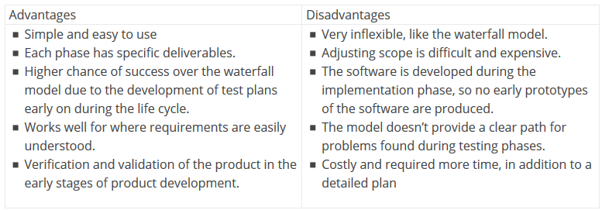
V-Model

